Slide 1
Team Mini Project 4: Writing SQL Queries
Brandon Boyle, Caleb Bush, Ellie Landoch
DS-450

Slide 2
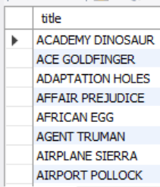
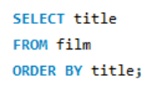
Single Table Queries
Get a list of all film titles alphabetized by title.

Slide 3
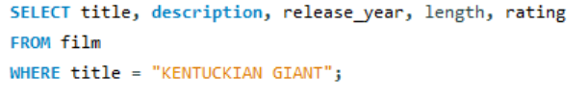
Single Table Queries
2. Find the description, release year, length, and rating for the movie “KENTUCKIAN GIANT”.

Slide 4


Single Table Queries
3. Find the first name and last name of each employee (staff table). Your query should include the last name first, and then the first name.

Slide 5

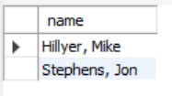
Single Table Queries
4. Repeat the query above, but this time, the results should include only one column with the format last name, first name. The output column should be named “name”.

Slide 6


Single Table Queries
5. Get the number of customers. The output should be a single number. Name the column “num_customers”.

Slide 7
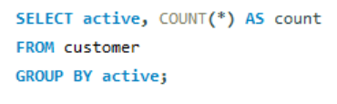
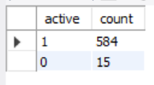
Single Table Queries
6. Get the number of customers who are active vs inactive in the system.

Slide 8


Single Table Queries
7. Get the average amount a customer spends on a rental.

Slide 9


Single Table Queries
8. Get maximum amount any customer has spent on a rental.

Slide 10
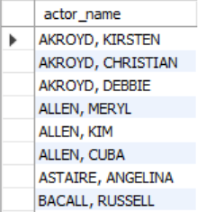
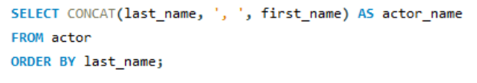
Single Table Queries
9. Get a list of the actors. The results should include only one column with the format last name, first name. The column should be named “actor_name” The results should be sorted be sorted alphabetically by the last name (ascending).

Slide 11
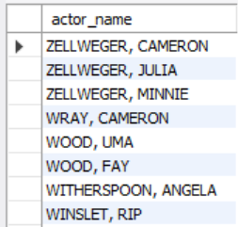
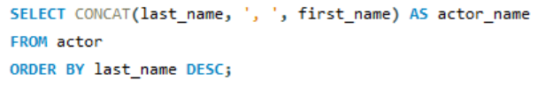
Single Table Queries
10. Repeat this query above, but the results should be in reverse order.

Slide 12
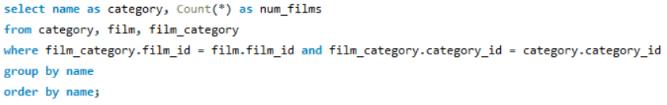
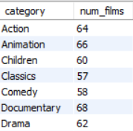
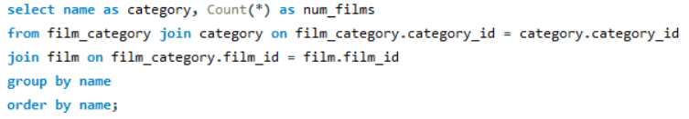
Multi-Table Queries
1.Get a list of category names and a count of movies that fall into that category. Name the category column “category” the count column “num_films”. Order the results alphabetically (ascending). Use the WHERE clause to join the tables.
2. Repeat the query above using a JOIN clause instead of the WHERE clause.

Slide 13
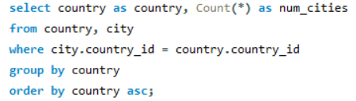
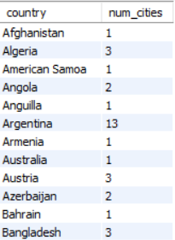
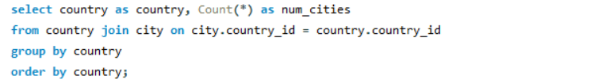
Multi-table Queries
3. Get a list of country names and a count of the cities that are in that country. Name the count column “num_cities”. Order the results alphabetically (ascending). Use the WHERE clause to join the tables.
4. Repeat the query above using a JOIN clause instead of the WHERE clause.

Slide 14
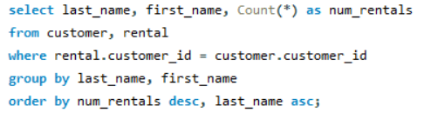
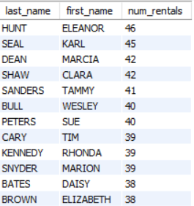
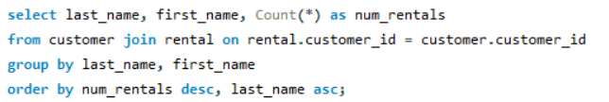
Multi-table Queries
5. Get a list of each customer’s last name and first name and the number of rentals they have. Name the count column “num_rentals”. Order the result by the number of rentals in descending order. The highest number of rentals should be at the top. Sort any es (same number of rentals) by last name (ascending). Use the WHERE clause to join the tables.
6. Repeat the query above using a JOIN clause instead of the WHERE clause.

Slide 15
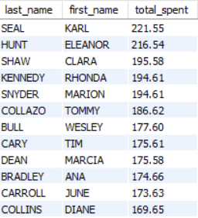
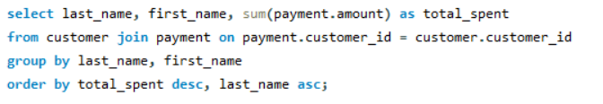
Multi-table Queries
7. Get a list of each customer’s last name and first name and the amount of money they have spent on rentals. Name the sum column “total_spent”. Order the result by the amount in descending order. The highest amount of money spent should be at the top. Sort any es (amount of money spent) by last name (ascending). Use the JOIN clause for this query.

Slide 16
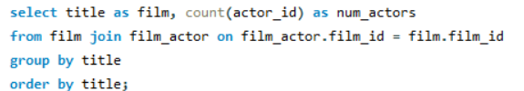
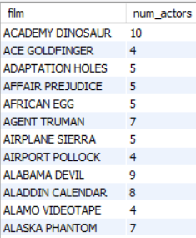
Multi-table Queries
8. Get the number of actors in each film. Order the results (ascending) by the film title and name the column with the actor count “num_actors”.

Slide 17
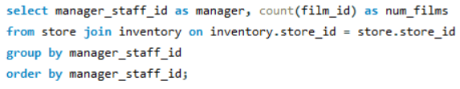

Multi-table Queries
9. Get the number of films each manager holds. Use only the manager staff id to identify the manager. Name the column with the number of films “num_films”.

Slide 18
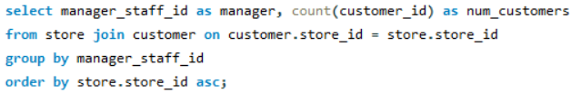

Multi-table Queries
10. Get the number of customers per manager. Use only the manager staff id to identify the manager. Name the column with the number of films “num_customers”. Order by store id (ascending).

Slide 19
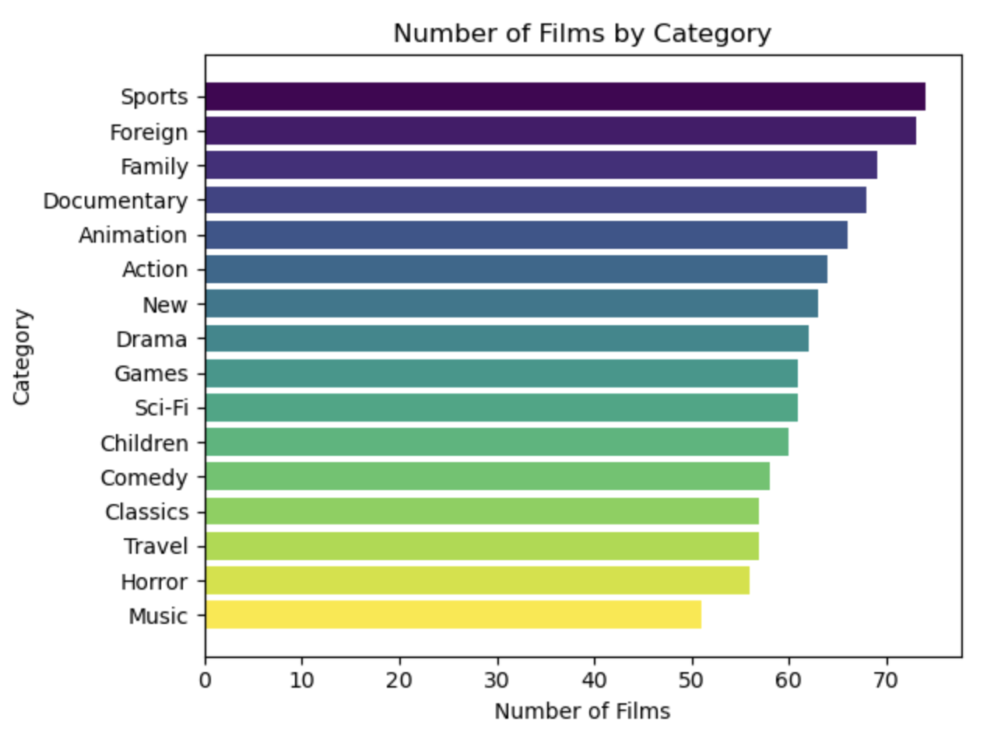

Slide 20
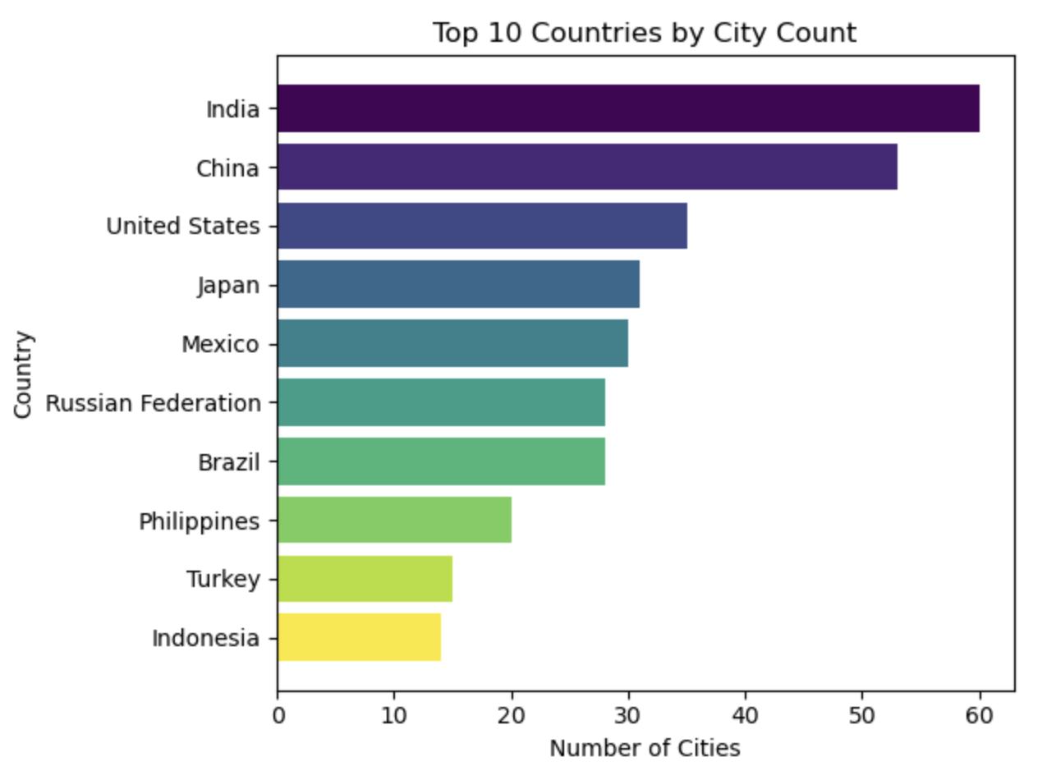

Slide 21
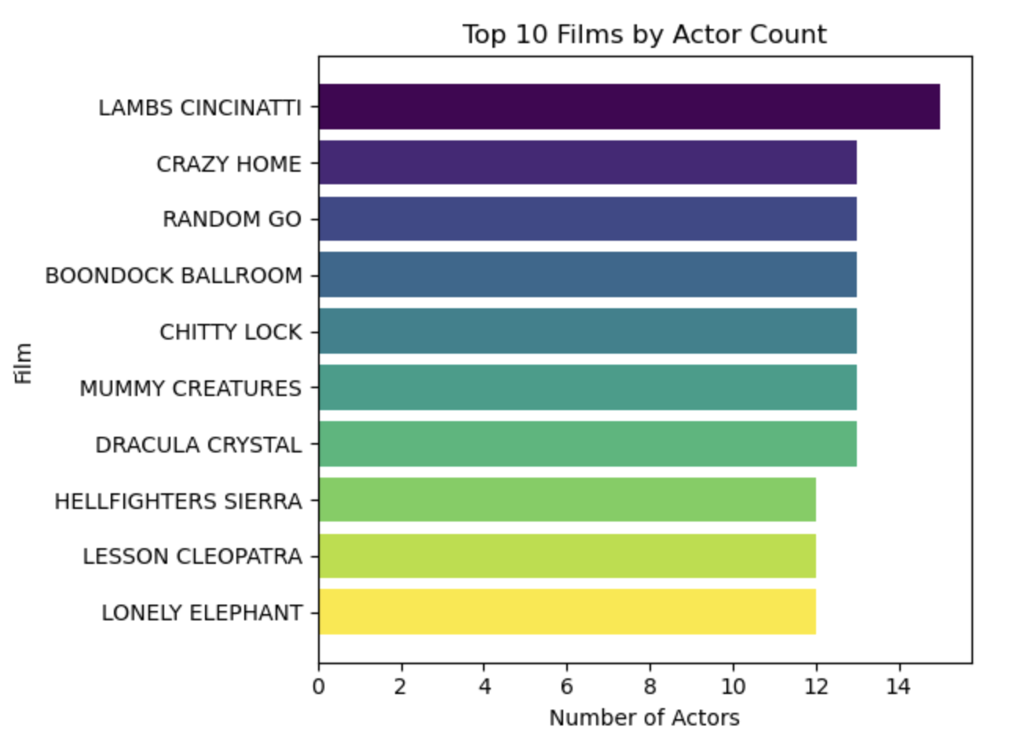

Slide 22
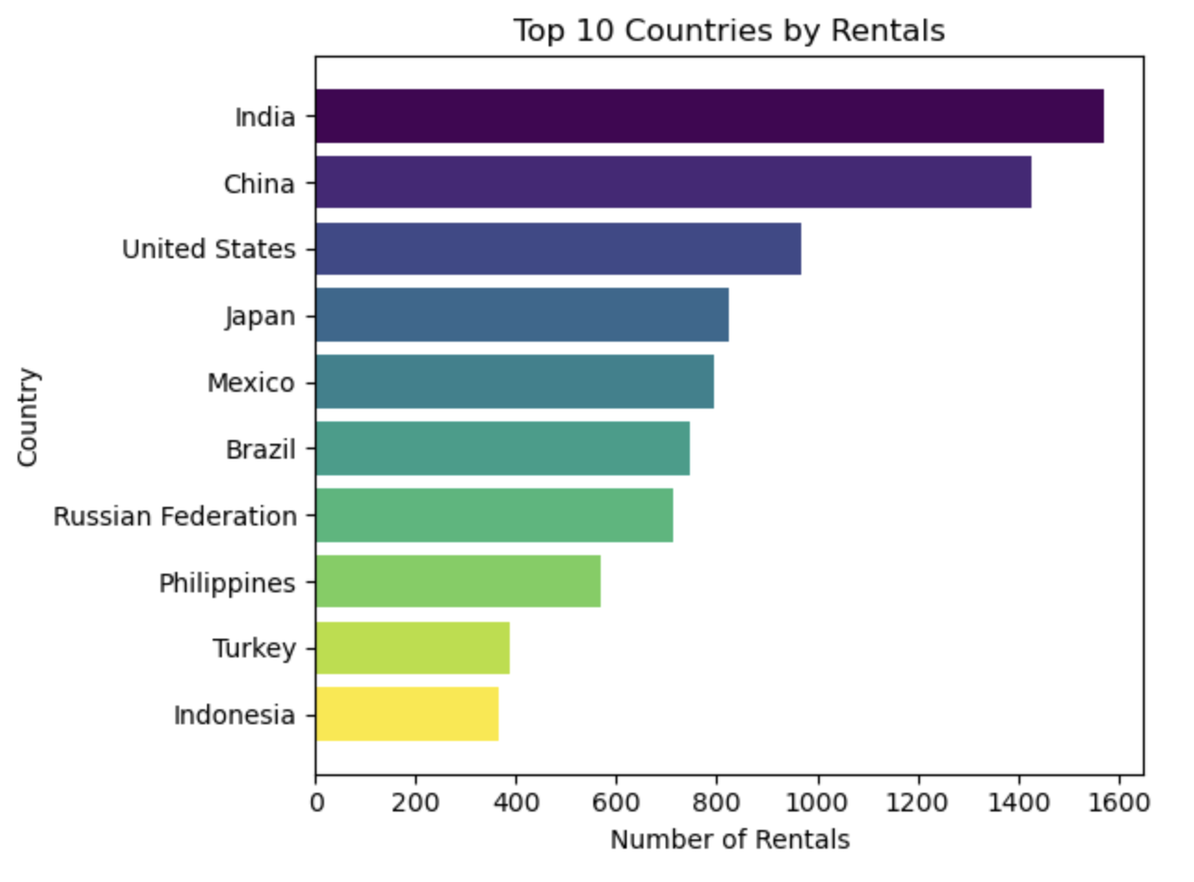

Slide 23
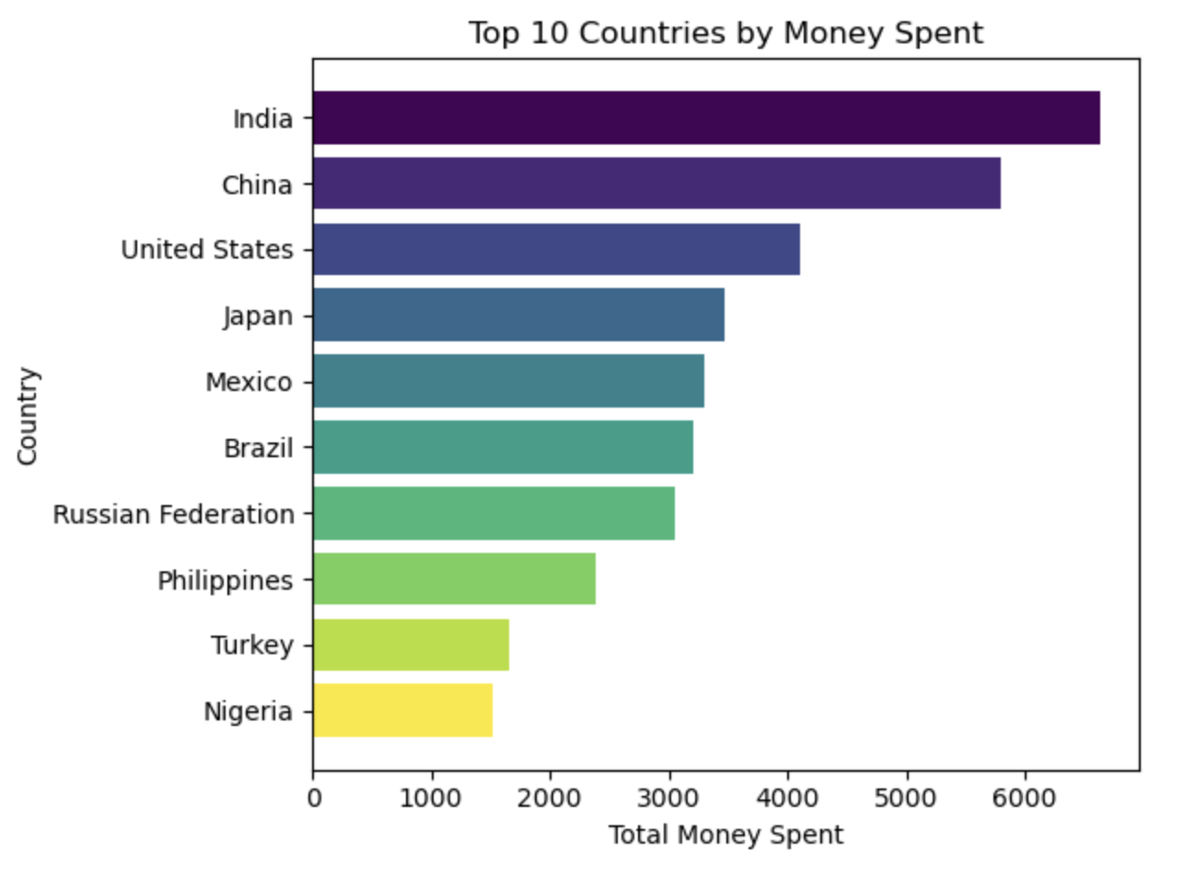

Slide 24
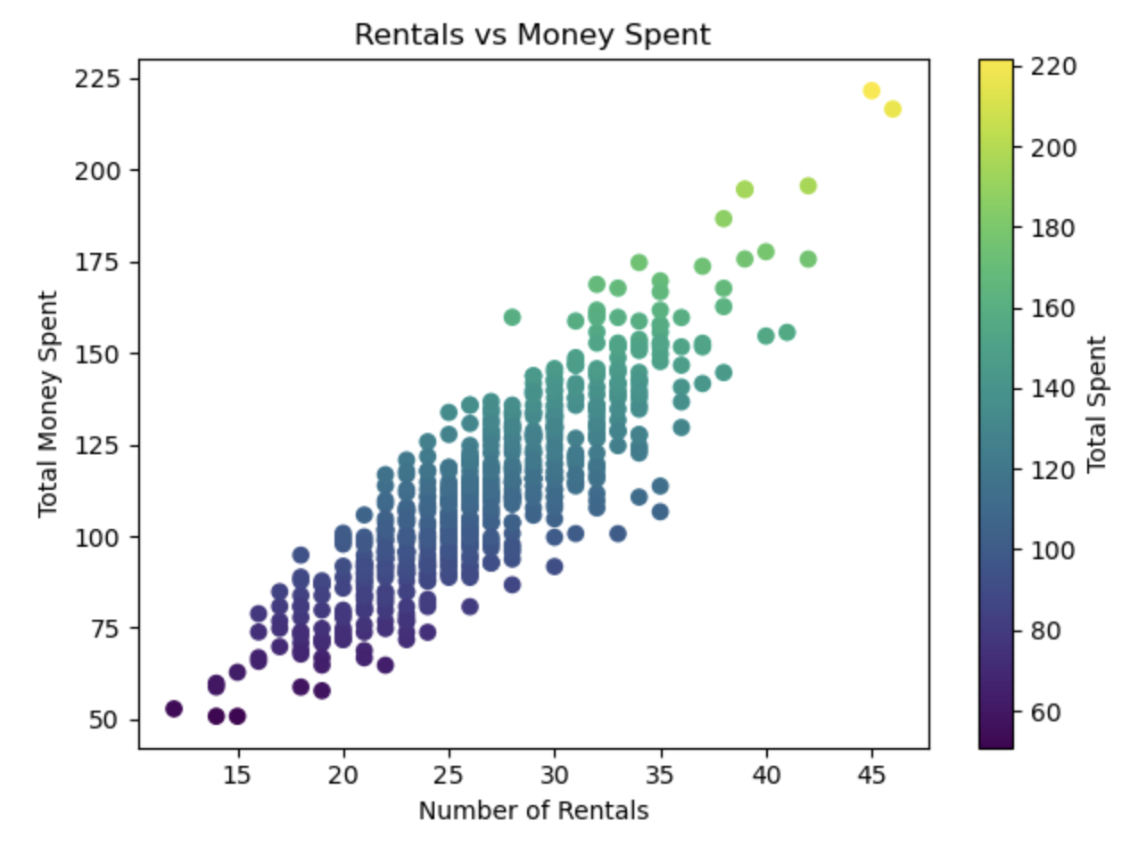

Slide 25
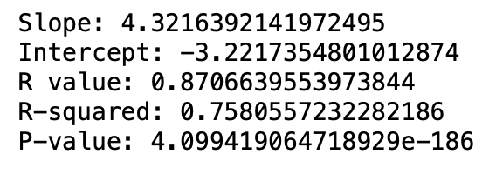
Relationship Between # of Rentals & Money Spent

