Slide 1
GAAD Hackathon
Team Ninjas
Raja H Henry
Elango Ramasamy
Tarun Luthra
Vikas Patil

Slide 2
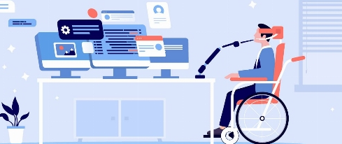
Why
solving accessibility issues with Markdown pages, users can create and share documents in a way that is more inclusive and user-friendly, reaching a broader audience
By using Theme Builder's accessibility-compatible themes for Markdown pages, users can ensure that their documents are fully accessible to all, regardless of their abilities
Generate documents adhere to accessiblity standards .
Improve inclusion
comply with web accessibility best practices and guidelines.

Slide 3
What
Generate contents meeting accessibility standards.
Making daily content work accessible and become well-versed in digital accessibility standards.

Slide 4
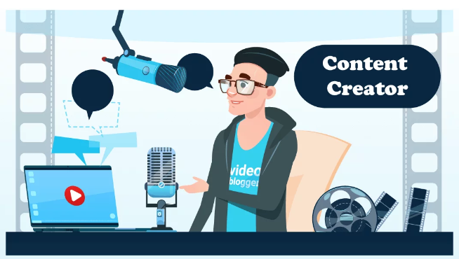
Who
Content Creators
People with special needs

Slide 5
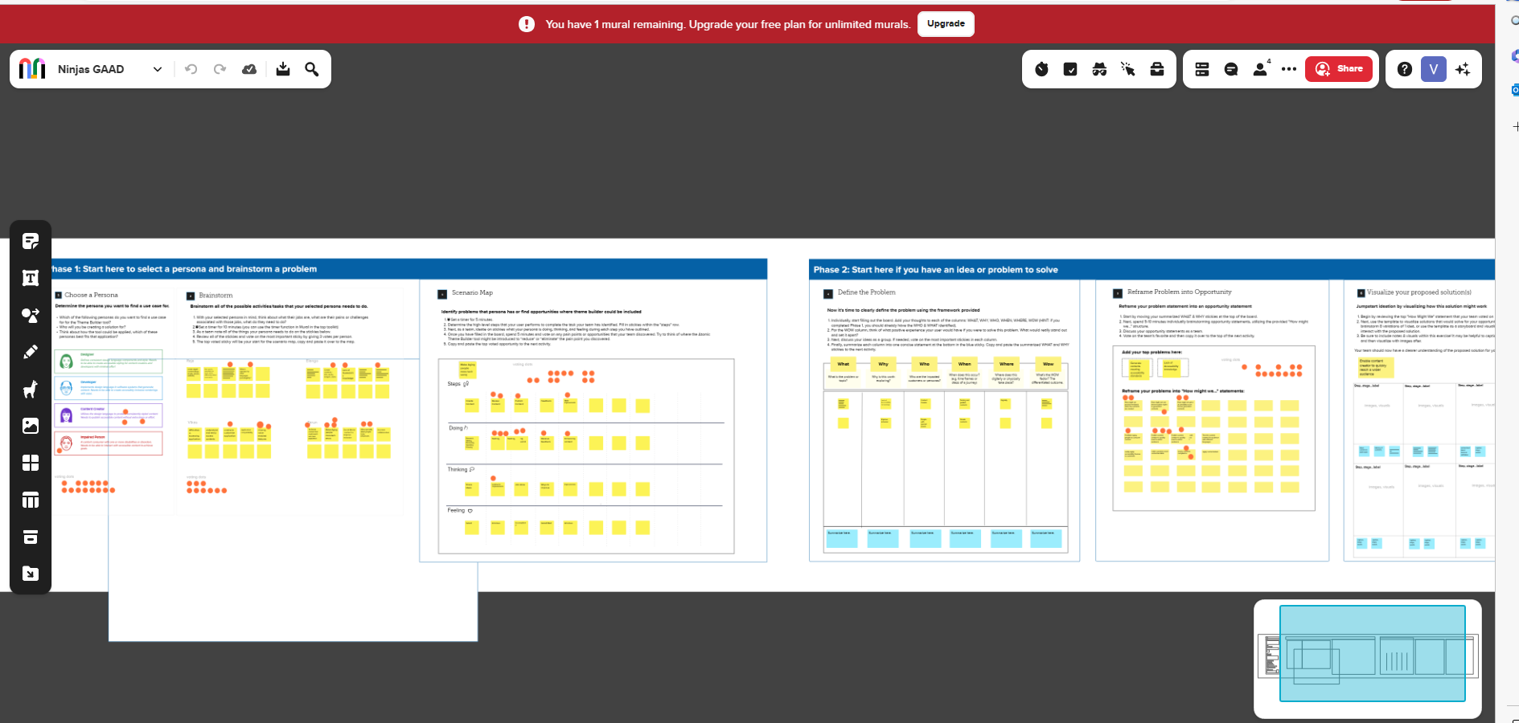

Slide 6
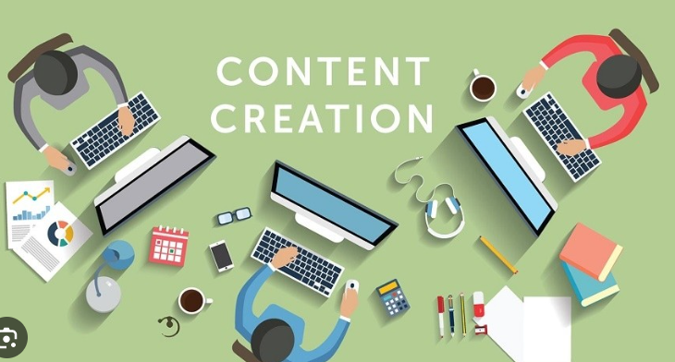
Where
It takes place digitally
Documentation Tools/platforms

Slide 7
When
Create contents
Testing/Review contents
Publishing contents
Ideation
Research

Slide 8
Wow
Make all segments of people content creators
Generated themes can be applied across many documentation platforms and tools.
Solution verify documents accessibility compliance .

