Slide 1
ASP.NET MVC Core

Slide 2
Agenda
What is ASP.NET Core?
ASP.NET Core Features
Advantages of ASP.NET Core
MVC Pattern
Understanding ASP.NET Core MVC
ASP.NET Core vs. ASP.NET MVC vs. ASP.NET Web Forms

Slide 4
HTTP Pipeline
HTTP Request
Browser
IIS
ASP.NET Runtime Engine
HTTP Response
HTML
HTTP Application
HTTP Context
HTTP Module(s)
HTTP Module(s)
HTTP Module(s)
HTTP Handler

Slide 5
ASP.NET
System.Web
Page Controller Pattern
1:1 View:Controller
ASP.NET MVC
System.Web.MVC
Front Controller Pattern
*:* View:Controller

Slide 6
Client Side AP AJAX,Jquery,JUI,HTML5,CSS3..),
ASP.NET
ASP.NET MVC
Cloud Computing
ASP.NET Core

Slide 7
Agenda
Model Binders
Dependency Injection
Routing
Views
Razor View Engine
Syntax
Layouts
Nested
Sections
HTML Helper
Tag Helper
Custom
Views
Validation
Client side
Server side
State Management
Client Side
Server side
Intro to Web API

Slide 8
Model Binders
HTTP Request
URL
Query String
Routing
HTTP Body
Standard format
Form Data
MIME Format
JSON
XML
Custom Format
HTTP Header
Inbuilt
Custom

Slide 9
Routing

Slide 10
Razor View Engine

Slide 11
Razor View Engine
Syntax
@Implicit Expression
@(Explicit Expression)
@{ server Side Code Block }
@: Single line Client side code
@Programming Constructs
@For,@if….
<text></text>

Slide 12
Layout
UI
MDI
SDI

Slide 13
Validation
Server Side
Inbuilt
Custom
Client Side
Inbuilt
Custom

Slide 14
Custom Validation
Two Approach
1. Inherit form any Validation Attribute
public class OnlyAlphaAttribute : RegularExpressionAttribute
2. Inherit from ValidationAttribute
public class MustContainPrjTypeAttribute : ValidationAttribute

Slide 15
State Management => Techniques
Client Side
URL
Hidden Variables
Cookies
Server Side
Between
Controller to View
Controller to Controller
User Level
Session State

Slide 16
Agenda
Intro to WEB API
REST vs SOA
Create RESTFul Service using Core WEB API
Meta Data
CRUD using EF Core (Code First Approach)
CONNEG

Slide 17
Flow of Architecture
Single Tier(app.exe)
DBMS
Two Tier(app.exe + product.dbf)
Three Tier(app.exe + dll(s) + product.dbf)
Dynamic EXE
Redundancy and Integration
Distributed Computing
N Tier
SOA(Web Service)
Cloud Computing
Microservice Architecture

Slide 18
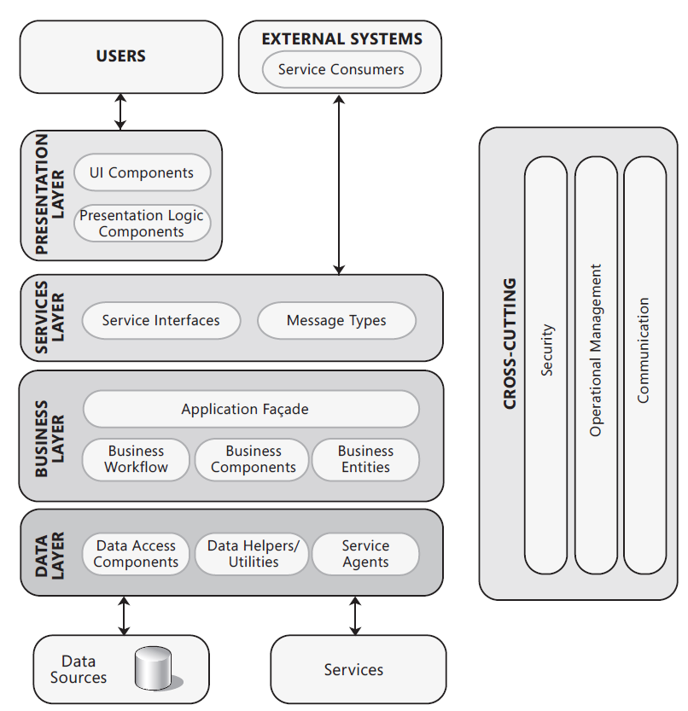
Common Application Architecture

Slide 19
SOA Basic Architecture
Discovery Agent
Find(WSDL)
Publish(WSDL)
Service Consumer
Service Provider
Interact
SOAP
Request(Add100,200)
← Response (AddResult(300))

Slide 20
WEB SERVICE
SOAP BASED
REST BASED
METHOD IS DESCRIBED USING WSDL AND REPRESENTED USING SOPA REQUEST/RESPONSE
ANY TRANSPORT PROTOCOL
IDKUUDKM
DATA FORMAT (Mostly any)
VENDOR SPECIFIC
ONLY HTTP
MOSTLY IKUUKM
DATA FORMAT
XML, JSON

Slide 21
REST vs SOA
SOA=>Architectural Pattern/ Style, Implementation of SOA is WEB Service Technology, APIs that Confine to SOA is ASP.NET Web Service(BP1.1) Later WCF(BP1.1-ws-*)

Slide 22
WEB
URL
NOUN
HTTP VERB
GET,POST,PUT…
HYPER TEXT
SELF DESCRIBING

Slide 23
Intro to RESTful

Slide 24
What Is a RESTful Service?
Representational State Transfer (REST) is an architectural style.
The term REST was introduced and defined by Roy T. Fielding in his doctoral dissertation in the year 2000.
November 2008, Leonard Richardson created a maturity model for REST
Richardson’s REST Maturity Model (RMM) provides service API developers the type of improvement map for building RESTful web services.
RMM starts at level 0 with a RPC-style interface, and then progresses up through three more levels—at which point you’ve achieved an API interface design that is, at least, according to Roy Fielding pre-condition for a RESTful service.
Notes:
REST is also resource-centric; that is, RESTful APIs use HTTP verbs to act on or
fetch information about resources. These would be the nouns in REST parlance
(e.g., Tasks, Users, Customers, and Orders). Thus, you have verbs acting on nouns.
Another way of saying this is that you perform actions against a resource.
Additionally, REST takes advantage of other aspects of HTTP systems, such as the
following:
·· Caching
·· Security
Statelessness
·· Network layering (with various firewalls and gateways in between
client and server)

Slide 25
REST Maturity Model (RMM)
Level 0
XML-RPC / SOAP
One URI
One HTTP method
Level 1 – Add URIs
Many URIs / Resources
One HTTP method
Level 2 – Add HTTP
Many URIs / Resources
Use of HTTP verbs
Level 3 – Add HATEOAS
Many URIs / Resources
Use of HTTP verbs
Hypermedia

Slide 26
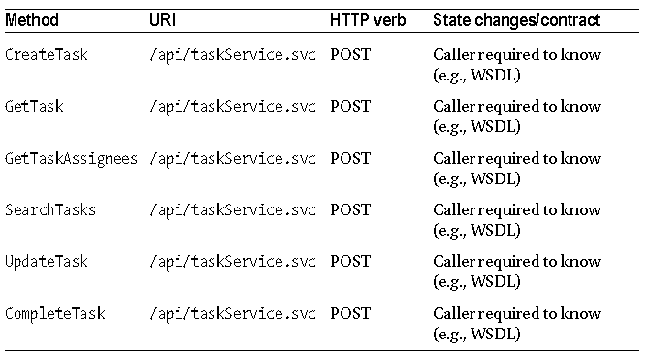
At Level 0, the API resembles most SOAP services. That is, the interface is characterized by having a single URI that supports only a single HTTP method or verb.
Level 0
XML-RPC / SOAP
One URI
One HTTP method

Slide 27
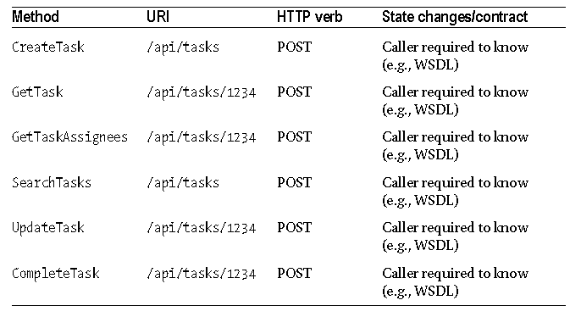
Level 1 – Add URIs
Many URIs / Resources
One HTTP method
Notes:
building a RESTful interface means you end up with an API that is very resource-centric. As such, you need to intentionally design the interface with resources being at the centre. Unlike RPC-style interfaces, where arbitrary service methods (i.e., the verbs) and their associated request and response messages rule the day, a REST interface will revolve around the resources (i.e., the nouns). The actions available to those resources are constrained by the use of HTTP. This is why you must map the available HTTP verbs into the API; you don’t have the freedom to create other actions or verbs.

Slide 28
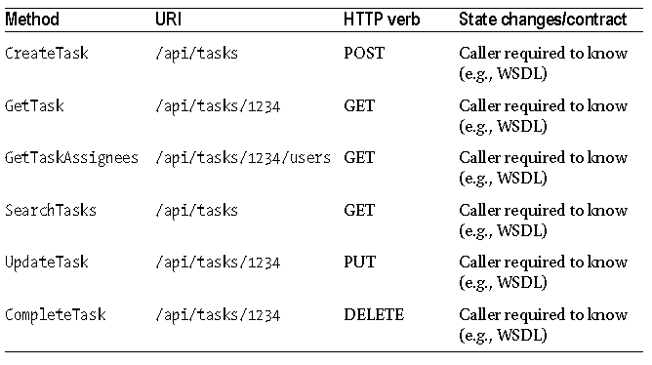
Level 2 – Add HTTP
Many URIs / Resources
Use of HTTP verbs
Notes:
REST architecture is agnostic about any specific protocol.
That includes the HTTP protocol. In other words, all you need is a protocol that provides
a language and mechanism for describing both states (i.e., representations) and state
changes. However, since this book is about building a REST service with ASP.NET, you’ll
focus on REST with HTTP. Fortunately, the HTTP protocol itself covers most of what you
need.

Slide 29
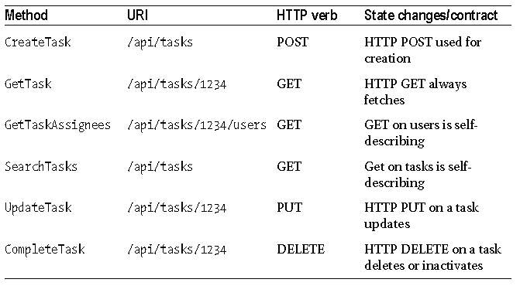
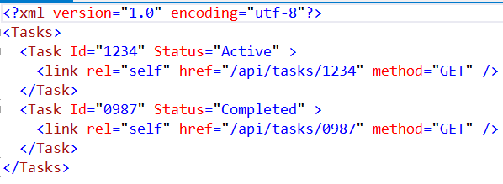
Level 3 – Add HATEOAS
Many URIs / Resources
Use of HTTP verbs
Hypermedia
Notes:
you can see that certain GET operations will return
collections of resources. One of the guiding principles of REST with HTTP is that callers
make transitions through application state only by navigating hypermedia provided
by the server. In other words, given a root or starting URI, the caller should be able to
navigate the collection of resources without needing prior knowledge of the URI scheme.
Thus, whenever a resource is returned from the service, whether in a collection or by
itself, the returned data should include the URI required to turn around and perform
another GET to retrieve just that resource.
Here’s an example of an XML response message that illustrates how each element in
the collection should contain a URI to the resource:

Slide 30
HATEOAS Hypermedia as the engine of application state

Slide 31
EF Core
Metadata
XML(EDMX)
Attribute
Fluent API
Scenario 1
Based on the Model Generate Database
Code first Database Creation
Scenario 2
Generate and Update Database as and When the Model changes
Code first With migration

