Slide 1
Agenda
Intro to .NET Framework
.NET Framework vs .NET Core
Intro to VS
Intro to CSharp
Console Project template
Intro to Basic of Programming
Sequence
Selection
Iteration
Intro to OOPs

Slide 2
APP
PL
OS
H/W

Slide 3
S/w
System => 10%
Application 90%
General( Word, Excel….) =>15%
Specific (Business App) => 85%

Slide 4
App Logic
App Infra Logic

Slide 5
Create c Program to Accept Employee Details(EmpId, Name, Salary) from User and Store it into a file

Slide 7
Layer
CLI=> DOS App
Single Tier(app.exe)
PL
BL
DL

Slide 8
Layer=> Logical ; Tier=> Physical
DOS App + GUI based APP(vb)
DOS App + GUI based APP(vb)
CLI=> DOS App
Single Tier(app.exe)
Two Tier(app.exe + product.dbf)
Three Tier(app.exe + dll(s) + product.dbf)
PL
PL
PL
DBMS
BL
Dynamic EXE
BL
BL(DLL(s))
BL
DL
DL(DBMS=>RDBMS)
DL(DBMS=>RDBMS)

Slide 9
In-Process Component
Three Tier(Invapp.exe + product.dbf)
InvoiceApp.Exe(Process)
PL
Execution
BL(invoice.DLL(s))
Invoice.Dll.GenerateInvoice()
DL(DBMS=>RDBMS)

Slide 10
Out-Process Component
NTier(Invapp.exe +
InvoiceComponent.exe product.dbf)
InvoiceApp.Exe
Process 1
Execution
PL
BL(invoiceLib.EXE)
DL(DBMS=>RDBMS)
DCOM(outprocess Component).GenerateInvoice()
Process 2

Slide 11
N-Tier is Extension to 3-tier where Middle Tier is Distributed
N-Tier(app.exe + product.dbf)
Distributed Computing
PL
BL(Com Exe)
BL(Com Exe)
BL(Com Exe)
DL(DBMS=>RDBMS)

Slide 12
Distributed Computing
IPC (Inter-Process communication(light weight RPC))
DCOM
REMOTING (.NET)
RPC
Intranet
DCOM
REMOTING
MSMQ
Internet
ASP.NET Web Service(WEB SERVICE)

Slide 13
Stdio.h=>stdio.lib
API =?

Slide 14
Lib
Static
Dynamic

Slide 15

Complier
Program
APP Logic
APP Infra Logic
Step 3: System Call Mapping( OS Spec Binding)
Step 1: Check for Syntax & Semantics
H
App Logic(Your Code)
.OBJ
Native Code
Step 2: Linking(Embedded - )
LIB
Updates Code
.EXE(Static)

Slide 16
Step 3: System Call Mapping( OS Spec Binding)
Step 1: Check for Syntax & Semantics
H
App Logic(Your Code)
.OBJ
MLC
Step 2: Linking(Truly Linking- Holds Reference to DLL)
Ref
Update Reference
InvApp.EXE
Runtime
Invoice.DLL

Slide 17
.Net Framework
Framework
Infra
Intranet and Internet framework
.NET Framework

Slide 18
APP
.NET Framework
OS
H/W

Slide 19

.NET Frameworks and the Common Language Runtime
Data & XML
ASP.NET
Base Classes
Win Forms/
Console
Common Language Runtime
.NET Framework
Windows CE, ME, 2000, .NET
Notes:
“Bringing them closer.”
.NET –
Tools and Frameworks;
Base Infrastructure – Windows, Servers;
Building Block Services;
Internet User Experience – on previous slide

Slide 20
App
.NET Framework
OS
H/W

Slide 21
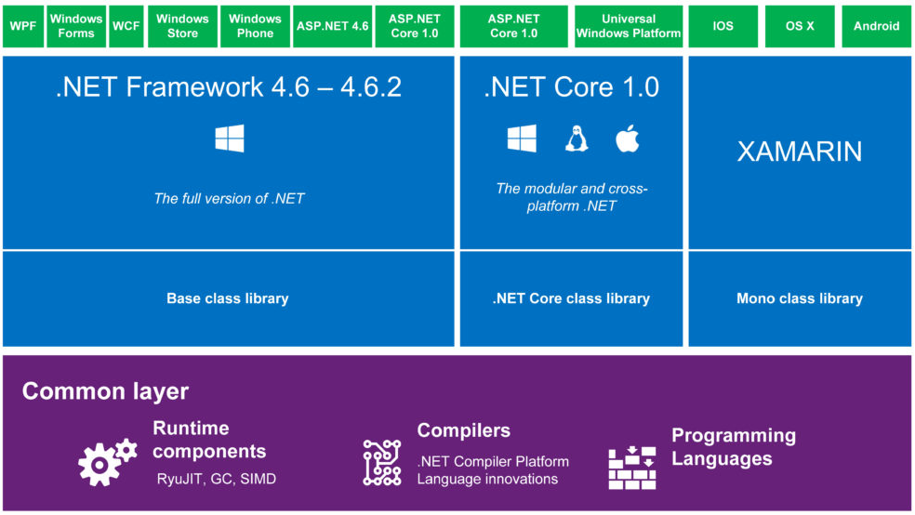
.NET Framework

Slide 22
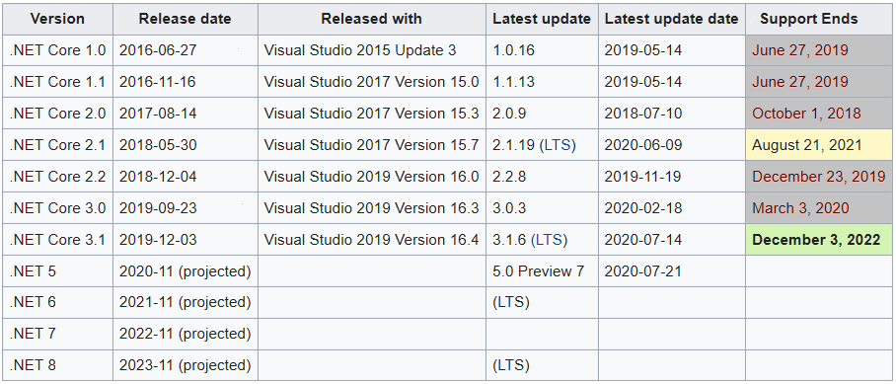
Version History
ASP.NET Version | VS
1.0 | 2002
1.1 | 2003
2.0 | 2005
3.5 | 2008
4.0 | 2010
4.5 | 2012
4.5.1 | 2013
4.6 | 2015

Slide 23
The .NET Framework The .NET Framework and Visual Studio.NET
VB
C++
C#
JScript
…
Common Language Specification
ASP.NET: Web Services
and Web Forms
Windows Forms
Visual Studio.NET
ADO.NET: Data and XML
.NET Framework Base Classes
Common Language Runtime
Notes:
The .NET framework exposes numerous classes to the developer. These classes allow the development of rich client applications and Web-based applications alike. The classes are shown here, divided into four areas.
ASP.NET provides the core Web infrastructure, such as Web Forms for UI-based development and Web Services for programmatic interface development.
User interface development on the Windows platform can be done using Windows Forms.
ADO.NET and XML provide the functionality for data access.
The core base classes provide infrastructure services such as security and transaction management.
You can create code in any of a large number of languages. This code will integrate in a deep, seamless manner via a standard called the Common Language Specification.
Visual Studio.NET provides tools that increases your productivity when creating applications.

Slide 24
Common Language Runtime Compilation
Source Code
Assembly
Compiler
C++, C#, VB or any .NET language
csc.exe or vbc.exe
DLL or EXE
Notes:
As a developer you can write code in the language of your choice. Your code is compiled into an Assembly, which is represented as a DLL or EXE.

Slide 25
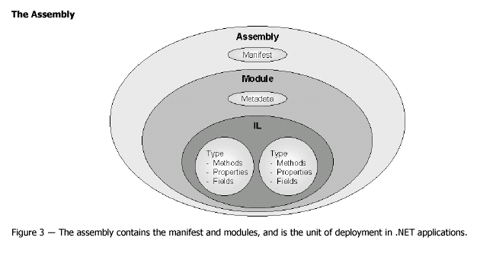
Common Language Runtime Assemblies

Slide 26
Development Machine
Deployed Machine(Client)

Slide 27
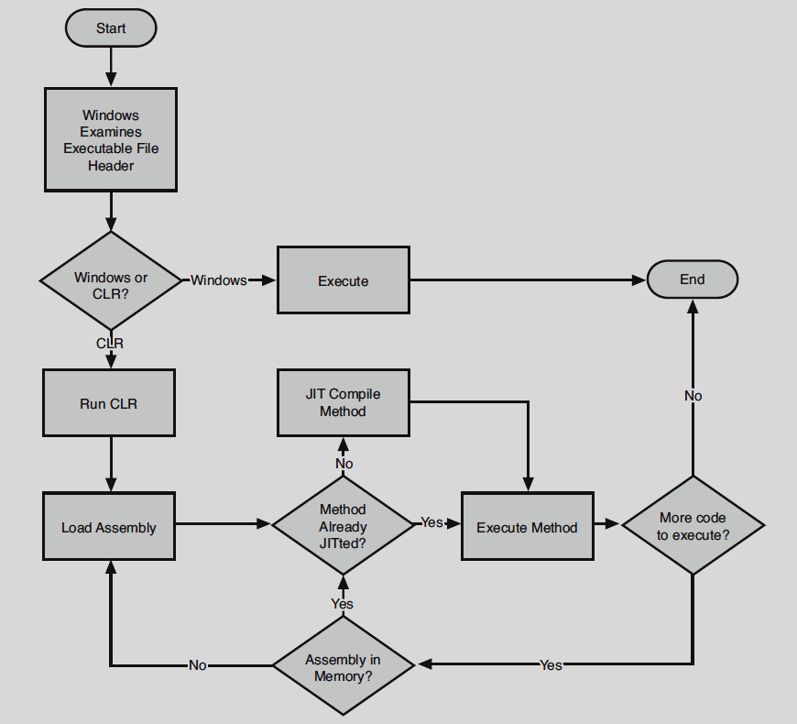

Slide 28
Common Language Runtime Execution Model
Source code
VB
C#
C++
Unmanaged
Component
Compiler
Compiler
Compiler
Managed
code
Assembly
IL Code
Assembly
IL Code
Assembly
IL Code
Common Language Runtime
JIT Compiler
Native Code
Operating System Services

Slide 29
Main method
static void Main(string[] args)
static void Main()
static int Main(string[] args)
static int Main()

Slide 30
Intro to Basic of Programming
Sequence
Variables
Datatypes
Method
Pass by
Value, Reference, Out
Named and Optional Arg
Param Array
Selection
If Condition & Switch Case
Iteration
While
For

Slide 31
Datatypes
Value Types
Inbuilt
Numeric
Without Decimal
Signed
Sbyte=>1 byte=> -128 to +127
Short=>2
Int=>4
Long=>8
Unsigned
Byte=>1 byte=> -0-255
UShort=>2
UInt=>4
ULong=>8
With Decimal
Float=> 4bytes
Double=>8Bytes
Decimal=16 B
Alphanumeric
Char= ‘A’ =>2 bytes
Logical=> bool/Boolean =true/false => 4 bytes
DateTime=>* Bytes
1 Jan 0001 00:00:00 to 31 Dec 9999 23:59:59
Value Types
User Defined
Struct
Enum
Value Types
Inbuilt
Numeric
Alphanumeric
Logical
Date & Time
User Defined
Reference Types
Inbuilt
String
Array
User Defined
Class
Interface
Delegate

Slide 32
Datatypes
Value type
Reference Type
Usually Allocated on Stack
Copying Value type to Another Value type Copied VALUE
Memory is clammed once method is terminated
Memory is not Defragmented
Always Allocated on Heap
Copying Reference type to Another Reference type Copied REFERENCE
Memory is Defragmented
If a Reference Variable is not Referred it is Considered as Garbage

Slide 33
Datatypes
Conversion
Implicit Conversion
Explicit Conversion
Boxing and Unboxing
Between
Value to Reference and vise versa
Casting
Implicit Casting
Explicit Casting

Slide 34
Type Safe

Slide 35
Application PL
System PL

Slide 36
Program
Data=Variable => array => Struct
Algorithm
Func

Slide 37
Which class is designed first is it base class and derived or reverse

Slide 38
Object oriented Programming
Bottom up Approach

Slide 39
Object Oriented Programming
Encapsulation
Brings in Code Redundancy to Solve it we have
Inheritance
Dynamic Polymorphism (Overriding)
Access Modifier Called Protected
Abstraction
Information Hiding
Access Modifiers / Visibility modifiers
Private / Public
Data Member & Functional Member
Implementation Hiding
Static Polymorphism (Function overloading/ Operator Overloading)

Slide 40
Parent/Base
Generalization
Child/Derived
Specialization

Slide 41
Scenario One Virtual
Empname
Virtual FillTaskSheet()
{
General Implementation
}
EMP
PM
PA
SE
ST
Overriding
Virtual FillTaskSheet()
{
Specific Extended/Replaced
}

Slide 42
Scenario 2 Abstract
Incomplete ; therefore cannot Instantiate
Abstract method=>Abstract Class; it abstracts the actual Implementation
The Method in the Base Class exists in derived class in many forms (Polymorphic)
Base class abstract Method is mapped to the Derived class Implementation at RUNTIME therefore it is RUNTIME Polymorphism
Empname
FillTaskSheet();
EMP
PM
PA
SE
ST
Overriding
Virtual FillTaskSheet()
{
Specific Extended/Replaced
}
Virtual FillTaskSheet()
{
Specific Extended/Replaced
}
Virtual FillTaskSheet()
{
Specific Extended/Replaced
}

Slide 43
Properties
Syntactically
Behaves like a data member outside the class
Is a method inside class
Setter
Getter
to Provide abstract Access to Data members of the Object
Read-only or Write-Only access
Calculated / computed Property
Validation of Data

Slide 44
Modes of VS
Design mode
Execution Mode
Debug Mode

Slide 45
Features version Wise
.Net 1.0
Delegates and Events
Collection
Icollection
Ilist & IDictionary
Ienumerable & Ienumurator
Properties
Threading
.NET 2.0
Generic
Type Inference
Delegate Type Inference
Anonymous Block/ Anonymous Method
Partial/Static/Nullable Types
Iterators
.Net 3.0
Local Type inference
Anonymous Type
Object Initializer & Collection initializer Syntax
Extension Method
Lambda Expression
.NET 3.5
LINQ
Query Expression
Standard operator

Slide 46
Agenda
Constructor
Destructor
Garbage Collection
Generic
Delegates and Events
Collection

Slide 47
Constructor
Is the Method that gets invoked implicitly once an object is created
For
Instantiate & Initialization of Object & Resources
Overloading
Initialization for Different Scenarios
Hierarchy of Constructor Call
Private
Static

Slide 48
Generic
Datatype Introduced Code Redundancy is Addressed by GENERIC
Generic Operator <> can be assigned to
Class level
Interface
Delegate
Method Level
Properties
Indexer

Slide 49
Delegates
Int Sum(int a, int b)
Int(int,int)
String ConCat(string a, string b)
Void fnDemo(string[] arg, employee e)
department fnGetDept(int Deptid, string FilterRule)
List<Employee> getAllEmpbyCriteria(string[] Criteria)

Slide 50
Delegate
What conceptually
Is similar to Function Pointer in other Languages
Technically
Is a Class
That must inherit from System.MultiCastDelegate which in-turn inherits from System.Delegate
Holds 0..* of method Reference
When
For Decoupling Caller from the Called Method (Dynamic)

Slide 51
Events
Are delegated with more restriction on the usage.
Enforcing Subscriber and Publisher Pattern

Slide 52
Agenda
Abstract vs Interface vs Delegate
Try catch
Collection
Ienum

Slide 53
Encapsulation => Modularity ; Inheritance => Code Reusability ;Polymorphism=>Extensibility
Abstract Class
Usually >80% Code Reusability and <20% Extensibility
Interface => 100% Extensibility
During Design
It is CONTRACT
At Runtime
It is INTERFACE(verb) that is Medium of Communication

Slide 54
Exception handling
Error
Compilation Error
Runtime Error
Exception Handling
What
Why
OS will
Error Message is Technical
Data Loss
Will not gracefully terminate Process
Resource Orphan
Resource Corruption
How
Two programming Style
Structured – Try Catch
Un-Structed -> Error No Based
Flow of Events
Normal
Alternate
Regular
Odd cases
Exceptional Cases

Slide 55
Catch block
Handled Exception
Caught
But Cannot handle
Throw it as it is
Throw by overriding
Replace
Amend

Slide 56
Collection
What
Technical
Is a Class that holds 0..* of Object Reference
Must inherit from class that implements ICollection or Implement Icollection
Can be Same Type of Different
1.0
System.Collection
2.0
System.Collection.Generic
Conceptual
Grouping Mechanisms , to represent Object Model

Slide 57
Collection
Retrieval
Sequential
IEnumerable
Random
Index Based
IList
Key Based
IDictionary

Slide 58
Agenda
2.0
Static / Partial/ Nullable types
3.0
LTI
Anonymous Type
Object Init
Extension Method
3.5
LINQ
1.0
Threading
4.0
Parallelism
TPL
PLINQ

Slide 59
Type inference
Based on value Datatype of a given variable is Inferred or understood
i=100; as 100 in integer therefore ‘i’ is Understood to be Integer
Static
Compilation
Var
Delegate type inference
Dynamic
Runtime

Slide 60
Extension Method
Feature of CSharp compiler
Must be
Static
Public
Declared inside Static Class
Must have ‘This’ keyword before First arguments type to which it is syntactically inherited

Slide 61
Language INtegrated Query(LINQ)
Is one Query API to Query Various Datasources
Data-Source
Object
Array, Collection;List,Dictionary….
ADO.NET
DataSet
DataTable
XML Document
Database
SQL Server,Oracle,Infomix, Sybase….

Slide 62
Standard Operations
Filter
Column Filter
99.95% of Query will have Select Clause
Row Filter
85% of Query will have Where Clause
Joins
75% of Query will have Joins Clause
Sorting
60% of Query will have Sorting Clause
Grouping
40% of Query will have Grouping Clause

Slide 63
Language INtegrated Query(LINQ)
3.5
LINQ To
Objects
ADO.NET
SQL
XML
4.0
LINQ to Entities(Entity Framework)

Slide 64
LINQ Query Syntax Style
Method Call style
Query Expression (intro in 3.5)
Select * from employee where DeptNo>10 group by deptno

Slide 65
Agenda
Threading
TPL
Assembly
Creating DLL
IO operation
Windows Form

Slide 66
Threading
Main()=> A()=>B()
Sync
Main()=>A()
Async
Main is Executed by OS, that is Primary Thread AKA Thread of Control
Any thread that branches from Main or Sub of Main is Secondary Thread
Is Asynchronous Concurrent?

Slide 67
Thread Synchronization
Two Types
Data Synchronization
In-Process
Lock / Monitor
Inter-Process
MUTEX
Execution Synchronization
Life Cycle Control
AutoEvents

Slide 68
Parallelism
System.Threading.Tasks
TPL
Parallel
Task

Slide 69
Cloud Computing
Client
Server
Internet
Client
Server

Slide 70
Could Terminologies
Cloud
A metaphor for a global network, first used in reference to the telephone network and now commonly used to represent the Internet.
Cloud Computing
A computing capability that provides an abstraction between the computing resource and its underlying technical architecture (e.g., servers, storage, networks), enabling convenient, on-demand network access to a shared pool of configurable computing resources that can be rapidly provisioned and released with minimal management effort or service provider interaction.
This definition states that clouds have five essential characteristics:
on-demand self-service,
broad network access,
resource pooling,
rapid elasticity,
measured service.
Cloud Operating System
A computer operating system that is specially designed to run in a provider’s datacenter and be delivered to the user over the Internet or another network.
Windows Azure is an example of a cloud operating system or “cloud layer” that runs on Windows Server 2008.
The term is also sometimes used to refer to cloud-based client operating systems such as Google’s Chrome OS.

Slide 71



Cloud Services
“IaaS”
“PaaS”
“SaaS”
Infrastructure-as-a-Service
Platform-as-a-Service
Software-as-a-Service
host
build
consume
Notes:
Slide Objectives:
Explain the three established terms in the industry for cloud services
Speaking Points:
With this in mind, it’s important to understand how to talk about our Cloud Services offerings.
There is a lot of confusion in the industry when it comes to the cloud.
It’s important that you understand both what is happening in the industry and how we think about the cloud.
This is the most commonly used taxonomy for differentiating between types of cloud services.
The industry has defined three categories of services:
IaaS – a set of infrastructure level capabilities such as an operating system, network connectivity, etc. that are delivered as pay for use services and can be used to host applications.
PaaS – higher level sets of functionality that are delivered as consumable services for developers who are building applications. PaaS is about abstracting developers from the underlying infrastructure to enable applications to quickly be composed.
SaaS – applications that are delivered using a service delivery model where organizations can simply consume and use the application. Typically an organization would pay for the use of the application or the application could be monetized through ad revenue.
It is important to note that these 3 types of services may exist independently of one another or combined with one another.
SaaS offerings needn’t be developed upon PaaS offerings although solutions built on PaaS offerings are often delivered as SaaS.
PaaS offerings also needn’t expose IaaS and there’s more to PaaS than just running platforms on IaaS.

Slide 72
.NET Framework

Slide 73
Version History
ASP.NET Version | VS
1.0 | 2002
1.1 | 2003
2.0 | 2005
3.5 | 2008
4.0 | 2010
4.5 | 2012
4.5.1 | 2013
4.6 | 2015

Slide 74
Brief History
GUI in 1980 by Xerox PARC Laboratory.
GUI by MS was Windows 1.0 1985
Windows 3.0 in 1990
Two DLLs ; User , GDI
VB ver. 1.0 in 1991; Ruby GUI built upon win DLLs- User , GDI
Replacement for Ruby; code named form3 , later used for browser space due to various reasons; renamed as Trident shipped as mshtml.dll; html specific engine.
Managed code ; java in 1994 by sun micro system exposed to notion of virtual machine next seven years was on managed code.
Ms DOTNET platform user32 & GDI+
Replacement for Ruby
Graphics had evolved with DirectX in 1995.

