Slide 1
Agenda
Dot net Framework
CLR
BCL
CLS
Intro to CSharp=> VS 2022
PC
Sequence
Selection
Iteration
OOP

Slide 2
App Logic=> “Hello World”
App Infra Logic
Stdio.h=>

Slide 3
APP
OS
PL
H/W

Slide 4
Complier
?
s/w
System
Application
General
Specific
Business App

Slide 5
PL
BL
DL

Slide 6
Single Tier(App.EXE)
2 Tier
3 Tier(App.EXE)
PL
PL (APP.EXE)
PL (APP.EXE)
DBMS
Dynamic EXE
BL
BL
BL (DLL(s))
DL(FH)
BL
DL(DBMS)
DL(DBMS)

Slide 7
n Tier
Microservice Architecture
PL (APP.EXE)
Distributed Computing (RPC)
Cloud Computing
BL (N)
DL(DBMS)

Slide 8
Complier
Program
APP Logic
APP Infra Logic
Step 3: System Call Mapping( OS Spec Binding)
Step 1: Check for Syntax & Semantics
H
App Logic(Your Code)
.OBJ
Native Code
Step 2: Linking(Embedded - )
LIB
Updates Code
.EXE(Static)
Step 3: System Call Mapping( OS Spec Binding)
Step 1: Check for Syntax & Semantics
H
App Logic(Your Code)
.OBJ
MLC
Step 2: Linking(Truly Linking- Holds Reference to DLL)
Ref
Update Reference
InvApp.EXE
Runtime
Invoice.DLL

Slide 9
DC
Inter-process
DCOM
REMOTING(>.NET)
RPC
Intranet
DCOM
REMOTING
MSMQ
Internet
WEB Service

Slide 10
Internet & Intranet Framework
.NET F/W
APP
APP
.NET Framework
OS
OS
H/W
H/W

Slide 11

.NET Frameworks and the Common Language Runtime
Data & XML
ASP.NET
Base Classes
Win Forms/
Console
Common Language Runtime
.NET Framework
Windows CE, ME, 2000, .NET
Notes:
“Bringing them closer.”
.NET –
Tools and Frameworks;
Base Infrastructure – Windows, Servers;
Building Block Services;
Internet User Experience – on previous slide

Slide 12
The .NET Framework The .NET Framework and Visual Studio.NET
VB
C++
C#
JScript
…
Common Language Specification
ASP.NET: Web Services
and Web Forms
Windows Forms
Visual Studio.NET
ADO.NET: Data and XML
.NET Framework Base Classes
Common Language Runtime
Notes:
The .NET framework exposes numerous classes to the developer. These classes allow the development of rich client applications and Web-based applications alike. The classes are shown here, divided into four areas.
ASP.NET provides the core Web infrastructure, such as Web Forms for UI-based development and Web Services for programmatic interface development.
User interface development on the Windows platform can be done using Windows Forms.
ADO.NET and XML provide the functionality for data access.
The core base classes provide infrastructure services such as security and transaction management.
You can create code in any of a large number of languages. This code will integrate in a deep, seamless manner via a standard called the Common Language Specification.
Visual Studio.NET provides tools that increases your productivity when creating applications.

Slide 13
Common Language Runtime Multiple Language Support
What about types?
Common type system (CTS)

Slide 14
Common Language Runtime Compilation
Source Code
Assembly
Compiler
C++, C#, VB or any .NET language
csc.exe or vbc.exe
DLL or EXE
Notes:
As a developer you can write code in the language of your choice. Your code is compiled into an Assembly, which is represented as a DLL or EXE.

Slide 15
Source
Code
Development Machine
Compiler
EXE/DLL
(IL)
Class Libraries
(IL)
Class Loader
Security Check
JIT Complier
Target Machine
Uncompiled Method
Managed
Native Code
Execution

Slide 16
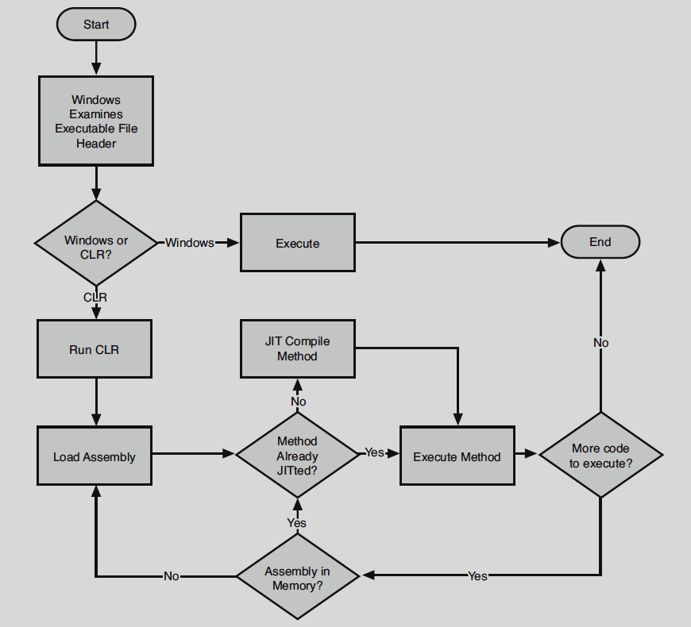

Slide 17
Common Language Runtime Execution Model
Source code
VB
C#
C++
Unmanaged
Component
Compiler
Compiler
Compiler
Managed
code
Assembly
IL Code
Assembly
IL Code
Assembly
IL Code
Common Language Runtime
JIT Compiler
Native Code
Operating System Services

Slide 18
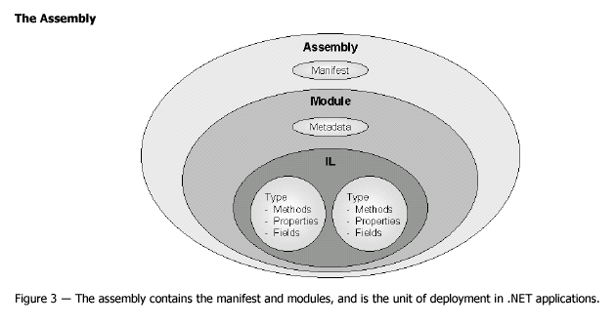
Common Language Runtime Assemblies

Slide 19
Common Language Runtime Manifest & Metadata in an Assembly
Type Descriptions
Classes
Base classes
Implemented interfaces
Data members
Methods
Assembly Description
Name
Version
Culture
Other assemblies
Security Permissions

Slide 20
Common Language Runtime Applications
One or more assemblies
Assemblies resolution
Using metadata
Local Assembly (preferred)
Shared Assembly
Global Assembly Cache
Different applications may use different versions of an assembly
Easier software updates
Easier software removal

Slide 21
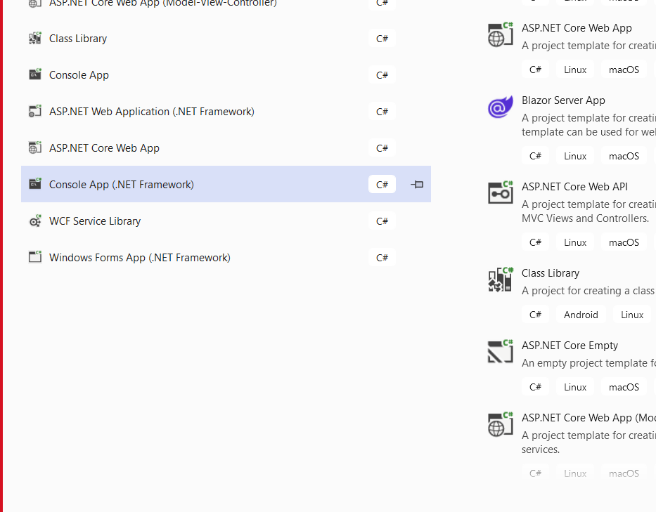

Slide 22
void Main(string[] args)
void Main()
int Main(string[] args)
int Main()

Slide 23
Vs Mode
Design Mode
Execution Mode
Debug Mode

Slide 24
Sequence
Datatype
Value Type
Reference Type
Method
By Val
By Ref
Out
Param
Named & Optional

Slide 25
Debugging
Step into
Step over
Step out
OOP

Slide 26
Datatype
Value Type
Memory is allocated on Stack
When assigned with other Value type it Copies the value
Reference Type
Memory is allocated on HEAP
Assigning reference type variable will copy reference

Slide 27
Value Type
Inbuilt
Numeric
Without Decimal
Signed
Sbyte - 128 – 127= 1 byte
Short – 2 byte
Int – 4
Long -8
Unsigned
Byte-0-255
Ushort
uint
With Decimal
Float - 4
Double -8
Decimal- 16
Alpha
Char=‘A’ 2 bytes
Logical
Boolean/Bool = >4 => TRUE/FALSE
DateTime
8 bytes – 1-Jan-0001 00:00 – 31-Dec-9999 23:59:59
UDT
Enum
Struct

Slide 28
Reference
InBuilt
Array
String
Object-
UDT
Class
Interface
Delegates

Slide 29
Conversion
Transform one value type to another value type
Two Types
Implicit – Auto
When there is no data loss, Manual Exxecute
Explicit – Manual
When there is data loss
Boxing & unboxing
Casting

Slide 30
Methods
Only for Value Type
By Value
By Reference
Out parameter
MethodA => MethodB
Argument passed can be
Input
input & output
Output
Reference type will always be passed as Reference

Slide 31
Object Oriented Programming
Conceptual & Design
Syntax in Csharp

Slide 32
Data + Al = Program
Object
Data
Variable
Array
Struct
Variable
Function
Global Variables
Function to function ;Highly/tightly coupled

Slide 33
Main()
Int Add(int a, int b)
Int Multi(int a, int b)
…..

Slide 34
Encapsulation

Slide 35
Encapsulation – Concept=>PL=>Class=>at Runtime Object
Abstraction
Information Hiding
Access Modifiers
Private & Public
Implementation Hiding

Slide 36
Encapsulation brings in Code Redundancy addressed through Inheritance
Generalization
FillTaskSheet()
EMP
PM
PA
SE
Specialization

Slide 37
Scenario -1 Specialization to Generalization to Specialization- Challenge
Fills in Daily
Overriding
FillTaskSheet()
EMP
Fills in weekly
PM
PA
SE
Tester
Over ride ; FillTaskSheet()

Slide 38
Scenario -2 Specialization to Generalization to Specialization- Challenge
Overriding
Fills in Daily
Emp Class is Incomplete- cannot create instance
Called Abstract method & Class
Polymorphism : FillTaskSheet is Existing in many forms in sub classes
Mapping of base class method to derived class is done at Runtime - RUNTIME POLYMORPHISM
FillTaskSheet();
EMP
Fills in weekly
PM
PA
SE
Tester
Override ; FillTaskSheet(){}
Override ; FillTaskSheet()

Slide 39
Encapsulation
Inheritance
Dynamic Polymorphism
overriding
Static Polymorphism
OverLoading

Slide 40
Int Add(int I , int J); = > Signature in OOP Context
Signature from OS Context => int(int,int)

Slide 41
Encapsulation
Modularity
Inheritance
Code Reusability
Polymorphism
Extensiblity

Slide 42
Abstract Class vs Interface

Slide 43
Interface
Is a contract at DESIGN
Is an Interface(Medium) at RUNTIME

Slide 44
Abstract Class
80%> is Code Reusability
<20% is Extensibility
Interface
100% Extensibility

Slide 45
Properties & Indexer
What
Syntactical Wrapper for methods used to Set & Get the value from object
Why
(Primary) Encapsulate / conceal data members(Field)
Access control , read only or write only or both
Computed value
Validation
Indexer
Is a property with [ ] (indexer Operator thereby Name Indexer) that can accept argument(s)
Name must be ‘this’ meaning the name is the name of the object itself.

Slide 46
.NET Version & Features List
1.0 => 2002 = > vs 7.0
Delegates & Events
Collections
Ienumerable & Ienumerator
2.0 => 2005 => vs8 vs 2005
Generic
Iterators
Anonymous Method / Block
3.0 > 2008 = > vs 9
Lambda Expression
Local Type Inference / Implicitly Typed
Extension Method
Object initializer & Collection Initializer Syntax
Anonymous Type
3.5 - > 2008 = > vs 9
LINQ
Query Expression
4.0 - > 2010 => vs 10
ADO.NET Entity Framework

Slide 47
Delegate
Preface
What is Pointer
Data
Type?
Memory?
Function
What
Is as Class
Holds 0..* of Method Reference
Must Inherit from System.MulticastDelegate=>System.Delegate
Why
Decouple Method Calls

Slide 48
Void main()
Void()=>signature
Int demo(string[] st, employee e)
Int(string[],employee)

Slide 49
Collections
What
In .NET framework, it Is a class
Holds 0..* no of Object Reference
Object Reference can be same type or Mixed
Why
Object Model
Grouping
Syntactically
Must be a class that implements Icollection
In 1.0/1.1
System.Collection
In 2.0
System.Collections.Generic

Slide 50
Generic
Datatype Introduced Code Redundancy is addressed by Generic
Generic Operator Level
Method Level
Property & Indexer
Class Level
Delegate
Interface

Slide 51
Collection
Collection holds 0..* no of object Reference
Retrieve Data / Accessing Data
Sequential
Ienumerable
Random
Index Based
Ilist
Key Based
Idictionary
Specialized Collection
Stack
Queue
Hashtable

Slide 52
3.0 > 2008 = > vs 9
Local Type Inference / Implicitly Typed
Object initializer & Collection Initializer Syntax
Anonymous Type
Extension Method

Slide 53
Type Inference
Based on the Value Datatype is Inferred
Var i=100;
Level of Inference
Static (Compilation Time)
Var i=100
Dynamic (at Runtime) (From 4.0 )

Slide 54
Extension Method
Is a syntactical sugar
Must be public & static
Must be defined in a static class
Must have ‘this’ keyword before first arguments type

Slide 55
LINQ
One Query API for Various Data Sources
Data Sources
Objects
Array
Collection
List
Dica
XML Doc
Database
Oracle
PL/SQl
SQL Server
T-SQL
Operation Performed on Datasource
DML insert,update,Delete ; 30%
DQL –Select 70% (Filter (90%), Joins(70%), Sorting(60%), Grouping(50%))

Slide 56
LINQ
3.5
To Objects
IEnumerable
To XML
To ADO.NET
To SQL
4.0
Replaced LINQ to SQL with
LINQ to Entities(ADO.NET EF)

Slide 57
Agenda
LINQ
Standard Operators
ADO.NET EF
Intro ORM
Developer Work flow
Model First, Db First, Code first
DbContext
DbSet
Change Tracking
CRUD operation
Invoke Stored Proc
Intro to ASP.NET
Intro
Page Controller Pattern
Page life cycle Events
Server Controls

Slide 58
OrderByDescending()
OrderBy() – Asc
ThenBy()
ThenByDescending()

Slide 59
ADO.NET
ActiveX Data Objects . Net

Slide 60
ADO.NET Entity Framework
Entity Framework is Extension to ADO.NET
ORM
Object Model to Relational Model Mapper
Object Relational Mapper
Datatable GetEmployeeDetails()
List<Employee> GetEmployeeDetails()
EF
Entity Layer (Generated)
DAL - Programming
EF is ORM Tools & API

Slide 61
Application Centric Data
Data Centric Application
Browser
HTML
REST
HTTP
VERB
URL
HTML

Slide 62
Web Application
Server Side Web Application
Asp.NET , ASP.NET MVC , ASP.NET Web API
Client Side Web Application
Angular, KO JS , React,

Slide 63
ASP.NET
Page Controller Pattern
Productivity is the KING
RAD for Web
Abstract Client Side Web Technologies
HTML, JS, CSS

Slide 64
UI App
Boundary
UI(App to Human)
Default.aspx
SI (App to Components/ App to App)
Controller
Controls Work Flow Logic(Bl,Dl,…)
Default.aspx.cs
Entity
Represents the data used in the system

Slide 65
HTTP Pipeline
HTTP Request
Browser
IIS
ASP.NET Runtime Engine
HTTP Response
HTML
HTTP Application
HTTP Context
HTTP Module(s)
HTTP Module(s)
HTTP Module(s)
HTTP Handler

Slide 66
ASP.NET
ASP.NET MVC
System.Web
Page Controller Pattern
First is Page(UI) then Controller(BL/DL)
Page is View logic & Code behind is Controller Logic mapping (1View:1Controller)
Issues
Reusability(cannot use view without controller & vise-versa)
Testability(controller cannot be tested without View and vise-versa)
Parallel Project Execution
View & Controller must be programmed by one.
Design issues
Abstract Web Technologies
Generated code
not meant to be maintainable
Heavy (more infra code(Event wire-up, control state, session state….) )
Performance
Size of page is more
New Client Side Libraries
Jquery, JQueryUI, Bootstrap,KO…
System.Web.MVC
Front Controller Pattern
First is Controller then Result(UI, JSON, File…)
View:Controller *:*
Reusability
Testability – Controller without View & vise-versa
View & Controller can be designed by different developers
Design
Embraces Client side web technologies
Code Generated is Pure HTML and Maintainable

Slide 67
Server Control
Browser Specific Code
Jquery/ Jquery UI
Provide Rich controls
Calendar, Date Time, Grid
Jquery UI/ Bootstarp
Control State, Event Handling …
JQuery

Slide 68
MVC=> Model then View Later Controller
With VS
Model then generate Controller through controller Generate View
MCV
URL points to a Page physical
In MVC must point to Controller (Class(Logical))
Front Controller pattern , Controller first then view
Challenge / Problem => Module Called “Routing”

Slide 69
Controller
Must Inherit from a class that implements Icontroller or Implement Icontroller
Must be Suffixed with “Controller”
All PUBLIC methods in the controller will be treated as Action Method by default if not marked otherwise using NonAction Attribute
Action Method Will Return ActionResult = > Base class for Various Specific Results

Slide 70
Routing
Check if the URL is not Physical
Routing module
Matches the URL with the Routes Sequentially from the top to the Bottom
If pattern is matched then it considers that route to resolve the controller & action method

Slide 71
Route Configuration Level
App_Start Level => Application level
Attribute based Routing; Controller / Action method Level

Slide 72
State management
Passing Data
Between Controller and View
ViewData
ViewBag
Between Controller to Controller
TempData
Between Request Same User
Client Side
Routing , URL, Cookies , Hidden Variable
Server Side
Session State
Between Users
Application
Cache

