Slide 1
Agenda
Pre
Layered Architecture
Static & Dynamic Exe
Distributed Computing
Cloud Computing
Intro to .NET Framework
CLR
BCL
Intro to CSharp
Intro VS 2022
Project Structure
Programming Construct
Sequence
Datatypes
Selection
If, Switch
Iteration
For While ….
Intro to CSharp…
OOPS
CSharp Language Features
Version wise

Slide 2
App
OS
PL
H/W

Slide 3
App Logic
Hello World!!!
App Infra Logic
STDIO.H=>Printf

Slide 4
S/W
System -10%
Application – 90%
General- 15%
Word Excel , ppt, Coral Draw
Specific (Business App) – > 85%

Slide 5
Layer is Logical => Tier is Physical
Single Tier(app.exe)
PL
PL
BL
BL
DL
DL

Slide 6
Layer=> Logical ; Tier=> Physical
DOS App + GUI based APP(vb)
DOS App + GUI based APP(vb)
CLI=> DOS App File Handling
Single Tier(app.exe)
Two Tier(app.exe + product.dbf)
Three Tier(app.exe + dll(s) + product.dbf)
PL
PL
PL
DBMS
BL
Dynamic EXE
BL
BL(DLL(s))
BL
DL
DL(DBMS=>RDBMS)
DL(DBMS=>RDBMS)

Slide 7
In-Process Component
Three Tier(Invapp.exe + product.dbf)
InvoiceApp.Exe(Process)
PL
Execution
BL(invoice.DLL(s))
Invoice.Dll.GenerateInvoice()
DL(DBMS=>RDBMS)

Slide 8
Out-Process Component
NTier(Invapp.exe +
InvoiceComponent.exe product.dbf)
InvoiceApp.Exe
Process 1
Execution
PL
BL(invoiceLib.EXE)
DL(DBMS=>RDBMS)
DCOM(outprocess Component).GenerateInvoice()
Process 2

Slide 9
N-Tier is Extension to 3-tier where Middle Tier is Distributed
N-Tier(app.exe + product.dbf)
Distributed Computing
PL
BL(Com Exe)
BL(Com Exe)
BL(Com Exe)
DL(DBMS=>RDBMS)

Slide 10
Stdio.h=>stdio.lib
API =?

Slide 11
Lib
Static
Dynamic

Slide 12

Complier
Program
APP Logic
APP Infra Logic
Step 3: System Call Mapping( OS Spec Binding)
Step 1: Check for Syntax & Semantics
H
App Logic(Your Code)
.OBJ
Native Code
Step 2: Linking(Embedded - )
LIB
Updates Code
.EXE(Static)

Slide 13
Step 3: System Call Mapping( OS Spec Binding)
Step 1: Check for Syntax & Semantics
H
App Logic(Your Code)
.OBJ
MLC
Step 2: Linking(Truly Linking- Holds Reference to DLL)
Ref
Update Reference
InvApp.EXE
Runtime
Invoice.DLL

Slide 14
.Net Framework
Framework
Infra
Intranet and Internet framework
.NET Framework

Slide 15
APP
.NET Framework
OS
H/W

Slide 16

.NET Frameworks and the Common Language Runtime
Data & XML
ASP.NET
Base Classes
Win Forms/
Console
Common Language Runtime
.NET Framework
Windows CE, ME, 2000, .NET
Notes:
“Bringing them closer.”
.NET –
Tools and Frameworks;
Base Infrastructure – Windows, Servers;
Building Block Services;
Internet User Experience – on previous slide

Slide 17
App
.NET Framework
OS
H/W

Slide 18
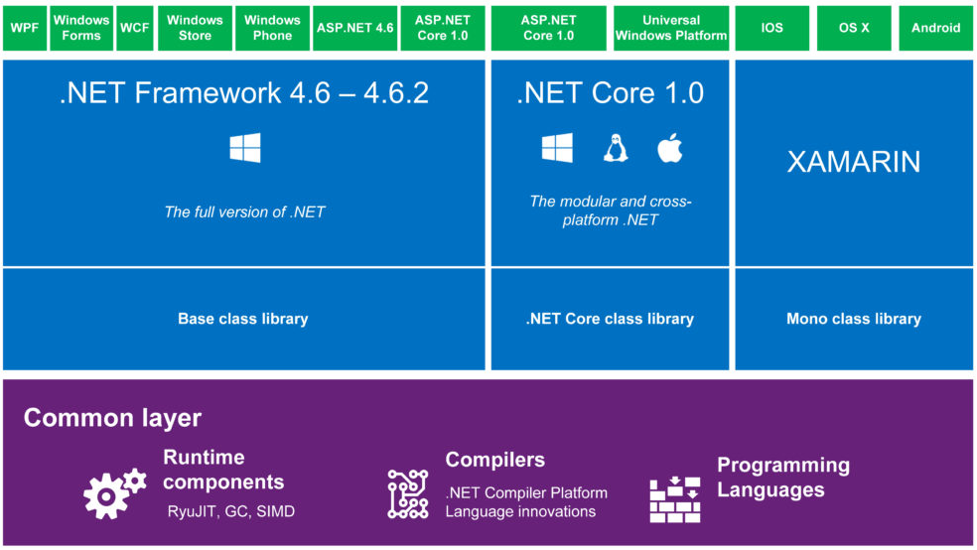
.NET Framework

Slide 19
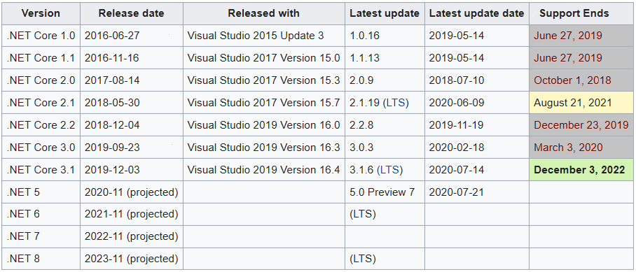
Version History
ASP.NET Version | VS
1.0 | 2002
1.1 | 2003
2.0 | 2005
3.5 | 2008
4.0 | 2010
4.5 | 2012
4.5.1 | 2013
4.6 | 2015

Slide 20
The .NET Framework The .NET Framework and Visual Studio.NET
VB
C++
C#
JScript
…
Common Language Specification
ASP.NET: Web Services
and Web Forms
Windows Forms
Visual Studio.NET
ADO.NET: Data and XML
.NET Framework Base Classes
Common Language Runtime
Notes:
The .NET framework exposes numerous classes to the developer. These classes allow the development of rich client applications and Web-based applications alike. The classes are shown here, divided into four areas.
ASP.NET provides the core Web infrastructure, such as Web Forms for UI-based development and Web Services for programmatic interface development.
User interface development on the Windows platform can be done using Windows Forms.
ADO.NET and XML provide the functionality for data access.
The core base classes provide infrastructure services such as security and transaction management.
You can create code in any of a large number of languages. This code will integrate in a deep, seamless manner via a standard called the Common Language Specification.
Visual Studio.NET provides tools that increases your productivity when creating applications.

Slide 21
Common Language Runtime Compilation
Source Code
Assembly
Compiler
C++, C#, VB or any .NET language
csc.exe or vbc.exe
DLL or EXE
Notes:
As a developer you can write code in the language of your choice. Your code is compiled into an Assembly, which is represented as a DLL or EXE.

Slide 22
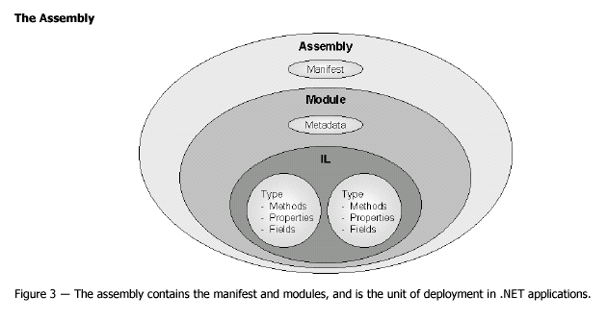
Common Language Runtime Assemblies

Slide 23
Development Machine
Deployed Machine(Client)

Slide 24
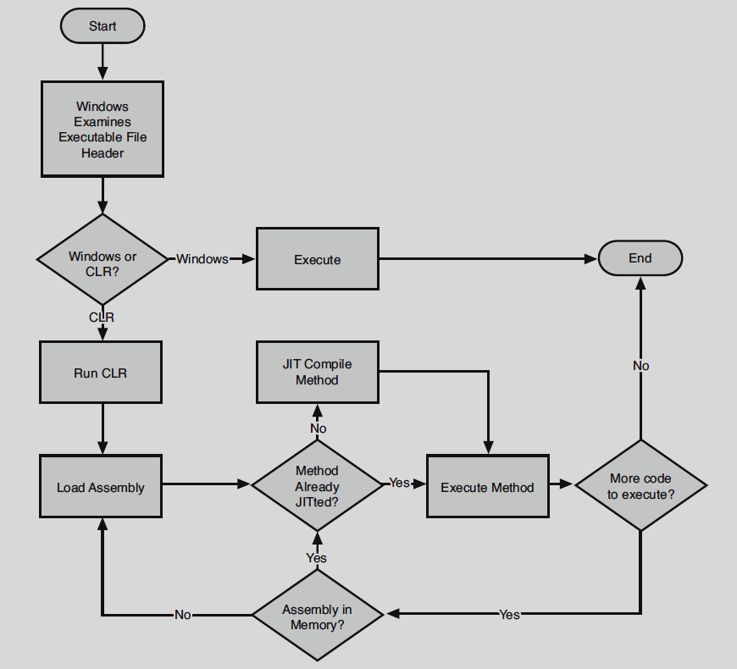

Slide 25
Common Language Runtime Execution Model
Source code
VB
C#
C++
Unmanaged
Component
Compiler
Compiler
Compiler
Managed
code
Assembly
IL Code
Assembly
IL Code
Assembly
IL Code
Common Language Runtime
JIT Compiler
Native Code
Operating System Services

Slide 26
Main method
static void Main(string[] args)
static void Main()
static int Main(string[] args)
static int Main()

Slide 27
Agenda
Datatype
Value Type
Reference Type
Conversion
Boxing and Unboxing
Methods
By Val
By Ref
Out Parameter
Param Array

Slide 28
Datatypes
Value Type
Inbuilt
Numeric
Without Decimal
Signed
Sbyte-> 1 byte - -128 +127
Short -> 2B
Int ->4B
Long-8B
Unsigned
Byte-> 1 byte – 0 to 255
UShort -> 2B
UInt ->4B
ULong-8B
With Decimal
Float –> 4B
Double -> 8B
Decimal -> 16B
Value Type
Inbuilt
Numeric
Alpha-Numeric
Char=> ‘a’=2B
Logical=>4B
Bool/Boolean=true/False
Date & Time
DateTime – 8B
1 Jan 0001 to 31 Dec 9999 23:59:59
User Defined
Enum
Struct

Slide 29
Datatypes
Reference Type
Inbuilt
String
Array
User Defined
Class
Interface
Delegate

Slide 30
Conversion
Implicit Conversion
Explicit Conversion
Between String and Primitive Type
Parse()
ToString()
Between value type and Reference type
Boxing and Unboxing
Casting(OOP)

Slide 31
Compare
Value Type
Reference Type
Usually allocated on STACK
Copying value type to Another Value type will copy VALUE
Cheaper memory management
Always Allocated on HEAP
Copying Reference type to Another Reference type will copy REFERENCE
Memory defragmented and expensive to manage

Slide 32
VS Modes
Design Mode
Execution Mode
Debugging Mode

Slide 33
Object Oriented Programming
Encapsulation
Abstraction
Information Hiding
Public , Private
Implementation Hiding
Static Polymorphism
Function/Method/Operator Overloading
Issue with Encapsulation
Brings in Code Redundancy
Solution
Inheritance
Runtime Polymorphism(Overriding)

Slide 34
Specialization to=> Generalization
Generalization
Emp
PM
PA
SE
Specialization

Slide 35
Scenarios
Two(Virtual)
One (Default)
Emp
Overridable FillTaskSheet()
{General imp}
Emp
FillTaskSheet()
{ general imp}
PM(Daily)
PA
SE
ST(Monthly)
PM
PA
SE
Override FillTaskSheet()
{
Specific Imp for ST
}
Three(Abstract)
Incomplete therefore cannot instantiate
Abstract => Method imp is resolved in derived class
Method in base class implementation exists in derived class in many form(polymorphism)
Base class abstract method is mapped to derived class implementation at RUNTIME therefor it is RUNTIME POLYMORPHISM
Emp
Abstract FillTaskSheet();
Override FillTaskSheet()
{
Specific Imp PM
}
PM
PA
SE
ST
Override FillTaskSheet()
{
Specific Imp ST
}
Override FillTaskSheet()
{
Specific Imp PA
}
Override FillTaskSheet()
{
Specific Imp SE
}

Slide 36
In nutshell
Encapsulation ; Modularity
Inheritance ; 100% Code Reusability
Polymorphism ; 100% Extensibility

Slide 37
Properties
Purpose
To enclose the data members and provide controlled access
What
It behaves like a data member as part of object , internal to a class it is method (Set and Get )
Why
Validation
Access control
Read only , Write only or both
Computed / Calculated member

Slide 38
Interface
Purpose
To Decouple Provider and Consumer thereby it is Dynamic
When there is Many Consumer to Many Provider
At Design Time (Noun)
Is is a Contract
At Runtime (Verb)
A medium of communication

Slide 39
Agenda
1.0
Collections
Ienumerable & ienumerator
Delegates & Events
Threading
2.0
Generic
Type Inference
Nullable type, Static Type, Partial Type
Anonymous Block/Method
3.0
Local type Inference
Object Initializer and collection Initializer Syntax
Anonymous type
Extension method
3.5
LINQ
Standard Operators
Query Expression
4.0
Parallelism
Tasks Parallel Library
P-LINQ
Dynamic Typing

Slide 40
Generic
Datatype Introduced Code Redundancy is addressed by Generic
Level
Method Level
Properties
Class Level
Interface
Delegates

Slide 41
Agenda – D3
Delegates & Events
Collections
Ienumerable & ienumerator
Nullable type, Static Type, Partial Type
Anonymous Block/Method
Local type Inference
Object Initializer and collection Initializer Syntax
Anonymous type
Extension method
3.5
LINQ
Standard Operators
Query Expression

Slide 42
Delegates
What
Conceptually
It is similar to Function pointer in other programming languages
To Decouple Caller from the Called Function/Method
Technically
It is a class
That can hold 0..n number of Method References
Must inherit from System.MultiCastDelegate =>System.Delegate

Slide 43
Void Main()
Void()
Int Add(int a, int b)
String SomeMethod(employee[] emps, department dept)

Slide 44
Collection
Conceptual
Is a Class
That holds 0..n number of Object Reference
To Represent Object Models
Technically
Must Implement ICollection
Must Provide Sequential Access
IEnumerable
IEnumerator
Object Access
Sequential
IEnumerable
Random
Index based
IList
Key Based
IDictionary
Technically
Dot net ver 1.0
System.Collections
Dot Net ver 2.0
System.Collections.Generic

Slide 45
2.0 Class
Static Type
Nullable Type
Partial Class
Single class content Spans across multiple file but in that project compiler will compile it as single class

Slide 46
Type Inference
Based on the Value type will be inferred (understood)
For instance if I=100 ; where I is set with the value 100 and 100 is integer therefore I is Inferred it to be Integer type variable.
Type can be Inferred at
Compilation Time (static type Inference)
Runtime (Dynamic type Inference)
Dot net version 4.0 onwards it is DLR

Slide 47
Extension Method
Must be static , public declared inside Static class
Must have ‘this’ keyword before the FIRST Arguments Type to Which the given method is Syntactically Extended

Slide 48
Language INtegrated Query
is ONE API to Query various Data Source
Data source
They way we retrieve (Filtering, Grouping, Sorting, Joining) will vary from one data source to another, leading to Redundancy of API Learning, developers needs to learn again and again.
The way we Filtering, Grouping, Sorting, Joining using Array is Different from List Collection is different from Dictionary Collection…
Objects
Array, List,Dictionary,….
(ADO.NET) Dataset
Datatable
XML
Database
Every database has its own dialect of SQL

Slide 49
LINQ
Dot Net Ver 3.5
LINQ For Objects
LINQ for ADO.NET
LINQ to XML LINQ to SQL
4.0
LINQ to Entities

Slide 50
public static IEnumerable<TSource> Where<TSource>(this IEnumerable<TSource> source, Func<TSource, bool> predicate)
Tsource is Candidate
Ienumerable<Candidate>
Func<Candidate,bool> fptr= (objC)=> objc.

Slide 51
Standard Operations /Operators
Filtering=>90%
Sorting=>75%
Joining=>70%
Grouping=> 40%
Programing Style/ Query Style
Method Call Style
Query Expression Style

Slide 52
Threading
Main()=>A()=>B()
Synchronous
Main()->A()=>B()
Asynchronous
Main() is invoked by the operating System that is why it is called Thread of Control / Primary Thread

Slide 53
Thread Synchronization
Data Sync
Monitor
Lock
Exec Sync
Thread Life Cycle Method/Events
AutoEvents / ManualEvents

Slide 54
H/w
Multi Core Processors
There is Parallelism
If a program is created using i3 processor and later deployed on i7 machine , program must have a ability to scale in and out
System.Threading.Tasks(Tasks Parallel Library)
Parallel Class
To provide abstractive access to TPL( for, foreach, invoke…)
Task Class

Slide 55
Agenda
WEB Service
SOAP Based(SOA)
REST Based
What is RESTFul
Why RESTFul Service
Creating RESTFul Service using ASP.NET Core Web API
Basic Intro
Project Structure
CRUD operations
Content Negotiation (CONNEG)
Custom Formatters
Enabling Metadata

Slide 56
Distributed Computing
IPC (Inter-Process communication(light weight RPC))
DCOM
REMOTING (.NET)
RPC
Intranet
DCOM
REMOTING
MSMQ
Internet
ASP.NET Web Service(WEB SERVICE)

Slide 57
INTRANET(Windows)
INTERNET

Slide 58
GDI=>RUBY Engine => VB
GDI=>GDI+ on dot net framework->Windows form
DirectX=>WPF
Mobile Device
Android , IOS …
Browser=> Silverlight
Browser=> Web Application
Client Side
Server Side
Windows 10=> UWP (Universal Windows Platform)

Slide 59
Service Layer
Business Layer
Data Layer

Slide 60
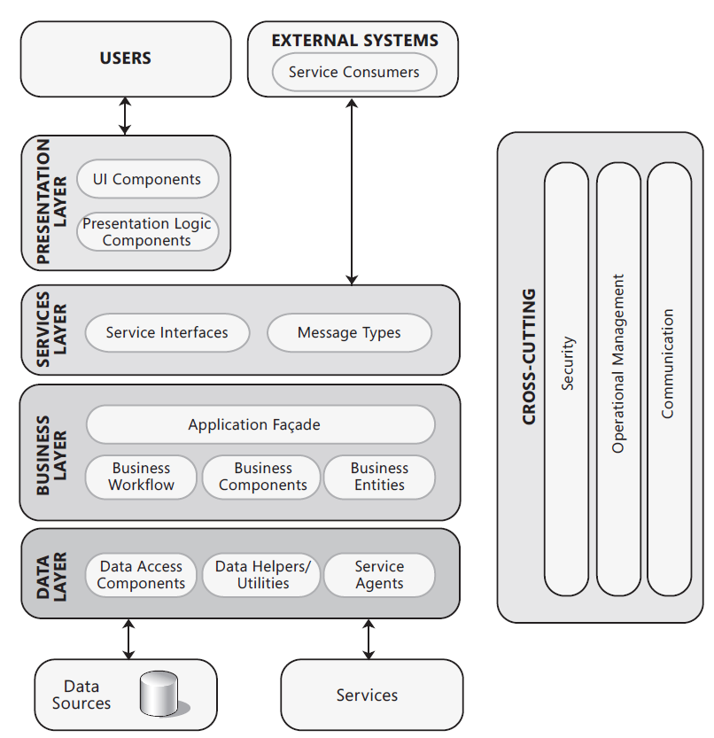
Common Application Architecture

Slide 61
Challenge
Redundancy of Functionality(85%)
Due to various application
Due to various UI technologies
Business Logic and Data Logic Redundancy
Automating Integration of Application(15%)
Enabling inter-Comm between Business Application without infrastructure dependency (like Server/Service IP Address/ URL Dependency, Service Provider Dependency..)

Slide 62
SOA
Basic Architecture
Extended Architecture
Web Service
Basic profile 1.1
WS-*
Discovery Agent
Publish(Server info / Service Info) (WSDL Doc)
Find(Server info / Service Info) (WSDL Doc)
Service Provider
Service Consumer
Interact(Packaging(SOAP(xml)) & Transporting([HTTP]))

Slide 63
SOA=> Architectural Pattern
WEB Service => Technology enabling SOA
WSDL,SOAP, [HTTP]
WCF => is API part of .NET Framework based on which we create Web Service

Slide 64
SOA is Architectural Pattern/Style (Conceptual)
Web Service is Technology(implements SOA)
APIs
ASP.NET Web Service (1.0, 2.0)
WCF (3.0)

Slide 65
WCF one API for All the Communication Requirement
IPC – inter-Process Communication (with in pc)
DCOM- Distributed Component Object Model
Remoting(.NET)
RPC pc 2 pc
Intranet
DCOM
Remoting
MSMQ
Internet
Web Service

Slide 66
Intro to RESTful

Slide 67
Challenge
Browser based App
SPA

Slide 68
Application Architecture
Presentation (UI/VIEW)
Win App
Mac App
Android App
Device Options
PC/Laptop
Hand-held
Mobile Phone
Tab
TV
Application
Native Applications
Windows OS
Mac Os
Mobile
I Os
Android
Web Applications
…
Functionalities
Business Logic
Business Workflow
Data Logic
Functionalities is Same whereas the way the UI is Created may vary(Win , Mac…)

Slide 69
REST => Architectural Style/Pattern Ful
URL
Noun
HTTP
Request (Carry Data())
HTTP Verb=> Action (Get,Put…)
Response
HTTP Status Code
200-299 Success
400-499 – user related Error
500-599- Server error (Critical)
Hyperlink - Hypermedia

Slide 70
RESTFul => API
If a API confines to REST architectural style then it is called RESTFul API

Slide 71
What Is a RESTful Service?
Representational State Transfer (REST) is an architectural style.
The term REST was introduced and defined by Roy T. Fielding in his doctoral dissertation in the year 2000.
November 2008, Leonard Richardson created a maturity model for REST
Richardson’s REST Maturity Model (RMM) provides service API developers the type of improvement map for building RESTful web services.
RMM starts at level 0 with a RPC-style interface, and then progresses up through three more levels—at which point you’ve achieved an API interface design that is, at least, according to Roy Fielding pre-condition for a RESTful service.
Notes:
REST is also resource-centric; that is, RESTful APIs use HTTP verbs to act on or
fetch information about resources. These would be the nouns in REST parlance
(e.g., Tasks, Users, Customers, and Orders). Thus, you have verbs acting on nouns.
Another way of saying this is that you perform actions against a resource.
Additionally, REST takes advantage of other aspects of HTTP systems, such as the
following:
·· Caching
·· Security
Statelessness
·· Network layering (with various firewalls and gateways in between
client and server)

Slide 72
REST Maturity Model (RMM)
Level 0
XML-RPC / SOAP
One URI
One HTTP method
Level 1 – Add URIs
Many URIs / Resources
One HTTP method
Level 2 – Add HTTP
Many URIs / Resources
Use of HTTP verbs
Level 3 – Add HATEOAS
Many URIs / Resources
Use of HTTP verbs
Hypermedia

Slide 73
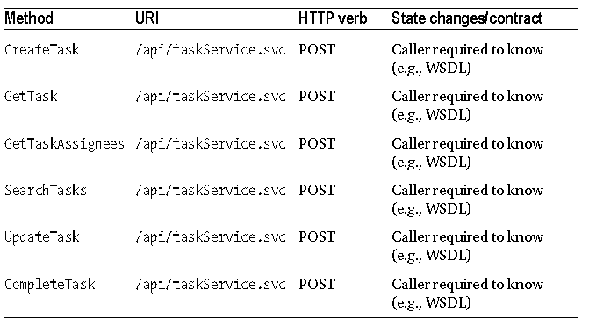
At Level 0, the API resembles most SOAP services. That is, the interface is characterized by having a single URI that supports only a single HTTP method or verb.
Level 0
XML-RPC / SOAP
One URI
One HTTP method

Slide 74
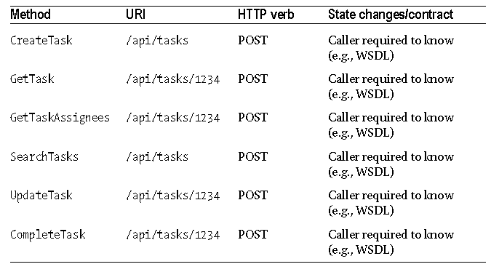
Level 1 – Add URIs
Many URIs / Resources
One HTTP method
Notes:
building a RESTful interface means you end up with an API that is very resource-centric. As such, you need to intentionally design the interface with resources being at the centre. Unlike RPC-style interfaces, where arbitrary service methods (i.e., the verbs) and their associated request and response messages rule the day, a REST interface will revolve around the resources (i.e., the nouns). The actions available to those resources are constrained by the use of HTTP. This is why you must map the available HTTP verbs into the API; you don’t have the freedom to create other actions or verbs.

Slide 75
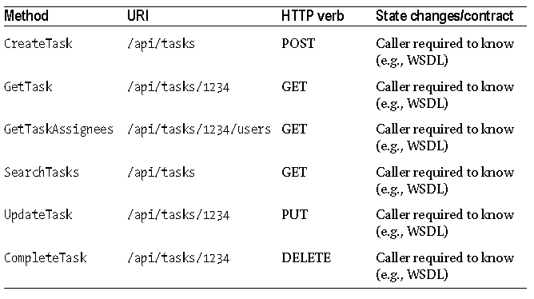
Level 2 – Add HTTP
Many URIs / Resources
Use of HTTP verbs
Notes:
REST architecture is agnostic about any specific protocol.
That includes the HTTP protocol. In other words, all you need is a protocol that provides
a language and mechanism for describing both states (i.e., representations) and state
changes. However, since this book is about building a REST service with ASP.NET, you’ll
focus on REST with HTTP. Fortunately, the HTTP protocol itself covers most of what you
need.

Slide 76
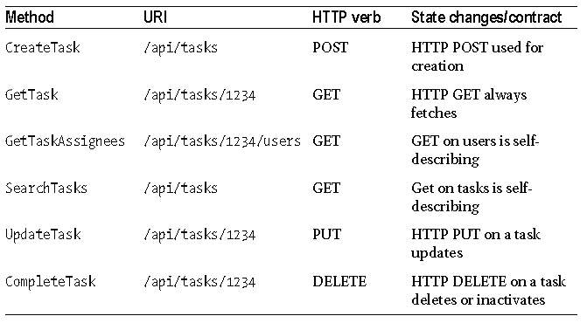
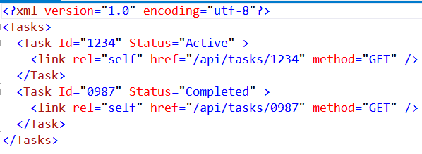
Level 3 – Add HATEOAS
Many URIs / Resources
Use of HTTP verbs
Hypermedia
Notes:
you can see that certain GET operations will return
collections of resources. One of the guiding principles of REST with HTTP is that callers
make transitions through application state only by navigating hypermedia provided
by the server. In other words, given a root or starting URI, the caller should be able to
navigate the collection of resources without needing prior knowledge of the URI scheme.
Thus, whenever a resource is returned from the service, whether in a collection or by
itself, the returned data should include the URI required to turn around and perform
another GET to retrieve just that resource.
Here’s an example of an XML response message that illustrates how each element in
the collection should contain a URI to the resource:

Slide 77
HATEOAS Hypermedia as the engine of application state

Slide 78
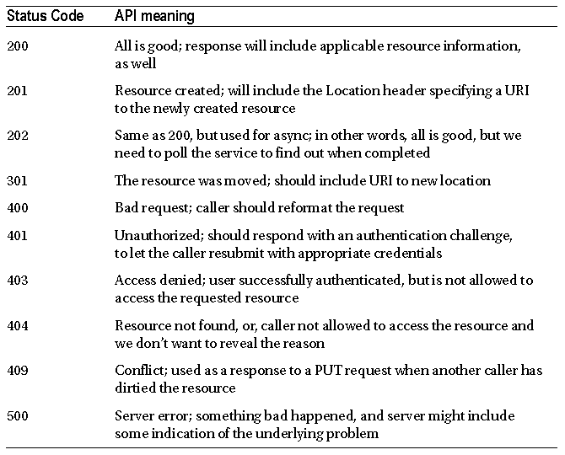

Slide 79
Web Service
SOAP Based
REST Based
Any Transport protocol that supports Text Format
IDKUUDKM
Data format any
Industry Standard Features
Security, Transaction, Metadata, Routing, Disco….
Truly Service infrastructure
Only HTTP
Usually it is IKUUKM
Usually XML & JSON
API Vendor Specific
Mostly used for SPA and Mobile

