Slide 1
Agenda
Pre
Layered Architecture
Static & Dynamic Exe
Distributed Computing
Cloud Computing
Intro to .NET Framework
CLR
BCL
Intro to CSharp
Intro VS 2022
Project Structure
Programming Construct
Sequence
Datatypes
Selection
If, Switch
Iteration
For While ….
Intro to CSharp…
OOPS
CSharp Language Features
Version wise

Slide 2
App
OS
PL
H/W

Slide 3
App Logic
Hello World!!!
App Infra Logic
STDIO.H=>Printf

Slide 4
S/W
System -10%
Application – 90%
General- 15%
Word Excel , ppt, Coral Draw
Specific (Business App) – > 85%

Slide 5
Layer is Logical => Tier is Physical
Single Tier(app.exe)
PL
PL
BL
BL
DL
DL

Slide 6
Layer=> Logical ; Tier=> Physical
DOS App + GUI based APP(vb)
DOS App + GUI based APP(vb)
CLI=> DOS App File Handling
Single Tier(app.exe)
Two Tier(app.exe + product.dbf)
Three Tier(app.exe + dll(s) + product.dbf)
PL
PL
PL
DBMS
BL
Dynamic EXE
BL
BL(DLL(s))
BL
DL
DL(DBMS=>RDBMS)
DL(DBMS=>RDBMS)

Slide 7
In-Process Component
Three Tier(Invapp.exe + product.dbf)
InvoiceApp.Exe(Process)
PL
Execution
BL(invoice.DLL(s))
Invoice.Dll.GenerateInvoice()
DL(DBMS=>RDBMS)

Slide 8
Out-Process Component
NTier(Invapp.exe +
InvoiceComponent.exe product.dbf)
InvoiceApp.Exe
Process 1
Execution
PL
BL(invoiceLib.EXE)
DL(DBMS=>RDBMS)
DCOM(outprocess Component).GenerateInvoice()
Process 2

Slide 9
N-Tier is Extension to 3-tier where Middle Tier is Distributed
N-Tier(app.exe + product.dbf)
Distributed Computing
PL
BL(Com Exe)
BL(Com Exe)
BL(Com Exe)
DL(DBMS=>RDBMS)

Slide 10
Distributed Computing
IPC (Inter-Process communication(light weight RPC))
DCOM
REMOTING (.NET)
RPC
Intranet
DCOM
REMOTING
MSMQ
Internet
ASP.NET Web Service(WEB SERVICE)

Slide 11
Stdio.h=>stdio.lib
API =?

Slide 12
Lib
Static
Dynamic

Slide 13

Complier
Program
APP Logic
APP Infra Logic
Step 3: System Call Mapping( OS Spec Binding)
Step 1: Check for Syntax & Semantics
H
App Logic(Your Code)
.OBJ
Native Code
Step 2: Linking(Embedded - )
LIB
Updates Code
.EXE(Static)

Slide 14
Step 3: System Call Mapping( OS Spec Binding)
Step 1: Check for Syntax & Semantics
H
App Logic(Your Code)
.OBJ
MLC
Step 2: Linking(Truly Linking- Holds Reference to DLL)
Ref
Update Reference
InvApp.EXE
Runtime
Invoice.DLL

Slide 15
.Net Framework
Framework
Infra
Intranet and Internet framework
.NET Framework

Slide 16
APP
.NET Framework
OS
H/W

Slide 17

.NET Frameworks and the Common Language Runtime
Data & XML
ASP.NET
Base Classes
Win Forms/
Console
Common Language Runtime
.NET Framework
Windows CE, ME, 2000, .NET
Notes:
“Bringing them closer.”
.NET –
Tools and Frameworks;
Base Infrastructure – Windows, Servers;
Building Block Services;
Internet User Experience – on previous slide

Slide 18
App
.NET Framework
OS
H/W

Slide 19
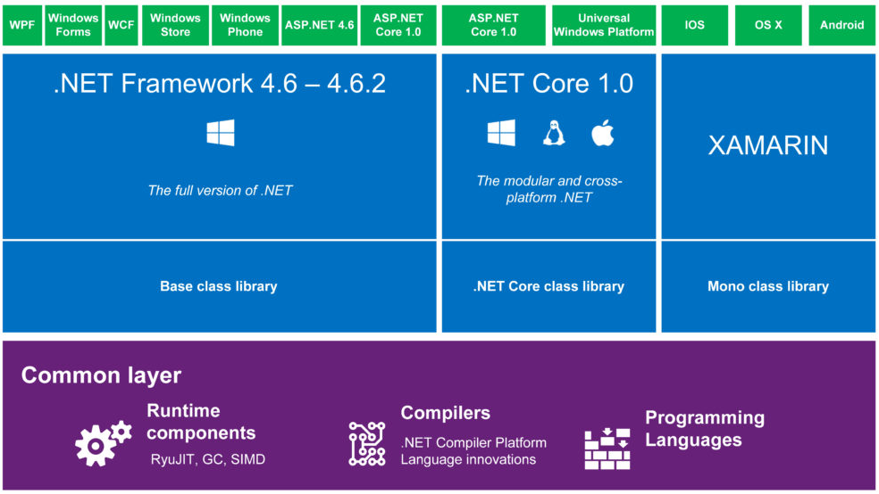
.NET Framework

Slide 20
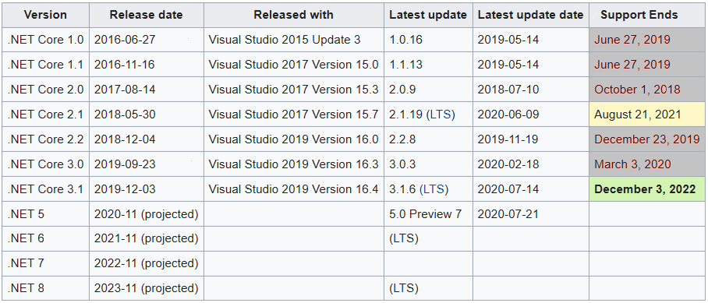
Version History
ASP.NET Version | VS
1.0 | 2002
1.1 | 2003
2.0 | 2005
3.5 | 2008
4.0 | 2010
4.5 | 2012
4.5.1 | 2013
4.6 | 2015

Slide 21
The .NET Framework The .NET Framework and Visual Studio.NET
VB
C++
C#
JScript
…
Common Language Specification
ASP.NET: Web Services
and Web Forms
Windows Forms
Visual Studio.NET
ADO.NET: Data and XML
.NET Framework Base Classes
Common Language Runtime
Notes:
The .NET framework exposes numerous classes to the developer. These classes allow the development of rich client applications and Web-based applications alike. The classes are shown here, divided into four areas.
ASP.NET provides the core Web infrastructure, such as Web Forms for UI-based development and Web Services for programmatic interface development.
User interface development on the Windows platform can be done using Windows Forms.
ADO.NET and XML provide the functionality for data access.
The core base classes provide infrastructure services such as security and transaction management.
You can create code in any of a large number of languages. This code will integrate in a deep, seamless manner via a standard called the Common Language Specification.
Visual Studio.NET provides tools that increases your productivity when creating applications.

Slide 22
Common Language Runtime Compilation
Source Code
Assembly
Compiler
C++, C#, VB or any .NET language
csc.exe or vbc.exe
DLL or EXE
Notes:
As a developer you can write code in the language of your choice. Your code is compiled into an Assembly, which is represented as a DLL or EXE.

Slide 23
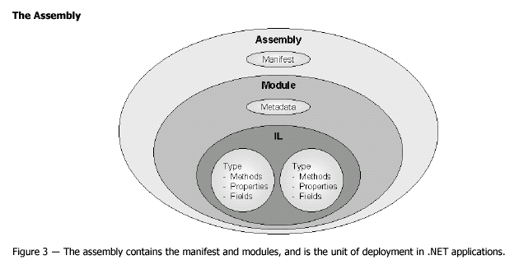
Common Language Runtime Assemblies

Slide 24
Development Machine
Deployed Machine(Client)

Slide 25
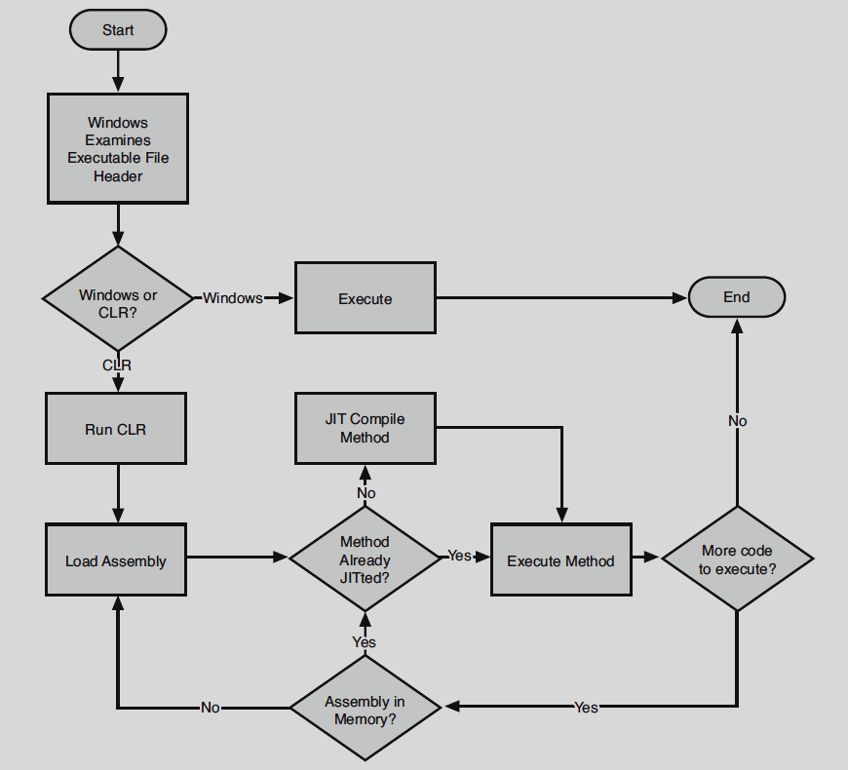

Slide 26
Common Language Runtime Execution Model
Source code
VB
C#
C++
Unmanaged
Component
Compiler
Compiler
Compiler
Managed
code
Assembly
IL Code
Assembly
IL Code
Assembly
IL Code
Common Language Runtime
JIT Compiler
Native Code
Operating System Services

Slide 27
Main method
static void Main(string[] args)
static void Main()
static int Main(string[] args)
static int Main()

Slide 28
Agenda
Datatype
Value Type
Reference Type
Conversion
Boxing and Unboxing
Methods
By Val
By Ref
Out Parameter
Param Array

Slide 29
Datatypes
Value Type
Inbuilt
Numeric
Without Decimal
Signed
Sbyte-> 1 byte - -128 +127
Short -> 2B
Int ->4B
Long-8B
Unsigned
Byte-> 1 byte – 0 to 255
UShort -> 2B
UInt ->4B
ULong-8B
With Decimal
Float –> 4B
Double -> 8B
Decimal -> 16B
Value Type
Inbuilt
Numeric
Alpha-Numeric
Char=> ‘a’=2B
Logical=>4B
Bool/Boolean=true/False
Date & Time
DateTime – 8B
1 Jan 0001 to 31 Dec 9999 23:59:59
User Defined
Enum
Struct

Slide 30
Datatypes
Reference Type
Inbuilt
String
Array
User Defined
Class
Interface
Delegate

Slide 31
Conversion
Implicit Conversion
Explicit Conversion
Between String and Primitive Type
Parse()
ToString()
Between value type and Reference type
Boxing and Unboxing
Casting(OOP)

Slide 32
Compare
Value Type
Reference Type
Usually allocated on STACK
Copying value type to Another Value type will copy VALUE
Cheaper memory management
Always Allocated on HEAP
Copying Reference type to Another Reference type will copy REFERENCE
Memory defragmented and expensive to manage

Slide 33
VS Modes
Design Mode
Execution Mode
Debugging Mode

Slide 34
Object Oriented Programming
Encapsulation
Abstraction
Information Hiding
Public , Private
Implementation Hiding
Static Polymorphism
Function/Method/Operator Overloading
Issue with Encapsulation
Brings in Code Redundancy
Solution
Inheritance
Runtime Polymorphism(Overriding)

Slide 35
Specialization to=> Generalization
Generalization
Emp
PM
PA
SE
Specialization

Slide 36
Scenarios
Two(Virtual)
One (Default)
Emp
Overridable FillTaskSheet()
{General imp}
Emp
FillTaskSheet()
{ general imp}
PM(Daily)
PA
SE
ST(Monthly)
PM
PA
SE
Override FillTaskSheet()
{
Specific Imp for ST
}
Three(Abstract)
Incomplete therefore cannot instantiate
Abstract => Method imp is resolved in derived class
Method in base class implementation exists in derived class in many form(polymorphism)
Base class abstract method is mapped to derived class implementation at RUNTIME therefor it is RUNTIME POLYMORPHISM
Emp
Abstract FillTaskSheet();
Override FillTaskSheet()
{
Specific Imp PM
}
PM
PA
SE
ST
Override FillTaskSheet()
{
Specific Imp ST
}
Override FillTaskSheet()
{
Specific Imp PA
}
Override FillTaskSheet()
{
Specific Imp SE
}

Slide 37
In nutshell
Encapsulation ; Modularity
Inheritance ; 100% Code Reusability
Polymorphism ; 100% Extensibility

Slide 38
Properties
Purpose
To enclose the data members and provide controlled access
What
It behaves like a data member as part of object , internal to a class it is method (Set and Get )
Why
Validation
Access control
Read only , Write only or both
Computed / Calculated member

Slide 39
Interface
Purpose
To Decouple Provider and Consumer thereby it is Dynamic
When there is Many Consumer to Many Provider
At Design Time (Noun)
Is is a Contract
At Runtime (Verb)
A medium of communication

Slide 40
Agenda
1.0
Collections
Ienumerable & ienumerator
Delegates & Events
Threading
2.0
Generic
Type Inference
Nullable type, Static Type, Partial Type
Anonymous Block/Method
3.0
Local type Inference
Object Initializer and collection Initializer Syntax
Anonymous type
Extension method
3.5
LINQ
Standard Operators
Query Expression
4.0
Parallelism
Tasks Parallel Library
P-LINQ
Dynamic Typing

Slide 41
Generic
Datatype Introduced Code Redundancy is addressed by Generic
Level
Method Level
Properties
Class Level
Interface
Delegates

Slide 42
Agenda – D3
Delegates & Events
Collections
Ienumerable & ienumerator
Nullable type, Static Type, Partial Type
Anonymous Block/Method
Local type Inference
Object Initializer and collection Initializer Syntax
Anonymous type
Extension method
3.5
LINQ
Standard Operators
Query Expression

Slide 43
Delegates
What
Conceptually
It is similar to Function pointer in other programming languages
To Decouple Caller from the Called Function/Method
Technically
It is a class
That can hold 0..n number of Method References
Must inherit from System.MultiCastDelegate =>System.Delegate

Slide 44
Void Main()
Void()
Int Add(int a, int b)
String SomeMethod(employee[] emps, department dept)

Slide 45
Collection
Conceptual
Is a Class
That holds 0..n number of Object Reference
To Represent Object Models
Technically
Must Implement ICollection
Must Provide Sequential Access
IEnumerable
IEnumerator
Object Access
Sequential
IEnumerable
Random
Index based
IList
Key Based
IDictionary
Technically
Dot net ver 1.0
System.Collections
Dot Net ver 2.0
System.Collections.Generic

Slide 46
2.0 Class
Static Type
Nullable Type
Partial Class
Single class content Spans across multiple file but in that project compiler will compile it as single class

Slide 47
Type Inference
Based on the Value type will be inferred (understood)
For instance if I=100 ; where I is set with the value 100 and 100 is integer therefore I is Inferred it to be Integer type variable.
Type can be Inferred at
Compilation Time (static type Inference)
Runtime (Dynamic type Inference)
Dot net version 4.0 onwards it is DLR

Slide 48
Extension Method
Must be static , public declared inside Static class
Must have ‘this’ keyword before the FIRST Arguments Type to Which the given method is Syntactically Extended

Slide 49
Language INtegrated Query
is ONE API to Query various Data Source
Data source
They way we retrieve (Filtering, Grouping, Sorting, Joining) will vary from one data source to another, leading to Redundancy of API Learning, developers needs to learn again and again.
The way we Filtering, Grouping, Sorting, Joining using Array is Different from List Collection is different from Dictionary Collection…
Objects
Array, List,Dictionary,….
(ADO.NET) Dataset
Datatable
XML
Database
Every database has its own dialect of SQL

Slide 50
LINQ
Dot Net Ver 3.5
LINQ For Objects
LINQ for ADO.NET
LINQ to XML LINQ to SQL
4.0
LINQ to Entities

