Slide 1

Digital portfolio
STUDENT NAME : Elanthamizhan J REGISTER NO: 24131030500121008
NMID: 72BC948799C610FAF4B4CC40B189E6D3
DEPARTMENT: BCA COLLEGE: GOVERNMENT ARTS COLLEGE, Chidambaram

Slide 2
PROJECT TITLE
Digital portfolio
A digital portfolio is an online collection of a person’s work, achievements, education, and skills. Unlike a traditional paper resume, a digital portfolio is interactive, visually appealing, and accessible from anywhere. It allows students, professionals, and creators to showcase their abilities effectively in the digital world.

Slide 3
AGENDA
1.Problem Statement
2.Project Overview
3.End Users
4.Tools and Technologies
5.Portfolio design and Layout
6.Features and Functionality
7.Results
8. Screenshots
9.Conclusion

Slide 4
PROBLEM STATEMENT
Many students face difficulties in presenting their skills, education, and personal details effectively. Traditional resumes often look plain and cannot showcase creativity or technical knowledge. Hence, there is a need for a digital portfolio that is more attractive, structured, and easy to share.

Slide 5
Project Overview
This project is a personal portfolio website created for Elanthamizhan, a BCA student at Government Arts College, Chidambaram. The portfolio is designed with a modern theme combining white, black, blue, and yellow colors. It highlights education, skills, and a contact form, making it easy for others to know about the student.

Slide 6
End Users
The main users of this portfolio are teachers, recruiters, classmates, and professionals who want to know about the student’s skills and background. It can also be used when applying for internships, job opportunities, or higher studies.

Slide 7
Tools and Technologies
The portfolio is built using simple HTML for structure and CSS for styling. It uses responsive design to look good on different devices. Images and gradients are used for design, and a mailto form is included for easy communication.

Slide 8
Portfolio Design and Layout
The design is clean and professional with a navigation bar at the top, a profile icon, and separate sections like About, Education, Skills, and Contact. The layout follows a structured approach, ensuring that visitors can quickly find important information.

Slide 9
Features and Functionality
* Profile section with name and course details * About section describing goals and interests * Education and skills sections * Contact form with email and message box * Top navigation bar for smooth movement between sections * Color theme (white, black, blue, yellow) for a modern look

Slide 10
Results
The result is a working personal portfolio website that represents the student’s background in a professional manner. The site can be hosted online and shared as a digital resume.

Slide 11
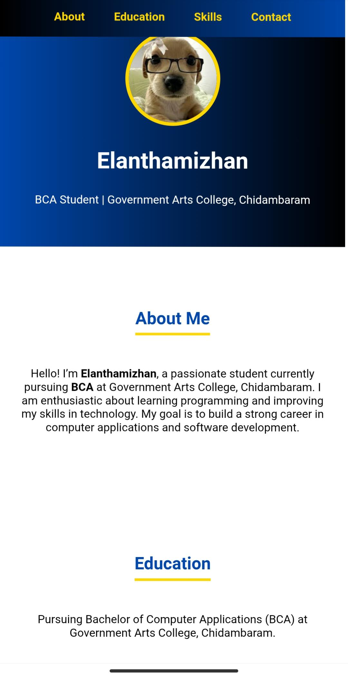
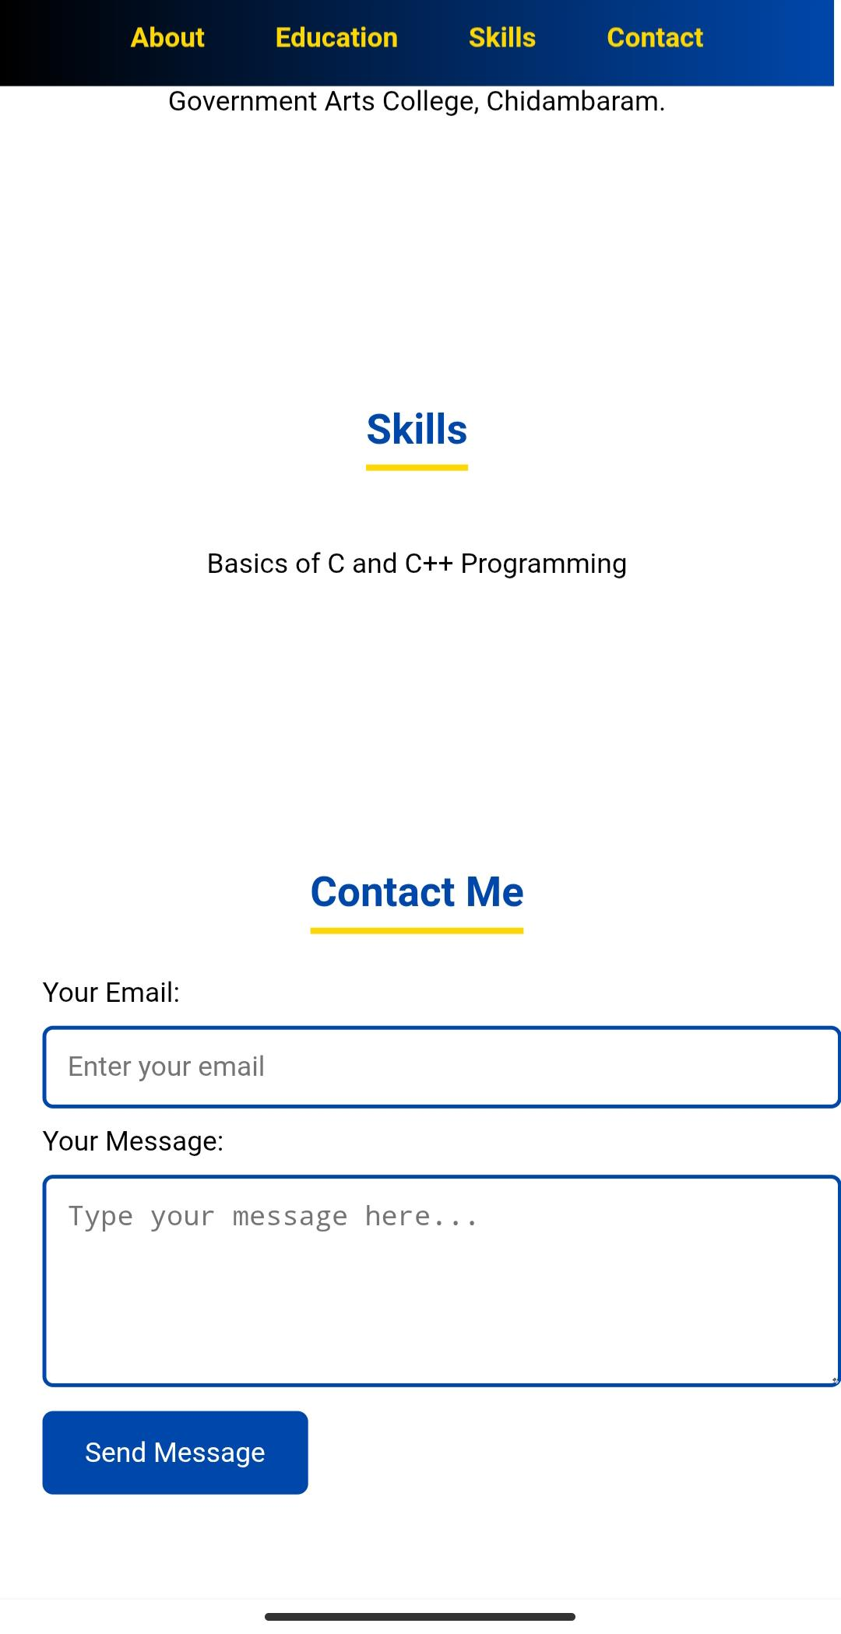
Screenshots

Slide 12
Conclusion
The portfolio project successfully demonstrates how students can present themselves digitally. It helps in career opportunities, enhances professional presence, and shows basic knowledge of web development.
“THANK YOU”

