Slide 1
ChatGPT’s role in developer conversations across software platforms
By: Elina Antonova
Supervisor:
dr Mairieli Wessel

Slide 2
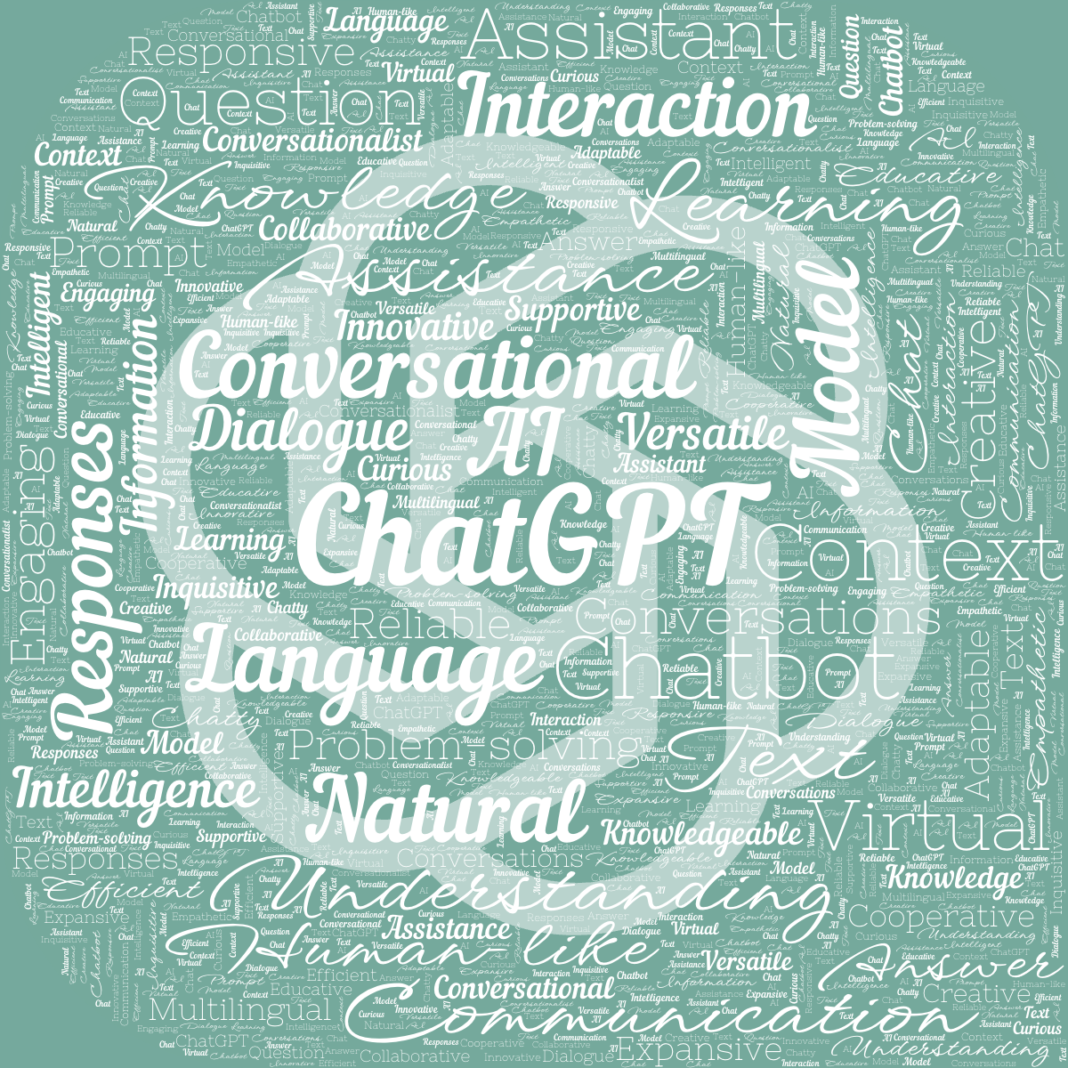
introduction
ChatGPT’s role in developer conversations across software platforms
ChatGPT is becoming more popular as a problem-solving tool: including software development domain.
Goal of this research
Investigate the expected role of ChatGPT in user-chatbot interaction within the software development domain
Connection to SWS and impact
Knowledge of the role of ChatGPT in developer-ChatGPT interaction can help the research that focuses on improving SE-oriented chatbots

Slide 3
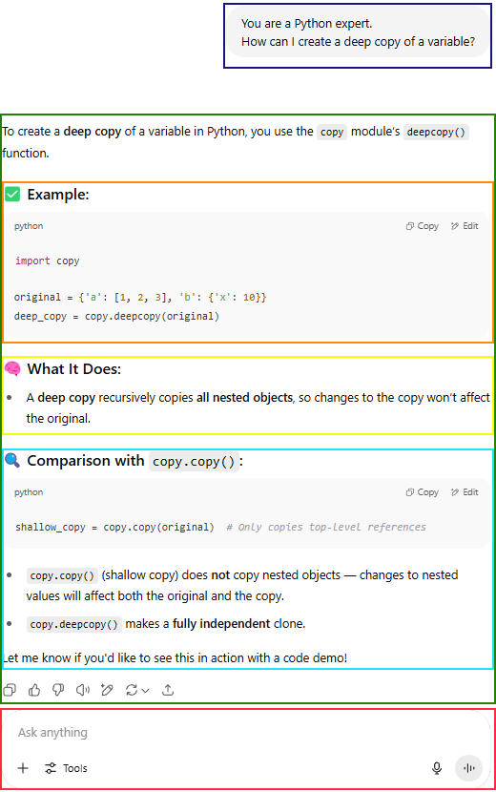
Chatgpt
INTRODUCTION
ChatGPT – Chat Generative Pre-trained Transformer:
Large-scale pre-trained language model
Developed by OpenAI
First release: November 2022
By November 2023: 100 million weekly users
Interaction consist of conversation with the chatbot that consist of pair of:
User prompts
ChatGPT responses
Focus of this research is on user prompts.

Slide 4
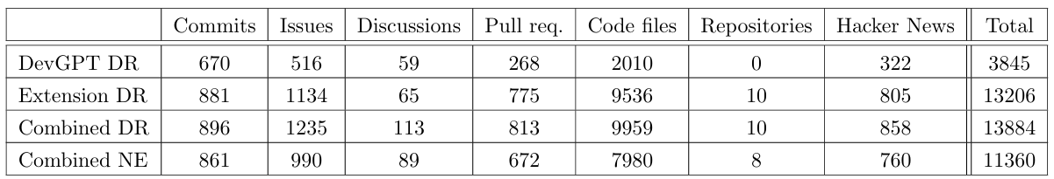
Devgpt & its extension
data
DevGPT – a dataset containing developer-ChatGPT conversations sourced from:
GitHub commits, issues, discussions, pull requests, code files, and HackerNews.
Latest DevGPT snapshot: 12th October 2023.
DevGPT extension: the data collected from the same sources and GitHub repositories.
Latest snapshot: March 2025.

Slide 5
Pre-processing
Data
Embedded code detection
So you want me to hard code the password in this section of src/pages/ api/getDeviceInfo.js? const pool = new Pool({ host : process.env.PGHOST 2, port : process.env.PGPORT 2, database : process.env.PGDATABASE 2, user : process.env.PGUSER 2, }); (Source: GitHub issue-related conversation) Approach:
Custom script.
Non-English language detection
mach mir noch so eine aufgabe zu dem selben muster, damit ich das thema besser verstehen kann. (Source: GitHub commit-related conversation) Approach:
Langdetect and pycld2 Python libraries.
Notes:
Mention guesslang for code detection Pycld2 = compact-language-detector

Slide 6
N-grams
Methodology
N-gram – a sequence of n consecutive characters, words or other textual structures.
Generated by sliding a window of size n over the text with original order of the elements.
Example:
That fox is chasing a rabbit.
Bi-grams: (that, fox), (fox, is), (is, chasing), (chasing, a), (a, rabbit);
Tri-grams: (that, fox, is), (fox, is, chasing), (is, chasing, a), (chasing, a, rabbit);
Quadri-grams: (that, fox, is, chasing), (fox, is, chasing, a), (is, chasing, a, rabbit).
This research: ngrams() function from nltk Python library, where n is between 1 and 4.
Visualisation using WordCloud.

Slide 7
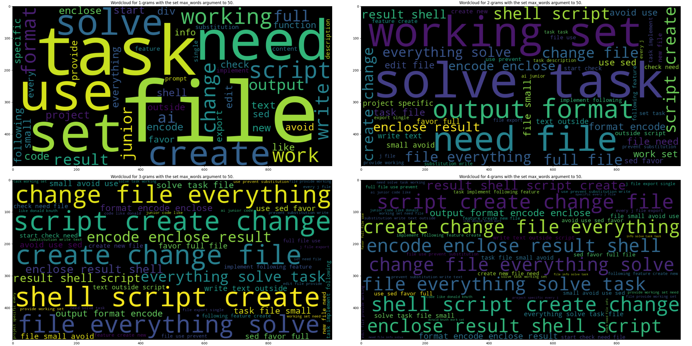
N-grams visualization of conversations sourced from GH commits
Methodology

Slide 8
Sequential pattern mining (SPM)
Methodology
Sequential pattern mining (SPM) is used to discover statistically relevant sequences of events or items.
SPM:
Sequence database – a set of sequences used as input;
Patterns – ordered sub-sequences that occur at least once;
Frequency – the number of sequences that contain a pattern.
Example:
{A, A, B, A, D} {C, B, A} {C, A, C, D}
Patterns with frequency=2:
{A, D} {B, A} {C, A}
This research: Seq2Pat Python library used with minimum frequency set to 2% of elements count in sequence database.

Slide 9
Latent Dirichlet allocation: topic modeling
Methodology
Topic modeling is a text analysis technique in NLP that automatically discovers hidden topics within a collection of documents.
Topics represents a recurring pattern of words that best describes a theme within a collection of documents. Each document is a mixture of topics.
Latent Dirichlet Allocation (LDA) – probabilistic generative model that is used to discover hidden thematic structures within a collection of documents.
Example:
Vocabulary: {pan, cook, football, basketball}
Topics:
Kitchen : “pan” and “cook” – high probabilities, “football” and “basketball” – low probabilities.
Sport : “football” and “basketball” – high probabilities, “pan” and “cook” – low probabilities.
This research: LatentDirichletAllocation class functionality from sklearn Python library with topic numbers selected between 2 and 10 based on the best coherence and perplexity scores.
Notes:
Coherence – measures semantic similarity of top words.
Perplexity - evaluates how well the model predicts unseen data. Lower perp = better generalisation.

Slide 10
results
conclusion
GH commits | GH issues | GH discussions* | GH pull requests | GH code files | GH repositories | HackerNews*
Task-based file management Functional testing UI layout planning | Code & model behavior Data & value processing | Product design feasibility Silicon Valley series Node installation issue Model calibration | C++ function signatures Ontology & classification Web attestation APIs Python packaging errors | Step-by-step coding guidance OWL/RFD ontologies Functional file operations Book passage writing | UI layout metagata Research effort | Conversational requests Narrative creation Game interaction errors File tracking utilities Code support
Action-based programming tasks | Debugging and coding | Software engineering, discussion, machine learning | Low-level code generation, system & library integration | Instructional sequences, data modelling, coding, storytelling | UI generation and interface rendering, vision statements | Discussion and storytelling simulation, utility-based interactions

Slide 11
Research conclusion
conclusion
ChatGPT roles:
Procedural collaborator: command line logic, code generation, low-level implementation
Pair-programmer: debugging, problem resolution
Mentor/coach: system architectural reasoning, verification and validation
Storytelling partner: book passage/text generation
Discussion partner: casual conversations and arguments

