Slide 1

DATA 5100 | 25FQ
Food Deserts, Socioeconomic Factors, and Obesity Rates Across U.S. Counties
EJ Bergevin
Emily Larson
Jack Neton

Slide 2
Research Question
How do socioeconomic factors and elements of food deserts relate to obesity rates?

Slide 3
Importance
Food deserts affect millions of Americans
  Especially in rural and low-income communities
Understanding which factors matter helps guide policy and resource allocation.

Slide 4
Dataset Overview
USDA Food Environment Atlas
Food access indicators
Food insecurity
Store types per capita
Socioeconomic indicators
Obesity Rates (dependent variable)
~3000 counties after cleaning

Slide 5
Key Predictors
Food Desert Components:
  Food insecurity rate
  Low-income/low-access percentage
  Store Type (grocery, supercenter, convenience, specialized)
  No vehicle access
Socioeconomic Factors:
  Median Income
  Poverty Rate
  Age (65+, for ex).
Outcome:
  Obesity Rate (%)

Slide 6
Data Cleaning & Transformations
Removed outlier values (-9999/-8888/NaN)
  Mean imputation at state level
Log-transformed skewed store variables
Standardized all continuous predictors
Checked distributions and correlations

Slide 7
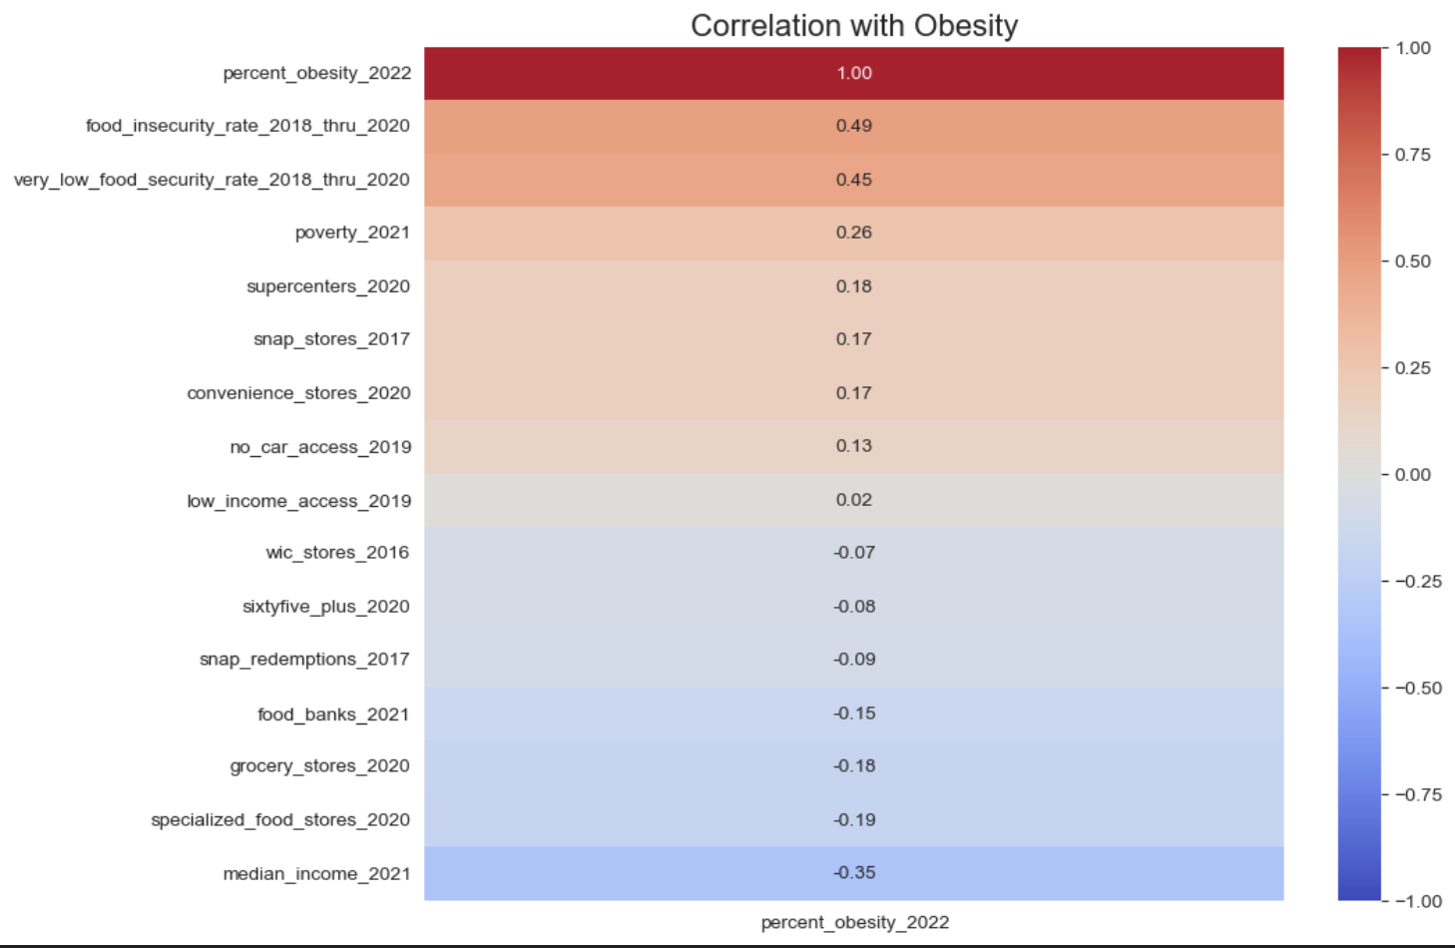
EDA: Correlations

Slide 8
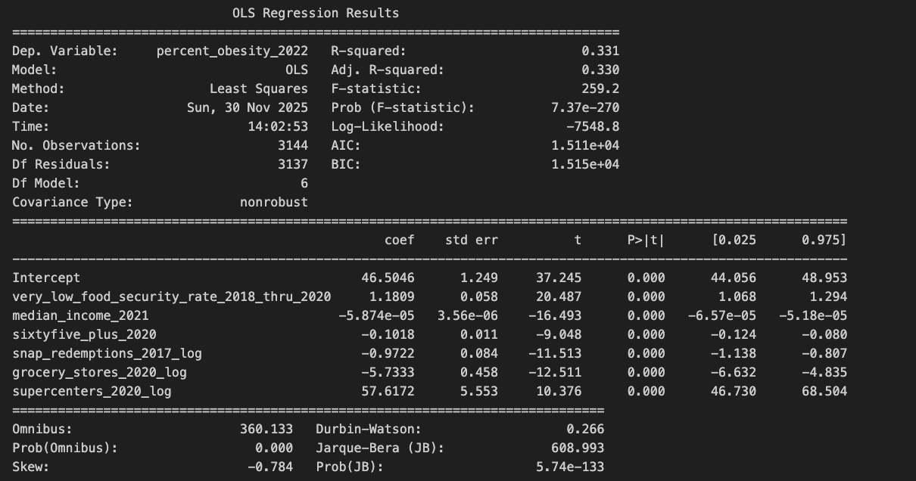
Initial Model:
Stepwise Regression
Variable selection unstable due to multicollinearity
  Highlighted need for regularization
Served as baseline model

Slide 9
Model Refinement
Why use Elastic Net?
Predictors shown to be highly correlated
  Elastic Net stabilizes estimates in this environment
Assists with feature importance interpretation

Slide 10
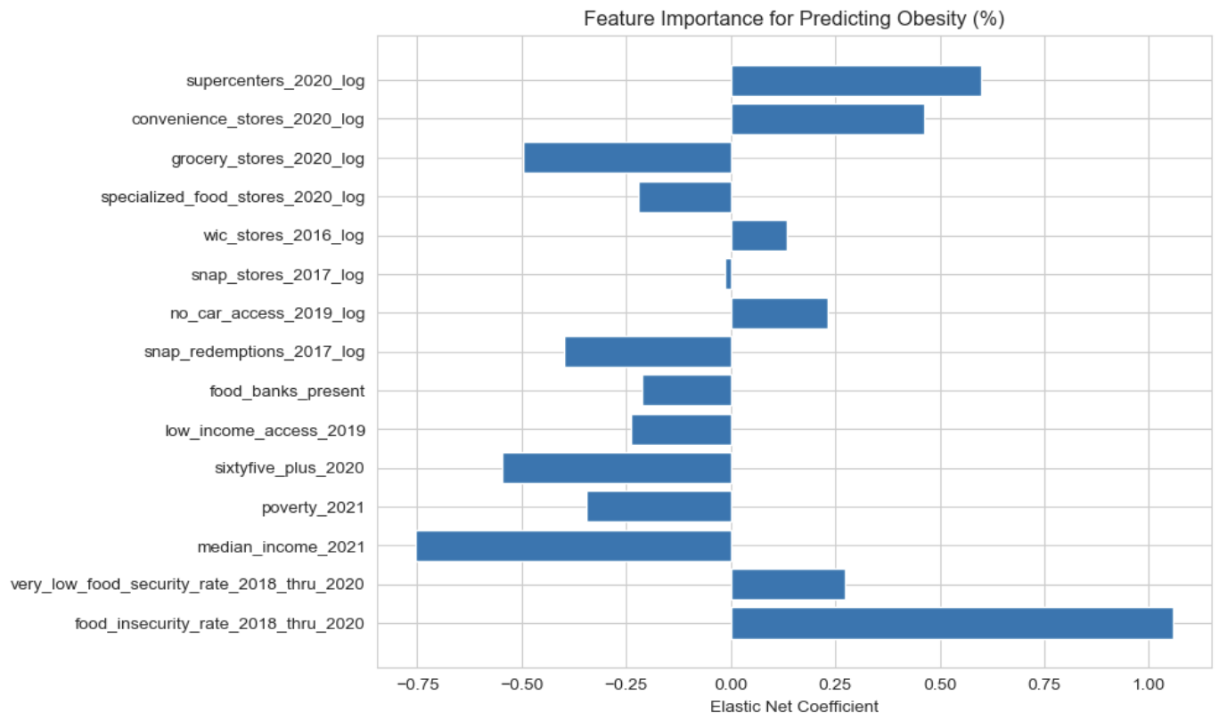
Model Refinement
Elastic Net Feature Coefficients
Food insecurity rate (1.232) strongest positive predictor
Supercenters (0.682) and convenience stores (0.505)
Grocery stores (-0.409) and specialized food stores (-0.206) reduce obesity

Slide 11
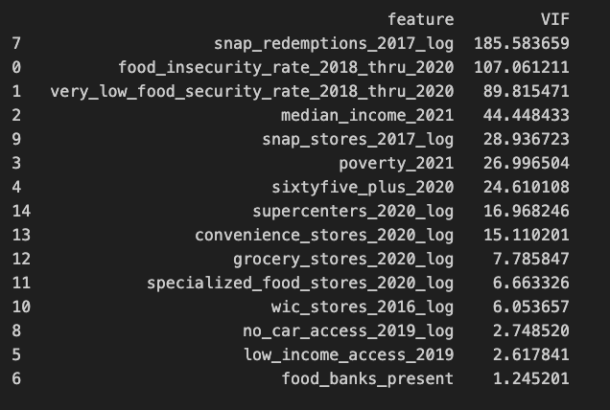
Mutlicollinearity Check (VIF)
Socioeconomic indicators showed high VIF.
Confirms overlapping information across predictors.

Slide 12
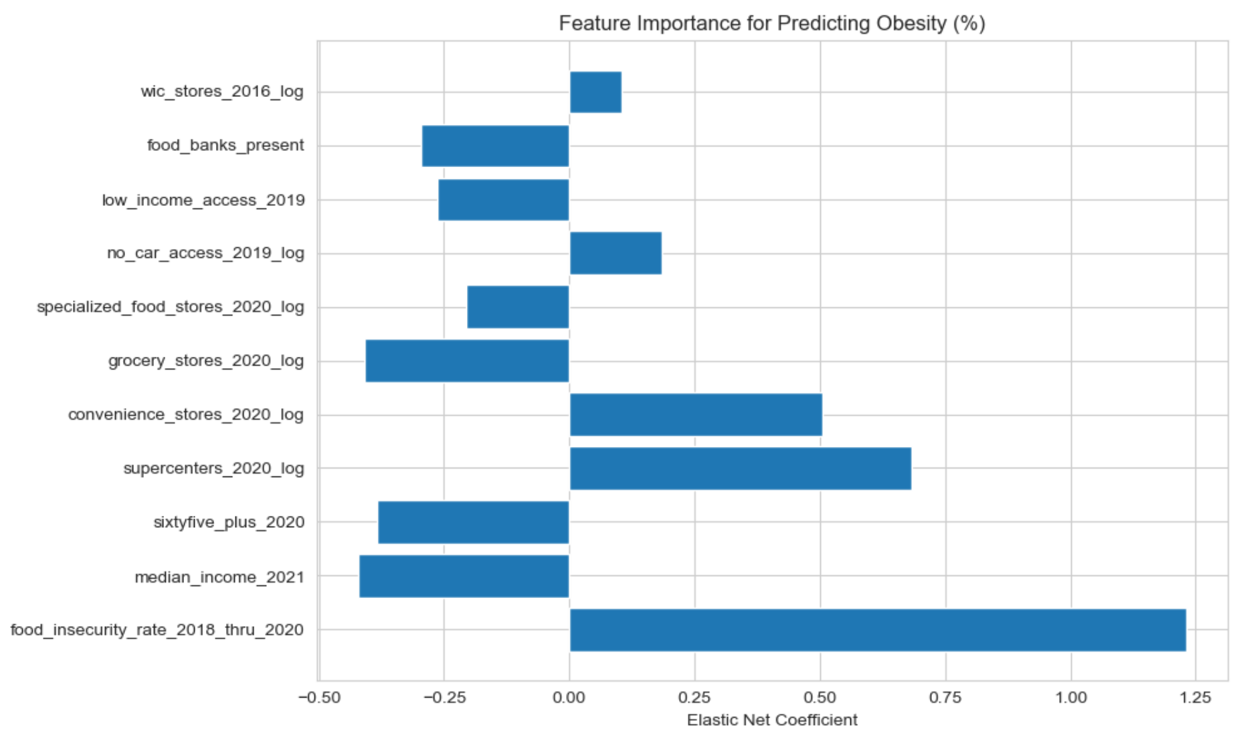
Final Elastic Net Model
Final Elastic Net Feature Coefficients
Food insecurity rate (1.232) remained strongest positive predictor
Supercenters (0.682) and convenience stores (0.505)
Grocery stores (-0.409) and specialized food stores (-0.206) reduce obesity

Slide 13
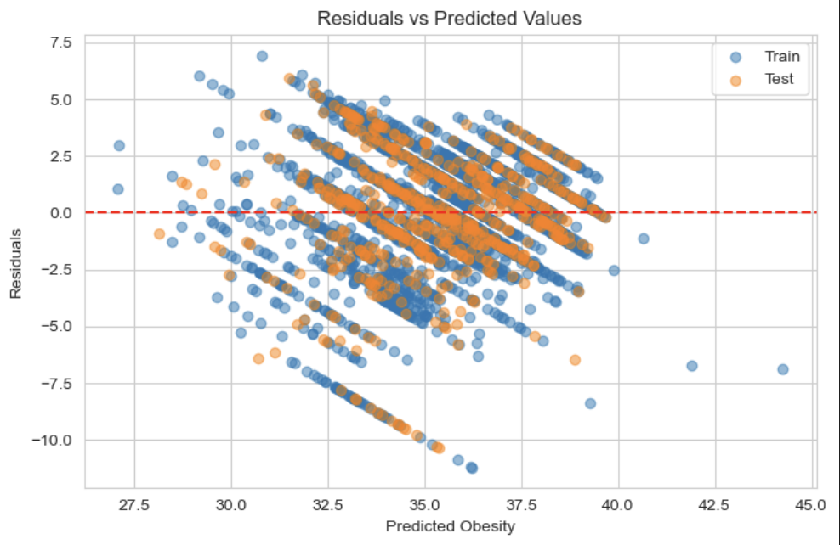
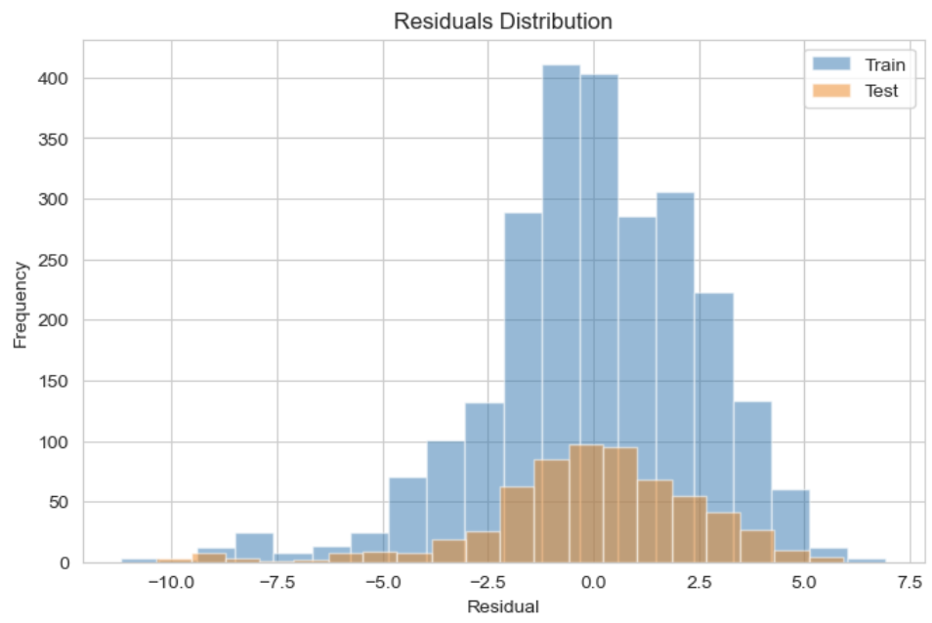
Residual Diagnostics
Final Elastic Net Model
Residuals centered around zero.
Train/test distributions overlap; no major overfitting
Mild, but acceptable, heteroscedasticity.

Slide 14
Interpretation
Convenience stores have more highly processed foods, therefore, leading to higher obesity rate.
Grocery stores & specialized food stores have healthier options, leading to lower obesity risk.
Food insecurity is the strongest direct food-desert signal.

Slide 15
PCA: Why?
Why try PCA?
Compress correlated predictors into independent components.
Check whether capturing shared variance improves predictions.

Slide 16
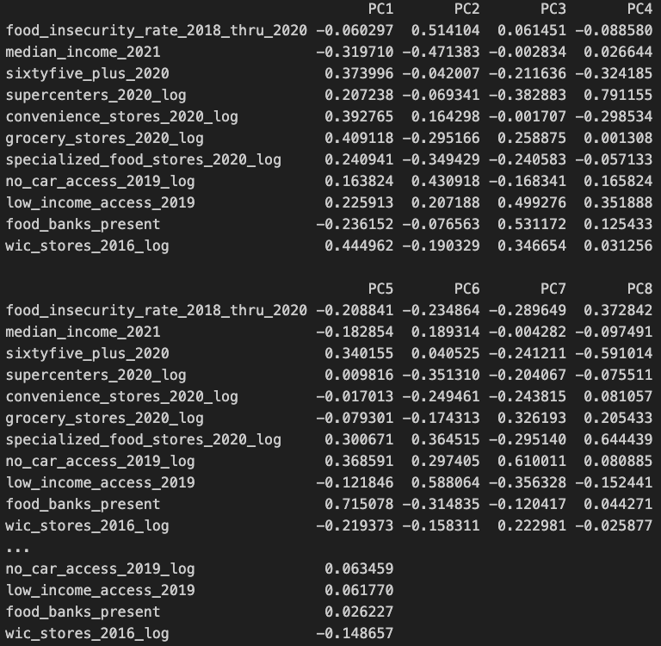
PCA: Components
PC1: socioeconomic + access gradient (income, poverty, food insecurity)
PC2/3: store-type differences
Performance:
  Reduced multicollinearity but did not improve accuracy.

Slide 17
Conclusions
Both food-desert components and socioeconomic factors meaningfully relate to obesity.
Food insecurity has the largest positive effect on obesity.
Greater access to grocery stores and specialized food stores reduces obesity.
Median income and older population share are protective socioeconomic factors.
Model explains a moderate share of obesity variation (R² ≈ 0.38-0.40).
Indicates obesity is multi-factorial environment + socioeconomic + behavioral factors.

Slide 18
Limitations &
Future Work
Limitations
Food access does not equal food choices.
Observational data cannot infer causality.
Future Work
Add behavioral/environmental features to modeling.
Explore more causal framework.

Slide 19
Thank you!

