Slide 1

FLEXBOX AND GRID

Slide 2
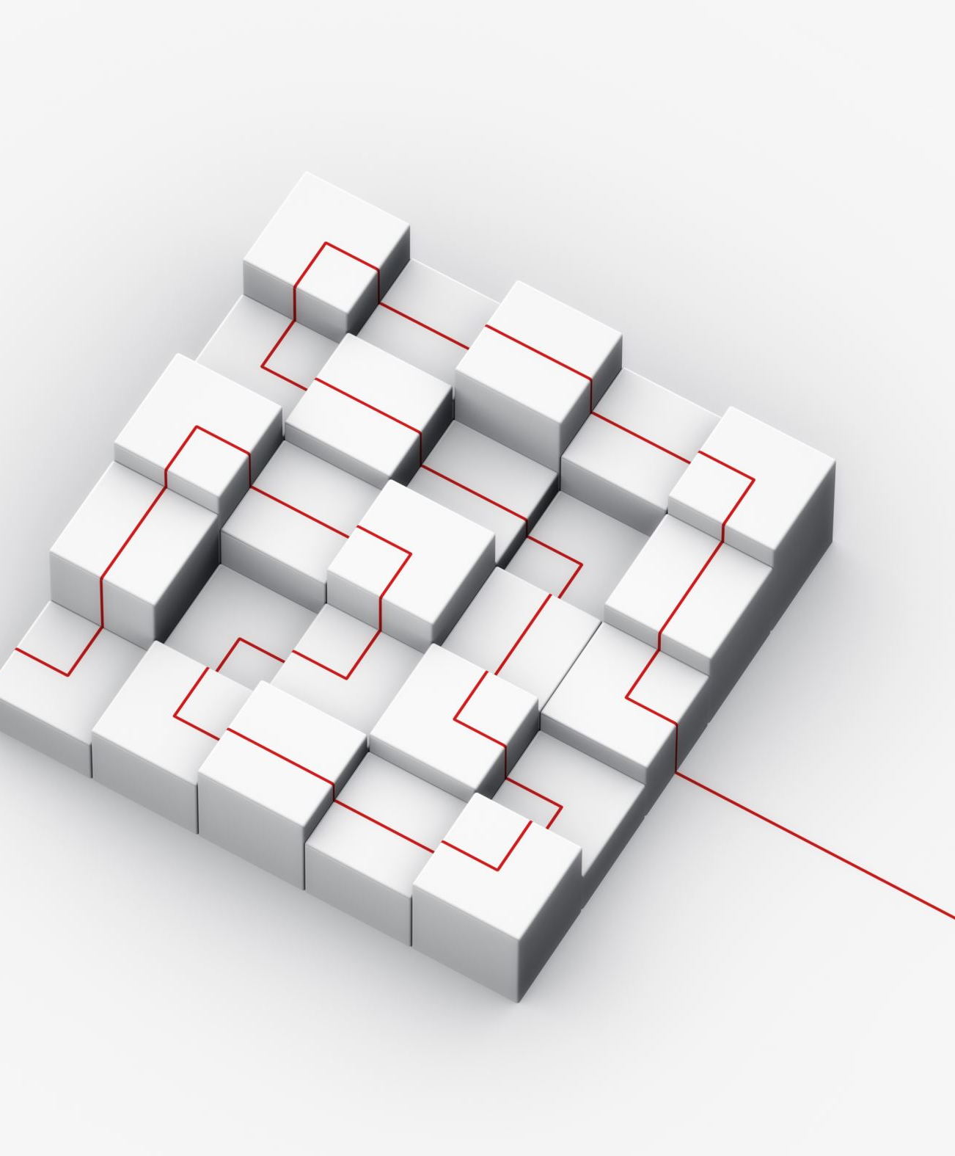
WHAT IS FLEXBOX?
This CSS module was designed to improve an aspect that gave many headaches:
The ordering, alignment and distribution of space between elements.
It is a one-dimensional model in which we can order elements as rows or columns.
The Flexible Box Layout Module, makes it easier to design flexible responsive layout structure without using float or positioning.

Slide 3
Properties
• flex: Allows all elements to have the same width, regardless of their content
• flex-basis: Sets an initial width of the element
• flex-direction: Marks the main direction of the container
• flex-wrap: Controls the element line change
• flex-flow: combines flex-direction and flex-wrap
• flex-grow: Mark the growth factor of the container
• flex-shrink: Marks the shrinkage factor of the container

Slide 4
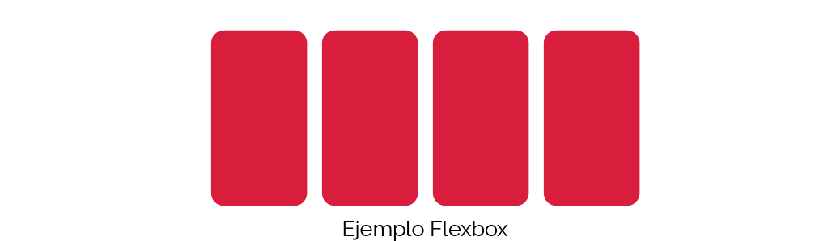
Example

Slide 5

WHAT IS GRID?
CSS Grid goes further, the control it gives of the layout is a higher level, and never better said, since,
If we said that flexbox was one-dimensional, CSS Grid works in a two-dimensional way:
Like flexbox, we have columns and rows, but both elements can be defined at the same time.
The CSS Grid Layout Module offers a grid-based layout system, with rows and columns, making it easier to design web pages without having to use floats and positioning.

Slide 6

Properties
• grid: Allows several rules to be joined in a single statement (grid-template-rows, grid-template-columns, grid-row-gap, grid-column-gap, grid-template-areas…)
• grid-template: Join in a single statement grid-template-rows, grid-template-columns and grid-template-areas
• grid-template-columns: Declare the number of columns and their width (full or relative)
• grid-template-rows: Declare the number of rows and their height (total or relative)

Slide 7
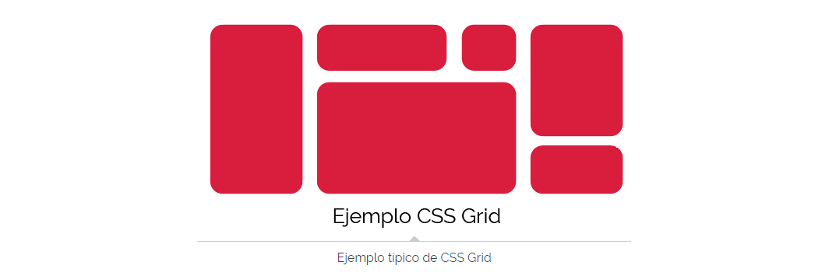
Example

