Slide 1
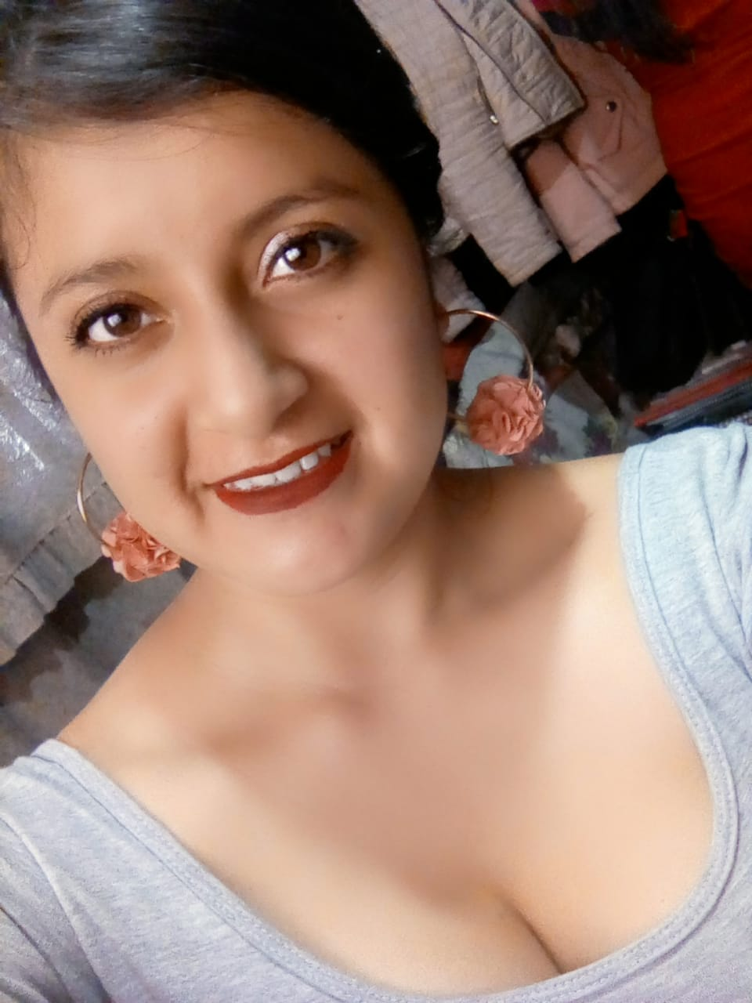
Introduce Myself
My name is Liliana Chora
I am 22 years old
I was born in the Isidro Ayora maternity hospital in Quito.
I live in the south of Quito with my mother.
My favorite color is purple.
My favorite food is humitas con café.
My hobby is dancing
In my free time I attend my dance group and when there are presentations I go dancing.
I am a nervous girl but I like to pursue my dreams.

Slide 2
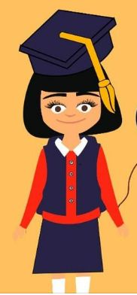

Studies
I was in the school “Latinoamerica Unida” in the south of Quito.
I entered 24 de Mayo Hight School and I graduated at 17 years old in 2017.
I waited two years trying to pass the SER BACHILLER exam and entered university at the age of 19.
I passed the SER BACHILLER exam on the third attempt.
I now study at ESPE University
I study Information Technology Engineering because the professionals in this field are essential support for technological development.

Slide 3
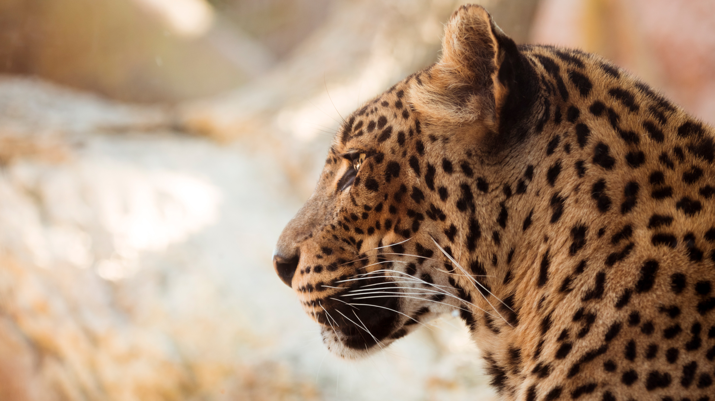

A dream doesn't come true by magic, it takes sweat, determination and hard work Colin Powell

