Slide 1
FLEXBOX & GRID
Karla Guayasamín

Slide 2
01
FLEXBOX

Slide 3
Flexbox is a layout model in CSS that allows you to align and distribute space among elements in a container.
It gives you control over how elements are aligned along the horizontal and vertical axes, and also allows you to specify how elements should be distributed in the space available.
Flexbox is particularly useful for building responsive layouts, as it makes it easy to adjust the layout of a page based on the size of the screen or the size of the browser window.

Slide 4
How to use?
To use Flexbox, you first need to create a container and set its display property to flex or inline-flex. You can then use the Flexbox properties to control the alignment and distribution of space among the child elements within the container.

Slide 5
Common Properties
Justify-content
Align-items
Flex-direction
Aligns the child elements along the main axis
Aligns the child elements along the cross axis
Flex-wrap
Flex-wrap
Flex-wrap
Sets the main axis and the cross axis. Possible values are “row”, “row-reverse” and “column”, ”column-reverse”
Indicates whether the elements should fit on a single line or should wrap onto multiple lines.
Indicates how much a element should grow relative to the other elements in the container.

Slide 6
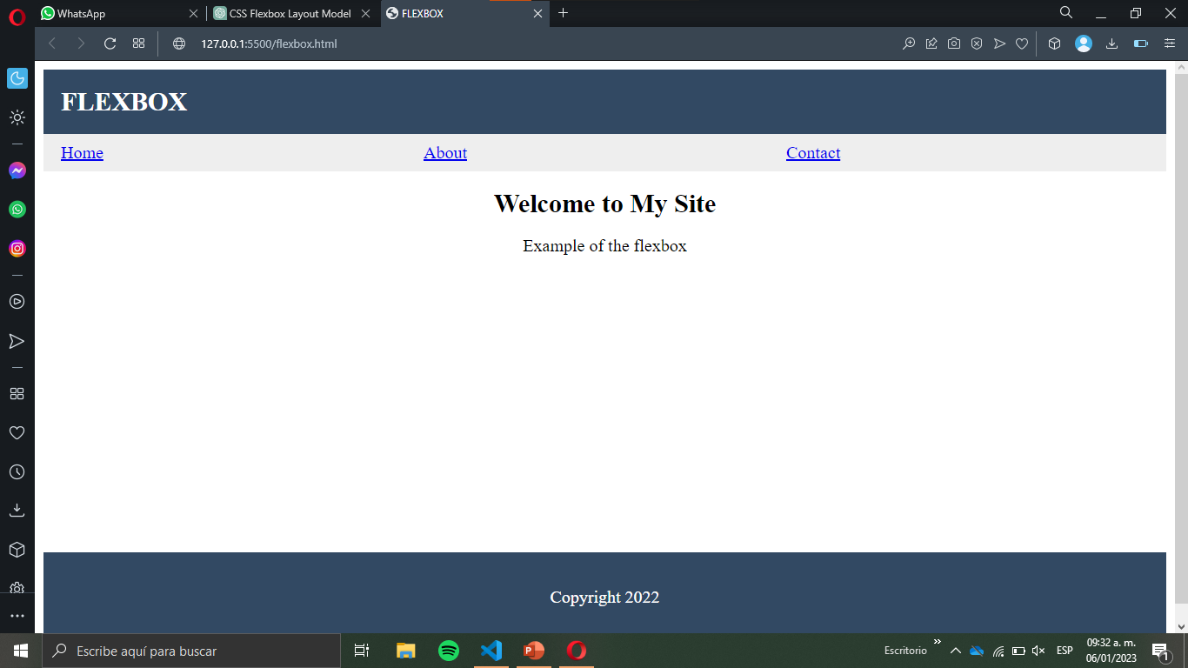
SWOT ANALYSIS
Mercury is the closest planet to the Sun
Jupiter is the biggest planet of them all
Mercury
Jupiter
S
W
O
T
Venus is the second planet from the Sun
Neptune is the farthest planet from the Sun
Venus
Neptune

