Slide 1
Responsive Web
Design
By Juliana Escobar

Slide 2
Responsive Web Design
Responsive Web Design is about using HTML and CSS to automatically resize, hide, shrink, or enlarge, a website, to make it look good on all devices (desktops, tablets, and phones)

Slide 3
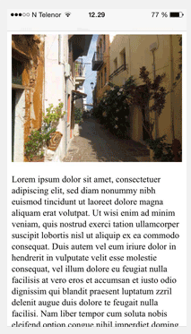
Setting the viewport
<meta name="viewport" content="width=device-width, initial-scale=1.0">
To create a responsive website, add the following <meta> tag to all your web pages:
Example:

Slide 4
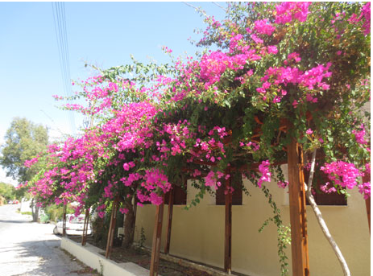
Responsive Images
<img src="img.jpg" style="width:100%";>
Responsive images are images that scale nicely to fit any browser size.
Example:
Using the width Property:
Using the max-width Property:
<img src="img.jpg" style="max-width:100%";height:auto;”>

Slide 5

Responsive Text Size
<h1 style="font-size:10vw">Hello Word </h1>
The text size can be set with a "vw" unit, which means the "viewport width".
Example:

Slide 6
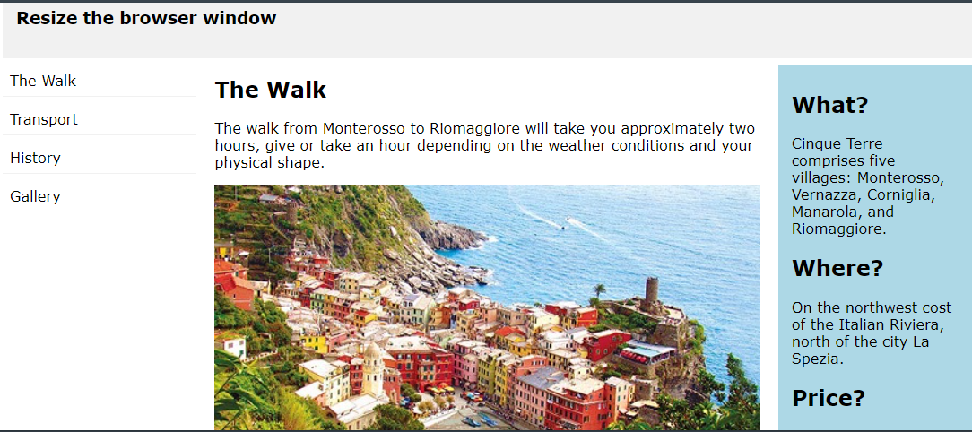
Example of Responsive Web Design

Slide 7
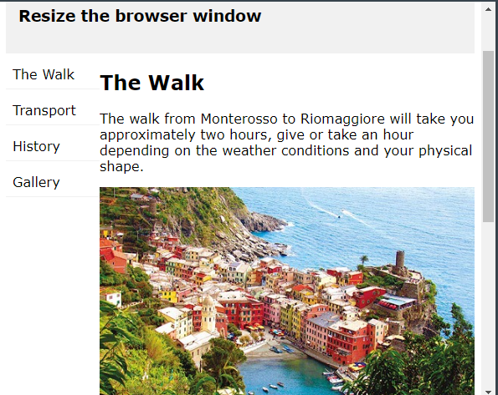
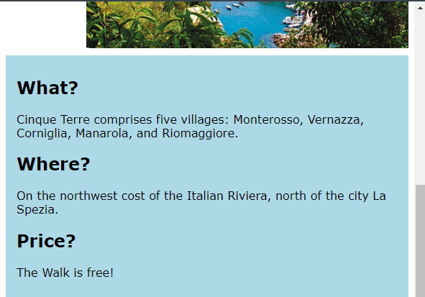
Example of Responsive Web Design

Slide 8
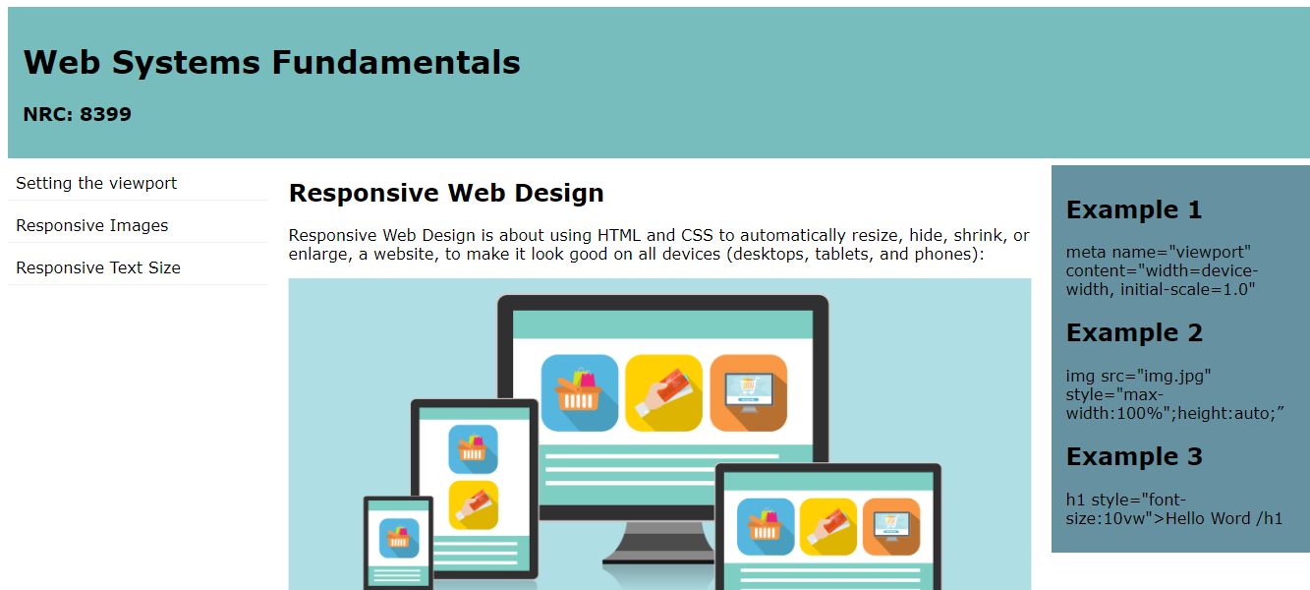
Example of Responsive Web Design

Slide 9
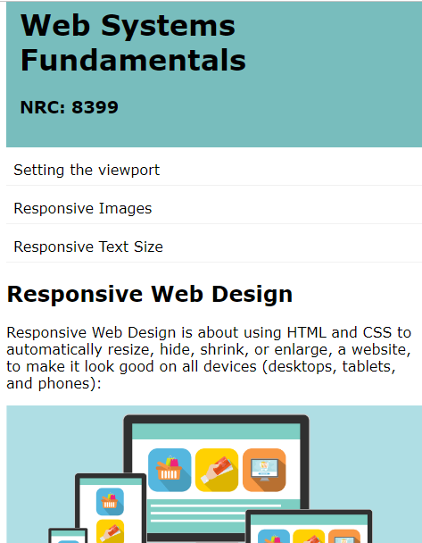
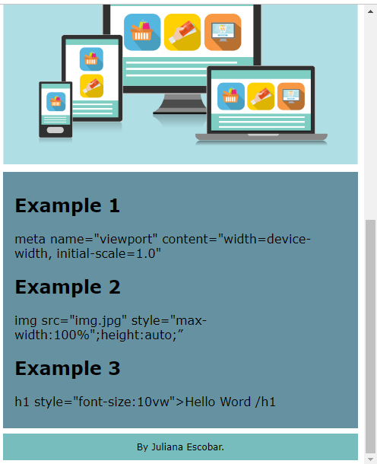
Example of Responsive Web Design

