Slide 1
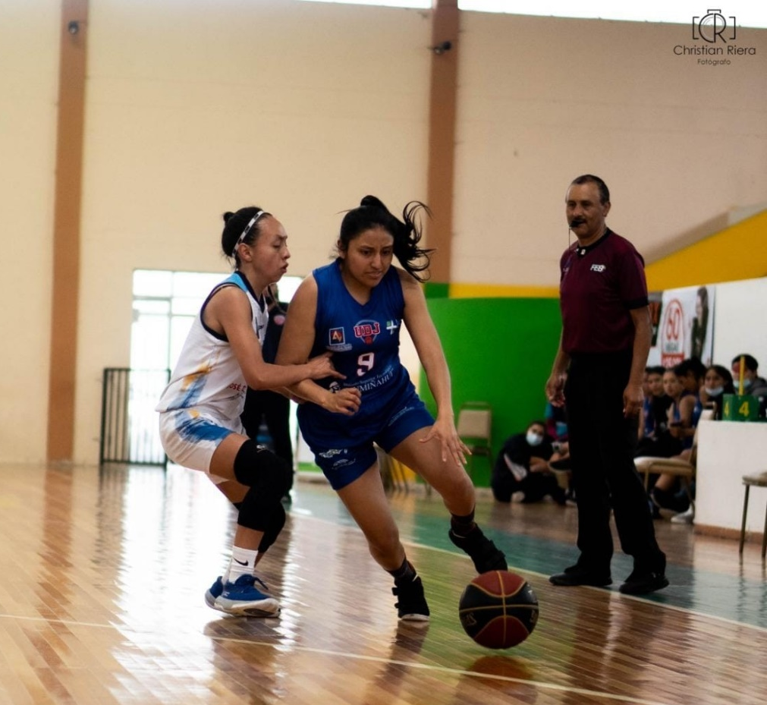
PRESENTATION OF DAYANA ANCHAPAXI
My name is Dayana Anchapaxi
I am 21 years old.

Slide 2
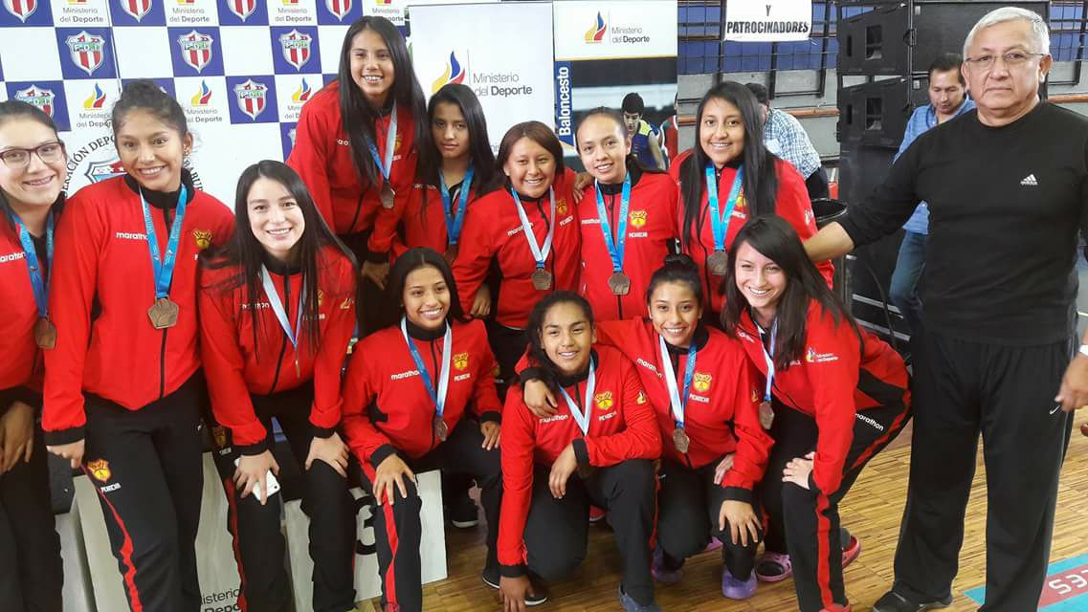
I played representing the province of Pichincha.

Slide 3


I graduated from the Unidad Educativa Particular "Marqués de Selva Alegre" in 2018
July,2018
I was assigned by SENECYT, entering in 2018 to the University of the Armed Forces, but the career I really wanted was Mechatronics Engineering, but I accepted the quota because I wanted to study any engineering.
August,2018

Slide 4
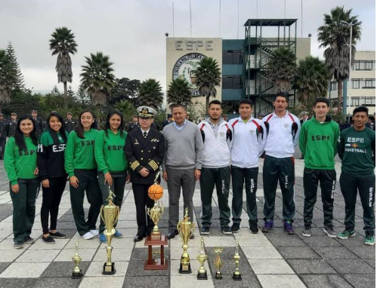
Already entering the first two semesters of my career I played in the basketball team of the University until 2020, so I fell behind in some subjects, a semester ago.
ESPE basketball team, since 2018 to 2020

Slide 5

I didn’t enter to study, because I wanted to enter the Ecuadorian Air Force, to be military, but they rejected me due to medical problems.
Ecuadorian Air Force

Slide 6


Currently I am starting to like the career, and I want to finish it .

Slide 7
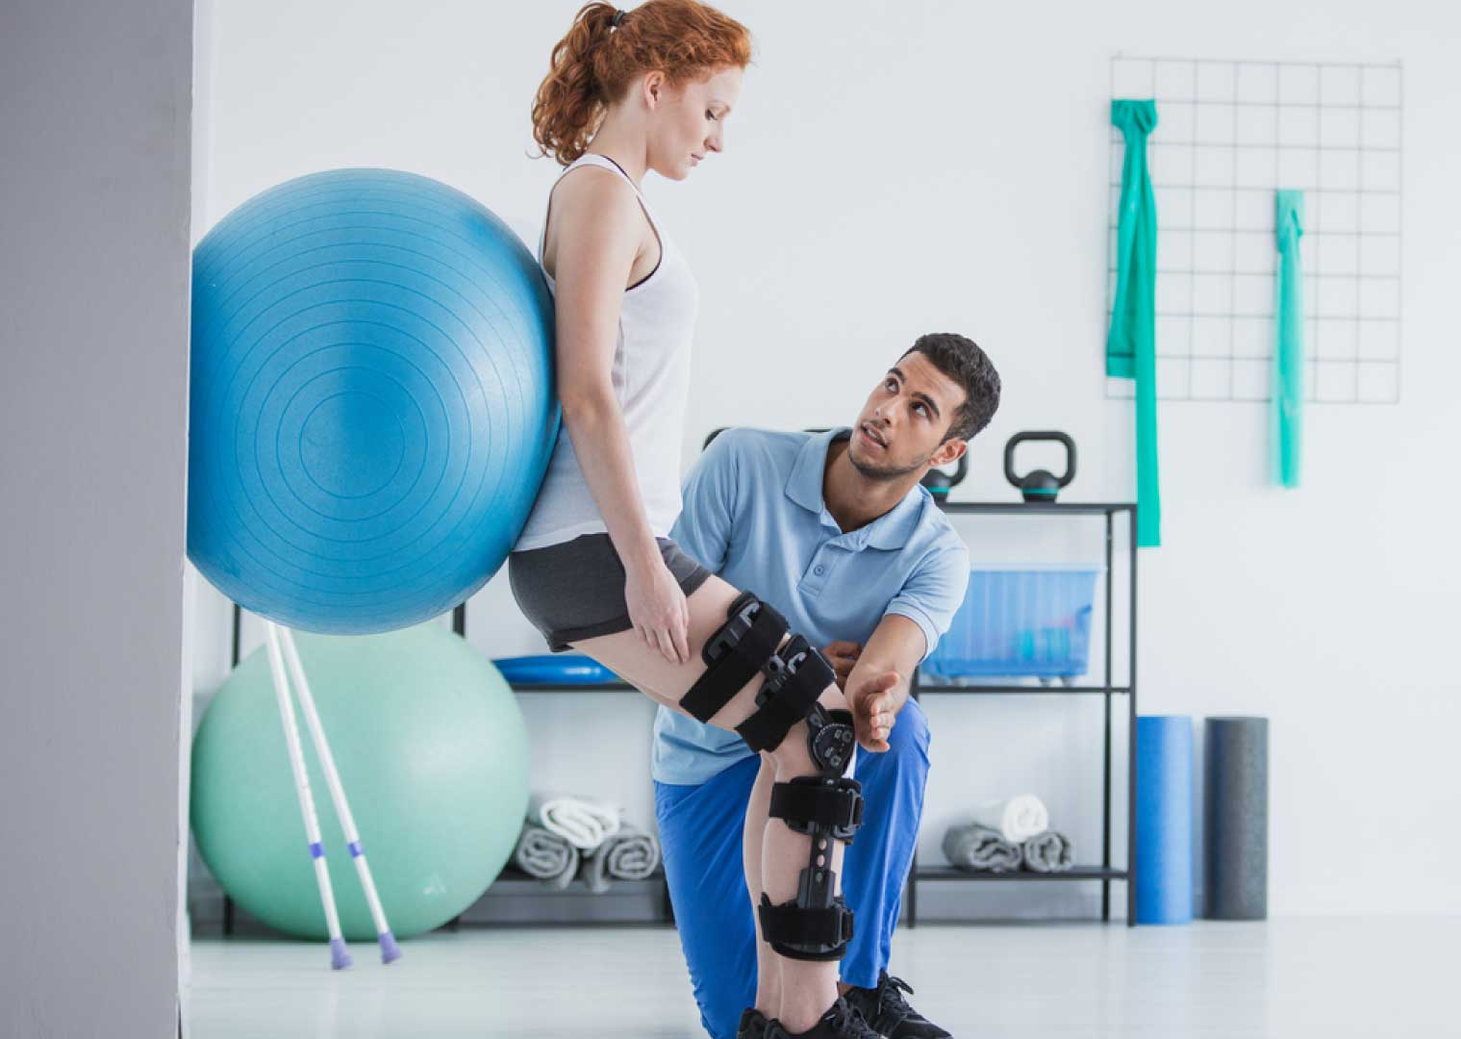

Physiotherapy
To continue as a second career, physiotherapy, or sports training, to continue contributing to the soccer academy that we have together with my brother.
Sport Training, or Soccer Video Analyst

