Slide 1

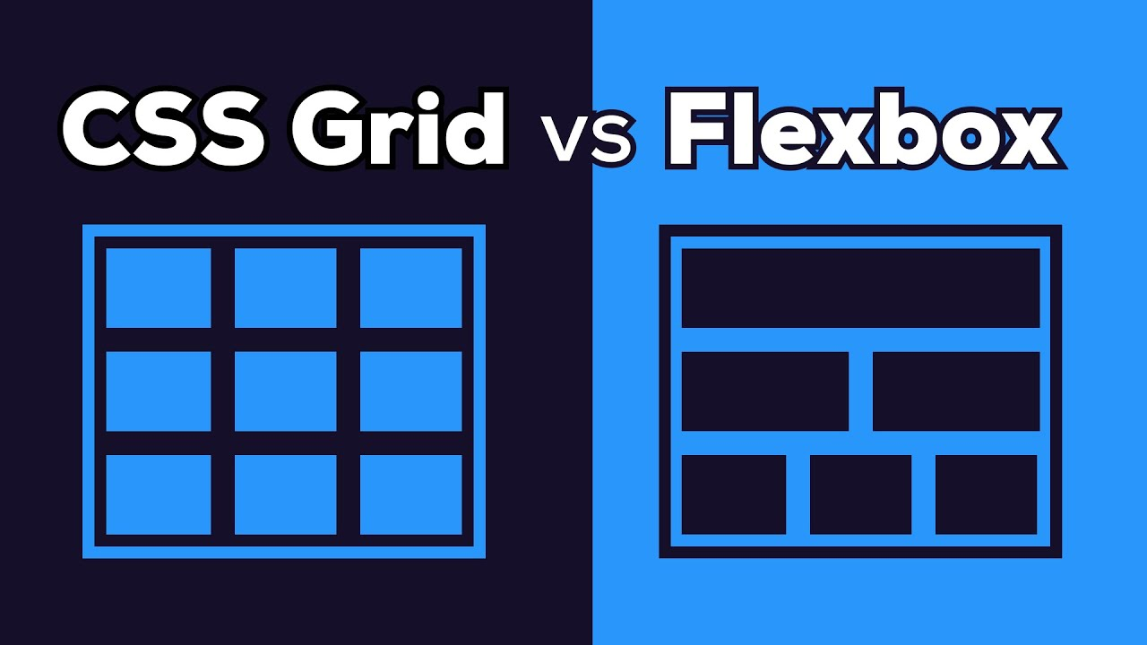
What is FLEXBOX/GRID
Diego Cadena
WEB SYSTEMS FUNDAMENTALS
NRC: 8399

Slide 2
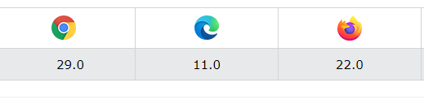
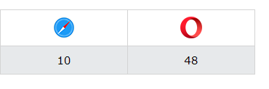

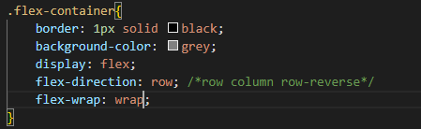
FLEXBOX FEATURES
The Flexible Box Module, commonly called flexbox
Before the Flexbox Layout module, there were three layout modes:
Block, for sections in a webpage
Inline, for text
Table, for two-dimensional table data
responsive layout structure without using float or positioning.
you need to first define a flex container.

Slide 3
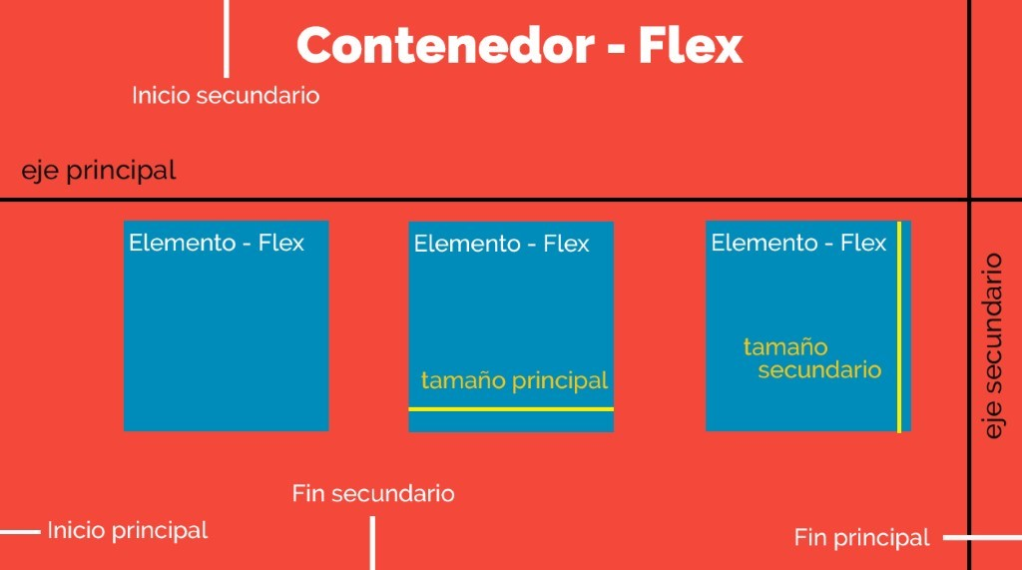
FLEXBOX
Flexbox is a CSS3 layout module that was created to improve the way responsive design is done, thus avoiding the use of floats, writing less code, and making it easier to position elements, even if you don't know their size.
Structure
The Flexbox structure is made up of parent and child containers (Flex-Container and Flex-Elements respectively).

Slide 4
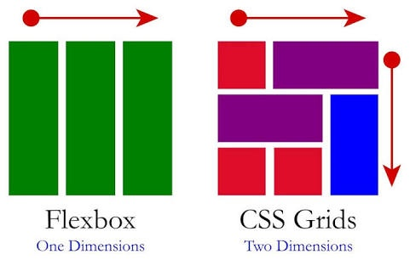
GRID
CSS grid layout or CSS grid is a technique of Cascading Style Sheets that allows web developers to create complex and adaptable designs with greater ease in all browsers.

