Slide 1
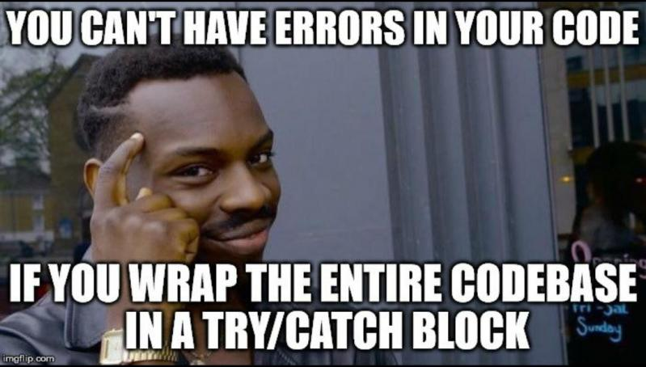
Exception.Classes {
exception.java
exception.class
int groupId = 2;
public static void tryToExplain() {
randomMember.explain();
}
}
OOP 9642

Slide 2
exception.java
exception.class
String definition = “In Java, most of the things” +
“use classes, even the exceptions, for” + “handling they the Exception class is the base” + “class for all exceptions. The Exception class” + “has a set of sub-classes for handling” +
“different types of exceptions.” ;
//Exception class is a throwable class
}
OOP 9642

Slide 3
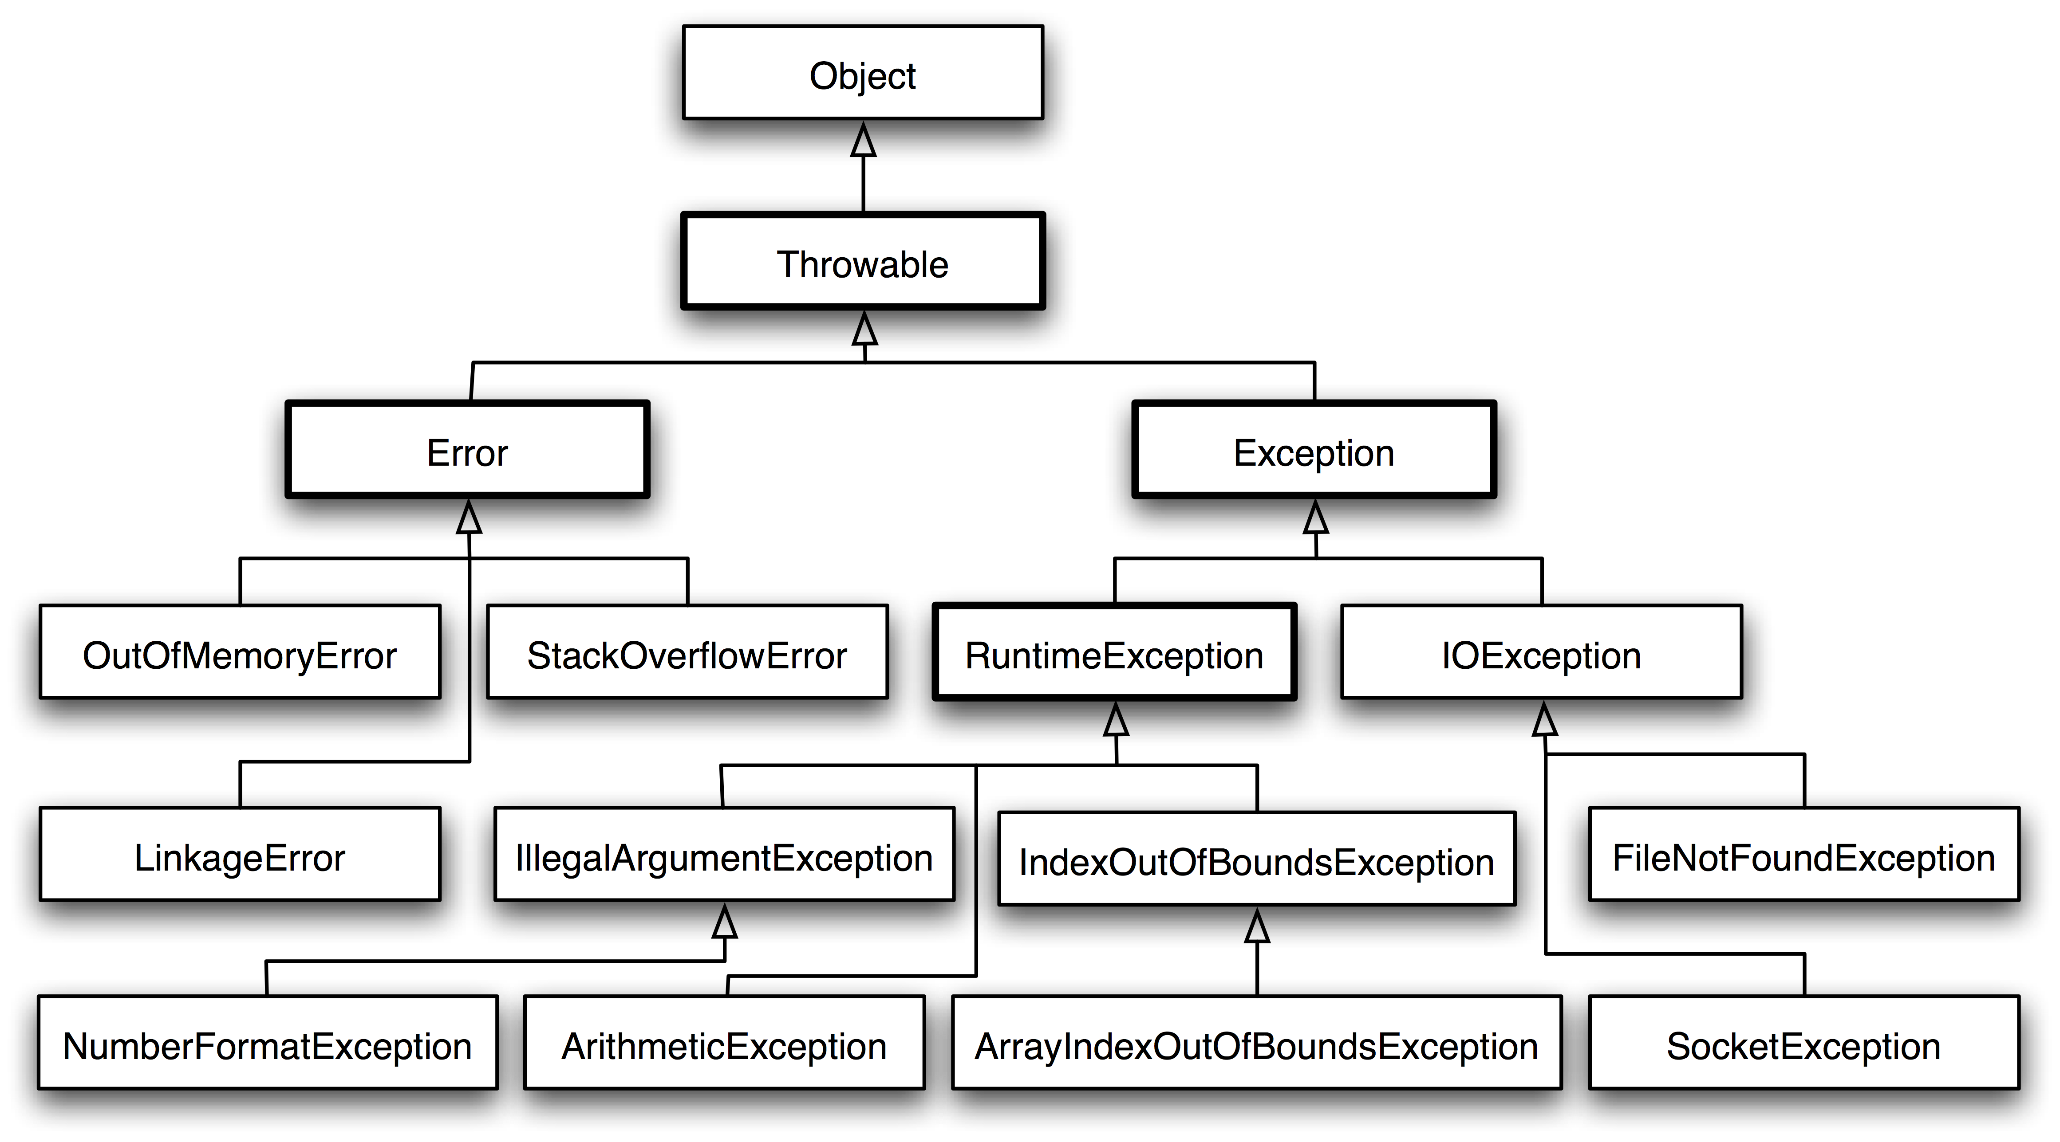
exception.java
exception.class
OOP 9642

Slide 4
exception.java
exception.class
Subclasses of Exception class
/01
AclNotFoundException
< This exception is thrown when a reference is made to an ACL (Access Control List) that does not exist.
/02
ActivationException
< This exception is thrown when activation fails during object deserialization.
/03
AlreadyBoundException
< This exception is thrown when an attempt is made to bind an object in the registry to a name that already has an associated binding.
OOP 9642

Slide 5
exception.java
exception.class
Subclasses of Exception class
/04
BadAttributeValueExpException
< This exception is thrown when the value of an attribute in the directory cannot be interpreted by the directory.
/05
BadLocationException
< This exception is thrown when a bad location is accessed in a document.
/06
CertificateException
< This exception indicates one of a variety of certificate problems.
OOP 9642

Slide 6
exception.java
exception.class
Subclasses of Exception class
/07
IOException
< Signals that an Input/Output exception of some sort has occurred.
/08
IllegalClassFormatException
< This exception indicates that there was an error while reading or parsing a class file.
/09
RuntimeException
< Is a type of exception that occurs at the time of execution.
/10
IndexOutOfBoundsException
< It is thrown when an array or vector has been accessed with an illegal index.
OOP 9642

