Slide 1


Exceptions
Errors

Slide 2
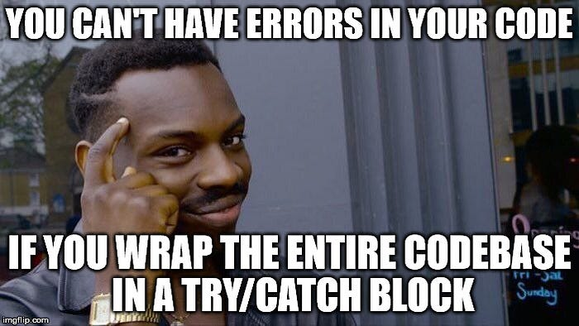
Errors
there are many types of errors that can be used exceptions for example hardware problems. bad hard drive or bad data.
when occurred this type of exceptions Java create a method called Throwable.
this method have an information about the exception include the type, state for program and the moment than occurred the error

Slide 3
Advantaje of controller errors
Separation of error handling from "normal" code.
Propagation of errors throughout the call stack.
Grouping of error types and differentiation between them.

Slide 4
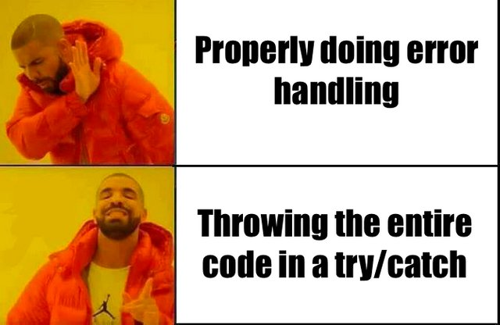
Separation of error handling
from "normal" code.
By using this method of exceptions. the mistakes have identified and controller for separated, this has a result a clean code and readable

Slide 5
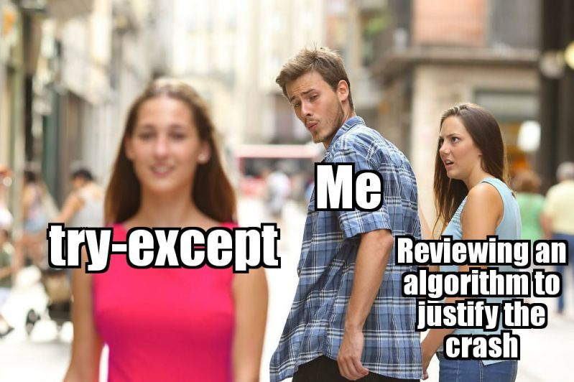
Propagation of errors throughout the call stack.
Another advantage of the controller exceptions in Java is the capacity of spread mistakes through stack calls.
when an exceptions occur is a method can be cast and spread a up if stack called until a find a controller of exceptions appropriate

Slide 6
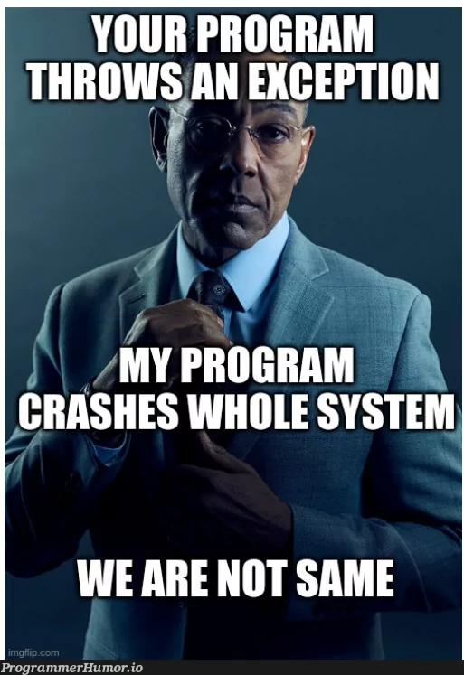
Grouping of error types and differentiation between them.
In Java, the exceptions organized in a hierarchy of class. this it means we can a defined and catch exceptions specifics for different types of mistakes
For example, can catch exceptions specific for mistakes of entry and exit, mistakes of connection or calculate, or more

Slide 7
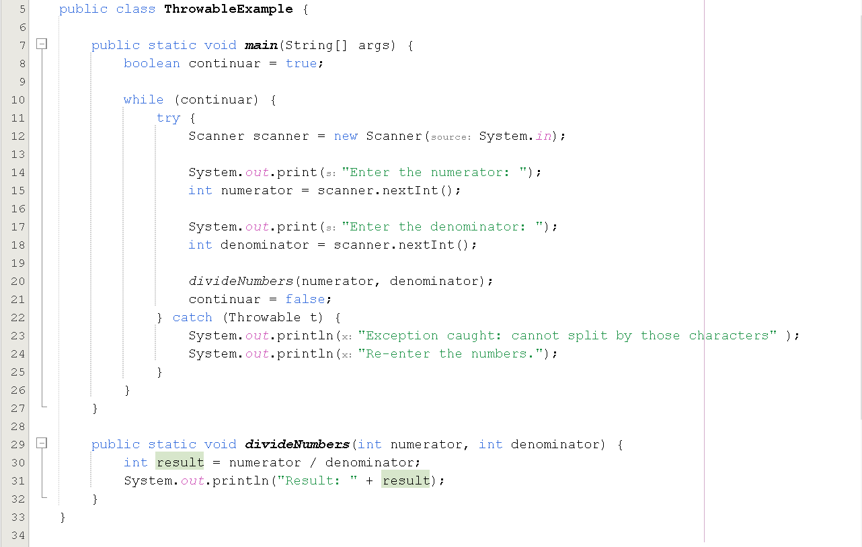
For example

Slide 8
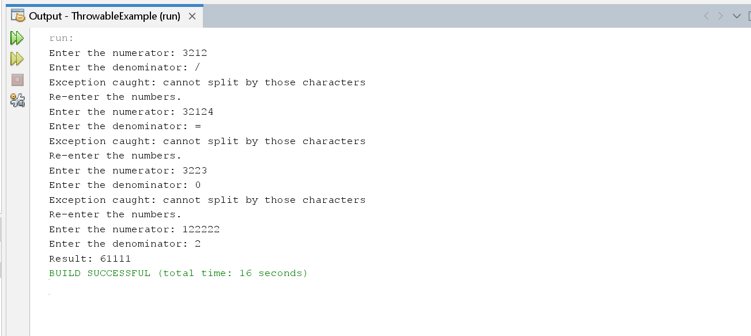
For example

