Slide 1
Getting Started
ElaSQL
June 12th 2021
elasql.org

Slide 2
Outline
Introduction to ElaSQL project
How to test/benchmark the system?

Slide 3
Outline
Introduction to ElaSQL project
What is ElaSQL?
Architecture
Design & Key Features
Implemented Systems & Papers
The Sequencer
How to test/benchmark the system?

Slide 4
ElaSQL
ElaSQL is a distributed relational database system that aims to provide
high scalability
high availability
elasticity
ElaSQL can be tested with ElaSQL-Bench, which is a benchmark tool that generate pressure to the system.
Currently, this is the only way to test ElaSQL.

Slide 5
The Relationship with VanillaDB
ElaSQL is built on top of two projects of VanillaDB
VanillaComm: as the communication module
VanillaCore: as the storage engine for each machine
Node A
Node B
Node C
ElaSQL
ElaSQL
ElaSQL
VanillaComm VanillaComm
Storage Engine
Storage Engine
Storage Engine
VanillaCore
VanillaCore
VanillaCore

Slide 6
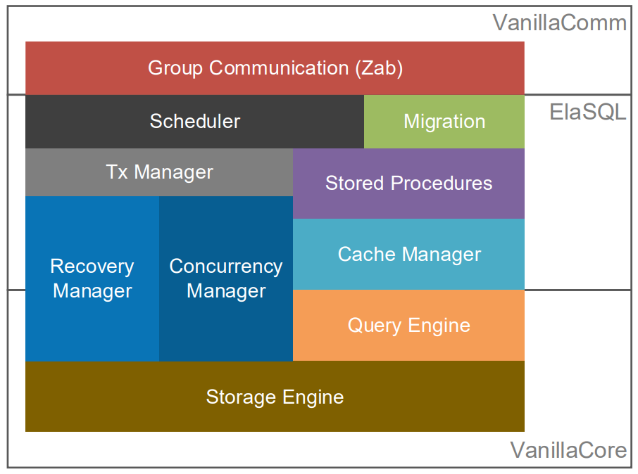
Architecture inside a Machine

Slide 7
A Deterministic Database System
ElaSQL is a deterministic database system, which is based on the idea of the following paper:
Thomson, Alexander, and Daniel J. Abadi. "The case for determinism in database systems." Proceedings of the VLDB Endowment 3.1-2 (2010): 70-80.
With determinism, ElaSQL can ensure a database always reach the same state from the same initial state with the same sequence of requests.

Slide 8
Key Features
Strong Consistency with high availability
ElaSQL uses determinism to ensure consistency without relying on two phase commit.
High Scalability
ElaSQL partitions a database to distribute the loads to multiple machines.
Elasticity
ElaSQL implements several data migration and re-partitioning algorithm to ensure that data partitions are always up to date.

Slide 9
Implemented Systems
Since ElaSQL is a research prototype, we have implemented several algorithms and systems proposed in research papers in ElaSQL.
Please check this list for available systems and algorithms and corresponding papers.

Slide 10
The Sequencer (ZAB Leader)
A deterministic database system requires a total-ordering protocol to ensure the order of transactions across machines in advance.
We implement Zookeeper Atomic Message Broadcast (ZAB) Protocol for this.
Which requires a machine to be the leader.
We call the leader as the sequencer.
In our design, the sequencer is one of servers in a cluster, but it does not have database functionality.

Slide 11
Message Flow
Client
Client
Client
Client
Sending requests
Sequencer
Server
Performing total ordering
Database
Server 1
Database
Server 2
Database
Server 3
Exchanging
data
Partition 1
Partition 2
Partition 3

Slide 12
Outline
Introduction to ElaSQL project
How to test/benchmark the system?
Let’s meet ElaSQL-Bench
Setting up development environment
Testing inside a Java IDE
Testing with runnable JARs
Testing in a cluster

Slide 13
Outline
Introduction to ElaSQL project
How to test/benchmark the system?
Let’s meet ElaSQL-Bench
Setting up development environment
Testing inside a Java IDE
Testing with runnable JARs
Testing in a cluster

Slide 14
ElaSQL-Bench
In order to test how ElaSQL performs under an extreme circumstance, we implement a benchmark tool.
Which is based on another project, VanillaBench.
This project includes two standard benchmarks:
The TPC-C Benchmark
The Yahoo! Cloud Serving Benchmark (YCSB)

Slide 15
Outline
Introduction to ElaSQL project
How to test/benchmark the system?
Let’s meet ElaSQL-Bench
Setting up development environment
Testing inside a Java IDE
Testing with runnable JARs
Testing in a cluster

Slide 16
Prerequisite
We assume that you have the following programs in your environment.
Java Development Kit (JDK) 8
We found some problems when running with JDK 10+. You may try, but there is no guarantee to work.
Eclipse
You may use another IDE, but we will demonstrate the following tasks in Eclipse.
Git
Bash

Slide 17
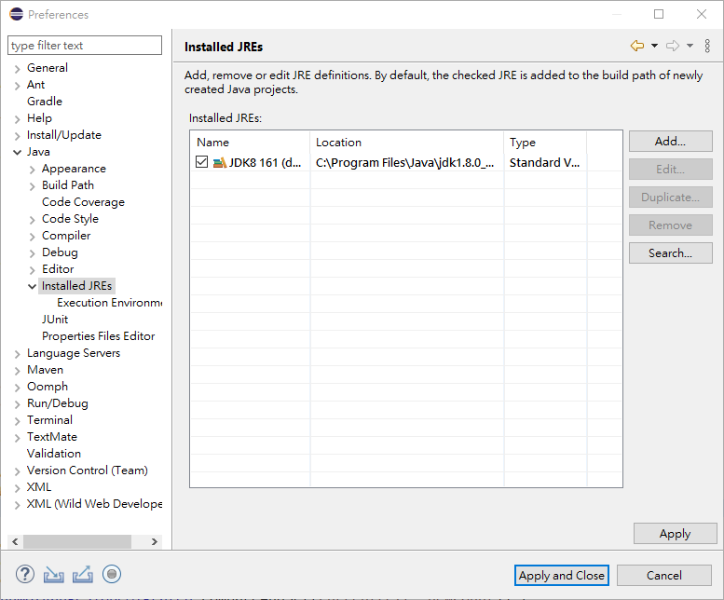
Changing Your JDK in Eclipse
You can change the JDK that your Eclipse uses in “Preferences”.

Slide 18
Steps to Setup Your Dev. Env.
Clone ElaSQL and ElaSQL-Bench
Import the projects to Eclipse
Done

Slide 19
Cloning the Project
Clone the following projects:
ElaSQL: https://github.com/elasql/elasql
ElaSQL-Bench: https://github.com/elasql/elasqlbench
Checkout the branch you need
The default branch is “master”.
However, if you want to reproduce certain experiments, you may want to checkout other branches.
For example, to reproduce MgCrab experiments, you may need to checkout “reproduce/mgcrab” branch.

Slide 20
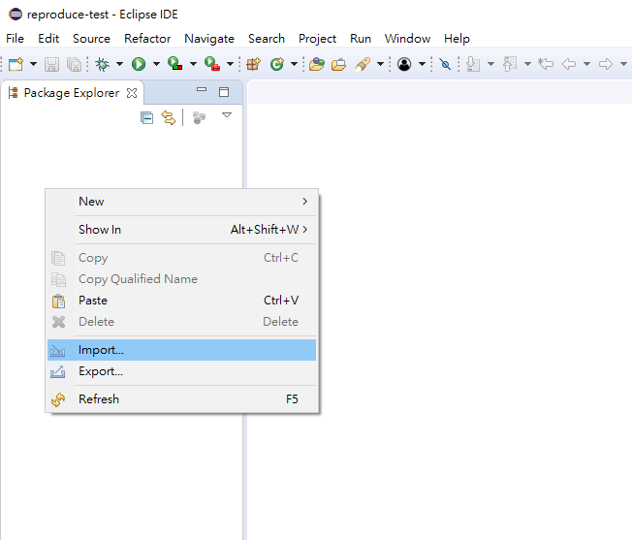
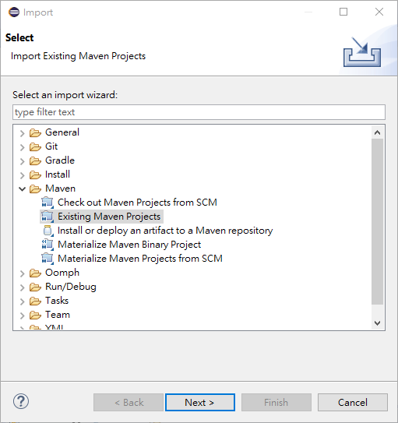
Importing into Eclipse
1. Right click
3.
2.
4.

Slide 21
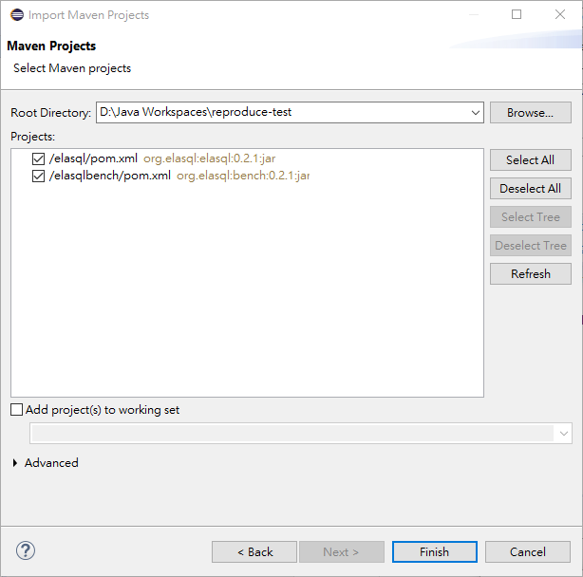
Importing into Eclipse
5. Select the directory that includes the projects
6. Make sure it finds the projects properly
7.

Slide 22
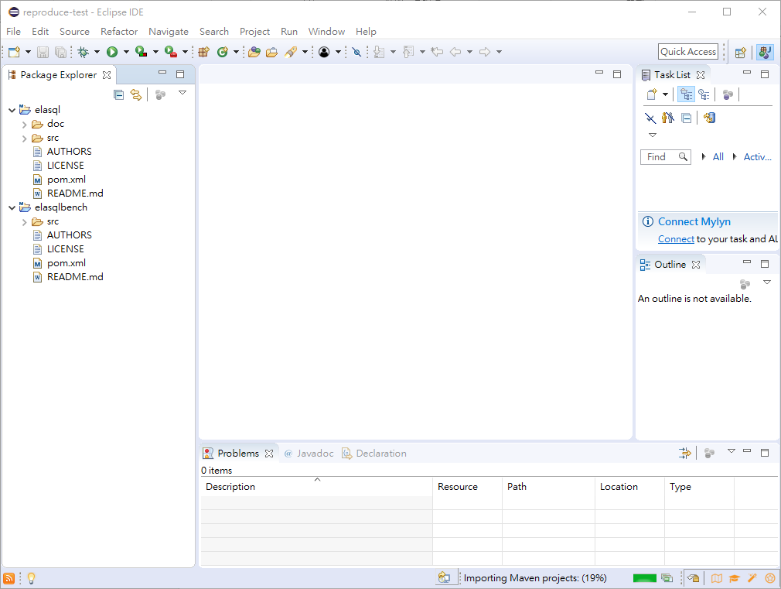
Importing into Eclipse
8. Wait for downloading dependencies

Slide 23
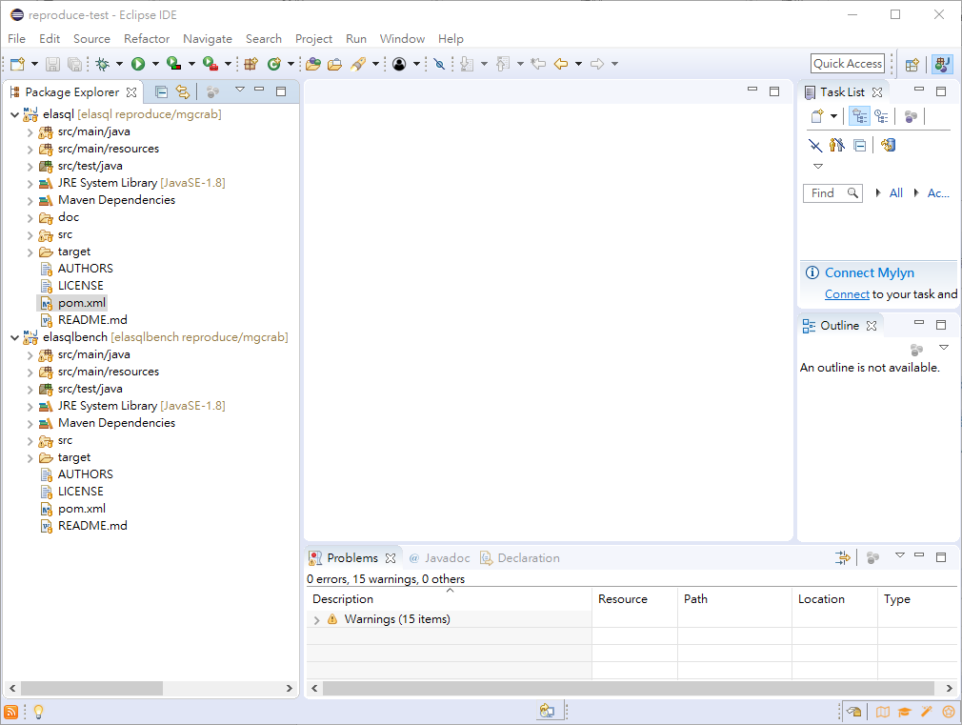
Done

Slide 24
Outline
Introduction to ElaSQL project
How to test/benchmark the system?
Let’s meet ElaSQL-Bench
Setting up development environment
Testing inside a Java IDE
Testing with runnable JARs
Testing in a cluster

Slide 25
Testing Environments
To launch a benchmarking test, at least three processes must be launched.
1 Sequencer Server (the ZAB leader)
1 Database Server
Adding more database servers can increase throughput
1 Benchmark Client
Adding more clients can generate higher pressure to the system
Sending the result back
Database
Server 1
Sequencer
Server
Client
Partition 1
Sending requests
Performing total ordering

Slide 26
Testing inside Eclipse
Setup the properties files
Which includes the configurations for ElaSQL and ElaSQL-Bench
Setup run configurations
Loading a testbed
Launch servers
Launch clients
Benchmarking
Launch servers
Launch clients

Slide 27
Testing inside Eclipse
Setup the properties files
Which includes the configurations for ElaSQL and ElaSQL-Bench
Setup run configurations
Loading a testbed
Launch servers
Launch clients
Benchmarking
Launch servers
Launch clients

Slide 28
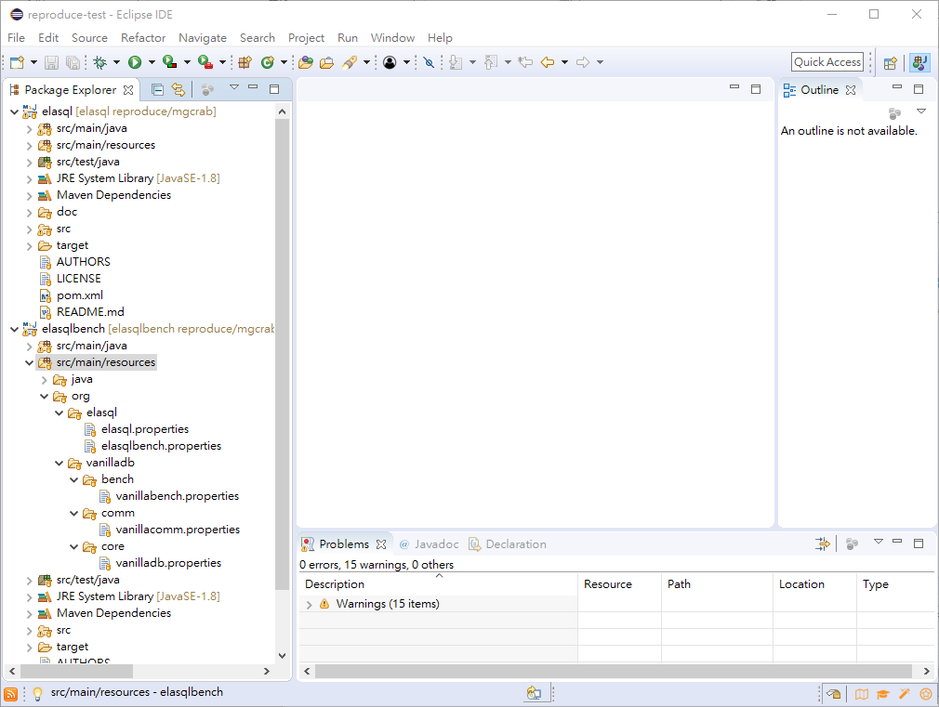
The Properties Files

Slide 29
Setting Up Network Addresses
ElaSQL uses VanillaComm to communicate through networks.
We need to tell VanillaComm where to find all the machines (including servers and clients).
The addresses should be put in vanillacomm.properties

Slide 30
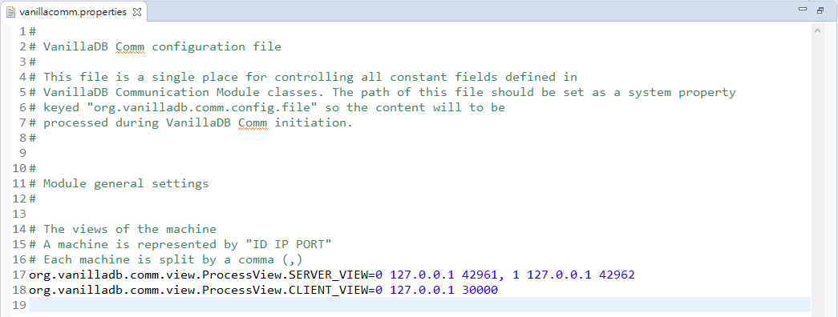
Setting Up Network Addresses
Here is an example to setup the addresses for 2 servers and 1 client.
The last server will become the sequencer.
The Sequencer = Server No.1

Slide 31
Setting Up The Storage Engine
ElaSQL uses VanillaCore as a storage engine to store data on each machine.
vanillacore.properties includes the configurations for the storage engine.
Most configurations have been tuned for benchmarking.
Only some of them should be checked carefully.

Slide 32
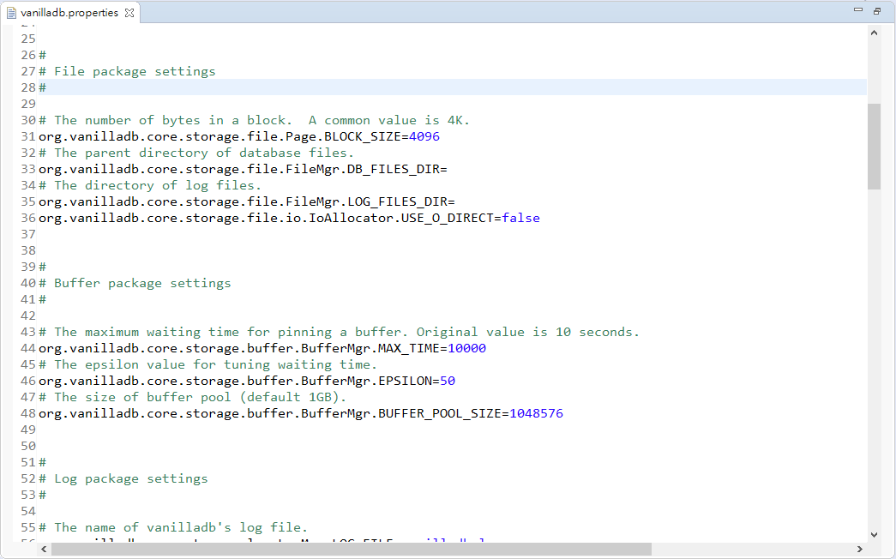
Setting Up The Storage Engine
where to put the database files
(default: home directory)
O_DIRECT should be used if the system runs on Linux environments
controls how much data are cached in memory
(note that this number means “the number of blocks”)

Slide 33
Setting Up ElaSQL (The Distributed Modules)
ElaSQL also has many configurations:
How many data partitions are there?
Which system to run? Calvin? Hermes?
Which data migration algorithm to use?
All these are put in elasql.properties
The file contains a comprehensive explanations for each parameter, so we will not go through all the parameters here.

Slide 34
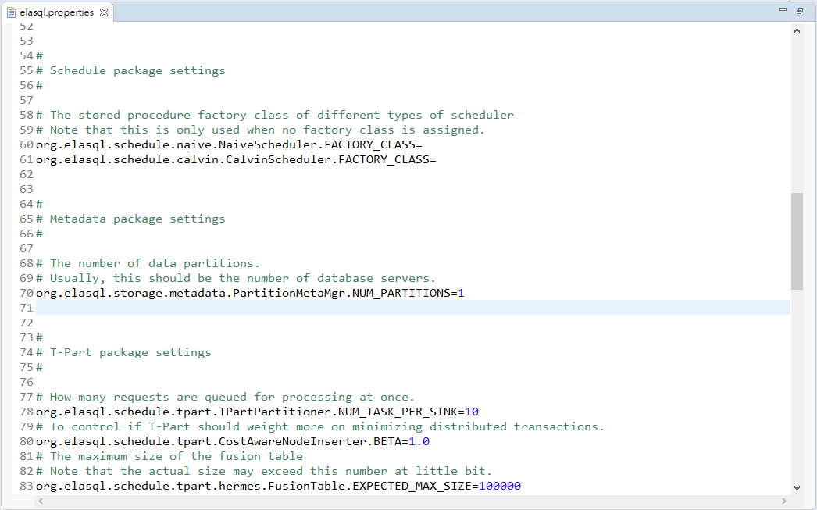
Setting Up ElaSQL (The Distributed Modules)
We set it to 1 because we only have 1 database server

Slide 35
Setting Up a Benchmarking Test
ElaSQL-Bench reuses the codebase of VanillaBench, which is a benchmarking tool for single-node DBMS.
So, the configurations are separated in two files:
vanillabench.properties (only the basic configrations)
elasqlbench.properties

Slide 36
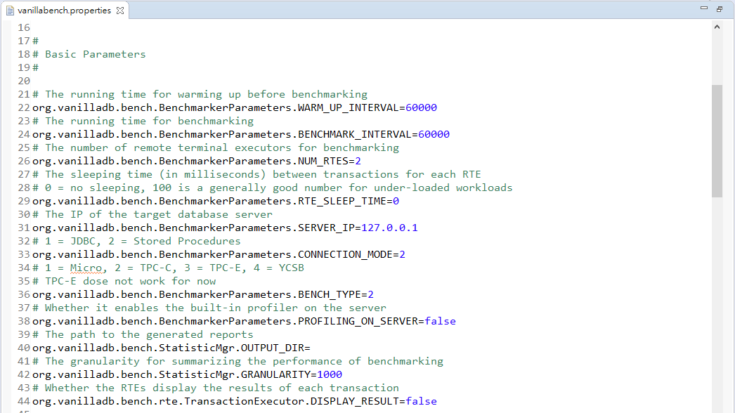
vanillabench.properties
Only these parameters
will take effect
on ElaSQL-Bench

Slide 37
vanillabench.properties
How long the benchmarking test
Number of RTE threads, each of which simulates a user
Which benchmark to use

Slide 38
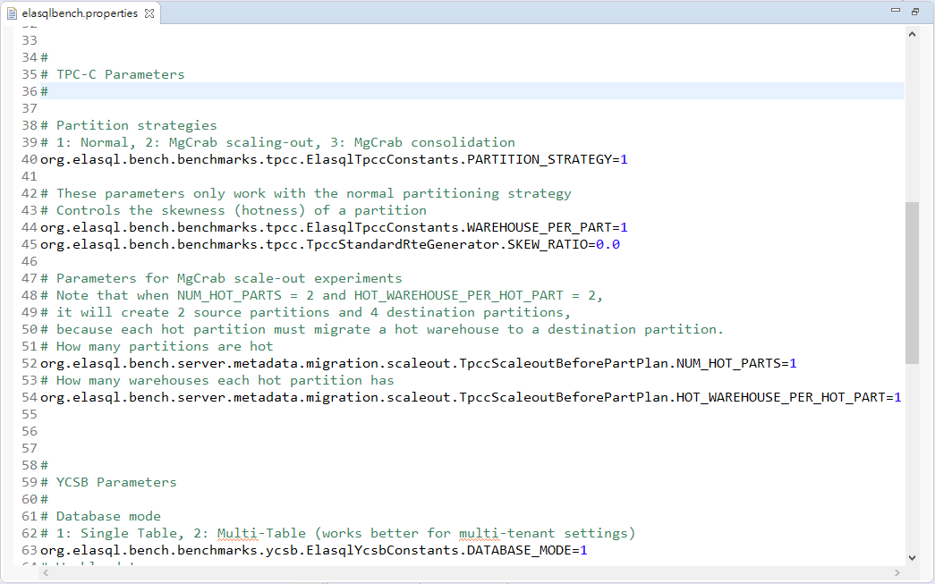
elasqlbench.properties
Nothing need to be changed

Slide 39
Testing inside Eclipse
Setup the properties files
Which includes the configurations for ElaSQL and ElaSQL-Bench
Setup run configurations
Loading a testbed
Launch servers
Launch clients
Benchmarking
Launch servers
Launch clients

Slide 40
Run Configurations
A run configuration configures how eclipse launch a Java process.
Each process must have its own run configuration.
3 configurations for a sequencer server, a database server, and a client.

Slide 41
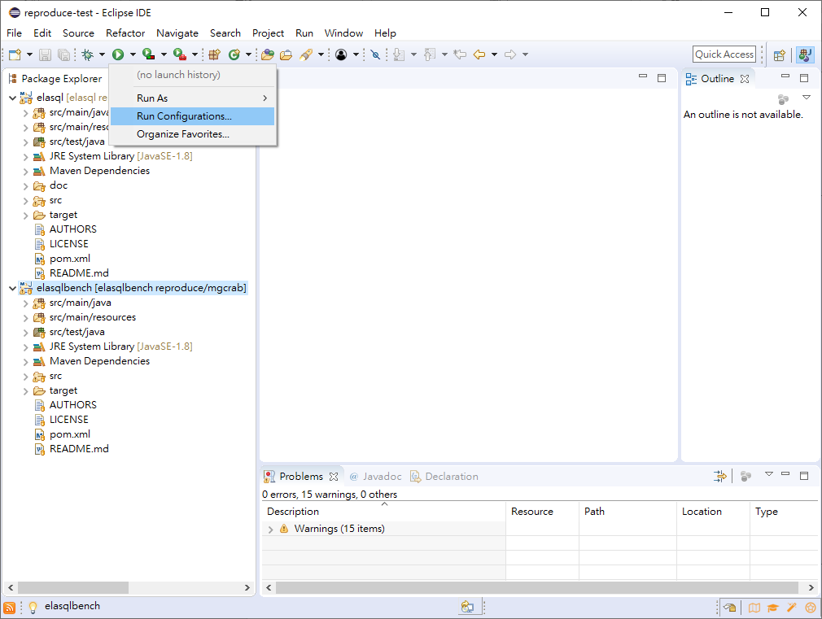
Setting Up Run Configurations
1.
2.

Slide 42
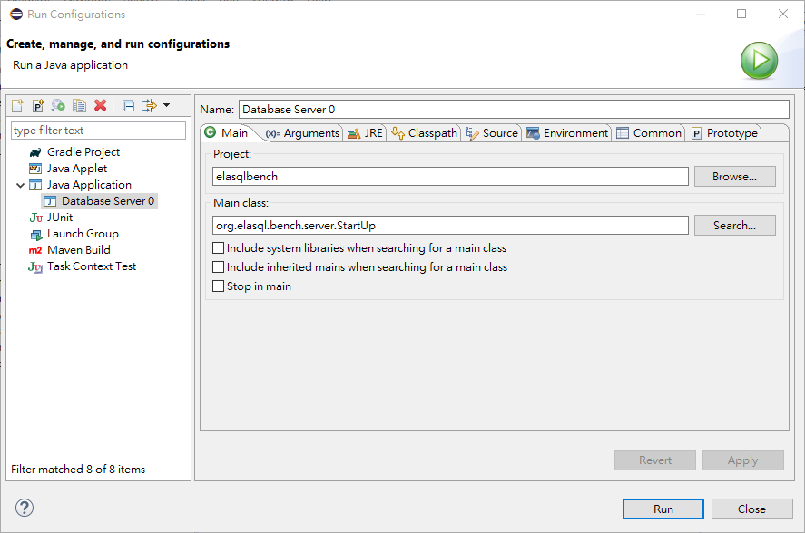
Setting Up Run Configurations (A Database Server)
4. Give it a name
3. Double Click
5. Choose “elasqlbench”
6. Select “org.elasql.bench.server.StartUp”

Slide 43
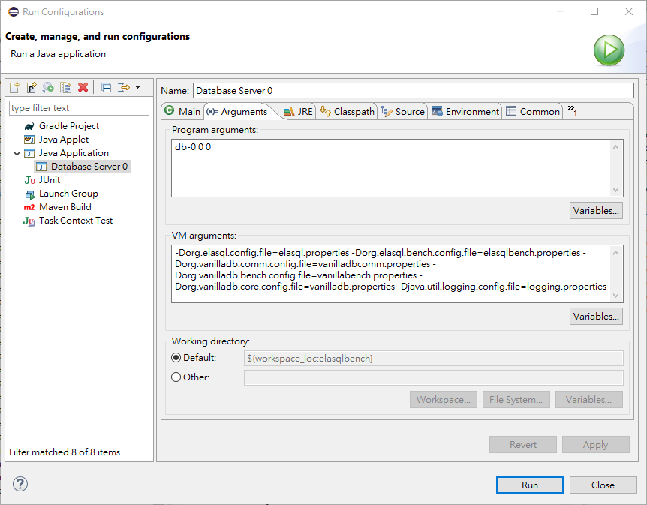
Setting Up Run Configurations (A Database Server)
7. Click “Arguments”
8. [DB Name] [Server ID] [Is Sequencer?]
9. See the next two slides
10. Apply

Slide 44
Program Arguments (For Servers)
Program Arguments
DB Name: the database name
Note that if you run servers on the same machine, each server should have an unique name for its database.
Server ID: the ID of the server process
Is Sequencer: to set if it is running in sequencer mode.
The server with the greatest ID should turn this ON.

Slide 45
VM Arguments
VM Arguments:
To tell ElaSQL where to find those properties files
Copy and paste this:
If you encounter any problem when copying the arguments from this slide, you can copy from here.
-Dorg.elasql.config.file=target/classes/org/elasql/elasql.properties
-Dorg.elasql.bench.config.file=target/classes/org/elasql/elasqlbench.properties
-Dorg.vanilladb.comm.config.file=target/classes/org/vanilladb/comm/vanillacomm.properties
-Dorg.vanilladb.bench.config.file=target/classes/org/vanilladb/bench/vanillabench.properties
-Dorg.vanilladb.core.config.file=target/classes/org/vanilladb/core/vanilladb.properties
-Djava.util.logging.config.file=target/classes/java/util/logging/logging.properties

Slide 46
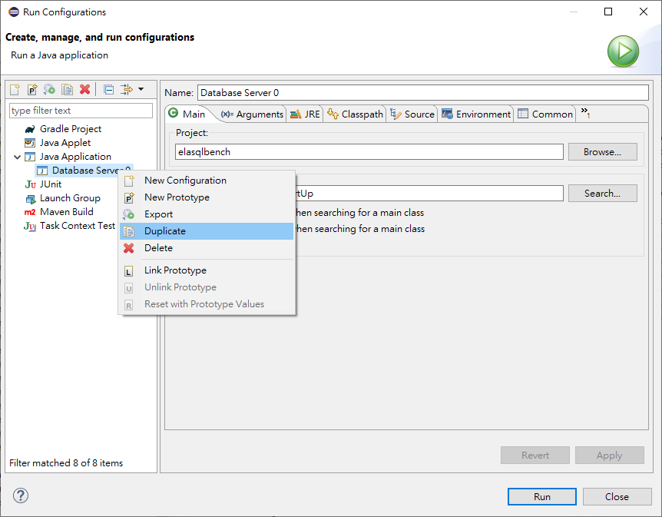
Setting Up Run Configurations (The Sequencer Server)
1.
2.

Slide 47
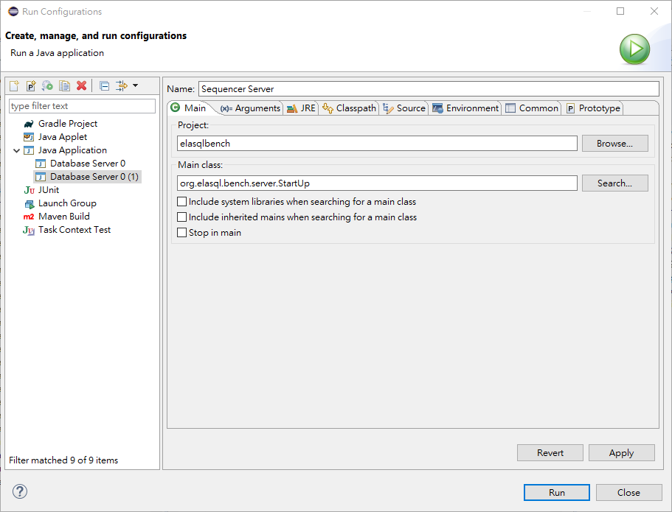
Setting Up Run Configurations (The Sequencer Server)
3. Change the name
1.
2.

Slide 48
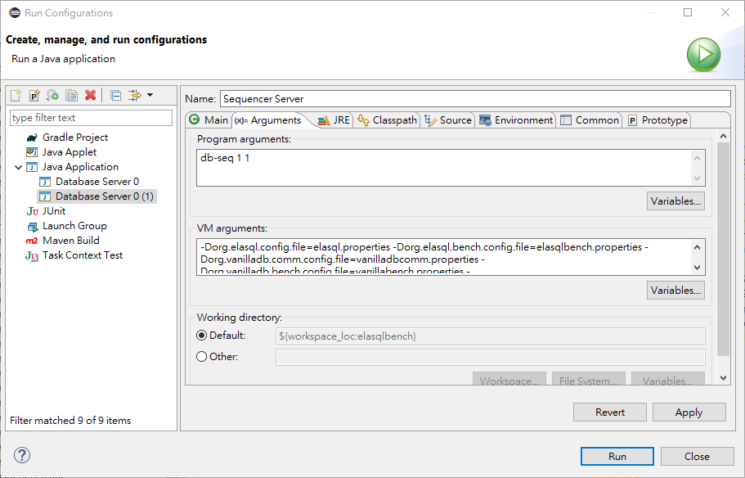
Setting Up Run Configurations (The Sequencer Server)
4. Change the setting for the sequencer
5. Apply
Note: the sequencer will not create any database file, so ‘db-seq’ is just a placeholder.

Slide 49
Setting Up Run Configurations (A Benchmarking Client)
1.
2.

Slide 50
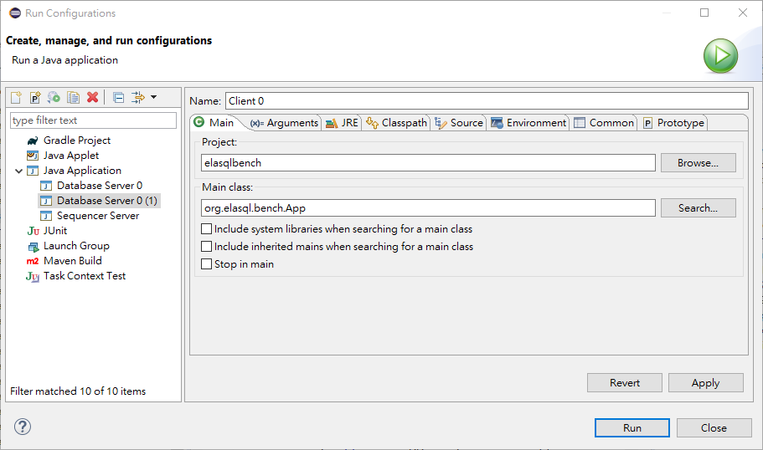
Setting Up Run Configurations (A Benchmarking Client)
3. Change the name
4. Change the main class to
“org.elasql.bench.App”

Slide 51
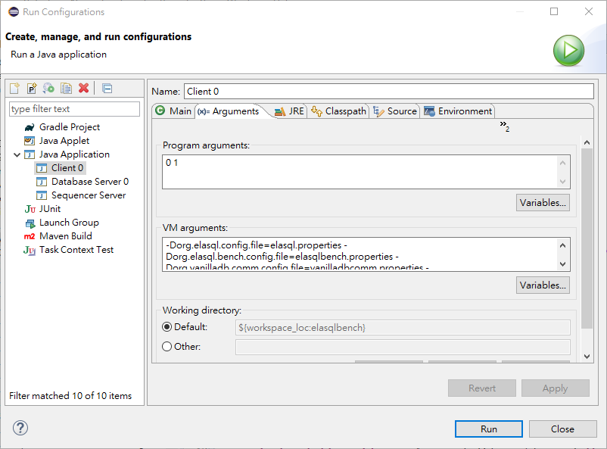
Setting Up Run Configurations (A Benchmarking Client)
5. [Client ID] [Load (1)/ Bench (2)]
6. Apply

Slide 52
Program & VM Arguments (For Clients)
Program Arguments
Client ID: the ID of the client process
Load/Bench: to controls the action of this client
1: Loading a new testbed on a clean database.
2: Benchmarking on an existing testbed.
Note that a client must first load a new testbed on a system before benchmarking it.
VM Arguments: same as the servers

Slide 53
Testing inside Eclipse
Setup the properties files
Which includes the configurations for ElaSQL and ElaSQL-Bench
Setup run configurations
Loading a testbed
Launch servers
Launch clients
Benchmarking
Launch servers
Launch clients

Slide 54
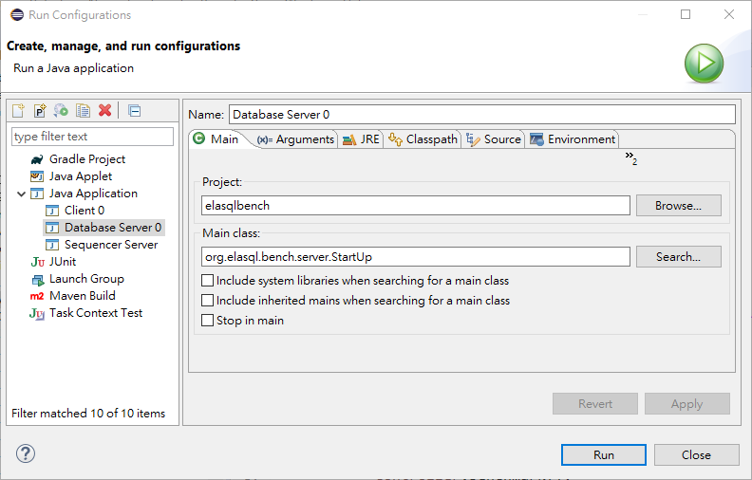
Launching A Database Server
1. Select the configuration
2. Run

Slide 55
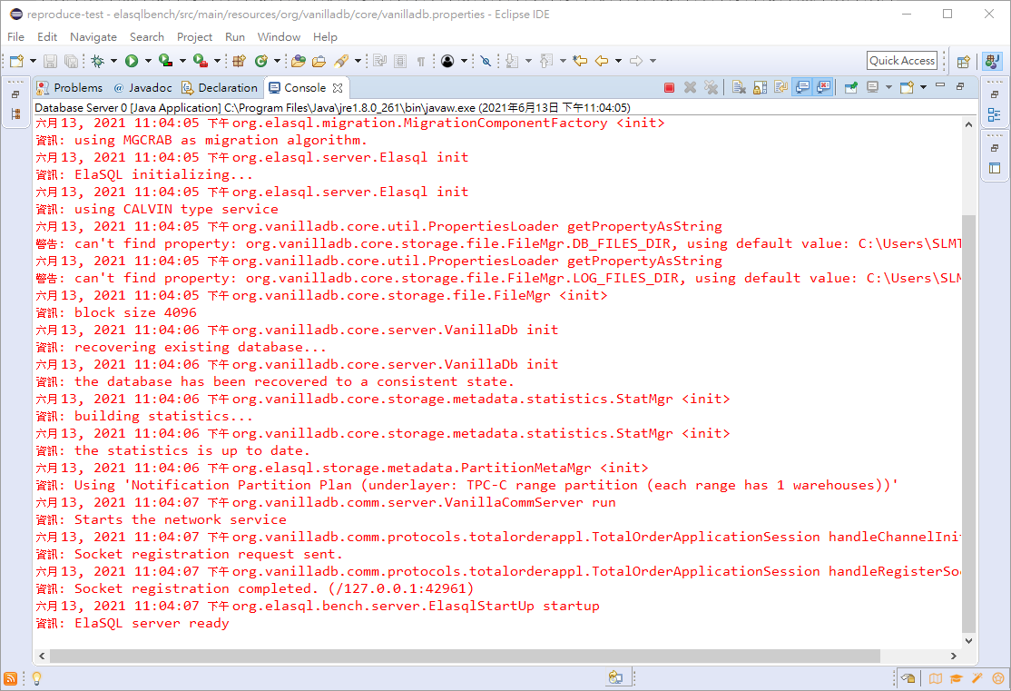

Slide 56
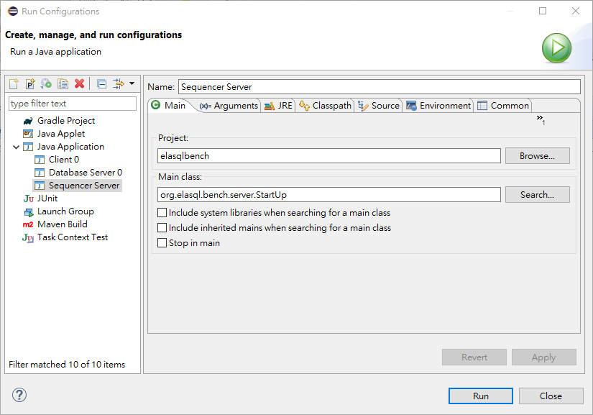
Launching The Sequencer
1.
2.

Slide 57
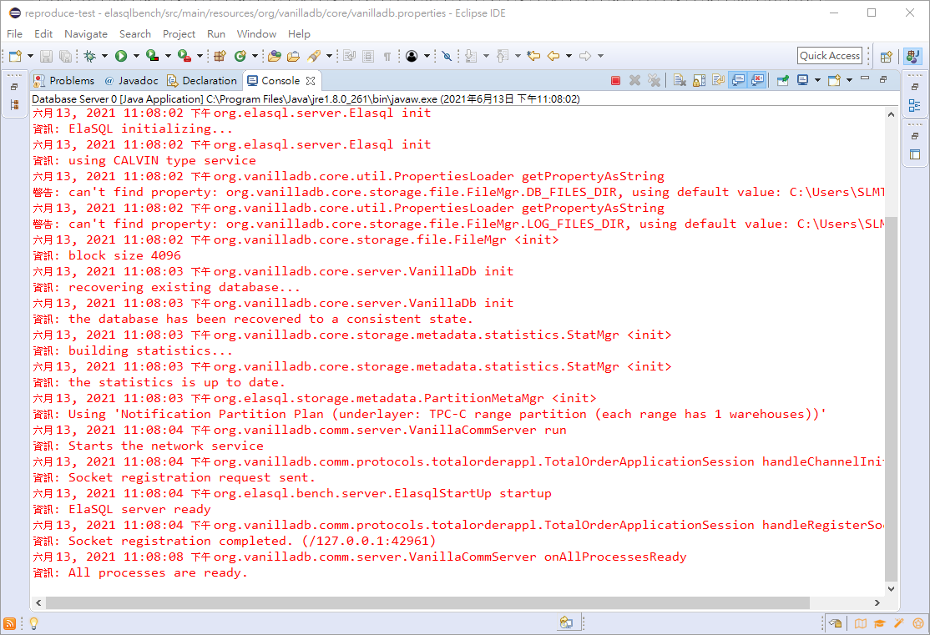

Slide 58
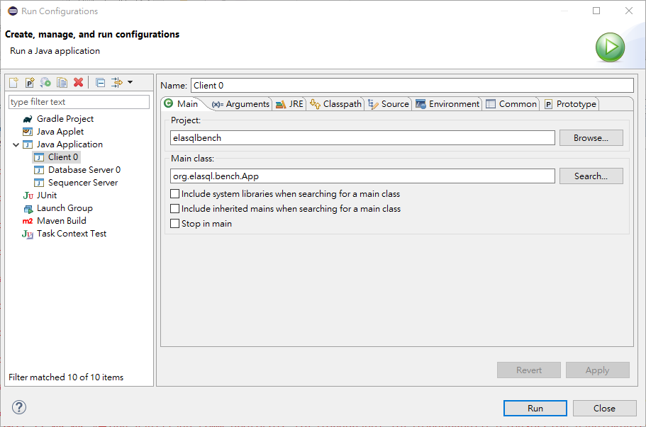
Launching a Client
1.
2.

Slide 59
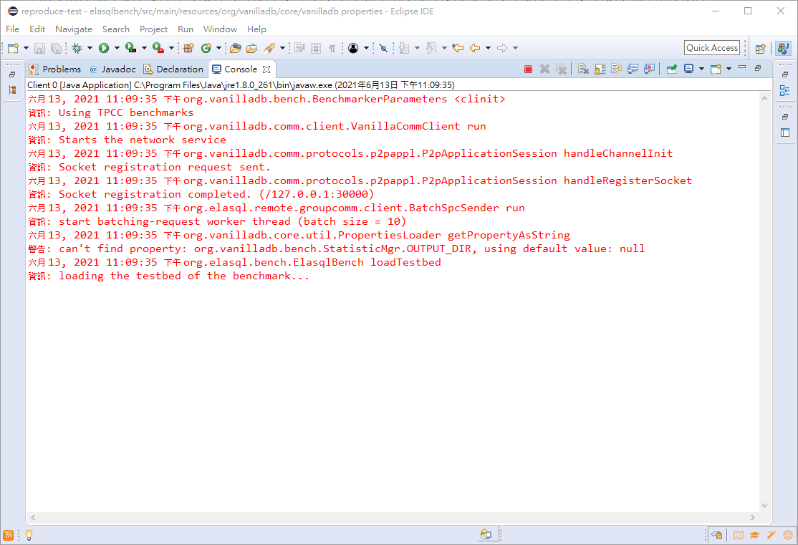

Slide 60
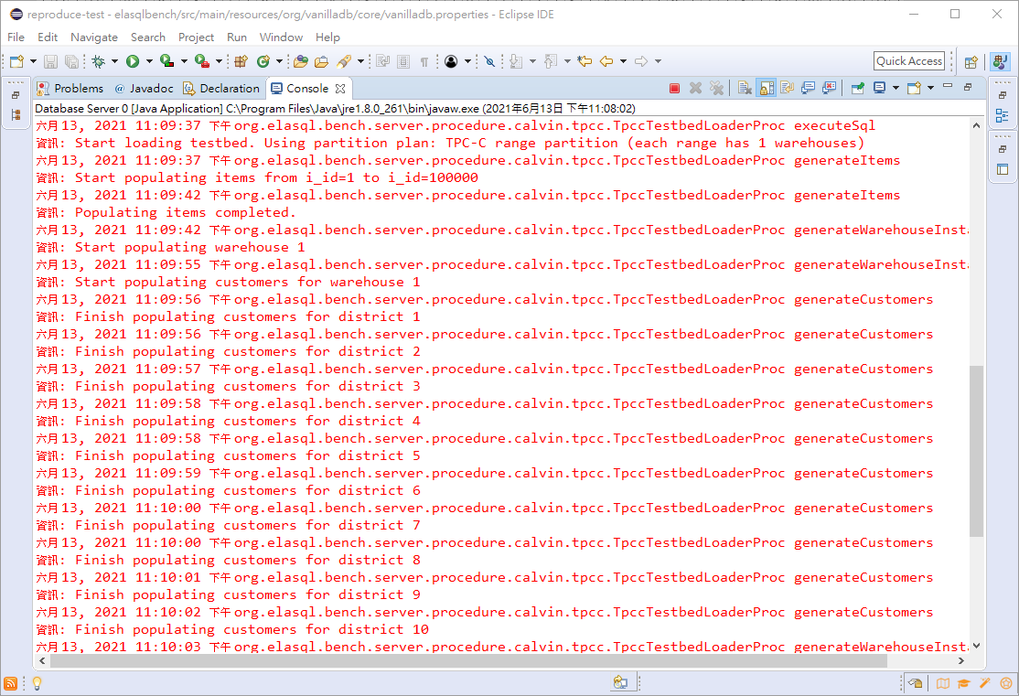
The database server will show some messages about the loaded data.

Slide 61
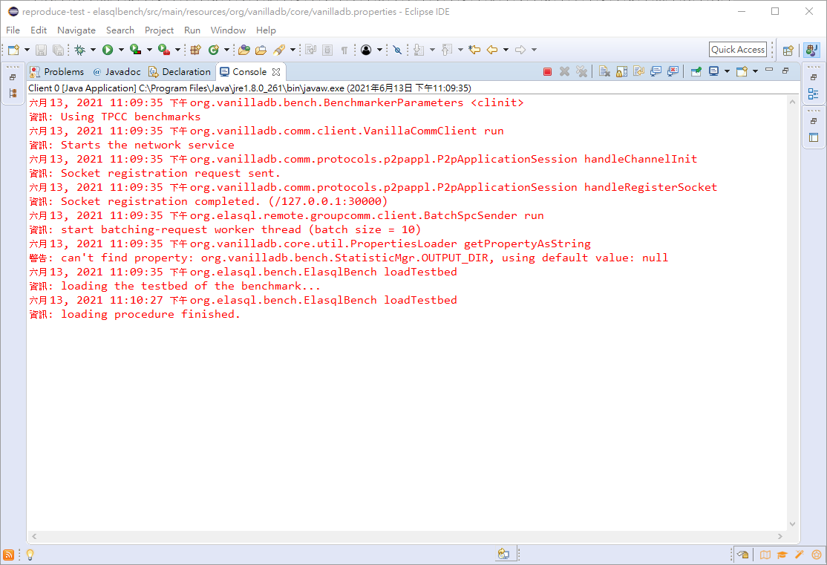
Note that the program won’t terminate by itself, so we have to stop it manually.

Slide 62
A Note
Remember always to terminate all the processes before the next run.
Since the database system may change the state of database files after each benchmarking test, in order to ensure the consistency of the benchmarking result, we suggest to
Backup the database directory (usually in your home directory)
Replace the database directory with the backup before each benchmarking run.

Slide 63
Testing inside Eclipse
Setup the properties files
Which includes the configurations for ElaSQL and ElaSQL-Bench
Setup run configurations
Loading a testbed
Launch servers
Launch clients
Benchmarking
Launch servers
Launch clients

Slide 64
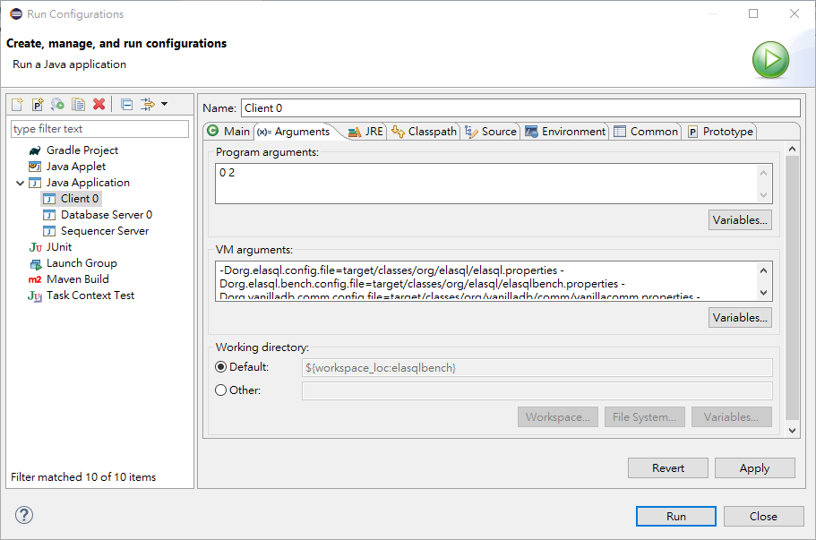
Changing the Client to Benchmarking Mode
2.
3. Change the second argument to 2
1.
4. Apply

Slide 65
Launching the Servers and the Client
Just follow the same launch procedure as loading a testbed.
Launch the database server
Launch the sequencer server
Wait for the server ready
Launch the client

Slide 66
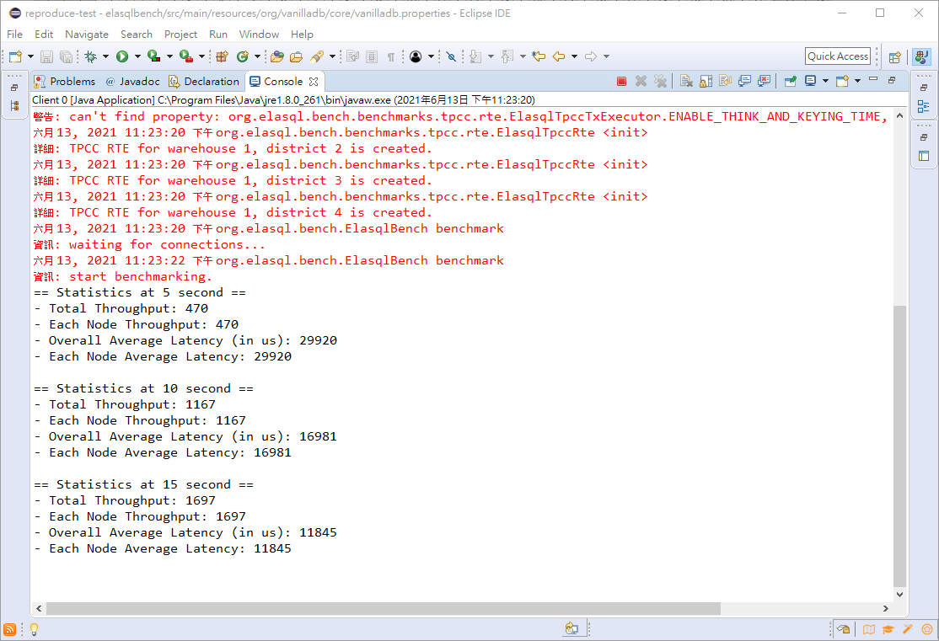
The client will show the statistics every 5 seconds.

Slide 67
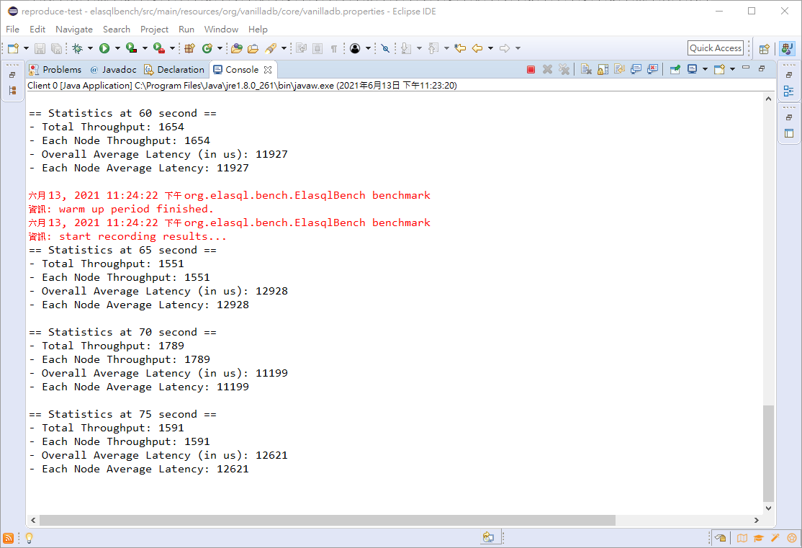
The results in the warm-up period will not be collected into the final report.

Slide 68
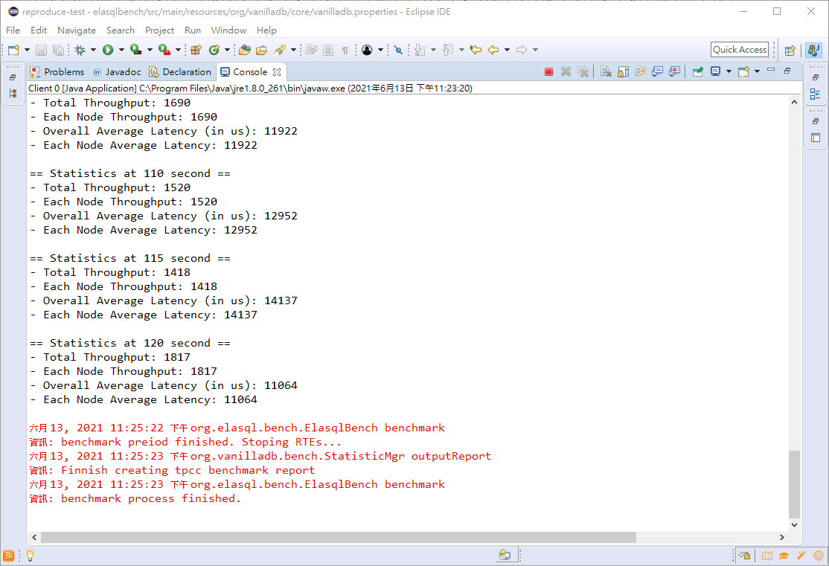
Done.

Slide 69
Reports
The report will be put in “$HOME$/benchmark_results” by default.
You can change this in vanillabench.properties
There are two report will be generated:
[Datetime]-[Benchmark Name]-[Client ID].csv
Record the timeline of system performance
[Datetime]-[Benchmark Name]-[Client ID].txt
Summary the result for each transaction type.

Slide 70
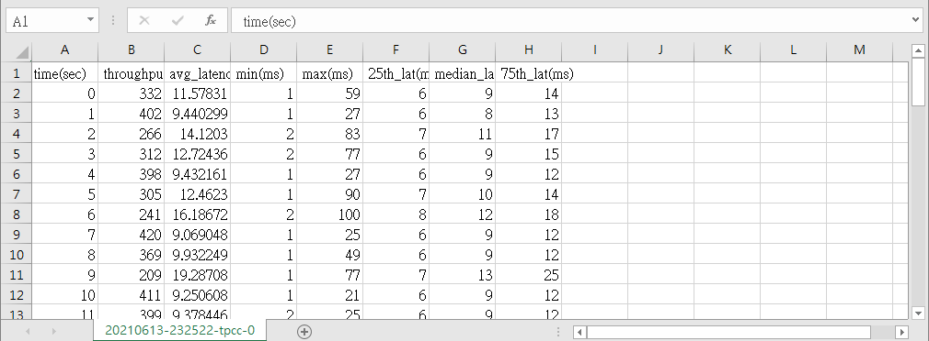
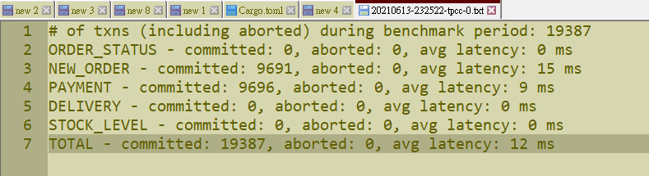
Examples of Reports

Slide 71
Outline
Introduction to ElaSQL project
How to test/benchmark the system?
Let’s meet ElaSQL-Bench
Setting up development environment
Testing inside a Java IDE
Testing with runnable JARs
Testing in a cluster

Slide 72
Testing with Runnable JARs
In most of time, you may want to test ElaSQL in clean environments without interfere, so running with an IDE may not be a proper way.
In that case, we export the projects as runnable JARs and run with scripts.

Slide 73
Steps to Run with Runnable JARs
Create a directory to put all things together
Export the projects into runnable JARs
One for servers (including the sequencer) and one for clients
Copy the properties files
Writing scripts
Run with scripts!

Slide 74
Steps to Run with Runnable JARs
Create a directory to put all things together
Export the projects into runnable JARs
One for servers (including the sequencer) and one for clients
Copy the properties files
Writing scripts
Run with scripts!

Slide 75
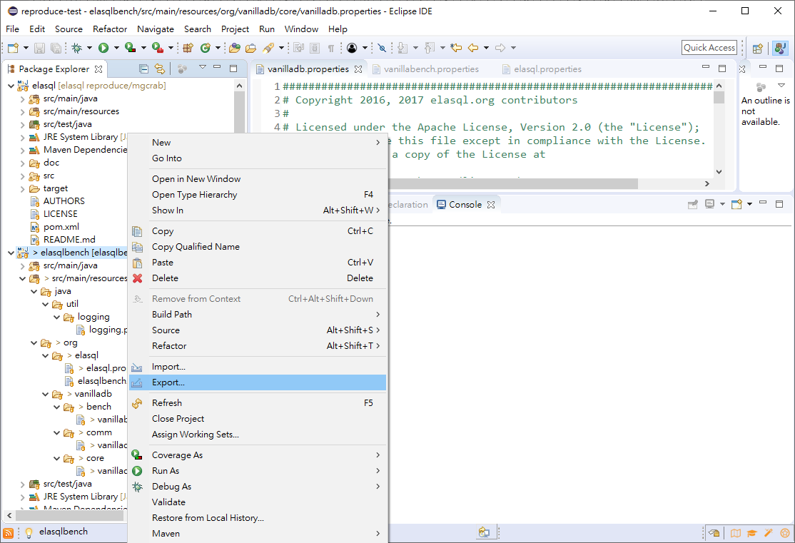
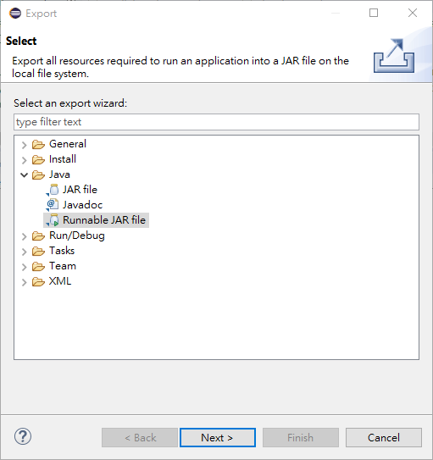
1.
3.
2.
4.

Slide 76
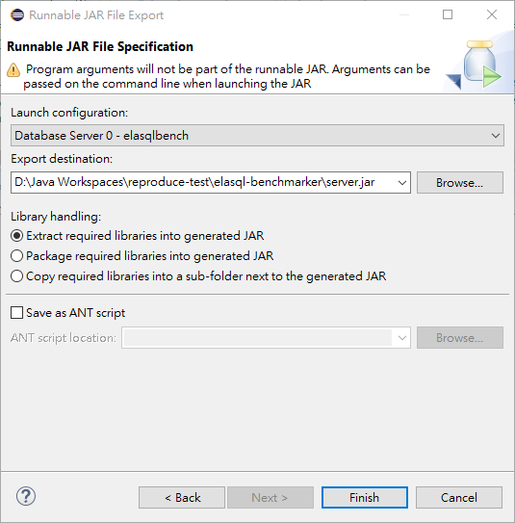
Exporting a Server JAR
5.
6. Find the directory you just created and give the JAR a name
7.

Slide 77
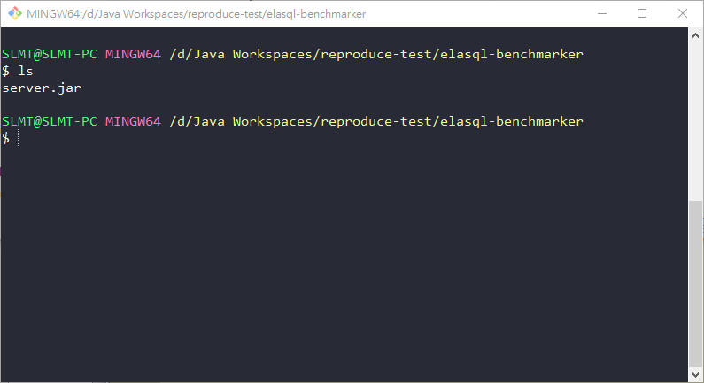
Server JAR

Slide 78
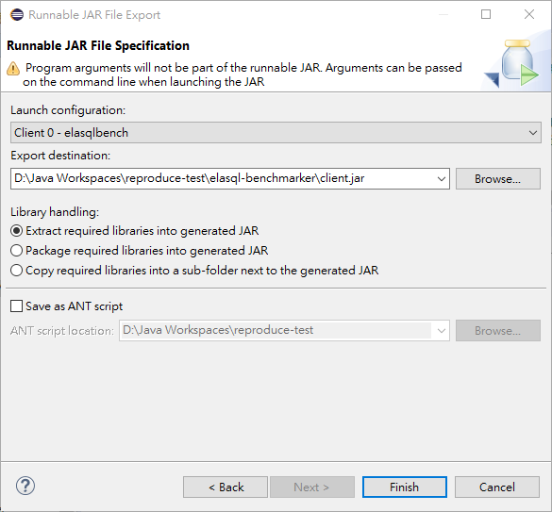
Exporting a Client JAR
Step 1~4 are same
5.
6.
7.

Slide 79
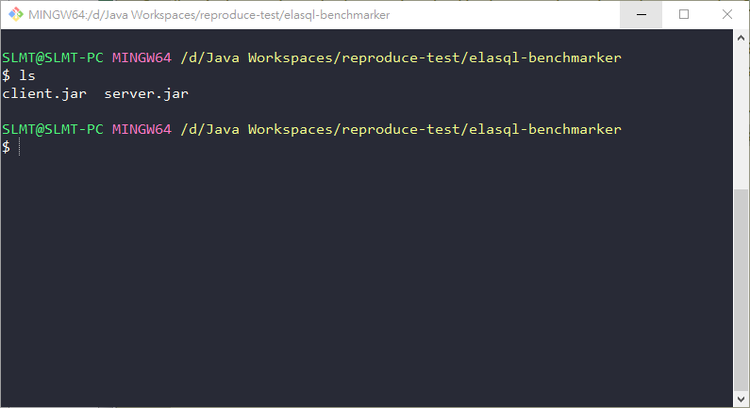
Server & Client JARs

Slide 80
Steps to Run with Runnable JARs
Create a directory to put all things together
Export the projects into runnable JARs
One for servers (including the sequencer) and one for clients
Copy the properties files
Writing scripts
Run with scripts!

Slide 81
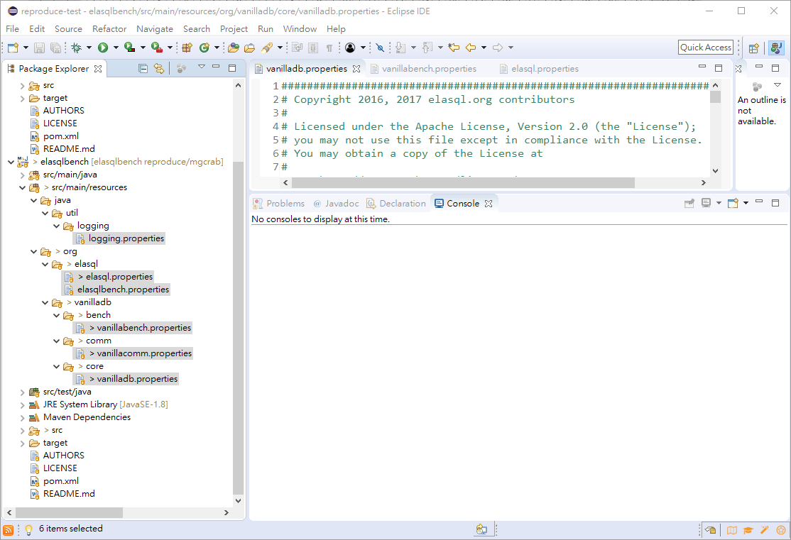
Copy these files and put them to the directory

Slide 82
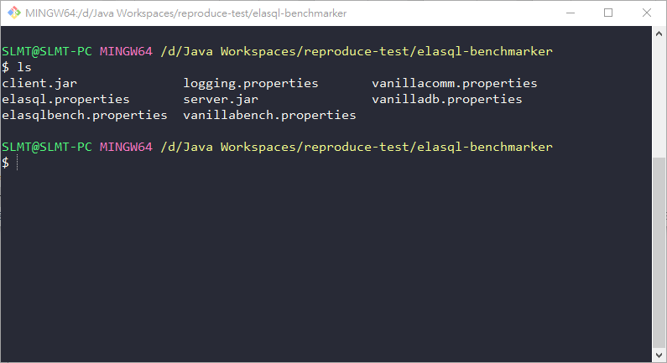
Server & Client JARs + Properties Files

Slide 83
Steps to Run with Runnable JARs
Create a directory to put all things together
Export the projects into runnable JARs
One for servers (including the sequencer) and one for clients
Copy the properties files
Writing scripts
Run with scripts!

Slide 84
Writing a Script for Servers (Including the Sequencer)
Copy the script below and save it as server.sh
java \
-Dorg.elasql.config.file=elasql.properties \
-Dorg.elasql.bench.config.file=elasqlbench.properties \
-Dorg.vanilladb.comm.config.file=vanillacomm.properties \
-Dorg.vanilladb.bench.config.file=vanillabench.properties \
-Dorg.vanilladb.core.config.file=vanilladb.properties \
-Djava.util.logging.config.file=logging.properties \
-jar server.jar \
$1 \
$2 \
$3 \
You can also copy the content of the script from here.

Slide 85
Writing a Script for Clients
Copy the script below and save it as server.sh
java \
-Dorg.elasql.config.file=elasql.properties \
-Dorg.elasql.bench.config.file=elasqlbench.properties \
-Dorg.vanilladb.comm.config.file=vanillacomm.properties \
-Dorg.vanilladb.bench.config.file=vanillabench.properties \
-Dorg.vanilladb.core.config.file=vanilladb.properties \
-Djava.util.logging.config.file=logging.properties \
-jar client.jar \
$1 \
$2 \
You can also copy the content of the script from here.

Slide 86
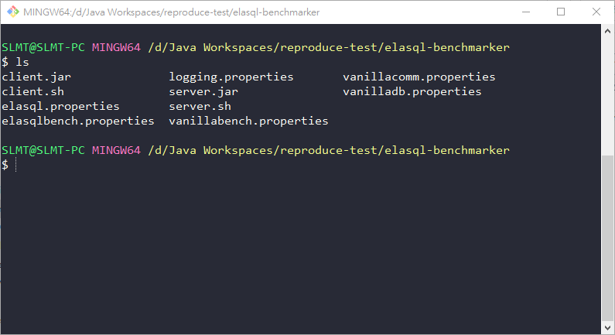
All the Things We Need Are Now In Place

Slide 87
Steps to Run with Runnable JARs
Create a directory to put all things together
Export the projects into runnable JARs
One for servers (including the sequencer) and one for clients
Copy the properties files
Writing scripts
Run with scripts!

Slide 88
Running the Servers & Clients
The procedure to run the servers and clients are identical with running in Eclipse.
The only difference is that we start processes with scripts.

Slide 89
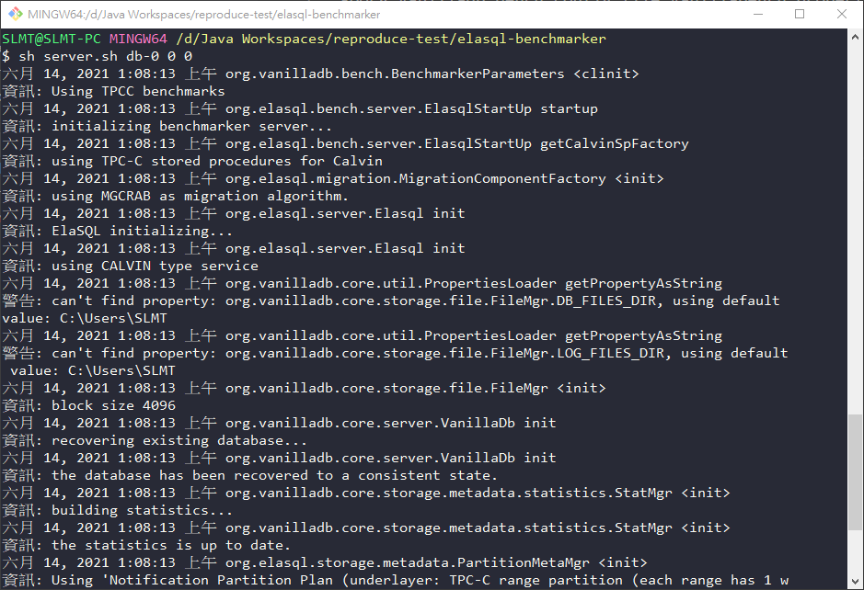
Starting a Database Server
Arguments are the same with the program arguments in run configurations

Slide 90
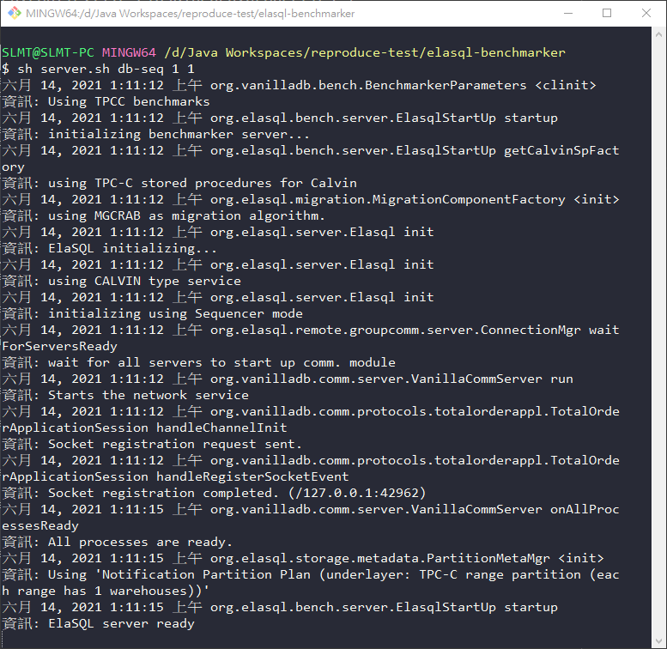
Starting a Sequencer Server

Slide 91
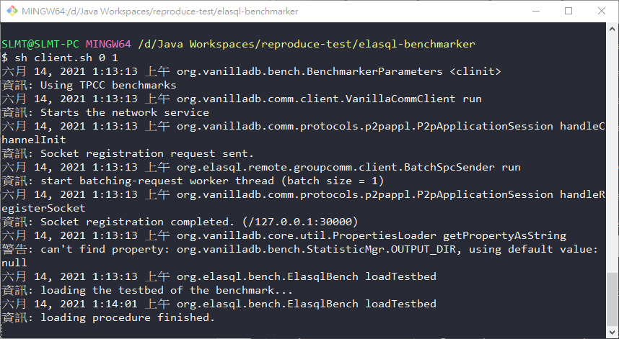
Starting a Client for Loading

Slide 92
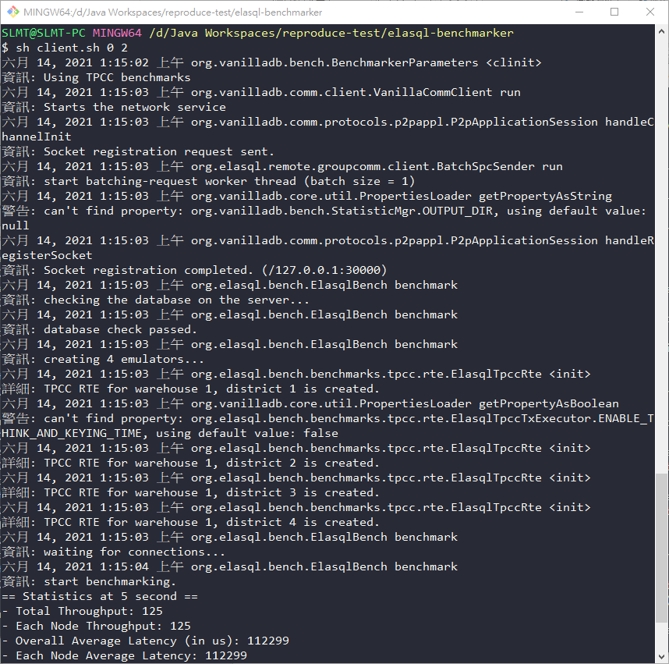
Starting a Client for Benchmarking

Slide 93
Outline
Introduction to ElaSQL project
How to test/benchmark the system?
Let’s meet ElaSQL-Bench
Setting up development environment
Testing inside a Java IDE
Testing with runnable JARs
Testing in a cluster

Slide 94
Testing in a Cluster
It is not hard to manually start a few servers and clients on some machines.
However, things get mess when there are tens of servers and clients to run on a cluster.
Imagine to run a scalability experiment with 20 servers, 1 sequencer, and 20 clients.
Since we have known how to run the projects with scripts, you can write your own scripts to deal with the large scale experiments.

Slide 95
Auto-Bencher
Or, you can just use the one we created:
https://github.com/SLMT/auto-bencher
Key Features
Setting up testing environments on a clean machine.
Deploying ElaSQL-Bench JARs to testing machines.
Backing up testbeds.
Organizing different parameters into a test set.
Collecting and summaries the reports from clients.
Note: we are currently working on migrating this project to JavaScript, so the above one may get outdated soon.

Slide 96
Have Fun!

