Slide 1
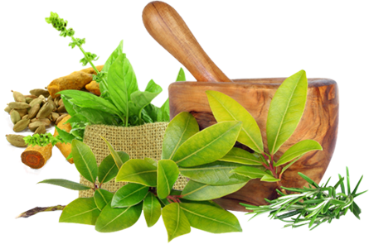
Ayurvedic leaf identification Using Machine Learning
Notes:
NOTE:
To change the image on this slide, select the picture and delete it. Then click the Pictures icon in the placeholder to insert your own image.

Slide 2
Supervised By
Presented By
Jannatul Ferduse (ID:11808002)
Md. Moin Uddin (ID:11808011)
Session:2017-18
Department of Computer Science and Engineering
Comilla University
Mahmuda Khatun
Assistant Professor
Department of Computer Science and Engineering
Comilla University

Slide 3
Outline
Methodology
Dataset
CNN
Source code

Slide 4
Methodology
Data Collection
Data Pre-processing
Model Design
Training
Validation
Testing
Deployment
Monitoring

Slide 5
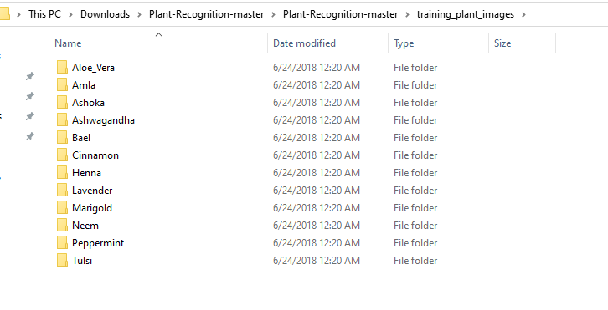

Slide 6
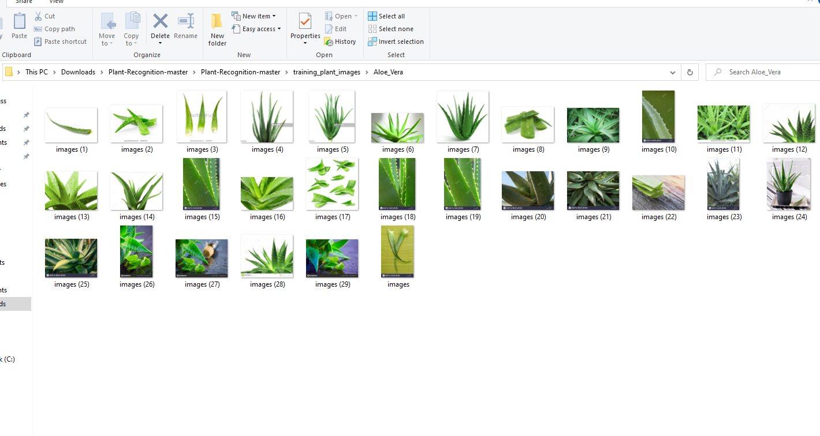

Slide 7
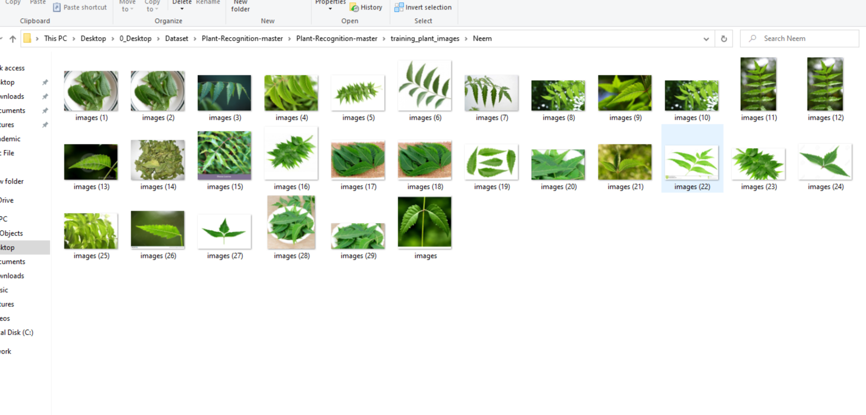

Slide 8
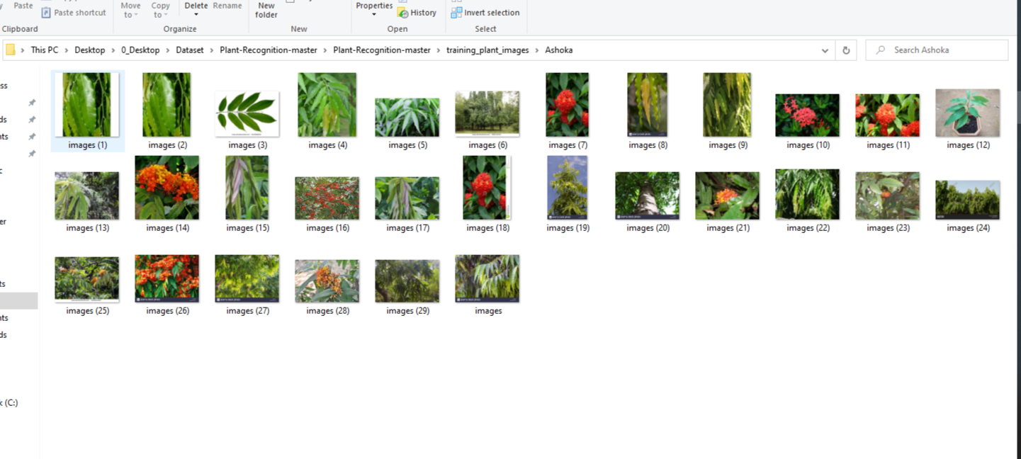

Slide 9
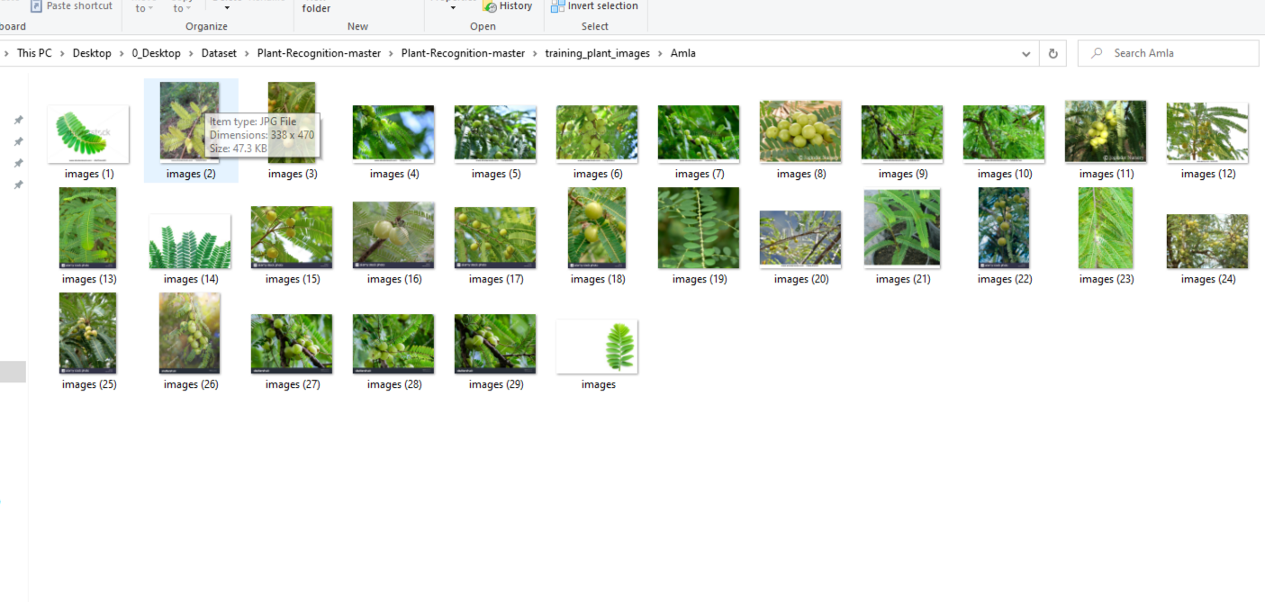

Slide 10
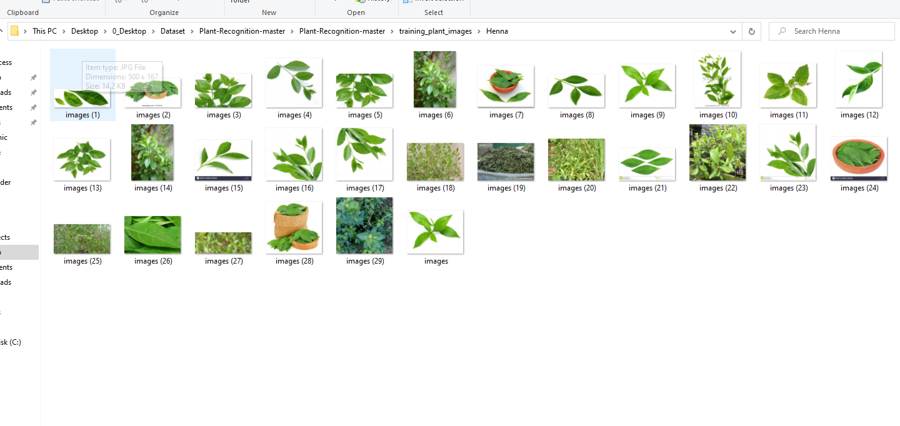

Slide 11
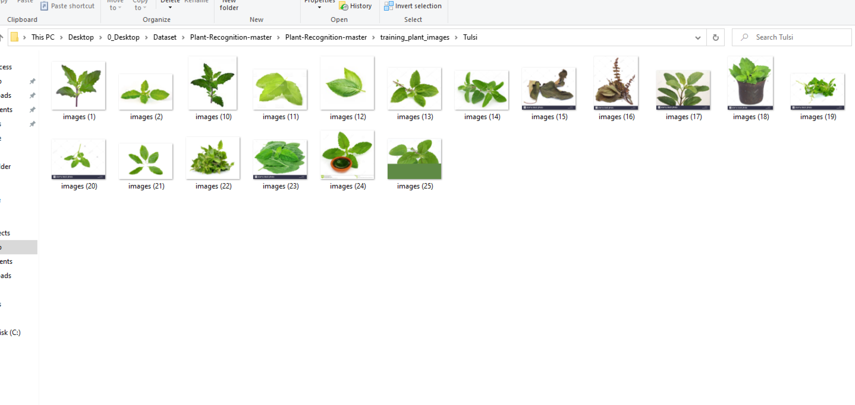

Slide 12
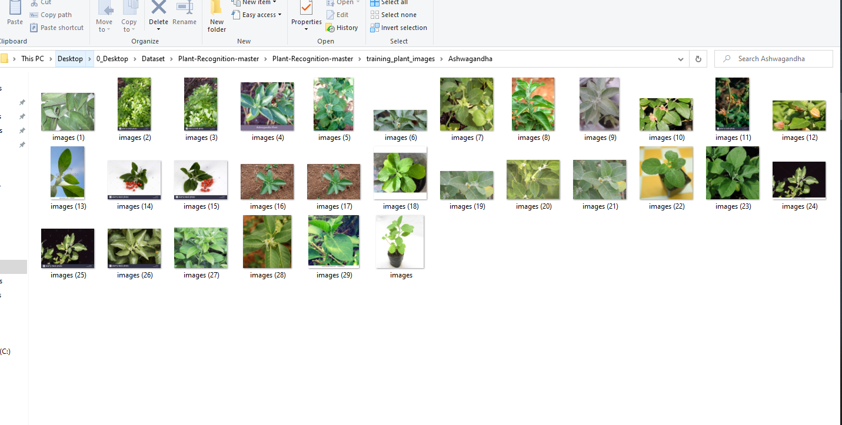

Slide 13

Introduction to CNN
CNNs are a class of Deep Neural Networks that can recognize and classify particular features from images and are widely used for analyzing visual images. Their applications range from image and video recognition, image classification, medical image analysis, computer vision and natural language processing.

Slide 14
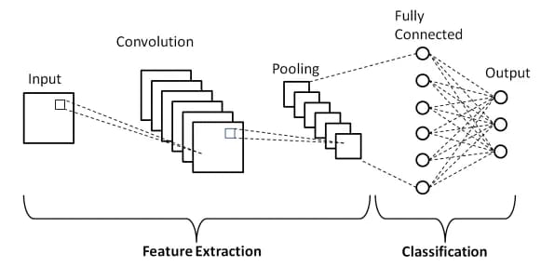
There are three types of layers that make up the CNN which are the convolutional layers, pooling layers, and fully-connected (FC) layers

Slide 15
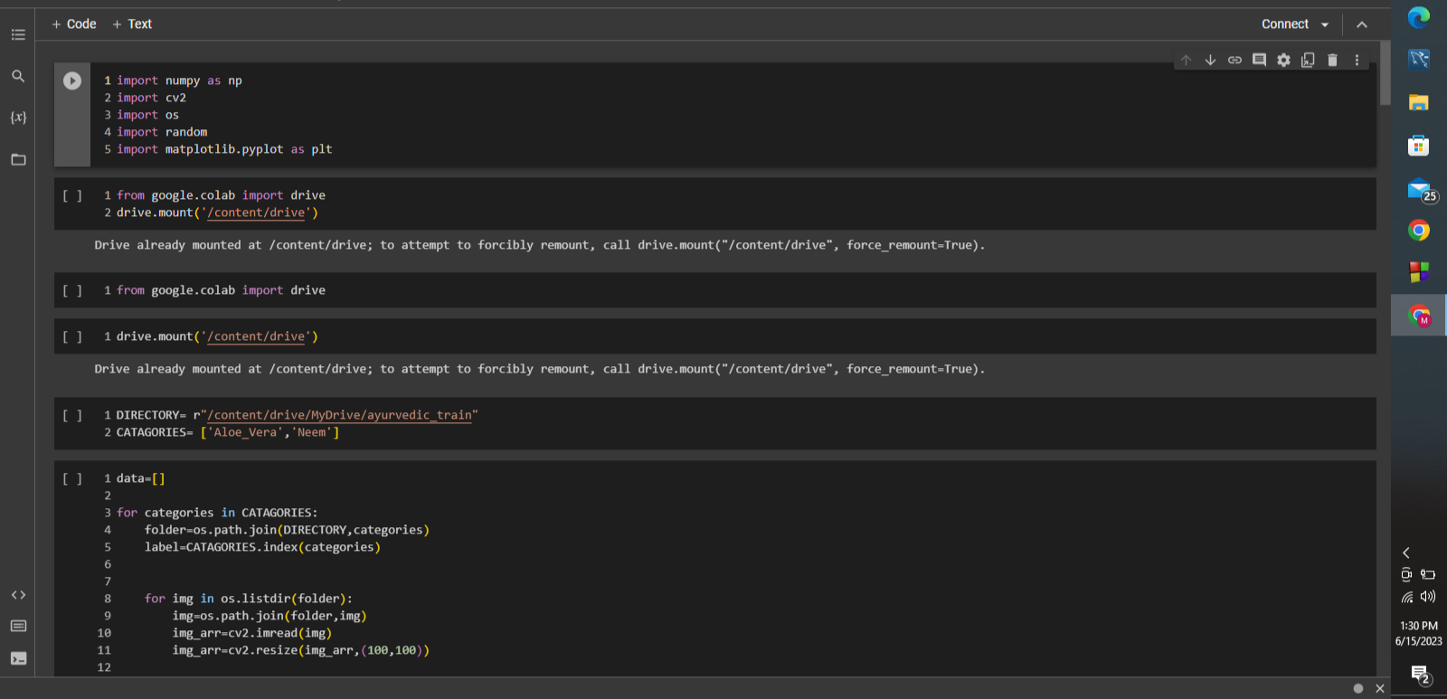

Slide 16
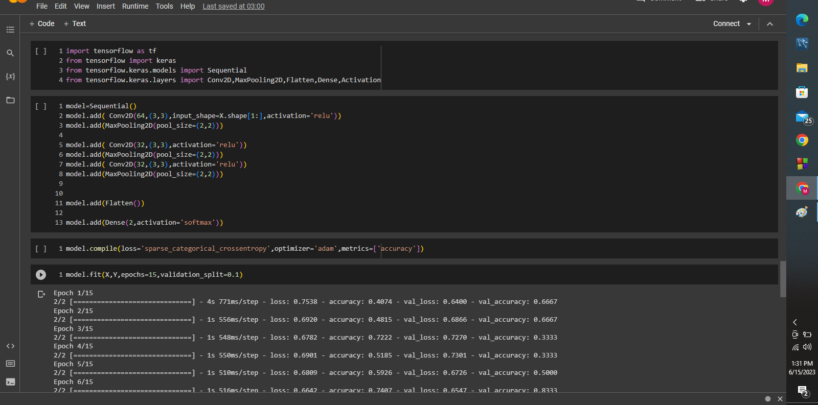

Slide 17
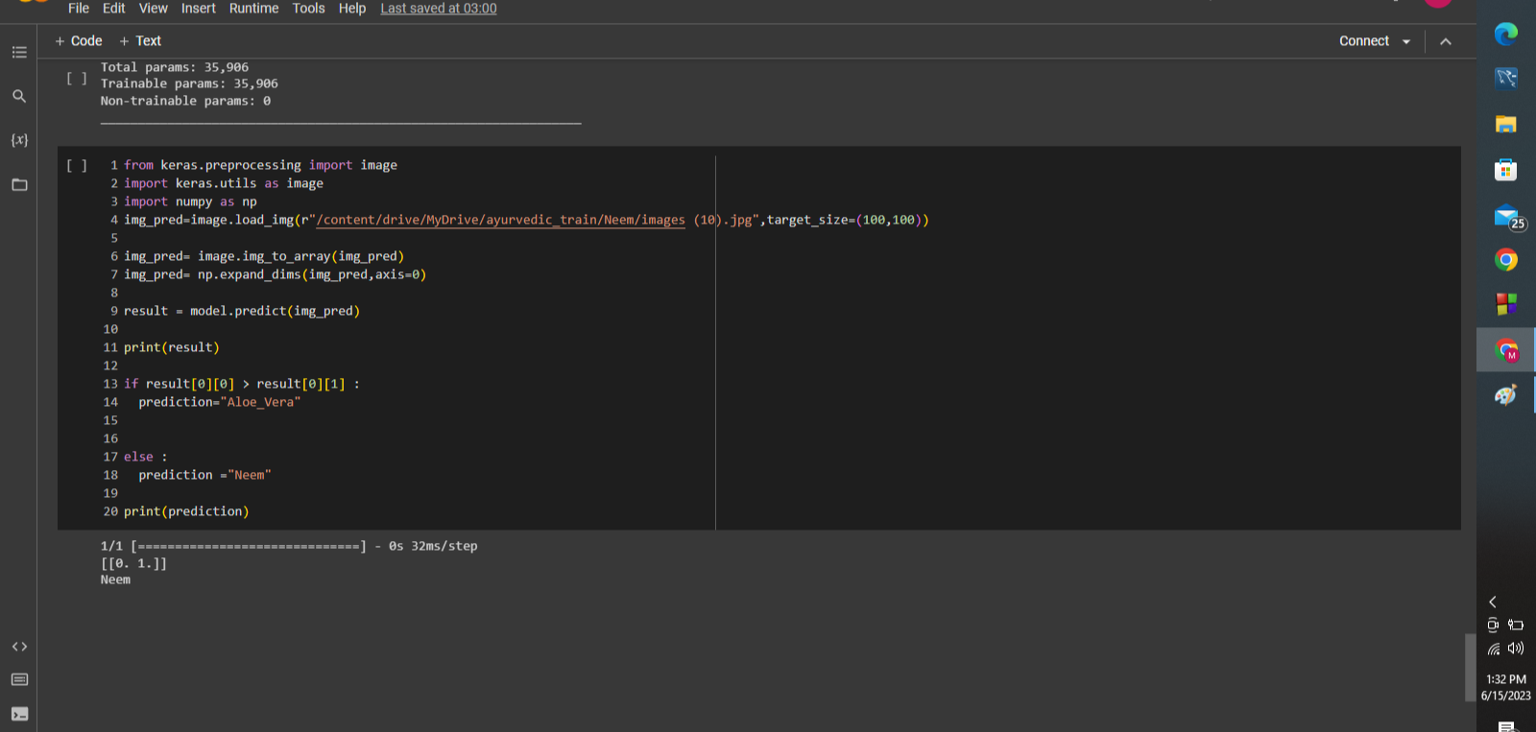

Slide 18
Expected Outcome
High Accuracy
Efficient Performance
Robustness
User Friendly Deployment
Continuous Improvement

Slide 19

Thank You

