Slide 1
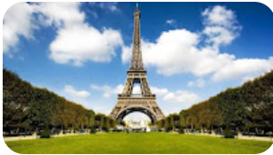
OhmyFood
bienvenue a Paris Parisian Restaurant
A elbaghdadi

Slide 2

Design Target
Desktop
Tablet
Phone
Responsive Website using HTML & CSS
With Graphic Effects & Animation
Compatible with

Slide 3
HTML & CSS brief
HTML HyperText Markup Language or HTML is the standard markup language for documents designed to be displayed in a web browser
Initial release: 1993
CSS Cascading Style Sheets is a style sheet language used for describing the presentation of a document written in a markup language such as HT

Slide 4
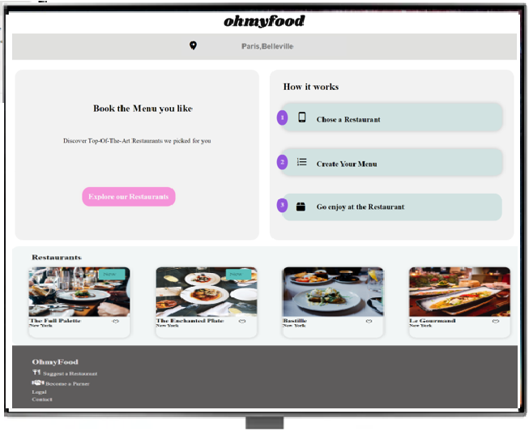
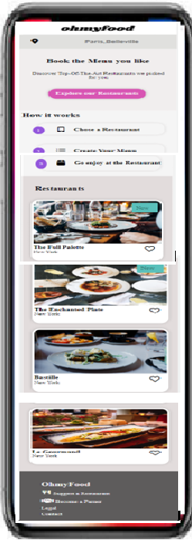
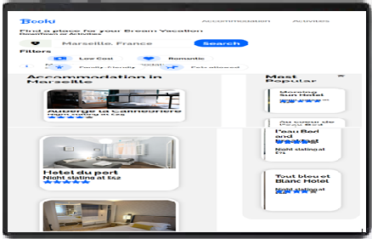
Layout View
Desktop
Tablet
Phone

Slide 5
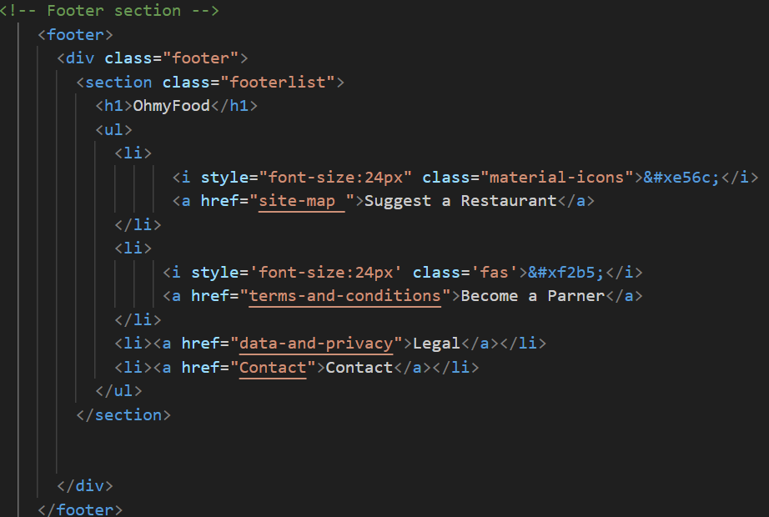
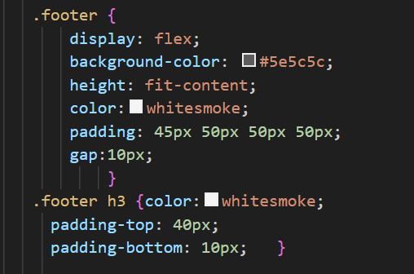
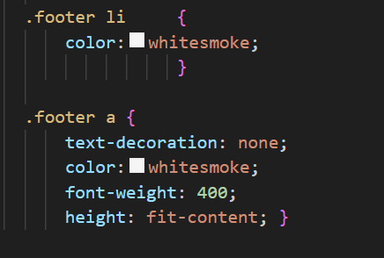
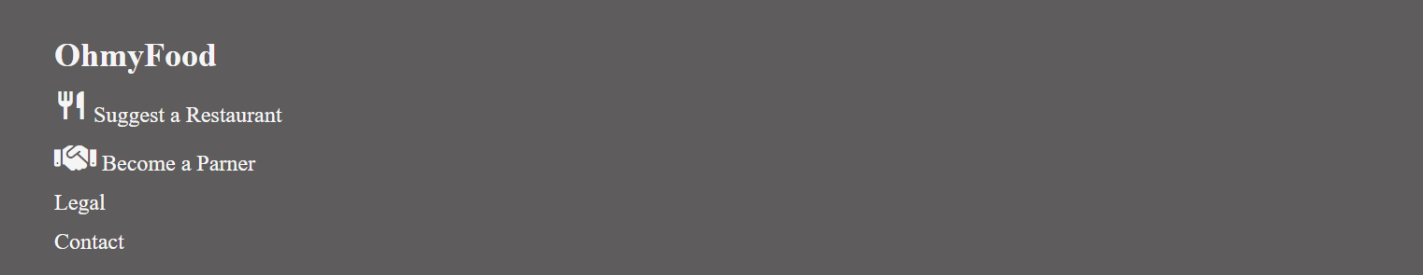
HTML & CSS Code Example

Slide 6
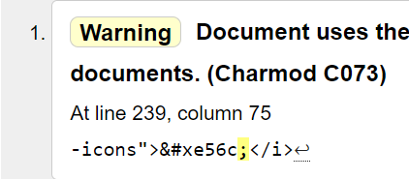
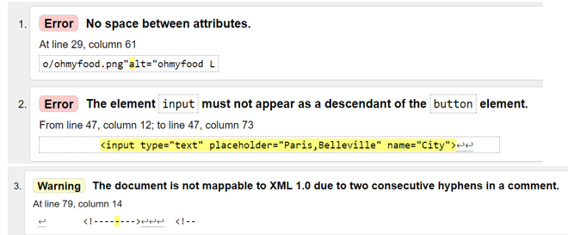
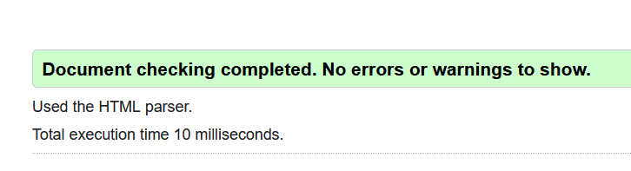
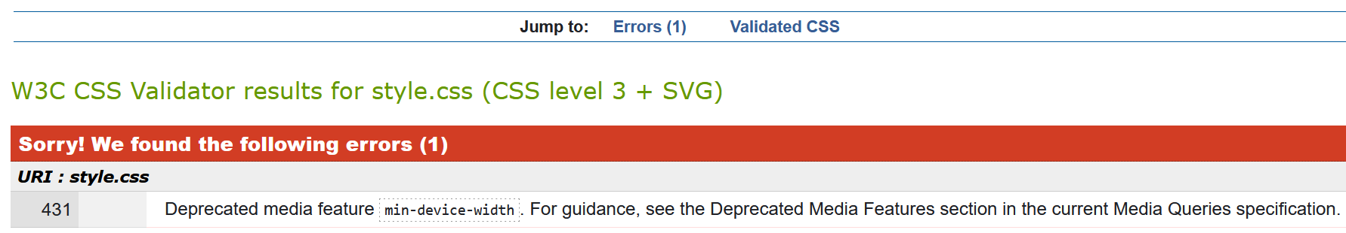
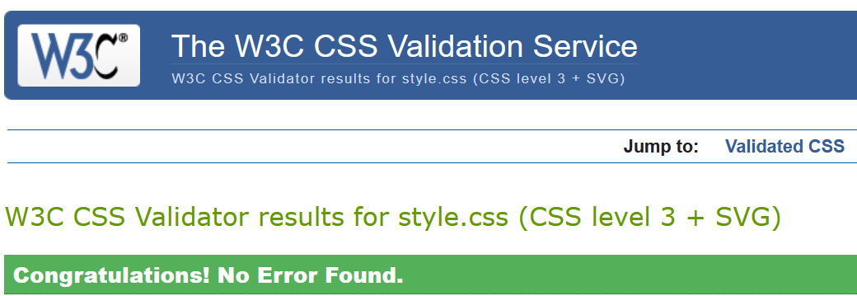
Validation

Slide 7
Demo
Demo of the OhmyFood Restaurant website ready to show

Slide 8
Difficulties
Animation and Graphic Effects
Box sizing/layout
Image sizing within container
Layouts to display devices view
Flex box orientation

Slide 9

Thank you
Abderrazak Elbaghdadi

