Slide 1
Research Initiation Seminar
Maha Elbayad, Simon Rodriguez
Détection de lunettes par CNN/Deep Learning
Safran Morpho

Slide 2
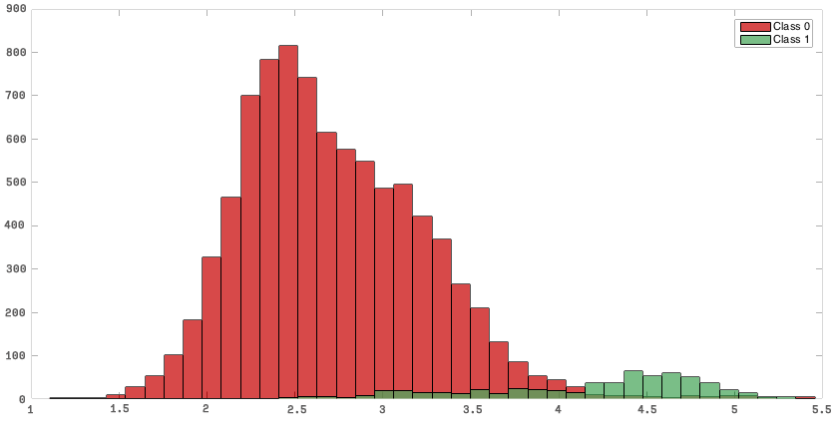
Subject
Train a CNN to say whether a facial image contains eyeglasses or not.
The training database labelled with an other classifier (local features)
Noisy labels:

Slide 3








Setup
Database : CASIA WebFace
380k faces (collected from IMDB)
96 x 96 x RGB
Cropped, scaled and centered on the eyes
Caffe with a predefined network configuration

Slide 4
Problem formalization
Preprocessing:
Build the labels from the classifier scores.
Simple thresholding
Dropping indecisive scores
Training the CNN
3x {conv-ReLU-pool}+ 2 fully connected layers
Softmax with loss .
Potential modification of the loss function to filter the labels noise (cf. bibliography)

Slide 5
Bibliography
Initial article :
T. Xiao, T. Xia, Y. Yang, C. Huang & X. Wang (2015). Learning from Massive Noisy Labeled Data for Image Classification
Techniques for dealing with pure noise, annotator bias,...
New possibilities :
S. Sukhbaatar, J. Bruna, M. Paluri, L. Bourdev & R. Fergus (2015). Training Convolutional Networks With Noisy Labels
N. Natarajan, I. S. Dhillon, P. Ravikumar & A. Tewari (2013). Learning with Noisy Labels

Slide 6
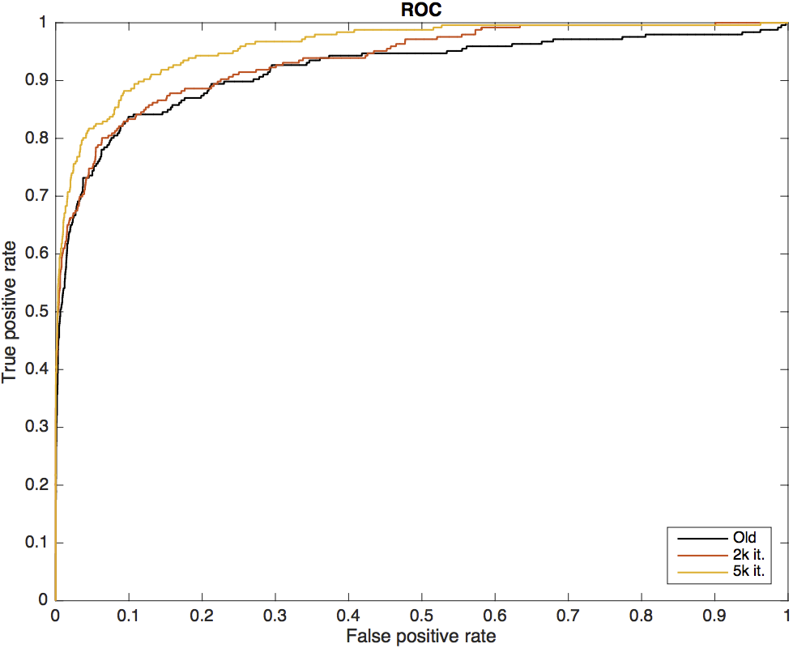
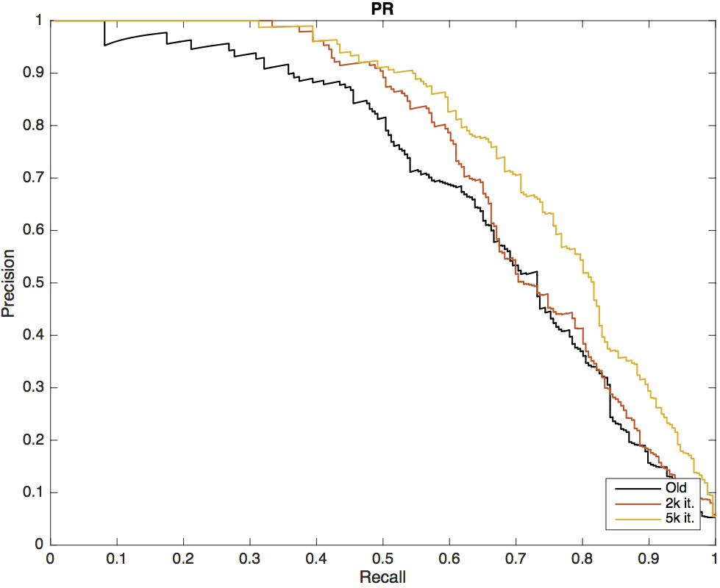
First results
Global approach for now (use as a baseline)
take the result of the classifier as uniformly biased.
Recreate the distribution observed on a manually labelled subset (4100 faces)
5% glasses → consider the top 5% to be labeled as ‘with glasses’

Slide 7
Other results
RGB / Gray levels pictures
Similar accuracy and ROC, the convergence is a bit (~100 it.) faster in RGB.
Started to introduce a rejection margin around the threshold
No significant improvement for now : less noise/less pictures equilibrium
T - margin
Threshold
T + margin
Label 0
Rejected
Label 1

Slide 8
Future organization
Cross validate the labelling parameters: the threshold and the width of the rejected band.
Assess the tolerated noise with respect to the database size.
Dealing with the noise in the training phase:
Implement the confusion matrix technique
Consider semi supervised learning (an adapted loss function)

Slide 9
Questions

Slide 10
First results – More data
 | Accuracy | AUC (ROC) | AUC (RC)
Old | / | 0,91964 | 0,67954
2000 it. | 0.971 | 0,93584 | 0,71894
5000 it. | 0.972 | 0,95956 | 0,77429

