Slide 1
BIMinferer
Or, how we can make use of all the DATA
Notes:
we are making use of all the data to help us on a daily basis?

Slide 2




Automate
mundain
Assuring Quality
Saving money & time
Notes:
High quality designs using less time

Slide 3

Hey, do you want me to help you with the task?

Slide 4
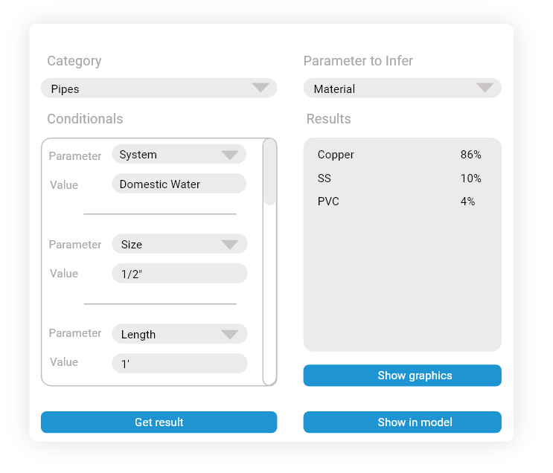
BIMinferer
Hey, you should be using a copper type material!
“As Grammarly is there for writing.... BIMinferer will be there for BIM modeling”

Slide 5
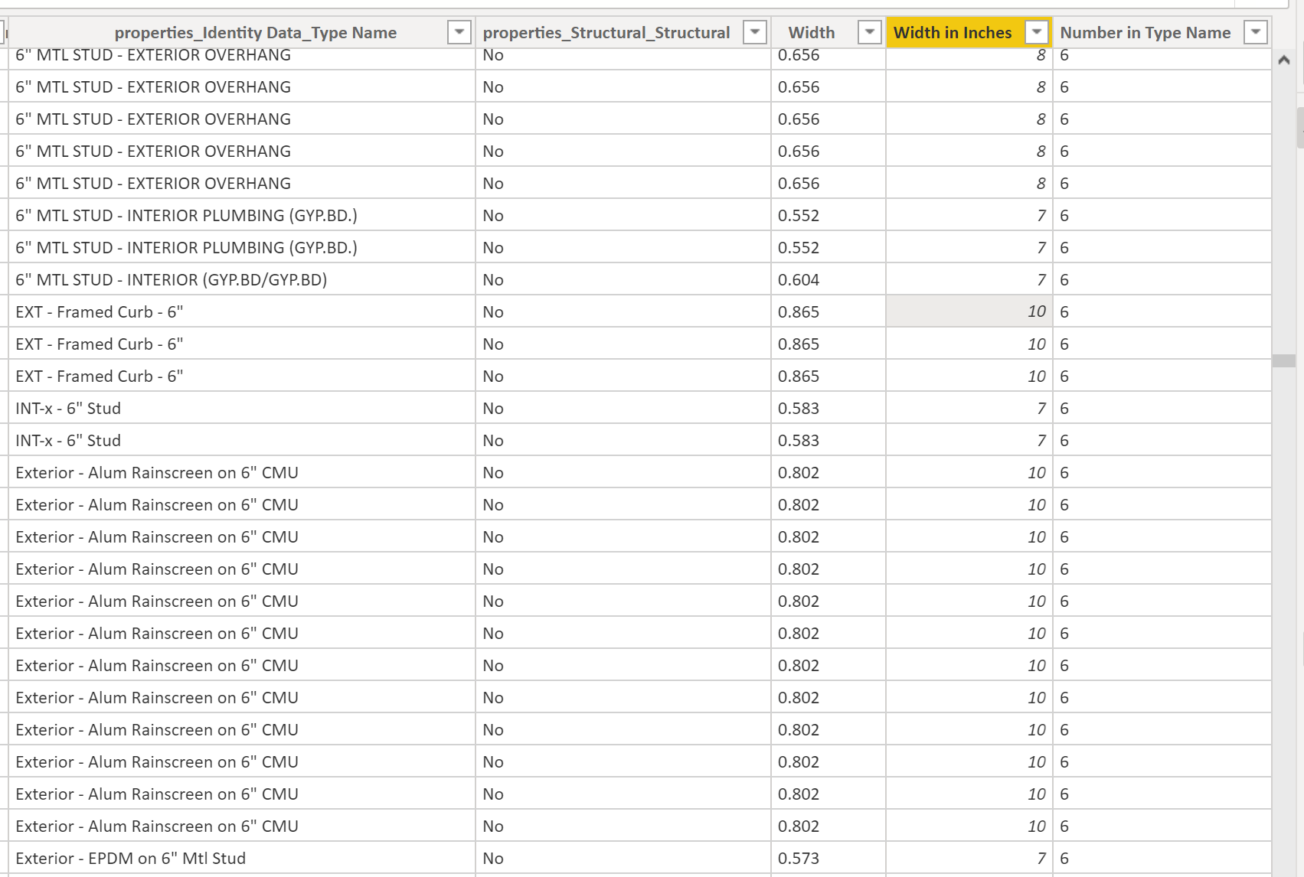
Problem statement - Data error example
User input
ML input

Slide 6
How?

Slide 7




SCRAP
PROCESS
ANALYZE
INFER
Notes:
Explaining the How

Slide 8
SCRAP
Obtaining the DATA

Slide 9
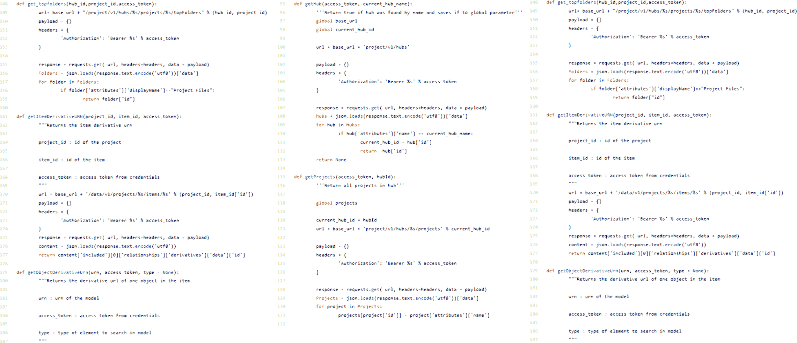



SCRAP
We Python scripts to access BIM 360 using Forge

Slide 10


SCRAP
Once in BIM 360 we retrieve all Revit elements metadata

Slide 11
PROCESS
Processing the DATA

Slide 12



PROCESS
Removing irrelevant and sensitive information

Slide 13

PROCESS
SERVE
We make the information accessible thru a server

Slide 14
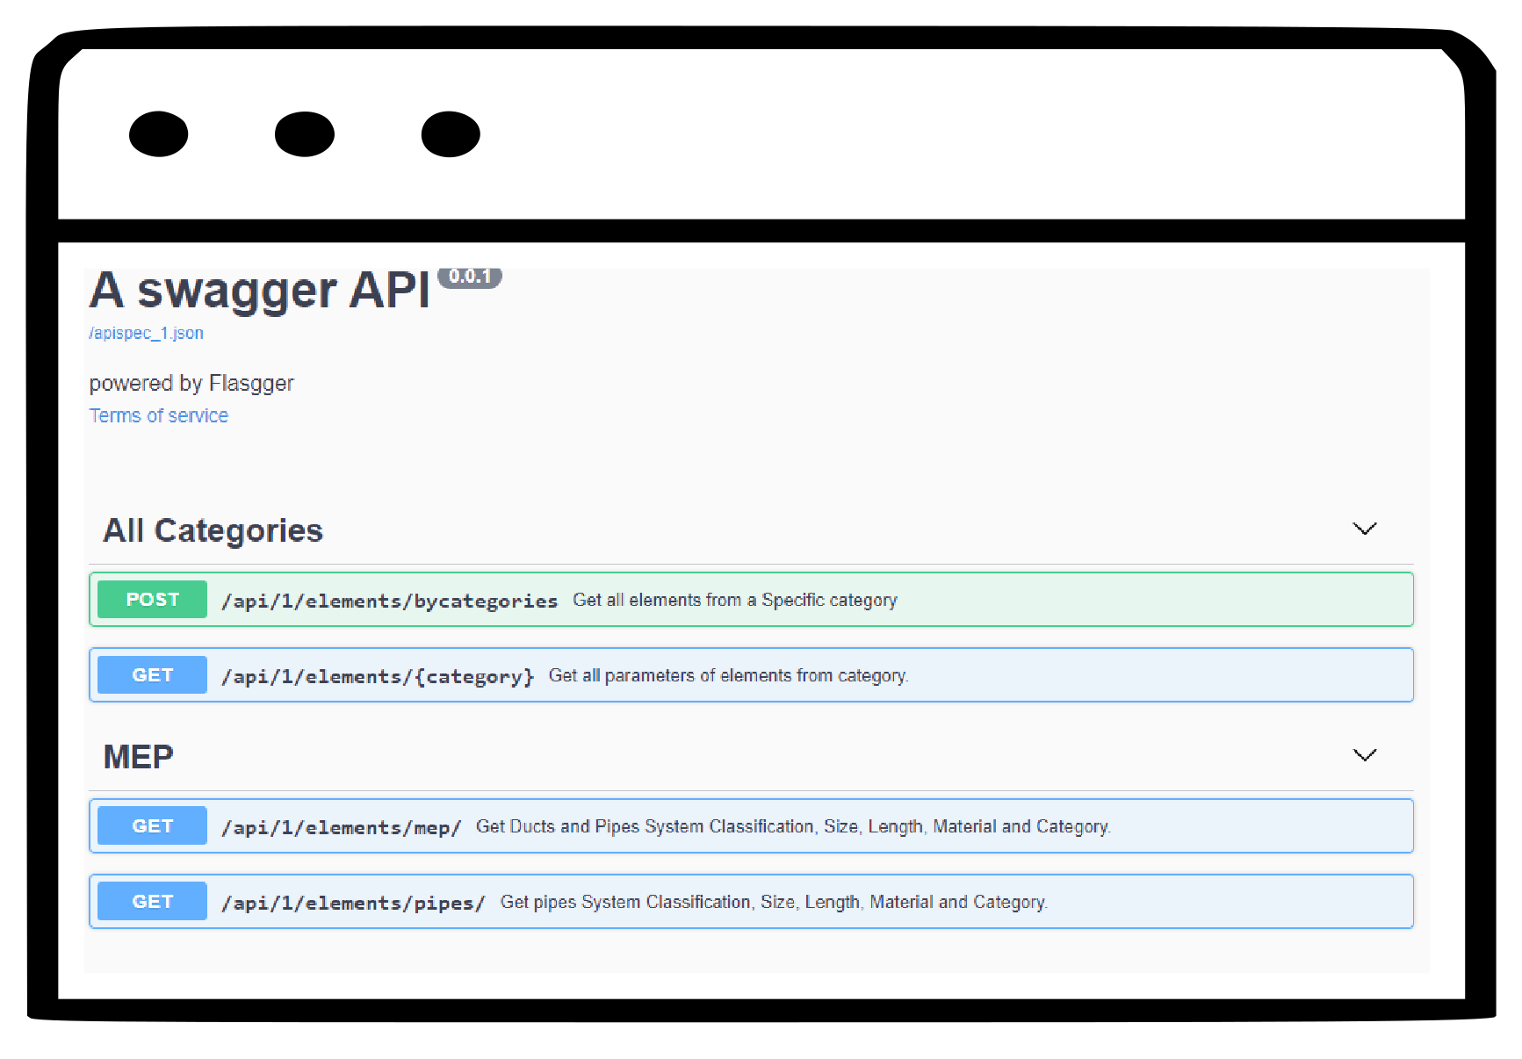



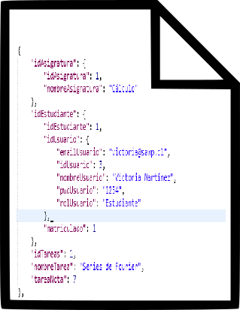
PROCESS
Insert data to a database and serve it thru a web API

Slide 15
ANALYZE
Explore the DATA

Slide 16


ANALYZE
CLEAN
(again)
FILTER
TAG
Prepare the information for data analysis

Slide 17

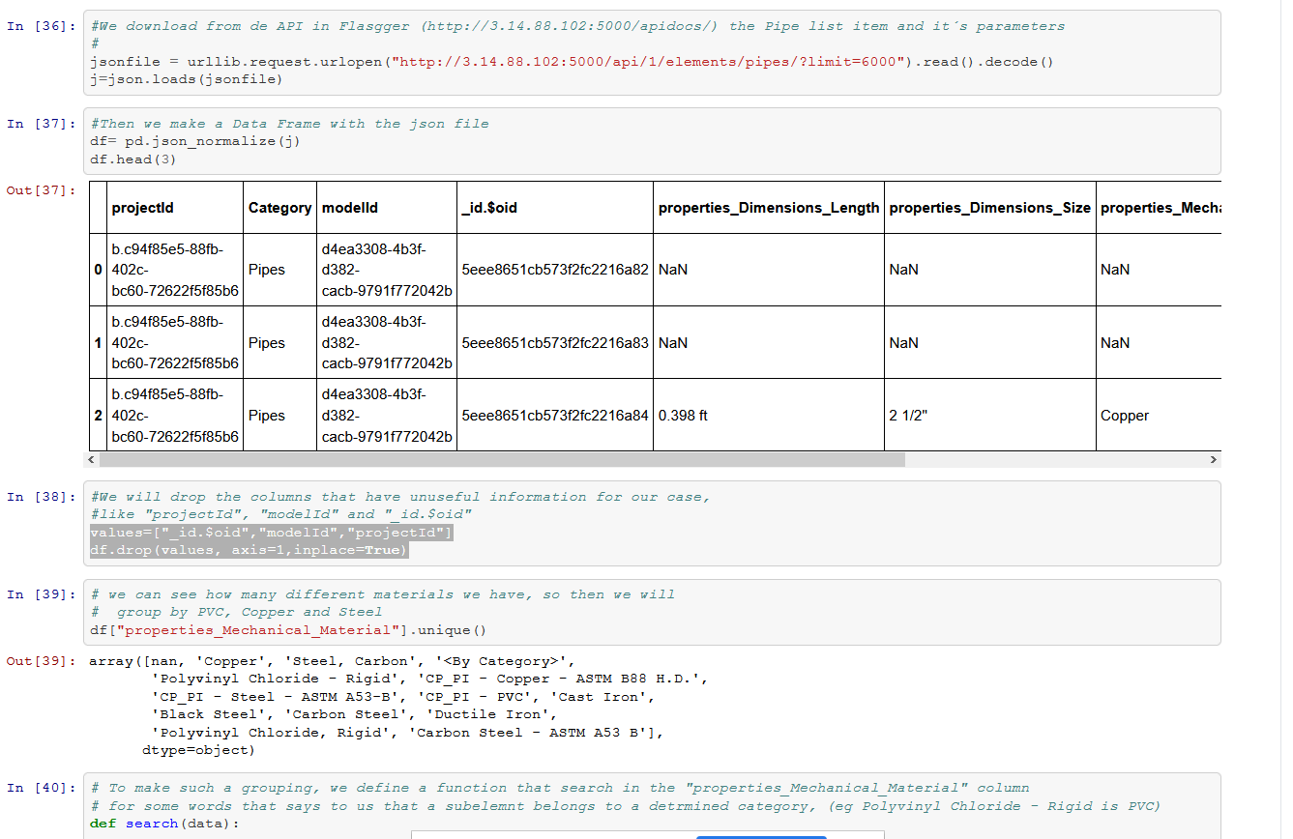

ANALYZE
Jupyter notebooks to format and visualize data

Slide 18
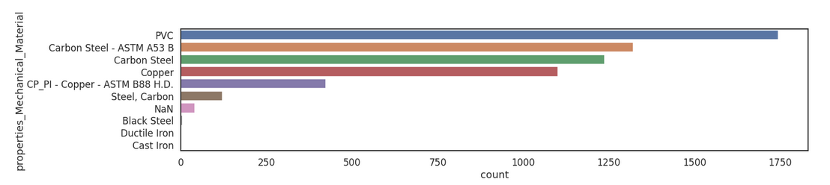

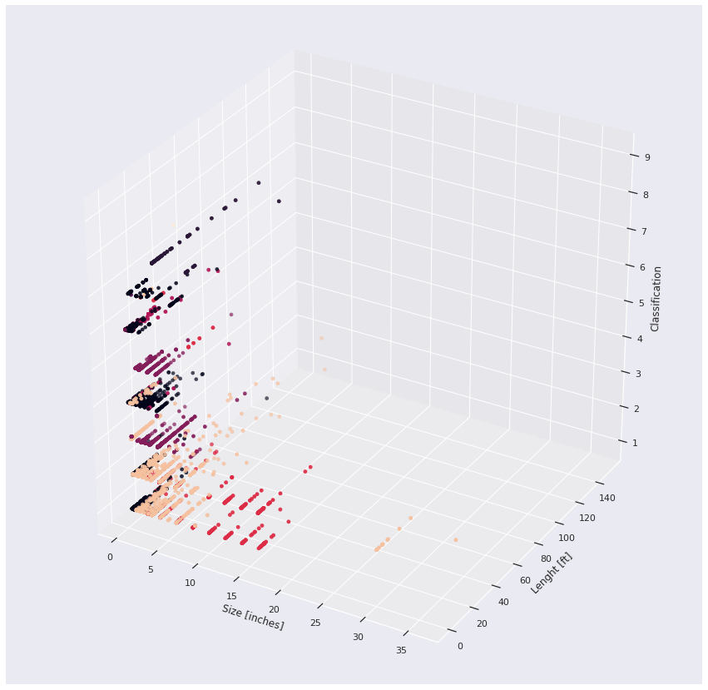
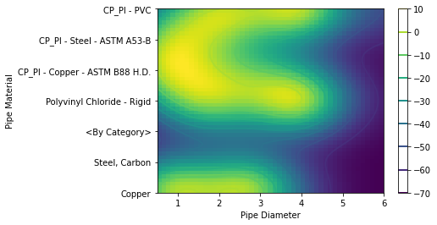
ANALYZE
RandomForestClassifier
One-Class SVM
scikit learn to make predictions and find anomalies

Slide 19
INFER RESULTS

Slide 20
Design suggester
(AKA Real time helper)

Slide 21
Inferences for quality assurance (Custom UI)
Random Forest to suggest options based on previous experiences
Hey, you should be using a copper type material!
Notes:
Suggesting options in real time to change element

Slide 22
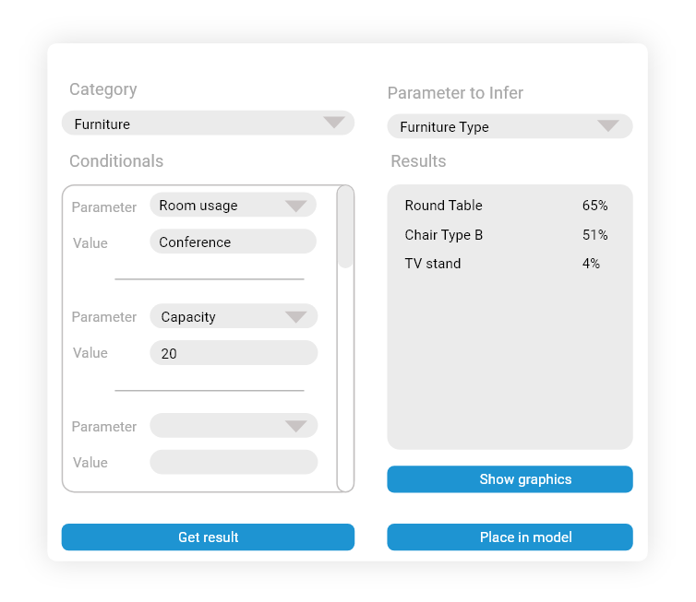
Inferences for element placing (Custom UI)
Random Forest to suggest options based on previous experiences
Hey, do you want me to place the furniture for you?
Notes:
Suggesting options in real time to place elements!

Slide 23
Deferred Analysis
(AKA QC)

Slide 24
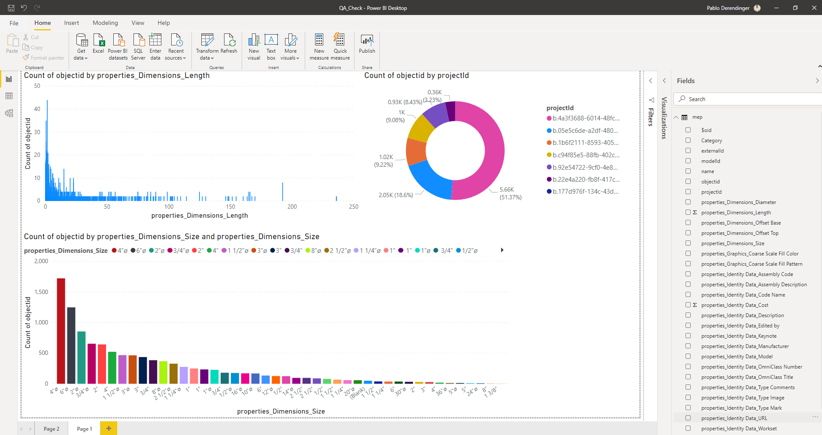
Quality Check -Dashboard
Dashboard showing models’ problems and possible solutions
Notes:
PREVENTIVE ACTIVE

Slide 25
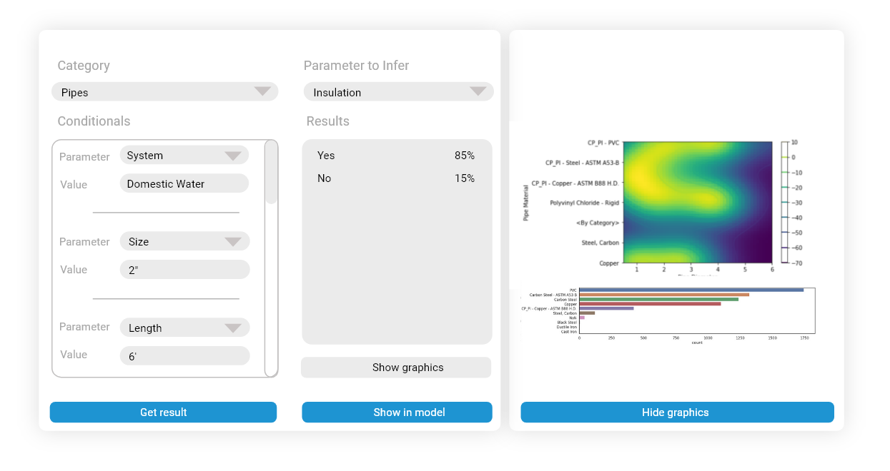
Inferences for Quality Assurance (Custom UI )
Outlier Detection to identify errors in the model
Notes:
Showing analysis information to

Slide 26



BIMinferer
Code
https://github.com/pabloderen/BIMinferer
API demo
http://3.14.88.102:5000/apidocs/
Team
Aleksandra Jastrzebska
Bernardo Derendinger
Rabi Adhikari
Pablo Derendinger

Slide 27


Slide 29
Enrich the BIM Data
Challenges to BIM - inconsistencies in data consumptions
AEC - Industries benefits from 3D spatial value
There is a lack of confidence in the human input parameters and requires intensive user actions.
Producing consistency in data modeling is often labor intensive and often ignored for the choice of 3D spatial value. Varying skill set in data modeling plays an important role.
Hope is to automate the mundane steps to help bring consistency thus enriching the parametric values.

Slide 30


Minions Work Matter
No minion work
Choices in design selection
Use the data from previous projects to train Machine Learning.
Presenting trends to minions allowing them to look for design selection
Naming Conventions – Shadow processing
Data driven naming conventions - presenting a choice to the user or performing an automatic coprocessing to free the burden for minions

Slide 31
Putting Machines to work not Minions
Minions are engineers, not drafters who are fixing stair details for rest of their lives.
Gru’s knowledge of stair details may help Minions accomplish design quickly.

