Slide 1
prototype
Game store

Slide 2
Loja de games
We are the game store, let is introduce your some of functional work. Below we will show our models, which are:
Desktop.
Tablet.
Mobile.

Slide 3
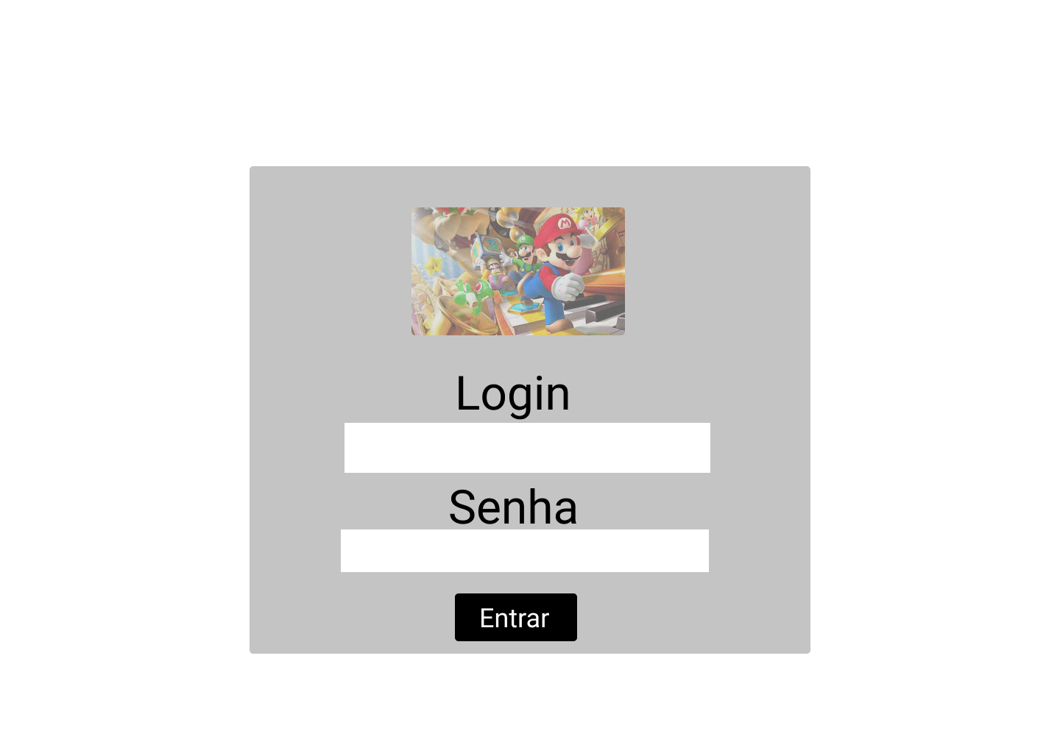
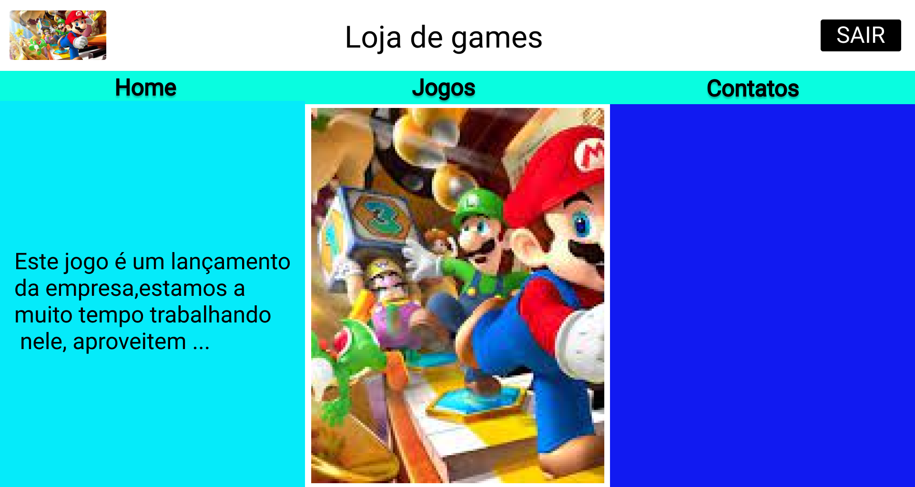
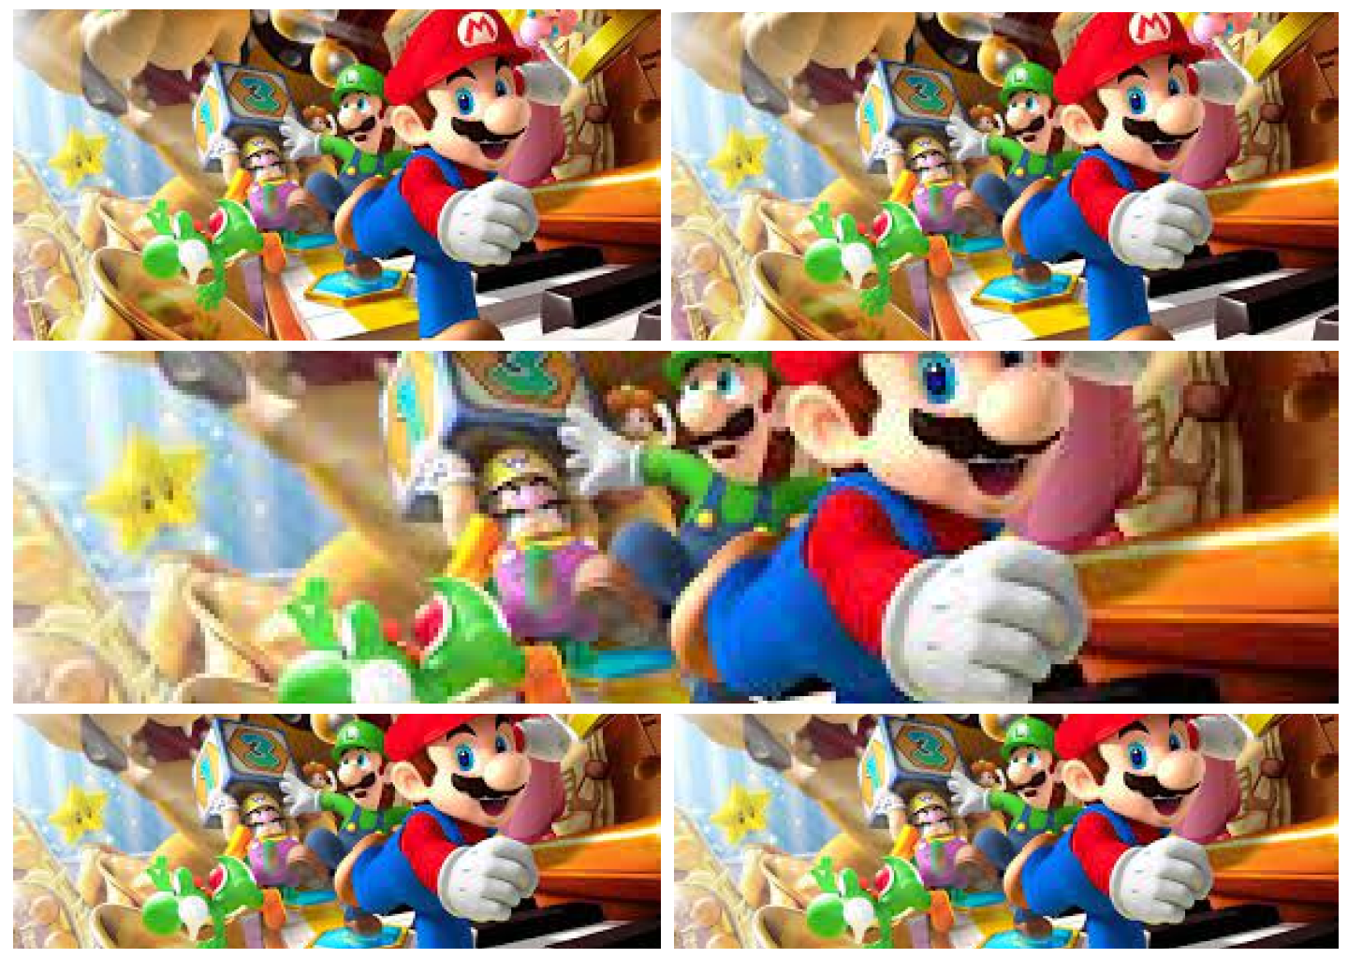
desktop version

Slide 4
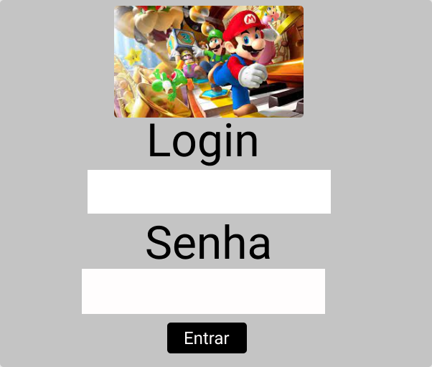
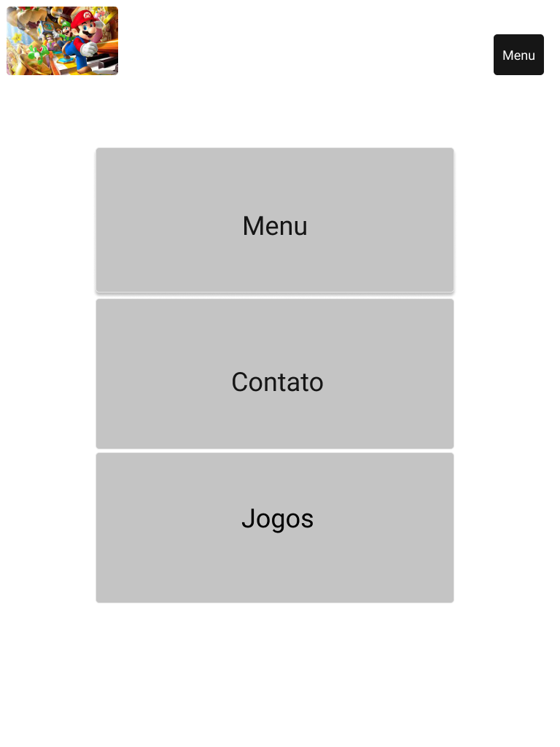
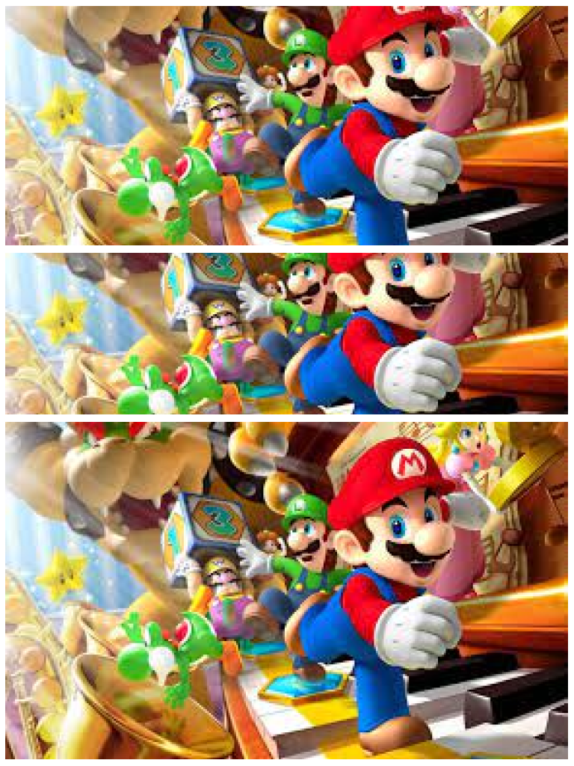
tablet vesion

Slide 5
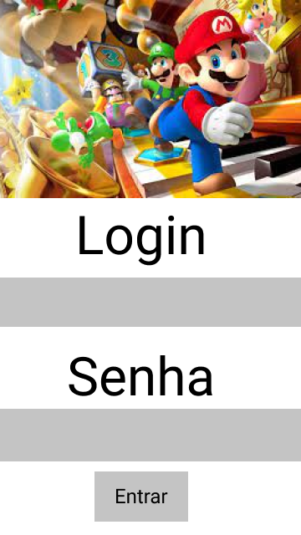
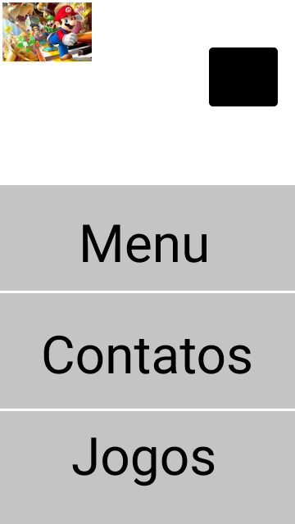
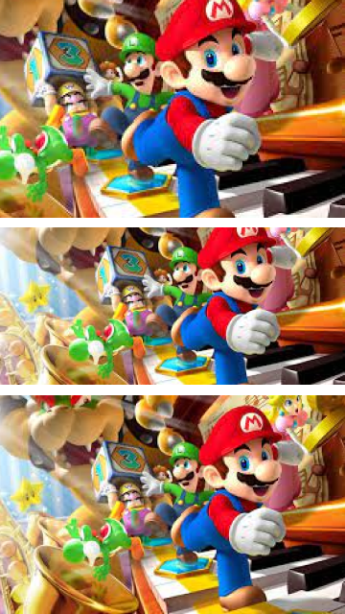
mobile version

Slide 6
Client BriefinG
Our method is to create a briefing document with our cliente, so that we know their needs.
Our team focuses on adapting customer request as a whole, to better satisfy them.
Our layout meets customer requirements, because it is a complete layout, adapted to 3 versions: desktop, tablet. Mobile. In addition to being responsive, a high level of performance, quality in the acquired content.

Slide 7
Ux principles
Our focus is to listen to the customer is needs, from the initial path to the final objective, studying the best trajectory, interaction, needs, deadlines, desired by the customer, imagining ourselves in the customer is place.

Slide 8
ui principles
We focus on customer interface, visual form, style.
We started a small draft, then the prototype, then the website.

Slide 9
interactive design
Our focus is to take care of the interaction, aesthetics of the site, such as:
Image
Link
Video
Button
Illustration

Slide 10
contact
elberteduardomartins@gmail.com
Marcos.rnunes@sp.senai.br
For more information, contact Senai from Indaiatuba-SP
Telephone +55 19 3825-3450

