Slide 1
FORMAL LANGUAGES AND COMPILERS Paola Quaglia

Slide 2
Goals & Expected Learning
Concepts, techniques, and algorithms for the implementation of compilers
Formal languages
Recognition of formal languages

Slide 3
compiler
Source Program
Executable
Code

Slide 4
A long way to go

Slide 5
A long way to go
E.g., the development of gcc has been going on for more than 20 years by now
Some years ago it already consisted of 2++ million lines of code

Slide 6
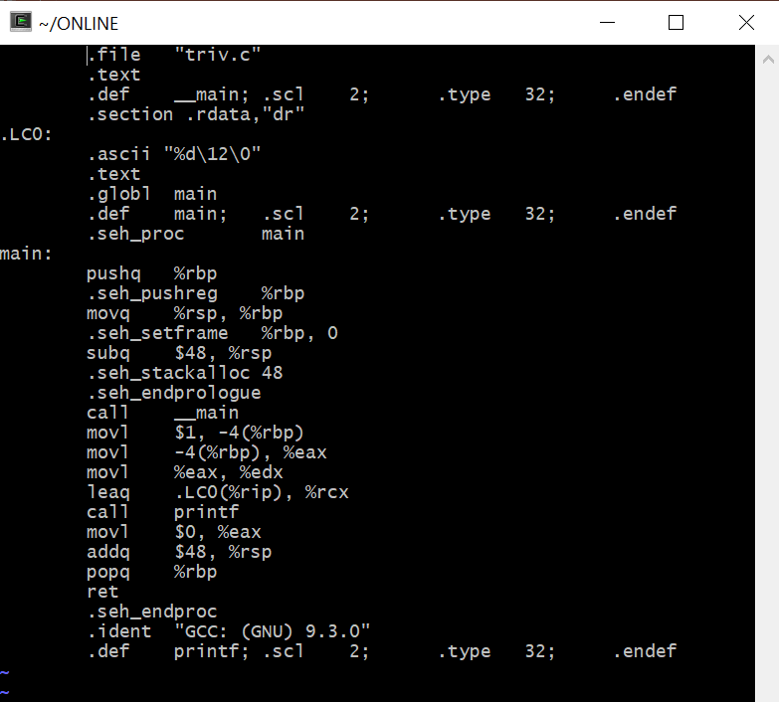
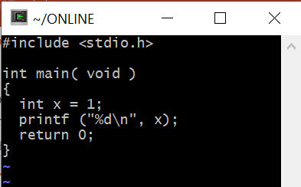
A long way to go
E.g., from source program to assembly code, we get:

Slide 7
A long way to go
E.g., from source program to assember

Slide 8
A long way to go
And assembly code it not yet executable
Still needed:
Conversion of textual instructions to binary instructions
Linking to include libraries

Slide 9
Various phases in pipe line
What we do have:
The program is written in a language which “adheres” to a specific grammar
Some programs are syntactically legal, some are not
The grammar lets us decide on this

Slide 10
Various phases in pipe line
pippo = 1;
pluto = 2;
while = 1
pluto = 2;
In most languages a keyword, cannot be used as an identifier
OK
NOK

Slide 11
The grammar
States the form of an assignment
IDENTIFIER ASSIGN EXPRESSION SEMICOLON
Cannot know “pippo”, “pluto”, nor the infinitely many strings we may use as variables

Slide 12
Lexical analysis
Translates a stream of characters into a stream of tokens
E.g. translates
pippo = 2*3;
Into
<ID,pippo> ASS <NUM,2> MUL <NUM,3> SEMCOL

Slide 13
Syntax analysis
Checks whether a stream of tokens “adheres” to the given grammar
If so, converts the stream of tokens into a parse tree (or better, into an abstract syntax tree)

Slide 14
Syntax analysis
<ID,pippo> ASS <NUM,2> MUL <NUM,3> SEMCOL
<ID,pippo>
ASS
SEMCOL
Parse tree
<NUM,2>
MUL
<NUM,3>

Slide 15
Syntax analysis
<ID,pippo> ASS <NUM,2> MUL <NUM,3> SEMCOL
ASS
MUL
<ID,pippo>
Abstract syntax tree
<NUM,2>
<NUM,3>

Slide 16
Semantic analysis
Are we actually multiplying two integers?
MUL
<NUM,2>
<NUM,3>

Slide 17
Intermediate code generation
Converts a parse tree into a textual intermediate code
ASS
MOVE 2,R1
MULT 3,R1
MOVE R1,ID1
MUL
ID
2
3

Slide 18
Target code generation
Translates intermediate code into target machine code (assembly code)

Slide 19
Plausible targets
Machine code not necessarily the target of compilation
May be a virtual machine
May be another language

Slide 20
Front-end & Back-end
Front-end
From lexical analysis all the way down to intermediate code generation
Back-end:
All the rest
Modularity:
N languages, N front-ends
K machines, K back-ends
N*K compilers, overall

Slide 21
That said

Slide 22
Goals & Expected Learning
Pervasive structures (finite state automata)
Methodologies at the basis of other areas, too (e.g., parsing of natural languages, soundness of queries to databases)

Slide 23
In a Nutshell
Regular languages and finite state automata (lexical analysis)
Context-free languages and parsing (syntax analysis)
Syntax driven definitions (semantic analysis & symbol tables)

Slide 24
In a Nutshell (ctd.)
Intermediate code generation
Machine code generation
Register allocation
Runtime environment

Slide 25
Main Textbook
Introduction to Compiler Design (Second Edition), Torben AEgidius Mogensen, Springer, 2017, 978-3319669656
Preliminary version available at
http://hjemmesider.diku.dk/~torbenm/Basics/index.html

Slide 26
Verification
Optional individual project +
Written test +
Oral test

Slide 27
Optional project
Individual
To hand in during before the January exam session
Max 2 points, to sum up to the score of the written test

Slide 28
Written Test
Closed books & No electronics
10 questions for open and succinct answers
You study you get
Questions on basic knowledge, application of known algorithms to instances of the problem
Max 30 points

Slide 29
Written Test (ctd)
Compulsory subscription on esse3
In case of subscription & no-show the student undergoes a skip-session
At most 3 submissions of the written test in 2023

Slide 30
Oral Test & Final Evaluation
Oral test: Max 32 points
Final score: written and oral contribute 50% each

