Slide 1
Generative Grammars

Slide 2
Generative Grammars Informally
Fix a vocabulary
A set of symbols
Some of these symbols, called terminals, play the tokens of the output stream of lexical analysis
E.g. take the vocabulary {S, a, b} where “a” and “b” are terminals

Slide 3
Generative Grammars
One non-terminal symbol of the vocabulary is chosen as start symbol
E.g., S in {S, a, b}

Slide 4
Generative Grammars
Fix a set of productions
Rules for rewriting strings into strings
Constraint:
the string to be replaced must contain at least a non-terminal
E.g. {S → aSb, S → ab}

Slide 5
Generative Grammars
These are the ingredients of a generative grammar
A language of words of terminals can be generated from the start symbol:
Apply the rewriting rules in any possible way, as many times as possible
Each rewriting is called a derivation step

Slide 6
{S → aSb, S → ab}
Notation for the derivation relation
S ⇒ a b
Is a one-step derivation from S
“ab” is made up of terminals only
Hence “ab” belongs to the language generated by the given grammar

Slide 7
{S → aSb, S → ab}
S ⇒ aSb ⇒ aabb
Is a two-step derivation from S
“aabb” is made up of terminals only
Hence “aabb” belongs to the language generated by the given grammar

Slide 8
{S → aSb, S → ab}
S ⇒ aSb ⇒ aaSbb
Is a two-step derivation of a string from S
But “aaSbb” contains a non-terminal
Hence “aaSbb” does not belong to the language generated by the given grammar

Slide 9
{S → aSb, S → ab}
Which is the language generated by this grammar?
{a^{n}b^{n} | n>0}

Slide 10
Notation
Capital letters for non-terminals

Slide 11
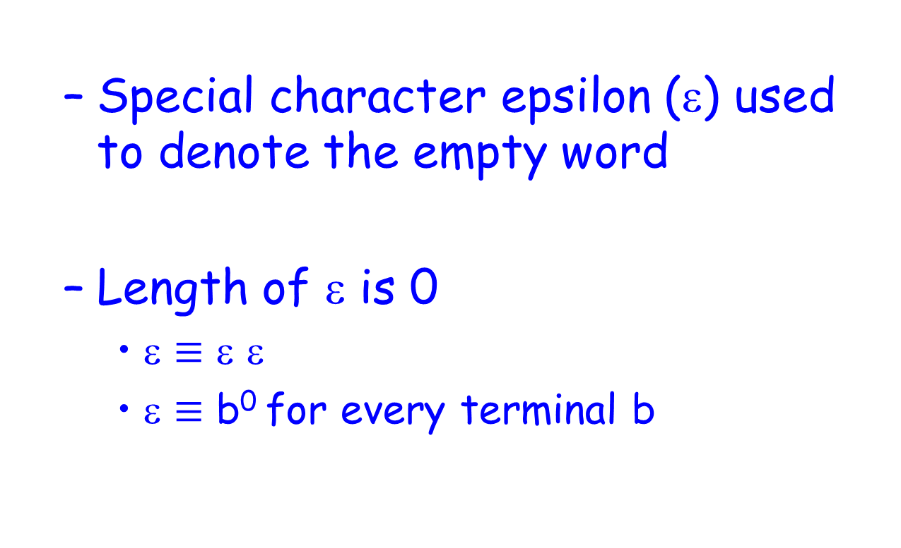
Convention
Special character epsilon (ε) used to denote the empty word
Length of ε is 0
ε $≡$ ε ε
ε $≡$ b⁰ for every terminal b

Slide 12
Example 1
S → aAb
aA → aaAb
A → ε
Generated language: {a^{n}b^{n} | n>0}
OBSERVE: Different grammars can generate the same language

Slide 13
Example 2
S → AB
A → aA
A → a
B → Bb
B → b
Generated language: {a^{n}b^{m} | n,m>0}

Slide 14
Example 3
S → aSBc
S → abc
cB → Bc
bB → bb
Generated language: {a^{n}b^{n}c^{n} | n>0}

Slide 15

Example 4
S → AB
A → a
Generated language: $∅$

Slide 16

Example 5
S → $ε$
Generated language: $\left\{ε\right\}$
$\left\{ε\right\}≠ ∅$

Slide 17

Example 6
S → aSb
S → ε
Generated language:
{a^{n}b^{n} | n>0}$∪\{ε\}$ = {a^{n}b^{n} | n$≥$0}

Slide 18
Example 7
Notation for more productions with same left-hand side
S → CD
C → aCA | bCB
AD → aD
BD → bD
Aa → aA
Ab → bA
Ba → aB
Bb → bB
C → ε
D → ε
Generated language?

Slide 19
Example 7: Derivation 1
S → CD
C → aCA | bCB
AD → aD
BD → bD
Aa → aA
Ab → bA
Ba → aB
Bb → bB
C → ε
D → ε
S ⇒ CD
CD ⇒ D
D ⇒ ε

Slide 20
Example 7: Derivation 2
S → CD
C → aCA | bCB
AD → aD
BD → bD
Aa → aA
Ab → bA
Ba → aB
Bb → bB
C → ε
D → ε
S ⇒ CD
CD ⇒ aCAD
aCAD ⇒ aCaD
aCaD ⇒ aaD
aaD ⇒ aa

Slide 21
Example 7: Derivation 3
S → CD
C → aCA | bCB
AD → aD
BD → bD
Aa → aA
Ab → bA
Ba → aB
Bb → bB
C → ε
D → ε
S ⇒ CD
CD ⇒ aCAD
aCAD ⇒ abCBAD
abCBAD ⇒ abCBA
abCBA ⇒ abBA

Slide 22
Example 7: Derivation 4
S → CD
C → aCA | bCB
AD → aD
BD → bD
Aa → aA
Ab → bA
Ba → aB
Bb → bB
C → ε
D → ε
S ⇒ CD
CD ⇒ aCAD
aCAD ⇒ abCBAD
abCBAD ⇒ abCBaD
abCBaD ⇒ abCaBD
abCaBD ⇒ abCabD
abCabD ⇒ ababD
ababD ⇒ abab

Slide 23
Generative Grammars Formally
A grammar is a tuple
(V,T,S,P)
V vocabulary of terminals and non-terminals
T set of terminals
S start symbol in (V\T)
P set of productions

Slide 24
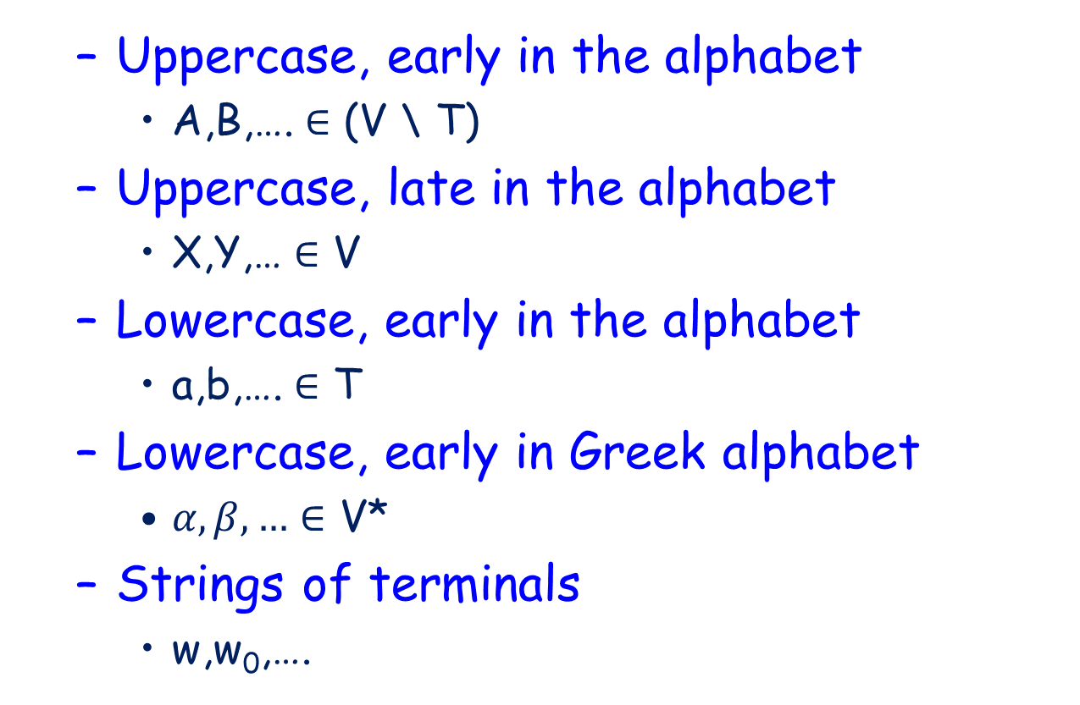
Notation
Zero or more repetitions of elements in the base set
Uppercase, early in the alphabet
A,B,…. $∈$ (V \ T)
Uppercase, late in the alphabet
X,Y,… $∈$ V
Lowercase, early in the alphabet
a,b,…. $∈$ T
Lowercase, early in Greek alphabet
$α,β,…∈$ V*
Strings of terminals
w,w₀,….

Slide 25
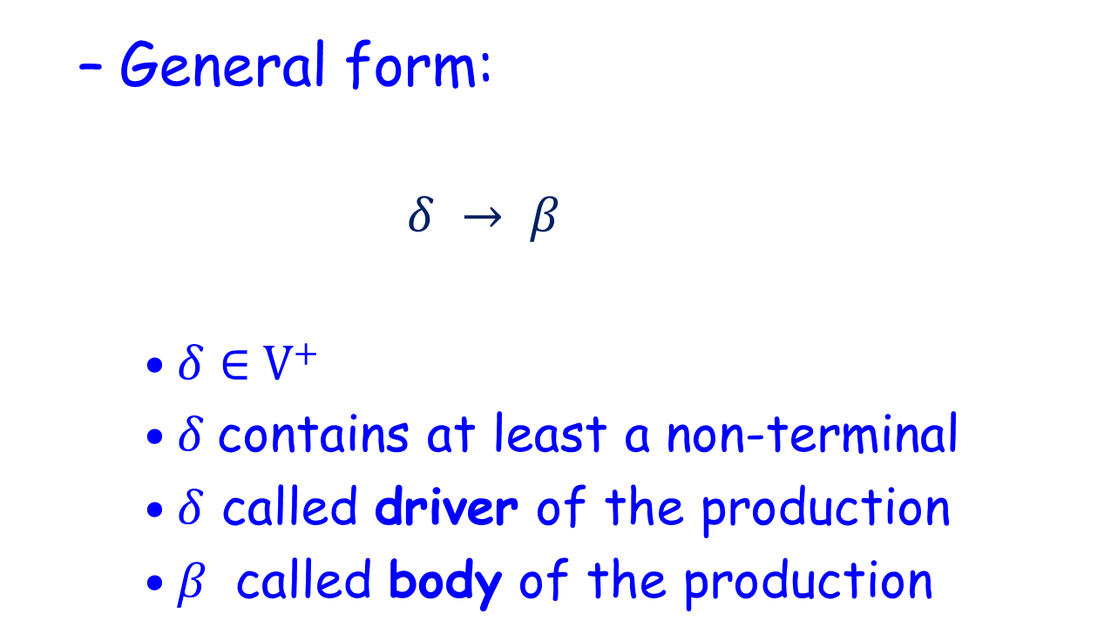
Productions
General form:
$$δ → β$$
$δ∈$ V⁺
$δ$contains at least a non-terminal
$δ$ called driver of the production
$β$ called body of the production
One or more repetitions of elements in the base

Slide 26
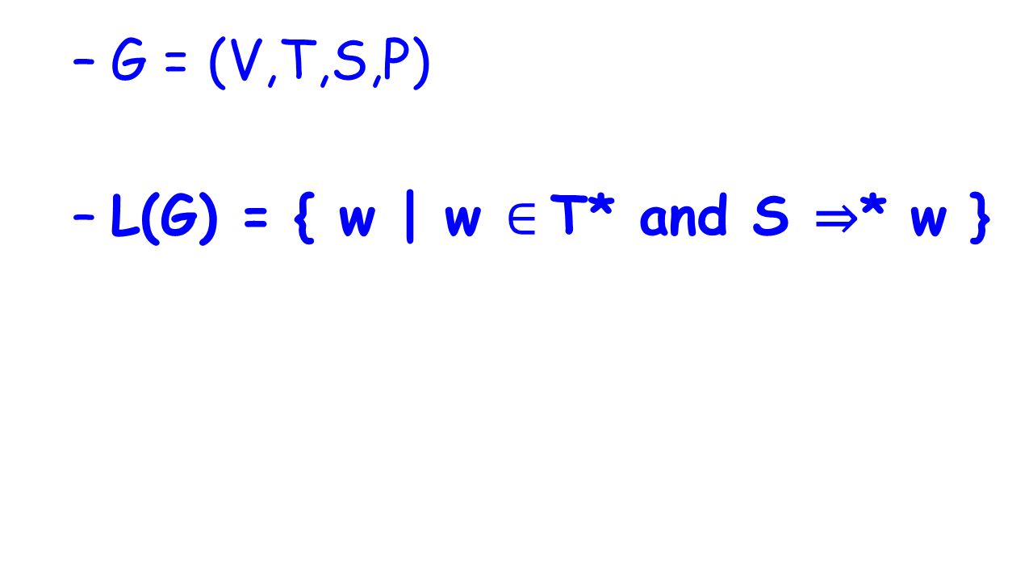

Generated Languages
G = (V,T,S,P)
L(G) = { w | w $∈$T* and S ⇒* w }
T* because w may just be $ε$

Slide 27
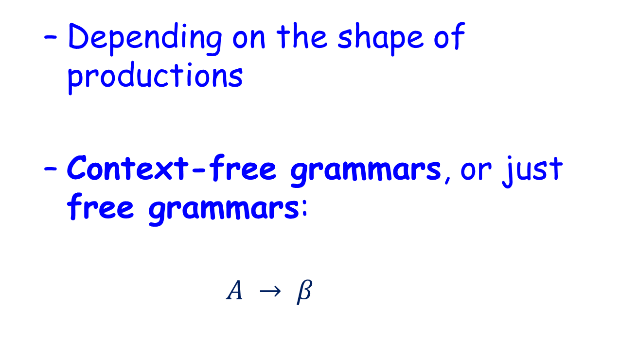
Hierarchy of Grammars
Depending on the shape of productions
Context-free grammars, or just free grammars:
$$A → β$$

Slide 28
Context-free Languages
L is a context-free language
Iff
There exists a context-free grammar G such that L=L(G)

Slide 29
Context-free Languages
Our focus

Slide 30
Canonical Derivations
Rightmost (Leftmost) derivation step:
Replace the rightmost (leftmost) non-terminal
Canonical derivations of words in the language:
Either every step is rightmost
Or every step is leftmost

Slide 31
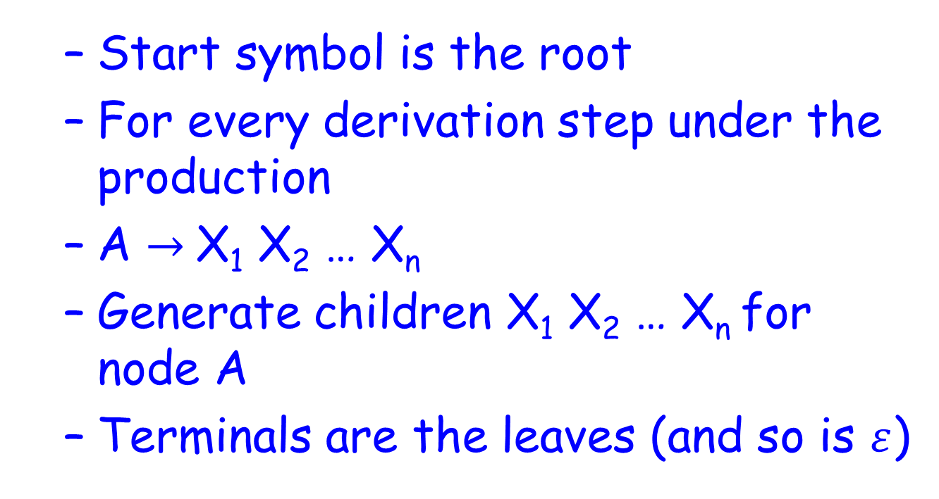
Derivation Trees
Start symbol is the root
For every derivation step under the production
A $→$X₁ X₂ … X_{n}
Generate children X₁ X₂ … X_{n} for node A
Terminals are the leaves (and so is $ε$)

Slide 32
Derivation Trees
The derived word is at the frontier of the tree

Slide 33

Example
S → aSb | ε
S
a
S
b
a
S
b
$$ε$$

Slide 34
Ambiguity in Natural Languages
L’uomo guarda la donna con il binocolo

Slide 35
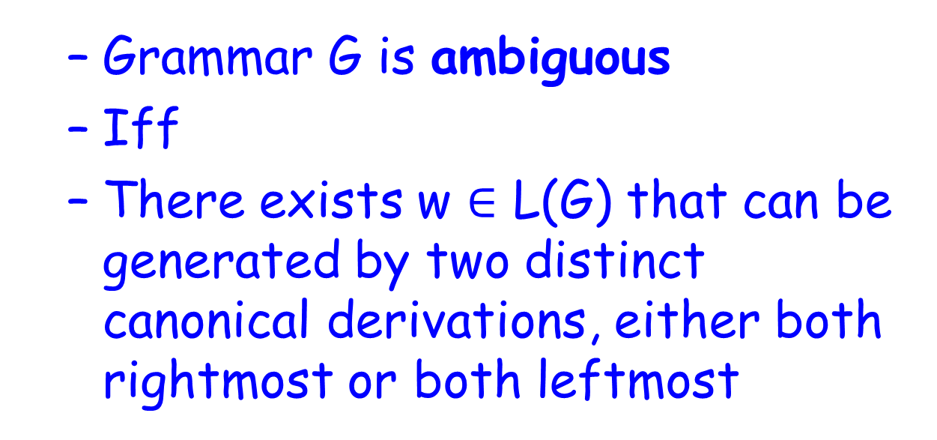
Ambiguity
Grammar G is ambiguous
Iff
There exists w $∈$ L(G) that can be generated by two distinct canonical derivations, either both rightmost or both leftmost

Slide 36
Arithmetic Expressions
E → E+E | E*E | n
Ambiguous?

Slide 37
Arithmetic Expressions
E → E+E | E*E | n
Take w = n+n*n

Slide 38
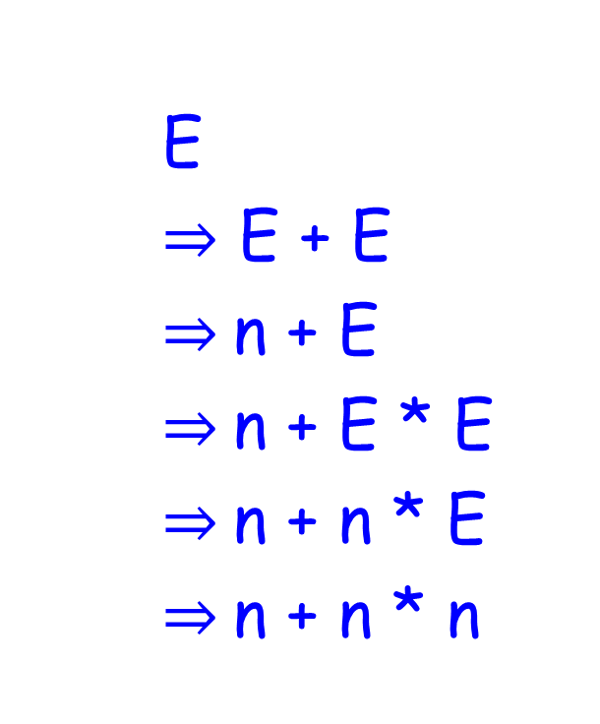
Arithmetic Expressions
E
$⇒$ E + E
$⇒$n + E
$⇒$n + E * E
$⇒$n + n * E
$⇒$n + n * n
E
E
E
+
n
E
E
*
n
n

Slide 39
Arithmetic Expressions
But also
E
E
E
*
E
E
n
+
n
n

Slide 40
Arithmetic Expressions
E
E
E
E
E
E
*
+
E
n
E
E
n
*
E
+
n
n
n
n

Slide 41
Arithmetic Expressions
E → E+E | E*E | n
Ambiguous!

Slide 42
Dangling Else
S → if b then S | if b then S else S | other
Ambiguous?

Slide 43
Dangling Else
S → if b then S | if b then S else S | other
Take
w = if b then if b then other else other
Which “then” matches “else”?

Slide 44
Dangling Else
S
S
if b then if b then other else other

Slide 45
Dangling Else
S
S
if b then if b then other else other

Slide 46
Dangling Else
S → if b then S | if b then S else S | other
Ambiguous!

Slide 47
Observation
Ambiguity is undecidable
No algorithm can be designed to decide whether a grammar is ambiguous or not

