Slide 1
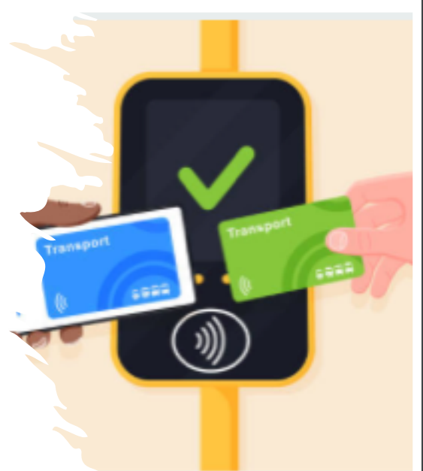

RFID, NFC and Public Transportation
Martí Caixal i Joaniquet – 1563587 Bruno Moya Ruiz - 1568176
Hernán Capilla Urbano - 1462773 Marc Garrofé Urrutia – 1565644
Ricard López Olivares - 1571136
SisTemes multimedia
ESCOLA D’ENGINYERIA. UNIVERSITAT AUTÒNOMA DE BARCELONA
Professors: JORDI SERRA, Fernando Vilariño i Ronny Romero

Slide 2



RFID, NFC and Public Transportation
“Hackathons of Cloud Services: Co-creating and deploying”
Sistemes Multimèdia 2021– 2022
Martí Caixal i Joaniquet – 1563587 Bruno Moya Ruiz - 1568176
Hernán Capilla Urbano - 1462773 Marc Garrofé Urrutia – 1565644
Ricard López Olivares - 1571136
Description
Contactless technologies as RFID, NFC and other are now part of our current life, and they can help developing a much better and human-centric approach to public transportation
Instead of the traditional way of paying, a new eco friendly way by using a smart phone and cloud services. We could get real time information of the bus occupation. Each client would be identified and be charged at the end of the month. By using their card when they leave the bus as well, we can charge them accordingly to the distance they travelled. Using a GPS in the device, we can also get real time location of the bus. Additionally, a whole lot of new statistics could be gotten using this system.
Additionally, by using a smarthphone app, the user is now able to check how to get from point A to point B by public transport and their profile statistics such as trips and CO2 emissions saved
We decided to embark into this project because it seemed very interesting and we are all very eco friendly and love plants. Actually, we are trying to go carnivore to save even more plants and additionaly eat animals that feed on plants. Nontheless, we also wanted to learn how to use API’s and link it with app developing frameworks like flutter.
The main aim of this project, along with the biggest contribution, is to abolish the use of disposable paper cards.
1

Slide 3
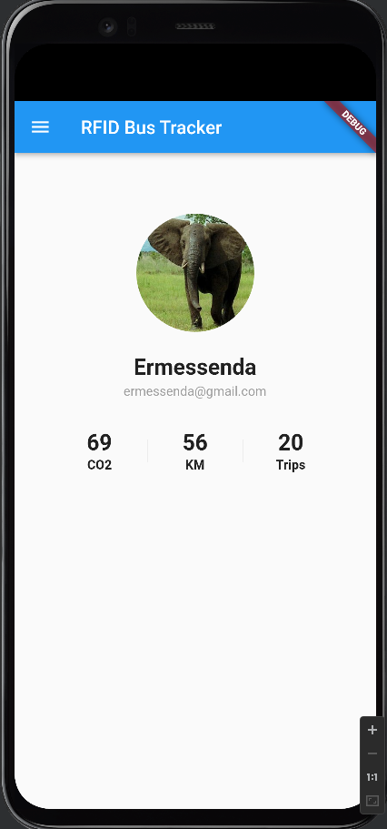
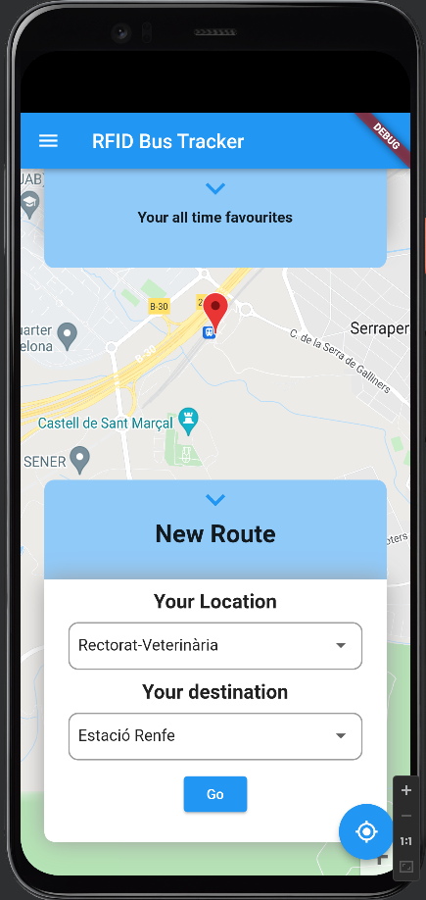
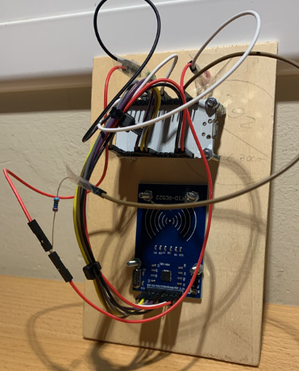
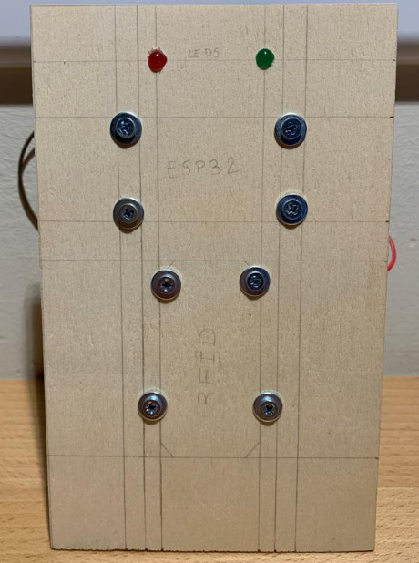







RFID, NFC and Public Transportation
“Hackathons of Cloud Services: Co-creating and deploying”
Sistemes Multimèdia 2021– 2022
Martí Caixal i Joaniquet – 1563587 Bruno Moya Ruiz - 1568176
Hernán Capilla Urbano - 1462773 Marc Garrofé Urrutia – 1565644
Ricard López Olivares - 1571136
Our challenge
State of the art
Currently a lot of cities are imposing this kind of billing system for public transport. Even Barcelona is now forcing its citizens to use “T-Mobilitat”.
RFID Reader on the bus
Smartphone App
2

Slide 4
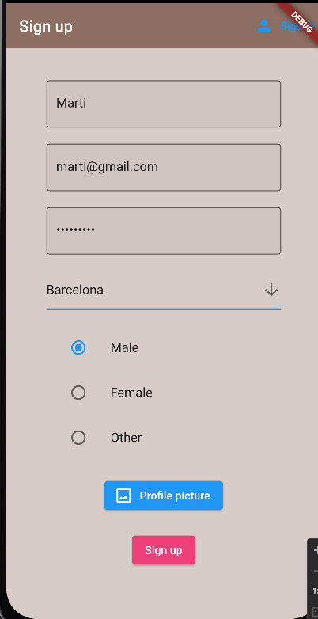
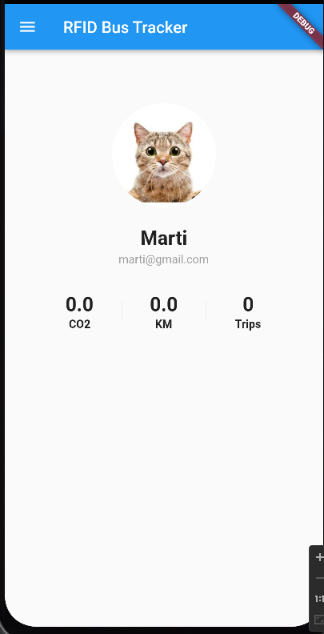
RFID, NFC and Public Transportation
“Hackathons of Cloud Services: Co-creating and deploying”
Sistemes Multimèdia 2021– 2022
Martí Caixal i Joaniquet – 1563587 Bruno Moya Ruiz - 1568176
Hernán Capilla Urbano - 1462773 Marc Garrofé Urrutia – 1565644
Ricard López Olivares - 1571136
RFID, NFC and Public Transportation
“Hackathons of Cloud Services: Co-creating and deploying”
Sistemes Multimèdia 2021– 2022
Martí Caixal i Joaniquet – 1563587 Bruno Moya Ruiz - 1568176
Hernán Capilla Urbano - 1462773 Marc Garrofé Urrutia – 1565644
Ricard López Olivares - 1571136
Methodology
User Sign Up
API’s used:
Firestore: store user data
Auth: manages encryption and login service
Storage: profile picture
Gets presented with their profile.
They can see the statistics, now being 0.
3

Slide 5
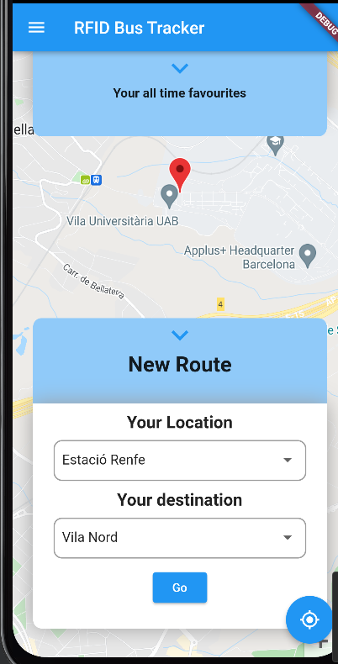
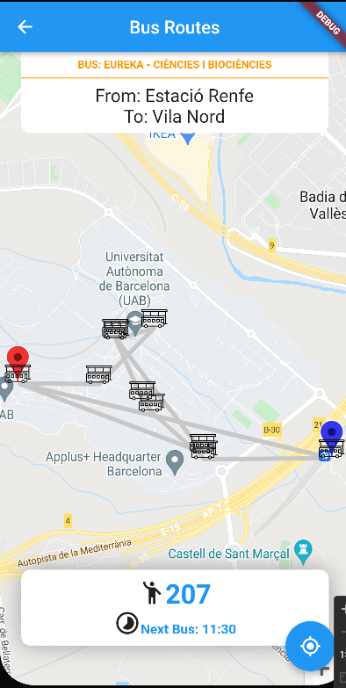
RFID, NFC and Public Transportation
“Hackathons of Cloud Services: Co-creating and deploying”
Sistemes Multimèdia 2021– 2022
Martí Caixal i Joaniquet – 1563587 Bruno Moya Ruiz - 1568176
Hernán Capilla Urbano - 1462773 Marc Garrofé Urrutia – 1565644
Ricard López Olivares - 1571136
RFID, NFC and Public Transportation
“Hackathons of Cloud Services: Co-creating and deploying”
Sistemes Multimèdia 2021– 2022
Martí Caixal i Joaniquet – 1563587 Bruno Moya Ruiz - 1568176
Hernán Capilla Urbano - 1462773 Marc Garrofé Urrutia – 1565644
Ricard López Olivares - 1571136
Methodology
Get bus indications
API’s:
Maps
Places
Directions
Realtime Fireabse
Services:
Python script updating bus locations on realtime to Realtime Firebase
User can choose point of origin and destination and sees the directions they should take, along with the ETA for the bus and how many people are on it.
69
3

Slide 6
RFID, NFC and Public Transportation
“Hackathons of Cloud Services: Co-creating and deploying”
Sistemes Multimèdia 2021– 2022
Martí Caixal i Joaniquet – 1563587 Bruno Moya Ruiz - 1568176
Hernán Capilla Urbano - 1462773 Marc Garrofé Urrutia – 1565644
Ricard López Olivares - 1571136
RFID, NFC and Public Transportation
“Hackathons of Cloud Services: Co-creating and deploying”
Sistemes Multimèdia 2021– 2022
Martí Caixal i Joaniquet – 1563587 Bruno Moya Ruiz - 1568176
Hernán Capilla Urbano - 1462773 Marc Garrofé Urrutia – 1565644
Ricard López Olivares - 1571136
Methodology
Client gets on the bus
Updates user statistics.
Updates bus current capacity.
API’s:
Realtime Firebase
Firestore
Services:
Python script calculating new values such as distance travelled.
Hardware:
ESP32 with RFID reader
A
origin
B
Destination
3

Slide 7
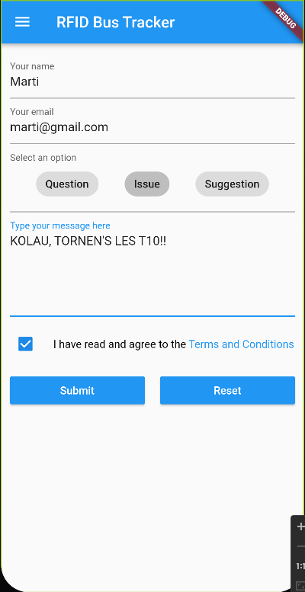
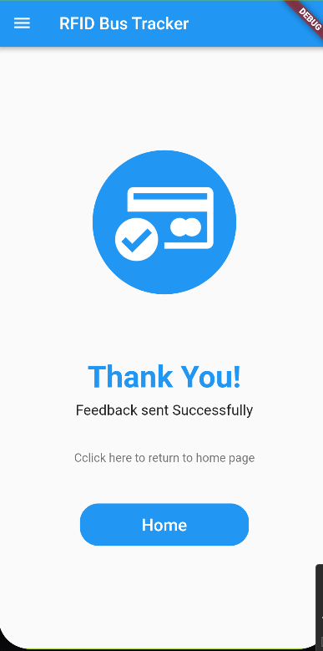
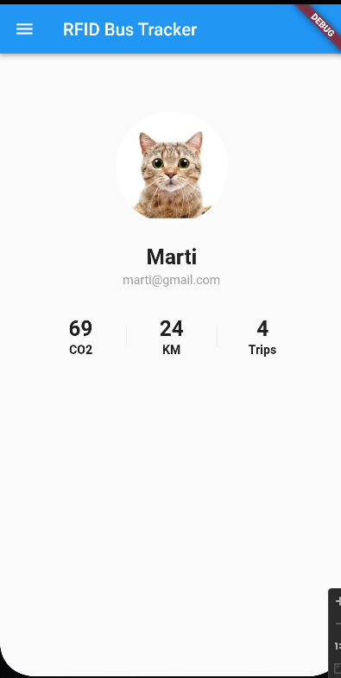
RFID, NFC and Public Transportation
“Hackathons of Cloud Services: Co-creating and deploying”
Sistemes Multimèdia 2021– 2022
Martí Caixal i Joaniquet – 1563587 Bruno Moya Ruiz - 1568176
Hernán Capilla Urbano - 1462773 Marc Garrofé Urrutia – 1565644
Ricard López Olivares - 1571136
RFID, NFC and Public Transportation
“Hackathons of Cloud Services: Co-creating and deploying”
Sistemes Multimèdia 2021– 2022
Martí Caixal i Joaniquet – 1563587 Bruno Moya Ruiz - 1568176
Hernán Capilla Urbano - 1462773 Marc Garrofé Urrutia – 1565644
Ricard López Olivares - 1571136
Methodology
Updated statistics are shown to the user
Additionally, the user is also able to send feedback
3

