Slide 1
On the Possibility of NLOS Reconstruction Using Spatial Decomposition [05/04/2021]
Eric Brandt
© Eric Brandt, 2021
UW-Madison

Slide 2
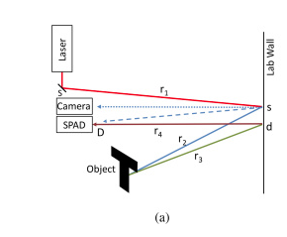
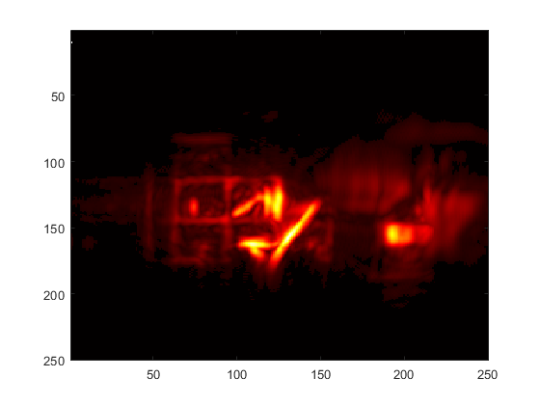
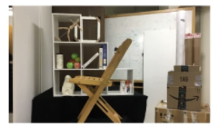
Recap
Familiar Concept: NLOS Image Reconstruction
Pulsed Laser - very short pulses (~250 fs)
SPAD counts + timestamps returned photons
Pulse laser at many locations on wall
Wall has 3D impulse response: (X, Y, T)
Create ‘Virtual Phasor Pulse’
Convolve with impulse response
Backproject to reconstruct
(b)
(c)
Fig (a). Non-line-of-sight imaging using a time-gated single photon avalanche diode, Buttafava et al, 2015
Figs (b), (c). Phasor field diffraction based reconstruction for fast non-line-of-sight imaging systems, Liu et al, 2020

Slide 3
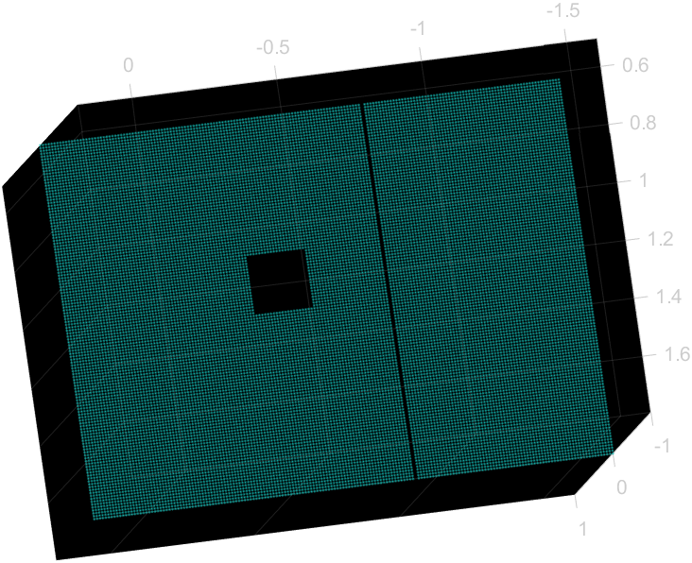
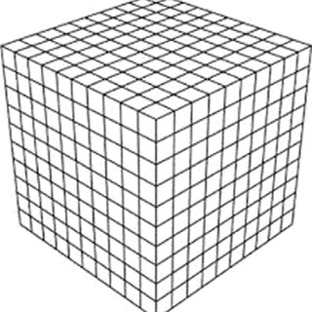
Problem
Curse of Dimensionality
Relay Wall: (L x M) laser locations
Scene Voxels: (X x Y x Z) locations to reconstruct
Each voxel is the sum of contributions of L x M intensities
Results in O(N⁵) complexity for scene reconstruction
Problem:
Increasing Volume…
Increasing Resolution…
Doubling scene volume = 8x voxels
Relay Wall (~150x150)
Scene Volume: 250x250x230
Notes:
150x150=22,500
250x250x230 = 14,375,000
Tota Summations = ~323 Billion

Slide 4
Observation & Idea
Observation
Most of the voxels are empty
Along each line of sight from the wall, only 1 voxel along that line should have non-zero signal* *(ignoring noise, higher order bounces, projection artifacts…)
Idea
Find the large empty areas quickly
Don’t bother reconstructing them at fine resolution
Multi-Resolution Spatial Decomposition
Toolset
Variable Resolution Reconstruction
3D Spatial Decomposition Representation

Slide 5
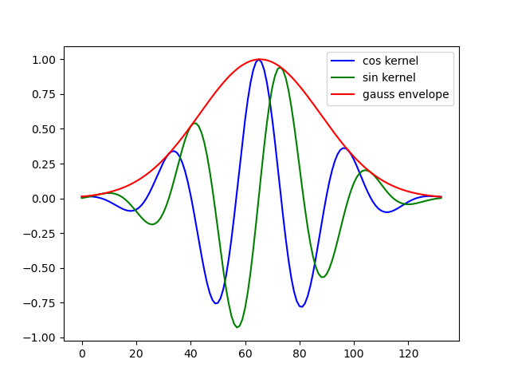
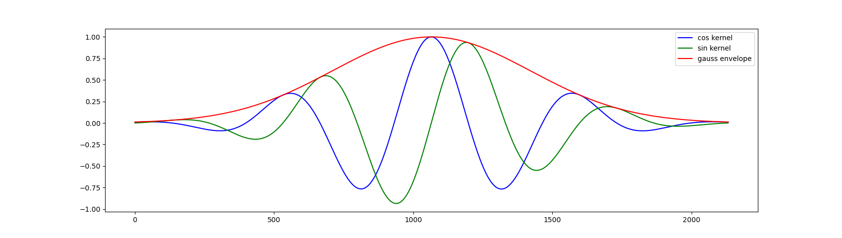
Toolset
Reconstruct at Different Resolution
Phasor field wavelength determines reconstruction resolution
Short Wavelength: High Resolution
Long Wavelength: Low Resolution
Convolve the Impulse Response with each different wavelength kernel
Downsample the laser positions on the relay wall

Slide 6
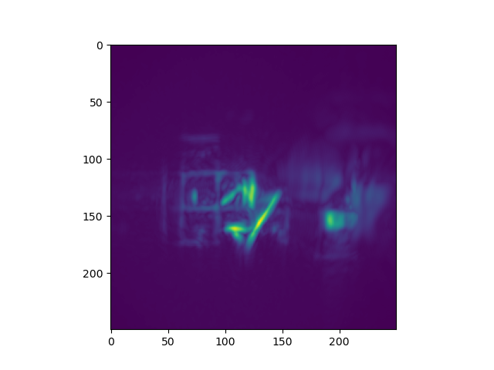
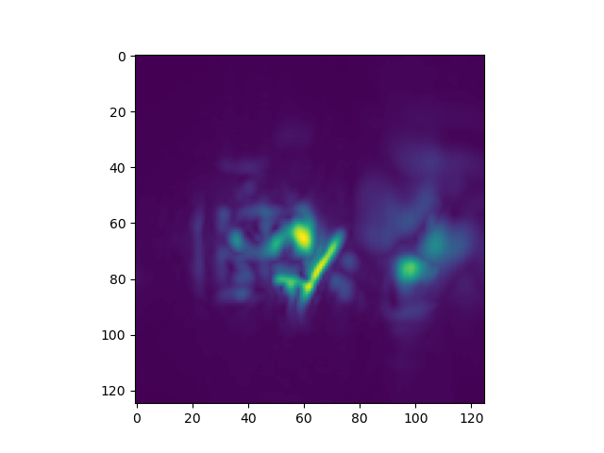
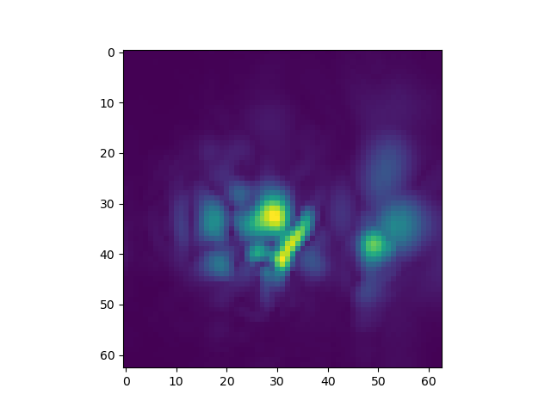
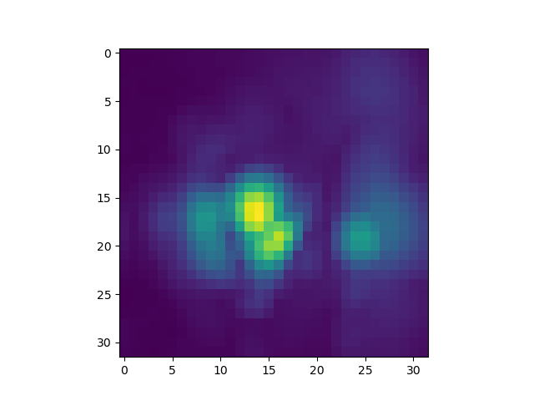
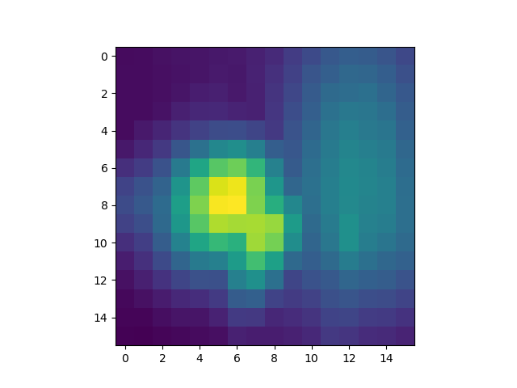
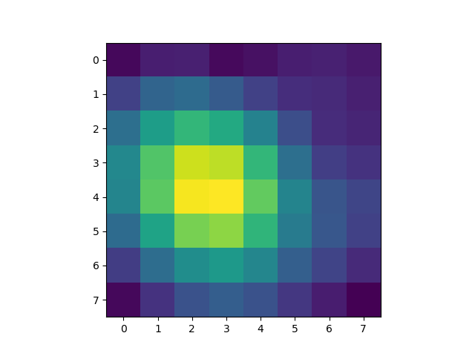
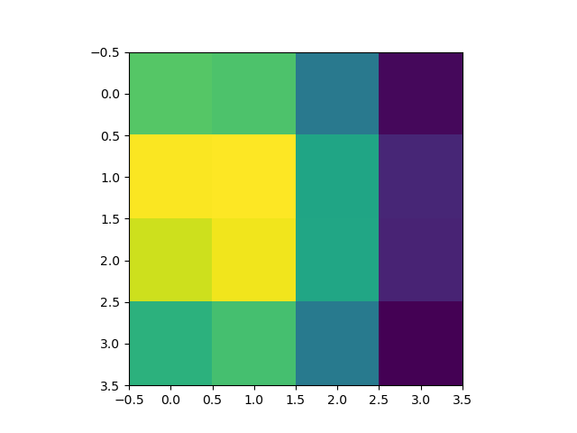
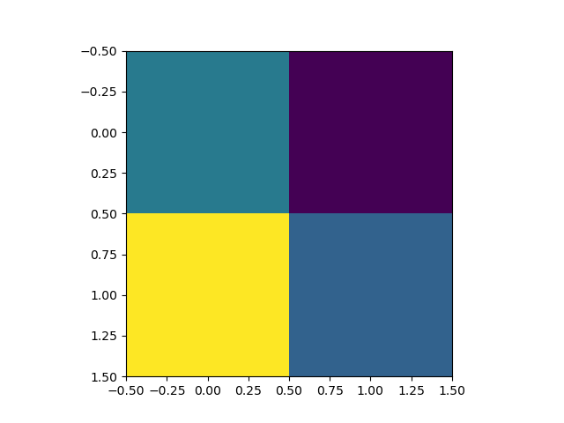
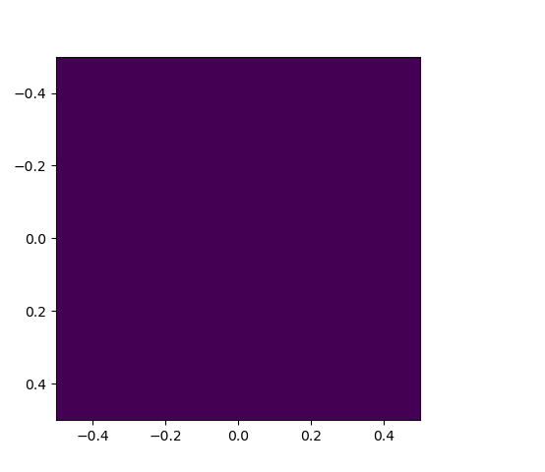
Toolset
Reconstruct at Different Resolution
Use Dataset from Liu et al, 2019 paper
Implement Backprojection Algorithm in Python with variable Virtual Wavelength
Reference Reconstruction
1cm resolution (Liu et al, 2019)
1 cm
2 cm
4 cm
8 cm
16 cm
32 cm
64 cm
128 cm
256 cm
Ref: Non-line-of-sight imaging using phasor-field virtual wave optics, Liu et al 2019

Slide 7
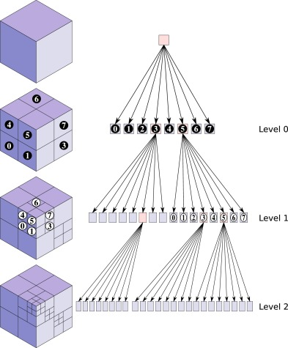
Toolset
Spatial Decomposition
“Octree” Data Structure
Tree with Root Node = Entire Volume
Each Node has 8 children (2 x 2 x 2 cube)
Only Populate (explore) Child Nodes if there is sufficient signal
Space (memory) efficient
Computationally efficient
Image credit: An octree-based adaptive semi-Lagrangian VOF approach for simulating the displacement of free surfaces, Laurmaa et al, 2016

Slide 8
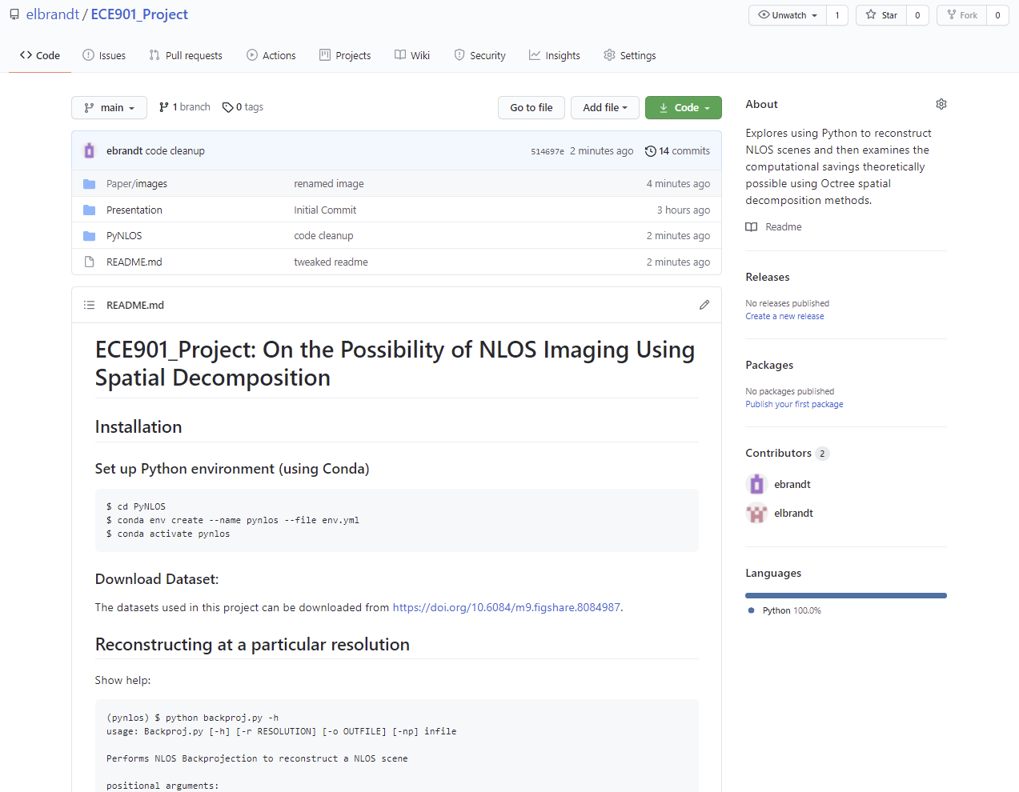
Investigation
NLOS Reconstruction By Spatial Decomposition
[ Live Demo ]
Full Code Available At:
https://github.com/elbrandt/ECE901_Project

Slide 9

Summary & Work Ahead
Current primal domain NLOS reconstruction methods are limited by size of reconstruction volume
Reconstructing at different resolutions is possible by using different virtual phasor field wavelengths
Spatial decomposition data structures are efficient in both memory and computational cost
Spatial Decomposition is a promising research area for reconstructing larger volumes using NLOS
Determining threshold signal levels for increasing depth remains a research opportunity.

