Slide 1
Website Revamp
You are the UX designer.
College and Career Exploration · Week 3 · Day 2
Bring your Find Your Future workbook (open to p. 28), a pencil, and your Chromebook (closed until we need it).
Notes:
Have this up as students walk in. Sticky notes on every table (about 4 per student today). Run time 50 minutes: warm-up 5, learn about UX 12, investigate 5, strengths and problems 9, fixes 9, sketch 4, exit ticket 6.
[Sources]
Find Your Future (Irving ISD / Hats & Ladders, ©2026), printed pp. 28-29; district-licensed workbook page images from the CCE Canvas course, not for public distribution.

Slide 2
As you enter
Pick the BEST website you have ever used and the WORST one.
What made the good one good? What made the bad one bad?
Say it like this
The best site I use is ________ because I can ________ fast.
The worst is ________ because I could not find ________.
Write one of each in your notebook. Two people share.
Notes:
0-5 min. Take two voices. Listen for verbs: 'I could not find', 'it took forever', 'the button did nothing'. Those verbs are the whole lesson; you will point back to them in Step 1.
[Sources]
Find Your Future (Irving ISD / Hats & Ladders, ©2026), printed pp. 28-29; district-licensed workbook page images from the CCE Canvas course, not for public distribution.

Slide 3
Today you will
1
Learn what good and bad UX look like (p. 28).
2
Investigate a real practice website and catch your first reactions on sticky notes.
3
List 3 things that work and 5 problems, then fix 3 of them (p. 29).
4
Sketch a better version of one page, then finish the Rosa exit ticket.
Word of the day: UX (user experience). How a website makes you feel while you use it.
Notes:
30 seconds. Read the four lines and move on.
[Sources]
Find Your Future (Irving ISD / Hats & Ladders, ©2026), printed pp. 28-29; district-licensed workbook page images from the CCE Canvas course, not for public distribution.

Slide 4
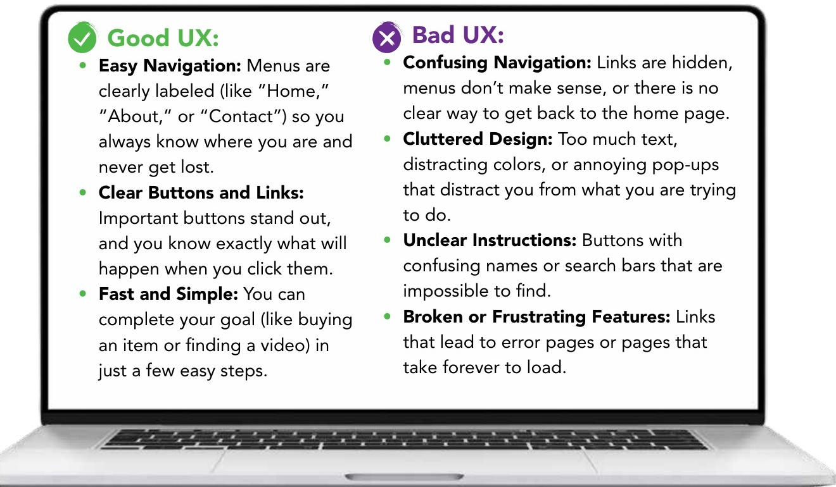
Good UX, bad UX
Find Your Future p. 28 · Step 1
Good UX
Menus are labeled.
Buttons stand out and do what they say.
You finish in a few steps.
Bad UX
Links are hidden.
Too much stuff on the page.
Buttons with confusing names.
Broken or slow pages.
Read along on p. 28
Notes:
5-17 min. Read the laptop box aloud from p. 28, then the two short lists on the right. Connect one warm-up answer to each list: 'Marcus said he could not find the menu; that is Confusing Navigation.' Chunking rule for the rest of the period: one step opens at a time, and you say what the step is for before it opens.
[Sources]
Find Your Future (Irving ISD / Hats & Ladders, ©2026), printed pp. 28-29; district-licensed workbook page images from the CCE Canvas course, not for public distribution.

Slide 5
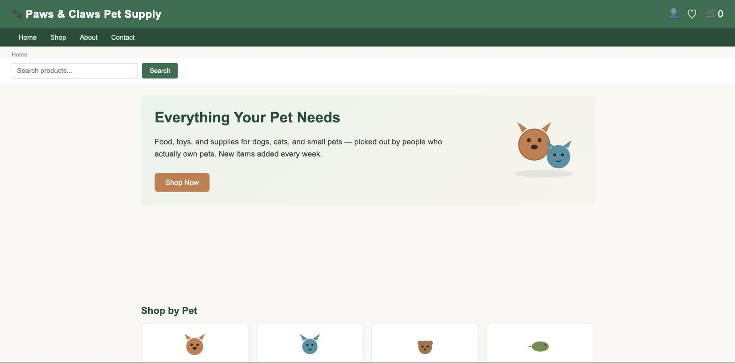
Investigate the website
Find Your Future p. 28 · Step 2 · pawsandclaws.hatsandladders.com
Stop and Jot
90 seconds. Click around. Do not list anything yet.
One thought per sticky note.
The first thing I tried to do was ________.
I got stuck when ________.
Paws & Claws Pet Supply. Type the address exactly. You are a customer trying to buy something.
5 minutes · Voice 0 · Chromebooks open now
Notes:
17-22 min. Open the site on the projector, then release Chromebooks. Give 90 seconds before any list-making; one thought per sticky. Read stickies over shoulders. If most name colors and fonts instead of navigation, pull the room back for 30 seconds and re-read the Easy Navigation and Clear Buttons rows from Step 1 before the lists open. The site is the practice store named on the Climber Notes deck; if it is blocked, the Day 2 student page has a full-page capture under 'Practice site unavailable or absent?'.
[Sources]
Find Your Future (Irving ISD / Hats & Ladders, ©2026), printed pp. 28-29; district-licensed workbook page images from the CCE Canvas course, not for public distribution. Paws & Claws Pet Supply (Hats & Ladders practice site) (https://pawsandclaws.hatsandladders.com), screenshot captured 2026-09-15; UI orientation only. Climber Notes: "Website Revamp" (Hats & Ladders teacher deck, district-licensed), not for public distribution.

Slide 6
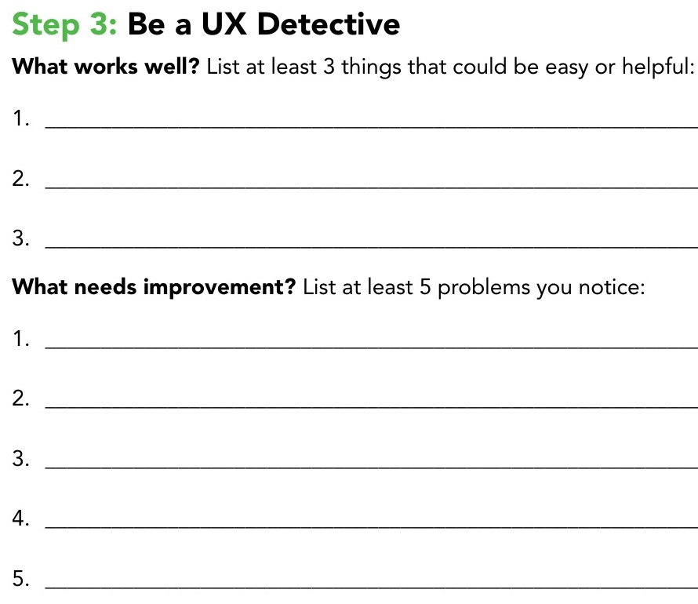
Be a UX detective
Find Your Future p. 29 · Step 3 · Write in your workbook
3 things that work
Something a customer can do easily. Name where it is on the page.
5 problems you can see
A problem is something you can point at: a button that looks different from the others, a menu that goes nowhere, a page that is mostly empty.
"It's ugly" is an opinion, not a problem.
9 minutes · strengths first, then problems · Voice 0
Notes:
22-31 min. Release strengths first; check by asking two students to read one strength. Then release problems. Lap at minute 12 of the block: every student has five problems, not two. If the room stalls at five, project the site and ask 'what happens when you click Shop?' without answering it.
[Sources]
Find Your Future (Irving ISD / Hats & Ladders, ©2026), printed pp. 28-29; district-licensed workbook page images from the CCE Canvas course, not for public distribution.

Slide 7
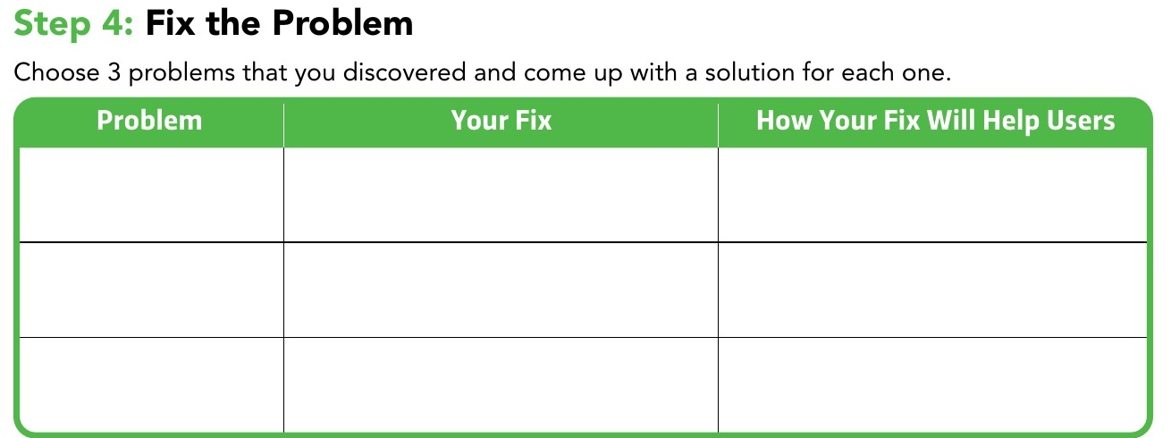
Fix the problem
Find Your Future p. 29 · Step 4 · Choose 3 of your 5 problems
Each row needs
the problem you saw
→ your fix
→ what a user can now do
Say it like this
This helps users because they can now ________.
9 minutes · Ask your partner at Voice 1 if you are stuck on a fix
Notes:
31-40 min. Model one row on the projector using a problem from a student's list (not your own). The third column is the one that matters; lap at minute 20 of the block and read that column only. A fix without a user benefit is not done. Optional scaffold Doc on the Day 2 page for students who need a worked model.
[Sources]
Find Your Future (Irving ISD / Hats & Ladders, ©2026), printed pp. 28-29; district-licensed workbook page images from the CCE Canvas course, not for public distribution.

Slide 8
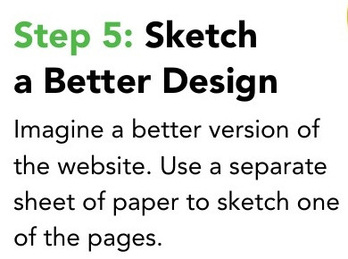
Sketch a better page
Find Your Future p. 29 · Step 5 · Plain paper
Pick ONE page and redraw it
Boxes and labels, not art. Show where the menu, the search, and the main button go.
Circle the fix you are proudest of and write its number from Step 4 next to it.
4 minutes · Keep the sketch. It goes in your folder with p. 29.
Finished early? Answer one Class Discussion question from p. 29 in your notebook: which improvement would make the biggest difference, and why?
Notes:
40-44 min. Four minutes is enough for boxes and labels. If time is short, the sketch is the thing to trim, never the three fixes.
[Sources]
Find Your Future (Irving ISD / Hats & Ladders, ©2026), printed pp. 28-29; district-licensed workbook page images from the CCE Canvas course, not for public distribution.

Slide 9
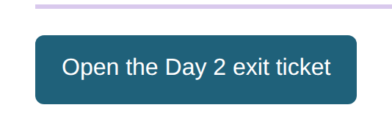
Exit ticket: Rosa's tutoring site
Open the Day 2 exit ticket on the Canvas page
Rosa is 16 and just opened a small tutoring business. Her website has one long page. The "Sign Up" button is gray and sits at the very bottom, under three paragraphs about her hobbies. The menu at the top says "Stuff," "More Stuff," and "Click Here." Parents keep phoning Rosa instead of signing up online.
1
Name TWO bad UX problems. Use words from today's lists.
2
Pick one. Write your fix and how it helps users.
6 minutes · Voice 0
3
Which fix brings Rosa the most new students? Why?
Notes:
44-50 min. The button opens a copy of the exit-ticket Doc. Look for list words (Confusing Navigation, Cluttered Design, Unclear Instructions) and a fix that names what the user can now do.
[Sources]
Find Your Future (Irving ISD / Hats & Ladders, ©2026), printed pp. 28-29; district-licensed workbook page images from the CCE Canvas course, not for public distribution. Canvas page renders of CCE course 98060 student pages, captured 2026-09-15.

Slide 10
Before you go
1
Workbook p. 29 finished: 3 strengths, 5 problems, 3 fixes.
2
Your sketch in your folder.
3
Exit ticket submitted.
Tomorrow you design an app from scratch. Bring the same workbook.
Notes:
Last minute. Chromebooks docked. Collect nothing today; the p. 29 page and sketch go in the Major 1 folder on Day 3.
[Sources]
Find Your Future (Irving ISD / Hats & Ladders, ©2026), printed pp. 28-29; district-licensed workbook page images from the CCE Canvas course, not for public distribution.

