Slide 1
Networking careers
Who keeps the Wi-Fi up?
College and Career Exploration · Week 3 · Day 1
Bring your notebook, a pencil, and your Chromebook. Find Your Future workbook only if you finish early (p. 38).
Notes:
Have this up as students walk in. Networking Career Cards printed or open on the Day 1 page. Run time 50 minutes: warm-up 5, compare four careers 22, transferable skills 15, exit ticket 8.
[Sources]
Find Your Future (Irving ISD / Hats & Ladders, ©2026), printed pp. 38; district-licensed workbook page images from the CCE Canvas course, not for public distribution.

Slide 2
As you enter
If the school Wi-Fi went down right now, whose job would it be to fix it?
What do you think they would actually DO to fix it?
Say it like this
First they would check ________, because ________.
Be specific: student devices, login accounts, access points, network cables, the server. Two people share.
Notes:
0-5 min. Push past 'the IT guy'. You want a checklist verb: check the access point, restart the server, look at the login system. That checklist is what a Network Administrator does on a bad morning.
[Sources]
Find Your Future (Irving ISD / Hats & Ladders, ©2026), printed pp. 38; district-licensed workbook page images from the CCE Canvas course, not for public distribution.

Slide 3
Today you will
1
Learn what a network is and meet the four careers that keep one running.
2
Record one technical task and one transferable skill for each.
3
Stop and Jot: name a skill that transfers between two careers.
4
Exit ticket: a Venn diagram, programming vs. networking.
Word of the day: transferable skill. A skill you can carry from one job to another.
Notes:
30 seconds.
[Sources]
Find Your Future (Irving ISD / Hats & Ladders, ©2026), printed pp. 38; district-licensed workbook page images from the CCE Canvas course, not for public distribution.

Slide 4

What is a network?
A network is a group of connected computers and devices that share information and resources.
Network cables in a server room (BLS video still)
Your school Wi-Fi is a network. So is the bank app on a phone, and a text message on its way to someone.
When it works, nobody notices. When it breaks, four kinds of people get called.
Notes:
5-7 min. Read the definition once, then connect it to the warm-up: the Wi-Fi checklist students just made is the network. The four people who get called are the next slide.
[Sources]
Definition: docs/1sw/wk3-computer-science-it/overview.md vocabulary. U.S. Bureau of Labor Statistics, Occupational Outlook Handbook, "Network and Computer Systems Administrators" (https://www.bls.gov/ooh/computer-and-information-technology/network-and-computer-systems-administrators.htm), screenshot captured 2026-09-15. Public domain.

Slide 5
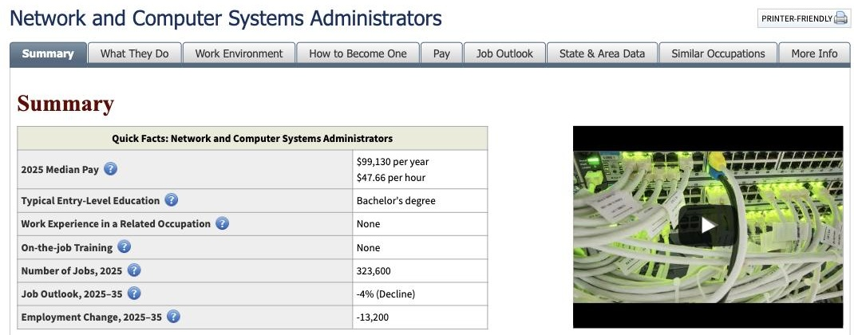
The four careers
Networking Career Cards · link on the Day 1 page
Network Administrator
Network Architect
Keeps the network running day to day: accounts, monitoring, troubleshooting, updates.
Plans and designs the network: equipment, capacity, security, cost tradeoffs.
Database Administrator
Systems Analyst
Organizes, protects, and backs up data so users get reliable answers.
Studies how an organization works and recommends technology changes; translates between tech and non-tech teams.
From the BLS Occupational Outlook Handbook.
Notes:
7-10 min. Read the four cards once. No salary numbers on the board today; the cards carry tasks and preparation only, and the salary work happens on Day 4 with dated figures. The BLS page shown is the source for the Network Administrator card. The cards say 'typical preparation'; if a student asks, typical means common, not required by every employer.
[Sources]
Networking Career Cards (CCE-authored, build/worksheet_sources/wk3-networking-career-cards.md; BLS OOH accessed 2026-08-09). U.S. Bureau of Labor Statistics, Occupational Outlook Handbook, "Network and Computer Systems Administrators" (https://www.bls.gov/ooh/computer-and-information-technology/network-and-computer-systems-administrators.htm), screenshot captured 2026-09-15. Public domain.

Slide 6
Who gets called?
30 seconds with a partner · Voice 1
The Wi-Fi is down Monday morning. Which of the four gets called first? Which one designed the network in the first place? Which one would notice if student data went missing?
Say it like this
The ________ gets called first because their job is to ________.
Two pairs share. Then open the cards.
Notes:
10-12 min. Fast. Administrator first, Architect designed it, Database Administrator watches the data. A wrong answer with a reason from the card is fine; that is the compare task starting early.
[Sources]
Networking Career Cards (CCE-authored, build/worksheet_sources/wk3-networking-career-cards.md; BLS OOH accessed 2026-08-09).

Slide 7
Compare the four roles
22 minutes · Voice 0 · Card set or notebook entry labeled 1SW Wk3 Networking
Task
One technical task this person does. Copy a verb from the card: monitor, back up, design, interview.
Skills to pick from
problem-solving
communication
attention to detail
time management
teamwork
curiosity
patience under pressure
Skill
One transferable skill this person needs, and why it matters in this job.
Four rows: Network Administrator, Network Architect, Database Administrator, Systems Analyst.
Finished early? Find Your Future p. 38: open Hats & Ladders, Clusters, Information Technology, and do the App Exploration checklist.
Notes:
12-31 min. Four rows, one per career. Lap 1 at minute 8: every student has a task verb for two careers. Lap 2 at minute 18: the skill column says why, not just the skill name. Students who record on the printed cards or in the notebook both count; use the response route your class set up in Week 0. The ten-skill list Doc is linked on the Day 1 page for students who want more choices than the seven on this slide.
[Sources]
Networking Career Cards (CCE-authored, build/worksheet_sources/wk3-networking-career-cards.md; BLS OOH accessed 2026-08-09). Canvas page renders of CCE course 98060 student pages, captured 2026-09-15. Find Your Future (Irving ISD / Hats & Ladders, ©2026), printed pp. 38; district-licensed workbook page images from the CCE Canvas course, not for public distribution.

Slide 8
What transfers?
A transferable skill moves with you from job to job
Technical skill
Transferable skill
Belongs to one job.
Configure a router. Restore a database backup. Write a network diagram.
Goes with you anywhere.
Explain a problem to someone who is not technical. Notice the small detail that breaks everything. Stay calm when the system is down.
A technical skill gets you one job. A transferable skill goes with you to the next one.
Notes:
31-34 min. One minute of teaching before the jot. Ask for one example of each from a student's own row before moving on.
[Sources]
Networking Career Cards (CCE-authored, build/worksheet_sources/wk3-networking-career-cards.md; BLS OOH accessed 2026-08-09).

Slide 9
Stop and Jot
60 seconds · Voice 0 · In your notebook
Pick a skill from your rows that TWO of the four careers need.
Write one complete sentence.
Say it like this
________ transfers across ________ and ________
because both workers must ________.
Words you will need
problem-solving · communication · attention to detail · time management · teamwork · curiosity · patience under pressure
Notes:
34-46 min including the discussion. 60 seconds silent, then three students read their sentence. Listen for the 'because' clause; a sentence without it is two job titles and a skill name. Board capture: write each skill students name and tally repeats. That tally is what the exit-ticket Venn draws from.
[Sources]
Networking Career Cards (CCE-authored, build/worksheet_sources/wk3-networking-career-cards.md; BLS OOH accessed 2026-08-09).

Slide 10
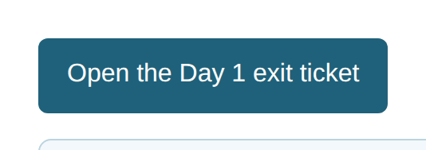
Exit ticket: programming vs. networking
Open the Day 1 exit ticket on the Canvas page · 8 minutes
Pick one programming career from Week 2 (Software Dev, Web Dev, App Dev, or Game Dev).
Pick one networking career from today.
Left: 2 skills only the programmer uses.
Right: 2 skills only the networking career uses.
Middle: 2 skills BOTH need (soft skills, not technical).
Bottom line: why do employers care about the middle as much as the technical sides? One sentence.
The button opens your own copy of the Venn diagram.
Say it like this
Employers care about ________ because ________.
Notes:
42-50 min. The button opens a copy of the Venn Doc. The middle must be soft skills; a student who writes 'coding' in the middle has the wrong idea about transfer. Grade the bottom line, not the count.
[Sources]
Canvas page renders of CCE course 98060 student pages, captured 2026-09-15.

Slide 11
Before you go
1
Four rows done: a task and a skill for each career.
2
Your Stop and Jot sentence in your notebook.
3
Exit ticket submitted.
Tomorrow: you become a UX designer and audit a real website. Bring your Find Your Future workbook.
Notes:
Last minute. Chromebooks docked. Keep the card sets if students wrote on them; they are Day 1 evidence.
[Sources]
Networking Career Cards (CCE-authored, build/worksheet_sources/wk3-networking-career-cards.md; BLS OOH accessed 2026-08-09).

