Slide 1
Learning styles
Xello quiz, then the lesson.
College and Career Exploration · Week 3 · Day 5
Bring your Chromebook. Turn in your Major 1 packet if you have not.
Notes:
Have this up as students walk in. Collect any late Major 1 packets before Xello opens. Run time 50 minutes: A/B/C prediction inside the first quiz block, quiz 20 (Voice 0, visible timer), lesson 30 (Voice 1 for the partner rehearsal inside it), connection sheet at the end of the lesson block.
[Sources]
Xello, "My Learning Styles lesson prerequisites, pp. 1-2" (district-licensed teacher resource), not for public distribution.

Slide 2
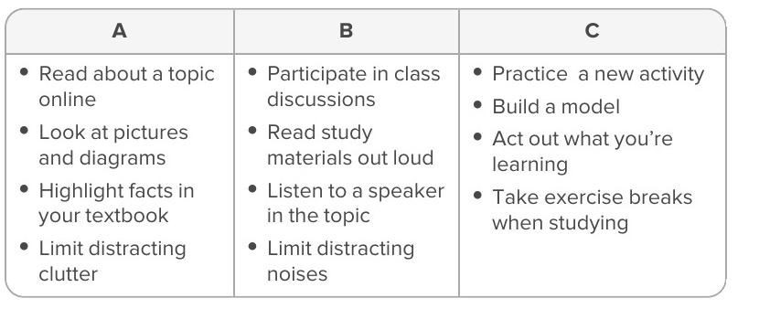
As you enter: A, B, or C?
Which one is you?
Read all three. Pick the one you actually do when you have to learn something new, not the one that sounds smart.
Write the letter and one example from your own life in your notebook.
Say it like this
I am mostly ____. Last time I learned something new, I ________.
Notes:
0-3 min, inside the quiz block. Do not name the three styles yet; the lesson names them later and the quiz should not be primed. Two voices, then open Xello.
[Sources]
Xello, "My Learning Styles lesson prerequisites, pp. 1-2" (district-licensed teacher resource), not for public distribution.

Slide 3
Today you will
1
Take the Xello Learning Style quiz (20 minutes, Voice 0).
2
Do the Learning styles lesson (30 minutes).
3
Pick one learning method and connect it to a real school task on the Method-to-Task sheet.
Your result is not a grade and does not measure ability. It is a starting point for choosing a method.
Notes:
30 seconds. Say the last line aloud; students who see a 'style' as a label stop trying other methods, which is the opposite of the lesson.
[Sources]
Xello, "My Learning Styles lesson prerequisites, pp. 1-2" (district-licensed teacher resource), not for public distribution.

Slide 4
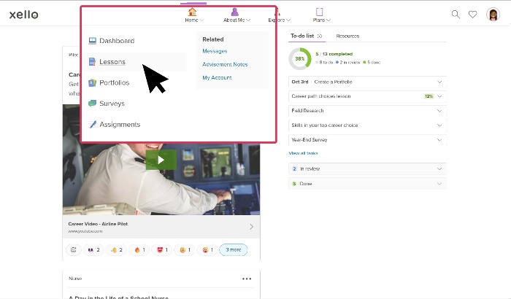
Open Xello
ClassLink → Xello → About Me → Learning Style
1
Open ClassLink and click the Xello tile.
2
Click About Me at the top.
3
Click Learning Style and start the quiz.
4
Stuck for two minutes? Raise a hand and start the Method-to-Task sheet while you wait.
Xello's Home menu. About Me is the next tab to the right.
Notes:
3-5 min. Model the three clicks on the projector before Chromebooks open. Devices flat while you model. If Xello does not launch for a student after a two-minute check, move them to the connection sheet; it carries the method chart so the thinking target still gets done. Add a live About Me > Learning Style screenshot here when a student demo login is available; the current image is the Home menu from the Xello teacher slides.
[Sources]
Xello, "Biases and career choices teacher slides, navigation slide (Home menu capture)" (district-licensed teacher resource), not for public distribution.

Slide 5
Learning Style quiz
20 minutes · Voice 0 · Private
Answer honestly
Timer
There are no right answers. Pick what you actually do, not what you wish you did.
Read each choice fully before you click.
When you finish, read your result page once, then close the lid halfway and wait.
20:00 on the board.
Done early? Reread your result and find one line you disagree with.
Devices flat while directions are given. Voice 0 until the timer ends.
Notes:
5-25 min. Walk once at minute 5 for stuck logins and once at minute 15 for finished students. The result page is the only thing worth reading twice.
[Sources]
Xello, "My Learning Styles lesson prerequisites, pp. 1-2" (district-licensed teacher resource), not for public distribution.

Slide 6
Learning styles lesson
30 minutes · Dashboard → View all lessons → Learning styles
1
Click Dashboard, then View all lessons.
Three methods
Visual: diagrams, models, color coding, written steps
Auditory: read aloud, explain to a partner, record and replay
Tactile: build, sort, trace, act out, practice by doing
2
Open Learning styles and work through it in order.
3
When the lesson asks you to talk to a partner, that is Voice 1 for that part only.
4
Finish the lesson's own reflection question inside Xello.
30:00 on the board. Voice 0 except the partner part.
Notes:
25-50 min, with the connection sheet inside the last part of this block. The method chart on the right is the same one printed on the Method-to-Task sheet, so a student who cannot load the lesson still has it.
[Sources]
Xello, "My Learning Styles lesson prerequisites, pp. 1-2" (district-licensed teacher resource), not for public distribution.

Slide 7
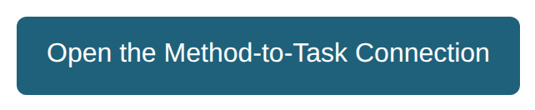
Talk, then write
Method-to-Task Connection · last 8 minutes of the lesson block
Say it like this
A method I can test is ____.
I will use it when I ____.
I will know it helped if ____.
Talk
Voice 1, 60 seconds each. Tell your partner one method from the chart and one real task this week you will try it on.
Write
Voice 0. Fill in the frame on the sheet. Name the task and how you will know it helped.
Words you will need
visual · auditory · tactile · method · obstacle · strategy
Notes:
42-50 min. The button opens a copy of the connection sheet. Talk before write is deliberate: emergent bilingual students rehearse the sentence out loud, then write it. Speech-to-text is fine. The sheet is Day 5 formative evidence; the quiz and lesson are checked separately in the Xello Completion Standards report and do not change the Major 1 score.
[Sources]
Canvas page renders of CCE course 98060 student pages, captured 2026-09-15. Xello, "My Learning Styles lesson prerequisites, pp. 1-2" (district-licensed teacher resource), not for public distribution.

Slide 8
Before you go
1
Learning Style quiz finished in Xello.
2
Learning styles lesson finished, reflection answered.
3
Method-to-Task sheet submitted.
Next week: Tech Support careers. Bring your Find Your Future workbook.
Notes:
Last minute. Chromebooks docked. Check the Xello Completion Standards report tonight for the quiz and lesson.
[Sources]
Xello, "My Learning Styles lesson prerequisites, pp. 1-2" (district-licensed teacher resource), not for public distribution.

