Slide 1
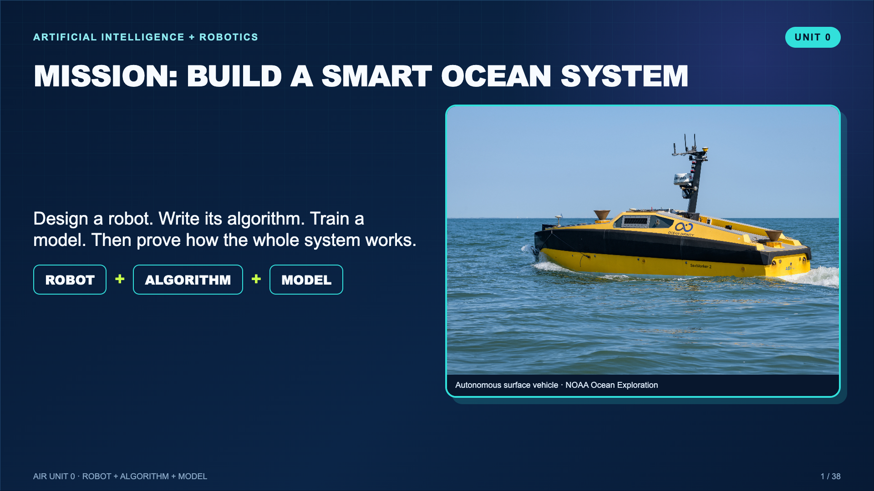
Notes:
Open with the mission, not vocabulary. Tell students they will build one connected idea across the week.
[Sources]
- https://oceanexplorer.noaa.gov/multimedia/explorations-21greatlakes-features-photolog-media-green/

Slide 2
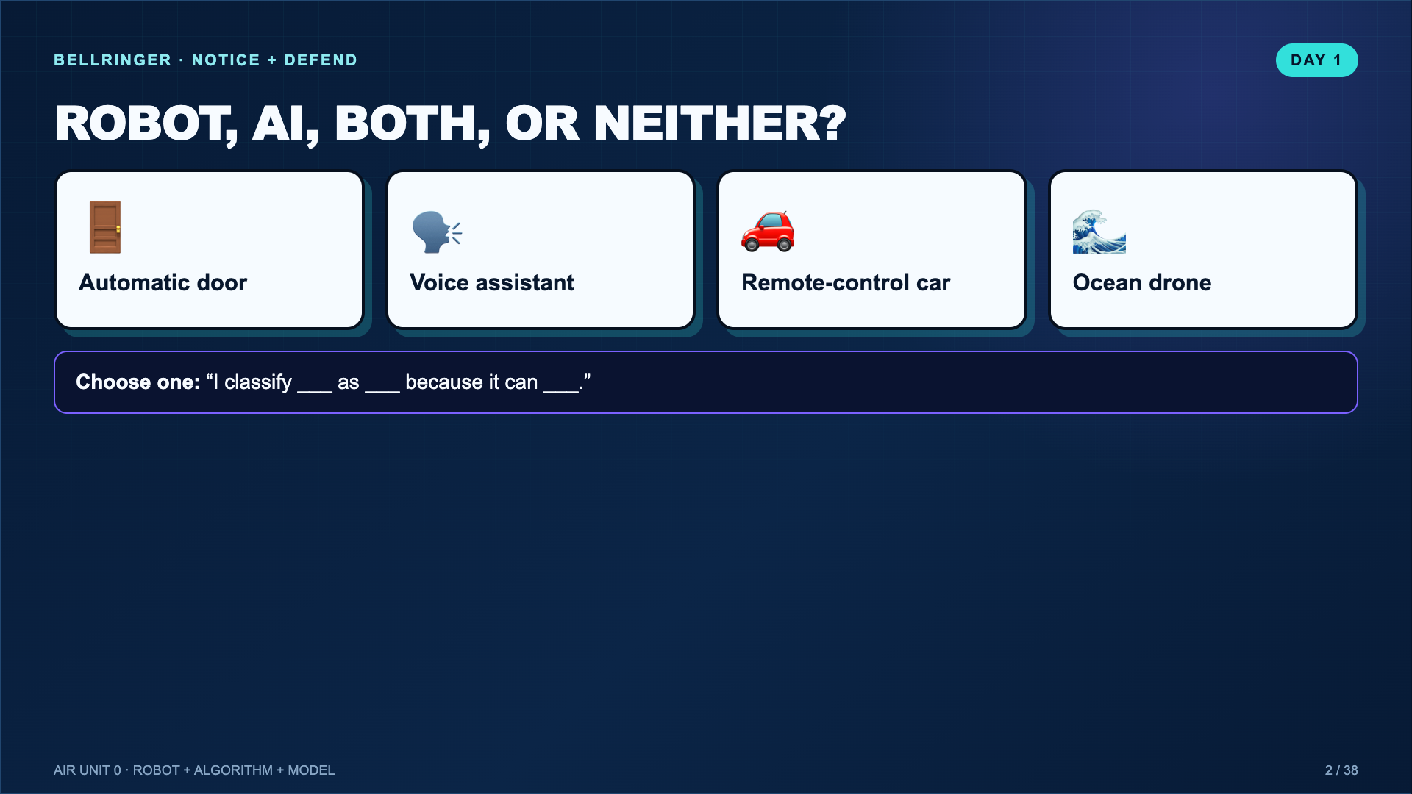
Notes:
Give students a minute to choose, then take two competing answers. Do not settle every case yet. The disagreement creates the need for definitions.
[Sources]
- https://www.youtube.com/watch?v=qPxBf8RKPoY

Slide 3
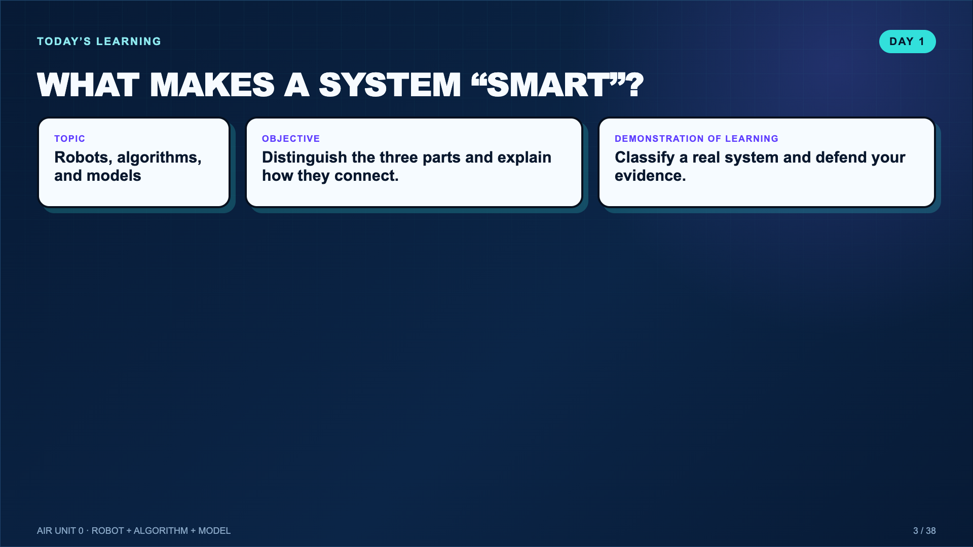
Notes:
Read the objective once, then preview that the week moves from physical design to instructions to learning from examples.
[Sources]
- Teacher-created instructional synthesis for this deck.

Slide 4
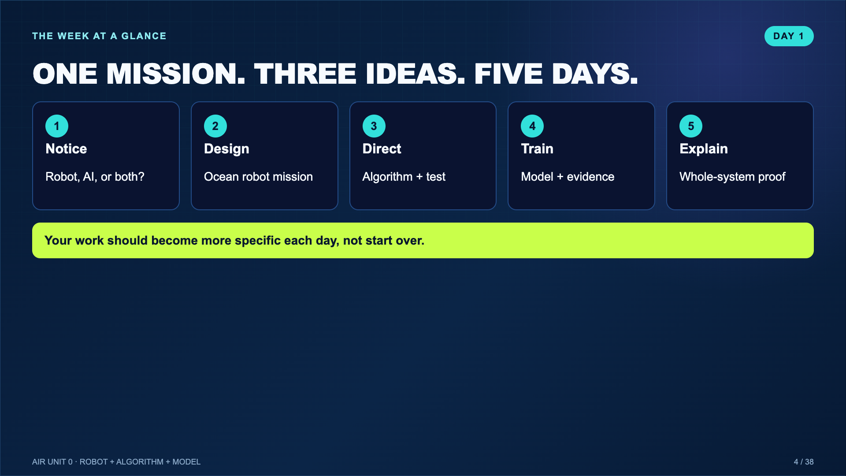
Notes:
Emphasize continuity: the robot students design on Day 2 is the same system they direct, train, and explain later.
[Sources]
- Teacher-created instructional synthesis for this deck.

Slide 5
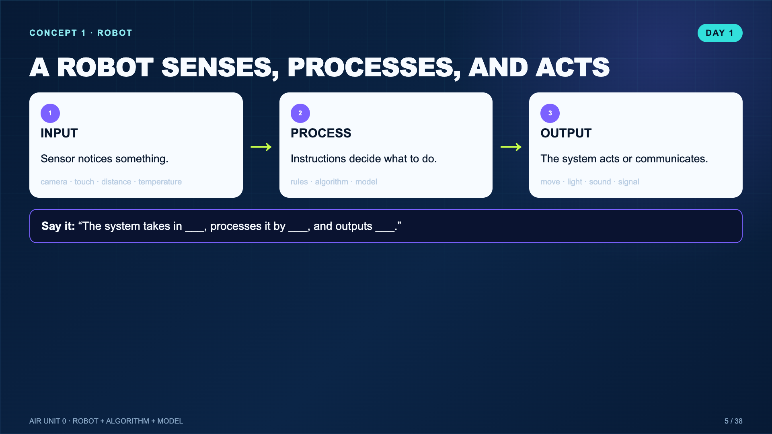
Notes:
Connect this directly to the input-process-output chain students saw in Comics gadget design and Circuits. A robot is a system, not merely a humanoid body.
[Sources]
- Teacher-created instructional synthesis for this deck.

Slide 6
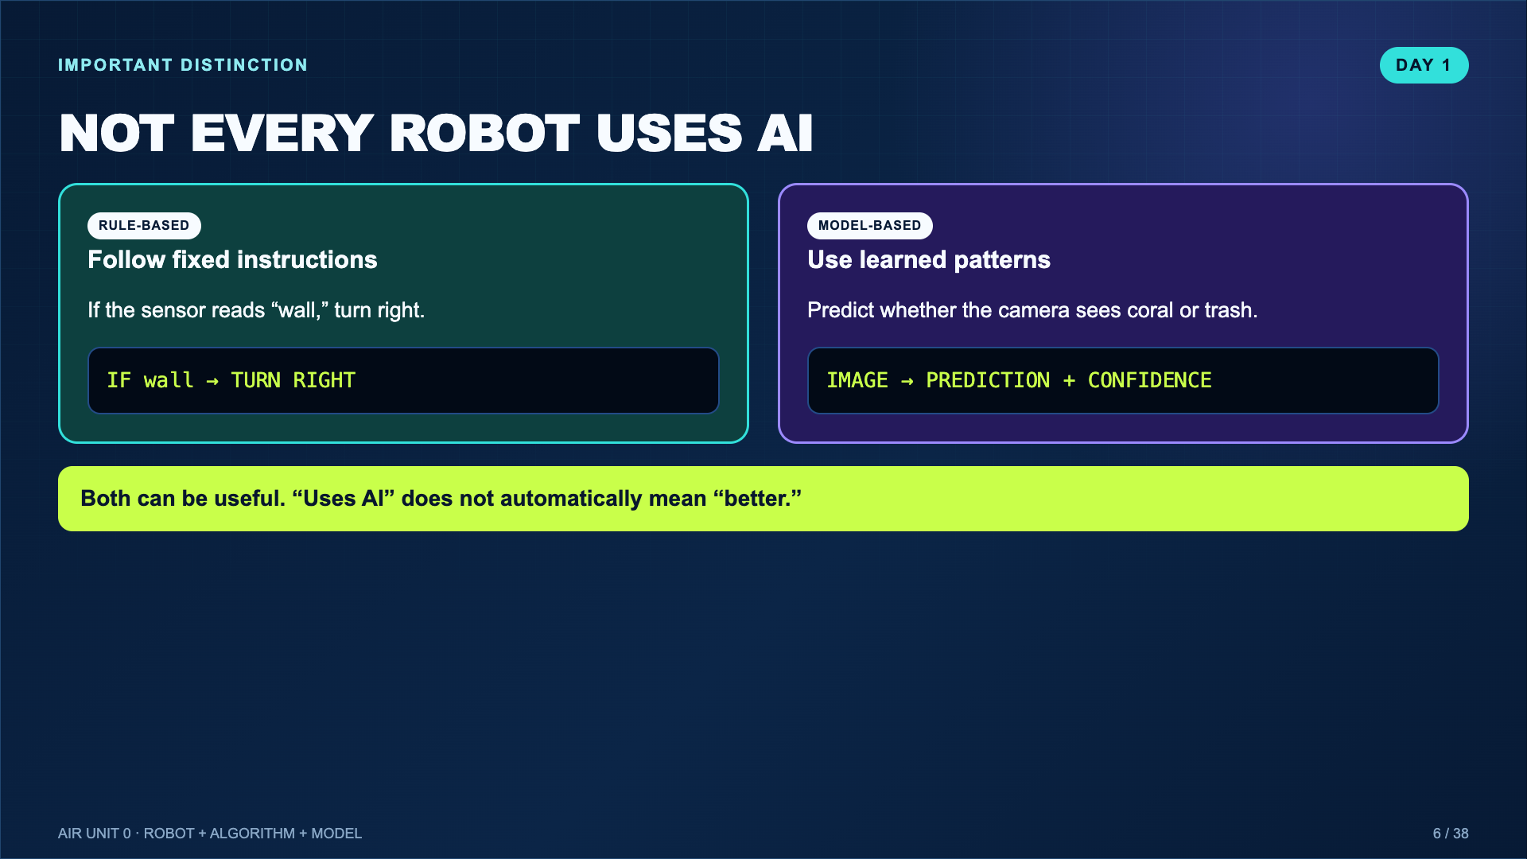
Notes:
Push back on the common misconception that any automated machine is AI. The engineering question is which method fits the job.
[Sources]
- Teacher-created instructional synthesis for this deck.

Slide 7
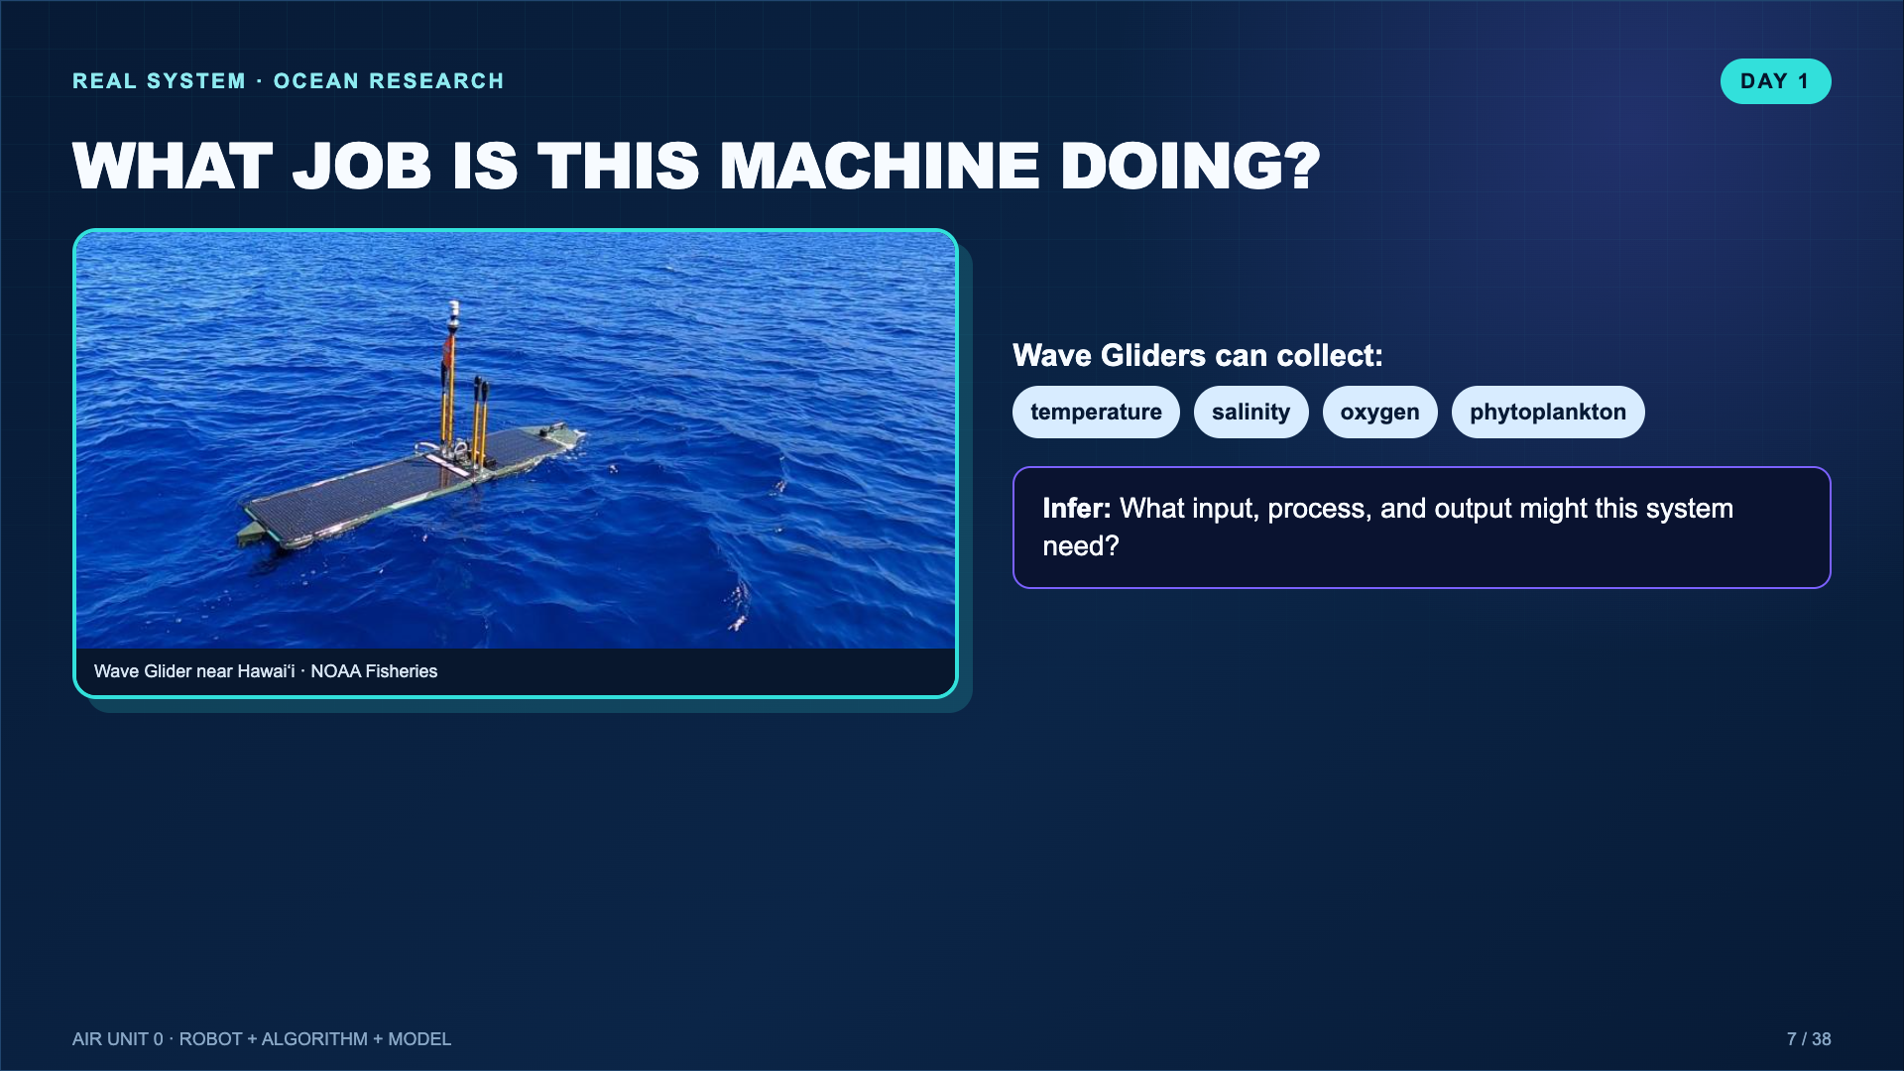
Notes:
Let students infer before revealing. The NOAA example makes “ocean robot” real without requiring students to copy its exact form.
[Sources]
- https://www.fisheries.noaa.gov/feature-story/autonomous-vehicles-powered-ocean-waves-support-noaa-fisheries-research

Slide 8
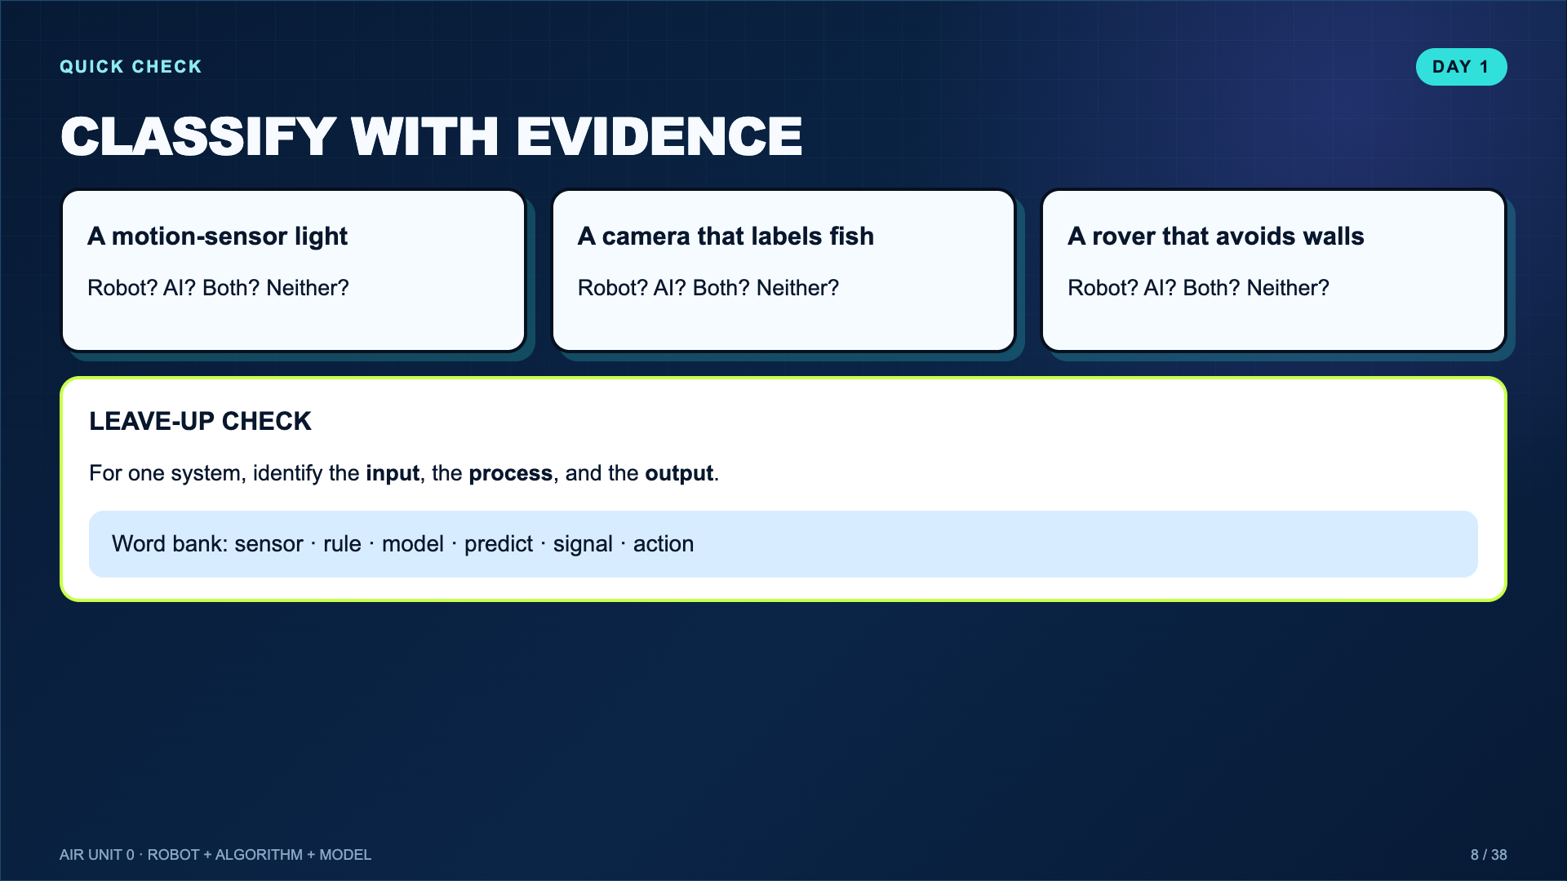
Notes:
Use this as the Day 1 closing screen. Listen for evidence instead of category guessing.
[Sources]
- Teacher-created instructional synthesis for this deck.

Slide 9
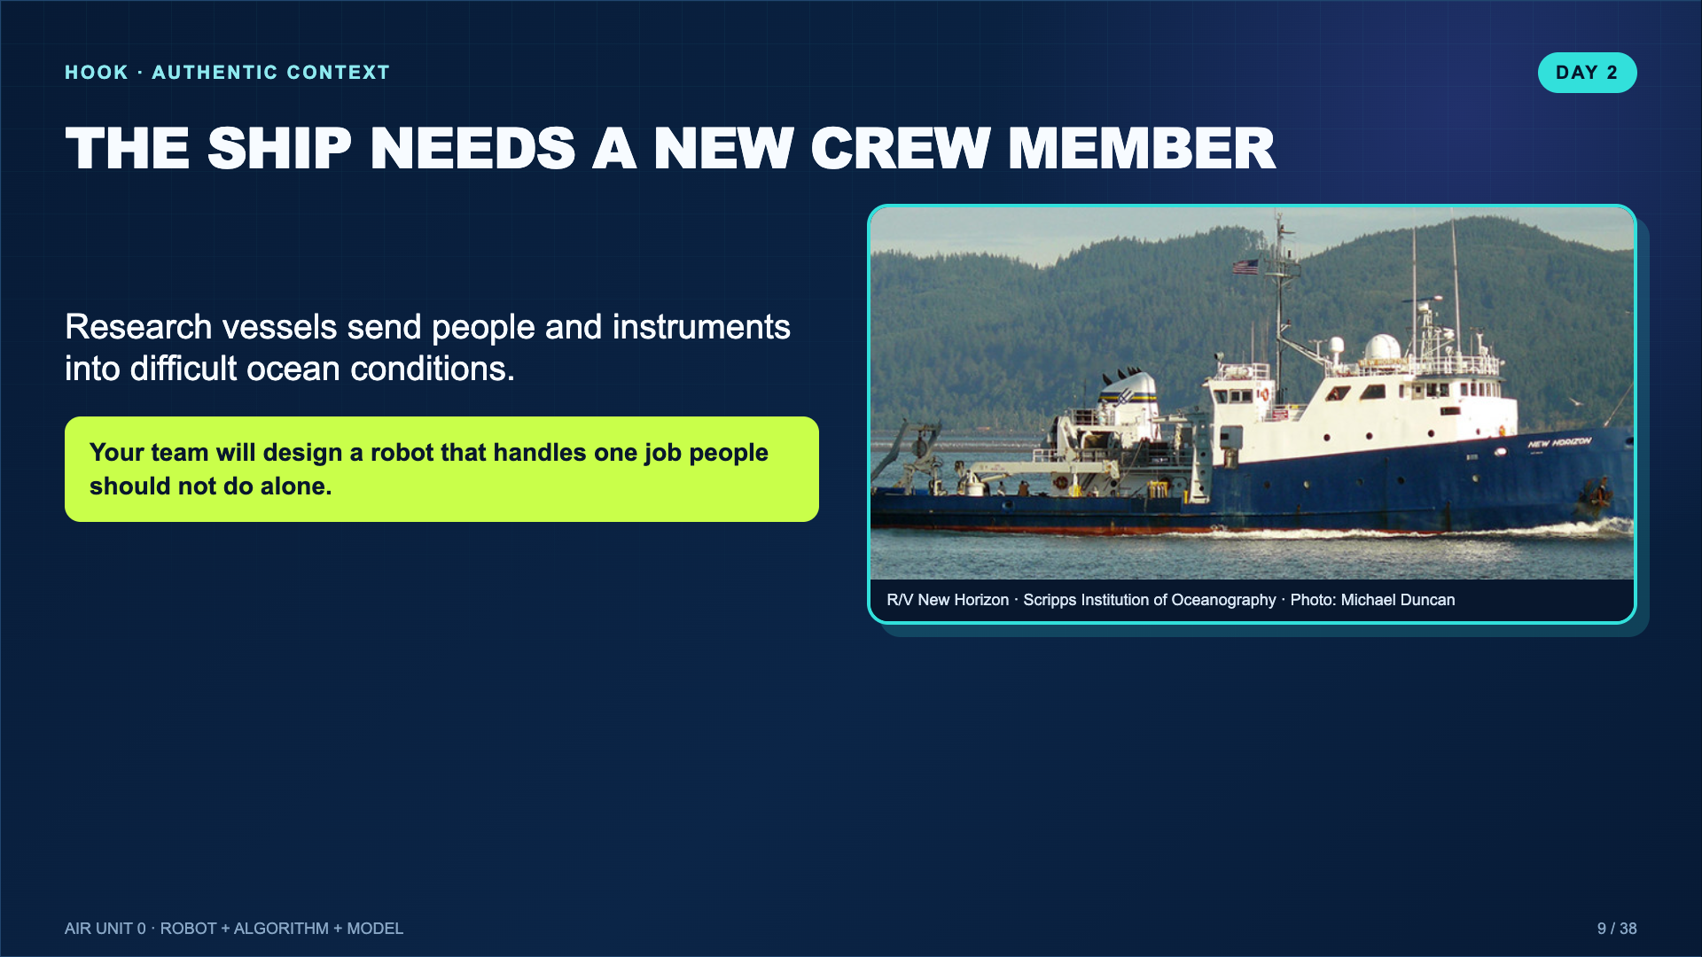
Notes:
Use the New Horizon connection from the original Lucero video. Keep the context but make the task about a real user and job, not a decorative robot.
[Sources]
- https://scripps.ucsd.edu/ships/new-horizon
- https://www.youtube.com/watch?v=yhSo2Y4txsc

Slide 10
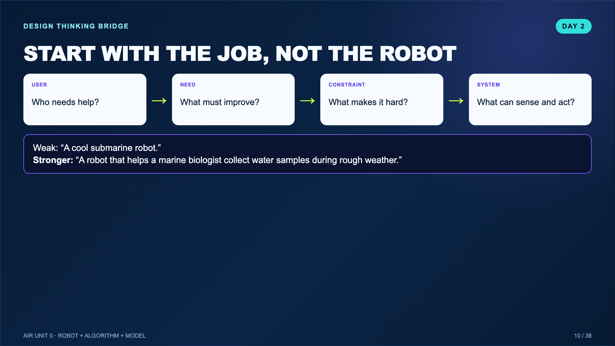
Notes:
Reuse the design-thinking verbs established in Ready, Set, Design. The robot is a response to a need, not the starting point.
[Sources]
- Teacher-created instructional synthesis for this deck.

Slide 11
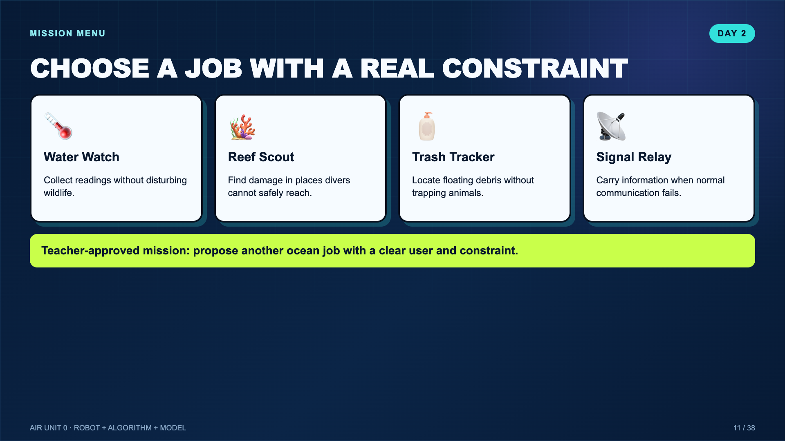
Notes:
These are constraints that breed creativity, not four answer choices. Teams may propose another mission if they can name a user, need, and constraint.
[Sources]
- Teacher-created instructional synthesis for this deck.

Slide 12
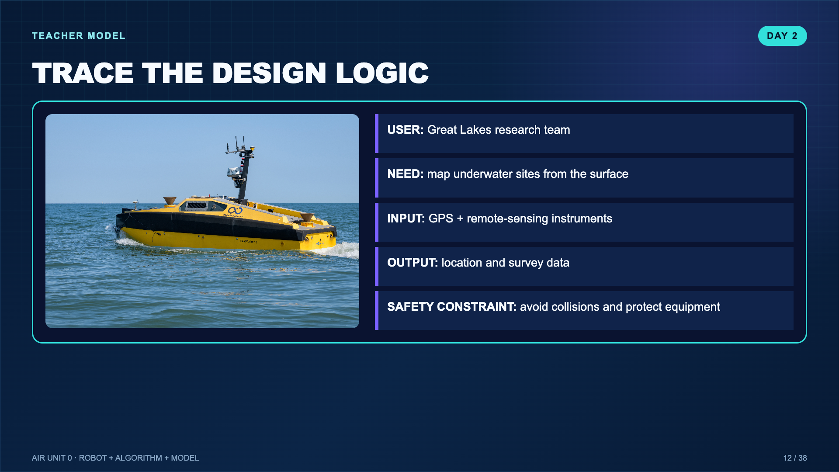
Notes:
Model how to label the system without inventing unsupported technical details. Students only need a plausible school-level concept.
[Sources]
- https://oceanexplorer.noaa.gov/multimedia/explorations-21greatlakes-features-photolog-media-green/

Slide 13
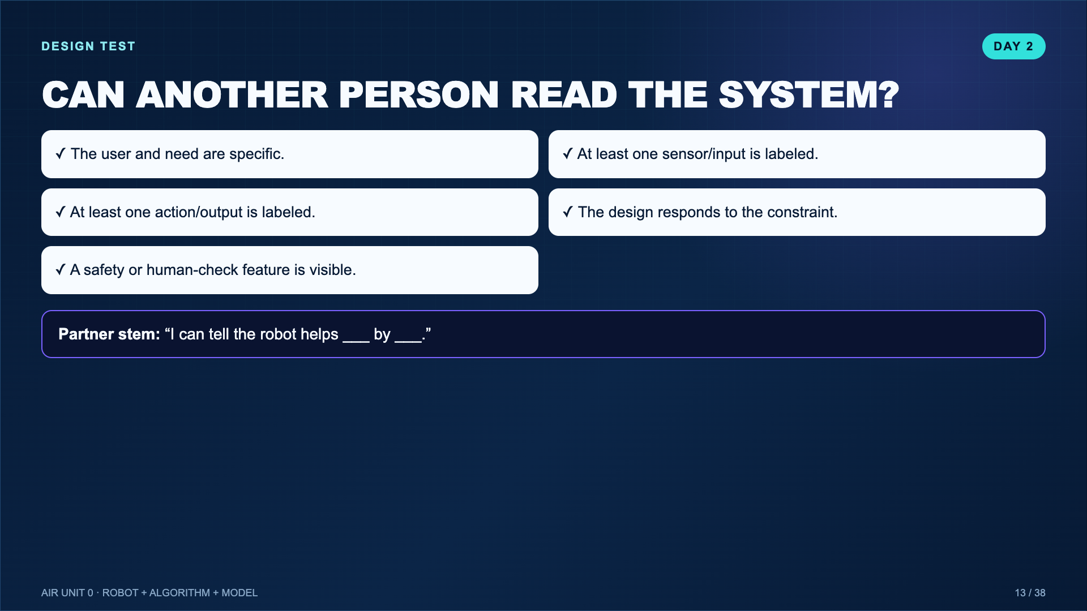
Notes:
Have partners point to evidence on the design, not merely say “looks good.”
[Sources]
- Teacher-created instructional synthesis for this deck.

Slide 14
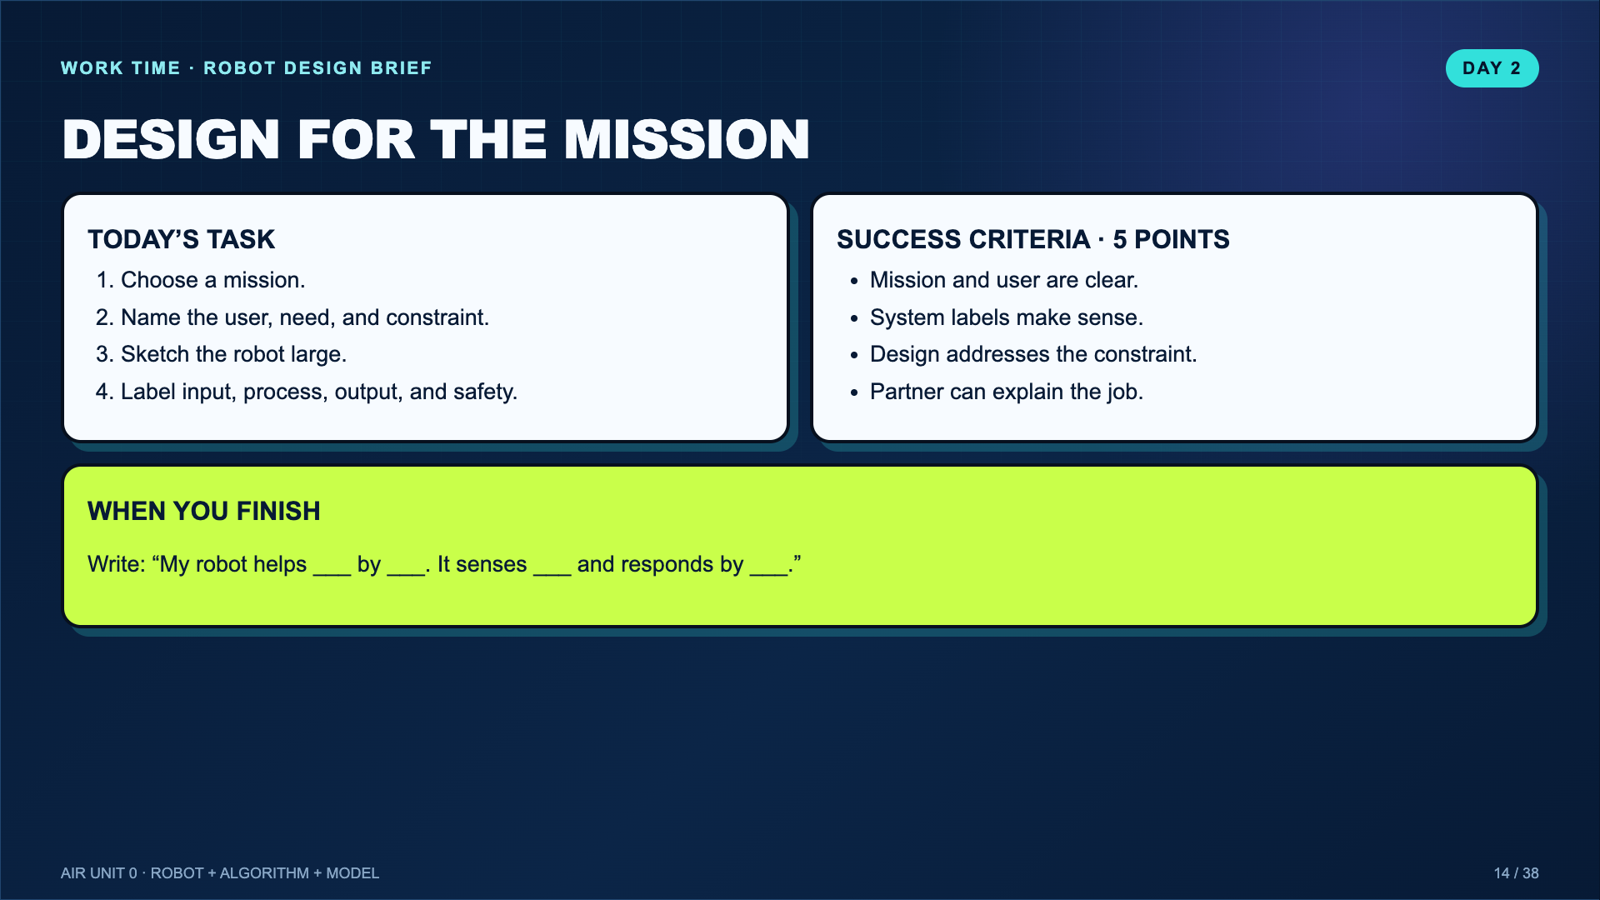
Notes:
Leave this projected during Day 2 work. The mission log contains the matching design brief.
[Sources]
- Teacher-created instructional synthesis for this deck.

Slide 15
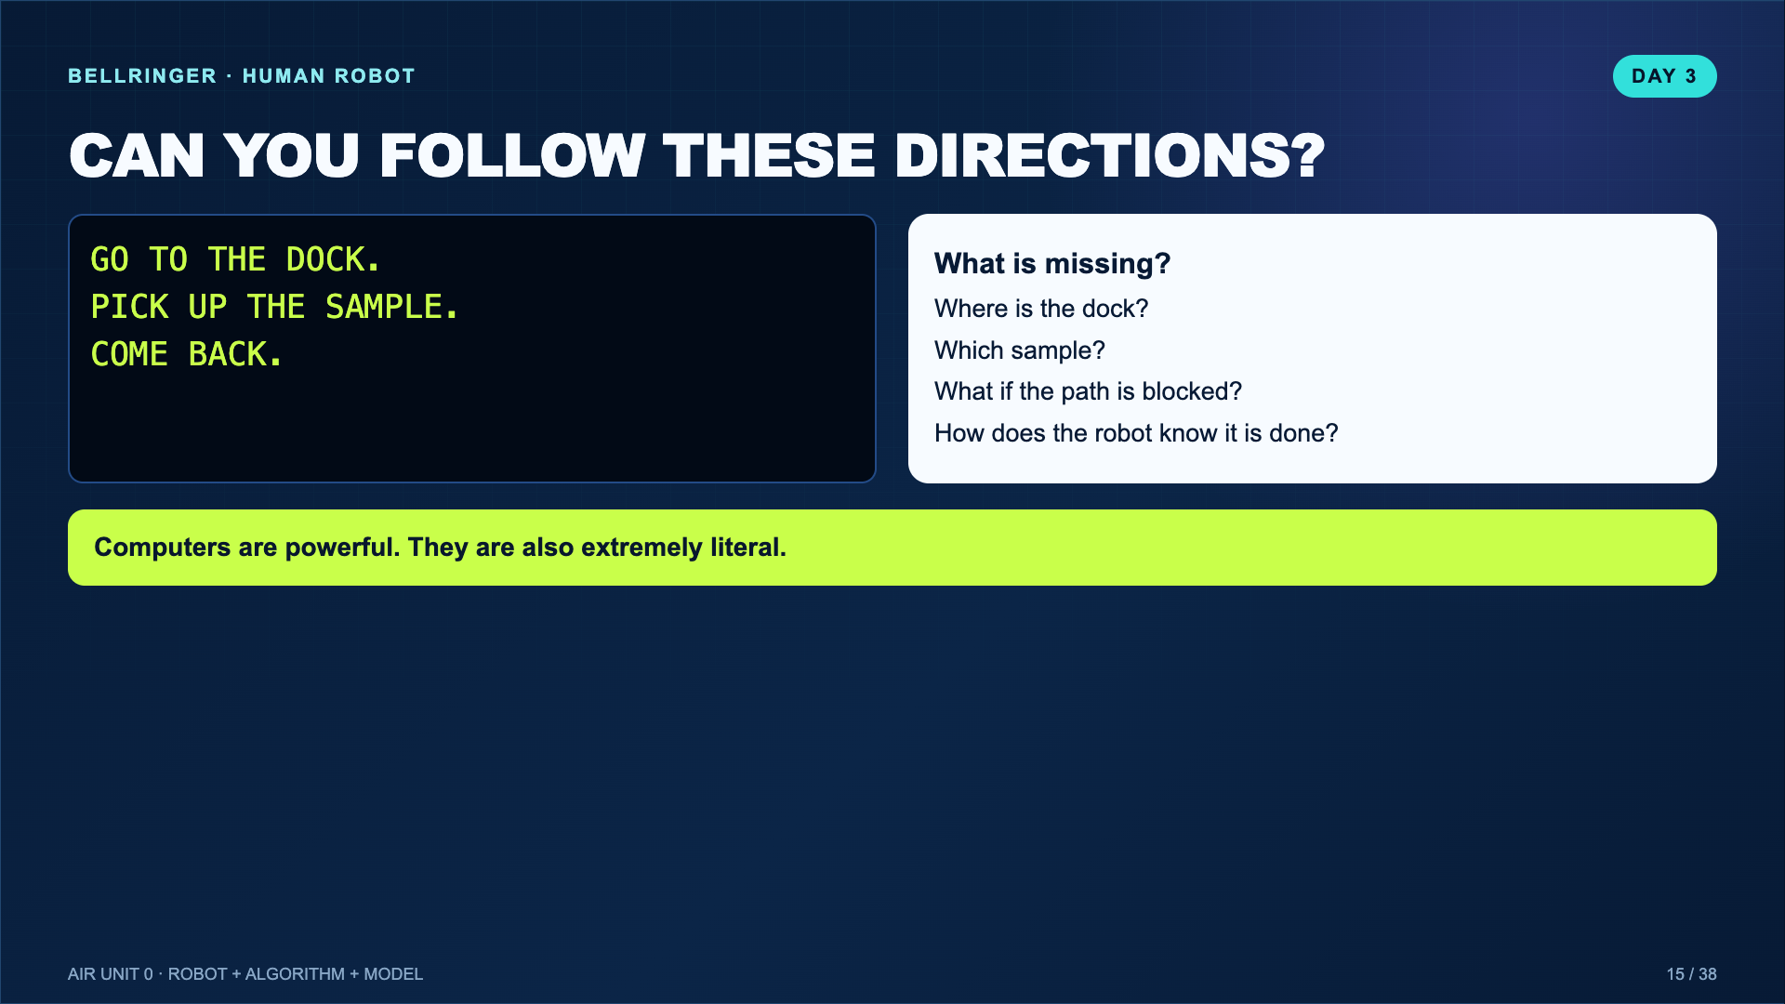
Notes:
Act out the vague directions badly on purpose. Let students identify ambiguity before naming the algorithm criteria.
[Sources]
- Teacher-created instructional synthesis for this deck.

Slide 16
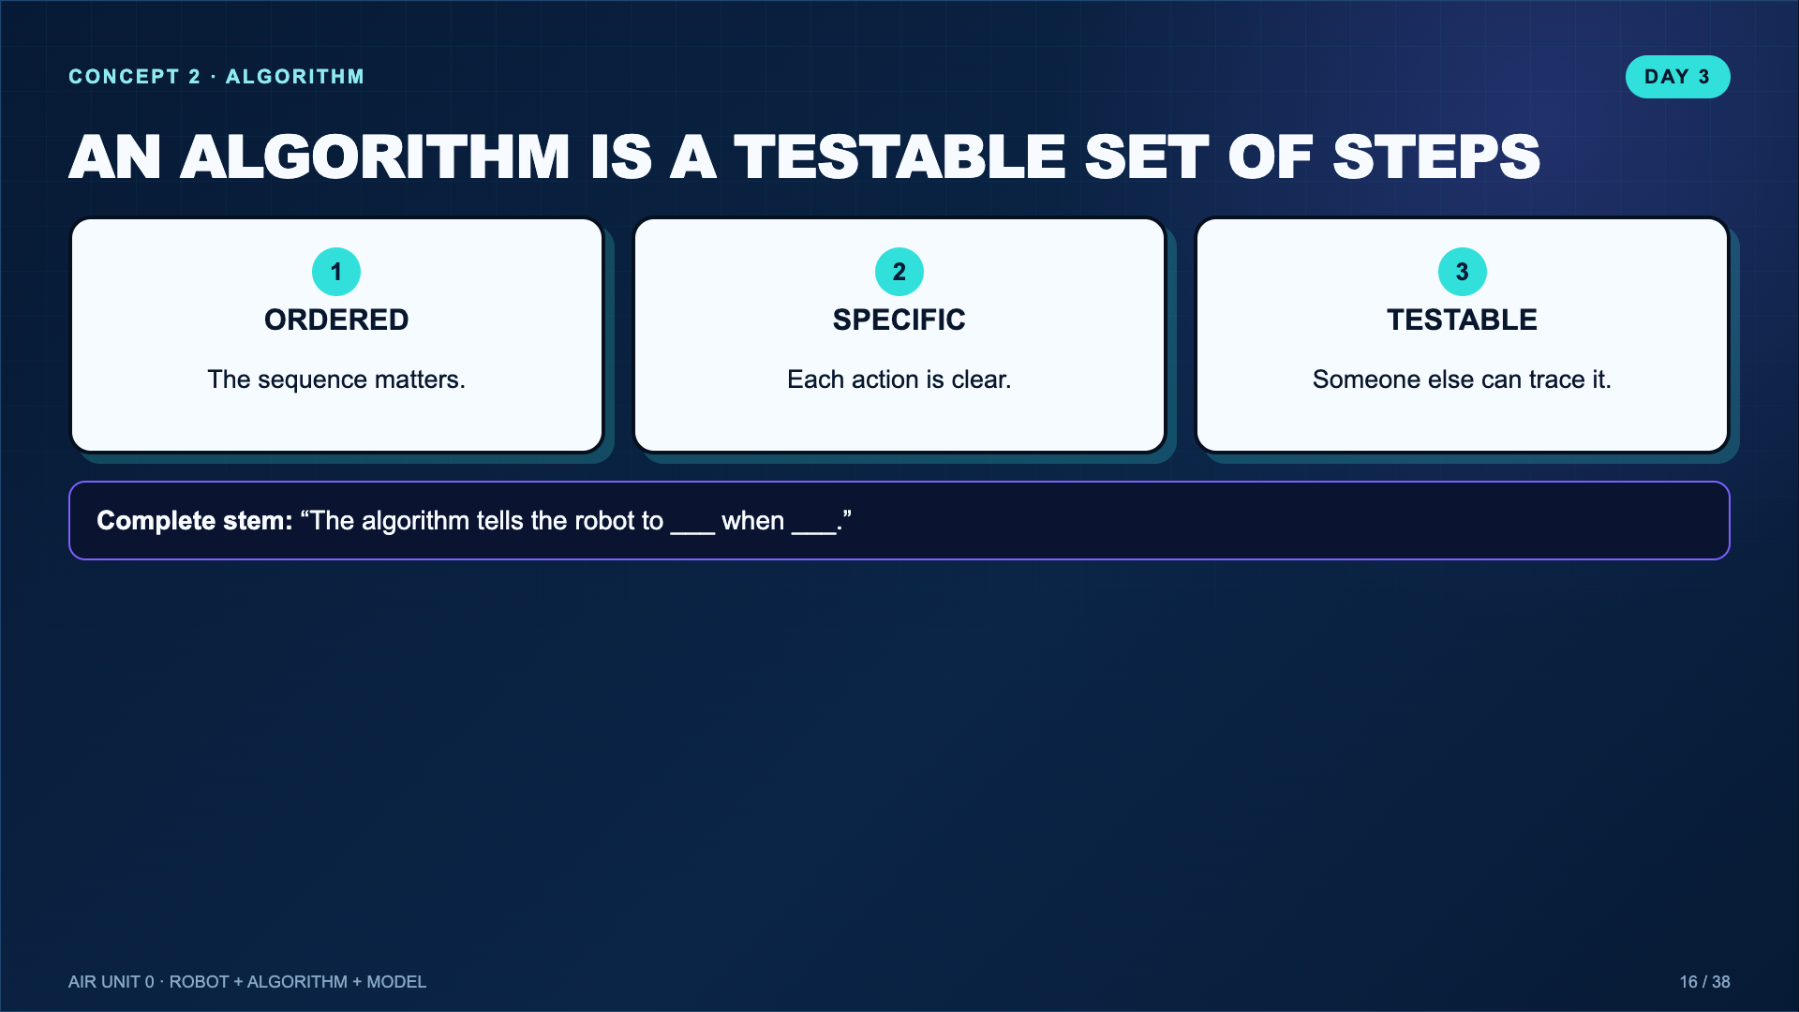
Notes:
Keep the definition concrete. A recipe analogy is fine, but return quickly to sensors and decisions.
[Sources]
- Teacher-created instructional synthesis for this deck.

Slide 17
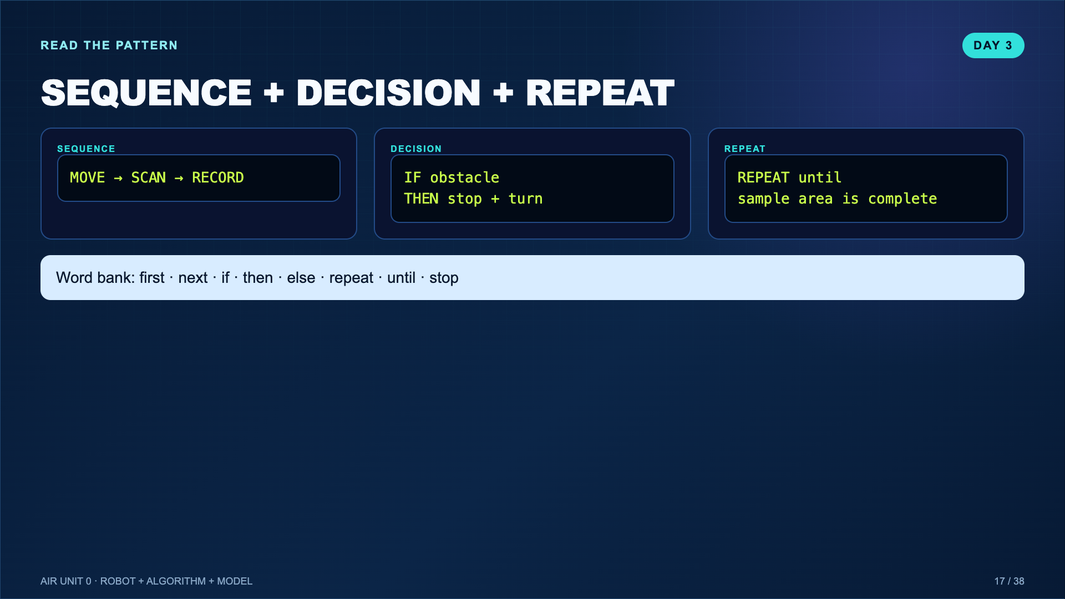
Notes:
Students do not need formal code syntax. They do need an ordered flow, at least one condition, and a stopping point.
[Sources]
- Teacher-created instructional synthesis for this deck.

Slide 18
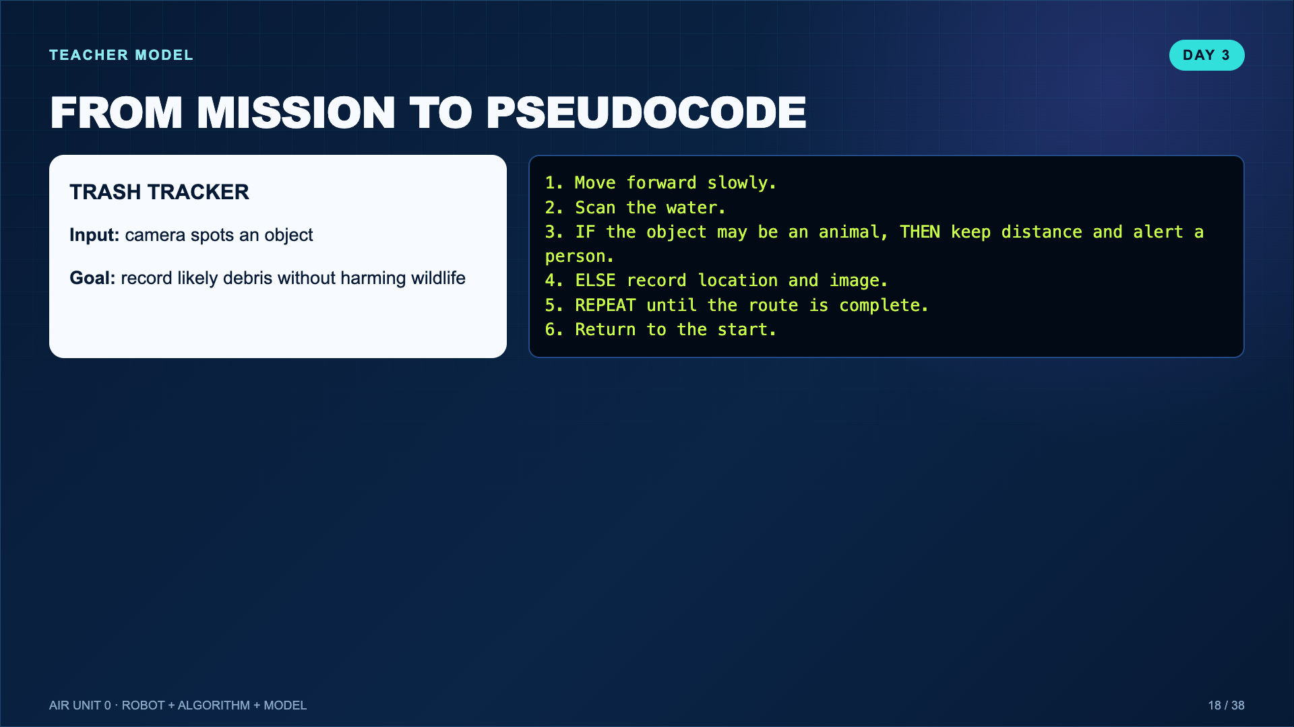
Notes:
Think aloud: the safety branch is not an extra decoration; it changes what the system does.
[Sources]
- Teacher-created instructional synthesis for this deck.

Slide 19
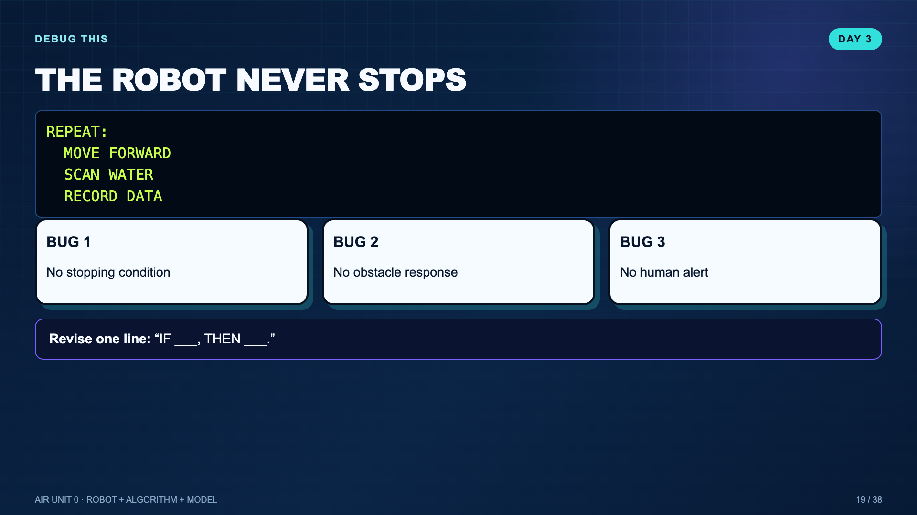
Notes:
Accept multiple valid revisions. The goal is seeing that a missing condition changes system behavior.
[Sources]
- Teacher-created instructional synthesis for this deck.

Slide 20
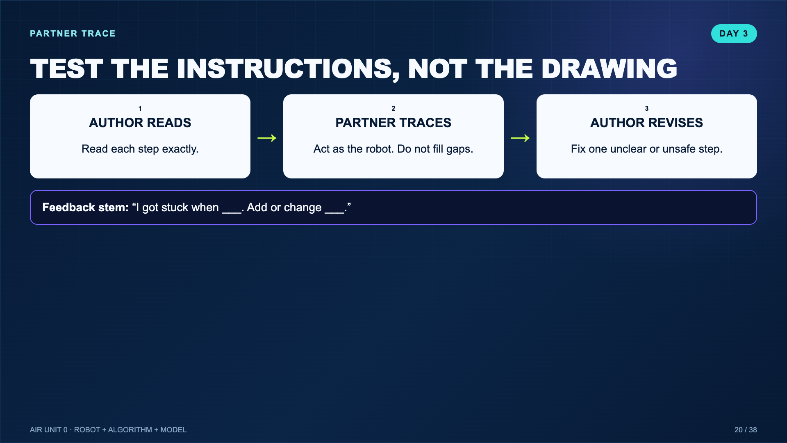
Notes:
Tell partners not to be helpful by guessing. Literal testing is the point.
[Sources]
- Teacher-created instructional synthesis for this deck.

Slide 21
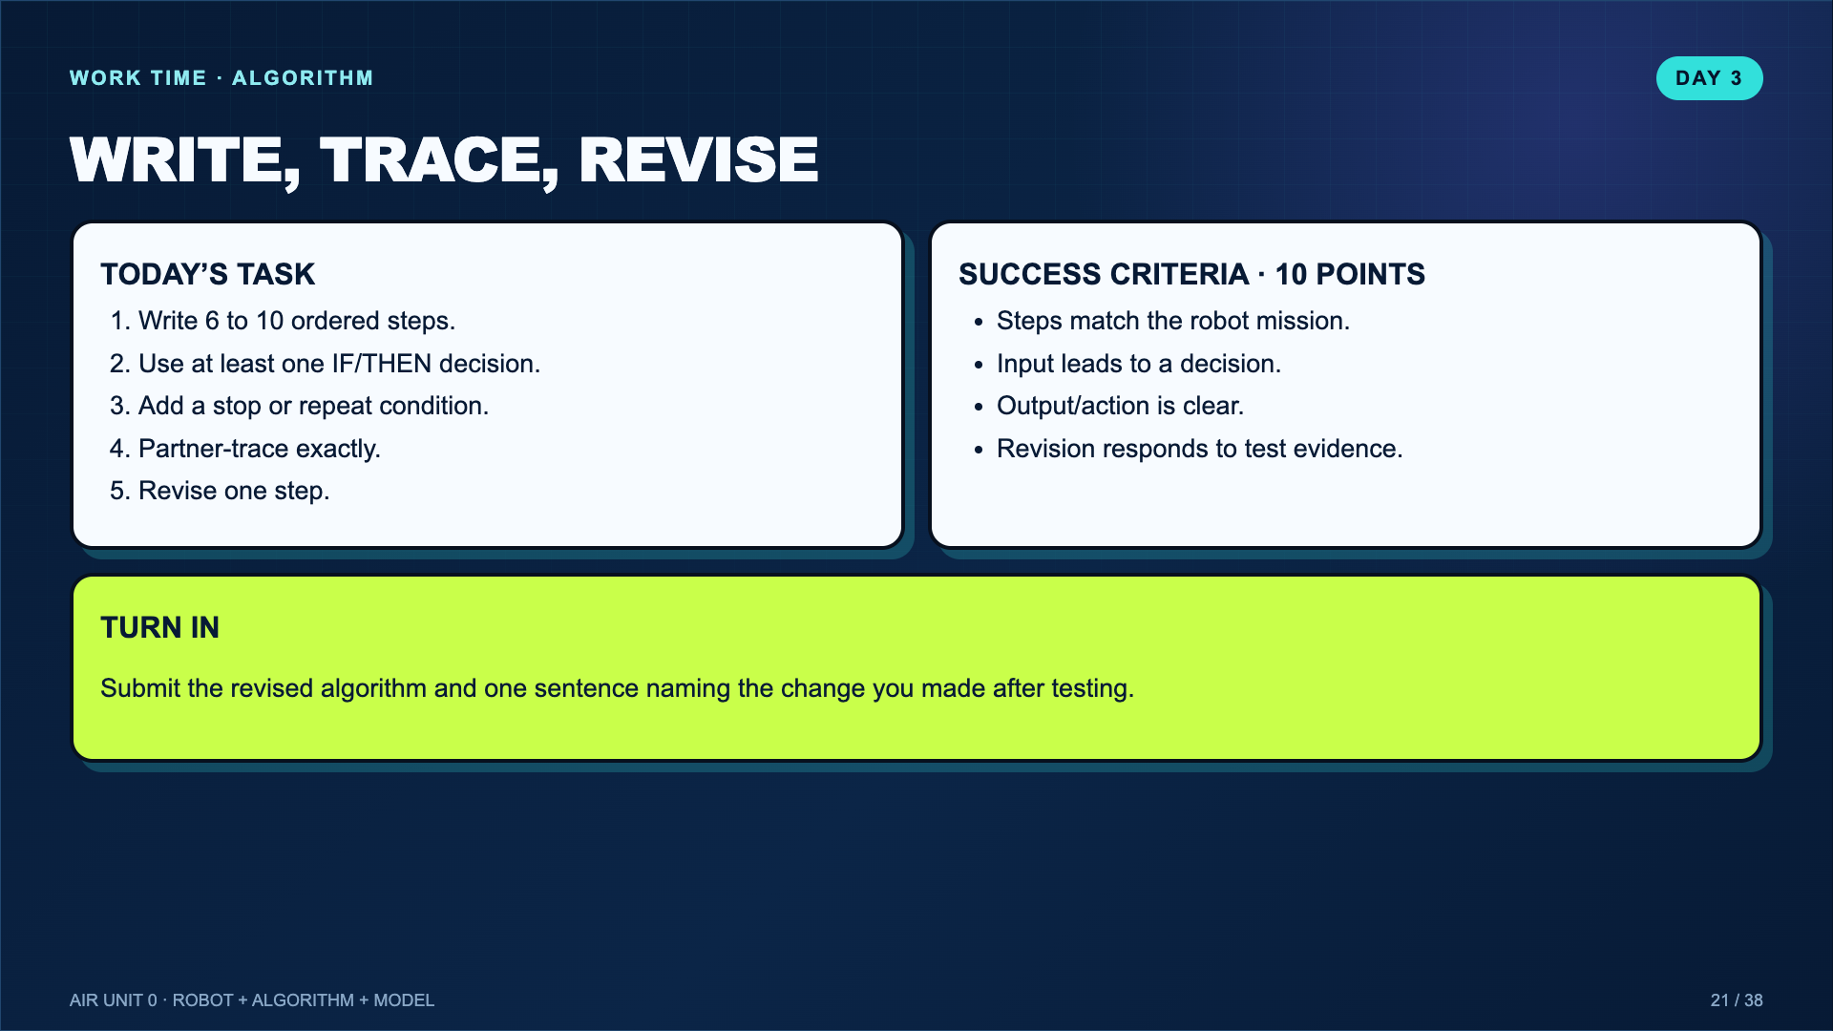
Notes:
Leave this projected. Students may handwrite in the mission log or submit a clear photo/file.
[Sources]
- Teacher-created instructional synthesis for this deck.

Slide 22
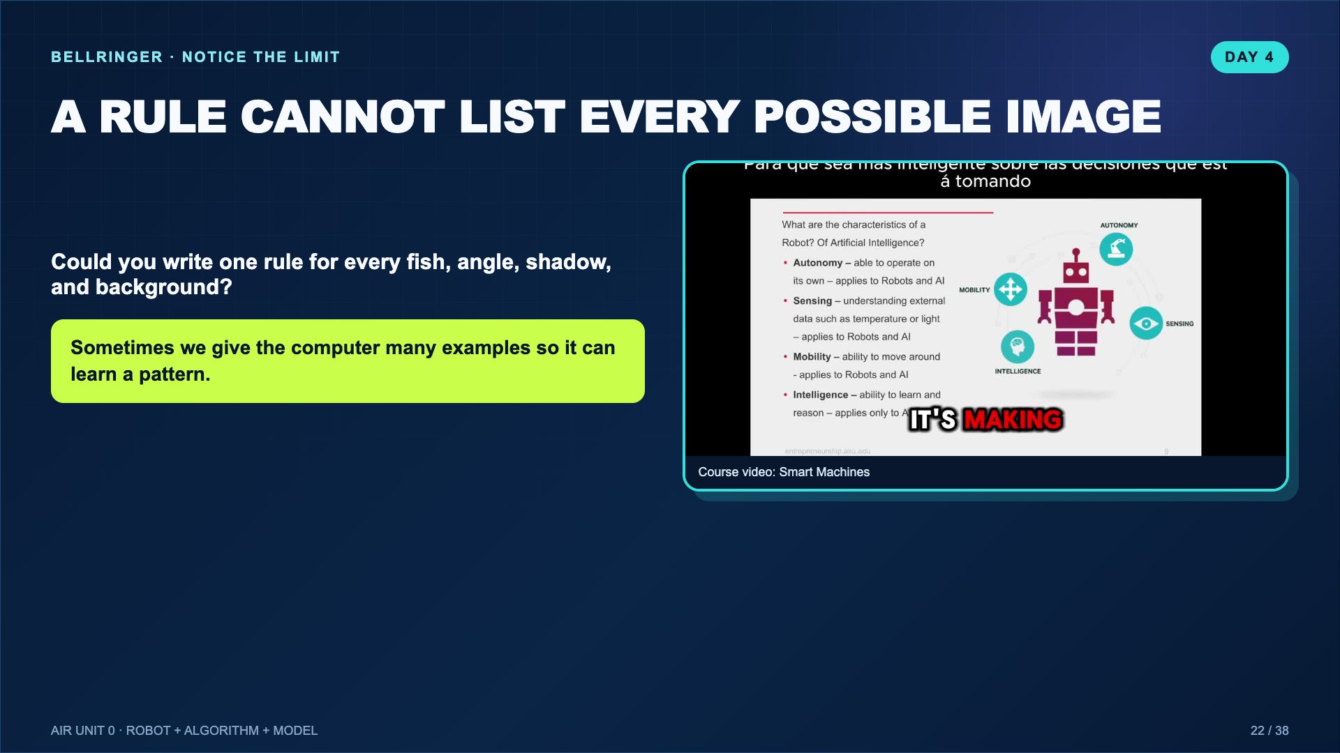
Notes:
Use this to create the need for a model. A model is not magic; it is a pattern learned from examples.
[Sources]
- https://www.youtube.com/watch?v=Htc-WXQRsR8

Slide 23
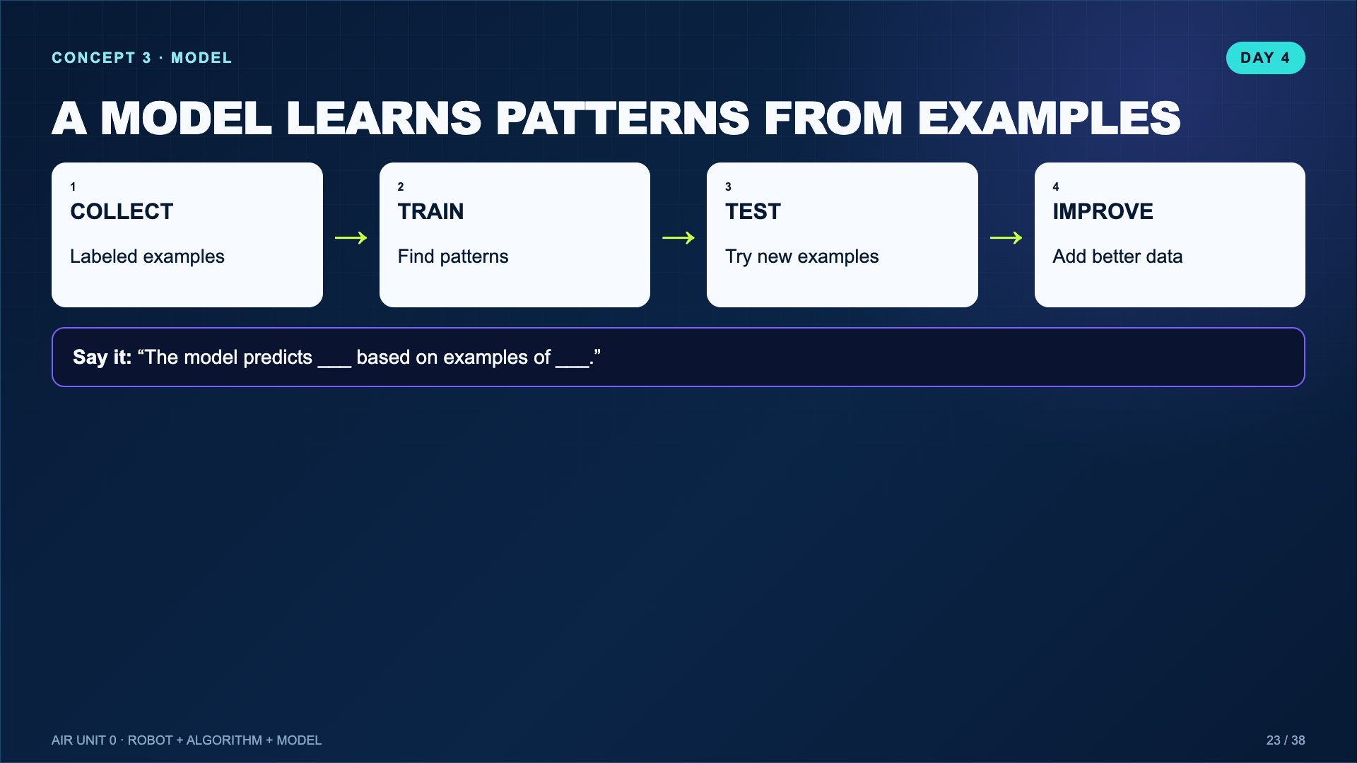
Notes:
Distinguish the model from the training tool. Teachable Machine is the tool; the trained classifier is the model.
[Sources]
- https://teachablemachine.withgoogle.com/v1/

Slide 24
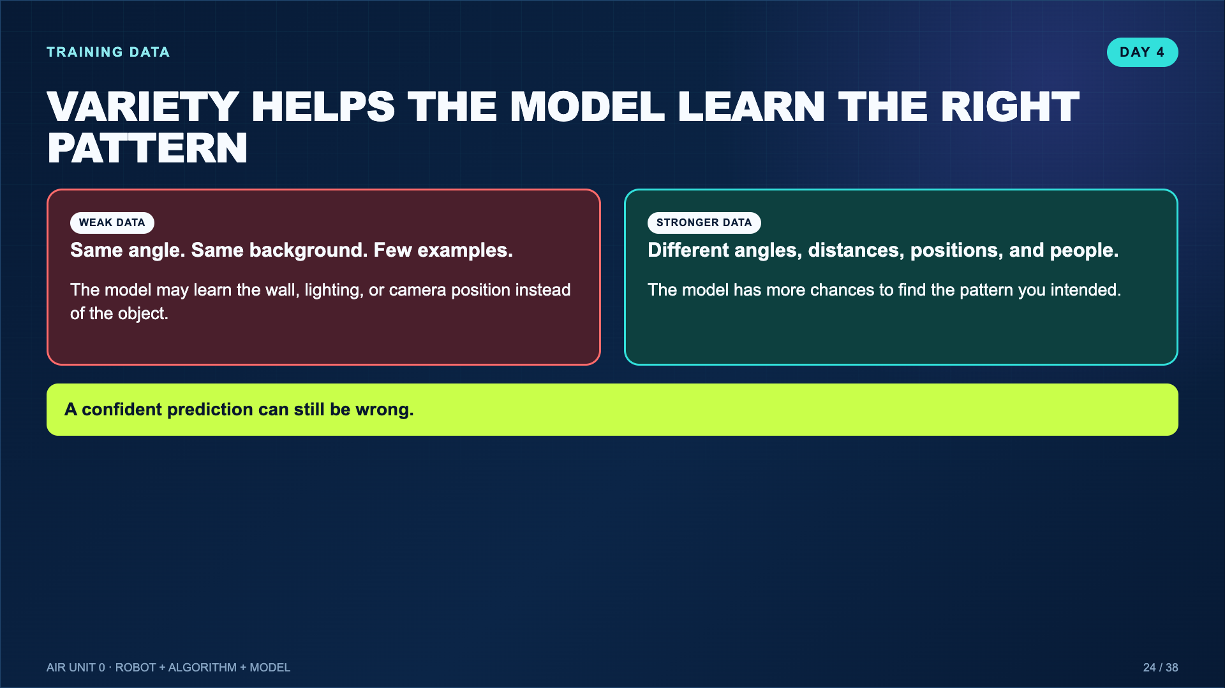
Notes:
Use a school-safe example such as two classroom objects or hand signals. Avoid faces or personal information. Google’s first Teachable Machine version recommends at least 30 images per class and varied angles.
[Sources]
- https://teachablemachine.withgoogle.com/v1/
- https://teachablemachine.withgoogle.com/faq

Slide 25
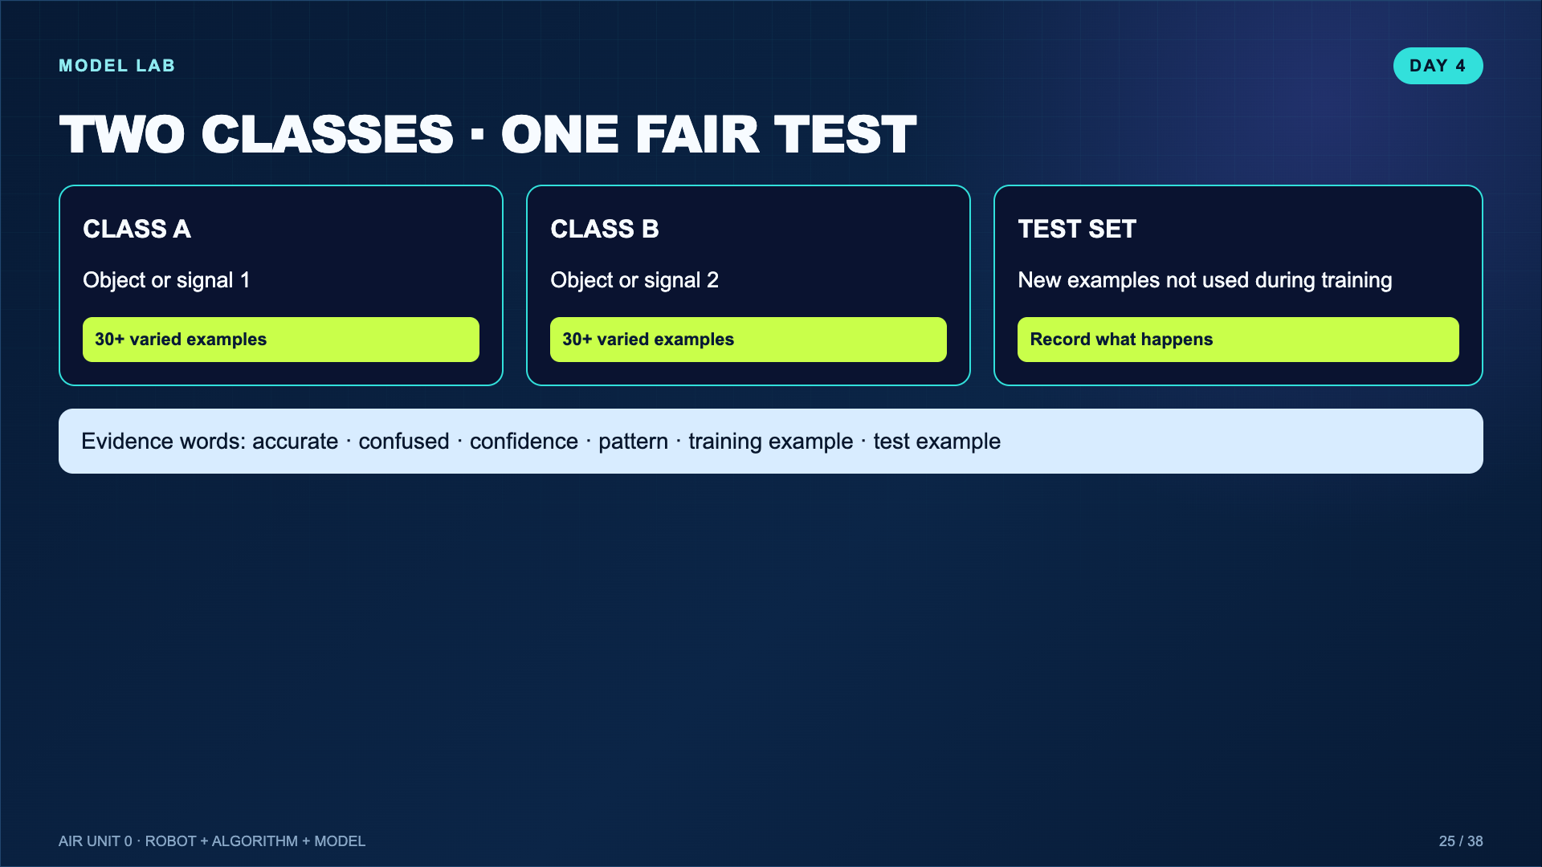
Notes:
If devices or cameras are limited, run one teacher model and have teams predict/record results. The learning target is data and testing, not account setup.
[Sources]
- Teacher-created instructional synthesis for this deck.

Slide 26
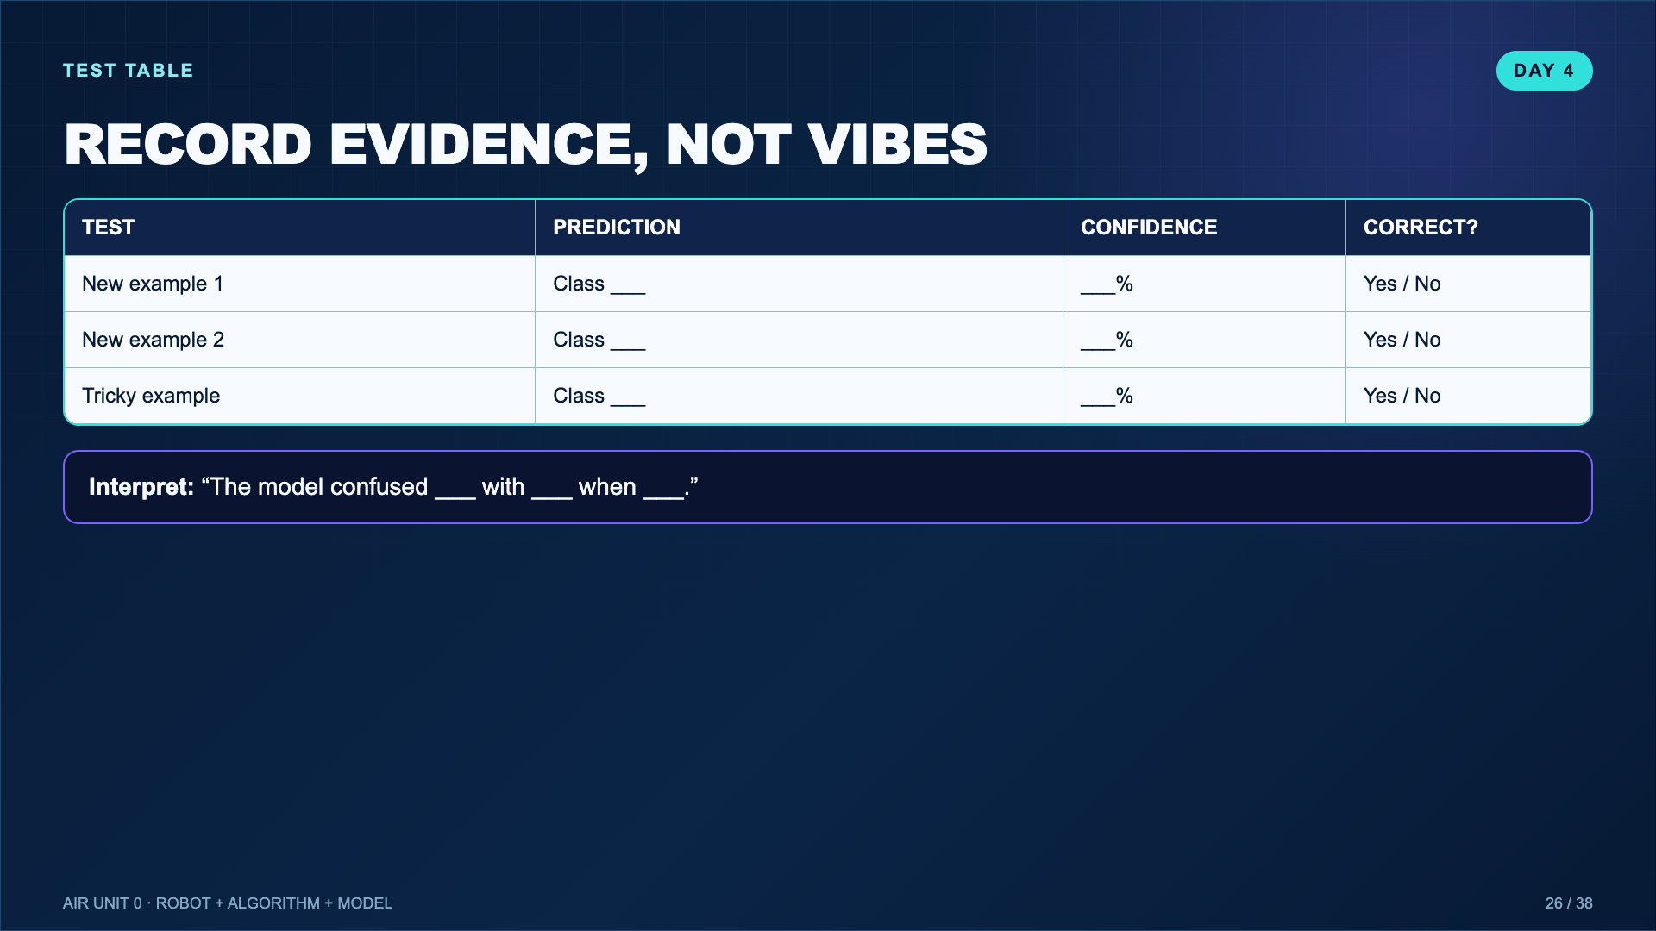
Notes:
Require at least one difficult test. A model that only sees easy examples does not reveal much.
[Sources]
- Teacher-created instructional synthesis for this deck.

Slide 27
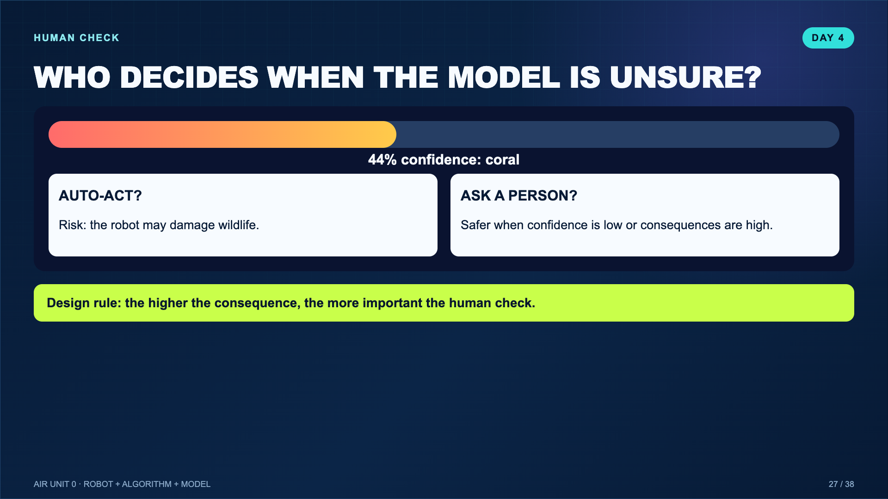
Notes:
This is the responsible-AI bridge. Do not imply a universal confidence threshold; students choose a reasonable rule and justify it.
[Sources]
- Teacher-created instructional synthesis for this deck.

Slide 28
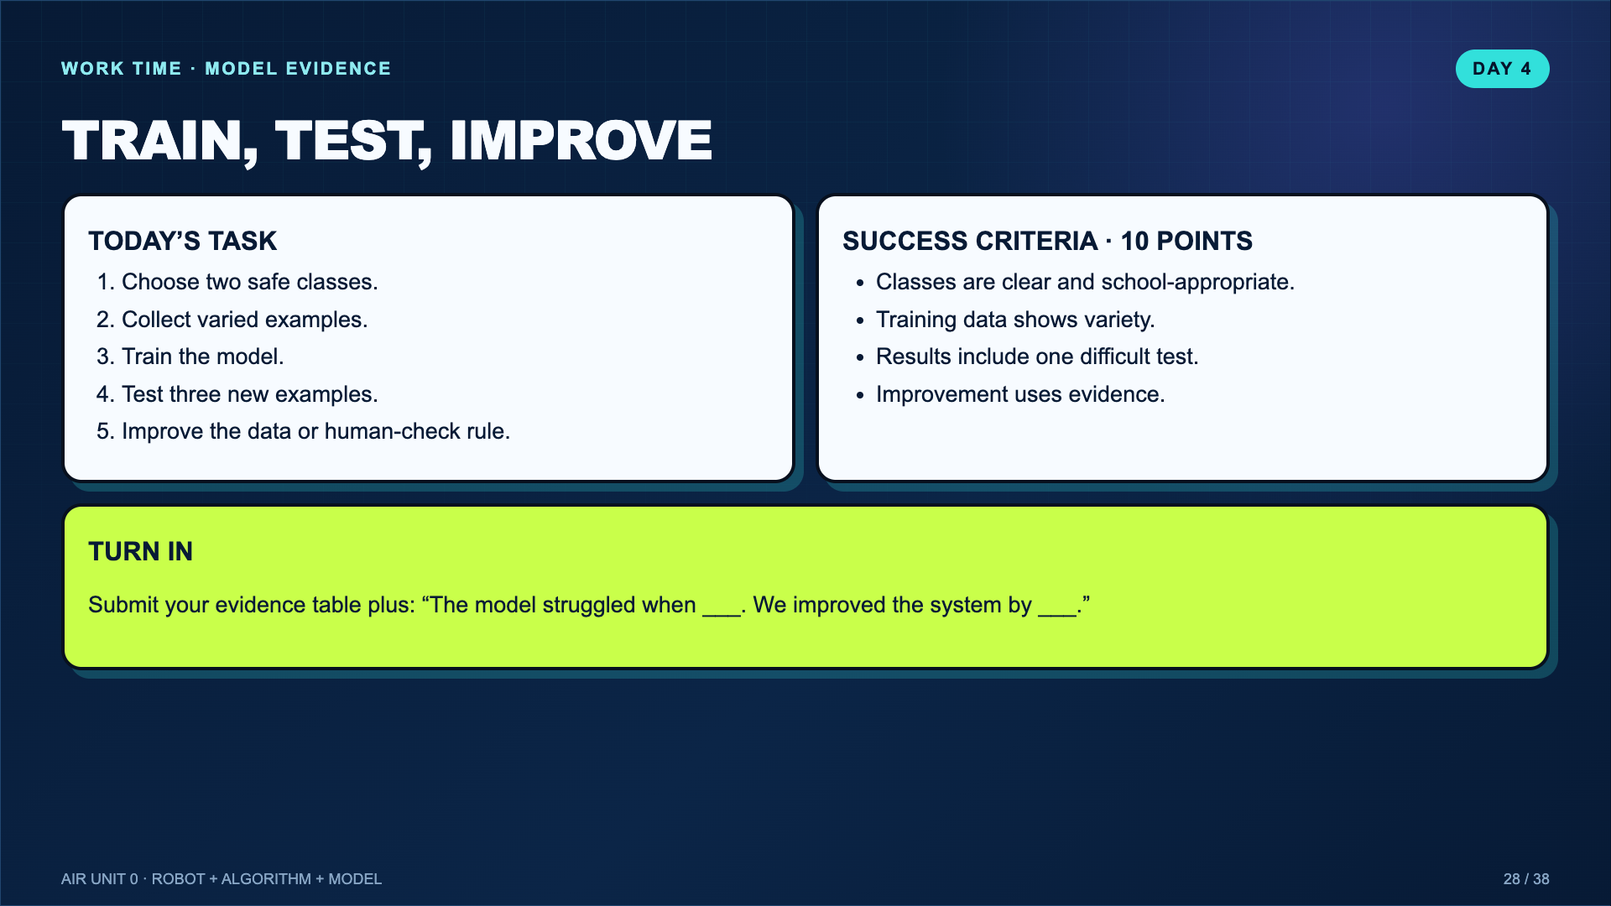
Notes:
Leave this projected. If using the teacher-led route, each student still records individual evidence and an improvement.
[Sources]
- Teacher-created instructional synthesis for this deck.

Slide 29
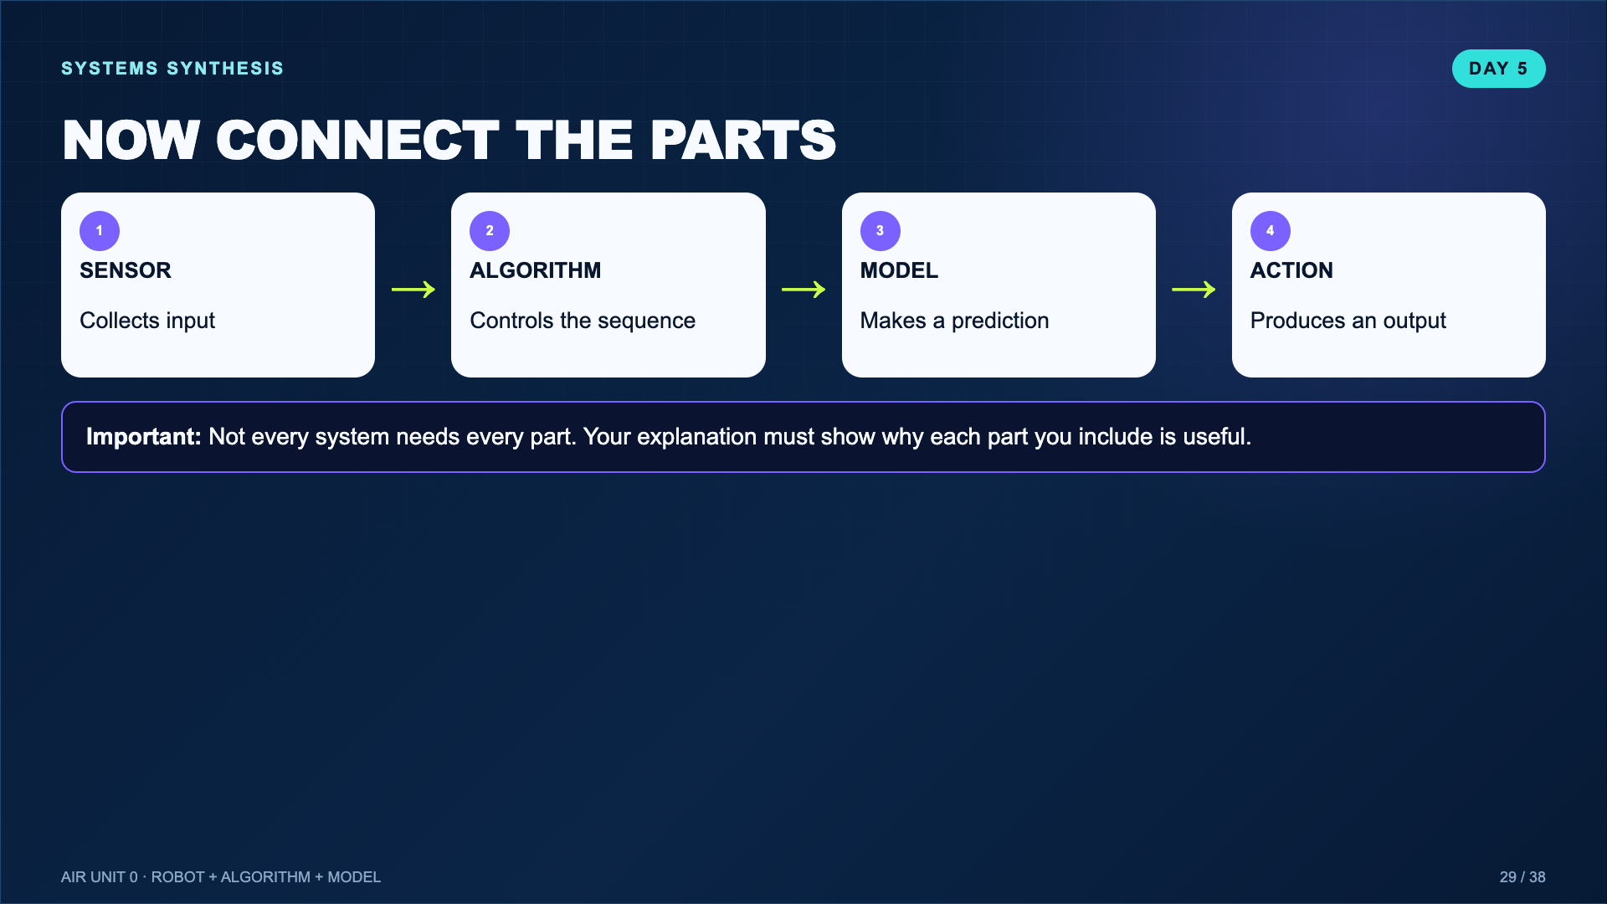
Notes:
Students should not add AI just to make the project sound advanced. A rule-based system may be the better design.
[Sources]
- Teacher-created instructional synthesis for this deck.

Slide 30
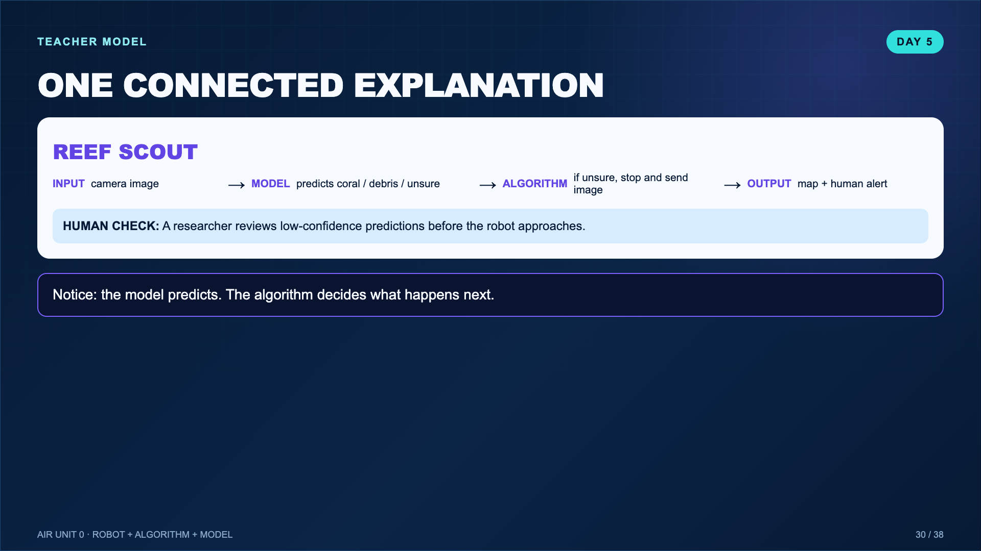
Notes:
This distinction is the conceptual center of the unit. The model does not “decide everything.”
[Sources]
- Teacher-created instructional synthesis for this deck.

Slide 31
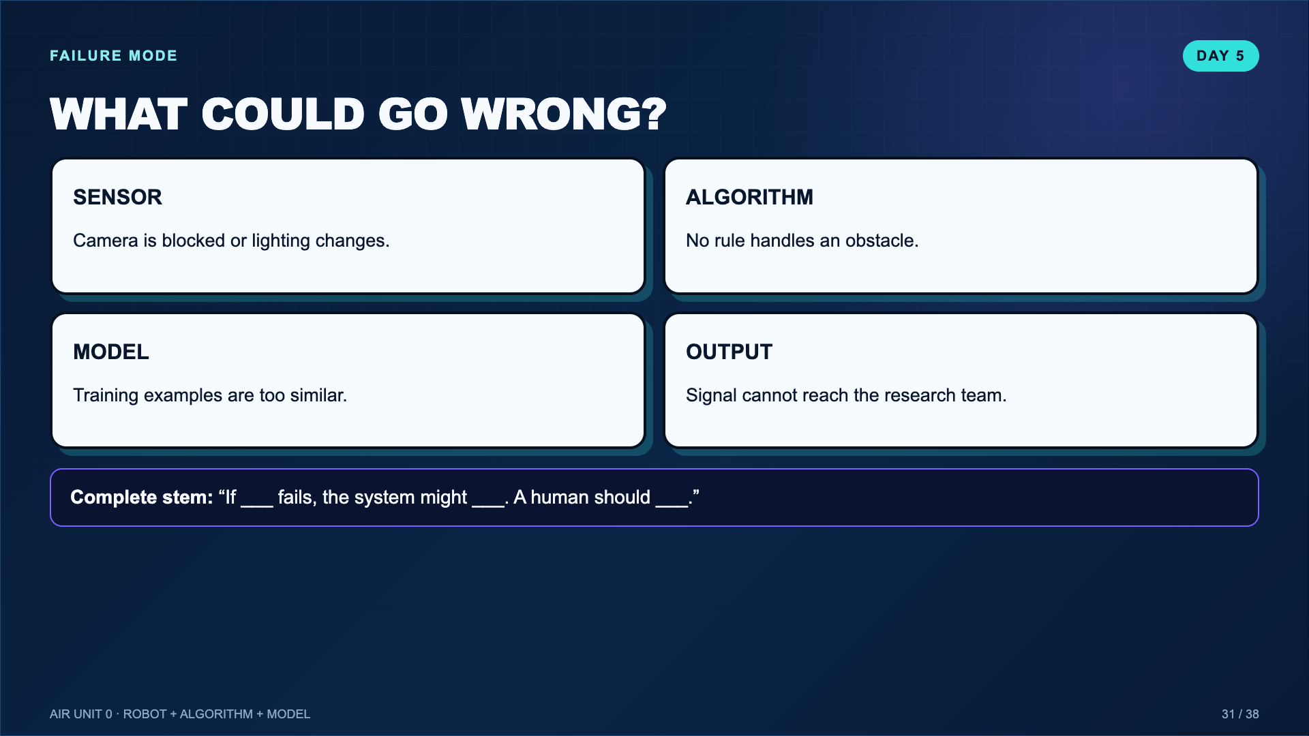
Notes:
Ask teams to choose one plausible failure, not list every imaginable risk.
[Sources]
- Teacher-created instructional synthesis for this deck.

Slide 32
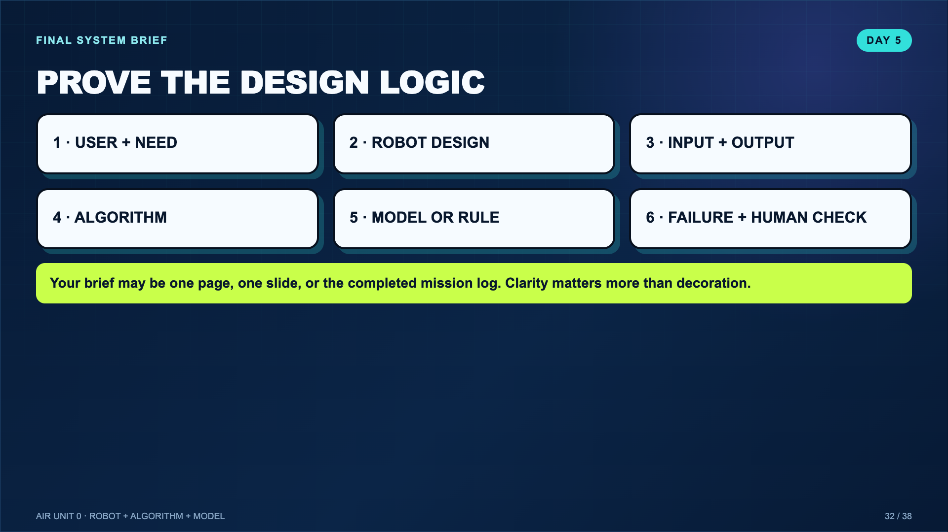
Notes:
This is the synthesis artifact. Do not require a new polished product if the mission log already contains the evidence.
[Sources]
- Teacher-created instructional synthesis for this deck.

Slide 33
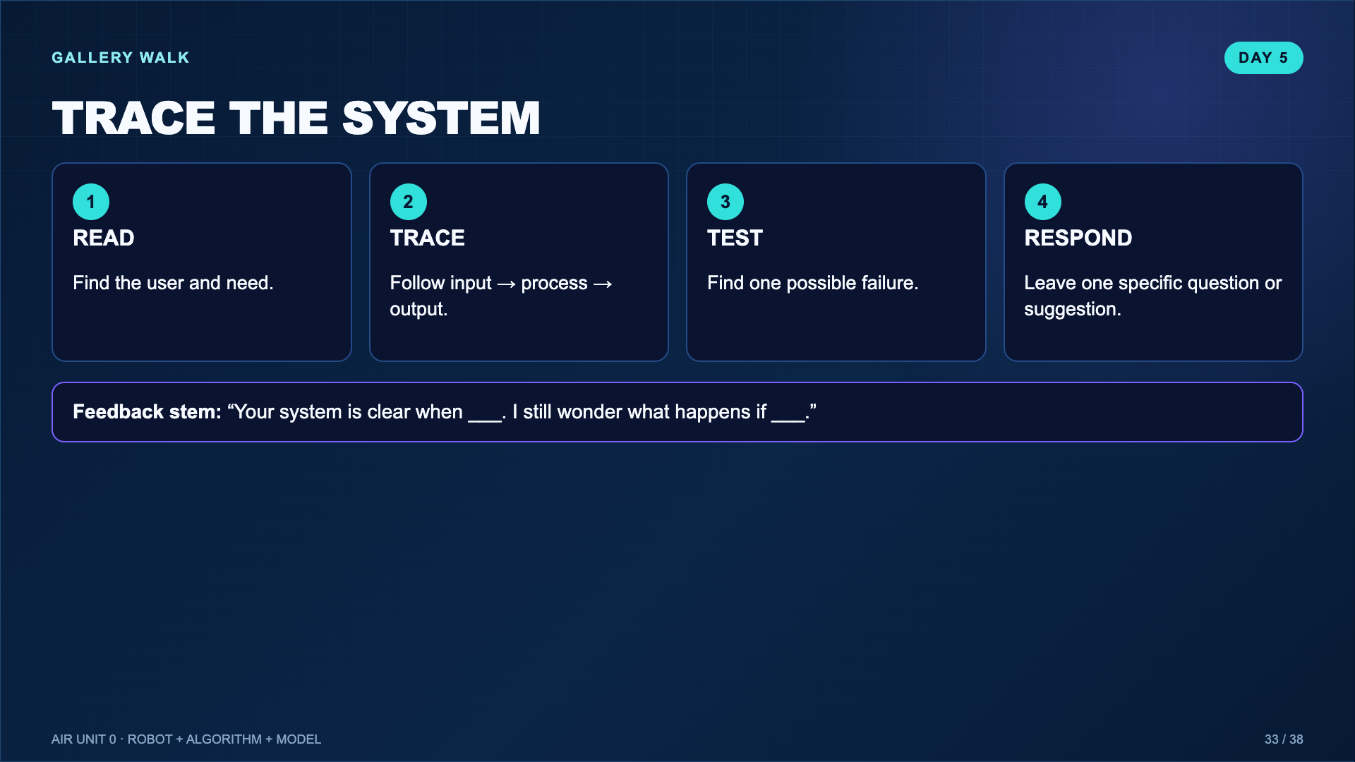
Notes:
Use sticky notes, comments, or oral partner feedback. One useful response is enough; the focus is revision evidence.
[Sources]
- Teacher-created instructional synthesis for this deck.

Slide 34
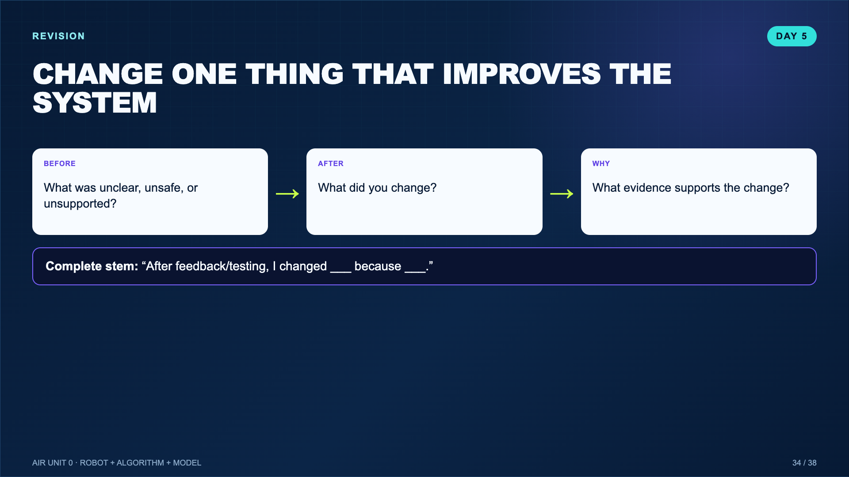
Notes:
Require one meaningful revision, not a color change unless color fixes a communication problem.
[Sources]
- Teacher-created instructional synthesis for this deck.

Slide 35
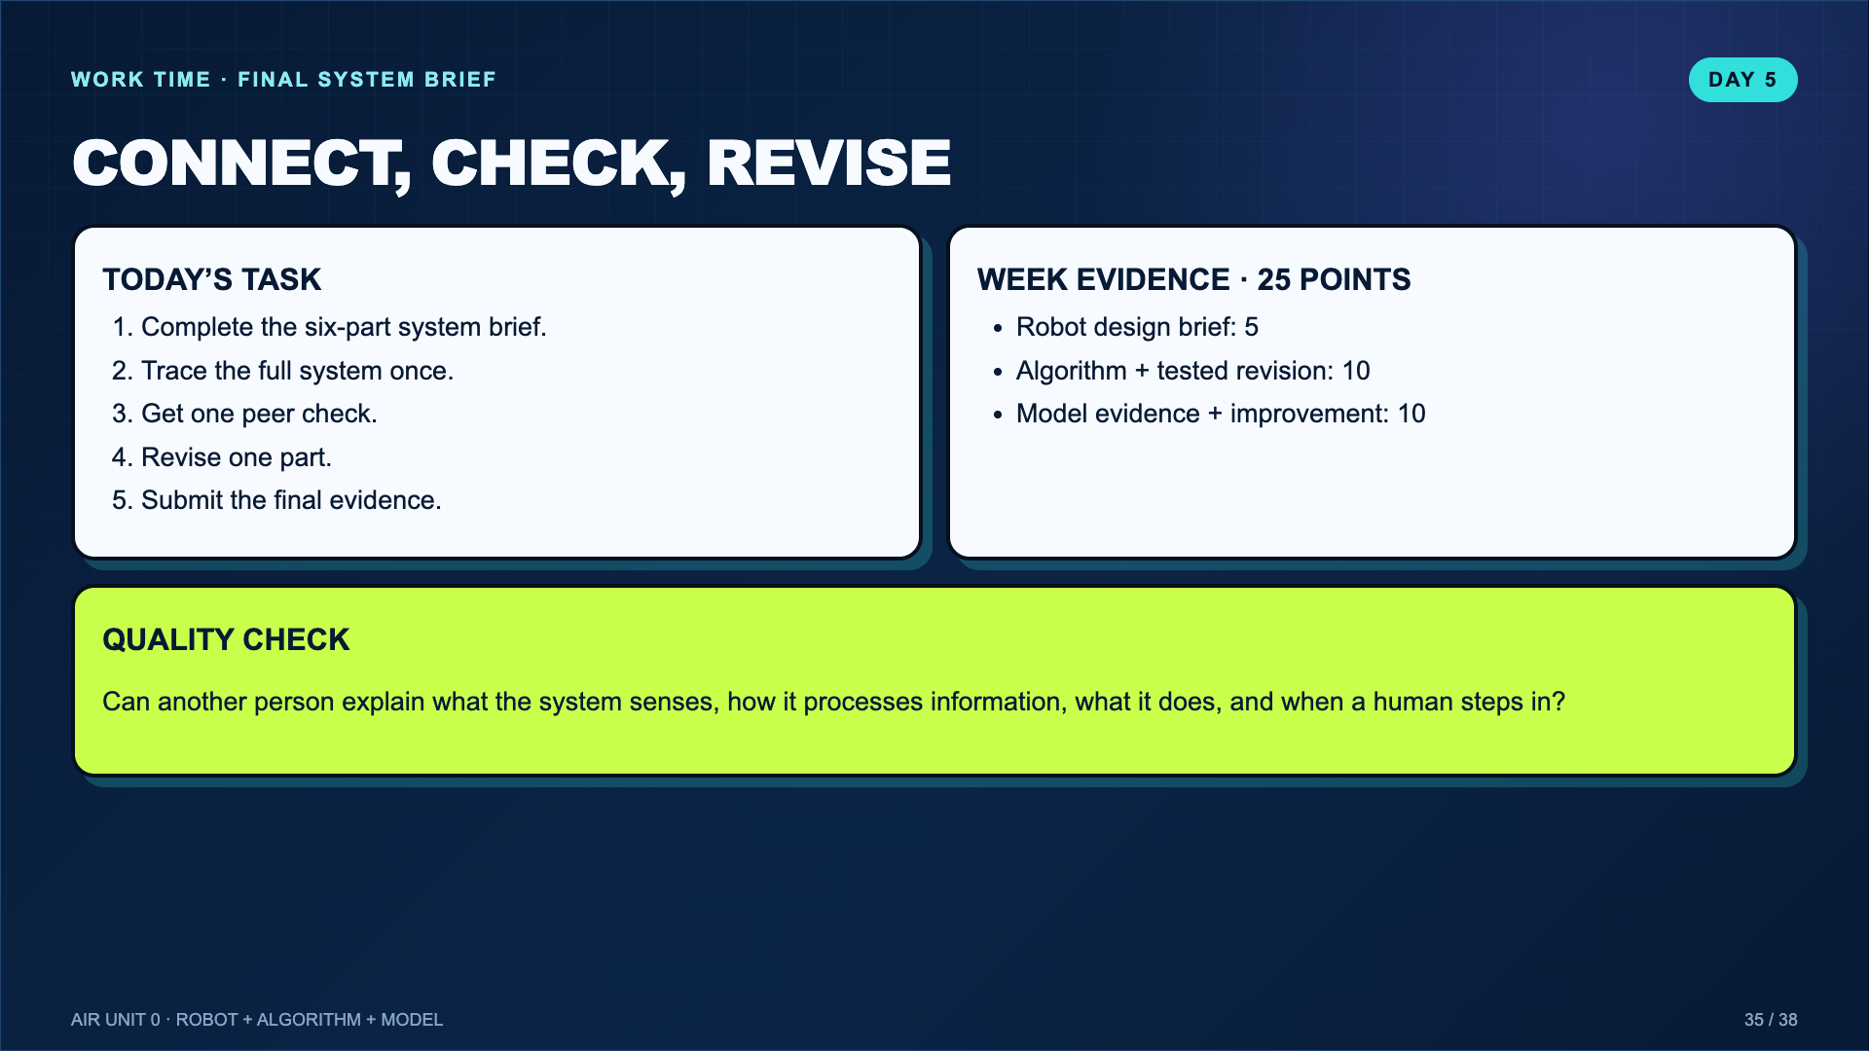
Notes:
Leave this projected for the final build. The grade is based on student technical evidence, not video completion.
[Sources]
- Teacher-created instructional synthesis for this deck.

Slide 36
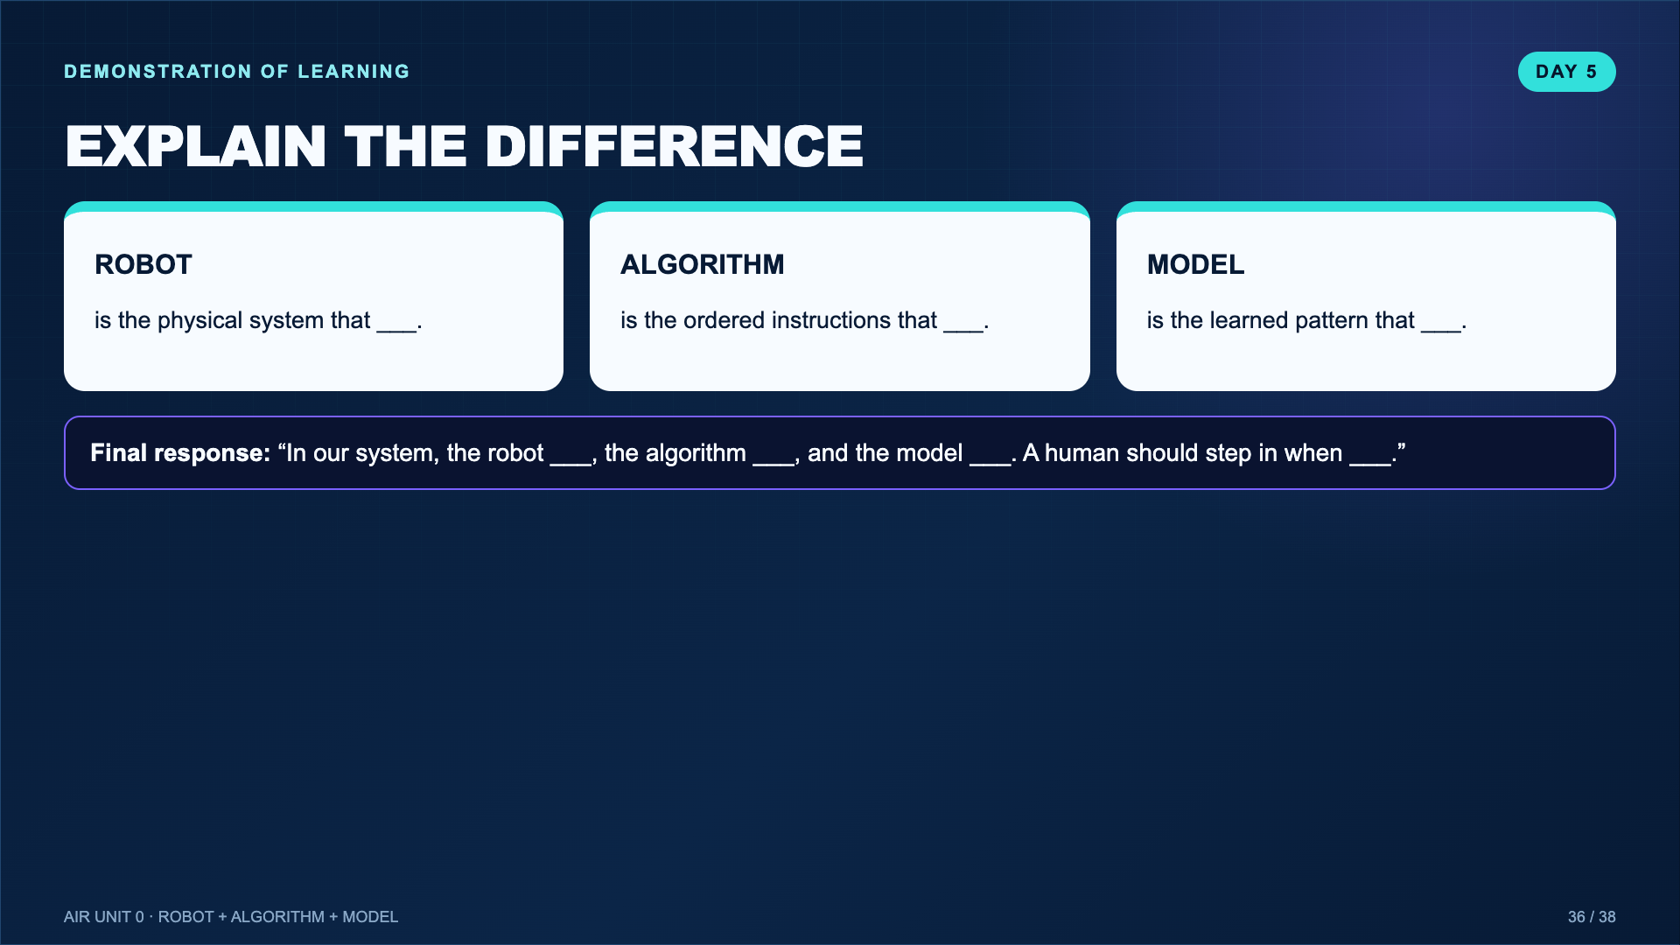
Notes:
Collect this as the final exit response. A student can meet the goal even if their prototype stayed on paper.
[Sources]
- Teacher-created instructional synthesis for this deck.

Slide 37
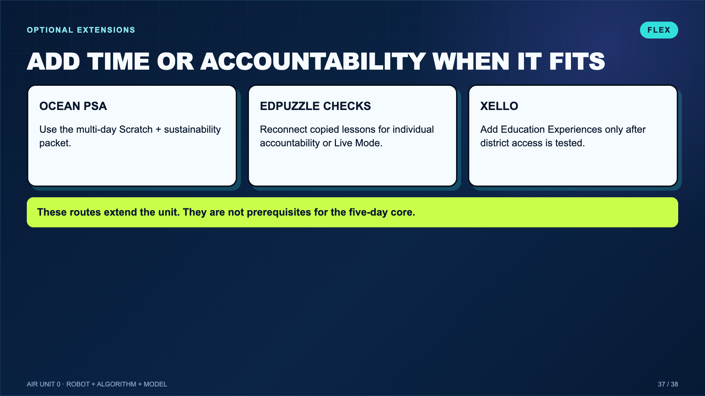
Notes:
This slide is teacher-only and belongs at the end of the deck. Do not project it as part of the student lesson.
[Sources]
- Teacher-created instructional synthesis for this deck.

Slide 38
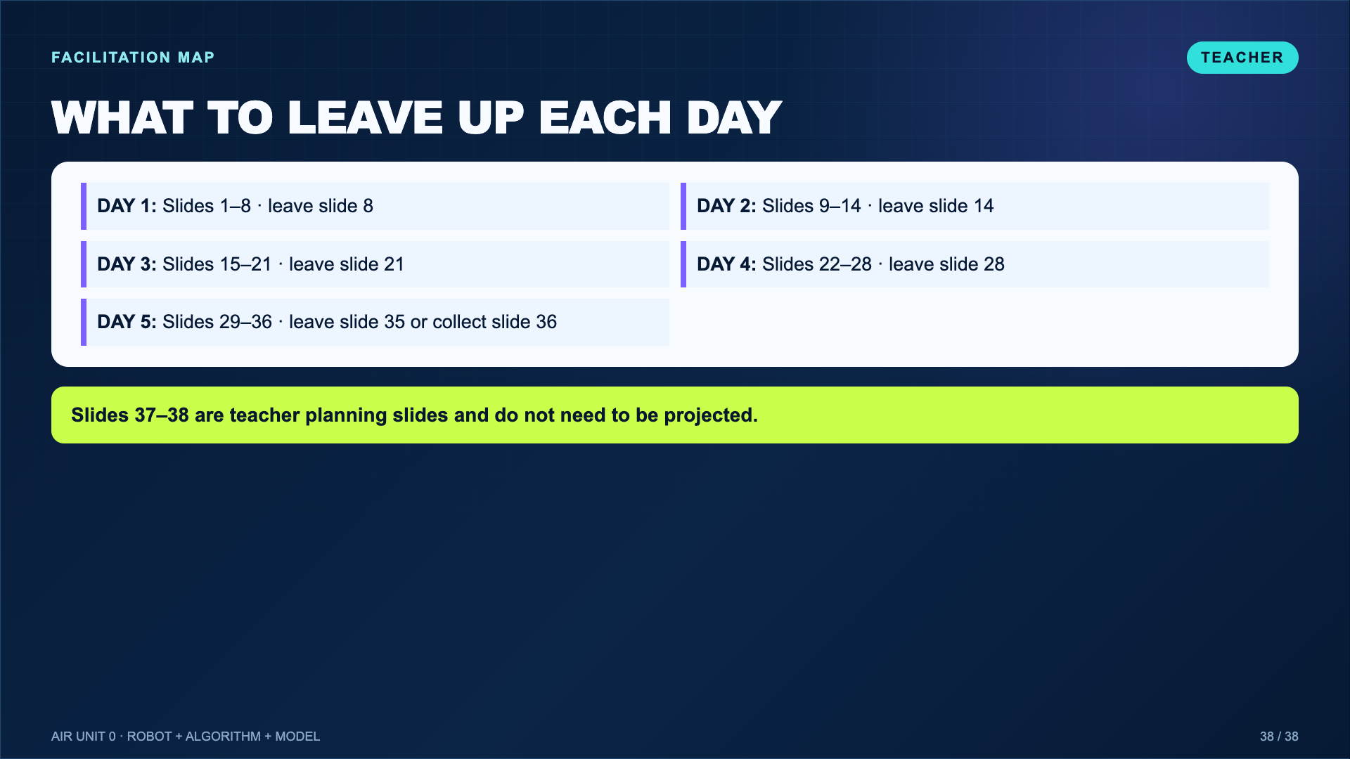
Notes:
Use this map in the facilitator guide. The deck is intentionally complete enough for whole-group teaching while Canvas remains the accessible review/absence route.
[Sources]
- Teacher-created instructional synthesis for this deck.

