Slide 1
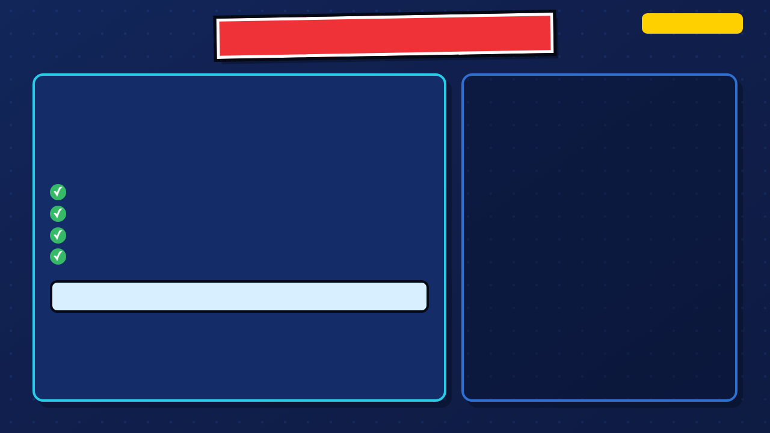
SUPERHERO MICRO-ANIMATION
5-DAY SIDE QUEST
ANIMATE THE PROMISE
Create a short GIF that makes your hero's new brand promise visible through action.
Define the promise
Plan a mini-story
Prototype in Piskel
Test, revise, and export
Five-day route: Define → Ideate → Prototype → Test → Iterate
1 / 69
Notes:
Launch the five-day arc. Students bring forward the hero and logo from Comics, then define a new brand promise before they plan or animate.
[Sources]
- Irving ISD VILS 2027 Template Animation student pages, rubric, and facilitator guide.
- Instructor-supplied Copy of Superhero Piskel (1).pptx; classroom source deck and embedded media.
- Texas Education Agency, 19 TAC Chapter 126, Technology Applications Grade 8, Adopted 2022: https://tea.texas.gov/laws-and-rules/texas-administrative-code/19-tac-chapter-126

Slide 2
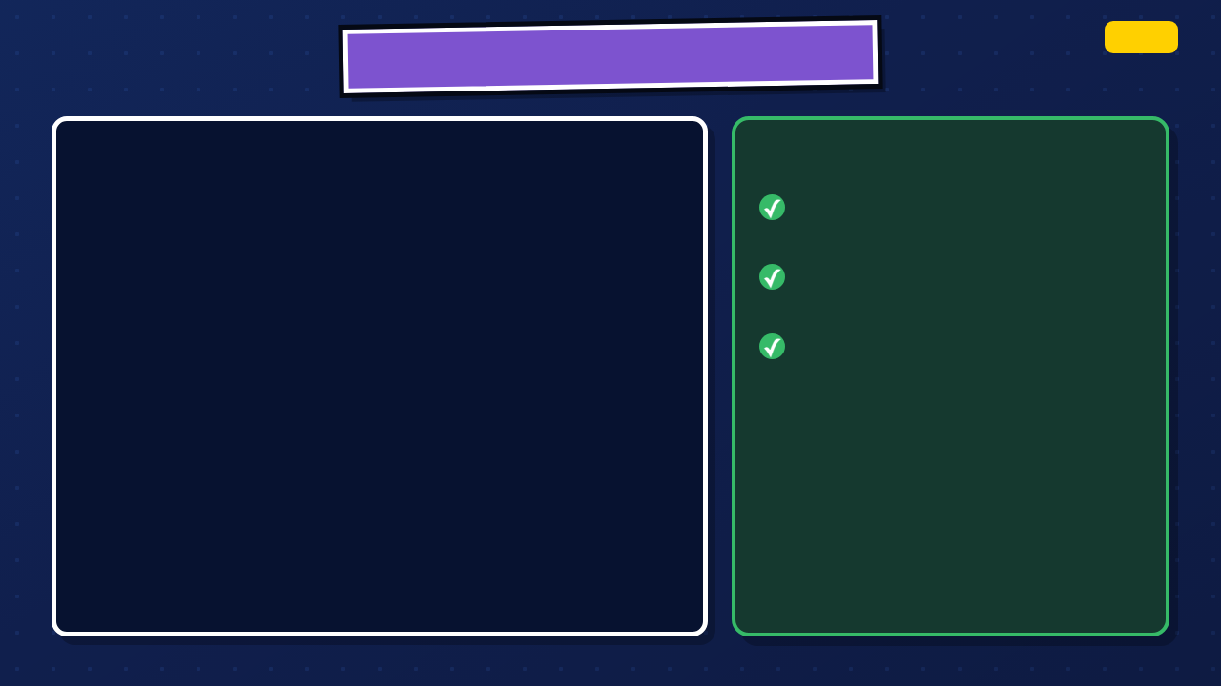
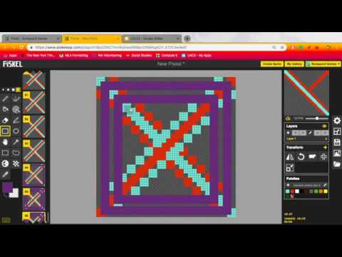
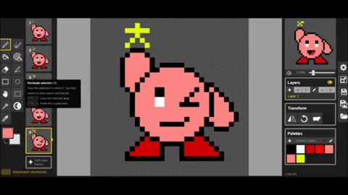
PISKEL IN MOTION
DEMO
WHILE IT PLAYS, NOTICE
The artist changes one frame at a time
The timeline moves through every frame
The preview turns small changes into motion
PLAY THE PISKEL TIME-LAPSE
2 / 69
Notes:
Play only enough of the Piskel time-lapse to show that animation is built frame by frame. Pause to point out duplication, small changes, and preview. The video is a demonstration, not the day's full tutorial.
[Sources]
- Instructor-supplied Copy of Superhero Piskel (1).pptx; classroom source deck and embedded media.
- Piskel time-lapse linked in the instructor deck: https://www.youtube.com/watch?v=FQKyQTDbOBQ

Slide 3

STUDENT GIF EXAMPLES
LOOK CLOSELY
STUDENT GIF 1
STUDENT GIF 2
STUDENT GIF 3
What can you understand from the motion alone?
3 / 69
Notes:
This slide is intentionally ready for teacher-selected student GIFs. Replace the three labeled frames with current, permission-cleared examples. Ask what the audience understands from motion alone.
[Sources]
- Instructor-supplied Copy of Superhero Piskel (1).pptx; classroom source deck and embedded media.

Slide 4
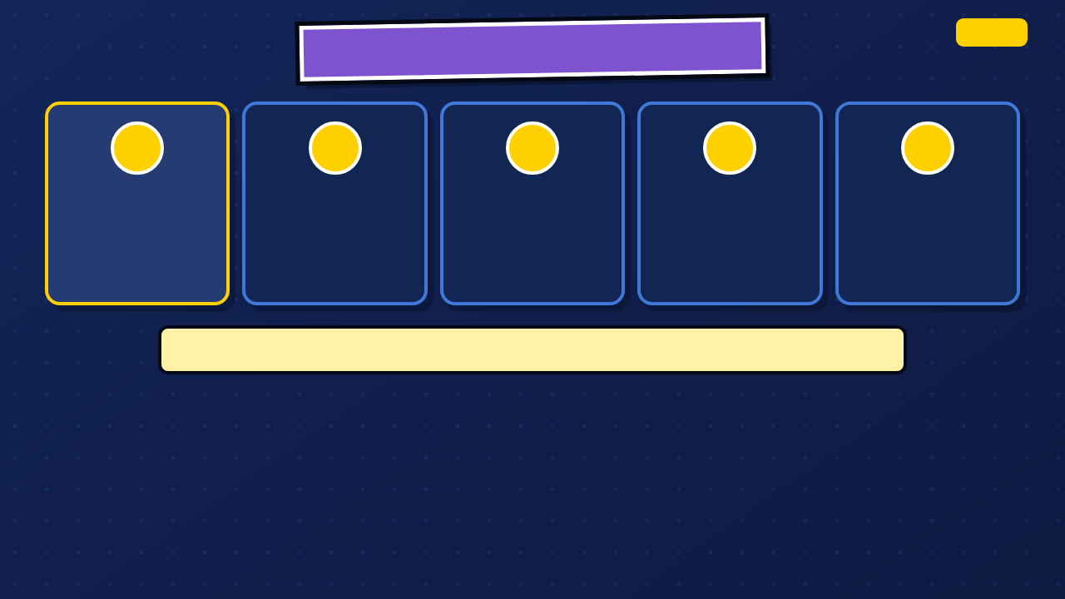
WHERE ARE WE IN DESIGN THINKING?
DEFINE
1
2
3
4
5
DEFINE
IDEATE
PROTOTYPE
TEST
ITERATE
Learn what a brand promise is and write one for your hero.
Plan the promise as a visible mini-story.
Build the motion in Piskel.
Let an audience watch before you explain.
Use evidence to revise and export.
Today we define what people should be able to count on your hero to do.
4 / 69
Notes:
Introduce the five design-thinking phases. Today is Define: students learn the concept and produce the promise.
[Sources]
- Texas Education Agency, 19 TAC Chapter 126, Technology Applications Grade 8, Adopted 2022: https://tea.texas.gov/laws-and-rules/texas-administrative-code/19-tac-chapter-126
- Irving ISD VILS 2027 Template Animation student pages, rubric, and facilitator guide.

Slide 5

TODAY'S OBJECTIVES: DAY 1
DEFINE
TODAY YOU WILL
YOU ARE DONE WHEN
Explain the difference between a logo and a brand
Your hero has one clear promise and one example of how the hero acts on it.
Infer what real brands want people to expect
Write a first brand promise for your superhero
TEKS connection: use an innovative design process to define, plan, test, and improve a digital solution.
5 / 69
Notes:
Read the objective and done-when. Students finish Day 1 with a new promise and one example action, not only a logo or a list of powers.
[Sources]
- Texas Education Agency, 19 TAC Chapter 126, Technology Applications Grade 8, Adopted 2022: https://tea.texas.gov/laws-and-rules/texas-administrative-code/19-tac-chapter-126
- Irving ISD VILS 2027 Template Animation student pages, rubric, and facilitator guide.

Slide 6

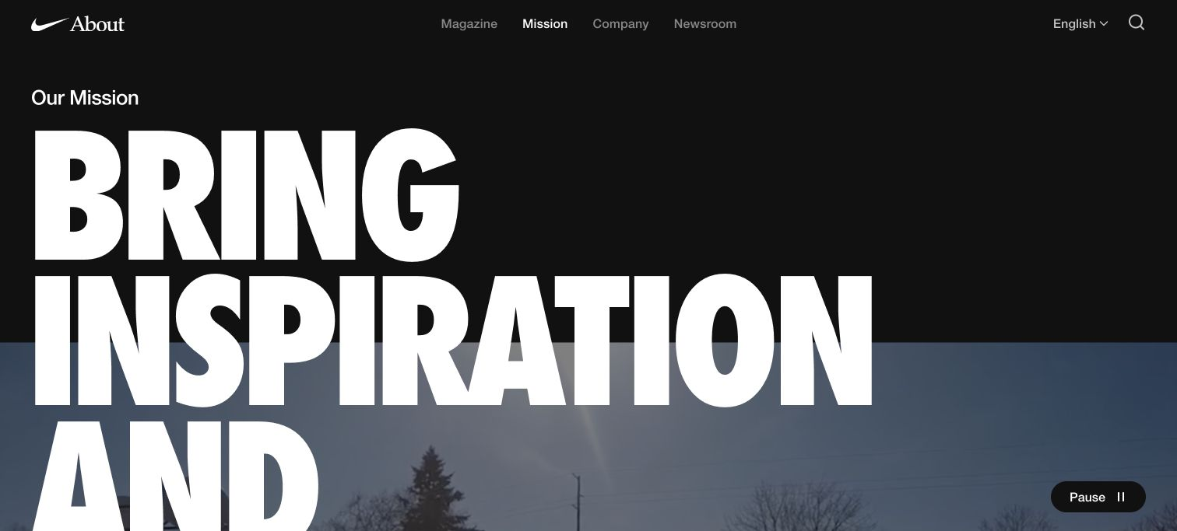
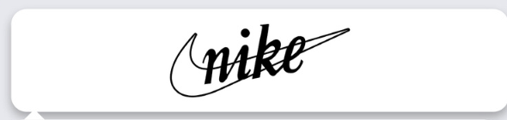
LOGO IS NOT THE SAME AS BRAND
DEFINE
LOGO: THE MARK
BRAND: THE EXPECTATION
You recognize the swoosh before you read a word.
The mark carries a promise about athletes, movement, and innovation.
The logo identifies Nike. The brand tells people what to expect.
6 / 69
Notes:
Use Nike as the concrete example. Point to the swoosh first, then ask what the mission page adds that the mark alone cannot say.
[Sources]
- Irving ISD VILS 2027 Template Animation student pages, rubric, and facilitator guide.
- Instructor-supplied Copy of Superhero Piskel (1).pptx; classroom source deck and embedded media.
- Nike official mission: https://about.nike.com/en/mission/
- Nike official mission page screenshot: https://about.nike.com/en/mission/

Slide 7
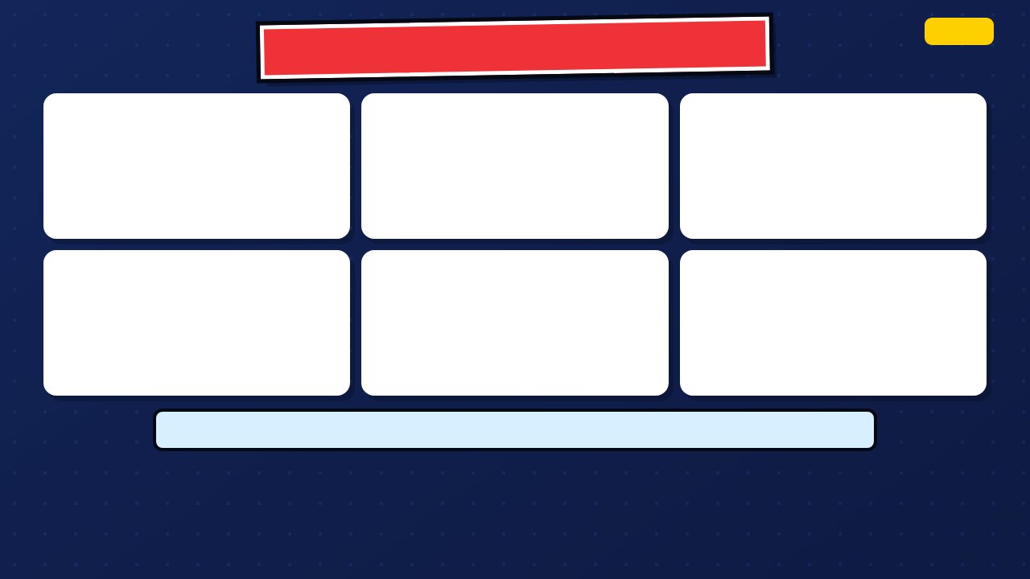
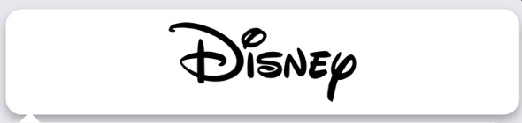
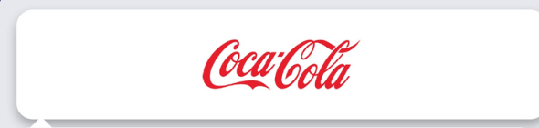
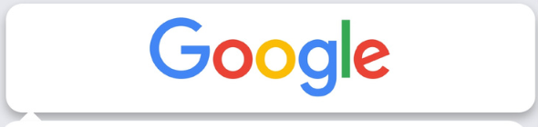
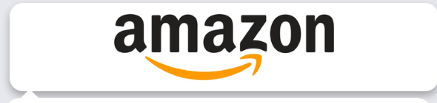
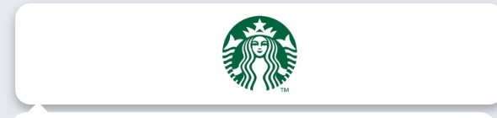
CORPORATE LOGOS: WHAT COMES TO MIND?
DEFINE
What values come to mind?
What does the swoosh suggest?
What feeling does it evoke?
What does the color suggest?
What does the smile suggest?
What experience do you expect?
What do these companies want you to think or feel before you buy anything?
7 / 69
Notes:
Show the logos without giving answers first. Ask what values, feelings, or experiences come to mind and what evidence in the mark led to that inference.
[Sources]
- Corporate logos and superhero pixel-art examples cropped from the instructor-supplied deck; original external provenance was not embedded. Trademarks and characters are shown for classroom analysis.
- The Walt Disney Company official mission: https://thewaltdisneycompany.com/about/
- Nike official mission: https://about.nike.com/en/mission/
- Google official mission: https://about.google/company-info/
- Starbucks current mission: https://about.starbucks.com/accessibility/

Slide 8
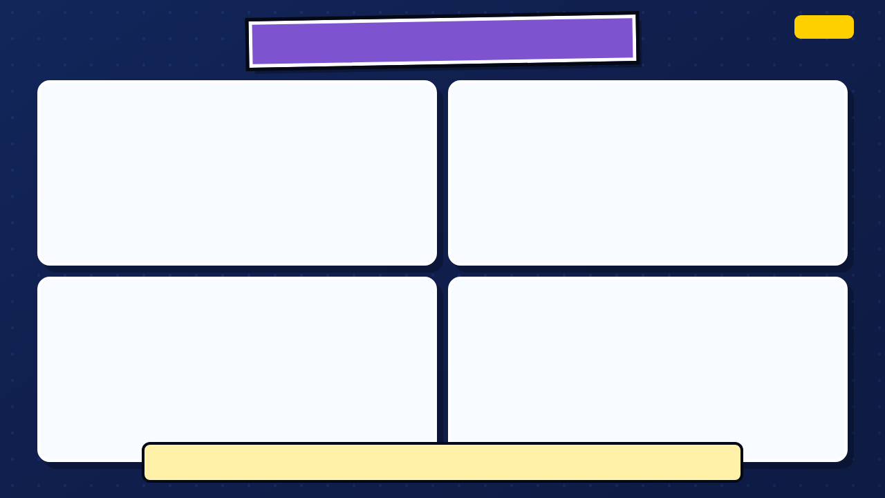
CORPORATE BRAND PROMISES
DEFINE
Entertain, inform, and inspire through unparalleled storytelling.
Bring inspiration and innovation to every athlete in the world.
Organize the world's information and make it universally accessible and useful.
Nurture the limitless possibilities of human connection.
What would each company have to do to keep this promise?
8 / 69
Notes:
Let students connect each logo to its official mission. Ask what the company would have to do for customers to believe the promise.
[Sources]
- Corporate logos and superhero pixel-art examples cropped from the instructor-supplied deck; original external provenance was not embedded. Trademarks and characters are shown for classroom analysis.
- The Walt Disney Company official mission: https://thewaltdisneycompany.com/about/
- Nike official mission: https://about.nike.com/en/mission/
- Google official mission: https://about.google/company-info/
- Starbucks current mission: https://about.starbucks.com/accessibility/

Slide 9



LOGOS AND PROMISES WORK TOGETHER
DEFINE
Making fashion accessible to all.
Craft and heritage since 1854.
Respond to customer demand
Long-lived craft traditions
Creative reinvention
Offer frequent new choices
Customers expect craft, heritage, and exclusivity.
Customers expect access, variety, and speed.
Both sell fashion. They teach customers to expect different things.
9 / 69
Notes:
Read the two official statements, then ask what a customer expects from each fashion brand. Keep the comparison on access, speed, craft, heritage, and exclusivity rather than price.
[Sources]
- SHEIN Group mission and on-demand model: https://www.sheingroup.com/our-group
- SHEIN Group official site header wordmark: https://www.sheingroup.com/our-group
- Louis Vuitton official heritage and craftsmanship history: https://id.louisvuitton.com/eng-id/magazine/articles/heritage
- Louis Vuitton official site header wordmark: https://us.louisvuitton.com/eng-us/magazine/articles/heritage

Slide 10

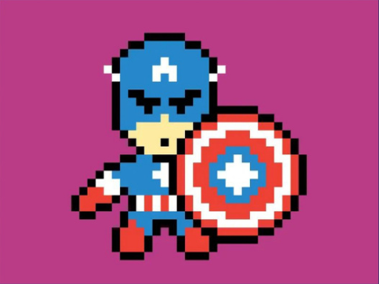
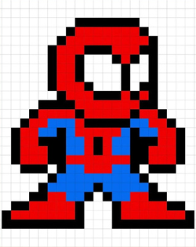
MINI-THINK: WHAT MAKES A PROMISE?
DEFINE
WHO + WHY
WHAT + WHEN
Who depends on the hero?
What does the hero do?
Why do they need help?
When does the promise matter?
Can you draw the promise as one action? If not, make it smaller.
10 / 69
Notes:
Use the two superhero images to test the promise. Students should be able to name who depends on the hero, what the hero does, and when the promise matters.
[Sources]
- Irving ISD VILS 2027 Template Animation student pages, rubric, and facilitator guide.
- Instructor-supplied Copy of Superhero Piskel (1).pptx; classroom source deck and embedded media.
- Corporate logos and superhero pixel-art examples cropped from the instructor-supplied deck; original external provenance was not embedded. Trademarks and characters are shown for classroom analysis.

Slide 11
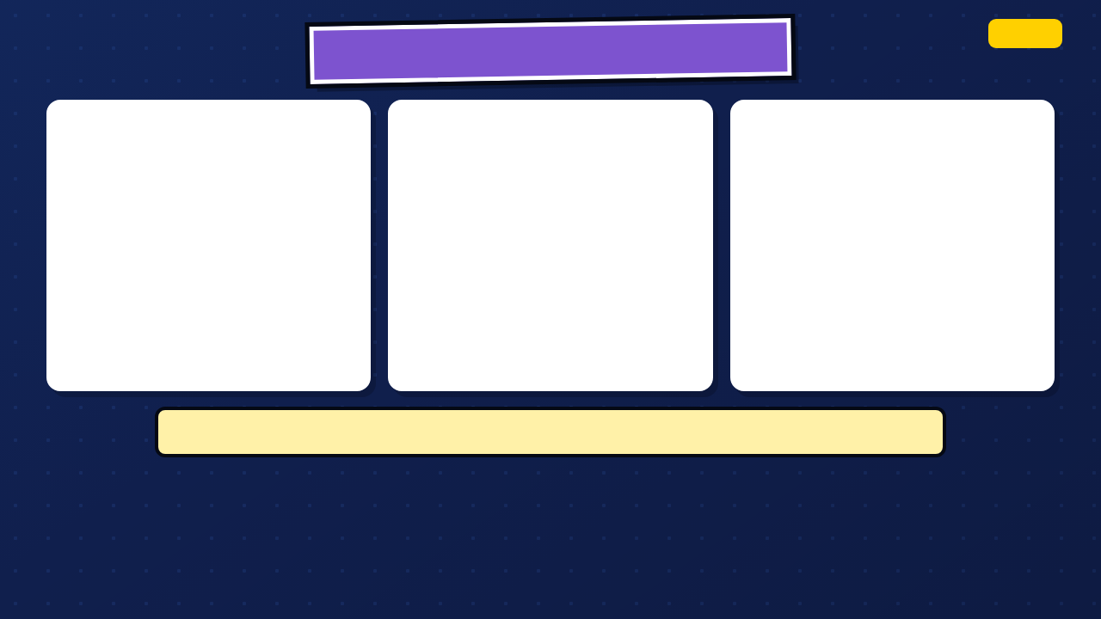

SUPERHERO EMBLEMS + VALUES
DEFINE
CAPTAIN AMERICA
SPIDER-MAN
BATMAN
freedom · justice · standing up to bullies
responsibility · selflessness · helping others
justice · determination · protection
What values does your hero represent, and what action could prove them?
11 / 69
Notes:
Use familiar superhero examples to infer values, then transfer the thinking to original student heroes. Do not require students to copy a commercial character, emblem, quote, or story.
[Sources]
- Corporate logos and superhero pixel-art examples cropped from the instructor-supplied deck; original external provenance was not embedded. Trademarks and characters are shown for classroom analysis.
- Irving ISD VILS 2027 Template Animation student pages, rubric, and facilitator guide.

Slide 12

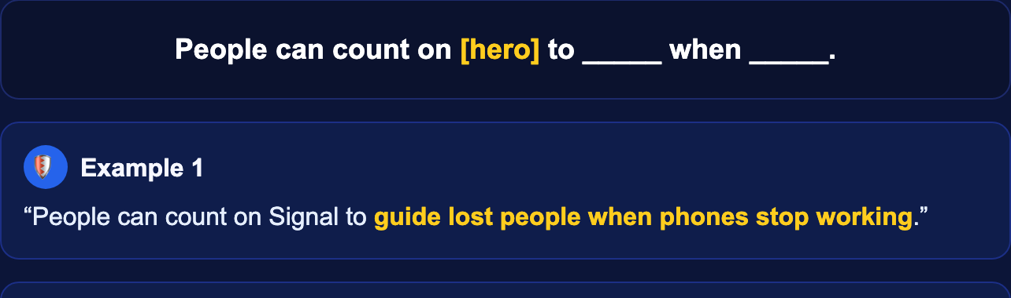
WHAT IS YOUR HERO'S PROMISE?
DEFINE
SUPERHERO PROMISE
WRITE YOUR HERO'S PROMISE
People can count on my hero to ________ when ________.
Example: guide lost people when phones stop working.
Example: warn neighbours before floodwater reaches the street.
In Canvas, open Superhero Promise.
Type both lines.
Done early? Experiment in Piskel.
The audience will see this when ________.
12 / 69
Notes:
The screenshot shows the two fields students type in Canvas. Give students quiet writing time, then check that the promise names one action and one situation.
[Sources]
- Irving ISD VILS 2027 Template Animation student pages, rubric, and facilitator guide.
- Instructor-supplied Copy of Superhero Piskel (1).pptx; classroom source deck and embedded media.
- Current synchronized Canvas Superhero Promise assignment prompt, course 23402 assignment 1183415, captured from the local public mirror without student data.

Slide 13

EXIT CHECK: SHARE YOUR PROMISE
DEFINE
POST YOUR PROMISE
LISTEN FOR CLARITY
Your complete promise sentence
Can classmates picture an action that would prove the promise?
One way your hero demonstrates it
Your name and your hero's name
I can picture your hero ________.
13 / 69
Notes:
Students share the new promise. Listeners respond with one action they can picture; that response is an early test of whether the promise is clear enough to animate.
[Sources]
- Irving ISD VILS 2027 Template Animation student pages, rubric, and facilitator guide.
- Instructor-supplied Copy of Superhero Piskel (1).pptx; classroom source deck and embedded media.

Slide 14

DIGITAL CITIZENSHIP
DAY 1
ANALYZE. DO NOT COPY.
CREDIT WHAT YOU USE
Use company logos only for classroom analysis
Name the source of outside images
Keep student work private unless sharing is approved
Create an original hero mark and original promise
On this project, every outside image needs a source line.
14 / 69
Notes:
Close Day 1 with the analysis-versus-copy boundary, image credits, and student privacy. The corporate and superhero examples are for classroom analysis; the final hero and promise are original.
[Sources]
- Texas Education Agency, 19 TAC Chapter 126, Technology Applications Grade 8, Adopted 2022: https://tea.texas.gov/laws-and-rules/texas-administrative-code/19-tac-chapter-126
- Irving ISD VILS 2027 Template Animation student pages, rubric, and facilitator guide.

Slide 15

PREVIEW: WHAT'S NEXT?
DAY 2: IDEATE
TOMORROW: IDEATE
BRING FORWARD
Turn the promise into one small scene with a beginning, problem, action, and visible result.
Your hero
Your new promise
One situation where the promise matters
15 / 69
Notes:
Preview Day 2. Students will keep the hero and new promise, then turn one situation into a compact plot and storyboard.
[Sources]
- Irving ISD VILS 2027 Template Animation student pages, rubric, and facilitator guide.

Slide 16
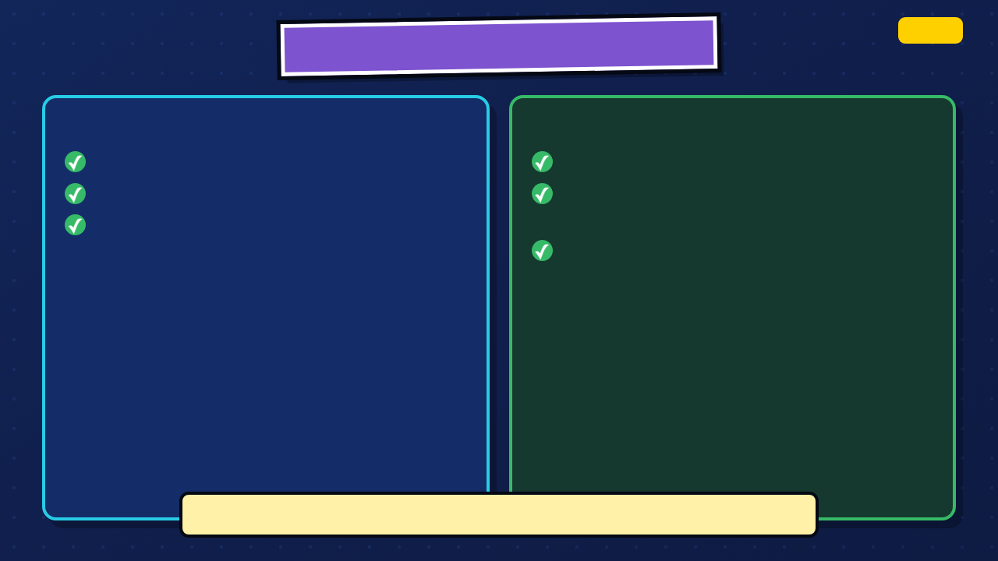
WHERE ARE WE IN DESIGN THINKING?
IDEATE
DEFINE IS COMPLETE
IDEATE TODAY
One visible hero promise
Turn the plot into visible beats
One problem or obstacle
Plan six panels or the approved four-panel route
One result the audience can see
Test one small motion in Piskel
Your six panels should tell you what to draw next.
16 / 69
Notes:
Re-enter the unit at Ideate. Today turns the plot into visible moments and gives students a low-stakes Piskel test before major production.
[Sources]
- Irving ISD VILS 2027 Template Animation student pages, rubric, and facilitator guide.

Slide 17

TODAY'S OBJECTIVES: DAY 2
IDEATE
TODAY YOU WILL
YOU ARE DONE WHEN
Turn your promise into a micro plot
Your storyboard shows a readable change from problem to result.
Storyboard six visible beats or the approved four-beat route
Pitch the action so a partner can follow it
17 / 69
Notes:
Read the Day 2 objective. The storyboard is done when another person can follow the change from problem to visible result without an oral explanation.
[Sources]
- Texas Education Agency, 19 TAC Chapter 126, Technology Applications Grade 8, Adopted 2022: https://tea.texas.gov/laws-and-rules/texas-administrative-code/19-tac-chapter-126
- Irving ISD VILS 2027 Template Animation student pages, rubric, and facilitator guide.

Slide 18

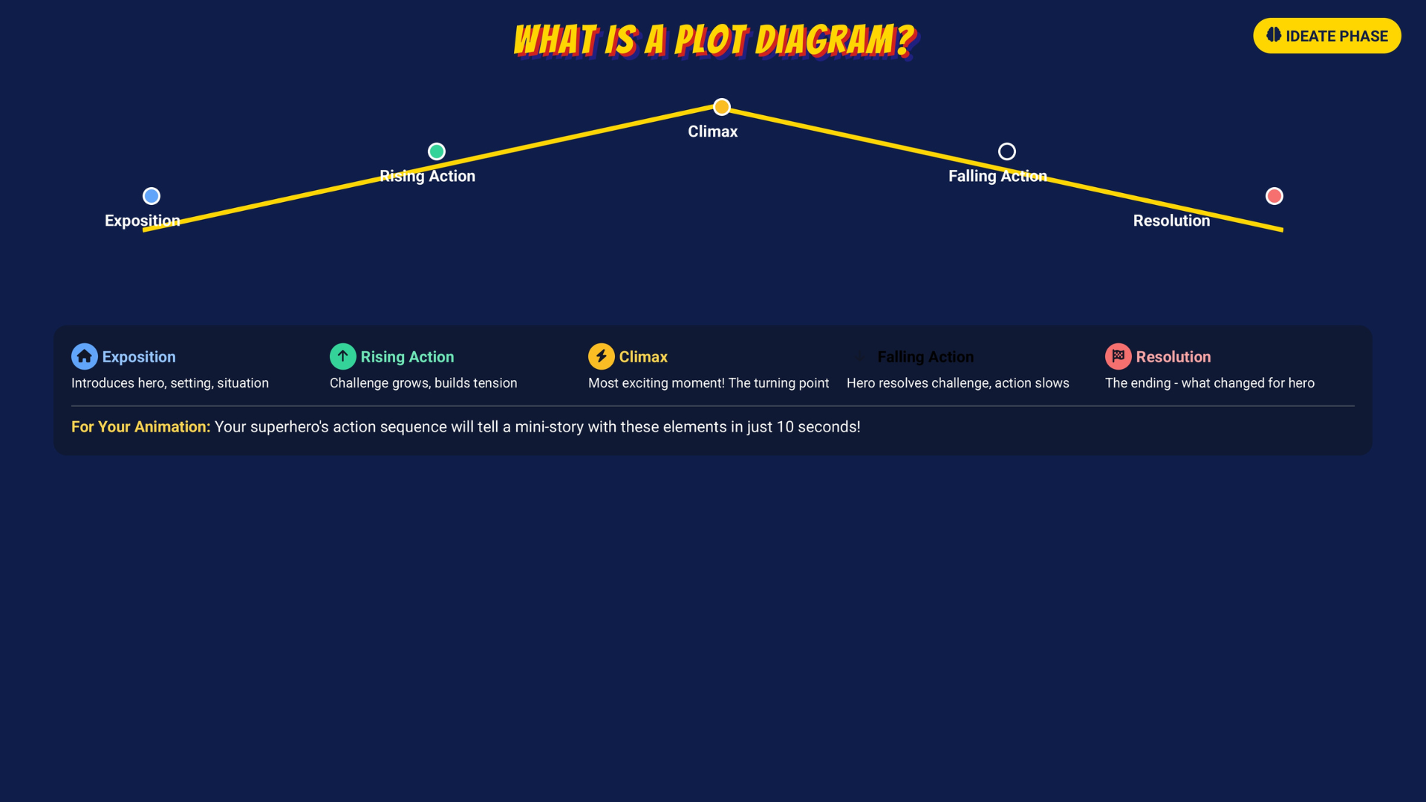
Falling Action
18 / 69
Notes:
Introduce the five plot parts as visual jobs. The template is a planning tool, not a long writing assignment.
[Sources]
- Irving ISD VILS 2027 Template Animation student pages, rubric, and facilitator guide.
- Course-author-created Superhero Piskel Canva deck: Superhero Micro-Animation in Piskel.

Slide 19

PLOT DIAGRAM: EXPOSITION
IDEATE
1
PLAN ONE CLEAR MOMENT
OPENING BEAT
Where is the hero?
What is the hero doing?
Show the hero, the setting, and what is normal before the problem begins.
What can the audience recognize right away?
Storyboard note: This is one beat or panel. In Piskel, that beat may use several displayed frames and held poses.
At the beginning, my hero is ________ in ________.
Al principio, mi héroe está ________ en ________.
19 / 69
Notes:
Model one opening beat that establishes who, where, and what is normal before the problem appears. Separate a storyboard beat from animation frames: one beat may use several displayed frames and held poses.
[Sources]
- Irving ISD VILS 2027 Template Animation student pages, rubric, and facilitator guide.

Slide 20

PLOT DIAGRAM: RISING ACTION
IDEATE
2
KEEP THE SCENE SMALL
ONE MAIN PROBLEM
One setting
One main problem
Something changes in one setting and gives the hero a reason to act.
One reason the hero must act
The problem begins when ________.
El problema comienza cuando ________.
20 / 69
Notes:
Keep the Rising Action small: one setting, one main problem, and one reason the hero must act. The micro-scene should build toward one choice instead of adding unrelated events.
[Sources]
- Irving ISD VILS 2027 Template Animation student pages, rubric, and facilitator guide.

Slide 21

PLOT DIAGRAM: CLIMAX
IDEATE
📡
THE CHOICE THAT SHOWS THE PROMISE
Signal climbs to a clear location and aims her receiver toward the lost group.
SIGNAL
A storm cuts off communication. Signal detects a faint emergency transmission.
People can count on Signal to ________ when ________.
La gente puede contar con Signal para ________ cuando ________.
21 / 69
Notes:
Use Signal as the course model. Name the turning point: she climbs and aims the receiver. Ask what that choice lets people count on her to do.
[Sources]
- Irving ISD VILS 2027 Template Animation student pages, rubric, and facilitator guide.

Slide 22

PLOT DIAGRAM: ACTION + VISIBLE RESULT
IDEATE
ACTION TAKES EFFECT
THE AUDIENCE SEES THE RESULT
Signal holds the receiver steady. The lost group's location reaches the rescuers.
The rescuers arrive. Communication is restored.
The audience knows the action worked because ________.
El público sabe que la acción funcionó porque ________.
Keep it visible: pose · signal · movement · reaction · change
22 / 69
Notes:
Trace action into result. The lost group's location reaches the rescuers, and communication is restored. Require a visible change rather than a written 'The End.'
[Sources]
- Irving ISD VILS 2027 Template Animation student pages, rubric, and facilitator guide.

Slide 23
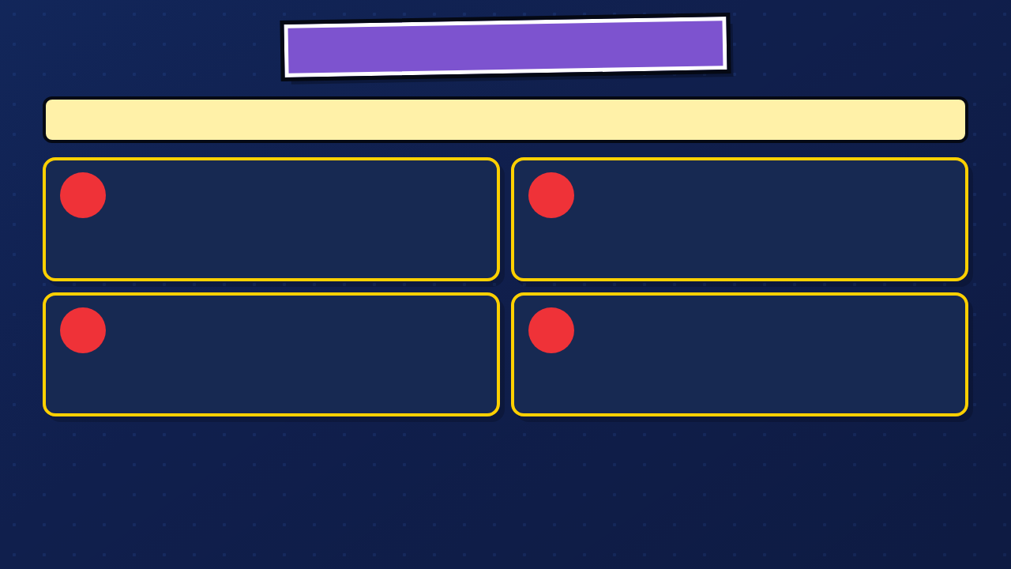
TURN THE PROMISE INTO FOUR BEATS
People can count on Signal to reconnect them when normal communication fails.
1
2
OPENING
PROBLEM
Signal monitors a storm.
A faint emergency signal appears.
3
4
CHOICE + ACTION
VISIBLE RESULT
She climbs and aims her receiver.
The group is found.
23 / 69
Notes:
Read Signal's promise and four beats from left to right. Students keep their own hero and problem while using the compact structure: opening, problem, choice and action, visible result.
[Sources]
- Irving ISD VILS 2027 Template Animation student pages, rubric, and facilitator guide.

Slide 24
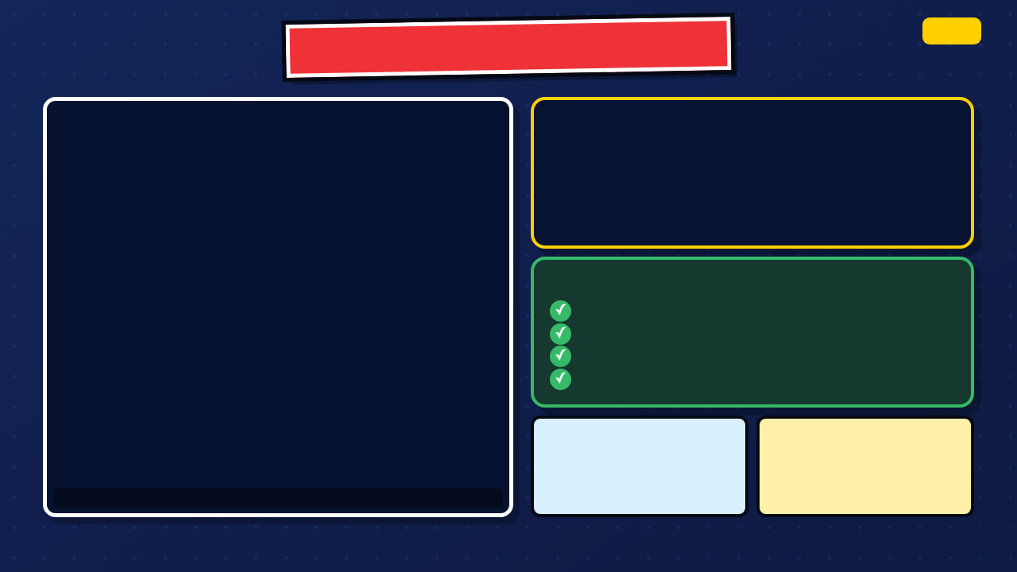
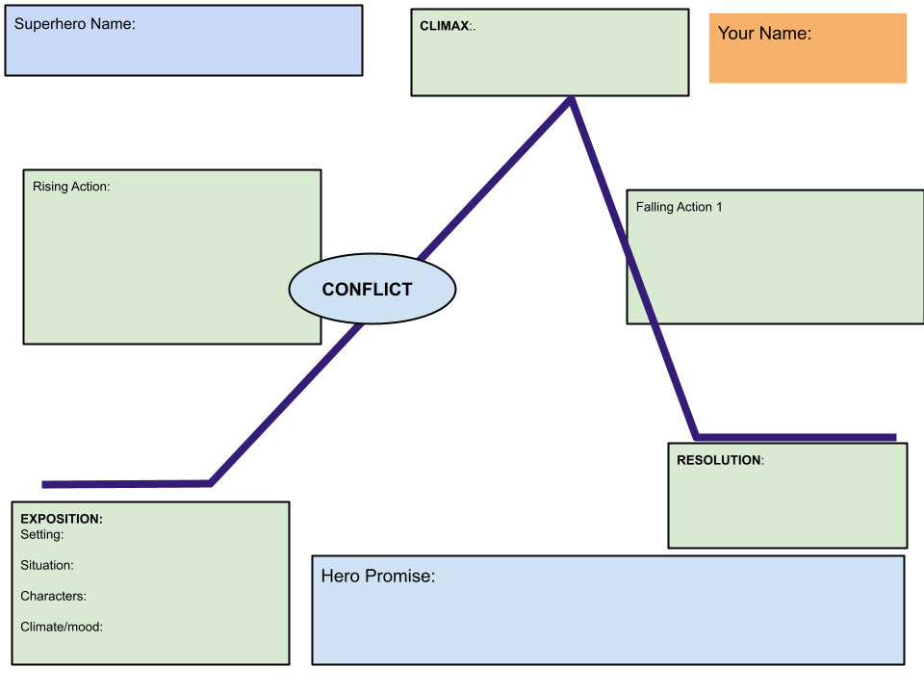
PLOT DIAGRAM WORK TIME
DAY 2
TODAY'S TASK
1. Open your own copy
2. Complete every plot box
3. Show the promise through action
4. Download as PDF
5. Upload the PDF to Canvas
SUCCESS CRITERIA
Problem is clear
Hero makes a choice
Action changes something
Ending shows the result
Word bank / Banco:
setting/escenario · problem/problema
choice/decisión · action/acción
result/resultado
My hero's choice changes ________ because ________.
La decisión de mi héroe cambia ________ porque ________.
Visual plot diagram template
24 / 69
Notes:
Leave this slide projected during Plot Diagram work. The PDF upload is the portable default. Check that every student can open their copy before circulating.
[Sources]
- Irving ISD VILS 2027 Template Animation student pages, rubric, and facilitator guide.
- Course-author Google Drawing plot template: https://docs.google.com/drawings/d/1DIc8FcmFNkTEJd5oxo5Lv8cfpXEvNOq63bdb9Qiwhqw/copy

Slide 25

STORYBOARD THE MOTION
STANDARD ROUTE: 6 PANELS
SUPPORT ROUTE: 4 PANELS
1. Opening pose
1. Opening pose
2. Problem appears
2. Problem
3. Hero notices
3. Hero action
4. Action begins
4. Visible result
5. Turning point
Both routes show the same promise. The support route uses fewer panels.
6. Visible result
Each panel should show a change the animator can build.
25 / 69
Notes:
Assign the standard six-panel route or the approved four-panel support route. Do not lower the communication, testing, revision, or export expectations for the support route.
[Sources]
- Irving ISD VILS 2027 Template Animation student pages, rubric, and facilitator guide.

Slide 26
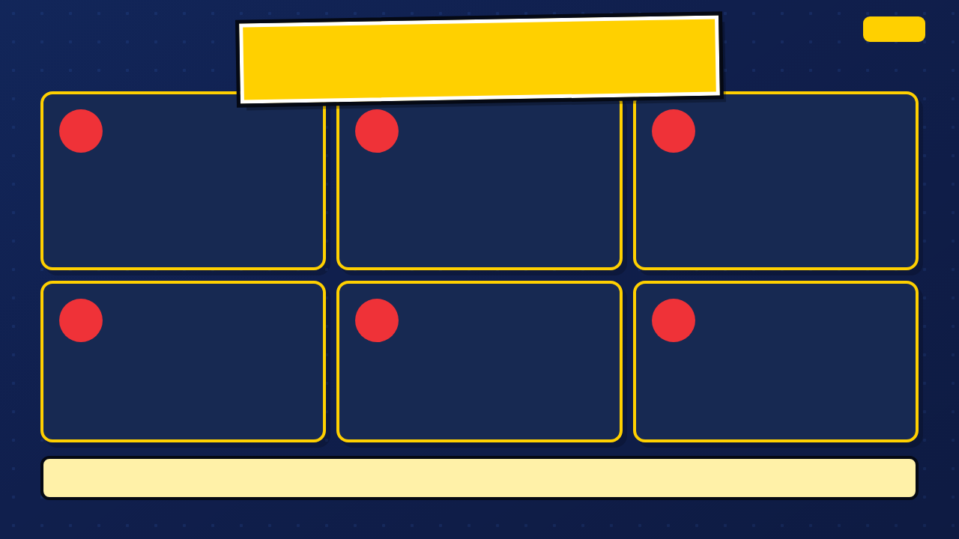
WHAT MAKES A STORYBOARD READY TO ANIMATE?
IDEATE
1
2
3
OPENING POSE
PROBLEM
ACTION STARTS
Hero and setting are easy to recognize.
A visible change gives the hero something to notice.
Pose and motion arrow show what moves.
4
5
6
TURNING POINT
CHANGE
VISIBLE RESULT
The most important choice gets its own beat.
The result begins to appear on screen.
The last pose shows what is different now.
Ready to animate means each panel tells the animator what to draw next.
26 / 69
Notes:
Ask students to point to the change in each panel. Motion arrows and readable poses matter more than polished drawing.
[Sources]
- Irving ISD VILS 2027 Template Animation student pages, rubric, and facilitator guide.

Slide 27
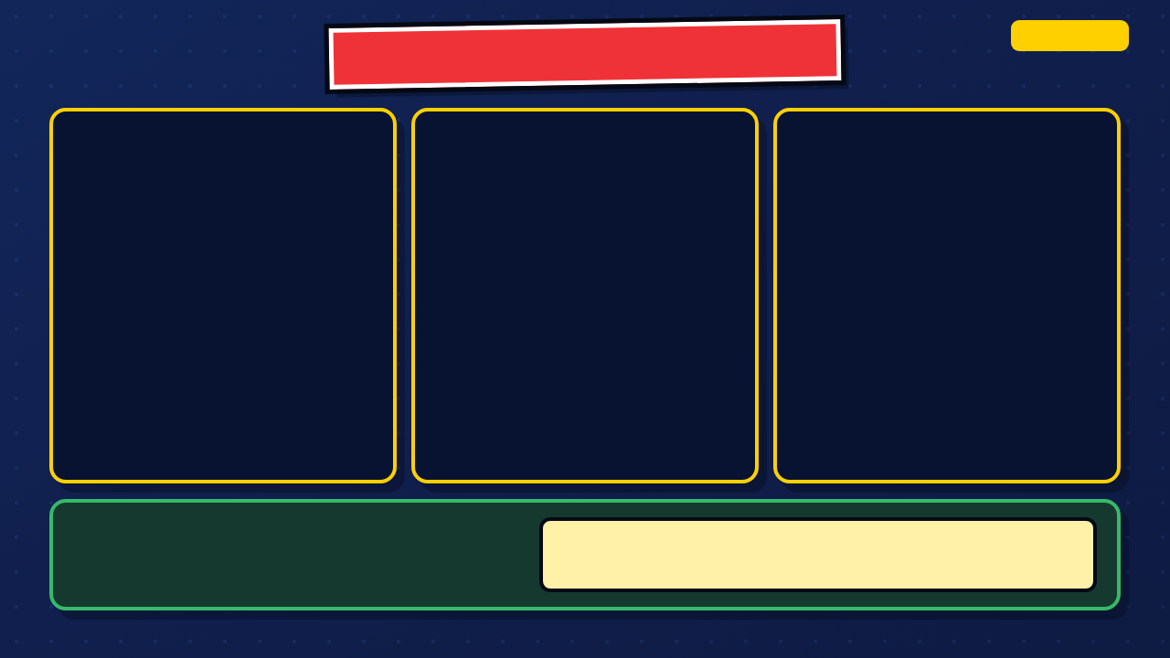
WHY THIS PLAN IS HARD TO ANIMATE
DIAGNOSE IT
Hero standing
Something happens
The end
NO SETTING
VAGUE ACTION
NO VISIBLE RESULT
Where is the hero? What is normal before the problem?
What changes? What should the animator draw next?
How can the audience tell the hero's action worked?
REPAIR THE PLAN
This panel is hard to animate because ________.
Este panel es difícil de animar porque ________.
Add a clear setting, specific poses, motion arrows, and a result the audience can see.
27 / 69
Notes:
Let students diagnose the missing setting, vague action, and skipped beats before you reveal the callouts.
[Sources]
- Irving ISD VILS 2027 Template Animation student pages, rubric, and facilitator guide.

Slide 28

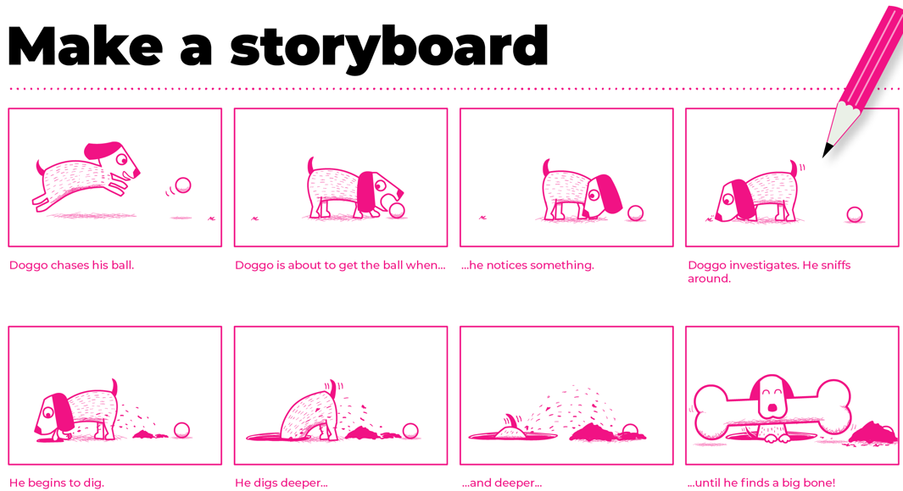
ACTIVITY: DRAW YOUR STORYBOARD
IDEATE
DRAW ONE CHANGE PER PANEL
PARTNER CHECK
1. Sketch one visible beat per panel
Point to the problem
2. Add motion arrows
Point to the hero's choice
3. Keep the hero recognizable
Point to the result
4. Show the final result
The promise becomes visible when ________.
28 / 69
Notes:
Leave this slide projected during storyboard work. Confer in this order: visible problem, hero choice, motion arrows, visible result.
[Sources]
- Irving ISD VILS 2027 Template Animation student pages, rubric, and facilitator guide.
- Instructor-supplied Copy of Superhero Piskel (1).pptx; classroom source deck and embedded media.

Slide 29

PARTNER PITCH: TRACE THE ACTION
IDEATE
📡
SAMPLE PITCH
1. A storm cuts off phone service.
SIGNAL
2. Signal notices a faint emergency transmission.
3. She climbs to a clear location and aims her receiver.
People can count on Signal to reconnect them when normal communication fails.
4. The lost group sends its location.
5. Rescuers reach them.
The promise is visible when ________.
La promesa se ve cuando ________.
29 / 69
Notes:
Partners present the beats in order, then ask for one specific place where the action becomes unclear or too large for the short animation.
[Sources]
- Irving ISD VILS 2027 Template Animation student pages, rubric, and facilitator guide.

Slide 30

EXIT CHECK: SUBMIT STORYBOARD
IDEATE
SUBMIT YOUR STORYBOARD
QUICK REFLECTION
1. Check every panel
The clearest action in my storyboard is ________.
2. Take a clear photo or export the file
3. Upload it to Canvas
One panel I may revise is ________ because ________.
30 / 69
Notes:
Require a clear submission image or exported file and one short reflection. Do not let polished drawing replace readable action.
[Sources]
- Irving ISD VILS 2027 Template Animation student pages, rubric, and facilitator guide.

Slide 31
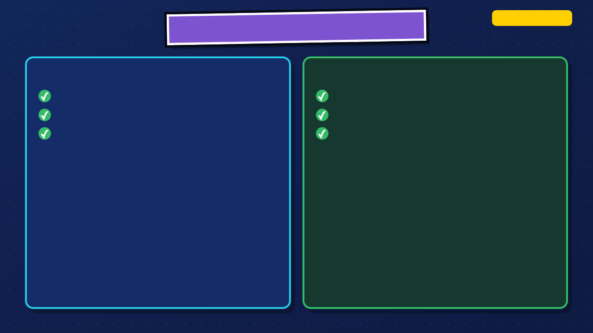
WHERE ARE WE IN DESIGN THINKING?
DAY 3: PROTOTYPE
IDEATE IS COMPLETE
PROTOTYPE TODAY
Promise
Learn the Piskel workspace
Plot
Try one small motion
Storyboard
Export and test a practice GIF
31 / 69
Notes:
Move into Prototype. Day 3 is the tool-and-practice day: orient to Piskel, build one small motion, and prove that both the source and GIF save correctly.
[Sources]
- Texas Education Agency, 19 TAC Chapter 126, Technology Applications Grade 8, Adopted 2022: https://tea.texas.gov/laws-and-rules/texas-administrative-code/19-tac-chapter-126
- Piskel official site and FAQ: https://www.piskelapp.com/ and https://www.piskelapp.com/faq/

Slide 32

TODAY'S OBJECTIVES: DAY 3
PROTOTYPE
TODAY YOU WILL
YOU ARE DONE WHEN
Set canvas to 32 × 32
Your motion previews clearly and your named .piskel file is saved.
Duplicate frames; preview at 5–8 FPS
Save a named .piskel file
32 / 69
Notes:
Read the Day 3 objective and done-when. Students should not begin the full animation until a small test GIF opens and plays.
[Sources]
- Texas Education Agency, 19 TAC Chapter 126, Technology Applications Grade 8, Adopted 2022: https://tea.texas.gov/laws-and-rules/texas-administrative-code/19-tac-chapter-126
- Piskel official site and FAQ: https://www.piskelapp.com/ and https://www.piskelapp.com/faq/

Slide 33

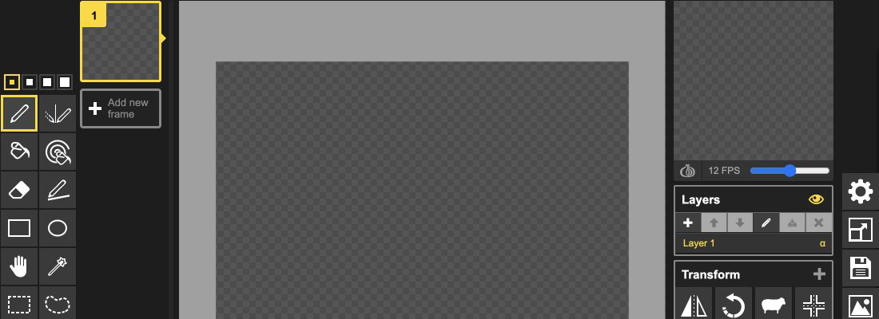
THE REAL PISKEL WORKSPACE
PROTOTYPE
Current Piskel web editor • captured Aug. 28, 2026
START 32 × 32 = 1,024 pixels
64 × 64 = 4× the pixel workload
More pixels = more drawing + cleanup
33 / 69
Notes:
Use the current Piskel screenshot to orient students to the frame list and tools on the left, the canvas in the center, and preview, FPS, layers, and export controls on the right. Students should point to each area on their own screen.
[Sources]
- Irving ISD VILS 2027 Template Animation student pages, rubric, and facilitator guide.
- Piskel official site and FAQ: https://www.piskelapp.com/ and https://www.piskelapp.com/faq/
- Piskel source, browser support, and Apache-2.0 license: https://github.com/piskelapp/piskel

Slide 34

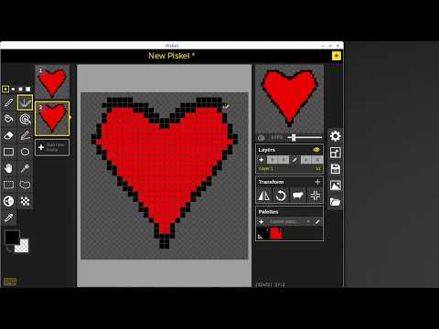
FPS CHANGES SPEED + WORKLOAD
PROTOTYPE
CONTEXT: HOLDS 2–3 FRAMES • FILM 24 • GAMES 30/60
DISPLAYED-FRAME WORKLOAD
30-SECOND PISKEL CLIP • TJ FREE
5 fps = 25 • 8 fps = 40
12 fps = 60 • 24 fps = 120
Holds + duplicated poses reduce unique drawings.
34 / 69
Notes:
Explain displayed frames rather than requiring 120 unique drawings. Duplicated frames and holds count toward the 10-second target and are legitimate timing tools.
[Sources]
- Irving ISD VILS 2027 Template Animation student pages, rubric, and facilitator guide.
- Piskel official site and FAQ: https://www.piskelapp.com/ and https://www.piskelapp.com/faq/

Slide 35
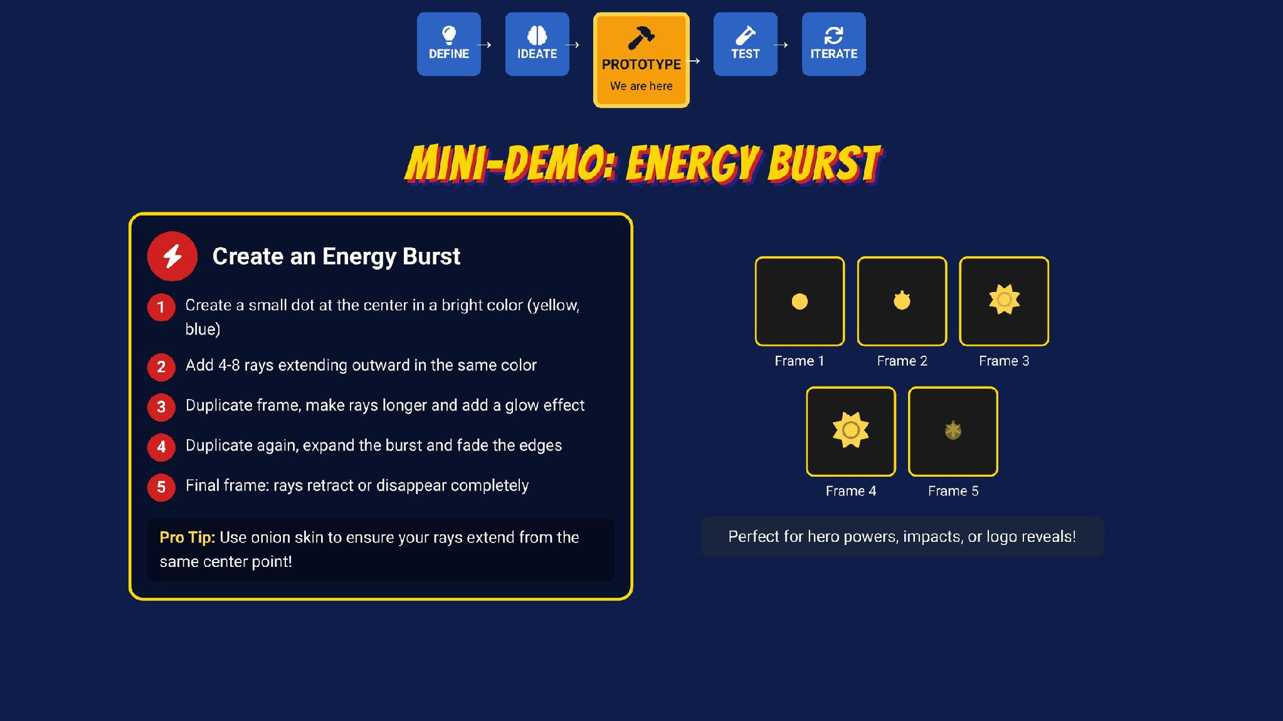
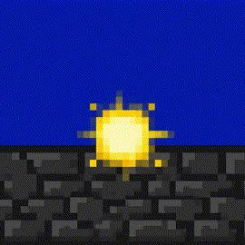
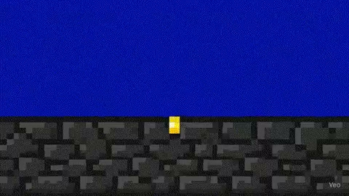
Notes:
Play the embedded energy-burst demonstration briefly. Ask what changes in each frame and which frames should be held longer for readability.
[Sources]
- Instructor-supplied Copy of Superhero Piskel (1).pptx; classroom source deck and embedded media.
- Piskel official site and FAQ: https://www.piskelapp.com/ and https://www.piskelapp.com/faq/

Slide 36
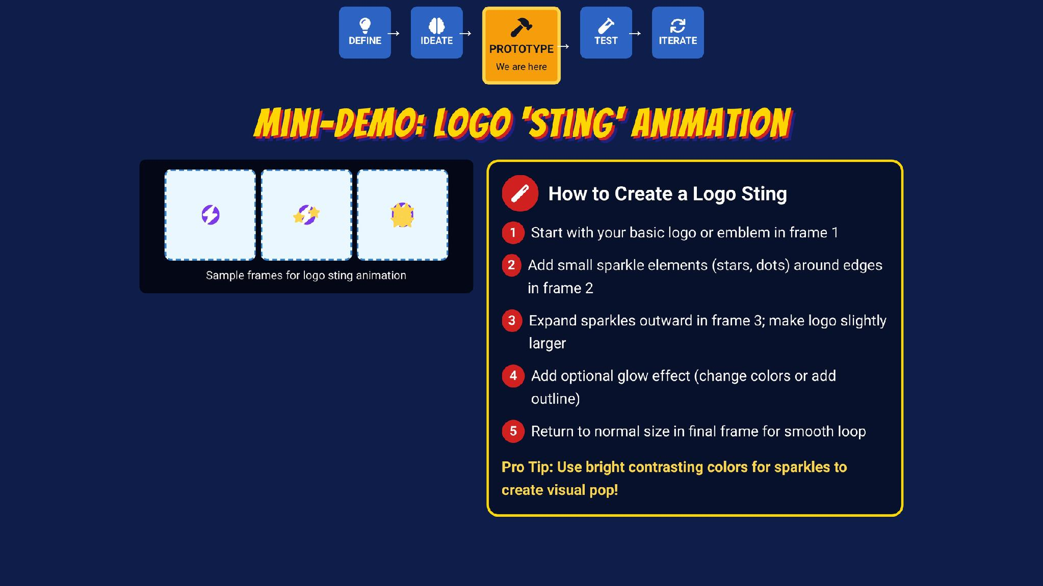


Notes:
Play the embedded logo-sting demonstration as a second motion pattern. Students may animate a character, object, effect, or emblem; the required outcome is a readable promise-in-action scene.
[Sources]
- Instructor-supplied Copy of Superhero Piskel (1).pptx; classroom source deck and embedded media.
- Piskel official site and FAQ: https://www.piskelapp.com/ and https://www.piskelapp.com/faq/

Slide 37

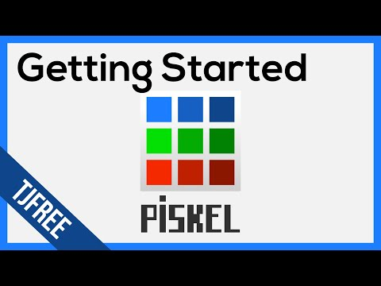
WATCH, PAUSE, TRY
DAY 3
▶
DAY 1 DRAWING + COLOR
1. Pencil, eraser + fill
CURRENT CANVAS TUTORIAL
2. Primary / secondary colors
3. Color picker
Play here or open the watch-and-try assignment in Canvas.
4. Select + move pixels
5. Replace the same color
PAUSE • TRY • CONTINUE
Source: TJ FREE / YouTube • full tutorial in Canvas
37 / 69
Notes:
The YouTube tutorial is the ready default. If you choose Edpuzzle, copy the lesson, reconnect the Day 2 assignment through External Tool, save unpublished, and test Student View before publishing.
[Sources]
- Irving ISD VILS 2027 Template Animation student pages, rubric, and facilitator guide.
- Piskel tutorial video: https://www.youtube.com/watch?v=gBn2WeY5yf8
- Optional reusable Edpuzzle lesson and Canvas setup guide: https://edpuzzle.com/media/68b65575f867be144b483551 and https://support.edpuzzle.com/hc/en-us/articles/360025042091-Using-Edpuzzle-With-Canvas
- Piskel official site and FAQ: https://www.piskelapp.com/ and https://www.piskelapp.com/faq/

Slide 38

DIGITAL CITIZENSHIP FOR ARTISTS
PROTOTYPE
CREATE RESPONSIBLY
SAVE + CREDIT
Draw original frames
Save the editable source
Use references to learn, not to copy
Credit outside assets you are allowed to use
Keep private student examples private
Use school-appropriate sharing spaces
38 / 69
Notes:
Reinforce original frames, responsible reference use, source credits, student privacy, and saving the editable source before students post any GIF.
[Sources]
- Texas Education Agency, 19 TAC Chapter 126, Technology Applications Grade 8, Adopted 2022: https://tea.texas.gov/laws-and-rules/texas-administrative-code/19-tac-chapter-126
- Piskel official site and FAQ: https://www.piskelapp.com/ and https://www.piskelapp.com/faq/

Slide 39
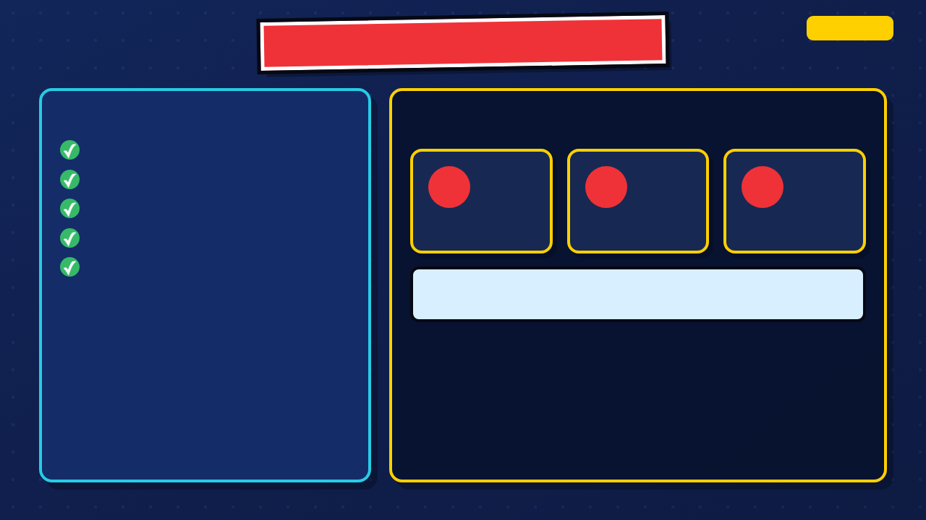
PRACTICE TASK: ONE SMALL MOTION
PROTOTYPE
CHOOSE ONE
BUILD 3 TO 5 UNIQUE POSES
Blink
Cape flutter
1
2
3
Arm raise
Start pose
Small change
Readable result
Glow or energy pulse
Another simple change
Then duplicate or hold poses: 12 to 24 displayed frames total · 1 to 2 seconds at 12 fps
39 / 69
Notes:
Keep the practice small. Students build 3 to 5 unique poses, then duplicate or hold poses until the GIF contains 12 to 24 displayed frames at 12 fps. The goal is one to two seconds of readable motion.
[Sources]
- Irving ISD VILS 2027 Template Animation student pages, rubric, and facilitator guide.
- Piskel official site and FAQ: https://www.piskelapp.com/ and https://www.piskelapp.com/faq/

Slide 40

PRACTICE: ONE SMALL MOTION
DAY 3
YOUR TEST
SUCCESS CRITERIA
Motion is easy to notice
Build 3 to 5 unique poses for a blink, cape flutter, arm raise, glow, or another simple change. Duplicate or hold poses until you reach 12 to 24 displayed frames.
Frames do not jump randomly
GIF opens after export
Word bank / Banco de palabras: frame/fotograma · duplicate/duplicar · onion skin/papel cebolla · preview/vista previa · motion/movimiento
CONTROL CHECK
Duplicate at least one frame
Use onion skin
I changed ________ between frames so ________.
Cambié ________ entre fotogramas para que ________.
Preview 1 to 2 seconds at 12 fps
Save the editable source
Export a GIF
40 / 69
Notes:
Leave this slide projected. Check for 3 to 5 unique poses, 12 to 24 displayed frames, onion skin, a one-to-two-second preview at 12 fps, the editable source, and a working GIF. Use the bilingual stem when students explain what changed.
[Sources]
- Irving ISD VILS 2027 Template Animation student pages, rubric, and facilitator guide.
- Piskel official site and FAQ: https://www.piskelapp.com/ and https://www.piskelapp.com/faq/

Slide 41

SAVE THE SOURCE, THEN EXPORT
PROTOTYPE
EDITABLE .PISKEL
SHAREABLE .GIF
1. Name the sprite clearly
1. Open Export
2. Click Save
2. Choose GIF and Download
3. Save the .piskel file
3. Open it to test the motion
4. Find it in Downloads
4. Return to Piskel to fix
Piskel is for editing. GIF is for sharing.
41 / 69
Notes:
Export a test GIF and open it outside Piskel. Fix the export now rather than discovering a broken file on Day 5.
[Sources]
- Irving ISD VILS 2027 Template Animation student pages, rubric, and facilitator guide.
- Piskel official site and FAQ: https://www.piskelapp.com/ and https://www.piskelapp.com/faq/

Slide 42

CANVAS PRACTICE WALL
POST YOUR TEST GIF
REPLY TO TWO CLASSMATES
1. Open the Practice Wall discussion
I notice ________. I wonder ________.
Noto ________. Me pregunto ________.
2. Reply with the GIF
3. Name the motion you tested
4. Check that the GIF plays
Feedback bank: smooth/suave · readable/claro · too fast/demasiado rápido · hold/sostener · repeat/repetir
Comment on the animation, not the person.
42 / 69
Notes:
Students post the GIF to the Canvas Practice Wall and reply to two classmates. Feedback names a visible motion or timing choice, not the quality of the person or drawing.
[Sources]
- Irving ISD VILS 2027 Template Animation student pages, rubric, and facilitator guide.

Slide 43

EXIT CHECK: SUBMIT TEST GIF
PROTOTYPE
SUBMIT YOUR TEST GIF
NAME ONE LEARNING
The GIF opens and plays
I learned that changing ________ made the motion ________.
The motion is easy to notice
The source file is saved
43 / 69
Notes:
Collect the practice GIF and one learning statement. Verify the editable source before cleanup; a working GIF alone is not an editable project.
[Sources]
- Irving ISD VILS 2027 Template Animation student pages, rubric, and facilitator guide.
- Piskel official site and FAQ: https://www.piskelapp.com/ and https://www.piskelapp.com/faq/

Slide 44
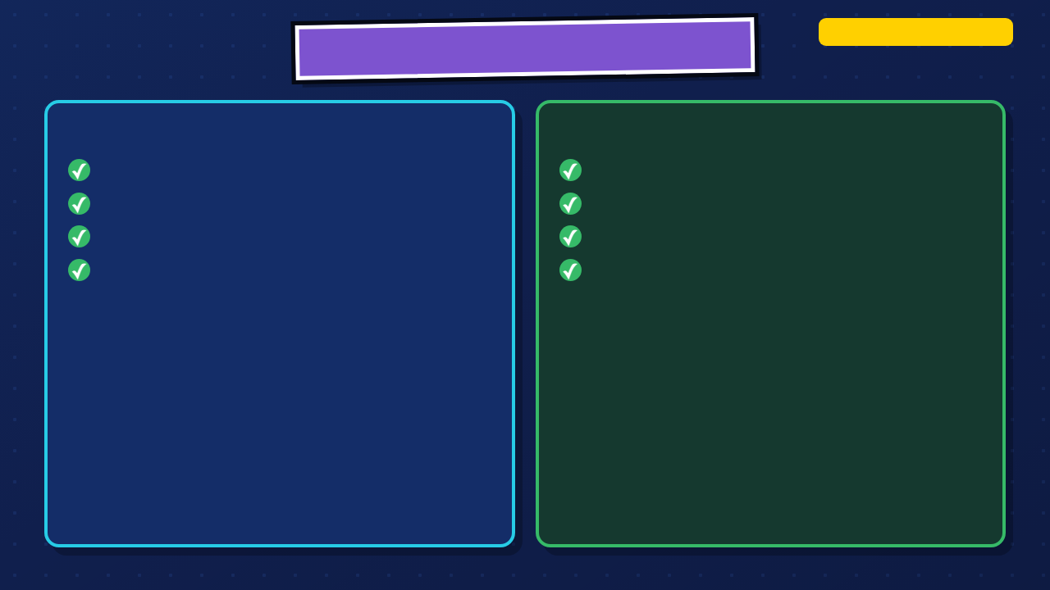
WHERE ARE WE IN DESIGN THINKING?
DAY 4 · PROTOTYPE → TEST
REFINE THE PROTOTYPE
PREPARE TO TEST
Connect key poses
Watch outside Piskel
Add holds and in-betweens
Let a partner watch before explaining
Keep the hero recognizable
Name one unclear moment
Export a WIP GIF
Choose one specific next step
44 / 69
Notes:
Day 4 continues Prototype and prepares for Test. Students finish the action, control timing, and leave with one feedback-based next step.
[Sources]
- Irving ISD VILS 2027 Template Animation student pages, rubric, and facilitator guide.

Slide 45

DAY 4: MAKE THE MOTION READABLE
PROTOTYPE → TEST
1. FINISH THE ACTION
2. CONTROL TIMING
3. GET FEEDBACK
Complete the opening, turning point, and result.
Add holds and in-betweens where the audience needs them.
Ask a partner what they notice and where the motion becomes unclear.
Before you leave, record one frame or timing change for tomorrow.
45 / 69
Notes:
Read the three jobs. Do not let the feedback step disappear because a student spent the whole period adding decoration.
[Sources]
- Irving ISD VILS 2027 Template Animation student pages, rubric, and facilitator guide.

Slide 46

WHAT A COMPLETE FIRST PASS INCLUDES
STORY READS
MOTION READS
Beginning pose
Small changes between frames
Problem or change
Important poses stay long enough to see
Hero action
Character remains recognizable
Visible result
Preview reaches the ending
A rough complete pass is more useful than one polished second with no ending.
46 / 69
Notes:
Use the two columns as the definition of a complete first pass. Readability and a reachable ending come before decorative effects.
[Sources]
- Irving ISD VILS 2027 Template Animation student pages, rubric, and facilitator guide.

Slide 47

BUILD IN PASSES
PROTOTYPE
1
2
3
ROUGH PASS
CLEAN PASS
POLISH + EXPORT
Build the key poses and reach the ending. Use simple shapes or temporary details.
Add the in-betweens, steady the shapes, and adjust the timing.
Clarify the result, remove distractions, test the loop, and save both files.
Finish the rough pass before polishing one moment.
47 / 69
Notes:
Use the three passes as a flexible production order, not a timer. Students should reach the ending in the rough pass before they spend time polishing one section.
[Sources]
- Irving ISD VILS 2027 Template Animation student pages, rubric, and facilitator guide.

Slide 48

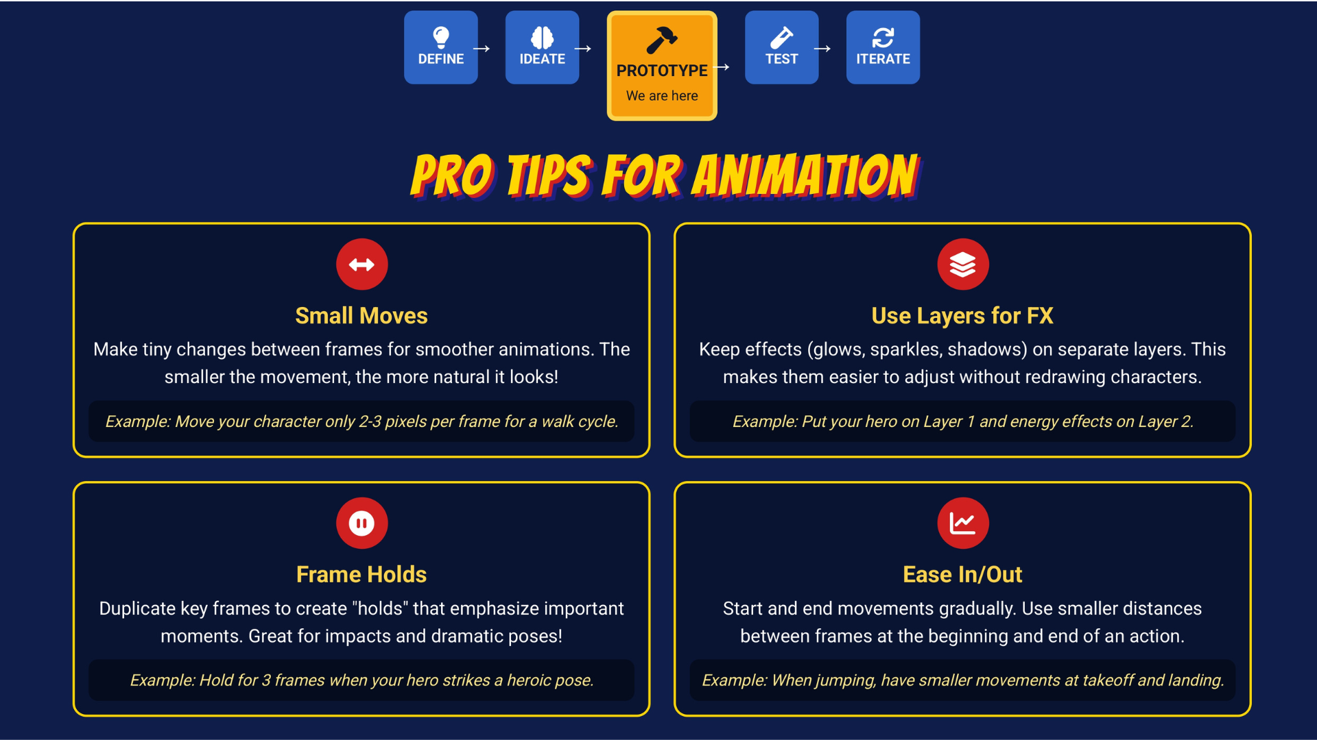
48 / 69
Notes:
Teach only the tip a student needs. Small moves and frame holds usually solve more problems than adding new effects.
[Sources]
- Irving ISD VILS 2027 Template Animation student pages, rubric, and facilitator guide.
- Course-author-created Superhero Piskel Canva deck: Superhero Micro-Animation in Piskel.

Slide 49

ADVANCED TOOLS: USE WHEN NEEDED
CONSISTENCY + MOTION
POLISH AFTER THE ROUGH PASS
Onion skin — connect each pose
Layers — separate effects / background
Paint same color + Shift — recolor frames
Lighten / darken — add volume
Vertical mirror — build symmetry
Dither — blend two colors
Selections — move without redrawing
Preview after every change
49 / 69
Notes:
Use the left column for jumping motion and the right column for rushed motion. Students should test one fix before making several changes at once.
[Sources]
- Irving ISD VILS 2027 Template Animation student pages, rubric, and facilitator guide.

Slide 50

MIDPOINT EXPORT + SELF-CHECK
GIF
TRACE THE WHOLE SCENE
1. What problem appears?
EXPORT A WIP GIF
2. What choice does the hero make?
3. What action changes the scene?
Open it outside Piskel. The exported file may reveal timing problems the editor preview hides.
4. What result can the audience see?
The clearest moment is ________. The confusing moment is ________.
El momento más claro es ________. El momento confuso es ________.
50 / 69
Notes:
Require a midpoint GIF and let students watch it outside Piskel. The four questions test whether the promise reads as a visible action and result.
[Sources]
- Irving ISD VILS 2027 Template Animation student pages, rubric, and facilitator guide.

Slide 51

PARTNER SPOT-CHECK
TEST
WATCH BEFORE THE CREATOR EXPLAINS
USE EVIDENCE
I notice ________ because ________.
Noto ________ porque ________.
1. Open the WIP GIF
2. Watch the full motion
3. Name the clearest moment
I wonder if ________ would make ________ clearer.
Me pregunto si ________ haría ________ más claro.
4. Name where the motion becomes hard to follow
Feedback bank / Banco: hold/sostener · repeat/repetir · shorten/acortar · clarify/aclarar · result/resultado
51 / 69
Notes:
Partners watch before the creator explains. Use the projected stems; a specific notice and wonder become evidence for the final revision.
[Sources]
- Irving ISD VILS 2027 Template Animation student pages, rubric, and facilitator guide.

Slide 52

DAY 4 CHECKPOINT: WIP + NEXT STEP
PROTOTYPE → TEST
SHOW YOUR TEACHER
RECORD ONE NEXT STEP
WIP GIF opens and plays
Name the exact frame, pose, timing choice, or unclear moment you will revise.
Beginning, action, and result appear
Editable .piskel source is saved
Tomorrow I will revise ________ by ________.
Mañana revisaré ________ al ________.
52 / 69
Notes:
Students export the WIP and record one next step. The step should name a frame, pose, timing choice, or unclear moment.
[Sources]
- Irving ISD VILS 2027 Template Animation student pages, rubric, and facilitator guide.

Slide 53
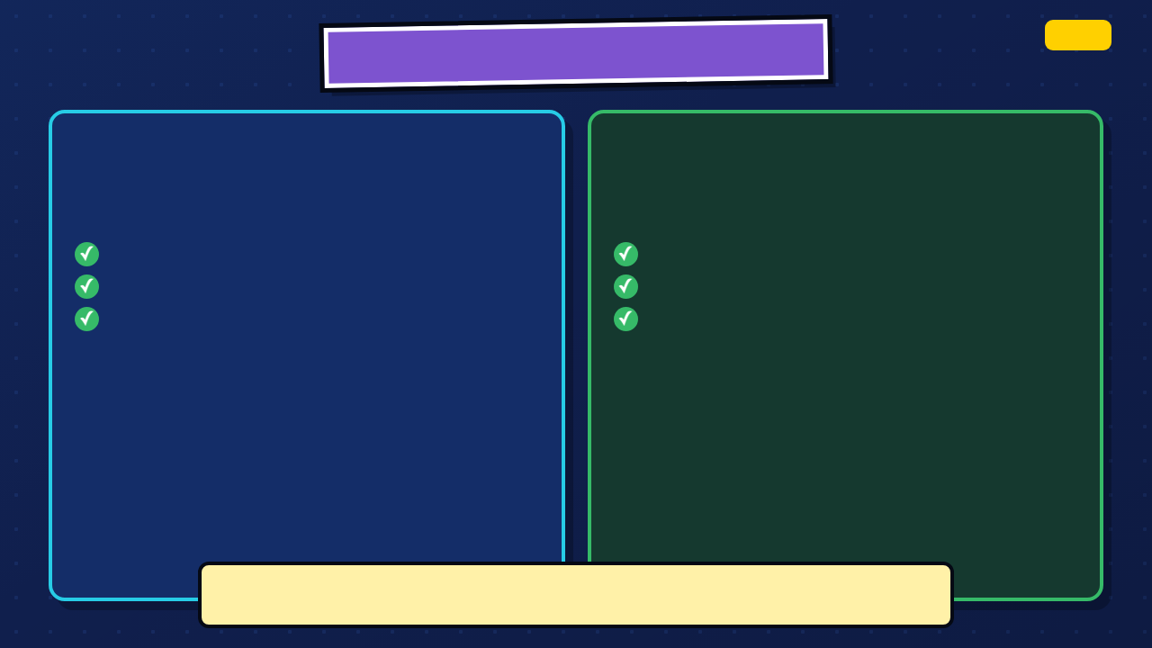
CHECKPOINT: TEST, THEN ITERATE
DAY 5
TEST
ITERATE
Let another person watch the full GIF before you explain it.
Use one specific piece of feedback to make one useful change.
What action is clear?
Hold a pose longer
Where does the timing become hard to follow?
Add or remove an in-between
Can the audience see the result?
Clarify the ending
I will revise ________ so the audience can ________.
Voy a revisar ________ para que el público pueda ________.
53 / 69
Notes:
Move the class into Test, then Iterate. The audience watches before the creator explains, and each student uses one specific comment to make one useful change.
[Sources]
- Irving ISD VILS 2027 Template Animation student pages, rubric, and facilitator guide.

Slide 54

DAY 5: TEST, REVISE, EXPORT
TEST + ITERATE
TEST
REVISE
SUBMIT
Let classmates watch without your explanation.
Make one specific change that improves communication or timing.
Upload the working GIF and answer both reflections in a Canvas comment.
Revision verbs: hold · shorten · repeat · add · remove · clarify · slow · connect
54 / 69
Notes:
Preview the three jobs and the submission-comment requirement. Students should know that reflection is part of the final submission, not an extra page.
[Sources]
- Irving ISD VILS 2027 Template Animation student pages, rubric, and facilitator guide.

Slide 55

GIVE FEEDBACK WITH EVIDENCE
TEST
NOTICE
WONDER
Name a motion, timing choice, or visible result that already communicates clearly.
Suggest one possible change without judging the creator or drawing style.
I notice ________ because ________.
Noto ________ porque ________.
I wonder if ________ would make ________ clearer.
Me pregunto si ________ haría ________ más claro.
Feedback bank / Banco: hold/sostener · repeat/repetir · shorten/acortar · clarify/aclarar · result/resultado
55 / 69
Notes:
Model the bilingual notice and wonder stems with a visible motion or timing detail. Replace praise such as 'looks good' with evidence and one possible change.
[Sources]
- Irving ISD VILS 2027 Template Animation student pages, rubric, and facilitator guide.

Slide 56

SET UP THE GALLERY WALK
TEST
1
2
3
OPEN THE GIF
FIND YOUR FEEDBACK SPACE
FOCUS ON THE WORK
Leave the exported animation ready to play.
Use the sticky note or Canvas link your teacher gives you.
Comment on a visible motion, timing, or clarity choice.
Write one I notice... and one I wonder....
56 / 69
Notes:
Set up the gallery walk before students move. Leave computers open to the exported GIF, not the editable project.
[Sources]
- Irving ISD VILS 2027 Template Animation student pages, rubric, and facilitator guide.

Slide 57

GALLERY WALK: IN SESSION
TEST
↻
AT EACH PROJECT
1. Watch from beginning to end
WATCH THE WHOLE LOOP
2. Find the clearest action or result
3. Notice one timing or clarity question
Let the animation communicate before you read or hear an explanation.
4. Leave feedback using the assigned route
Focus: action · timing · hold · result · readable motion
57 / 69
Notes:
Keep the movement routine brief and quiet. Students leave feedback on at least three animations and focus on the work, not the creator.
[Sources]
- Irving ISD VILS 2027 Template Animation student pages, rubric, and facilitator guide.

Slide 58

WHAT DID THE AUDIENCE NOTICE?
TEST → ITERATE
CLEAR ACTION
TIMING PATTERNS
NEXT STEP
Which moments communicated without an explanation?
Where did viewers ask for a hold, repeat, or slower change?
Which one change will improve what the audience sees?
The feedback I will use is ________.
La retroalimentación que usaré es ________.
58 / 69
Notes:
Collect patterns from the feedback. Ask which comments point to a communication problem, which point to timing, and which can wait for a future project.
[Sources]
- Irving ISD VILS 2027 Template Animation student pages, rubric, and facilitator guide.

Slide 59
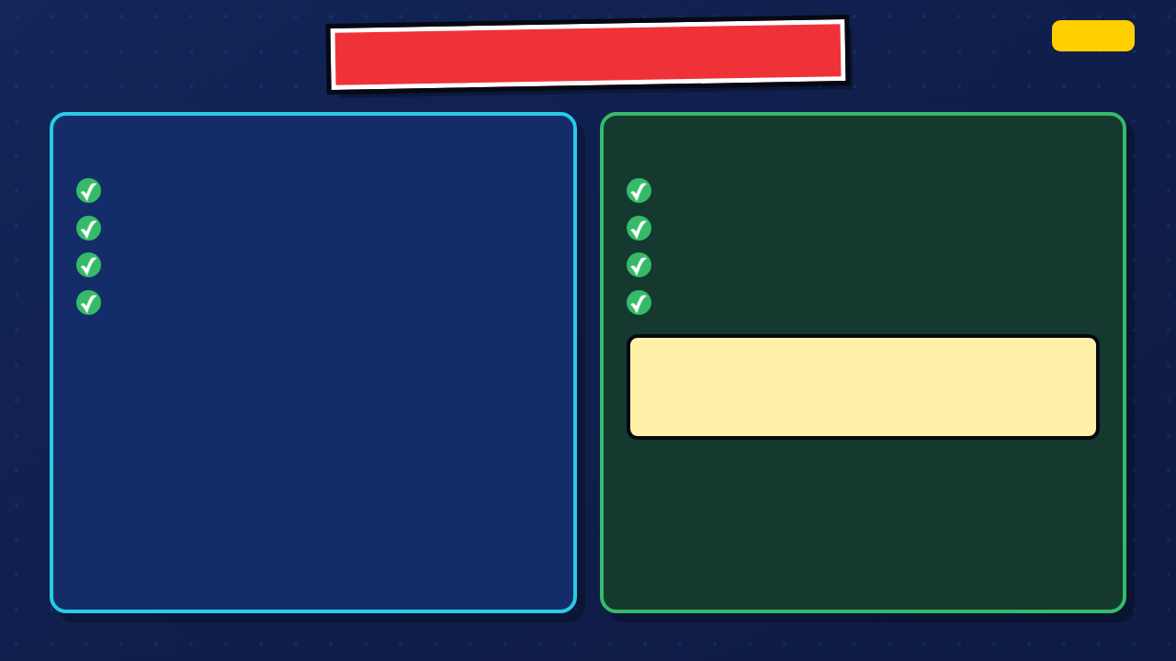
ONE TARGETED REVISION
ITERATE
CHOOSE ONE ISSUE
MAKE + TEST ONE CHANGE
Action is hard to follow
Add or remove an in-between
Important pose passes too quickly
Duplicate a pose to create a hold
Ending does not show the result
Clarify the final result
Extra detail distracts from the motion
Export and watch again
I revised ________ so the audience can ________.
Revisé ________ para que el público pueda ________.
59 / 69
Notes:
Each student chooses one targeted revision. A revision may hold a pose, add an in-between, clarify the result, or remove a distracting element.
[Sources]
- Irving ISD VILS 2027 Template Animation student pages, rubric, and facilitator guide.

Slide 60

FINAL EXPORT + FILE CHECK
STANDARD ROUTE
SAVE BOTH FILES
10 seconds
1. Download the final .piskel source
2. Export the animated GIF
12 fps target
3. Name the GIF clearly
About 120 displayed frames
4. Open the GIF outside Piskel
Clear loop or deliberate ending
5. Confirm the action and ending play
SUPPORT ROUTE
File name: Lastname-Firstname-HeroName-Piskel.gif
5 to 8 seconds
8 to 12 fps
One clear motion with holds
60 / 69
Notes:
Use the standard or approved support route already assigned. Both routes require a clear action and result, working source and GIF files, and the same rubric.
[Sources]
- Irving ISD VILS 2027 Template Animation student pages, rubric, and facilitator guide.
- Piskel official site and FAQ: https://www.piskelapp.com/ and https://www.piskelapp.com/faq/

Slide 61

SHARE THE FINAL GIF
TEST + ITERATE
PLAY YOUR ANIMATION
AUDIENCE NOTICES
Play the final GIF
What action, timing choice, or result made the promise clear?
Name the promise
Point to the moment that proves it
61 / 69
Notes:
Share the final animations. The creator names the promise and points to the exact moment that proves it; the audience names one visible action, timing choice, or result.
[Sources]
- Irving ISD VILS 2027 Template Animation student pages, rubric, and facilitator guide.

Slide 62

SUPERHERO ANIMATION REFLECTION
DAY 5
WHAT WORKED?
WHAT CHANGED?
The strongest motion or timing choice was ________ because ________.
After feedback, I revised ________ by ________.
WHAT DID THE AUDIENCE UNDERSTAND?
WHAT WILL YOU TRY NEXT?
Next time I will ________.
People can count on my hero to ________.
62 / 69
Notes:
Students complete the four-part reflection with evidence from their own animation and the feedback they used.
[Sources]
- Irving ISD VILS 2027 Template Animation student pages, rubric, and facilitator guide.

Slide 63

WHAT'S NEXT?
TRANSFER
CHARACTER DESIGN
MOTION DESIGN
GAME + UI ANIMATION
Use shape, color, and movement to make a character recognizable.
Use timing and transitions to guide attention.
Use clear feedback so users understand what happened.
Choose one place where a short animation would help someone understand what happened.
63 / 69
Notes:
Transfer the skill beyond this unit: character motion, interface feedback, games, and motion graphics all use timing to communicate meaning.
[Sources]
- Irving ISD VILS 2027 Template Animation student pages, rubric, and facilitator guide.

Slide 64
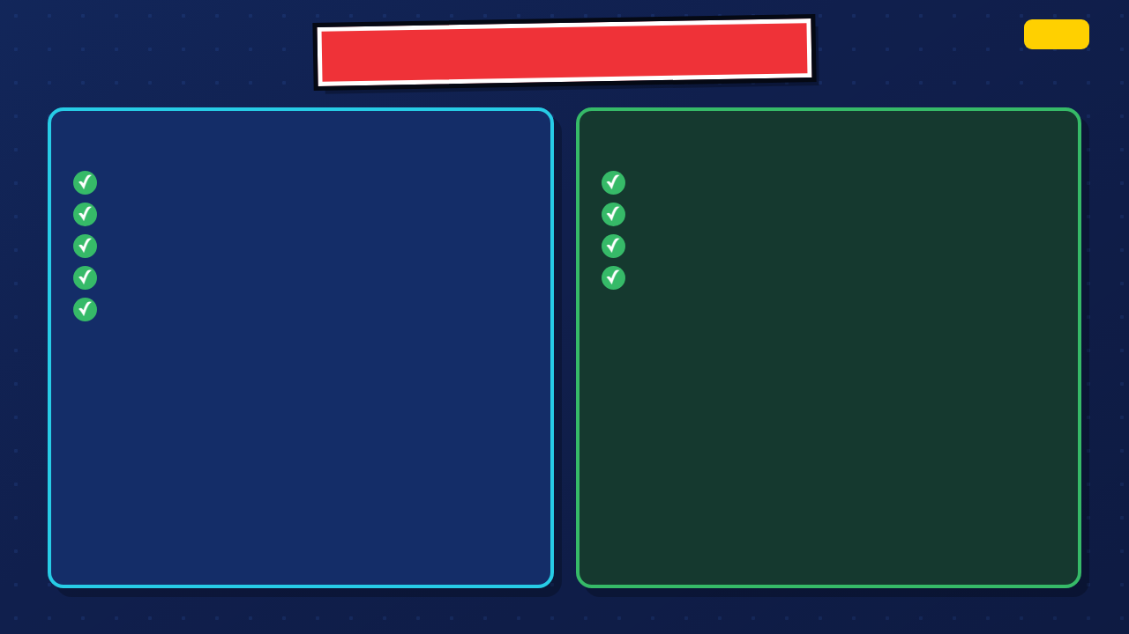
STUDENT-FACING CHECKLIST
DAY 5
PROJECT COMPLETE
FILES COMPLETE
Brand promise written
Editable .piskel source saved
Plot diagram submitted
Final animated GIF opens
Storyboard submitted
Submission comment added
Practice GIF tested
Reflection complete
Final animation revised
64 / 69
Notes:
Use the checklist as a final student self-audit before submission. Do not accept the GIF as a substitute for the editable source.
[Sources]
- Irving ISD VILS 2027 Template Animation student pages, rubric, and facilitator guide.
- Piskel official site and FAQ: https://www.piskelapp.com/ and https://www.piskelapp.com/faq/

Slide 65
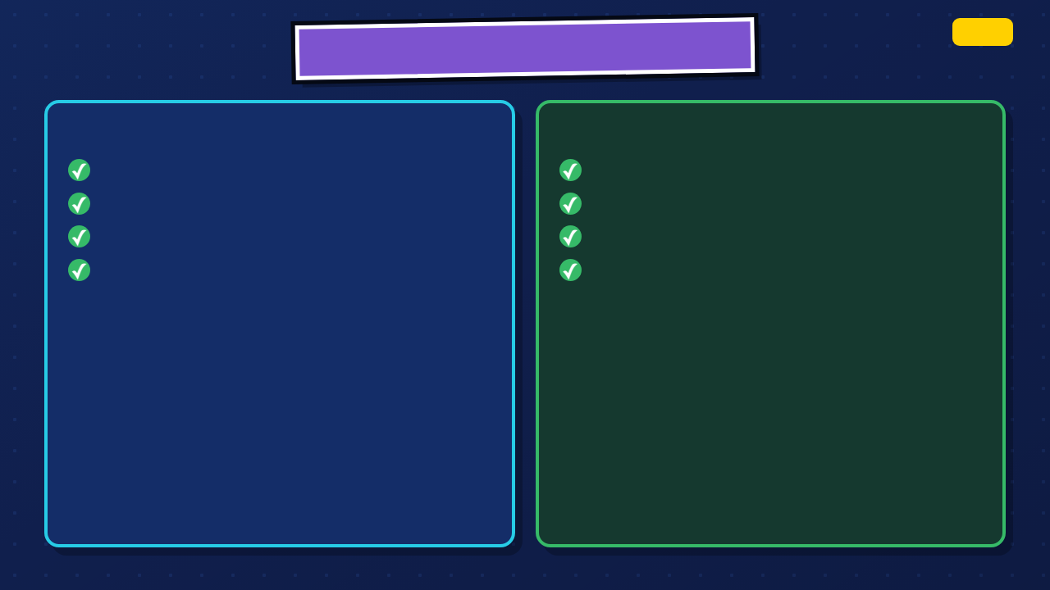
TECHNICAL SPECS
DAY 5
STANDARD ROUTE
SUPPORT ROUTE
10 seconds
5 to 8 seconds
12 fps target
8 to 12 fps
About 120 displayed frames
One clear motion with holds
Clear loop or deliberate ending
Same promise, test, and revision expectations
65 / 69
Notes:
Confirm the route assigned to each student. The support route changes duration and complexity, not the promise, testing, revision, file, or reflection expectations.
[Sources]
- Irving ISD VILS 2027 Template Animation student pages, rubric, and facilitator guide.
- Piskel official site and FAQ: https://www.piskelapp.com/ and https://www.piskelapp.com/faq/

Slide 66

DIGITAL CITIZENSHIP REMINDER
DAY 5
BEFORE YOU SHARE
CHECK ONE MORE TIME
Use only approved assets
Open the GIF. Read the source line. Check that no student name appears.
Remove names or private information
Credit sources in the required place
66 / 69
Notes:
Before public or class sharing, check approved assets, credits, names, and privacy. Keep the class route inside district-approved tools.
[Sources]
- Texas Education Agency, 19 TAC Chapter 126, Technology Applications Grade 8, Adopted 2022: https://tea.texas.gov/laws-and-rules/texas-administrative-code/19-tac-chapter-126
- Irving ISD VILS 2027 Template Animation student pages, rubric, and facilitator guide.

Slide 67

HOW THE FINAL ANIMATION IS SCORED
PROMISE THROUGH ACTION
MOTION, TIMING + ENDING
VISUAL CLARITY
PLAN, FEEDBACK + REVISION
FILES + REFLECTION
25
25
20
20
10
The visible action and result show what people can count on the hero to do.
Frames, holds, and transitions create readable motion and a controlled loop or ending.
The hero stays recognizable and the important action remains easy to see.
The animation follows the plan and shows one revision from feedback.
The source is saved, the GIF works, and both reflections use project evidence.
67 / 69
Notes:
Preview the exact five criteria before students submit. The support route is not penalized for length; it is scored on the same communication, timing, revision, and file expectations.
[Sources]
- Irving ISD VILS 2027 Template Animation student pages, rubric, and facilitator guide.

Slide 68
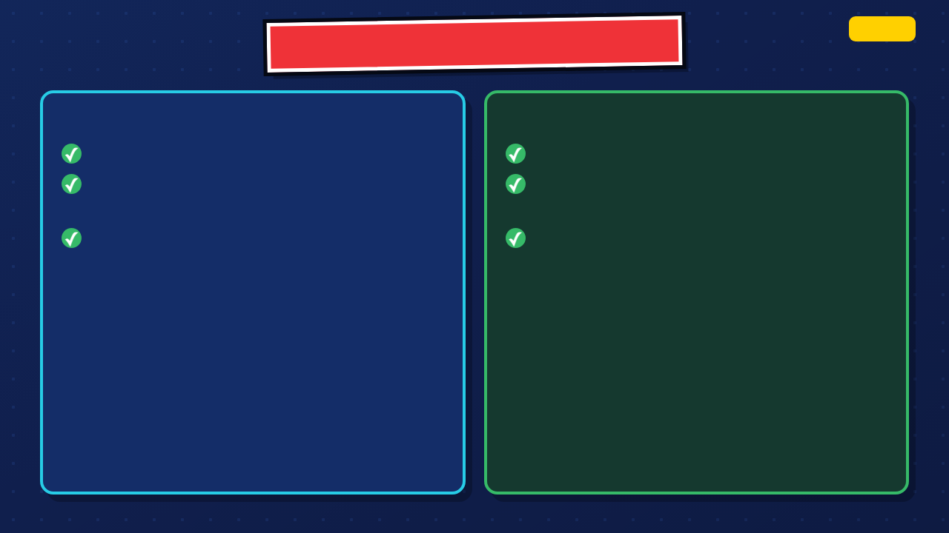
REVISION EVIDENCE + EXTENSIONS
ITERATE
SHOW THE CHANGE
EXTEND IF READY
Name the feedback you used
Add an intentional secondary motion
Name the frame, pose, timing, or result you changed
Improve a transition without hiding the main action
Explain why the revision helped
Test the loop one more time
68 / 69
Notes:
Require one traceable revision. Students who are ready may add secondary motion only after the central promise-in-action remains readable.
[Sources]
- Irving ISD VILS 2027 Template Animation student pages, rubric, and facilitator guide.

Slide 69

MISSION COMPLETE
✓
YOUR ANIMATION NOW SHOWS
A hero the audience can recognize
YOU MADE THE PROMISE VISIBLE
An action connected to the hero
A visible change from problem to result
Timing choices that help the scene read
A revision made from feedback
The strongest moment in my animation is ________.
El momento más fuerte de mi animación es ________.
69 / 69
Notes:
Close with evidence. Ask students to name the strongest moment and the specific action the audience can count on their hero to take.
[Sources]
- Irving ISD VILS 2027 Template Animation student pages, rubric, and facilitator guide.

