Slide 1

New shapes, new colors
A band logo for Rainbow Music Collective
Combine shapes into a new form.
Blend colors with a gradient.
Keep the band name readable.
Example logo
Notes:
About 50 minutes. Open Canva and the Combo app in the school account before class. Students create the current band-logo task: the exact band name, at least one compound shape from Combo, and at least one gradient. A bold 1960s style is welcome. Printing or buying a logo product is not part of this task.
[Sources]
Student task: Verizon Canvas course 23402, assignment 1183374 (Lesson 5: Advanced Shapes and Colors), read September 22, 2026. Teaching sequence: the September 7 Lesson 5 deck, rebuilt as editable slides at Elisha Lucero's request on September 22, 2026. Standard: innovative-technology-site/docs/SLIDE_AUTHORING_STANDARD.md.
Example: Rainbow Music Collective logo from the Canvas assignment (source-58.jpg, supplied classroom material).

Slide 2
As you enter
How could two circles become a crescent moon?
“I would overlap ______
and remove ______.”
Two overlapping circles
A crescent
Notes:
Bell ringer, 2 minutes. Students sketch or describe an overlap and a cut. Accept an initial prediction before opening the app, then save the answer for the Subtract demonstration on slide 9. This is the one planned opening discussion.
[Sources]
Student task: Verizon Canvas course 23402, assignment 1183374 (Lesson 5: Advanced Shapes and Colors), read September 22, 2026. Teaching sequence: the September 7 Lesson 5 deck, rebuilt as editable slides at Elisha Lucero's request on September 22, 2026. Standard: innovative-technology-site/docs/SLIDE_AUTHORING_STANDARD.md.
Diagram: original editable shapes.

Slide 3
Your mission
Design a 1960s band logo for Rainbow Music Collective.
1
The band’s full name, readable.
2
At least one compound shape made in Combo.
3
At least one gradient, anywhere in the logo.
4
A bold 1960s look: groovy, psychedelic, colorful.
Stuck? Start with two circles, use Subtract to make a crescent, add a gradient and the name.
Notes:
1 minute. Read the four parts from the assignment. Compound shape and gradient are the two skills of the day; the name and the 1960s look carry over from earlier lessons. The level-up (recreate the target image with compound shapes) stays optional.
[Sources]
Student task: Verizon Canvas course 23402, assignment 1183374 (Lesson 5: Advanced Shapes and Colors), read September 22, 2026. Teaching sequence: the September 7 Lesson 5 deck, rebuilt as editable slides at Elisha Lucero's request on September 22, 2026. Standard: innovative-technology-site/docs/SLIDE_AUTHORING_STANDARD.md.

Slide 4
Grouping is not combining
Which one makes a new shape?
A
B
Grouped: two shapes that move together
Combined: one new shape
Group
Compound shape
Grouping keeps the outlines. A Combo operation calculates a new region: union, subtract, intersect, or exclude.
Notes:
2 minutes. Ask which side makes a new shape, then click once to reveal. Demonstrate two ordinary shapes grouped in Canva: they move together but keep their outlines. Combo’s four operations calculate new regions. Ask students whether the parts still exist as separate objects after each.
[Sources]
Student task: Verizon Canvas course 23402, assignment 1183374 (Lesson 5: Advanced Shapes and Colors), read September 22, 2026. Teaching sequence: the September 7 Lesson 5 deck, rebuilt as editable slides at Elisha Lucero's request on September 22, 2026. Standard: innovative-technology-site/docs/SLIDE_AUTHORING_STANDARD.md.
Diagram: original editable shapes.

Slide 5

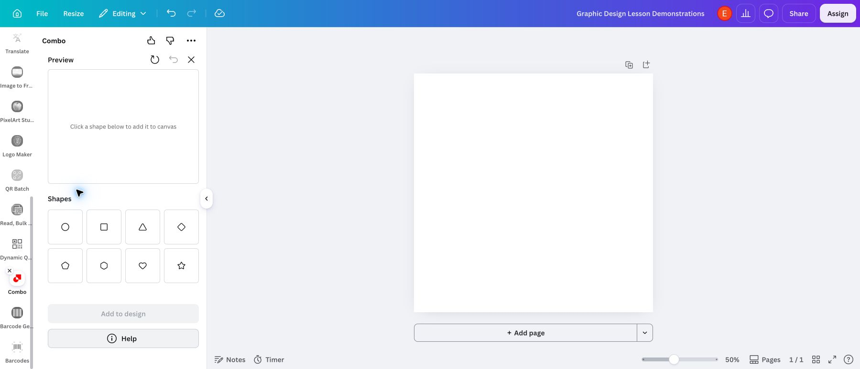
The Combo app
Apps, search Combo, click this icon.
1
Click Apps in the left rail.
2
Search Combo.
3
Click the Combo icon.
4
Add shapes in its Preview.
Combo is a Canva app, not a menu. If Apps is hidden, scroll the left rail.
Notes:
2 minutes. The verified app builds shapes in its own Preview, then inserts the result into Canva. Do not start by selecting objects on the main Canva page and expect the app to import them. Point to the four Actions at the bottom of the panel; students will use exactly one of them for the assignment.
[Sources]
Student task: Verizon Canvas course 23402, assignment 1183374 (Lesson 5: Advanced Shapes and Colors), read September 22, 2026. Teaching sequence: the September 7 Lesson 5 deck, rebuilt as editable slides at Elisha Lucero's request on September 22, 2026. Standard: innovative-technology-site/docs/SLIDE_AUTHORING_STANDARD.md.
Canva and Combo screenshots: Graphic Design Lesson Demonstrations design, Bowie Middle School account, captured September 7, 2026. The Combo app is a third-party Canva app; button names can change. Recheck before teaching.

Slide 6
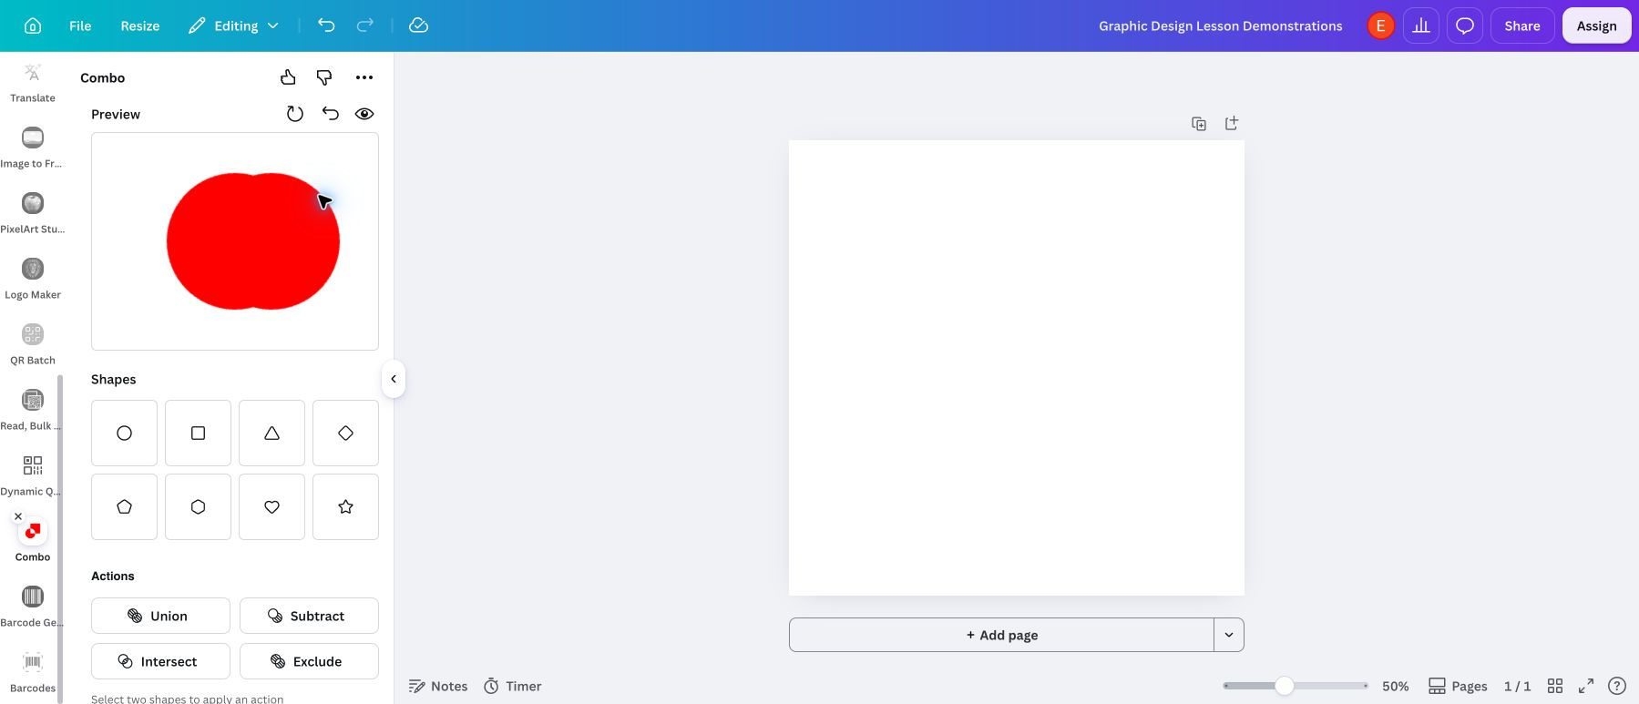
Two overlapping circles
1
Add Circle twice in Combo.
2
Drag one circle sideways.
3
Select both with Shift-click.
If they cover each other exactly, Subtract can leave nothing. Offset them first.
Notes:
3 minutes. Expand Layers if selecting in the Preview is difficult: click one Circle row and Shift-click the other. Choose exactly two. If the two circles perfectly cover each other, subtraction may leave nothing, so offset them first. This is a check for understanding, not just a click sequence.
[Sources]
Student task: Verizon Canvas course 23402, assignment 1183374 (Lesson 5: Advanced Shapes and Colors), read September 22, 2026. Teaching sequence: the September 7 Lesson 5 deck, rebuilt as editable slides at Elisha Lucero's request on September 22, 2026. Standard: innovative-technology-site/docs/SLIDE_AUTHORING_STANDARD.md.
Canva and Combo screenshots: Graphic Design Lesson Demonstrations design, Bowie Middle School account, captured September 7, 2026. The Combo app is a third-party Canva app; button names can change. Recheck before teaching.

Slide 7
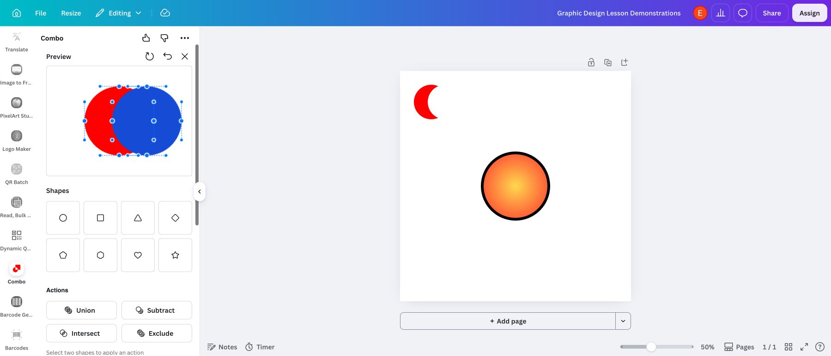
Choose an action
Predict the result, then press one button.
Union
Subtract
Intersect
Exclude
Four buttons, four different regions. The next four slides show each result.
Notes:
2 minutes. Point to Union, Subtract, Intersect, and Exclude in the actual app. These are the four operations verified in the school account. Divide appears in some other vector editors but is not a button here. Keep the pair overlapped and selected, then model each result on the next slides.
[Sources]
Student task: Verizon Canvas course 23402, assignment 1183374 (Lesson 5: Advanced Shapes and Colors), read September 22, 2026. Teaching sequence: the September 7 Lesson 5 deck, rebuilt as editable slides at Elisha Lucero's request on September 22, 2026. Standard: innovative-technology-site/docs/SLIDE_AUTHORING_STANDARD.md.
Canva and Combo screenshots: Graphic Design Lesson Demonstrations design, Bowie Middle School account, captured September 7, 2026. The Combo app is a third-party Canva app; button names can change. Recheck before teaching.

Slide 8

Union
Keeps the area covered by either shape.
Two circles become one joined silhouette.
Real result in Combo
Notes:
1 to 2 minutes. Model Union. Ask which region remains. Use a new pair or Undo to prepare the next comparison; check the overlap again after undoing. Say the plain-language definition aloud; students will use it in their reflection: union keeps the area covered by either shape.
[Sources]
Student task: Verizon Canvas course 23402, assignment 1183374 (Lesson 5: Advanced Shapes and Colors), read September 22, 2026. Teaching sequence: the September 7 Lesson 5 deck, rebuilt as editable slides at Elisha Lucero's request on September 22, 2026. Standard: innovative-technology-site/docs/SLIDE_AUTHORING_STANDARD.md.
Canva and Combo screenshots: Graphic Design Lesson Demonstrations design, Bowie Middle School account, captured September 7, 2026. The Combo app is a third-party Canva app; button names can change. Recheck before teaching.

Slide 9
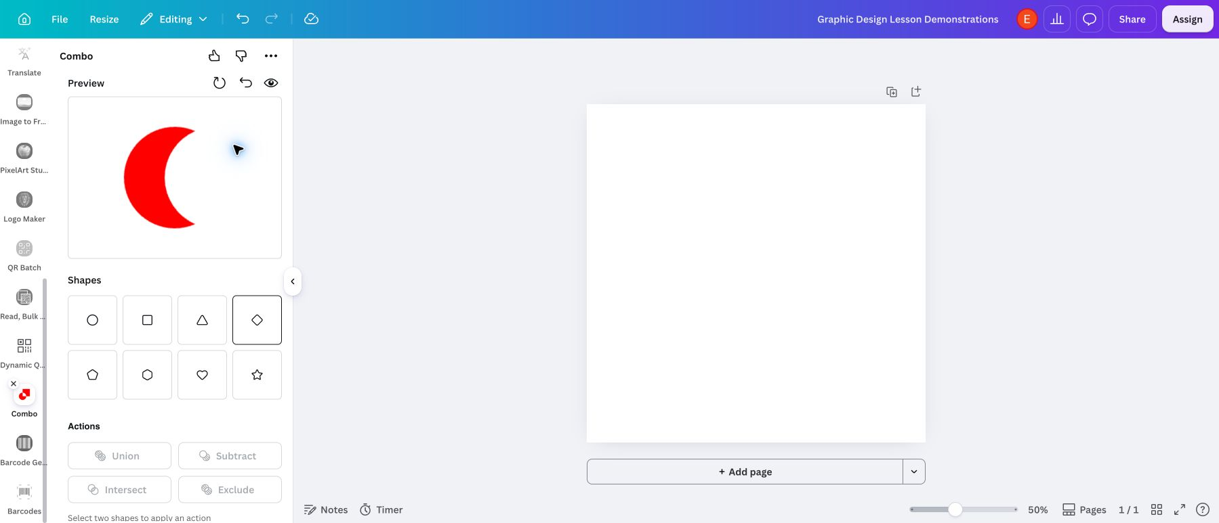
Subtract
Cuts the top shape out of the bottom shape.
The overlap becomes a cutout: a crescent.
Real result in Combo
Notes:
1 to 2 minutes. Model the crescent from the bell ringer. Order matters: if the wrong side survives, inspect the layer order. If everything disappears, the circles were identical and aligned. Say the plain-language definition aloud; students will use it in their reflection: subtract cuts the top shape out of the bottom shape.
[Sources]
Student task: Verizon Canvas course 23402, assignment 1183374 (Lesson 5: Advanced Shapes and Colors), read September 22, 2026. Teaching sequence: the September 7 Lesson 5 deck, rebuilt as editable slides at Elisha Lucero's request on September 22, 2026. Standard: innovative-technology-site/docs/SLIDE_AUTHORING_STANDARD.md.
Canva and Combo screenshots: Graphic Design Lesson Demonstrations design, Bowie Middle School account, captured September 7, 2026. The Combo app is a third-party Canva app; button names can change. Recheck before teaching.

Slide 10
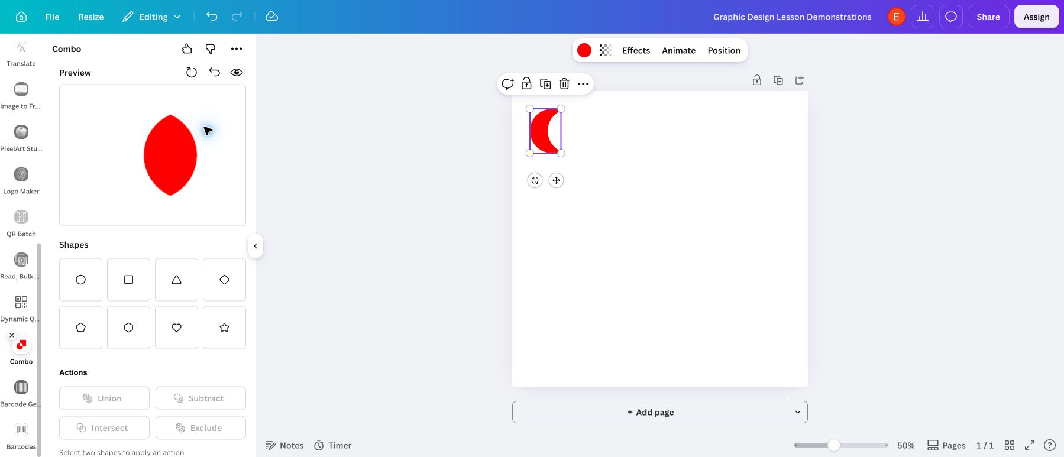
Intersect
Keeps only the overlap.
The shared area becomes a lens.
Real result in Combo
Notes:
1 to 2 minutes. Ask students to predict the result before showing it. Intersect keeps the common area, so separated shapes produce no visible result. Say the plain-language definition aloud; students will use it in their reflection: intersect keeps only the overlap.
[Sources]
Student task: Verizon Canvas course 23402, assignment 1183374 (Lesson 5: Advanced Shapes and Colors), read September 22, 2026. Teaching sequence: the September 7 Lesson 5 deck, rebuilt as editable slides at Elisha Lucero's request on September 22, 2026. Standard: innovative-technology-site/docs/SLIDE_AUTHORING_STANDARD.md.
Canva and Combo screenshots: Graphic Design Lesson Demonstrations design, Bowie Middle School account, captured September 7, 2026. The Combo app is a third-party Canva app; button names can change. Recheck before teaching.

Slide 11
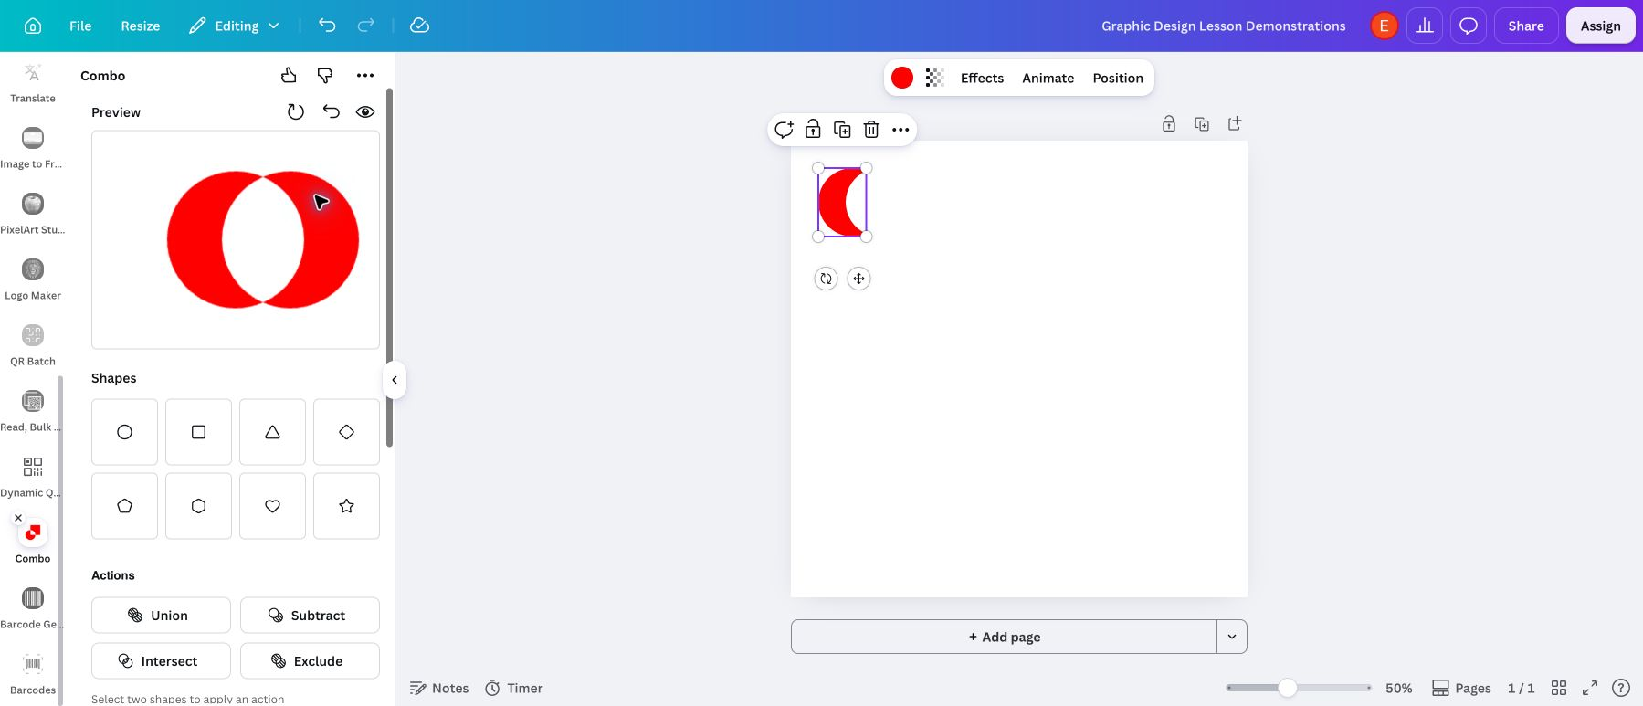
Exclude
Removes the overlap and keeps the outside parts.
Both outer crescents remain.
Real result in Combo
Notes:
1 to 2 minutes. The current app labels this Exclude; older materials call it Difference. The live result contains two parts in Layers, so do not describe it as one continuous object. Say the plain-language definition aloud; students will use it in their reflection: exclude removes the overlap and keeps the outside parts.
[Sources]
Student task: Verizon Canvas course 23402, assignment 1183374 (Lesson 5: Advanced Shapes and Colors), read September 22, 2026. Teaching sequence: the September 7 Lesson 5 deck, rebuilt as editable slides at Elisha Lucero's request on September 22, 2026. Standard: innovative-technology-site/docs/SLIDE_AUTHORING_STANDARD.md.
Canva and Combo screenshots: Graphic Design Lesson Demonstrations design, Bowie Middle School account, captured September 7, 2026. The Combo app is a third-party Canva app; button names can change. Recheck before teaching.

Slide 12
Which operation fits?
Name the button before you press it.
A single crescent
Only the lens
One joined silhouette
“I would use ______ because it keeps / removes ______.”
Subtract · Intersect · Union
Subtract cuts the top shape out. Intersect keeps only the overlap. Union merges both into one.
Notes:
2 minutes. Students answer all three before you click once to reveal. Ask one student to explain the region that survives. If they only memorize button names, return to the two overlapping circles.
[Sources]
Student task: Verizon Canvas course 23402, assignment 1183374 (Lesson 5: Advanced Shapes and Colors), read September 22, 2026. Teaching sequence: the September 7 Lesson 5 deck, rebuilt as editable slides at Elisha Lucero's request on September 22, 2026. Standard: innovative-technology-site/docs/SLIDE_AUTHORING_STANDARD.md.
Diagram: original editable shapes.

Slide 13
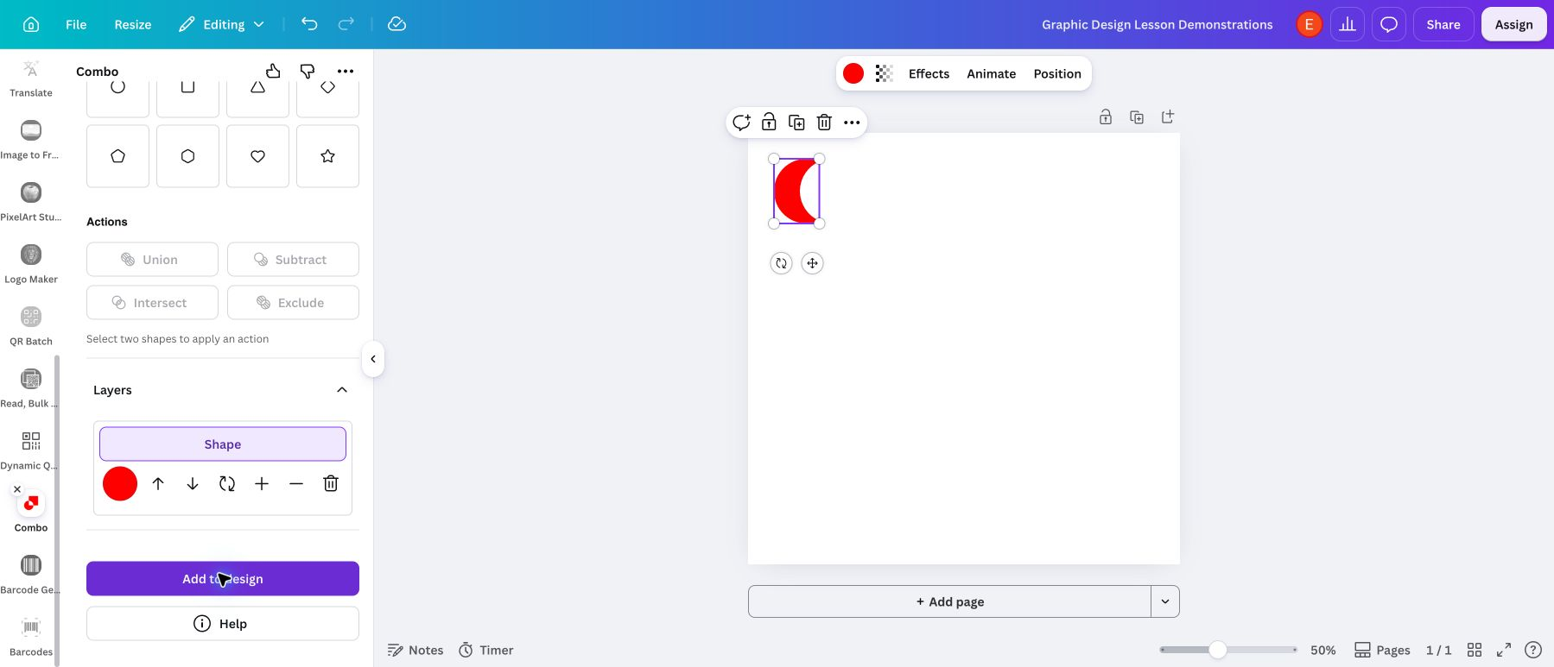
The result enters Canva
1
Check the shape in Combo.
2
Choose Add to design.
3
Resize and position it on your page.
The inserted shape can land small near the top-left. Drag a corner handle to enlarge it.
Notes:
2 minutes. Keep the result visible before closing Combo. The inserted shape may be small and near the top-left of the page; select it and enlarge it from a corner handle.
[Sources]
Student task: Verizon Canvas course 23402, assignment 1183374 (Lesson 5: Advanced Shapes and Colors), read September 22, 2026. Teaching sequence: the September 7 Lesson 5 deck, rebuilt as editable slides at Elisha Lucero's request on September 22, 2026. Standard: innovative-technology-site/docs/SLIDE_AUTHORING_STANDARD.md.
Canva and Combo screenshots: Graphic Design Lesson Demonstrations design, Bowie Middle School account, captured September 7, 2026. The Combo app is a third-party Canva app; button names can change. Recheck before teaching.

Slide 14
A gradient blends colors
Flat stripes or a smooth change?
A
B
Separate flat colors
One color flowing into another
Stripes
Gradient
A gradient changes color gradually across an area. It can sit in a background or a shape; it does not have to be inside the compound shape.
Notes:
1 minute. Ask which side is a gradient, then click once. Compare a smooth transition with separate stripes of flat colors. A gradient can be in a background or a supporting shape; the assignment needs both techniques, not necessarily in one object.
[Sources]
Student task: Verizon Canvas course 23402, assignment 1183374 (Lesson 5: Advanced Shapes and Colors), read September 22, 2026. Teaching sequence: the September 7 Lesson 5 deck, rebuilt as editable slides at Elisha Lucero's request on September 22, 2026. Standard: innovative-technology-site/docs/SLIDE_AUTHORING_STANDARD.md.
Diagram: original editable shapes. Side B is stepped with eleven stops so it stays editable; a real Canva gradient is continuous.

Slide 15
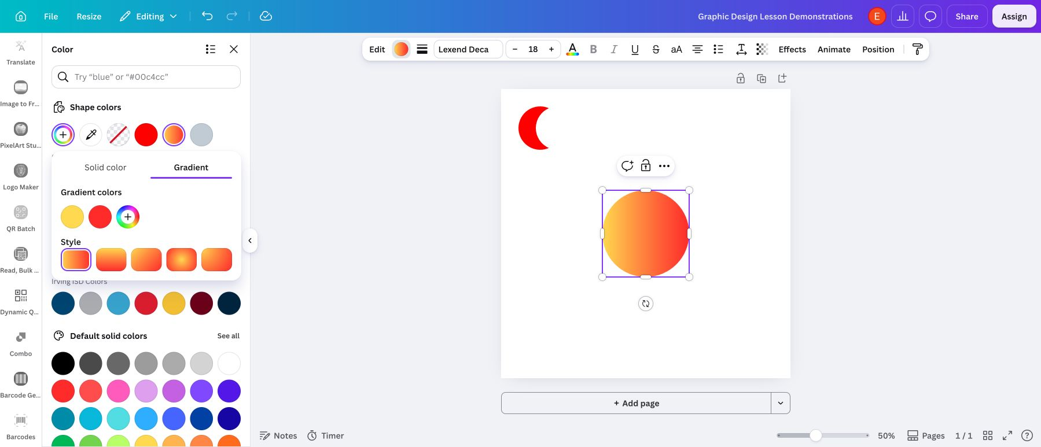
A gradient in Canva
Gradient sits beside Solid color in the color panel.
1
Select a native shape or the page background.
2
Open its color control.
3
Choose Gradient, then pick or edit the colors.
Imported graphics can lack this control. If the Combo shape only offers solid color, put the gradient in the background or another shape.
Notes:
2 minutes. The verified route uses a native Canva circle. Imported graphics and some other object types expose different controls. If the compound result only offers solid color, use a gradient background or a native shape alongside it. Click each color circle to change it.
[Sources]
Student task: Verizon Canvas course 23402, assignment 1183374 (Lesson 5: Advanced Shapes and Colors), read September 22, 2026. Teaching sequence: the September 7 Lesson 5 deck, rebuilt as editable slides at Elisha Lucero's request on September 22, 2026. Standard: innovative-technology-site/docs/SLIDE_AUTHORING_STANDARD.md.
Canva and Combo screenshots: Graphic Design Lesson Demonstrations design, Bowie Middle School account, captured September 7, 2026. The Combo app is a third-party Canva app; button names can change. Recheck before teaching.

Slide 16
Linear gradient
Colors blend along one direction.
Horizontal, vertical, or diagonal: the style tiles set the direction. Click a color stop to change it.
Notes:
1 minute. Click each color stop to edit it. Compare the horizontal, vertical, and diagonal style tiles. The demonstration uses yellow and red so the transition is easy to see.
[Sources]
Student task: Verizon Canvas course 23402, assignment 1183374 (Lesson 5: Advanced Shapes and Colors), read September 22, 2026. Teaching sequence: the September 7 Lesson 5 deck, rebuilt as editable slides at Elisha Lucero's request on September 22, 2026. Standard: innovative-technology-site/docs/SLIDE_AUTHORING_STANDARD.md.
Canva and Combo screenshots: Graphic Design Lesson Demonstrations design, Bowie Middle School account, captured September 7, 2026. The Combo app is a third-party Canva app; button names can change. Recheck before teaching.

Slide 17
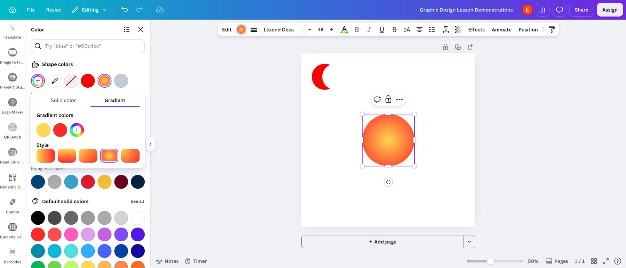
Radial gradient
Colors blend outward from a center.
Canva calls this style Circular. It can start in the middle or at a corner. Linear or circular both satisfy the gradient requirement.
Notes:
1 minute. The current picker offers circular styles centered in the shape or starting at a corner. The old lesson mentions angular gradients, but no angular control appeared in the verified picker. Linear or radial satisfies the requirement.
[Sources]
Student task: Verizon Canvas course 23402, assignment 1183374 (Lesson 5: Advanced Shapes and Colors), read September 22, 2026. Teaching sequence: the September 7 Lesson 5 deck, rebuilt as editable slides at Elisha Lucero's request on September 22, 2026. Standard: innovative-technology-site/docs/SLIDE_AUTHORING_STANDARD.md.
Canva and Combo screenshots: Graphic Design Lesson Demonstrations design, Bowie Middle School account, captured September 7, 2026. The Combo app is a third-party Canva app; button names can change. Recheck before teaching.

Slide 18
The band name stays clear
1
Add the text Rainbow Music Collective.
2
Place it where the background is calm.
3
Check it at a smaller size.
Dark text on a light area, or light text on a dark area. Keep small text off the busiest part of the gradient.
One solution, not a template
Notes:
2 minutes. Model adding the exact band name with a text box. Compare dark text on a light area with light text on a dark area. Avoid placing small text over the busiest part of a gradient or shape. The exemplar is one possible solution, not a template.
[Sources]
Student task: Verizon Canvas course 23402, assignment 1183374 (Lesson 5: Advanced Shapes and Colors), read September 22, 2026. Teaching sequence: the September 7 Lesson 5 deck, rebuilt as editable slides at Elisha Lucero's request on September 22, 2026. Standard: innovative-technology-site/docs/SLIDE_AUTHORING_STANDARD.md.

Slide 19
Canva demo and replay
Watch one logo come together, then build yours.
Two circles
One action
Add to design
Gradient
Band name
Download PNG
Combo tutorial video
Compound shapes and gradients overview
Notes:
Live demonstration, 6 to 8 minutes. Two circles in Combo, one action (Subtract works well), Add to design, enlarge it, add a gradient to a native shape or the background, add the band name, then Share, Download, PNG and rename the file LastName-FirstName-BandLogo.png. Show the upload and the Comments box in Lesson 5. The first link is the existing Combo tutorial: https://www.youtube.com/watch?v=goCGQ3b9DvM . The second is the older concept overview: https://www.youtube.com/watch?v=qCK07WdB7W8 ; it shows an older tool, so use this deck’s screenshots for the interface.
[Sources]
Student task: Verizon Canvas course 23402, assignment 1183374 (Lesson 5: Advanced Shapes and Colors), read September 22, 2026. Teaching sequence: the September 7 Lesson 5 deck, rebuilt as editable slides at Elisha Lucero's request on September 22, 2026. Standard: innovative-technology-site/docs/SLIDE_AUTHORING_STANDARD.md.
Canva and Combo screenshots: Graphic Design Lesson Demonstrations design, Bowie Middle School account, captured September 7, 2026. The Combo app is a third-party Canva app; button names can change. Recheck before teaching.

Slide 20
A final design check
Point to your compound shape. Which button made it?
Subtract
Intersect
Union
Exclude
“I used ______. It ______ my two shapes.”
union = merges them · subtract = cuts the top shape out · intersect = keeps only the overlap · exclude = removes the overlap
Notes:
2 minutes within work time. Ask students to point to the actual compound result and name the button. If they only grouped ordinary shapes, revisit Combo. Also check whether the gradient or decorations hide the name.
[Sources]
Student task: Verizon Canvas course 23402, assignment 1183374 (Lesson 5: Advanced Shapes and Colors), read September 22, 2026. Teaching sequence: the September 7 Lesson 5 deck, rebuilt as editable slides at Elisha Lucero's request on September 22, 2026. Standard: innovative-technology-site/docs/SLIDE_AUTHORING_STANDARD.md.
Diagram: original editable shapes.

Slide 21


Rainbow Music Collective
Canvas: SW1 · Graphic Design with the 1960s
Make
The band’s full name.
At least one shape made in Combo.
At least one gradient.
A bold 1960s look.
Ready to turn in?
The name is readable.
You can name your Combo button and what it did.
File named LastName-FirstName-BandLogo.png
Examples: a Combo result and a finished logo
Turn it in
Open Lesson 5 in Canvas
Share, Download, PNG. Upload it to Lesson 5.
Comments: I used ______ (union, subtract, intersect,
or exclude). It ______ my two shapes, which made ______.
union = merges · subtract = cuts out · intersect = keeps the overlap
exclude = removes the overlap · crescent · lens · ring · gradient
Notes:
Leave this screen projected for the whole work block. Check three things in order: a real Combo shape (not a group); a gradient somewhere; the band name readable. Export as PNG, name the file LastName-FirstName-BandLogo.png, upload it to Lesson 5, and write the one reflection sentence in Comments: I used ______ (union, subtract, intersect, or exclude). It ______ my two shapes, which made ______ in my logo. The word bank on the assignment gives the plain-language meaning of each button. The existing rubric and 5 points stay authoritative.
[Sources]
Student task: Verizon Canvas course 23402, assignment 1183374 (Lesson 5: Advanced Shapes and Colors), read September 22, 2026. Teaching sequence: the September 7 Lesson 5 deck, rebuilt as editable slides at Elisha Lucero's request on September 22, 2026. Standard: innovative-technology-site/docs/SLIDE_AUTHORING_STANDARD.md.
Examples: real Combo Subtract result (September 7 capture) and the Rainbow Music Collective logo from the assignment. Canvas banner: real teacher-view capture, September 7, 2026.

