Slide 1
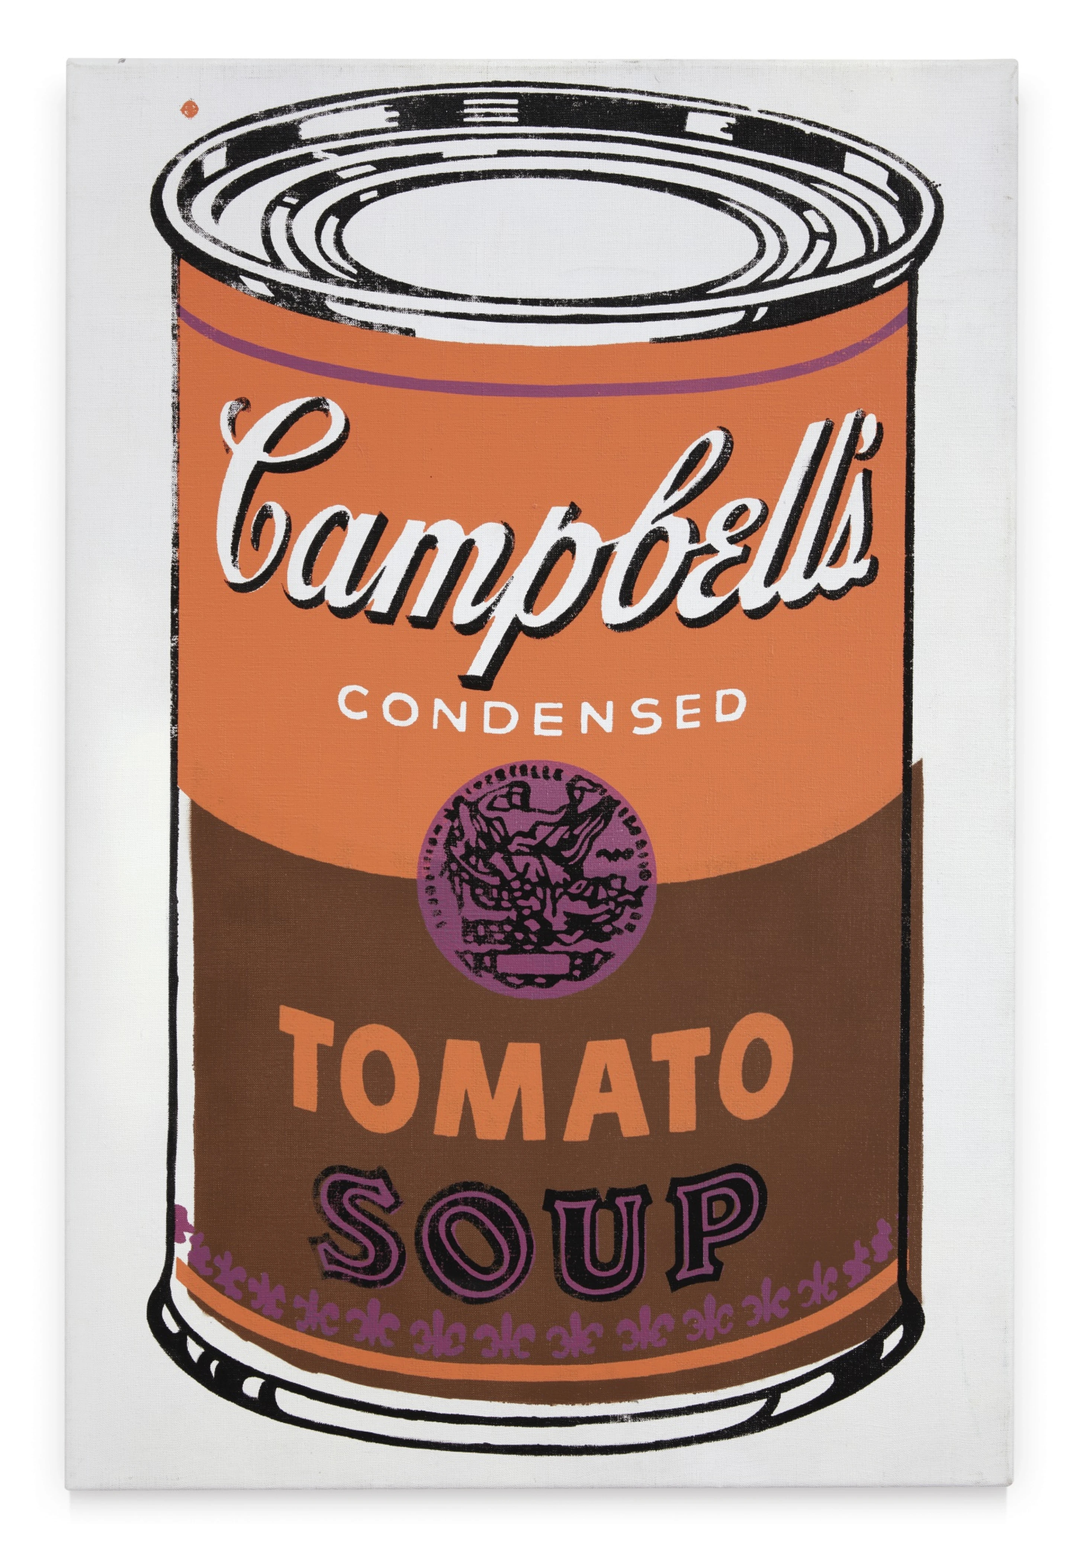
POP ART OF THE 60s
POP
ART
Everyday images. Who gets to call them art?
Notes:
Begin with the everyday-object question on the next slide. Have paper, pencils and coloring tools ready. This is a teacher-led visual lesson followed by the existing name-tag task. The opening and the final reflection are the two planned discussion moments. Keep other slides moving with explanation and pointing to visual evidence. The video is optional.
[Sources]
Existing Lesson 1: Pop Art of the 60s, canonical Canvas course 23402, item 2634021; user-supplied name-tag examples and approved work slide.

Slide 2
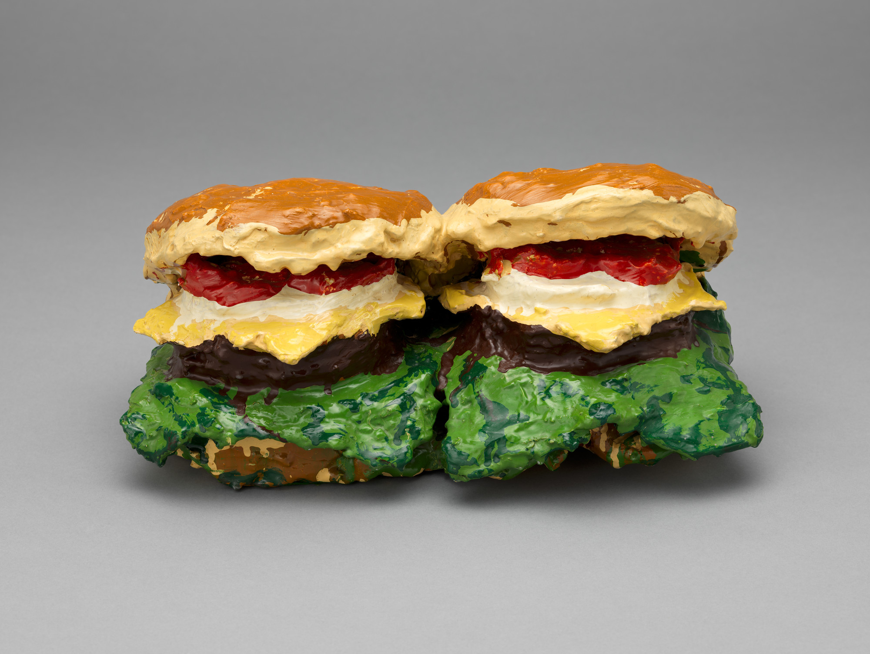
As you enter
If you could put one object from modern-day life in a museum, what would it be?
A burger can be a sculpture. Claes Oldenburg, Dual Hamburgers, 1962.
“I would display _____ because _____.”
Notes:
OPENING DISCUSSION, about 2 minutes. Take two or three responses. A controller, shoe, snack package or phone can work. Ask for one reason, then connect: artists also chose objects from everyday life. These are painted sculptures, not food photographs. Keep the opening open-ended rather than grading students’ tastes.
[Sources]
MoMA, Claes Oldenburg, Two Cheeseburgers, with Everything (Dual Hamburgers) (1962). https://www.moma.org/collection/works/81183

Slide 3
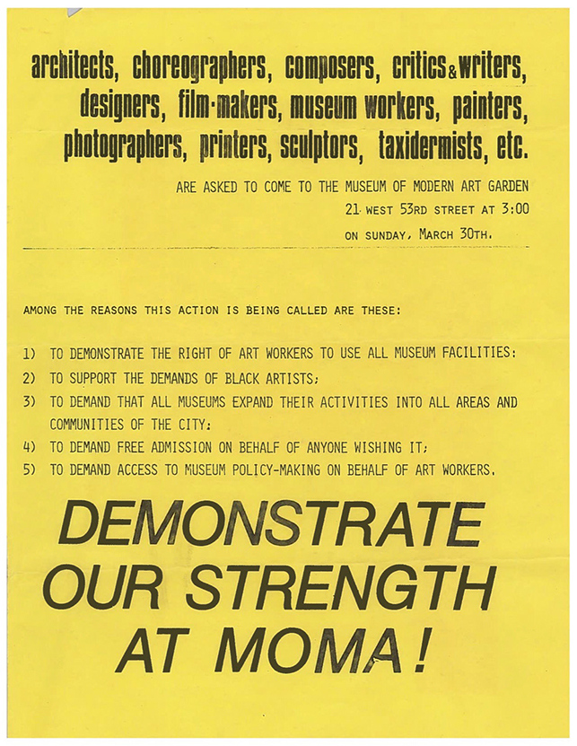
An argument about “serious” art
Popular culture could belong in a gallery.
Pop artists brought grocery labels, comics and celebrity images into fine art.
Artists also demanded wider access to museums. MoMA Archives, 1969.
Notes:
TEACHER EXPLANATION, 2 minutes. Pop developed in Britain in the 1950s and became prominent in the United States in the 1960s. It challenged the boundary between prestigious fine art and everyday commercial imagery. Make the provocation concrete: a comic or grocery label could receive the attention usually reserved for a gallery painting. The 1969 flyer documents a related but distinct fight over museum access, including free admission. Pop was not one unified political protest; some artists celebrated consumer culture while others criticized it. Do not claim all earlier art belonged only to rich people.
[Sources]
MoMA, The Modern Studio: Pop Art. https://www.moma.org/calendar/events/3937
MoMA Archives, Faith Ringgold, the Art Workers Coalition, and the Fight for Inclusion (2016). https://www.moma.org/explore/inside_out/2016/07/29/from-the-archives-faith-ringgold-the-art-workers-coalition-and-the-fight-for-inclusion-at-the-museum-of-modern-art/

Slide 4
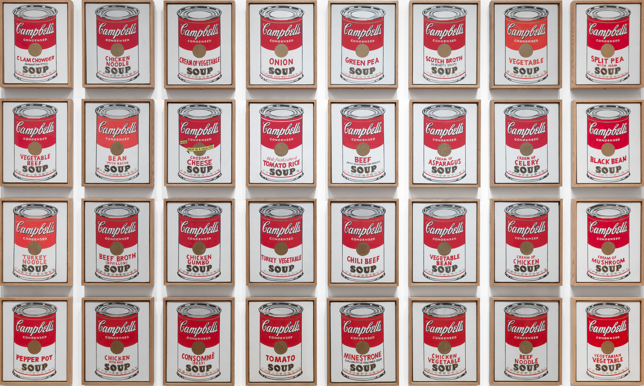
Warhol made repetition the subject
Andy Warhol, Campbell’s Soup Cans, 1962. 32 paintings, one for each flavor. © Andy Warhol Foundation / ARS.
Notes:
TEACHER EXPLANATION, 90 seconds. Point across a row: the can, size and label design repeat; the soup variety changes. In the first exhibition the canvases stood on shelves like groceries. The 1962 paintings were painted by hand, although their repeated design looks machine-made. Repetition is more than a decorative background here: it makes a familiar product dominate the viewer’s attention. Point out the small flavor changes; no partner discussion is needed.
[Sources]
MoMA, Andy Warhol, Campbell’s Soup Cans (1962). https://www.moma.org/collection/works/79809

Slide 5
The same package, unexpected color
Orange
Violet
Dark brown
Color can change the feeling while the object stays recognizable.
1962: familiar label colors
1965: a later color experiment
Notes:
TEACHER EXPLANATION, 90 seconds. Compare the earlier red-and-white label with this actual 1965 painting. Warhol kept the package recognizable and changed its palette to orange, violet and brown. These are two different historical works. The original 1962 set did not have 32 different color schemes. In the name tag, students can similarly choose colors for an effect rather than copying realistic colors.
[Sources]
MoMA, Andy Warhol, Campbell’s Soup Cans (1962). https://www.moma.org/collection/works/79809
Sotheby’s, Andy Warhol, Colored Campbell’s Soup Can (1965), lot 41, 2019. https://www.sothebys.com/en/auctions/ecatalogue/2019/contemporary-art-evening-auction-n10069/lot.41.html
Images: MoMA collection reproduction (detail) and Sotheby’s lot 41 reproduction; artwork © Andy Warhol Foundation / ARS.

Slide 6
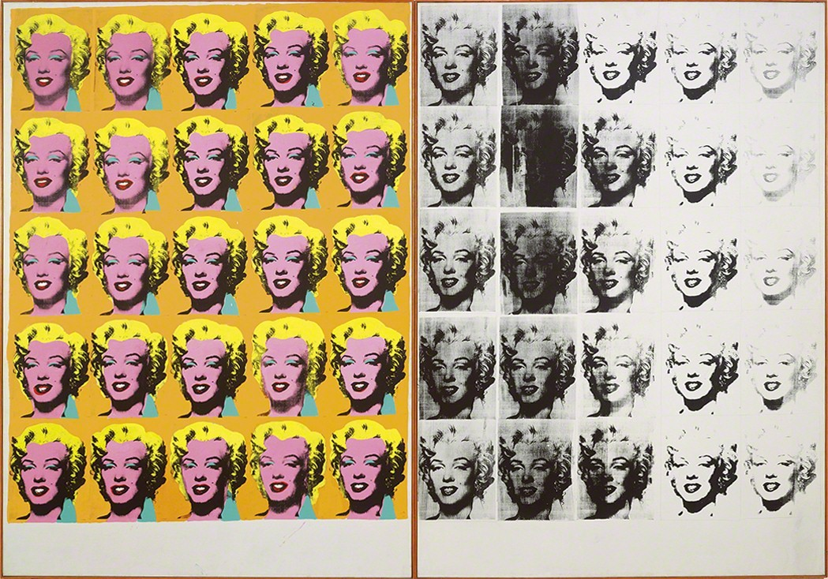
A famous face, repeated 50 times
Andy Warhol, Marilyn Diptych, 1962. Tate. Reproduction via Artsy/Tate. © Andy Warhol Foundation.
Notes:
TEACHER EXPLANATION, 90 seconds. Both halves repeat the same image of Marilyn Monroe, a film star. Point out the bright color on the left and the uneven, fading black-and-white impressions on the right. Screenprinting let Warhol repeat a photographic image while changes in color and ink changed its effect. The work can prompt ideas about fame and loss; present those as interpretations, not a single correct answer. Stay with the visual comparison instead of adding a turn-and-talk.
[Sources]
Tate, Andy Warhol, Marilyn Diptych (1962). https://www.tate.org.uk/art/artworks/warhol-marilyn-diptych-t03093
The Met, Green Pea from Campbell’s Soup I, discussion of Warhol’s printing and color. https://www.metmuseum.org/art/collection/search/395026
Image reproduction: https://www.artsy.net/article/artsy-editorial-warhol-whitney-retrospective-holds-surprises

Slide 7
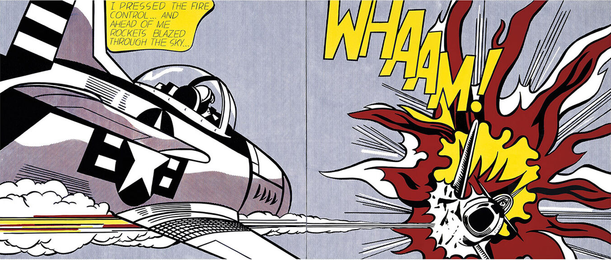
Roy Lichtenstein brought comics into Pop
Existing comic panels became enormous paintings.
Whaam!, 1963. Main comic source: Irv Novick for DC Comics, 1962. © Estate of Roy Lichtenstein.
Notes:
TEACHER EXPLANATION, 2 minutes. If students ask who came up with the comic-strip idea in Pop Art, name Roy Lichtenstein as a major artist who made this approach famous. He did not invent comic books. He adapted imagery made by working comic illustrators. The main source for Whaam! was a panel by Irv Novick in DC Comics’ All-American Men of War #89 (1962). Give Novick credit. Explain that the painting changes scale, arrangement and color. Borrowing raises questions about credit and originality; students will borrow visual techniques for their own names, not copy an artist’s whole composition.
[Sources]
Tate, Roy Lichtenstein, Whaam! (1963). https://www.tate.org.uk/art/artworks/lichtenstein-whaam-t00897
Ernesto Priego, The Comics Grid, Year One, discussion of Irv Novick and Whaam! https://openaccess.city.ac.uk/3082/1/The_Comics_Grid_Year_One_singlePage_.pdf
Visual reproduction: Tate Shop, Roy Lichtenstein Whaam! art print. https://shop.tate.org.uk/roy-lichtenstein-whaam-art-print/26242.html . White print border cropped; complete artwork retained.

Slide 8
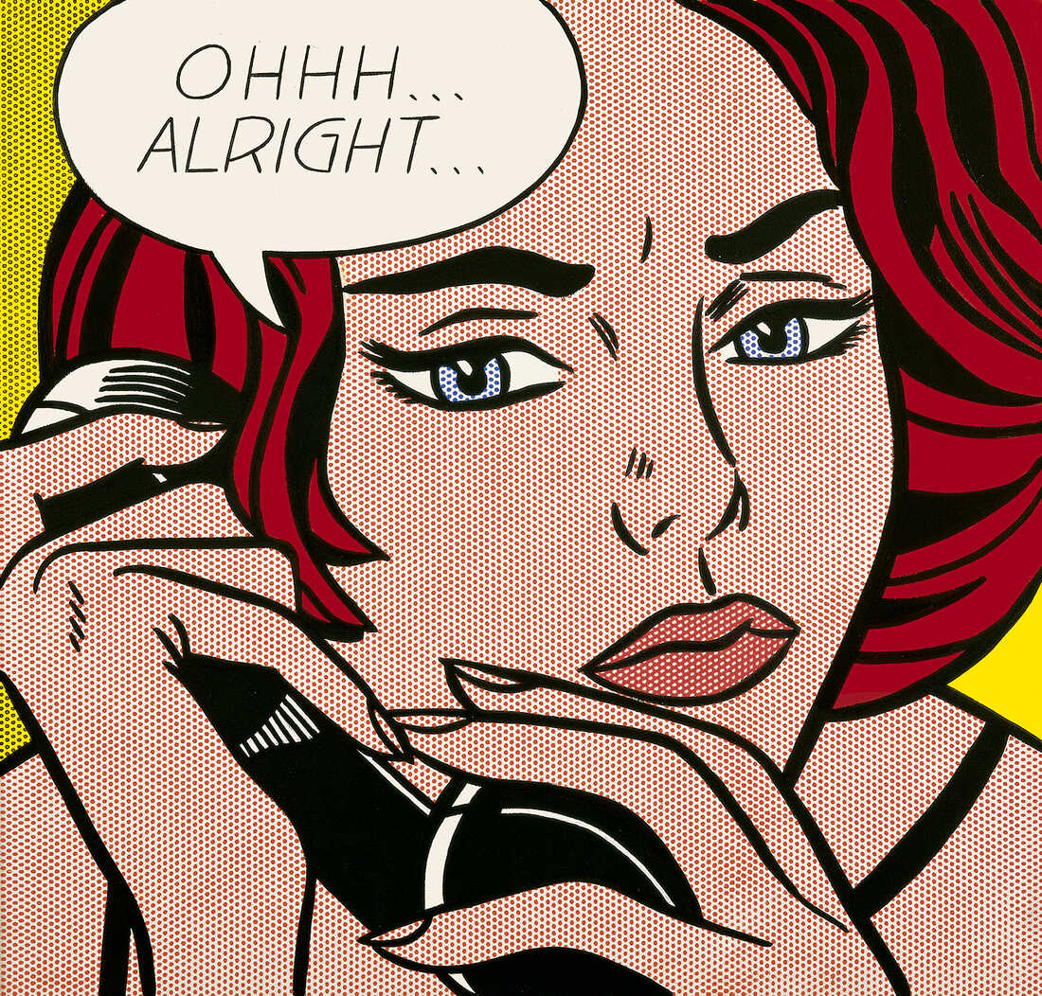
The comic look
Thick black outlines
Flat areas of color
Speech bubbles
Small printing dots
Roy Lichtenstein, Ohhh… Alright…, 1964. © Estate of Roy Lichtenstein.
Notes:
TEACHER EXPLANATION, 90 seconds. Point to each feature while naming it. The black outline separates the face, hair and background. The red and yellow areas are flat color. The speech balloon supplies a voice. The dots recall inexpensive commercial printing, often called Ben-Day dots. These are techniques to try in an original name-tag design.
[Sources]
Roy Lichtenstein Catalogue Raisonné, Ohhh… Alright… (1964), RLCR 936. https://www.lichtensteincatalogue.org/catalogue/entry.php?id=530
Existing Lesson 1: Pop Art of the 60s, canonical Canvas course 23402, item 2634021; user-supplied name-tag examples and approved work slide.

Slide 9
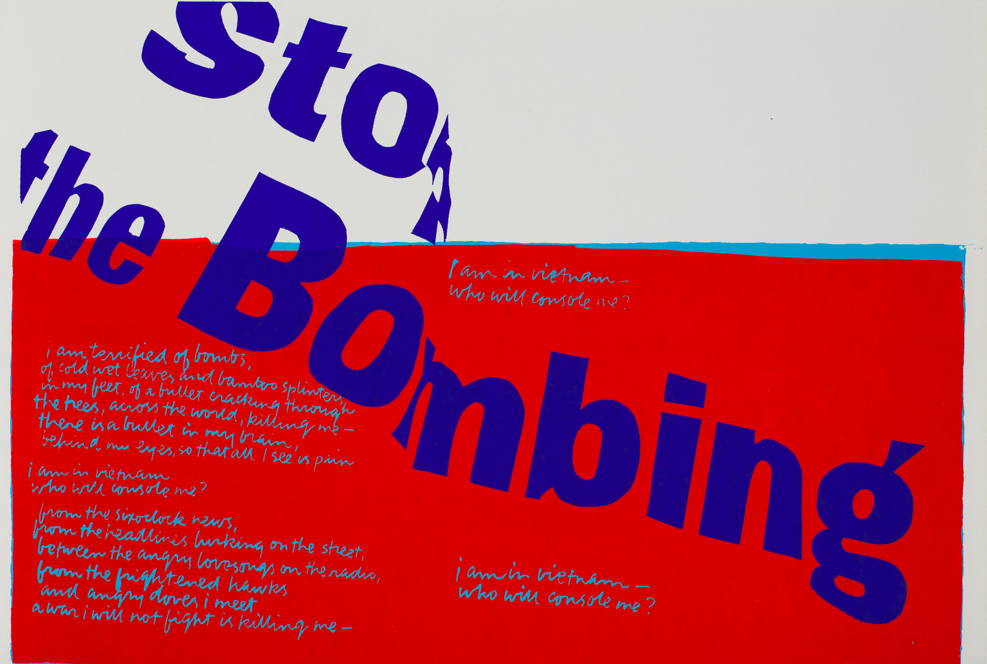
Pop’s visual language could protest
Corita Kent
stop the bombing
1967
The message is direct.
The letters demand attention.
Serigraph. Corita Art Center, archive 67-29. © Corita Art Center.
Notes:
TEACHER EXPLANATION, 2 minutes. Kent was an artist and teacher whose prints put words and strong color to work. This 1967 print directly opposes the bombing in the Vietnam War. Point out the oversized letters, diagonal movement and blue/red contrast. Her work is a clear example of Pop-associated graphic language carrying a political message. Avoid making this the intention of every Warhol or Lichtenstein work. Students can use strong lettering to express their own identity without being required to share a political position.
[Sources]
Corita Art Center, stop the bombing (1967), archive 67-29. https://collection.corita.org/piece/67-29
Smithsonian American Art Museum, Corita Kent, stop the bombing (1967). https://americanart.si.edu/artwork/stop-bombing-121032

Slide 10
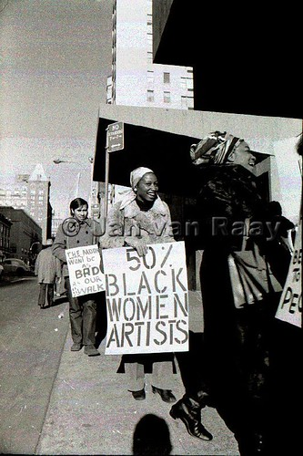
Artists fought to be seen
Women and artists of color were making art. Major museums often gave them far less space.
Faith Ringgold helped organize protests for greater representation.
Whitney Museum protest, January 31, 1971. Photo © Jan van Raay.
Notes:
TEACHER EXPLANATION, 2 minutes. This photograph shows a real protest at the Whitney on January 31, 1971. Faith Ringgold and others challenged the exclusion of Black artists and women. Whitney records that its 1969 Annual included only eight women among 151 artists; the 1970 exhibition included twenty among one hundred after protests. The struggle was about access, recognition and power, not an absence of artistic ability. Distinguish these organized museum protests from Pop Art as a style. Ringgold belongs here as an artist-activist in the same wider fight over the art world, not as a claim that all her work is Pop.
[Sources]
Whitney Museum, The Biennial and Women Artists: A Look Back at Feminist Protests (2010). https://whitney.org/education/blog/biennial-and-women-artists
Jan van Raay, Black Emergency Cultural Coalition protest at the Whitney Museum, January 31, 1971. https://www.flickr.com/photos/janvanraay/908457076/ . Photo © Jan van Raay.
Photograph identification also discussed by Michele Faith Wallace: https://www.flickr.com/photos/mjsoulpictures/galleries/72157623976615706/with/1272872980/

Slide 11
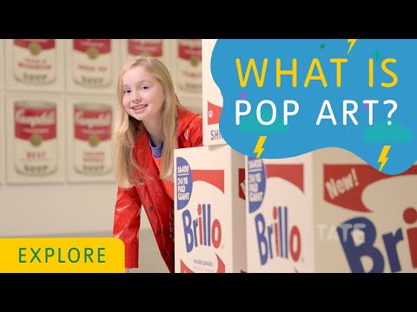
Pop Art history
An optional video recap
Look for the everyday images and visual choices you have just seen.
Watch the Pop Art video
Notes:
OPTIONAL. Keep the existing linked video as a recap or alternate explanation. The preceding artwork slides cover the core ideas, so the deck still works when playback is unavailable. Do not add another required partner discussion after the video. Move into the visual choices students can use in their name tags.
[Sources]
Existing Lesson 1: Pop Art of the 60s, canonical Canvas course 23402, item 2634021; user-supplied name-tag examples and approved work slide.
Existing video: https://www.youtube.com/watch?v=DhEyoDCTSDQ

Slide 12
Lettering changes the voice
MAYA
Block letters
Wide and sturdy
MAYA
Narrow letters
Tall and dramatic
MAYA
Rounded letters
Loose and playful
Modern lettering examples: Arial Black, Impact and Comic Sans MS Bold. You can draw your own letters.
Notes:
LIVE EXPLANATION, about 1 minute. These are modern type examples, not the fonts used to paint the historical artworks. Read the same name in each style. Point out width, weight, height and curves. Students draw with paper and pencil in this lesson, so they can invent letterforms instead of hunting for software fonts. Show how the shape of the letters can make the name feel sturdy, energetic or friendly. Treat those feelings as possible interpretations. No additional discussion stem is needed.
[Sources]
Existing Lesson 1: Pop Art of the 60s, canonical Canvas course 23402, item 2634021; user-supplied name-tag examples and approved work slide.

Slide 13
Flat, bold color
MAYA
Blue + yellow
MAYA
Deep green + pink
MAYA
Black + red + white
Solid color areas, a strong outline, and a name that stands apart from its background.
Notes:
LIVE EXPLANATION, about 1 minute. Each example uses solid color areas. Point out the two-color pair beside its label. In the third example, a white outline separates the red letters from black. These are possible classroom palettes, not a rule that every Pop artist used only primary colors. Have students choose a small palette they can fill cleanly with the materials available. Gradients are not needed for this task.
[Sources]
Existing Lesson 1: Pop Art of the 60s, canonical Canvas course 23402, item 2634021; user-supplied name-tag examples and approved work slide.
The Met, Green Pea from Campbell’s Soup I, discussion of Warhol’s printing and color. https://www.metmuseum.org/art/collection/search/395026

Slide 14
Contrast makes the name readable
READ ME
A
READ ME
B
A stronger difference between letters and background helps the name read from across the room.
Notes:
QUICK VISUAL CHECK, 30–45 seconds. Point to A, then B. Demonstrate rather than launching another turn-and-talk. The font and word stay the same; the letter color changes. Bright colors still need enough light/dark difference or a strong outline. During work time, check names from across a table.
[Sources]
Existing Lesson 1: Pop Art of the 60s, canonical Canvas course 23402, item 2634021; user-supplied name-tag examples and approved work slide.

Slide 15
Small dots, strong outlines
Dots can create texture.
An outline keeps the edge clear.
For your name tag, keep a pattern smaller than the letters.
Detail: Roy Lichtenstein, Ohhh… Alright…, 1964. © Estate of Roy Lichtenstein.
Notes:
TEACHER MODEL, 1 minute. Zoom into the actual Lichtenstein work. Point to the repeated small dots and the bold contour. Then return to the student’s task: a background pattern should support the name. Model a few small dots or stripes, leaving space around the letters. Keep students’ attention on the actual printing dots and contour.
[Sources]
Roy Lichtenstein Catalogue Raisonné, Ohhh… Alright… (1964), RLCR 936. https://www.lichtensteincatalogue.org/catalogue/entry.php?id=530
Existing Lesson 1: Pop Art of the 60s, canonical Canvas course 23402, item 2634021; user-supplied name-tag examples and approved work slide.

Slide 16
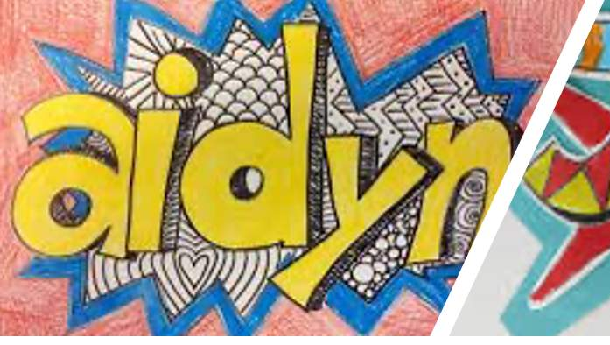
A first sketch
1 Large letters
2 A clear outline
3 Flat, contrasting colors
Pencil first. Make the name readable before adding the background.
Notes:
LIVE DEMO, about 2 minutes. Draw your own name on paper in large pencil letters. Outline the letters and fill one with a solid color. Add a contrasting area beside it. Pause for students to start their pencil sketch, then move to the existing work slide. Do not add a new graded requirement or additional submission. The next slide stays projected through work time and already includes the exemplar, done criteria, Canvas image, turn-in directions and final reflection.
[Sources]
Existing Lesson 1: Pop Art of the 60s, canonical Canvas course 23402, item 2634021; user-supplied name-tag examples and approved work slide.

Slide 17
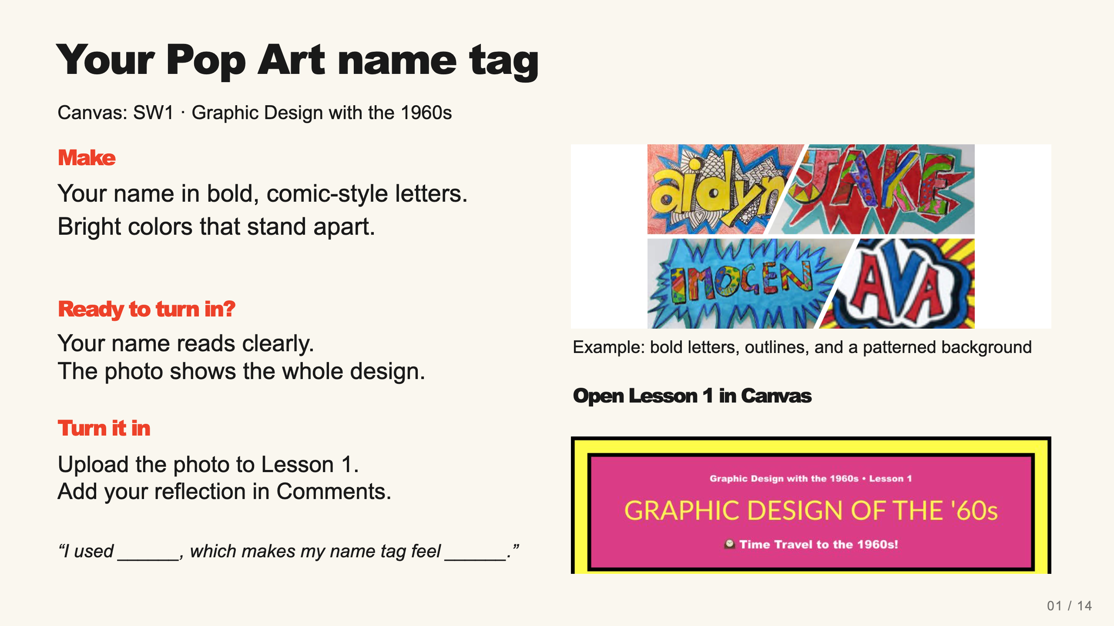
Notes:
Teacher move: Leave this screen projected throughout independent work. It contains the required product, observable completion checks, an exemplar, and the existing submission route. Use verbal reminders and brief conferences instead of cycling through separate task, submission, and done slides. The exemplar is inspiration, not a template to copy. Before class, open the named assignment in your own course and confirm the submission controls.
Students may add a repeating background after the name is readable. Photograph the paper artifact. Use the existing Canvas reflection rather than another exit ticket.
The existing assignment rubric and points remain authoritative. Confer on one useful revision at a time.
[Sources]
Current course snapshot, generated student pages and facilitator guides in innovative-technology-site, inspected 2026-09-07. Original ZIP supplied by Elisha Lucero.
Tate, Pop art, https://www.tate.org.uk/art/art-terms/p/pop-art ; MoMA, Campbell’s Soup Cans, https://www.moma.org/collection/works/79809 . Accessed 2026-09-07.
Exemplar: source-56.jpg, from the supplied classroom materials. Canvas: live assignment and submission types verified through the API on September 7, 2026. Screenshot: real teacher-view assignment banner, cropped to omit editing controls. The unpublished template module prevents Student View access; publication was not changed.

