Slide 1
PICTURE THIS | DAY 1 OF 5
Meet the AI
Today you'll touch a tool that learns from what it sees.
Smart Solutions | Engineering & Technology
Your Teacher
MON | 1/9
Notes:
Use the visible prompt to teach and model the concept. Ask students to name the evidence they are using.
[Sources]
- Teacher-authored Picture This classroom presentation (Lucero, 2025).
- Google Teachable Machine, official tool: https://teachablemachine.withgoogle.com/ (accessed 2026-08-15).

Slide 2
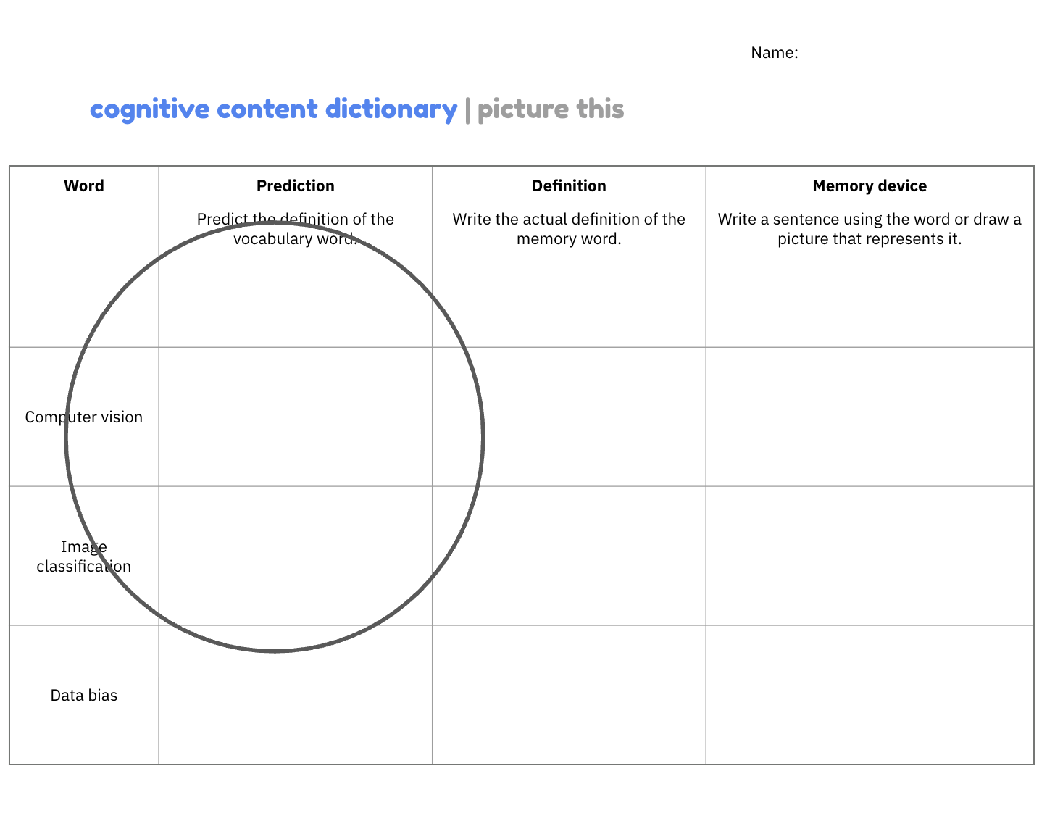
picture this
warm-up
Grab a sheet from the computer stand
Write your own predicted definition for the terms “Computer Vision” and “Image Classification”
Notes:
Use the visible prompt to teach and model the concept. Ask students to name the evidence they are using.
[Sources]
- Teacher-authored Picture This classroom presentation (Lucero, 2025).
- Google Teachable Machine, official tool: https://teachablemachine.withgoogle.com/ (accessed 2026-08-15).

Slide 3
part 1 | launch
Notes:
Use the visible prompt to teach and model the concept. Ask students to name the evidence they are using.
[Sources]
- Teacher-authored Picture This classroom presentation (Lucero, 2025).
- Google Teachable Machine, official tool: https://teachablemachine.withgoogle.com/ (accessed 2026-08-15).

Slide 4
today’s learning targets
Learning targets:
Define image classification as a type of computer vision.
Create an image classification model.
How will learning this help us become responsible designers of AI?
Computer vision is an important field of AI.
Our final projects will be centered on image classification.
Notes:
Use the visible prompt to teach and model the concept. Ask students to name the evidence they are using.
[Sources]
- Teacher-authored Picture This classroom presentation (Lucero, 2025).
- Google Teachable Machine, official tool: https://teachablemachine.withgoogle.com/ (accessed 2026-08-15).

Slide 5
intro
Computer vision
Computers can use computer vision to understand the world.
Object detection
Face
recognition
Video processing
Image classification
Computer vision: AI that helps computers find meaning in images and video.
Example:
Cat pictures vs.
dog pictures
Computer vision and some of its fields.
Notes:
Use the visible prompt to teach and model the concept. Ask students to name the evidence they are using.
[Sources]
- Teacher-authored Picture This classroom presentation (Lucero, 2025).
- Google Teachable Machine, official tool: https://teachablemachine.withgoogle.com/ (accessed 2026-08-15).

Slide 6
intro
Computer vision
Image classification examples:
Healthy vs. diseased tissue in the body
Croissants vs. bagels at a grocery store checkout
Players on your team vs. my team on the football field
Object detection
Face
recognition
Video processing
Image classification
Example:
Cat pictures vs.
dog pictures
Image classification: AI that sorts an image into a learned category.
Computer vision and some of its fields.
Notes:
Use the visible prompt to teach and model the concept. Ask students to name the evidence they are using.
[Sources]
- Teacher-authored Picture This classroom presentation (Lucero, 2025).
- Google Teachable Machine, official tool: https://teachablemachine.withgoogle.com/ (accessed 2026-08-15).

Slide 7
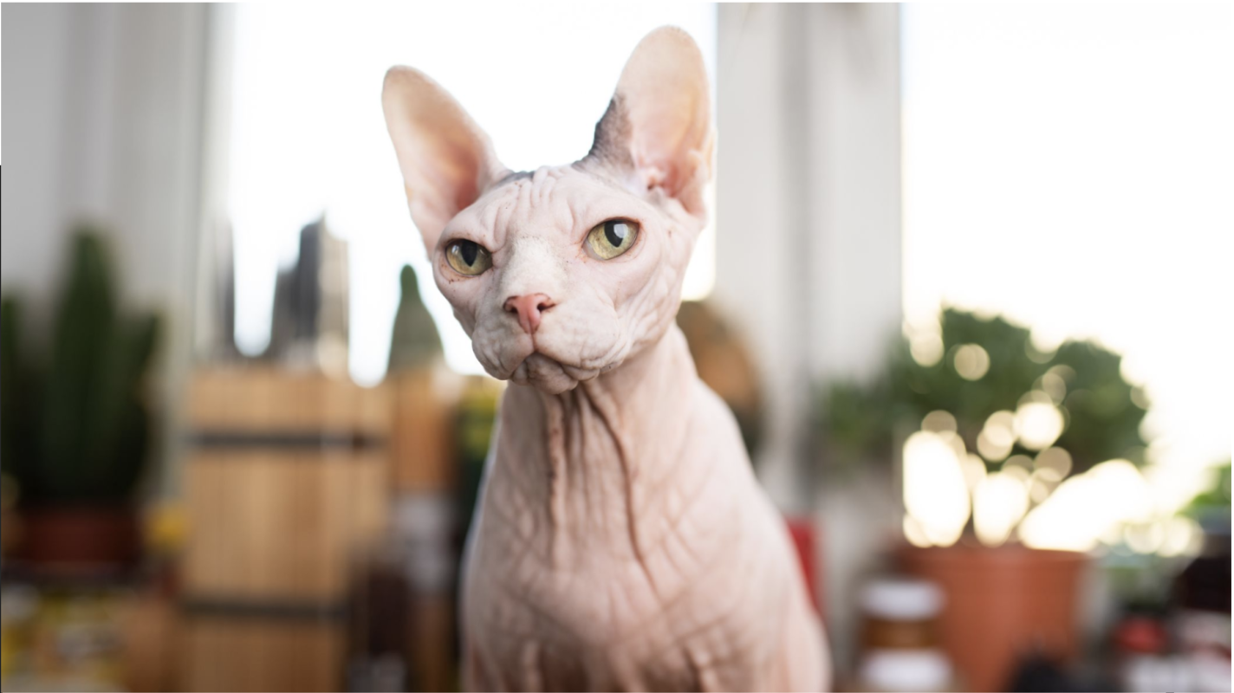

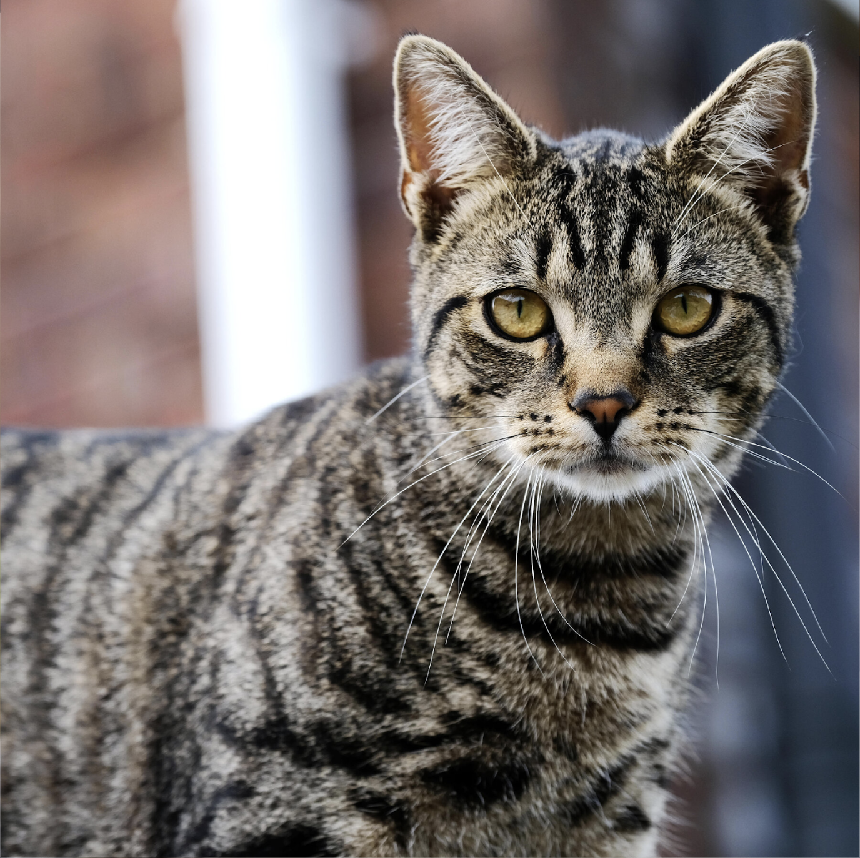

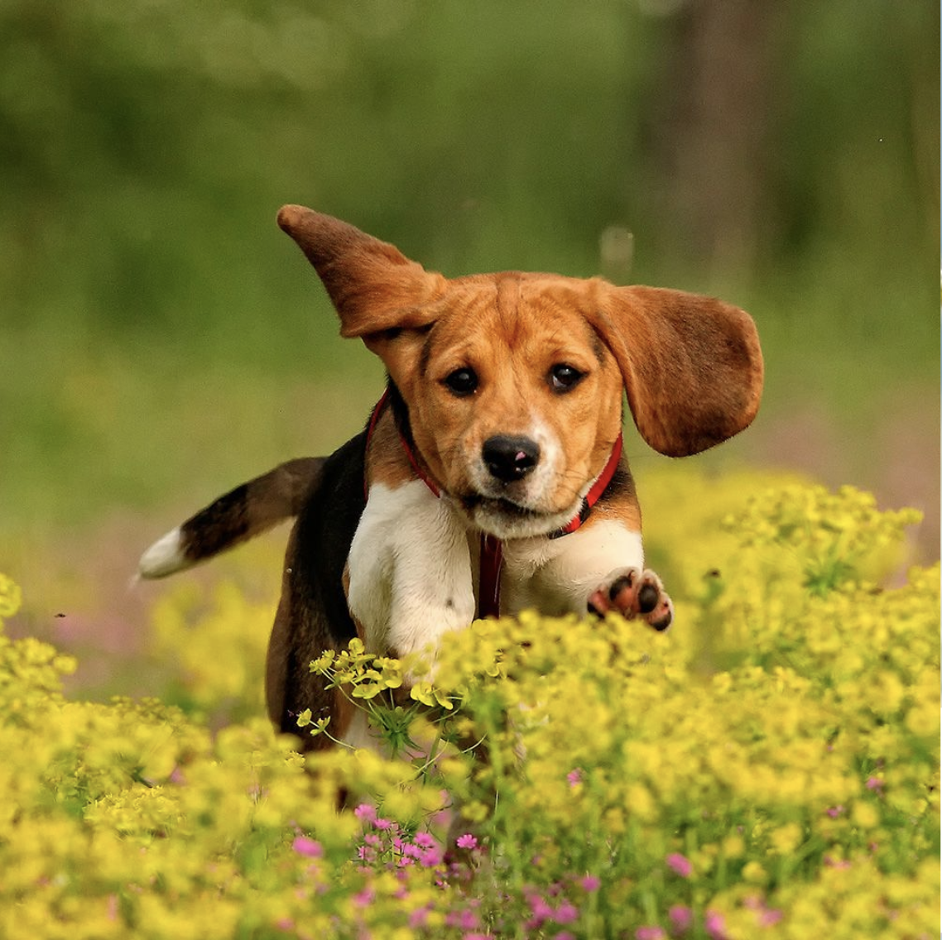
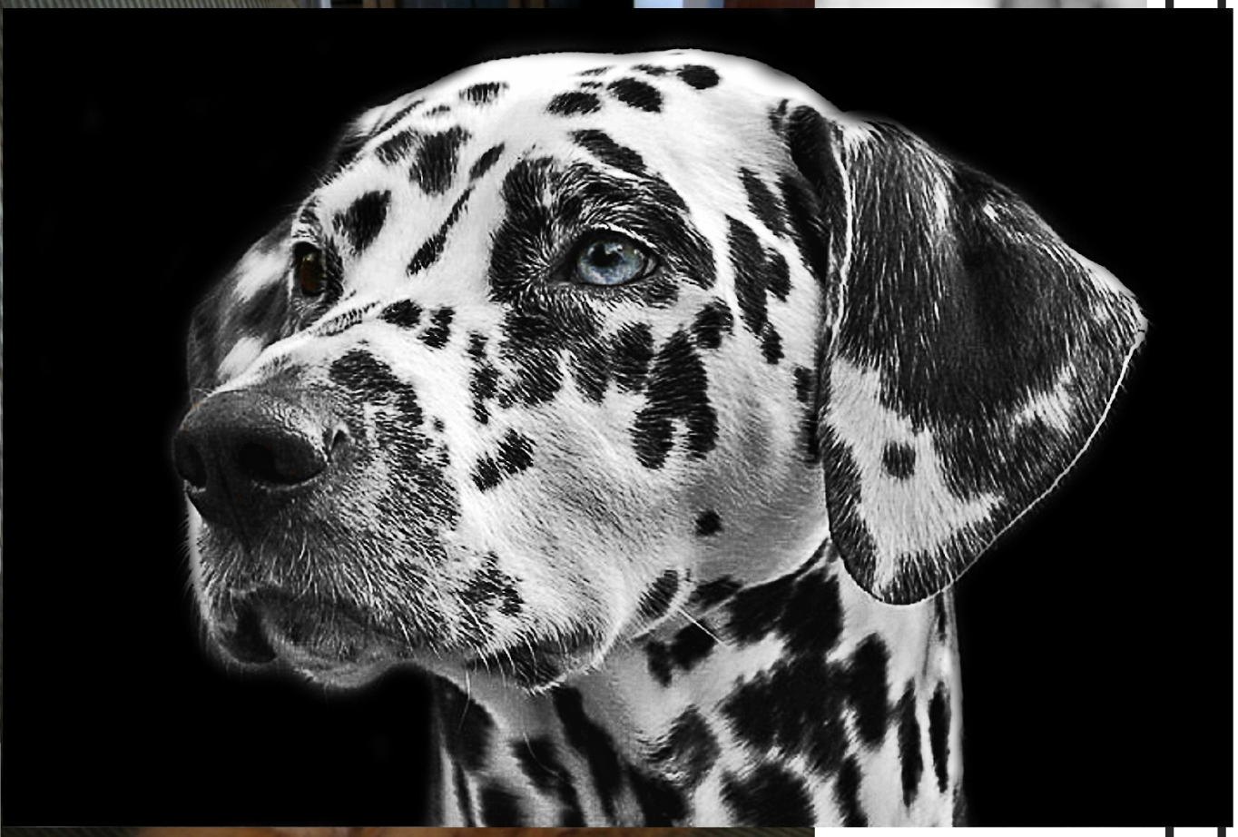
WHAT IS IMAGE CLASSIFICATION?
Pictures go in. AI sorts them into groups.
PICTURES IN
AI
CAT
AI
DOG
Looks at each
picture. Decides.
Each group is called a CLASS. We'll see this work for real in 1 minute.
Smart Solutions | Engineering & Technology
Your Teacher
MON | 4/9
Notes:
Use the visible prompt to teach and model the concept. Ask students to name the evidence they are using.
[Sources]
- Teacher-authored Picture This classroom presentation (Lucero, 2025).
- Google Teachable Machine, official tool: https://teachablemachine.withgoogle.com/ (accessed 2026-08-15).

Slide 8
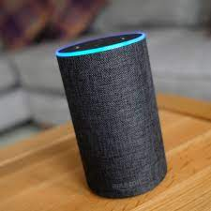
check for understanding
Do Alexa and Siri use computer vision?
No
Notes:
Use the visible prompt to teach and model the concept. Ask students to name the evidence they are using.
[Sources]
- Teacher-authored Picture This classroom presentation (Lucero, 2025).
- Google Teachable Machine, official tool: https://teachablemachine.withgoogle.com/ (accessed 2026-08-15).

Slide 9
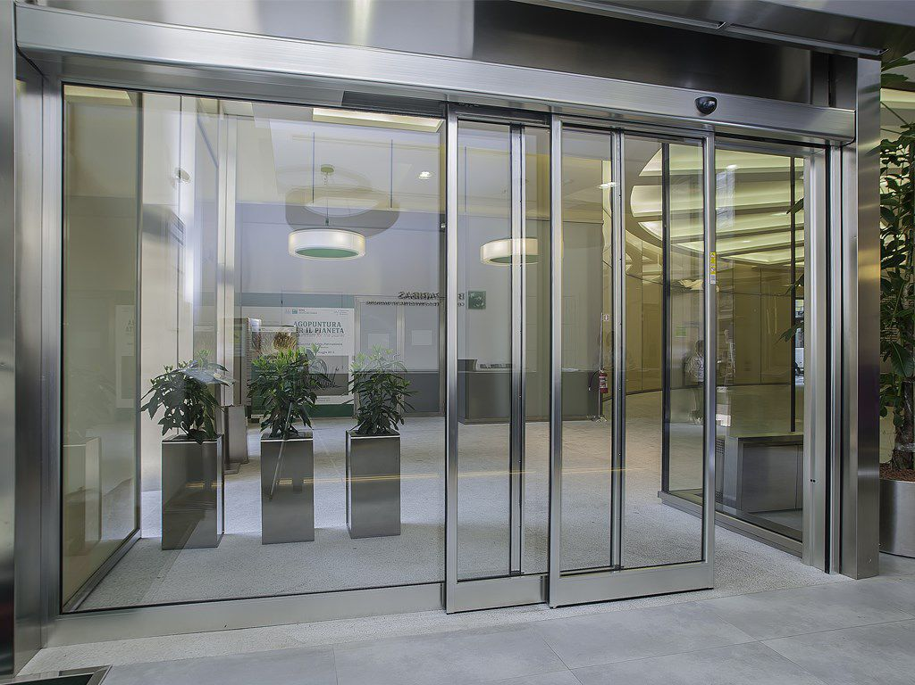
check for understanding
Do automatic doors use computer vision?
No
Notes:
Use the visible prompt to teach and model the concept. Ask students to name the evidence they are using.
[Sources]
- Teacher-authored Picture This classroom presentation (Lucero, 2025).
- Google Teachable Machine, official tool: https://teachablemachine.withgoogle.com/ (accessed 2026-08-15).

Slide 10
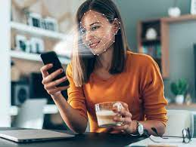
check for understanding
Does smartphone face unlock use computer vision?
Yes
Notes:
Use the visible prompt to teach and model the concept. Ask students to name the evidence they are using.
[Sources]
- Teacher-authored Picture This classroom presentation (Lucero, 2025).
- Google Teachable Machine, official tool: https://teachablemachine.withgoogle.com/ (accessed 2026-08-15).

Slide 11
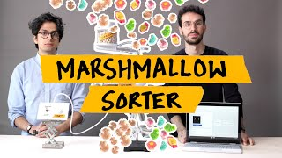
Notes:
Use the visible prompt to teach and model the concept. Ask students to name the evidence they are using.
[Sources]
- Teacher-authored Picture This classroom presentation (Lucero, 2025).
- Google Teachable Machine, official tool: https://teachablemachine.withgoogle.com/ (accessed 2026-08-15).

Slide 12
exploring teachable machine
Go to the Teachable Machine website.
Build your own image classifier in Teachable Machine.
Stuck? Try:
Thumbs up vs. thumbs down
Red vs. orange vs. yellow (using lots of different examples for each color)
Hands in the air vs. hands to the side vs. hands down
Books I’ve read vs. books I haven’t read
Notes:
Use the visible prompt to teach and model the concept. Ask students to name the evidence they are using.
[Sources]
- Teacher-authored Picture This classroom presentation (Lucero, 2025).
- Google Teachable Machine, official tool: https://teachablemachine.withgoogle.com/ (accessed 2026-08-15).

Slide 13
Voice 2 | Working
Build | 25 min
BUILD STEPS | TEACHABLE MACHINE
1
2
3
4
Open TM
Name your classes
Take photos
Train and test
teachablemachine.withgoogle.com → Get Started → Image Project → Standard.
Rename Class 1 and Class 2 (e.g., "Thumbs Up" and "Thumbs Down").
Click Webcam. Hold to capture. Aim for 30+ photos per class.
Click Train Model. Watch the preview. Try to fool it.
Smart Solutions | Engineering & Technology
Your Teacher
MON | 7/9
Notes:
Use the visible prompt to teach and model the concept. Ask students to name the evidence they are using.
[Sources]
- Teacher-authored Picture This classroom presentation (Lucero, 2025).
- Google Teachable Machine, official tool: https://teachablemachine.withgoogle.com/ (accessed 2026-08-15).

Slide 14
STUCK? | TRY TO BREAK IT
Stuck?
Try to break your AI
• Re-read directions
• Hold your thumb sideways
• Ask a neighbor
• Move closer or farther
• Raise your hand with a specific question
• Try with your other hand
• (not "I don't get it")
• Cover part of your hand
• Use a different background
Smart Solutions | Engineering & Technology
Your Teacher
MON | 8/9
Notes:
Use the visible prompt to teach and model the concept. Ask students to name the evidence they are using.
[Sources]
- Teacher-authored Picture This classroom presentation (Lucero, 2025).
- Google Teachable Machine, official tool: https://teachablemachine.withgoogle.com/ (accessed 2026-08-15).

Slide 15
Voice 0 | Silent
EXIT TICKET
Explain what you did to a 4th grader.
"Today I used ___________ to teach a ___________ how to ___________."
Use at least ONE of: computer vision, image classification, model.
Smart Solutions | Engineering & Technology
Your Teacher
MON | 9/9
Notes:
Use the visible prompt to teach and model the concept. Ask students to name the evidence they are using.
[Sources]
- Teacher-authored Picture This classroom presentation (Lucero, 2025).
- Google Teachable Machine, official tool: https://teachablemachine.withgoogle.com/ (accessed 2026-08-15).

