Slide 1
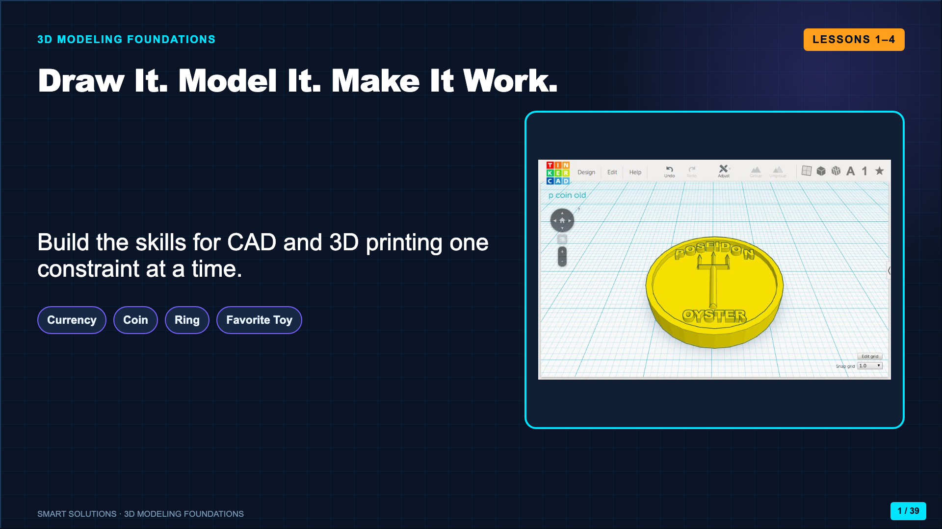
Notes:
Open the unit by naming the ladder. Students first communicate an idea on paper, then model it, design it to fit a body, and finally decompose a complex object into simple 3D forms.
[Sources]
- Smart Solutions 3D Modeling Canvas lessons and facilitator guides (Lucero classroom materials, 2026).
- Lucero classroom model, “Fort Dollars” front-and-back currency design (2026).

Slide 2
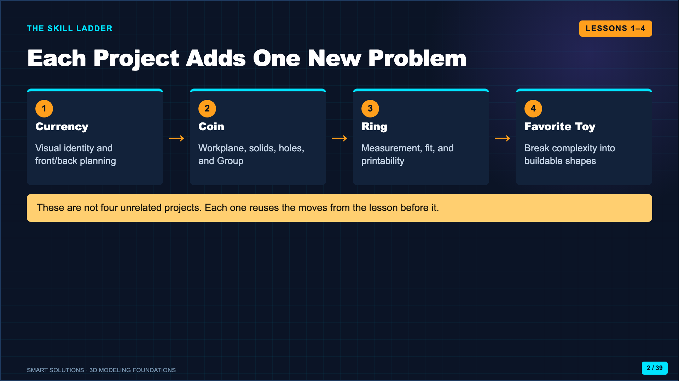
Notes:
Trace the ladder from left to right. Tell students they are building a toolkit that will later support the Dream Room project.
[Sources]
- Smart Solutions 3D Modeling Canvas lessons and facilitator guides (Lucero classroom materials, 2026).

Slide 3
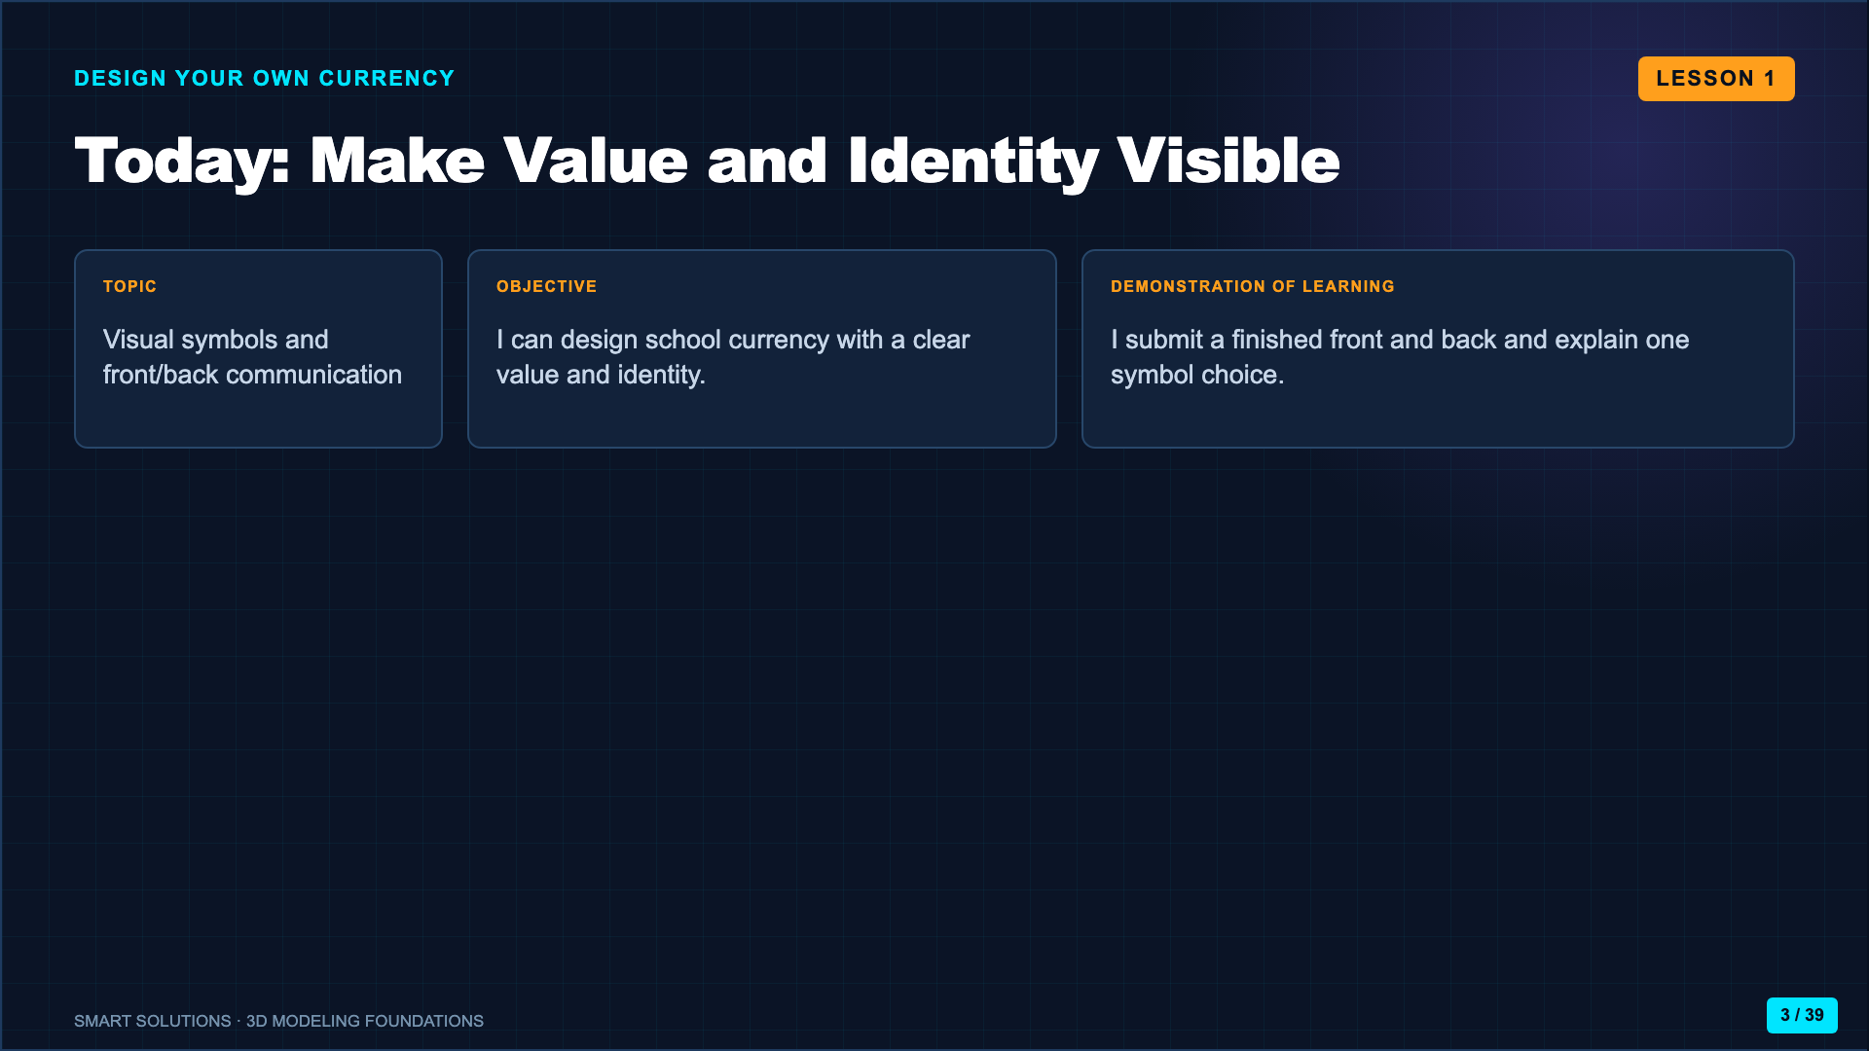
Notes:
Use this as the administration-ready opening. The drawing is the learning task, not decoration before Tinkercad.
[Sources]
- Smart Solutions 3D Modeling Canvas lessons and facilitator guides (Lucero classroom materials, 2026).

Slide 4
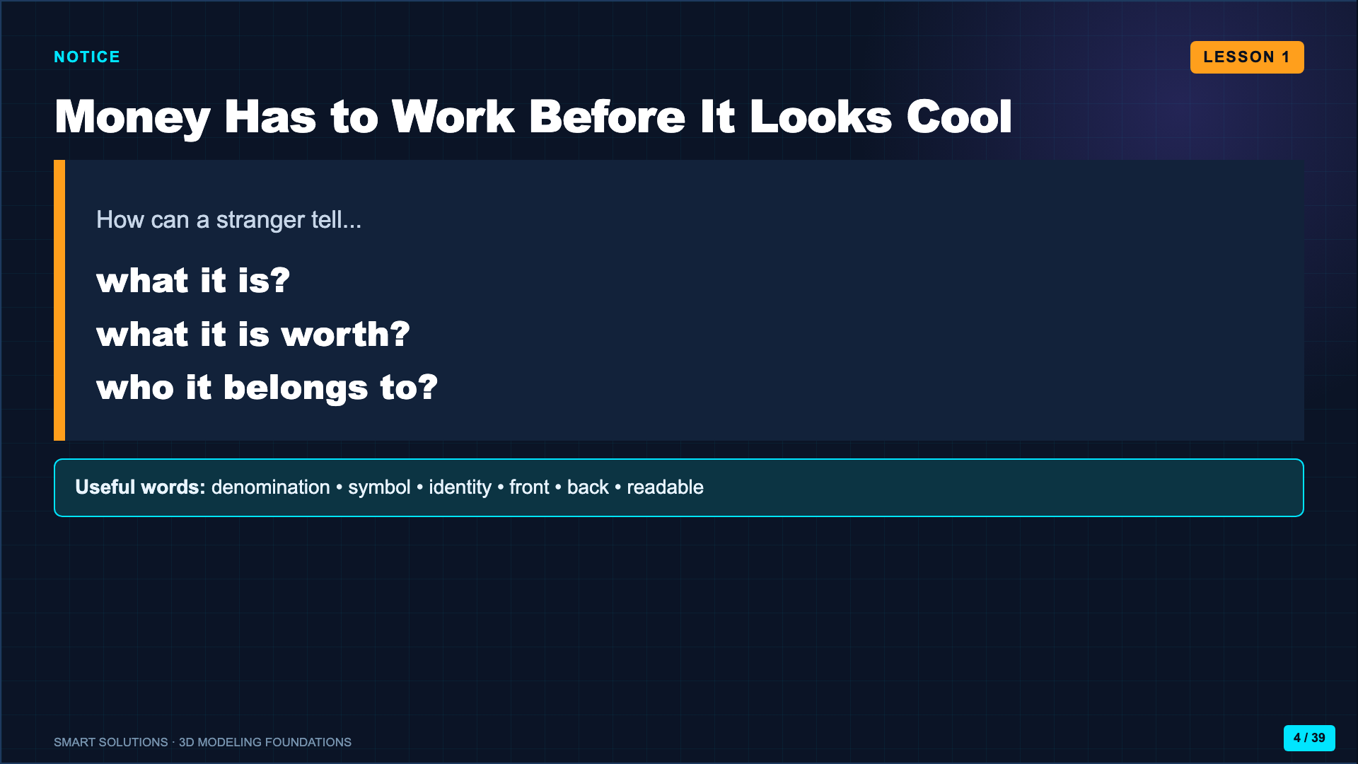
Notes:
Project a familiar bill or coin. Ask students to point to the evidence that communicates value, identity, and authenticity. Do not begin with color preferences.
[Sources]
- Smart Solutions 3D Modeling Canvas lessons and facilitator guides (Lucero classroom materials, 2026).

Slide 5
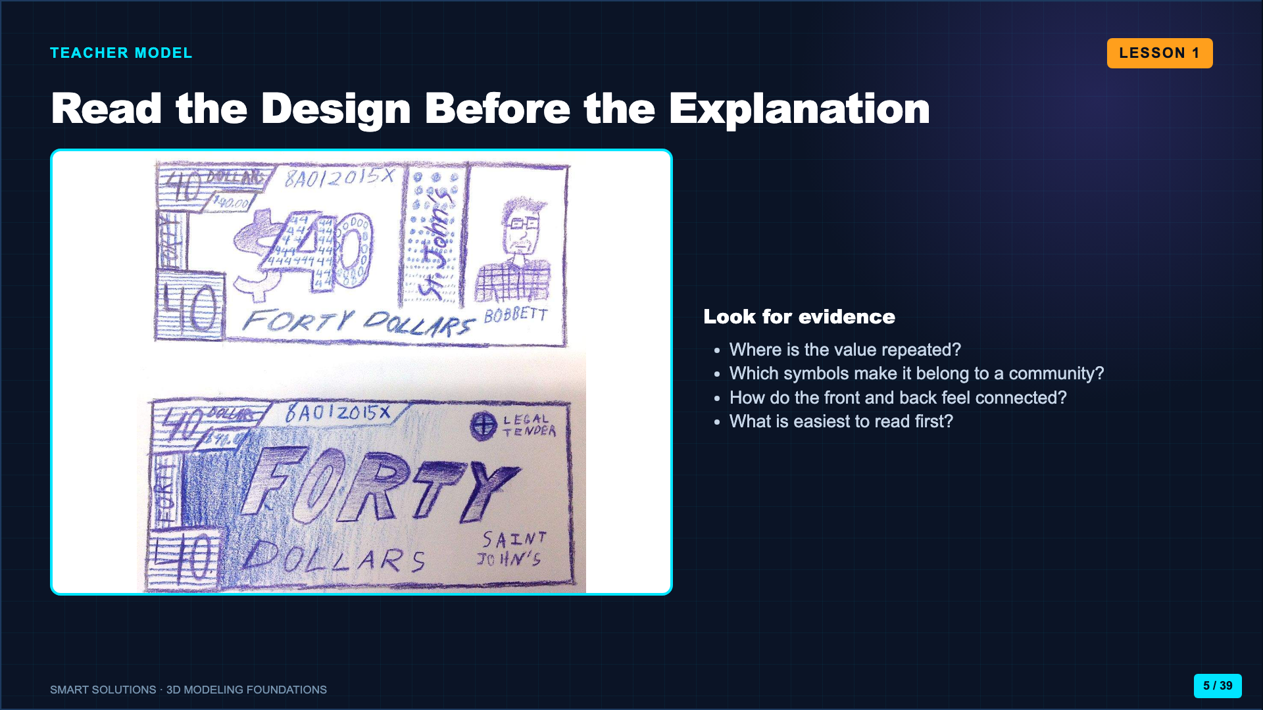
Notes:
Let students inspect the model before you explain it. Take observations about hierarchy, repetition, symbols, and front/back continuity.
[Sources]
- Lucero classroom model, “Fort Dollars” front-and-back currency design (2026).

Slide 6
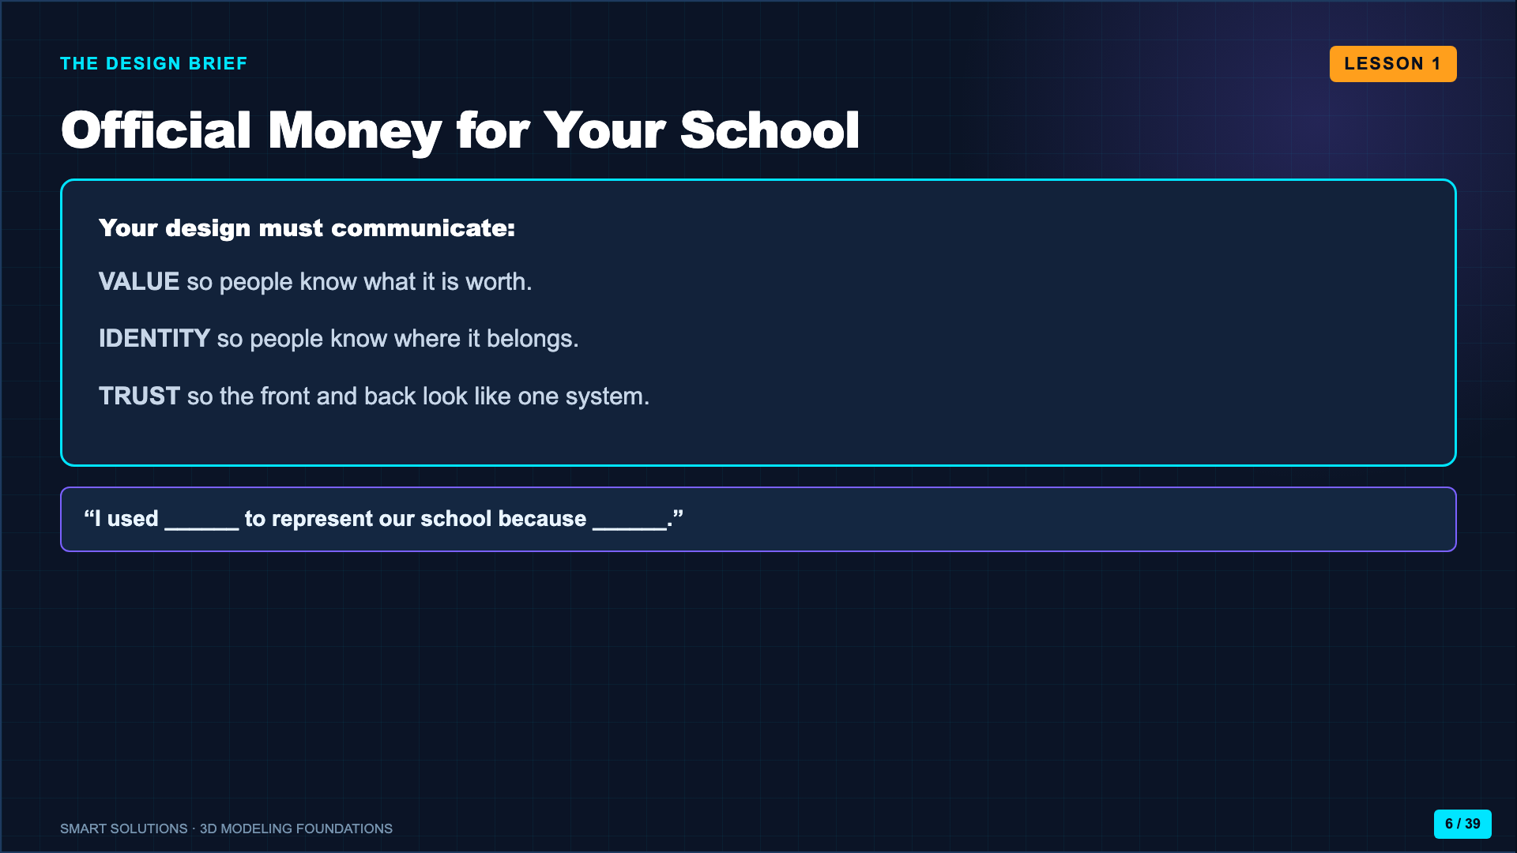
Notes:
Name the audience as students and staff who need to recognize the currency quickly. Students may invent the currency name and denomination, but the communication jobs remain fixed.
[Sources]
- Smart Solutions 3D Modeling Canvas lessons and facilitator guides (Lucero classroom materials, 2026).

Slide 7
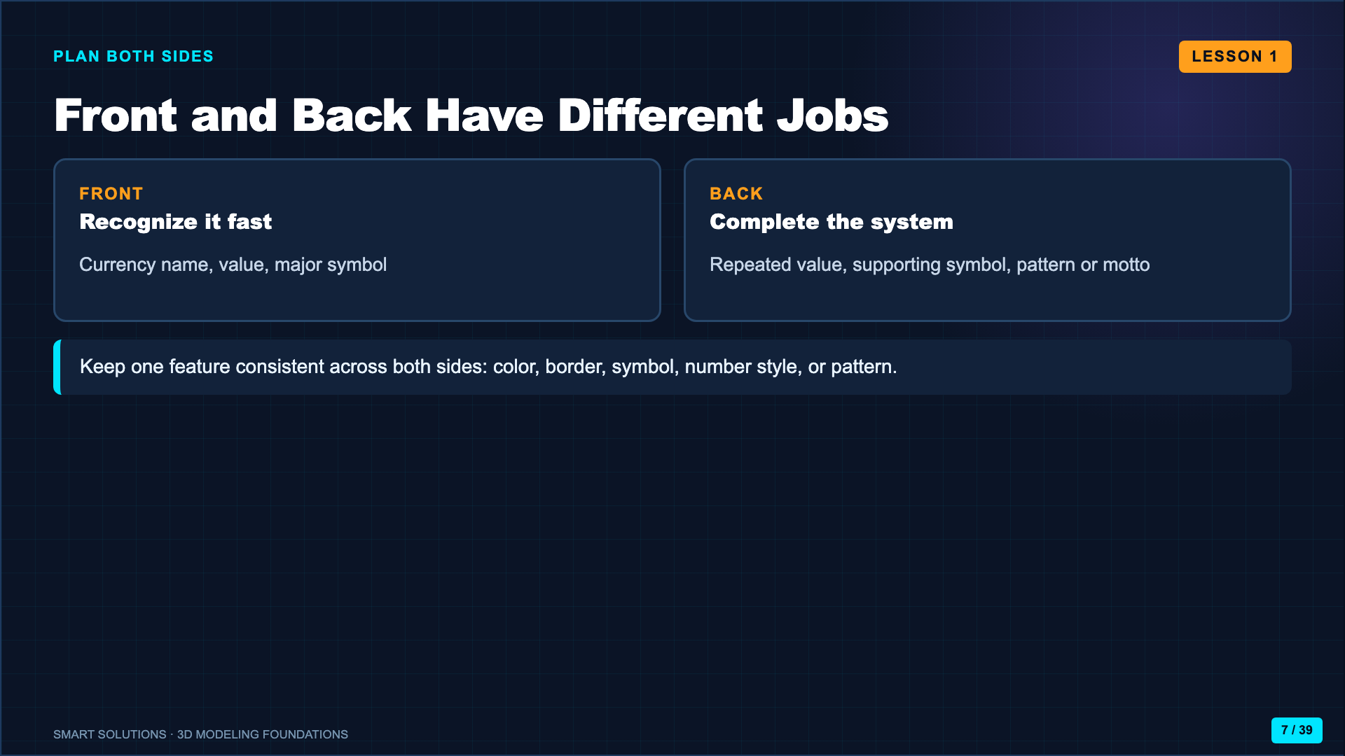
Notes:
Fold paper or draw two equal frames. Students sketch the major placement before adding detail. Ask them to choose one repeated system feature.
[Sources]
- Smart Solutions 3D Modeling Canvas lessons and facilitator guides (Lucero classroom materials, 2026).

Slide 8
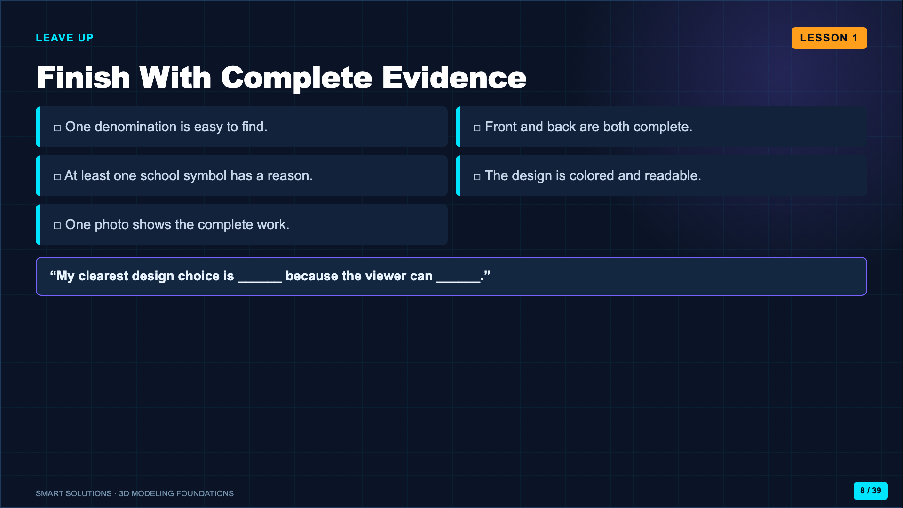
Notes:
Leave this slide up during work time. Require a complete front and back before students photograph and submit.
[Sources]
- Smart Solutions 3D Modeling Canvas lessons and facilitator guides (Lucero classroom materials, 2026).

Slide 9
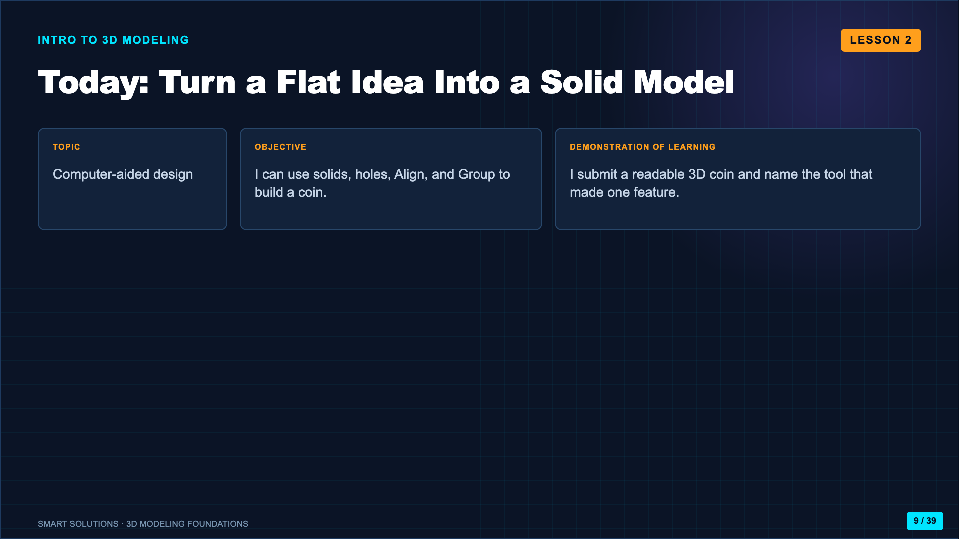
Notes:
Connect the paper currency to the coin. The visual idea remains, but students now have to control width, depth, and height.
[Sources]
- Smart Solutions 3D Modeling Canvas lessons and facilitator guides (Lucero classroom materials, 2026).
- Autodesk Tinkercad. “Learn 3D Design.” https://www.tinkercad.com/learn/designs (accessed 2026-08-16).

Slide 10
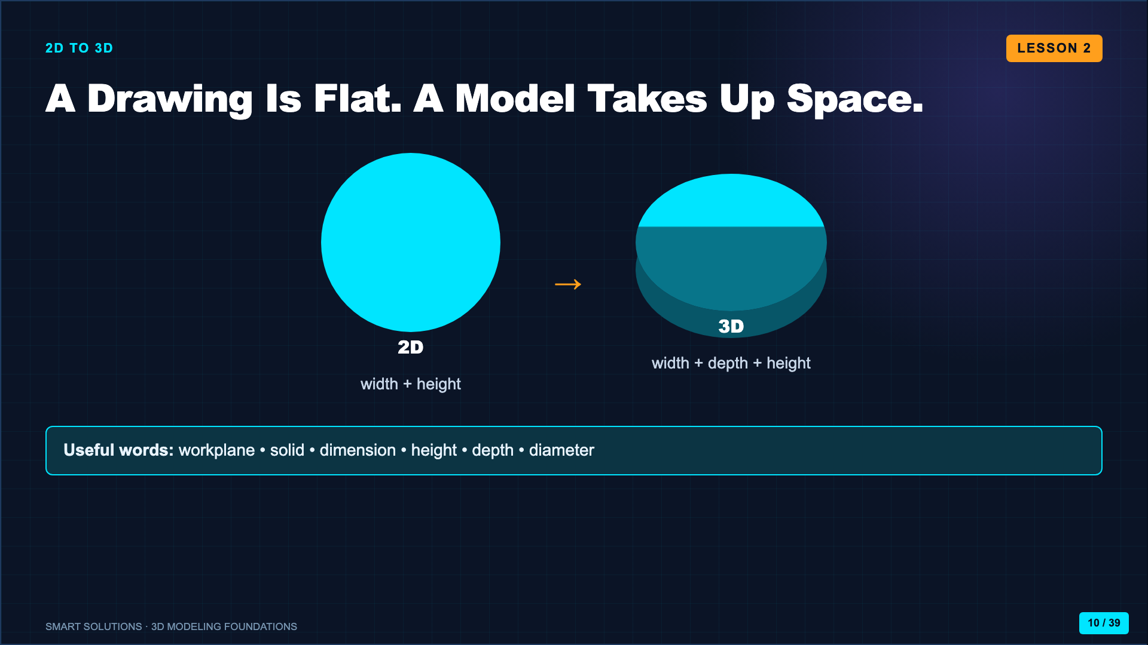
Notes:
Use your hands to show width, depth, and height. Ask students which new decisions appear when an object has thickness and must be viewed from more than one angle.
[Sources]
- Autodesk Tinkercad. “Learn 3D Design.” https://www.tinkercad.com/learn/designs (accessed 2026-08-16).

Slide 11

Notes:
Before class, create the Tinkercad Classroom and test the district-approved join route. Project only the code and nickname directions students actually need.
[Sources]
- Autodesk. “Tinkercad Classrooms.” https://www.autodesk.com/company/legal-notices-trademarks/privacy-statement/childrens-privacy-statement (accessed 2026-08-16).
- Smart Solutions 3D Modeling Canvas lessons and facilitator guides (Lucero classroom materials, 2026).

Slide 12
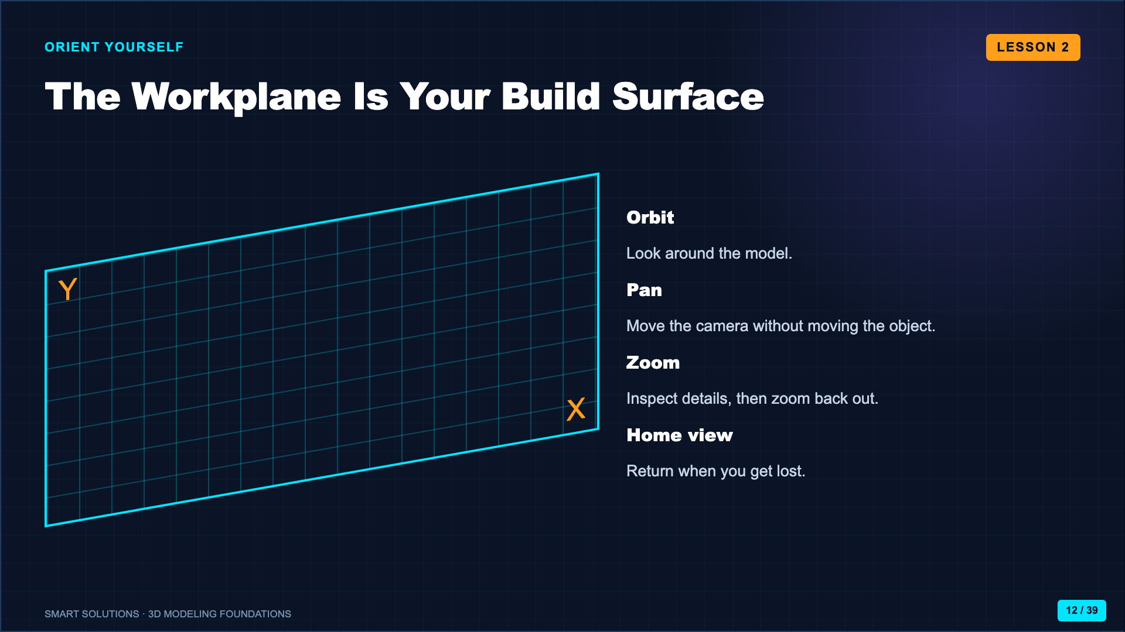
Notes:
Live-demo orbit, pan, zoom, and home view before students place shapes. Deliberately get lost once, then recover with Home view.
[Sources]
- Autodesk Tinkercad. “Learn 3D Design.” https://www.tinkercad.com/learn/designs (accessed 2026-08-16).
- ASU Edson Entrepreneurship + Innovation. “Activity Video: 3D Modeling with Tinkercad.” https://youtu.be/EturuXSyYa8 (accessed 2026-08-16).

Slide 13
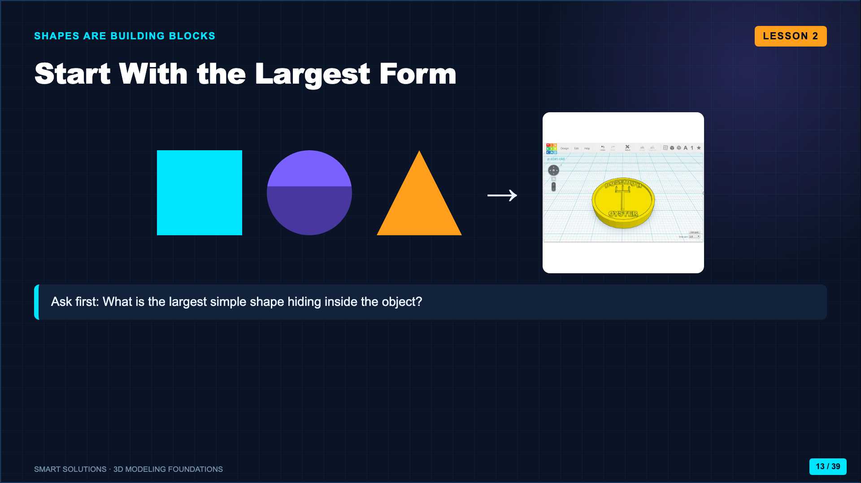
Notes:
Drag a cylinder to the workplane and resize it into a coin base. Students should see complex models as arrangements of simple forms.
[Sources]
- Autodesk Tinkercad. “Learn 3D Design.” https://www.tinkercad.com/learn/designs (accessed 2026-08-16).
- Smart Solutions 3D Modeling Canvas lessons and facilitator guides (Lucero classroom materials, 2026).

Slide 14
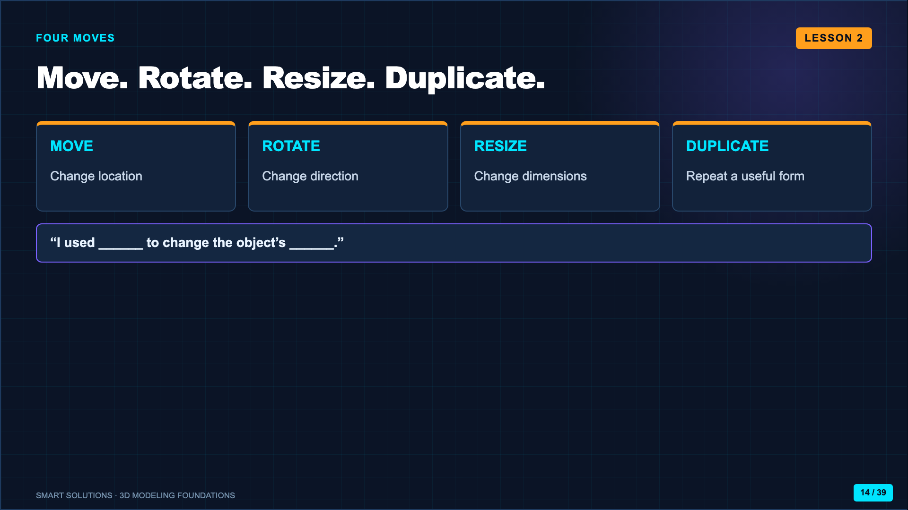
Notes:
Demonstrate each move on the same cylinder. Keep the vocabulary visible and make students name the move before you perform it.
[Sources]
- Autodesk Tinkercad. “Learn 3D Design.” https://www.tinkercad.com/learn/designs (accessed 2026-08-16).

Slide 15
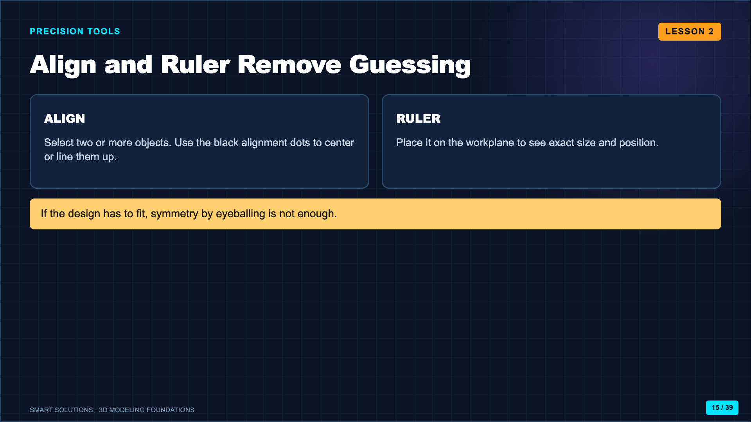
Notes:
Center a smaller cylinder on the coin base with Align. Show one exact dimension with the Ruler.
[Sources]
- Autodesk Tinkercad. “Learn 3D Design.” https://www.tinkercad.com/learn/designs (accessed 2026-08-16).

Slide 16
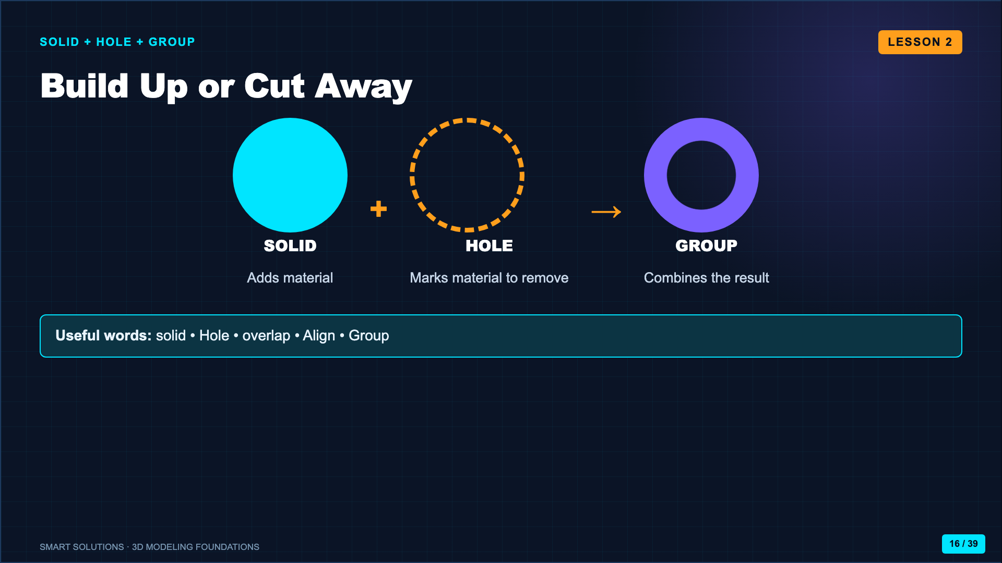
Notes:
Create a hole in a large cylinder and Group it. Clarify that simply placing a Hole on top does not cut until the objects are grouped.
[Sources]
- Autodesk Tinkercad. “Learn 3D Design.” https://www.tinkercad.com/learn/designs (accessed 2026-08-16).
- ASU Edson Entrepreneurship + Innovation. “Activity Video: 3D Modeling with Tinkercad.” https://youtu.be/EturuXSyYa8 (accessed 2026-08-16).

Slide 17
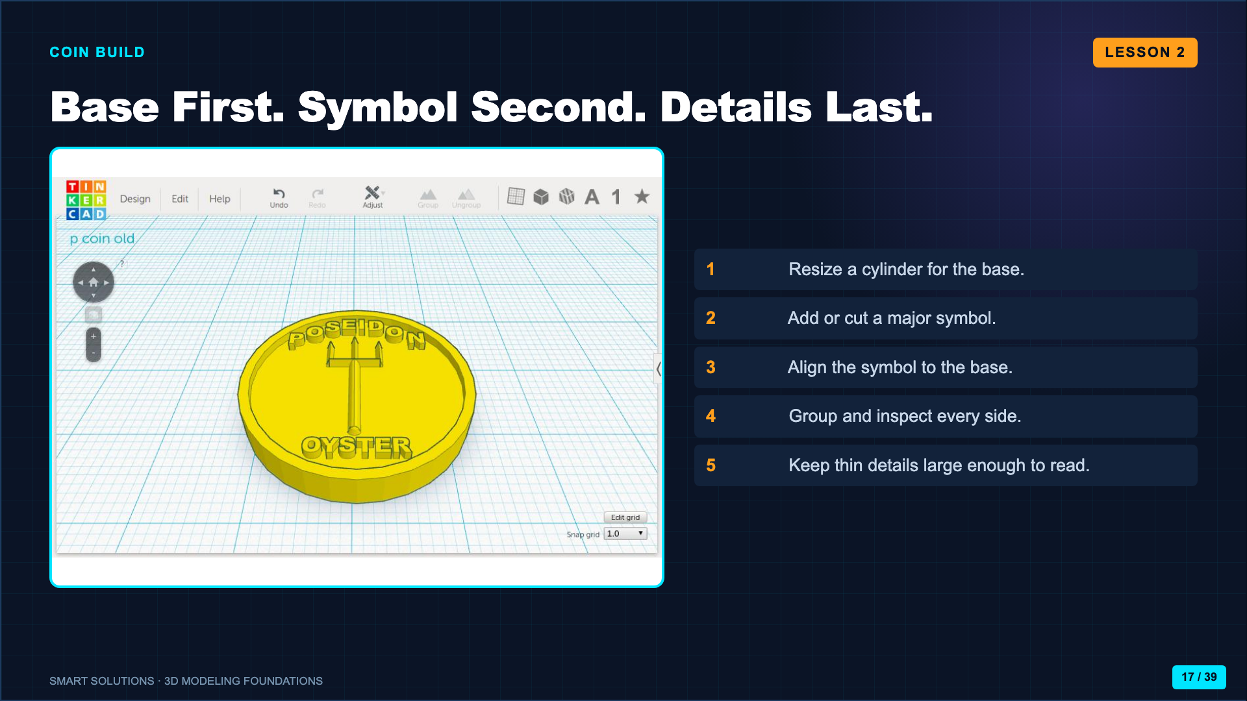
Notes:
Build a simple coin live through the first three steps, then release students. Keep the live model simpler than the assignment so students still make design decisions.
[Sources]
- Smart Solutions 3D Modeling Canvas lessons and facilitator guides (Lucero classroom materials, 2026).
- ASU Edson Entrepreneurship + Innovation. “Activity Video: 3D Modeling with Tinkercad.” https://youtu.be/EturuXSyYa8 (accessed 2026-08-16).

Slide 18
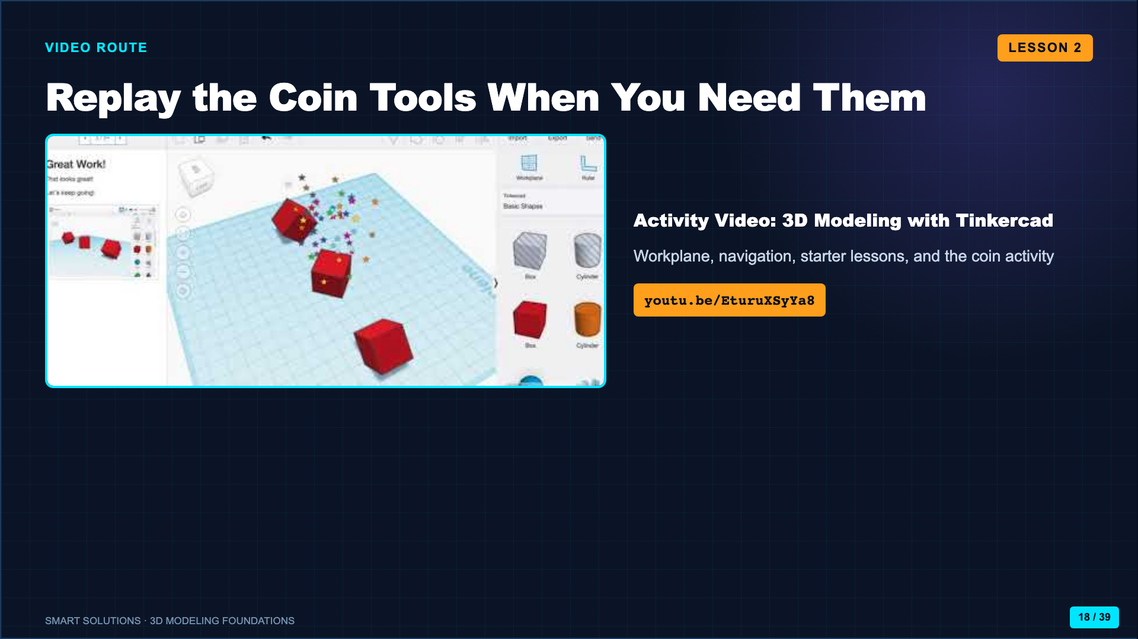
Notes:
Use the video as a paced replay or absence route. Pause after navigation and after the first coin operation if using it whole-group.
[Sources]
- ASU Edson Entrepreneurship + Innovation. “Activity Video: 3D Modeling with Tinkercad.” https://youtu.be/EturuXSyYa8 (accessed 2026-08-16).

Slide 19
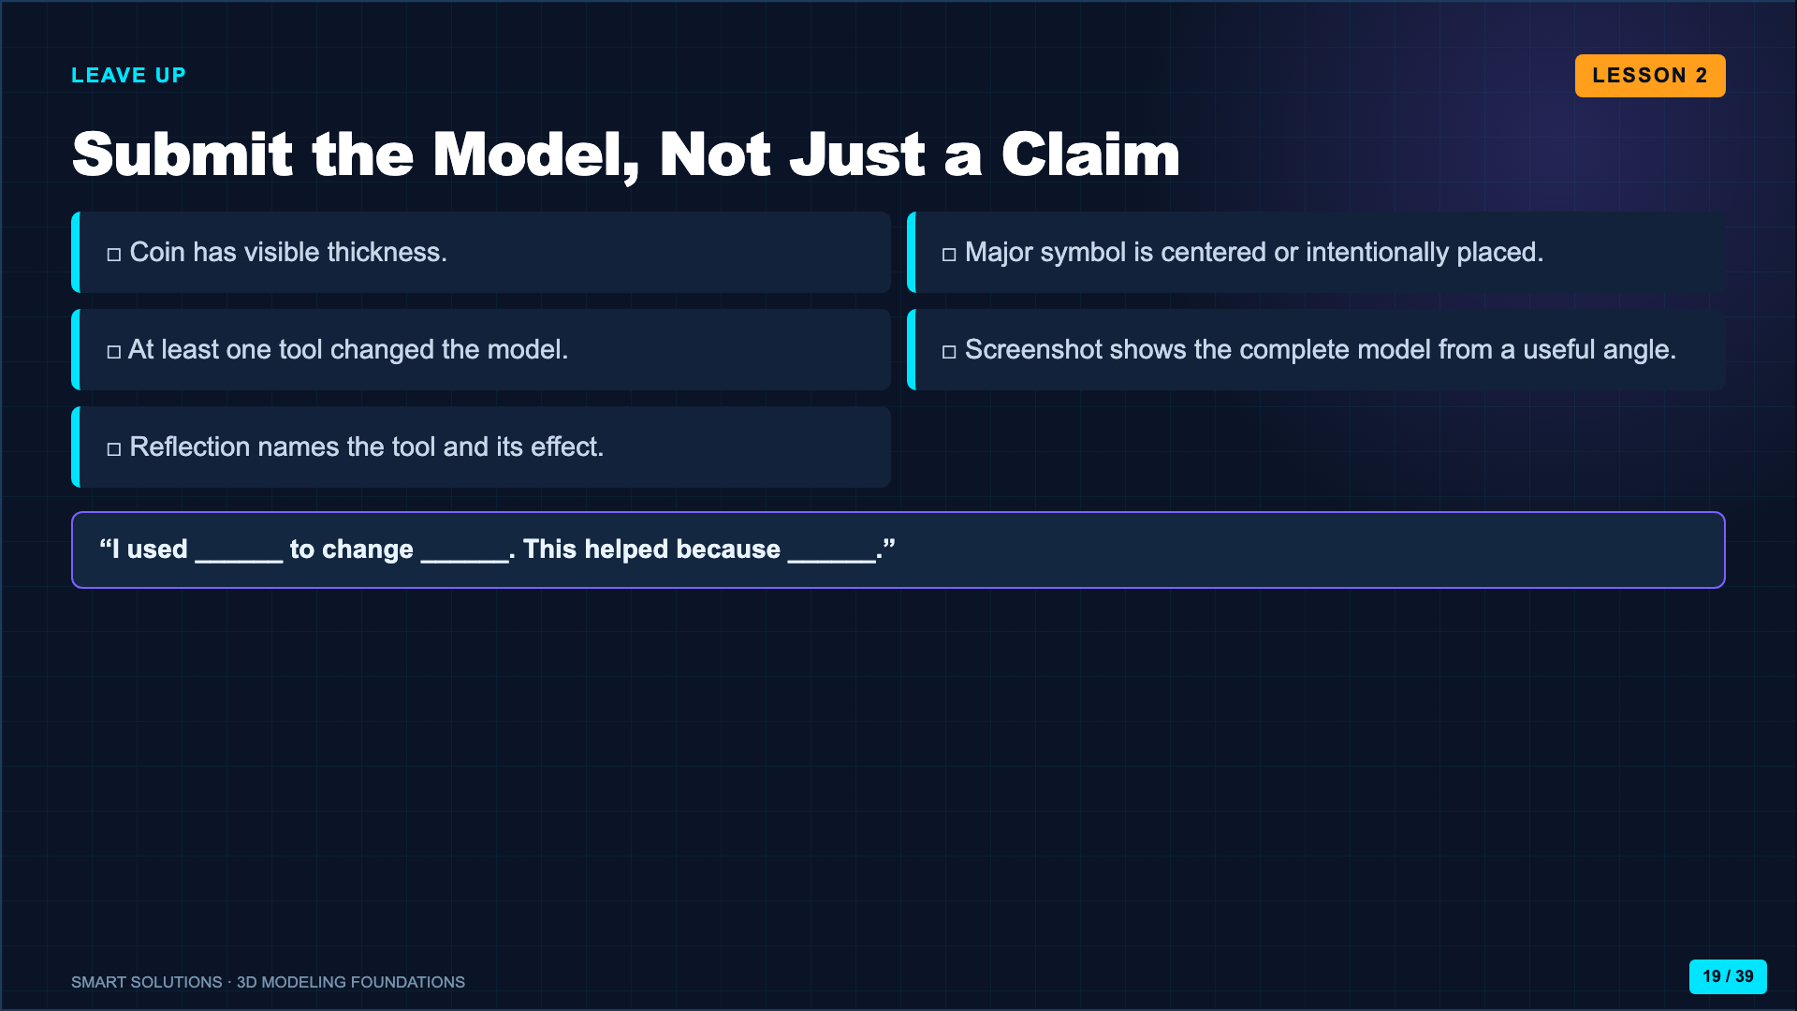
Notes:
Require a screenshot that proves the actual model exists. A sentence without visible evidence is not a complete submission.
[Sources]
- Smart Solutions 3D Modeling Canvas lessons and facilitator guides (Lucero classroom materials, 2026).

Slide 20
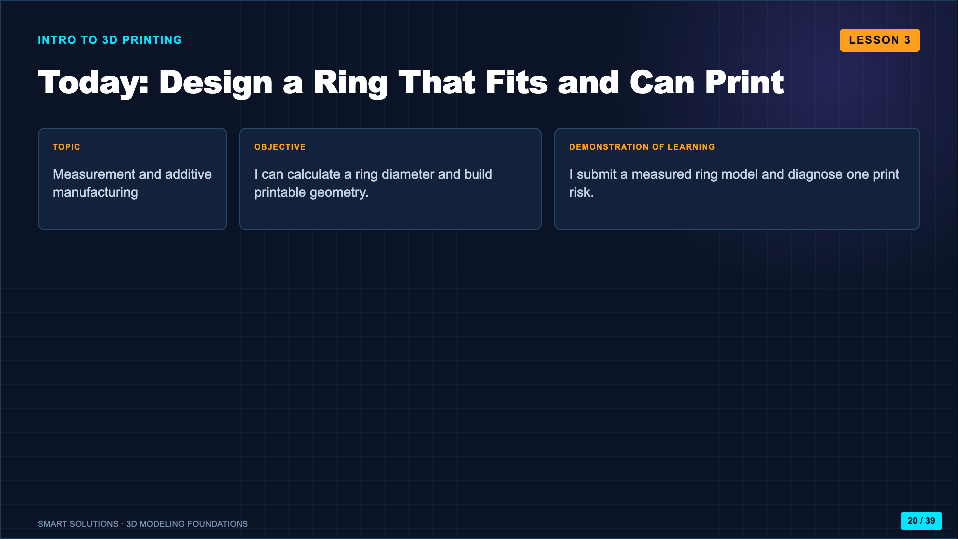
Notes:
Frame the ring as a new constraint: the object now has to fit a real body and survive the printing process.
[Sources]
- Smart Solutions 3D Modeling Canvas lessons and facilitator guides (Lucero classroom materials, 2026).

Slide 21
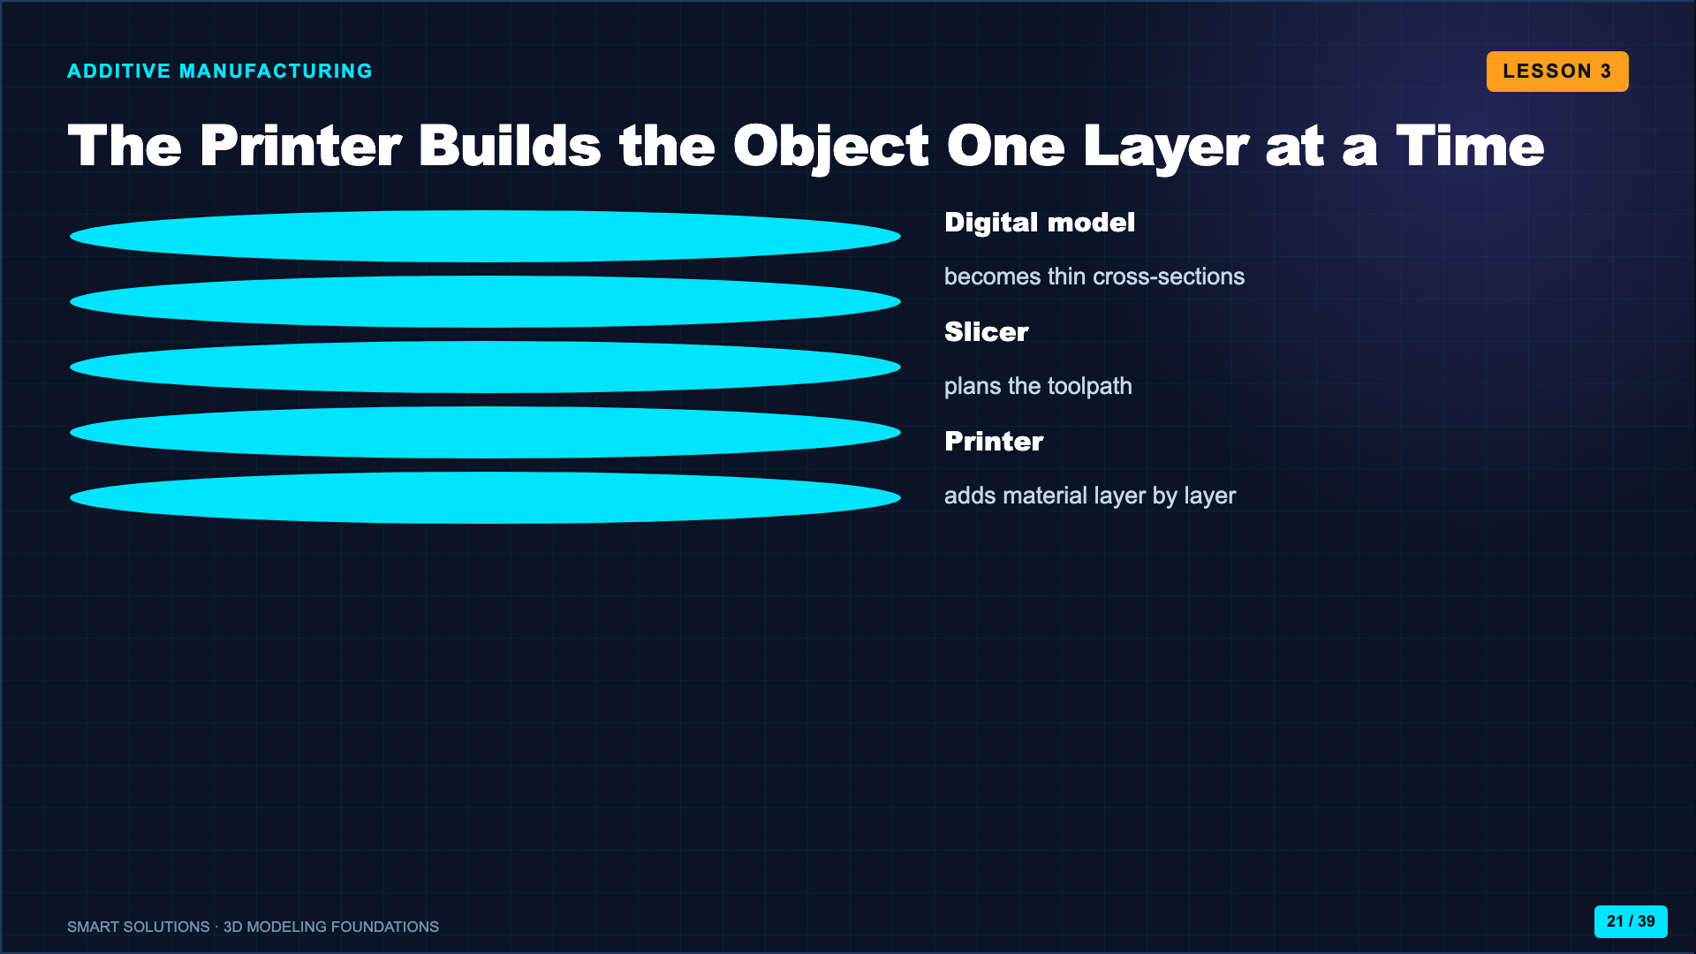
Notes:
Use the Nat Geo clip to establish additive manufacturing. Ask what would happen to a feature that begins in midair without support.
[Sources]
- National Geographic Kids. “3D Printers.” https://youtu.be/HlvK6DLwCz4 (accessed 2026-08-16).
- Smart Solutions 3D Modeling Canvas lessons and facilitator guides (Lucero classroom materials, 2026).

Slide 22
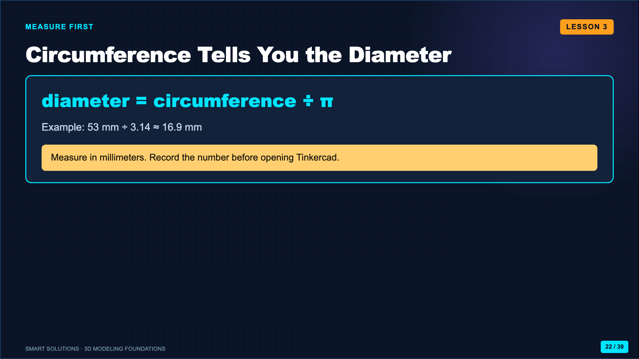
Notes:
Demonstrate measuring a paper strip around a finger. Calculate one class example together. Remind students that a measurement error becomes a fit error.
[Sources]
- Smart Solutions 3D Modeling Canvas lessons and facilitator guides (Lucero classroom materials, 2026).

Slide 23
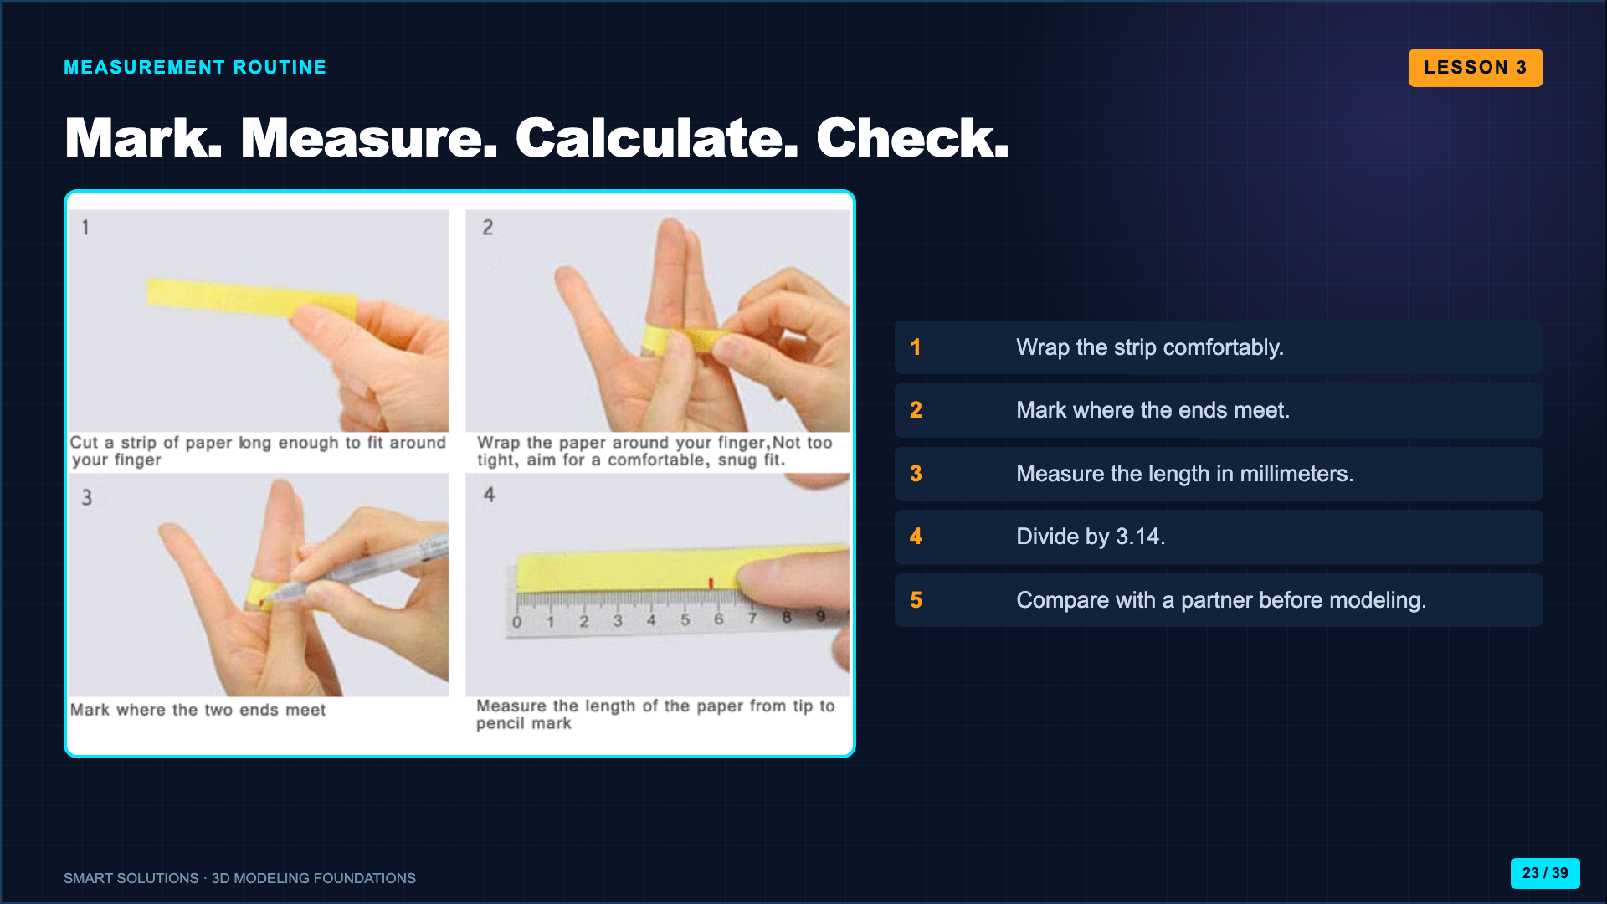
Notes:
Model a snug but not tight fit. Students should record circumference and calculated diameter before they touch the 3D model.
[Sources]
- Smart Solutions 3D Modeling Canvas lessons and facilitator guides (Lucero classroom materials, 2026).

Slide 24
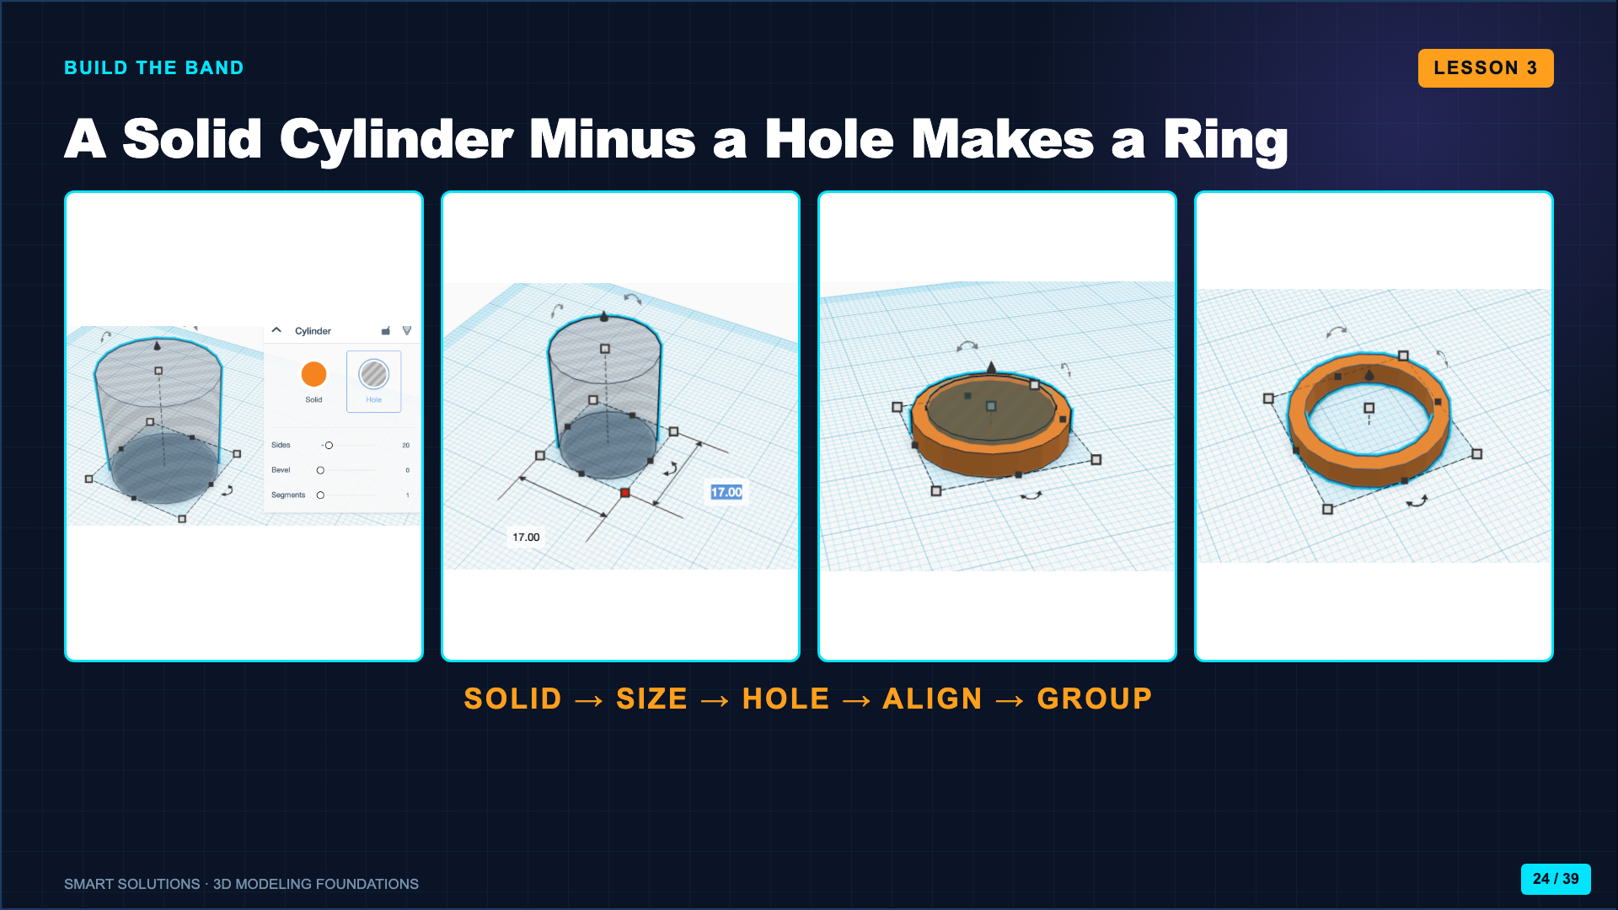
Notes:
Walk through the images left to right. Students set the inside Hole diameter from their calculation, then add enough band thickness around it.
[Sources]
- Smart Solutions 3D Modeling Canvas lessons and facilitator guides (Lucero classroom materials, 2026).
- Autodesk Tinkercad. “Learn 3D Design.” https://www.tinkercad.com/learn/designs (accessed 2026-08-16).

Slide 25
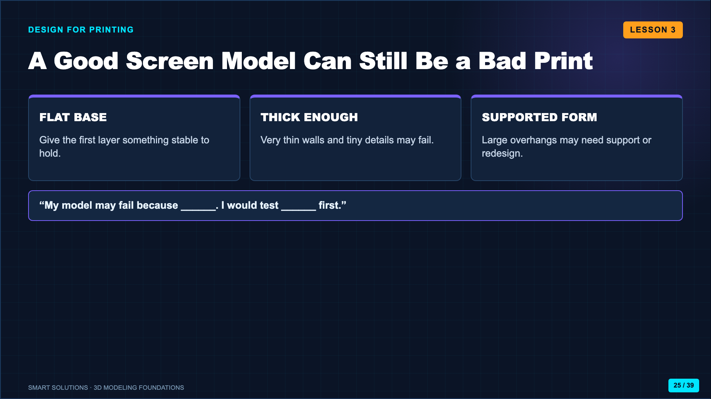
Notes:
Show a failed print if available. Ask students to diagnose the geometry before talking about printer settings.
[Sources]
- Teaching Tech. “Designing for 3D Printing.” https://youtu.be/QdvSzXByi_g (accessed 2026-08-16).
- Smart Solutions 3D Modeling Canvas lessons and facilitator guides (Lucero classroom materials, 2026).

Slide 26
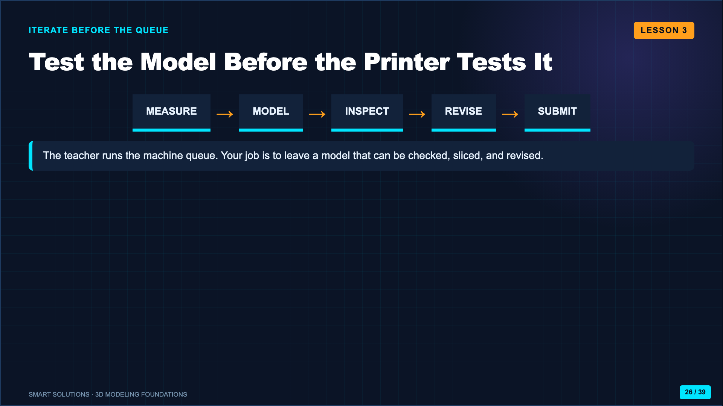
Notes:
Clarify the classroom queue. Students submit the Canvas evidence and leave the model in the class; do not promise same-day printing.
[Sources]
- Smart Solutions 3D Modeling Canvas lessons and facilitator guides (Lucero classroom materials, 2026).

Slide 27
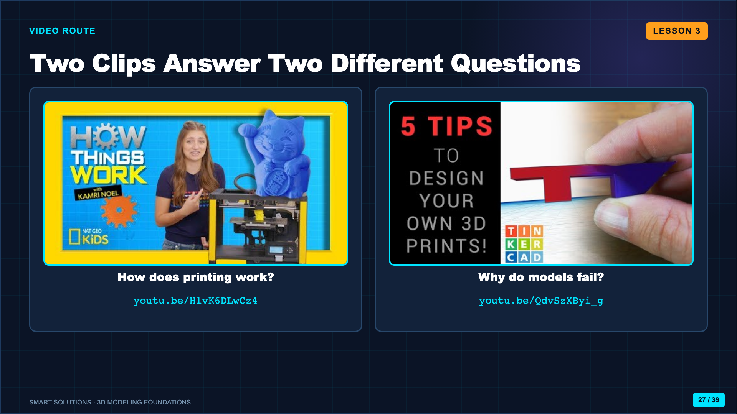
Notes:
Use the first clip for the additive-process concept and selected moments from the second for printability. Do not play eleven minutes without a listening purpose.
[Sources]
- National Geographic Kids. “3D Printers.” https://youtu.be/HlvK6DLwCz4 (accessed 2026-08-16).
- Teaching Tech. “Designing for 3D Printing.” https://youtu.be/QdvSzXByi_g (accessed 2026-08-16).

Slide 28
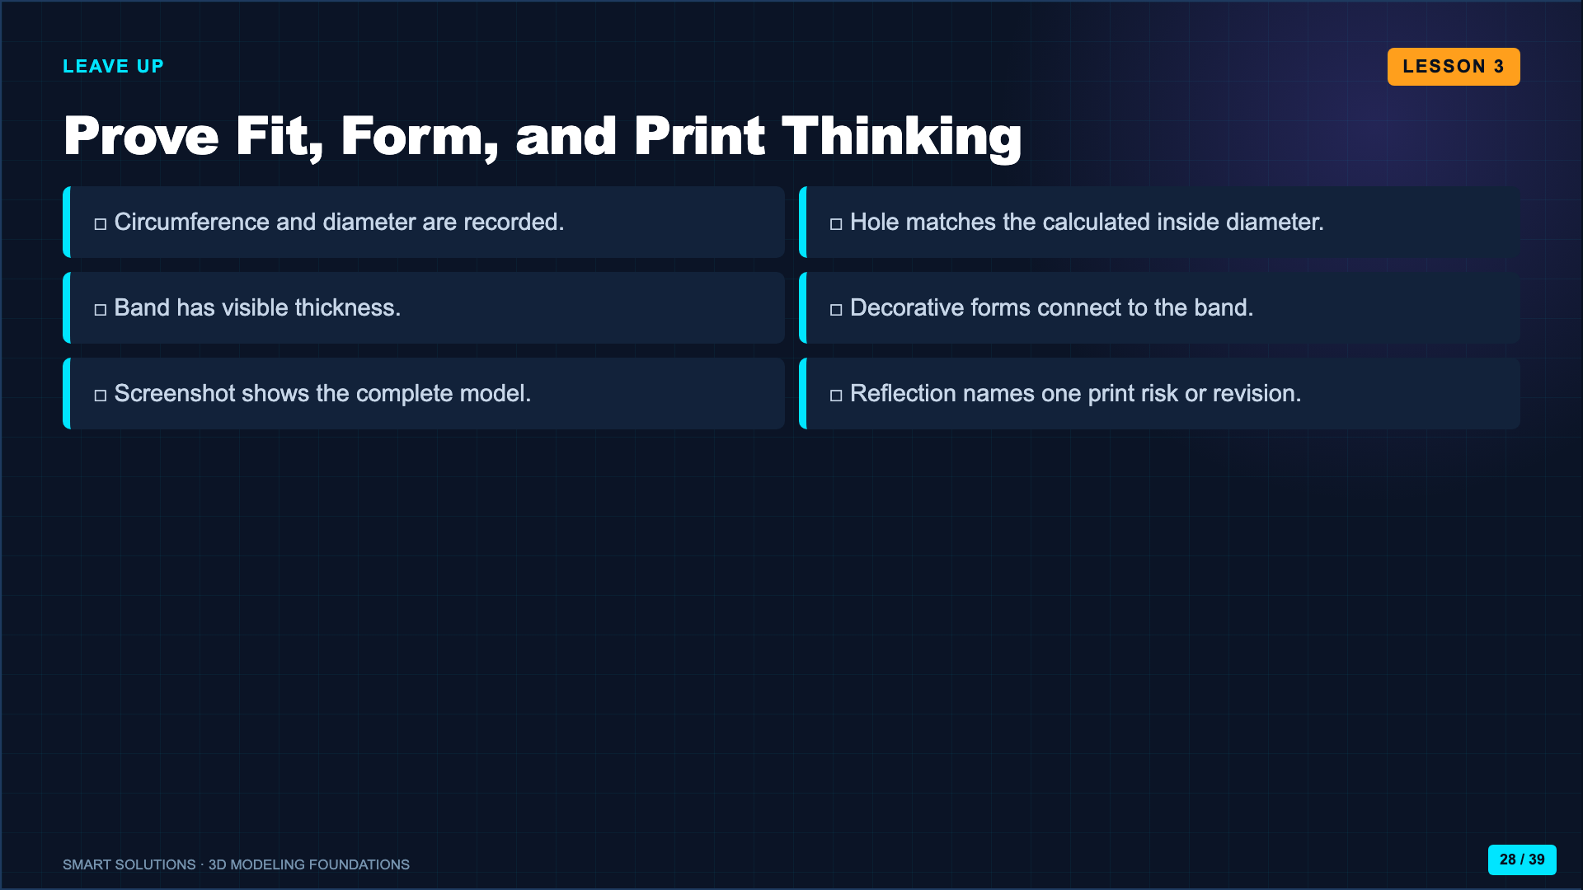
Notes:
Require measurement evidence plus the model screenshot. Students who finish early inspect a partner model for thin walls, floating forms, and oversized overhangs.
[Sources]
- Smart Solutions 3D Modeling Canvas lessons and facilitator guides (Lucero classroom materials, 2026).

Slide 29
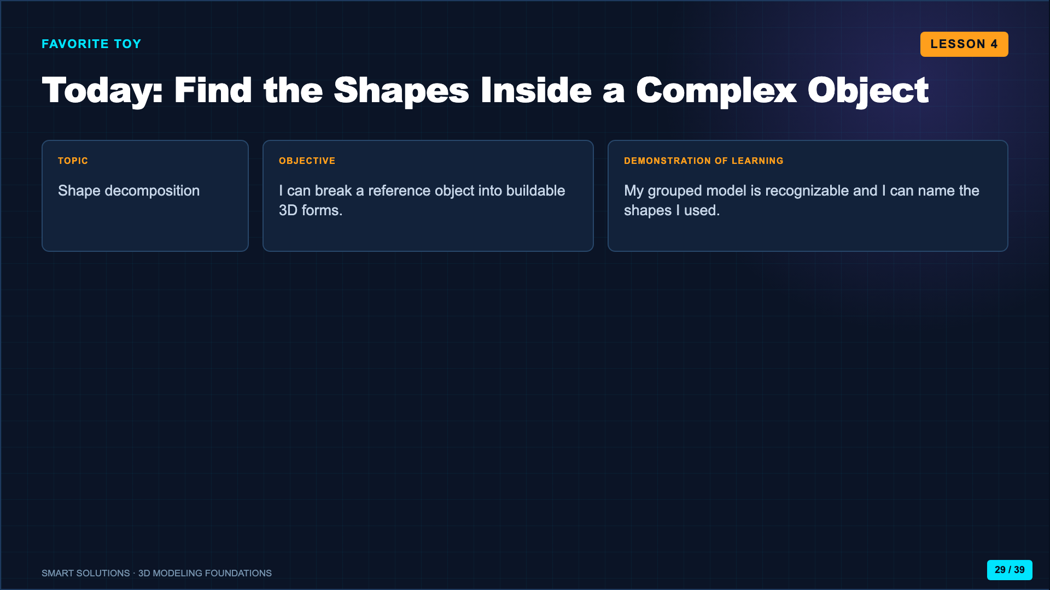
Notes:
Name this lesson as the bridge from following a recipe to planning an unfamiliar model. The challenge is deciding which forms matter.
[Sources]
- Smart Solutions 3D Modeling Canvas lessons and facilitator guides (Lucero classroom materials, 2026).
- A Messy Art Room. “How to Draw Anything Using Basic Shapes.” https://youtu.be/5_Mix_2LeRY (accessed 2026-08-16).

Slide 30
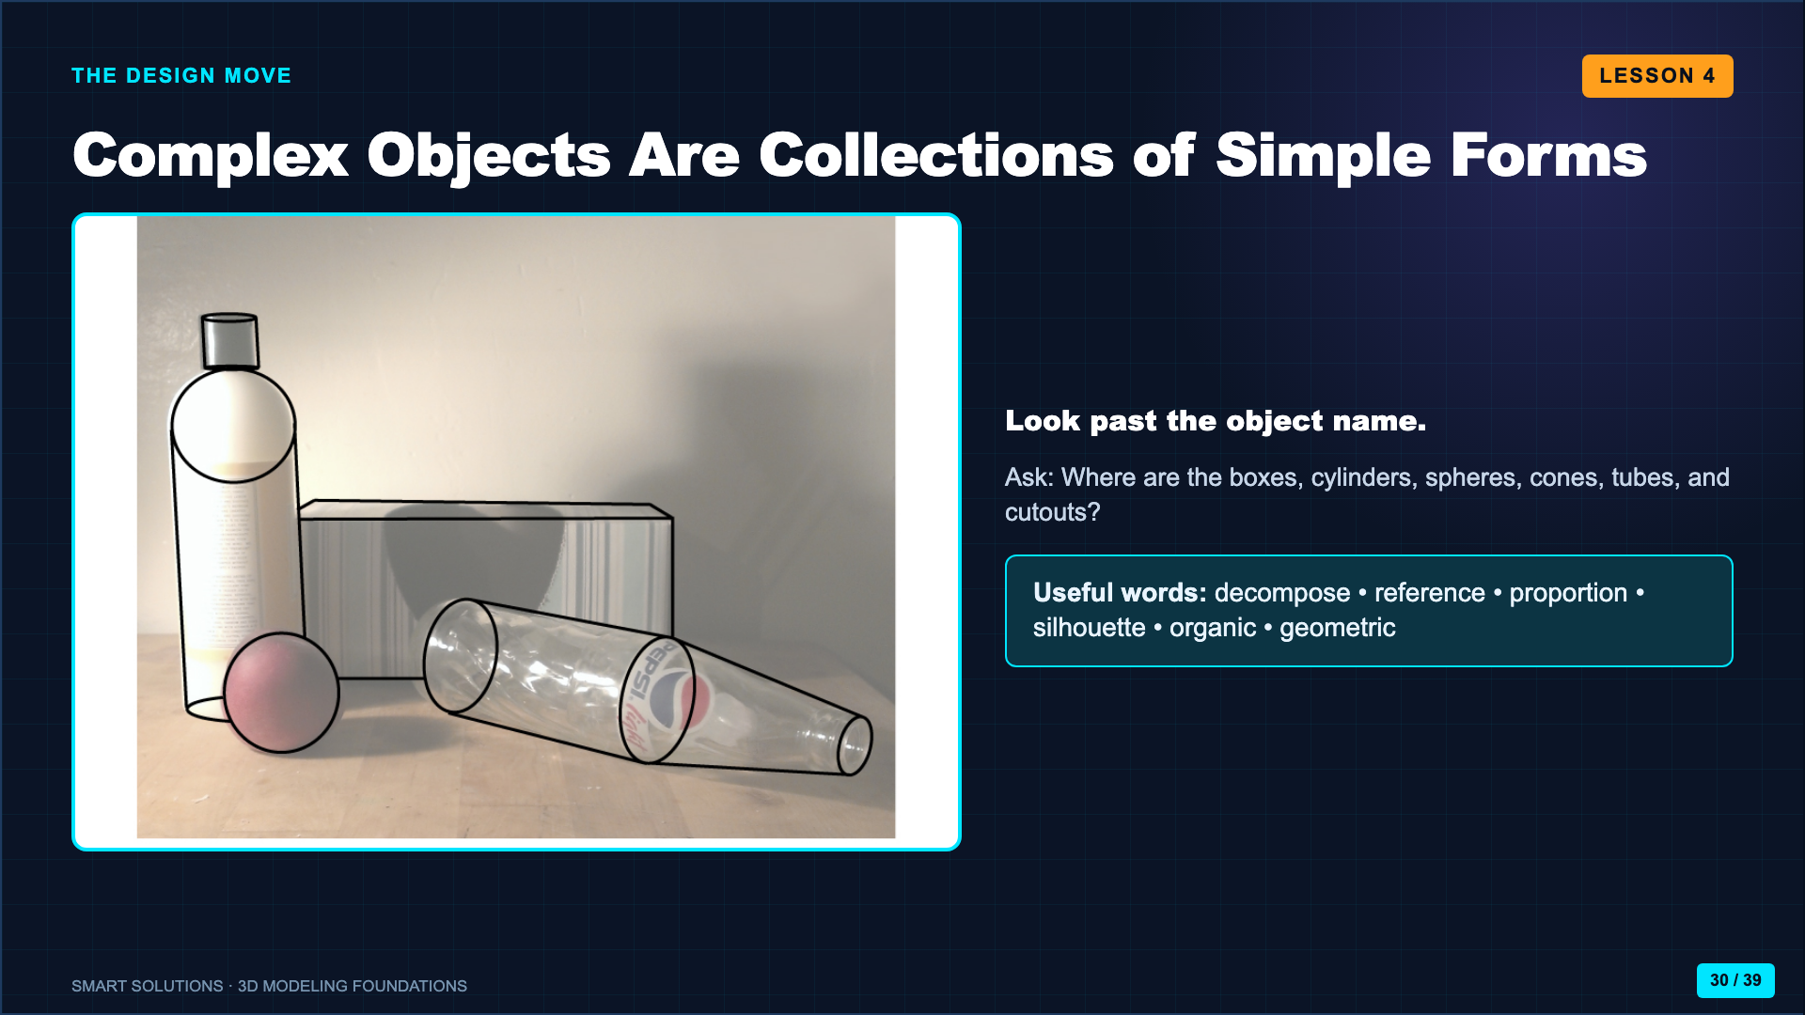
Notes:
Have students silently trace simple forms in the image with a finger. Then take several answers that describe forms, not object names.
[Sources]
- Smart Solutions 3D Modeling Canvas lessons and facilitator guides (Lucero classroom materials, 2026).
- A Messy Art Room. “How to Draw Anything Using Basic Shapes.” https://youtu.be/5_Mix_2LeRY (accessed 2026-08-16).

Slide 31
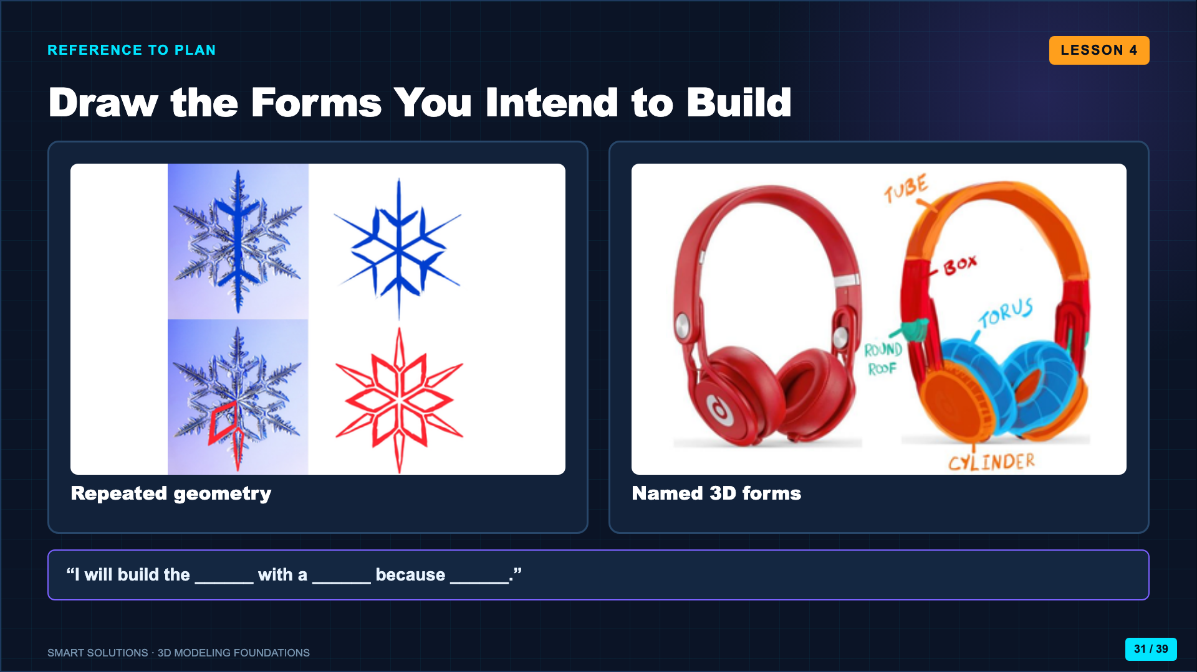
Notes:
Students annotate a reference photo or make a planning sketch. Require at least three named forms before opening Tinkercad.
[Sources]
- Smart Solutions 3D Modeling Canvas lessons and facilitator guides (Lucero classroom materials, 2026).

Slide 32
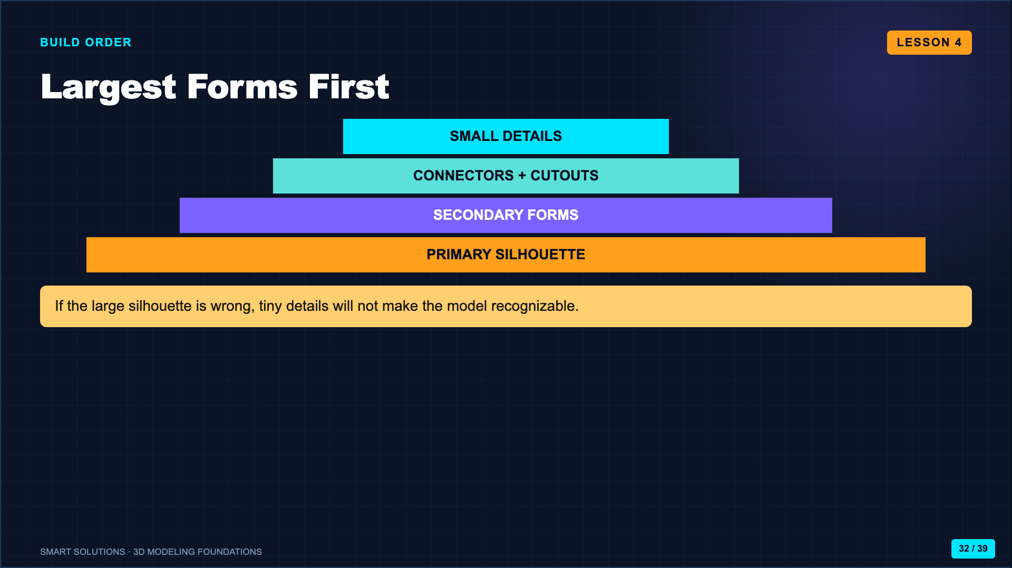
Notes:
Model ordering the build by visual importance. Ask students which one or two forms carry the silhouette of their toy.
[Sources]
- Smart Solutions 3D Modeling Canvas lessons and facilitator guides (Lucero classroom materials, 2026).

Slide 33
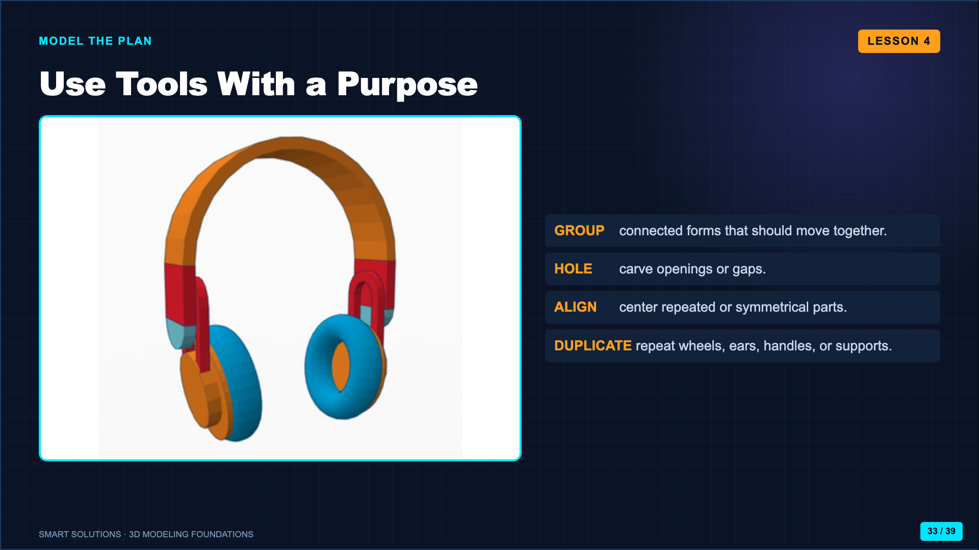
Notes:
Ask students to name the job before choosing the tool. Tool use should respond to a design need, not become random clicking.
[Sources]
- Smart Solutions 3D Modeling Canvas lessons and facilitator guides (Lucero classroom materials, 2026).
- Autodesk Tinkercad. “Learn 3D Design.” https://www.tinkercad.com/learn/designs (accessed 2026-08-16).

Slide 34
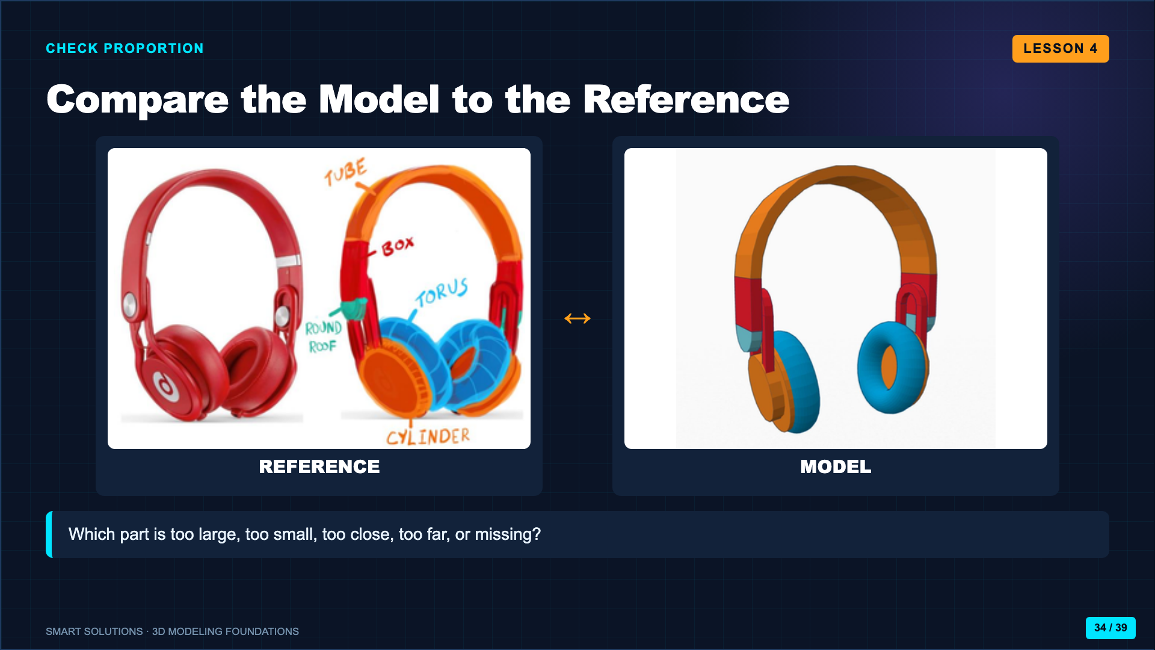
Notes:
Pause the class for a side-by-side check. Students must identify one proportional adjustment before adding more detail.
[Sources]
- Smart Solutions 3D Modeling Canvas lessons and facilitator guides (Lucero classroom materials, 2026).

Slide 35
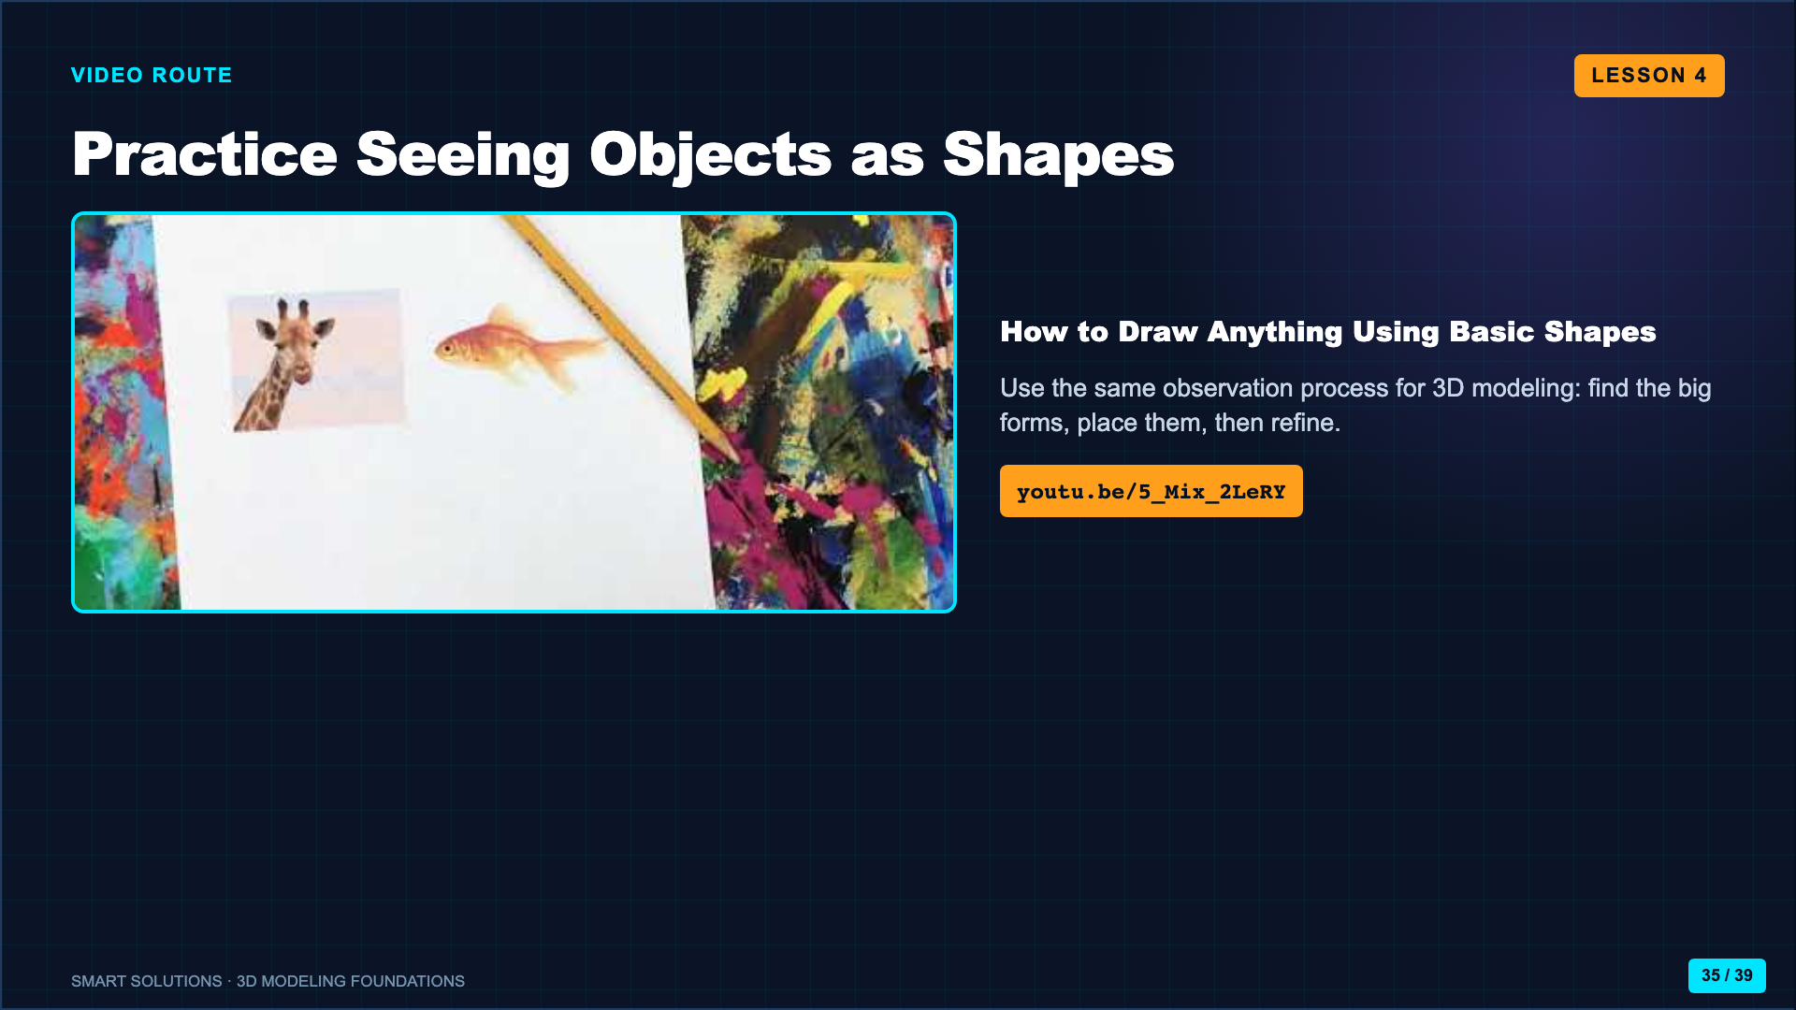
Notes:
Use the video to rehearse decomposition. Pause on an example and ask students to predict the next simple form before it appears.
[Sources]
- A Messy Art Room. “How to Draw Anything Using Basic Shapes.” https://youtu.be/5_Mix_2LeRY (accessed 2026-08-16).

Slide 36
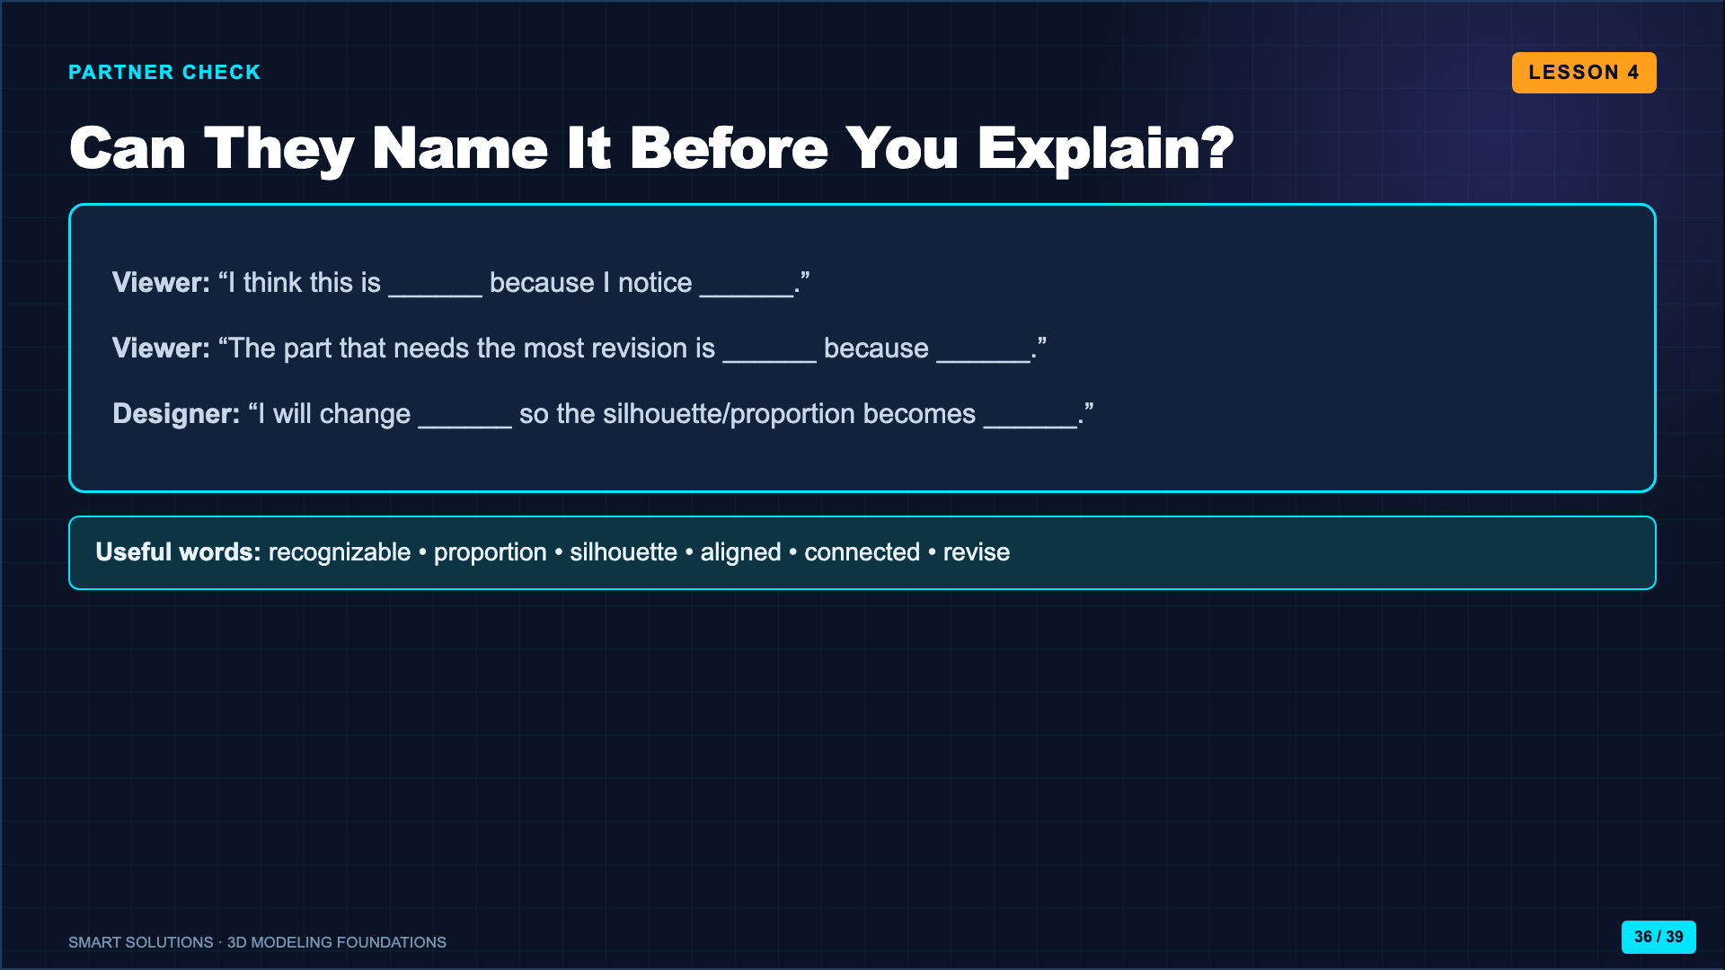
Notes:
Partners inspect from one useful angle before hearing the title. The designer records one visible revision.
[Sources]
- Smart Solutions 3D Modeling Canvas lessons and facilitator guides (Lucero classroom materials, 2026).

Slide 37
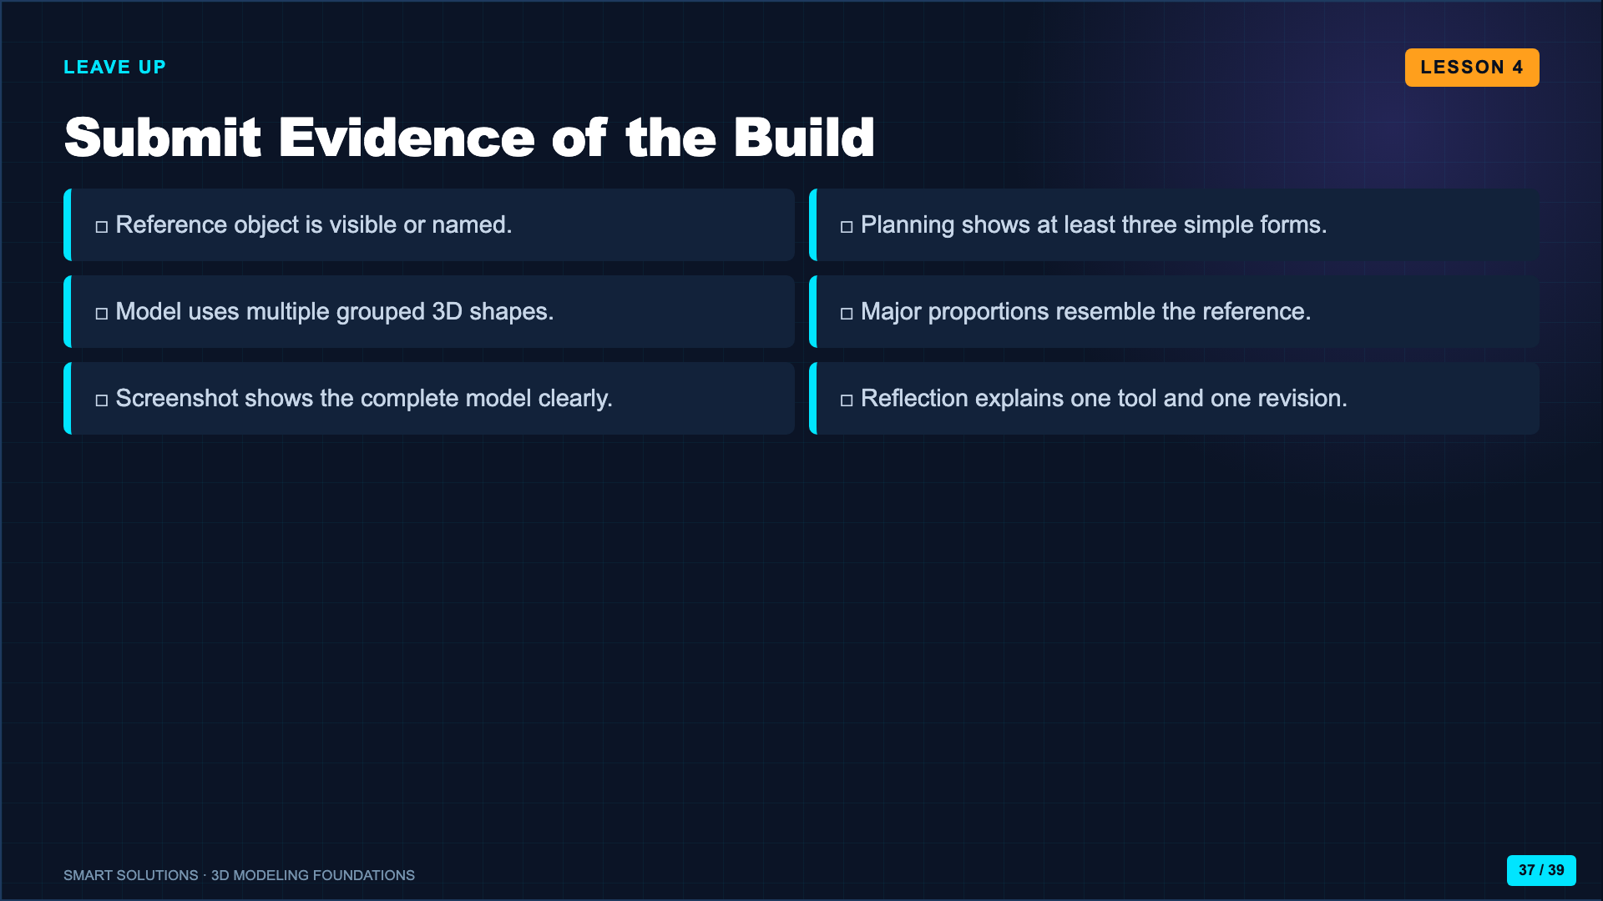
Notes:
Require the reference, plan, model screenshot, and reflection according to the Canvas route. This is the accountability evidence that confirms the build occurred.
[Sources]
- Smart Solutions 3D Modeling Canvas lessons and facilitator guides (Lucero classroom materials, 2026).

Slide 38
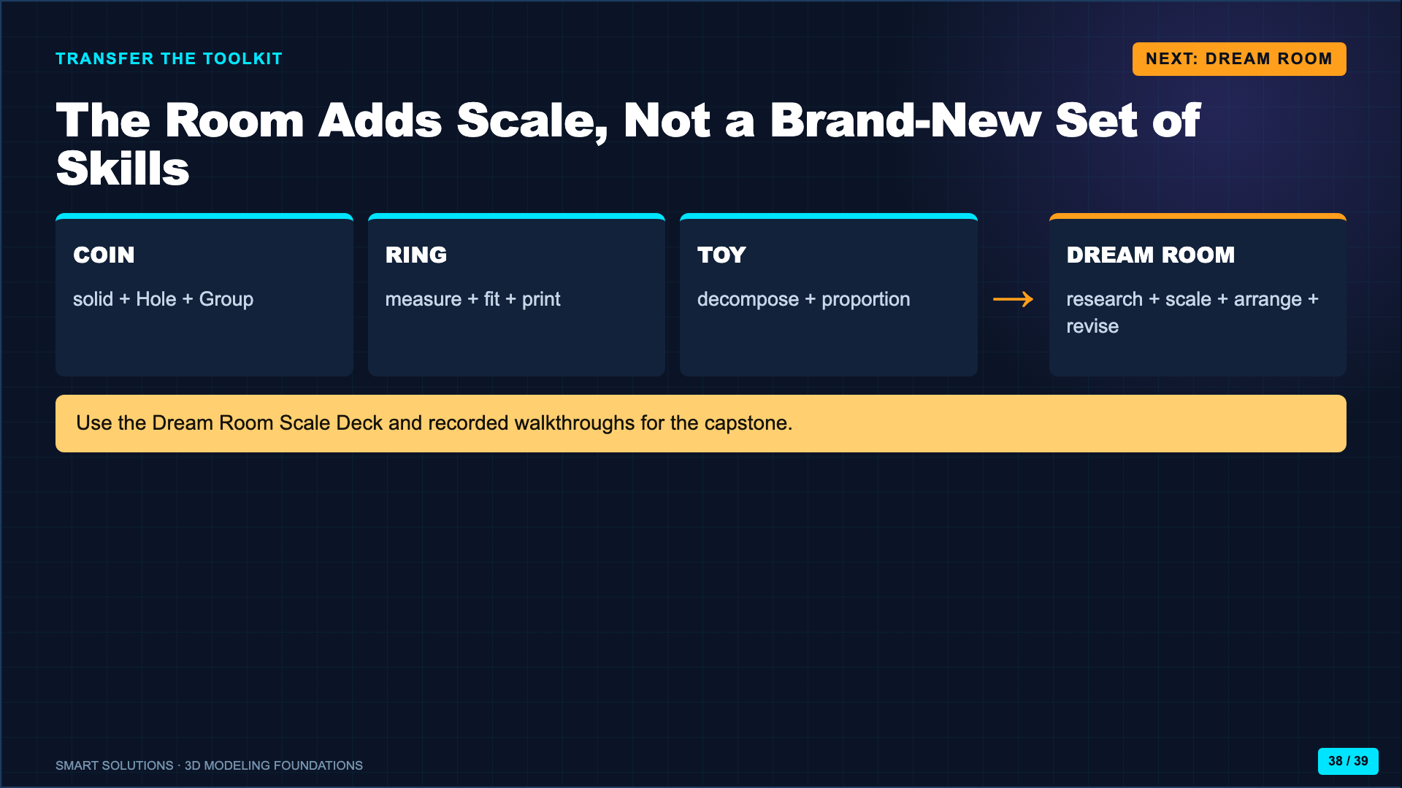
Notes:
Close by making the transfer explicit. The Dream Room deck teaches the scaling component; the videos model the project, conversion, furniture workflow, and finished result.
[Sources]
- Smart Solutions 3D Modeling Canvas lessons and facilitator guides (Lucero classroom materials, 2026).
- Elisha Lucero. Dream Room project walkthrough. https://youtu.be/i54utS_oYYs (accessed 2026-08-16).
- Elisha Lucero. Dream Room scaling walkthrough. https://youtu.be/707PbaFdfmo (accessed 2026-08-16).

Slide 39
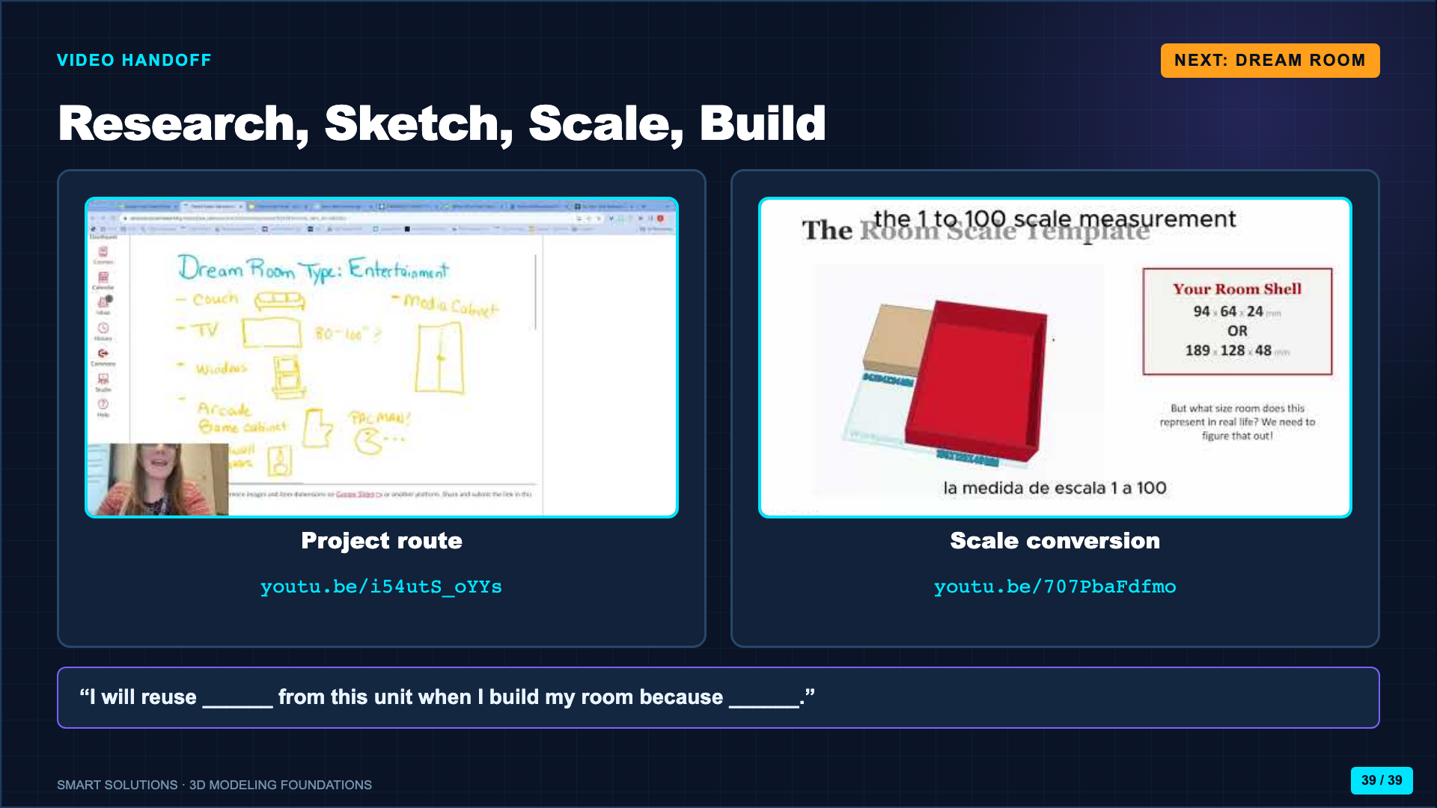
Notes:
Preview only enough to establish the next project. Use the separate Dream Room Scale Deck and Canvas videos for the full capstone instruction.
[Sources]
- Elisha Lucero. Dream Room project walkthrough. https://youtu.be/i54utS_oYYs (accessed 2026-08-16).
- Elisha Lucero. Dream Room scaling walkthrough. https://youtu.be/707PbaFdfmo (accessed 2026-08-16).
- Smart Solutions 3D Modeling Canvas lessons and facilitator guides (Lucero classroom materials, 2026).

