Slide 1
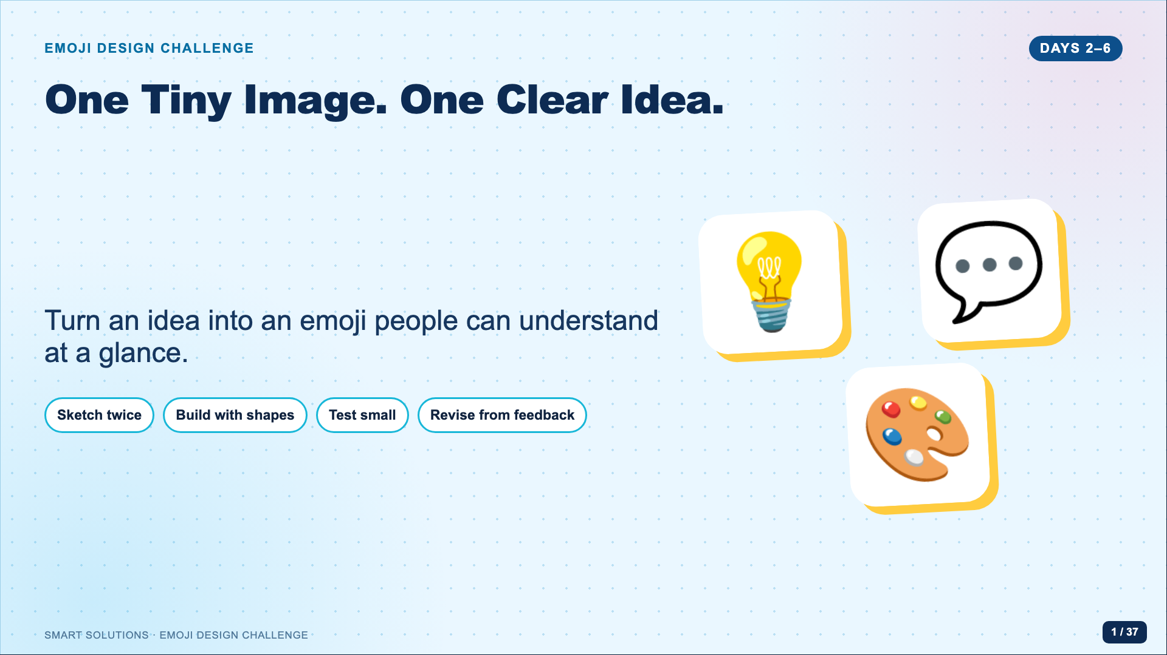
Notes:
Open after the history lesson. Tell students that they now move from studying emoji to designing one. Preview the complete five-day route without explaining every step yet.
[Sources]
- Emoji Facilitator Guide (Lucero classroom materials, 2026).
- Google. Noto Emoji image assets, Apache License 2.0. https://github.com/googlefonts/noto-emoji (accessed 2026-08-16).

Slide 2
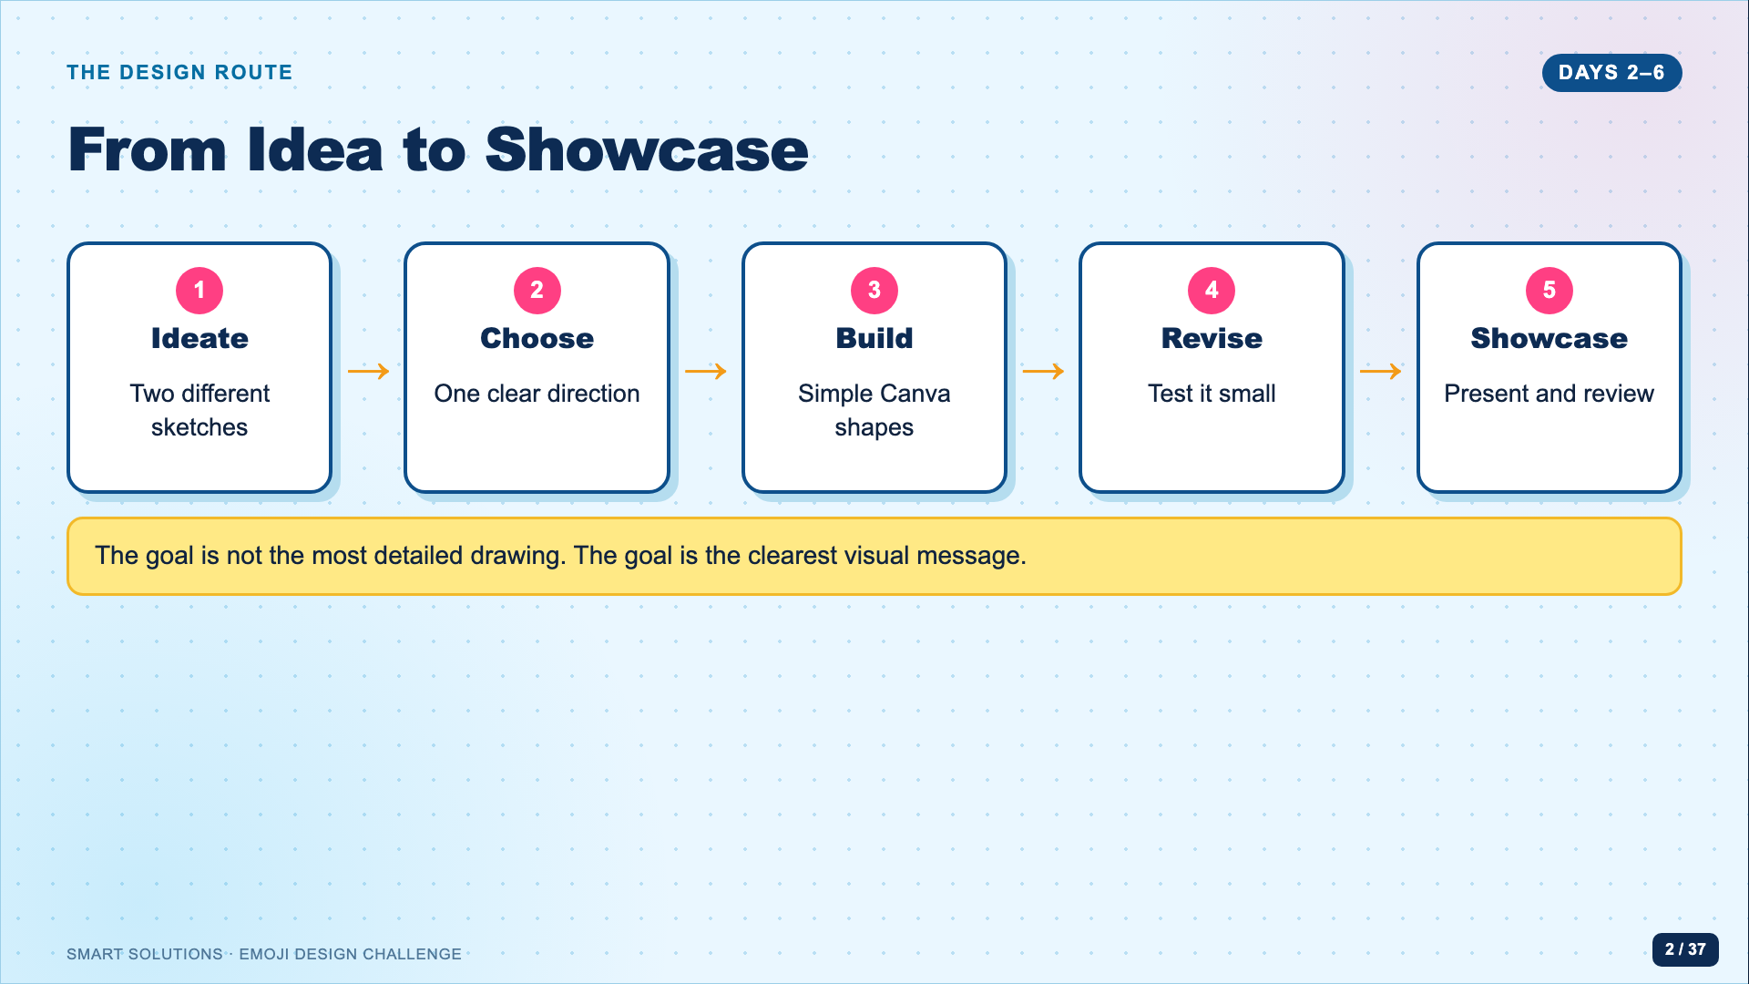
Notes:
Read the route left to right. Emphasize that students will not jump straight into Canva. The sketches and small-size test protect them from decorating an unclear idea.
[Sources]
- Emoji Facilitator Guide (Lucero classroom materials, 2026).
- Unicode Consortium. “Submitting Emoji Proposals.” https://www.unicode.org/emoji/proposals.html (accessed 2026-08-16).

Slide 3
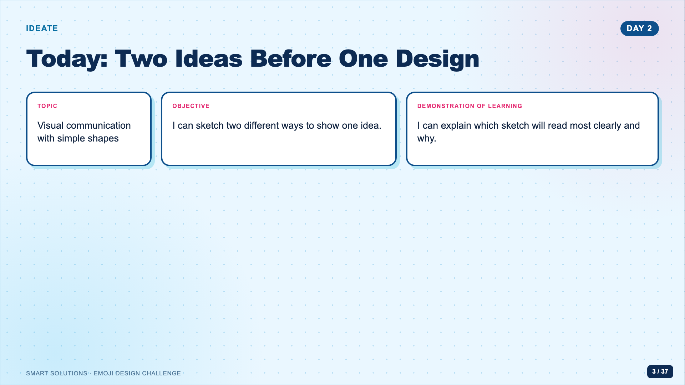
Notes:
Use this as the administration-ready opening. Students should leave with two genuinely different sketches, one selection, and a short pitch.
[Sources]
- Emoji Facilitator Guide (Lucero classroom materials, 2026).
- Emoji Ideate Sketch Page (Lucero classroom materials, 2026).

Slide 4
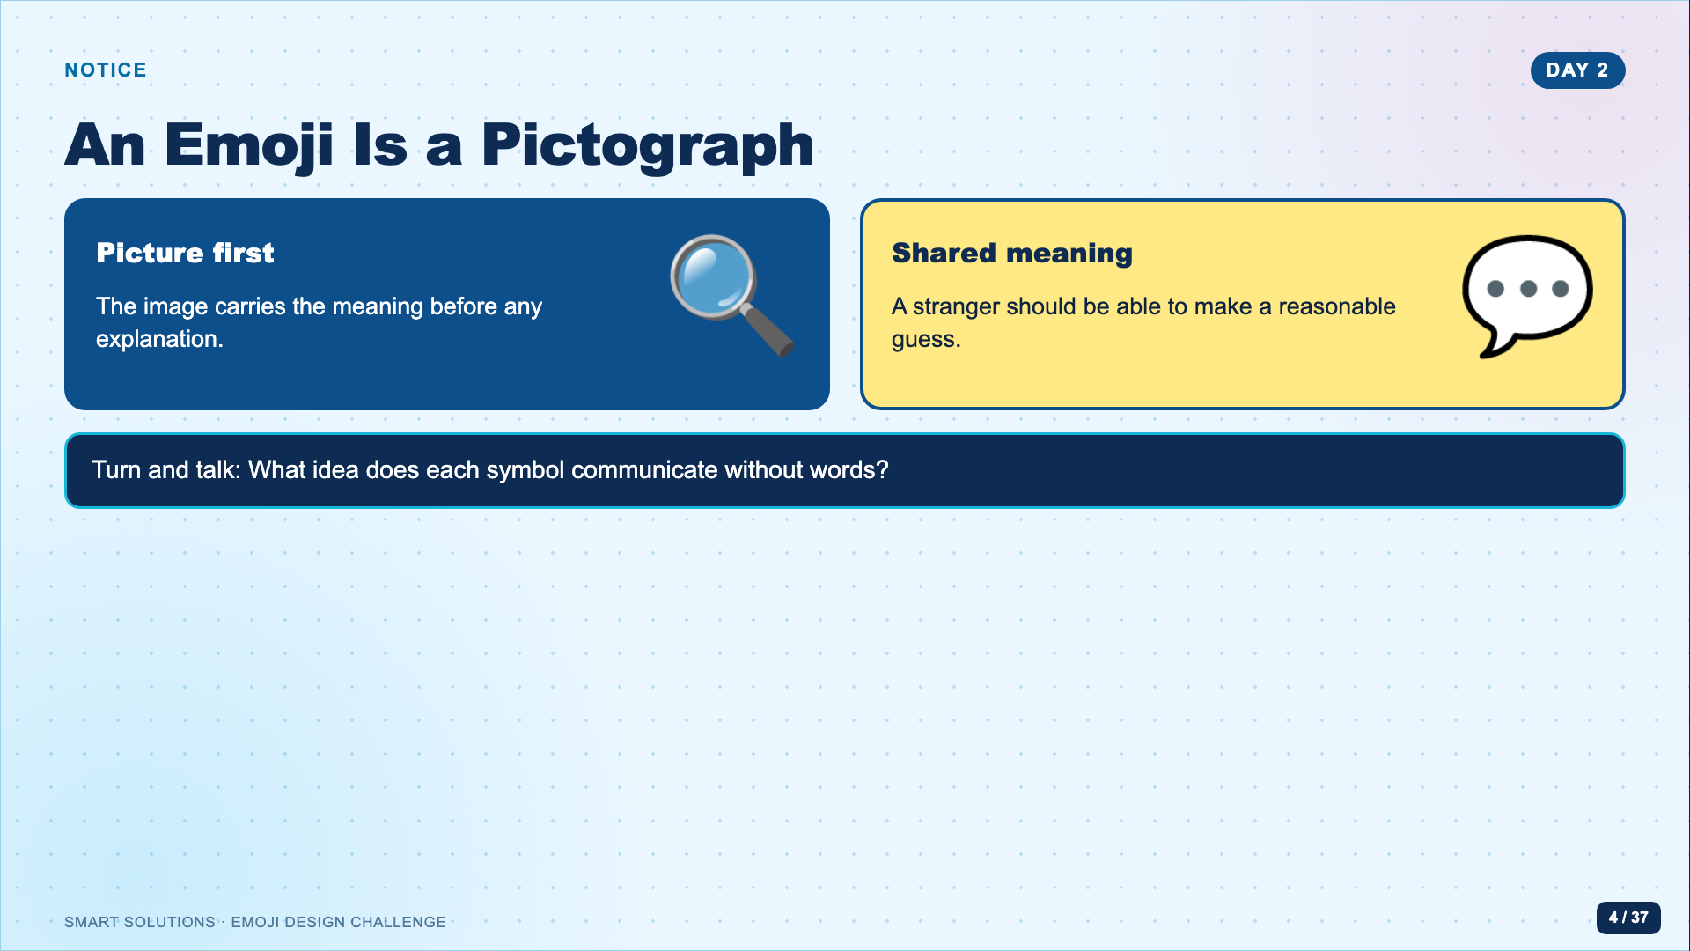
Notes:
Give students ten quiet seconds to read the two symbols, then take two interpretations. Connect back to the history lesson: a pictograph has to survive outside the designer’s personal story.
[Sources]
- Half as Interesting. “How to Make an Emoji.” https://www.youtube.com/watch?v=4cxWEJpZWV4 (accessed 2026-08-16).
- Google. Noto Emoji image assets, Apache License 2.0. https://github.com/googlefonts/noto-emoji (accessed 2026-08-16).

Slide 5
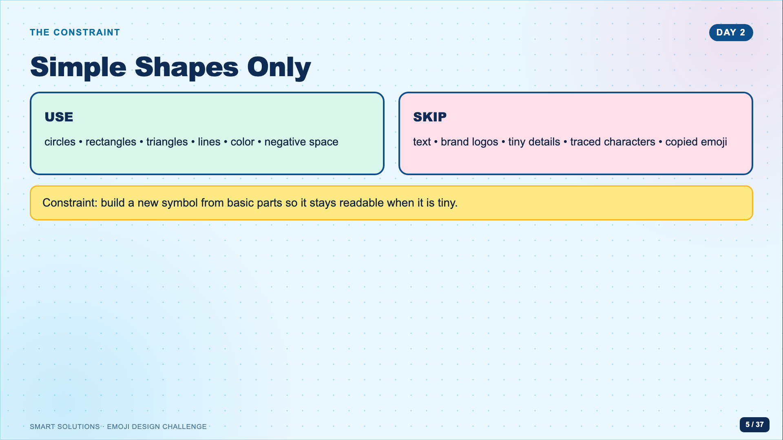
Notes:
Name the constraint as a creativity tool. Students may use letter-like shapes only when the form functions as a symbol, not as a written label. Do not turn this into a copyright lecture; the practical rule is to make an original, shape-built design.
[Sources]
- Emoji Facilitator Guide (Lucero classroom materials, 2026).
- Unicode Consortium. “Submitting Emoji Proposals.” https://www.unicode.org/emoji/proposals.html (accessed 2026-08-16).

Slide 6
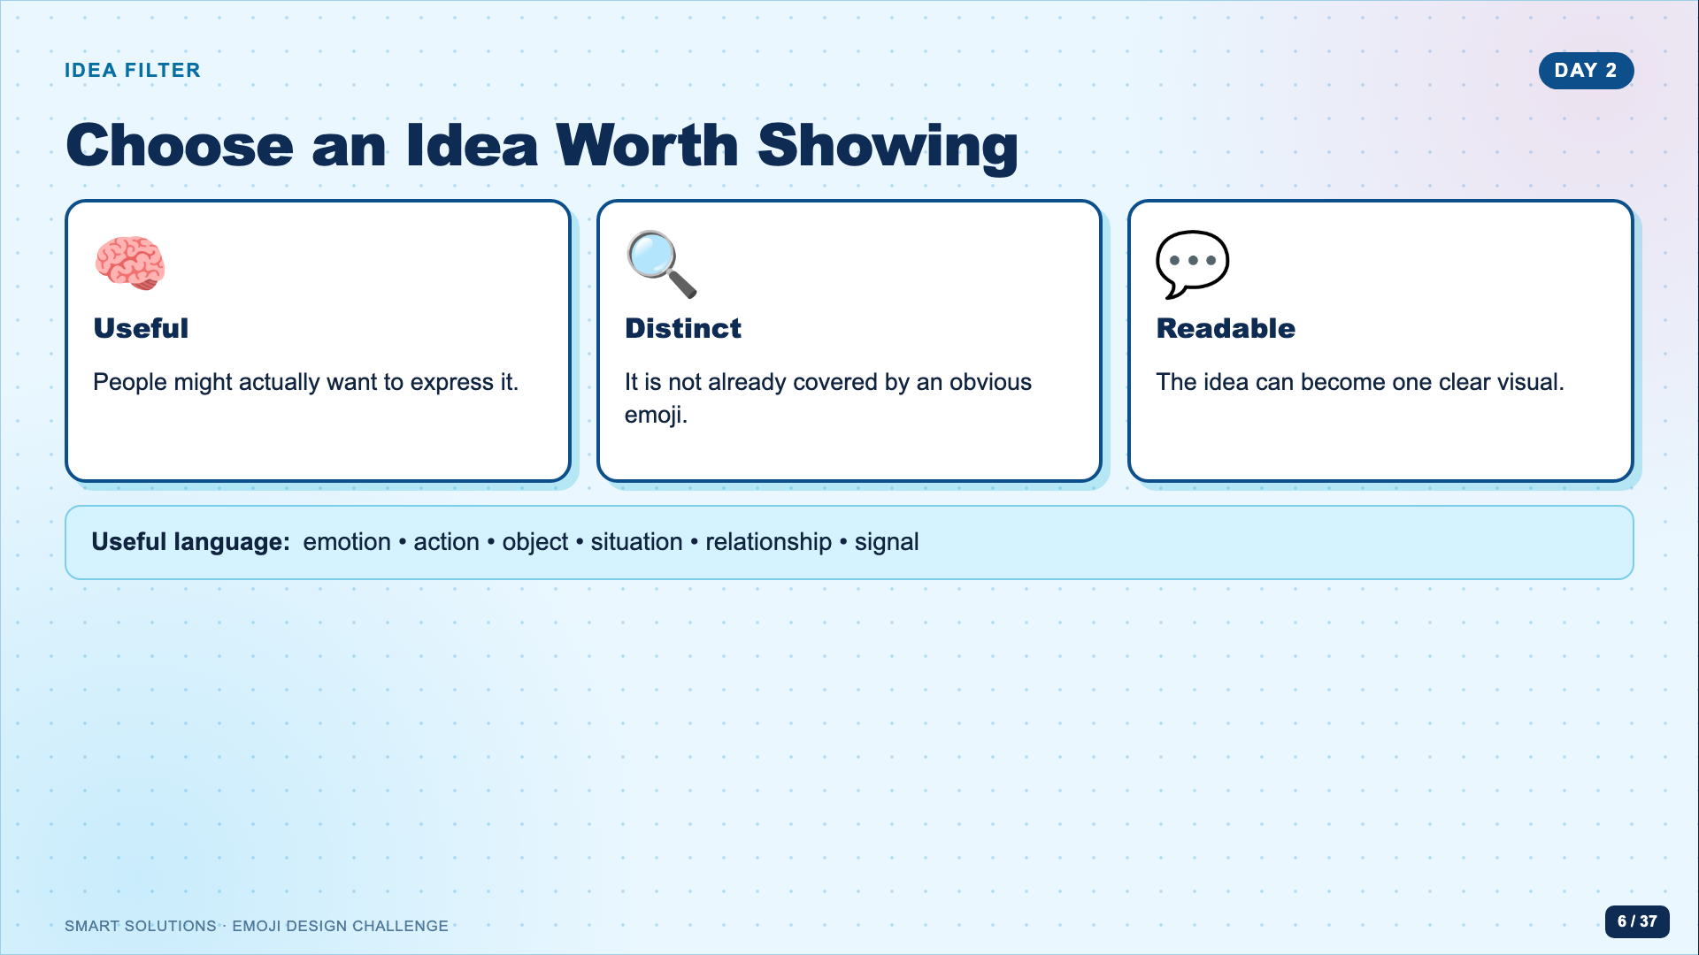
Notes:
Ask students to name the idea in two or three words before drawing. If the idea needs a paragraph, narrow it. These are student-friendly versions of the usefulness, distinctiveness, and visual clarity questions used in emoji proposal review.
[Sources]
- Unicode Consortium. “Submitting Emoji Proposals.” https://www.unicode.org/emoji/proposals.html (accessed 2026-08-16).
- Emoji Facilitator Guide (Lucero classroom materials, 2026).

Slide 7
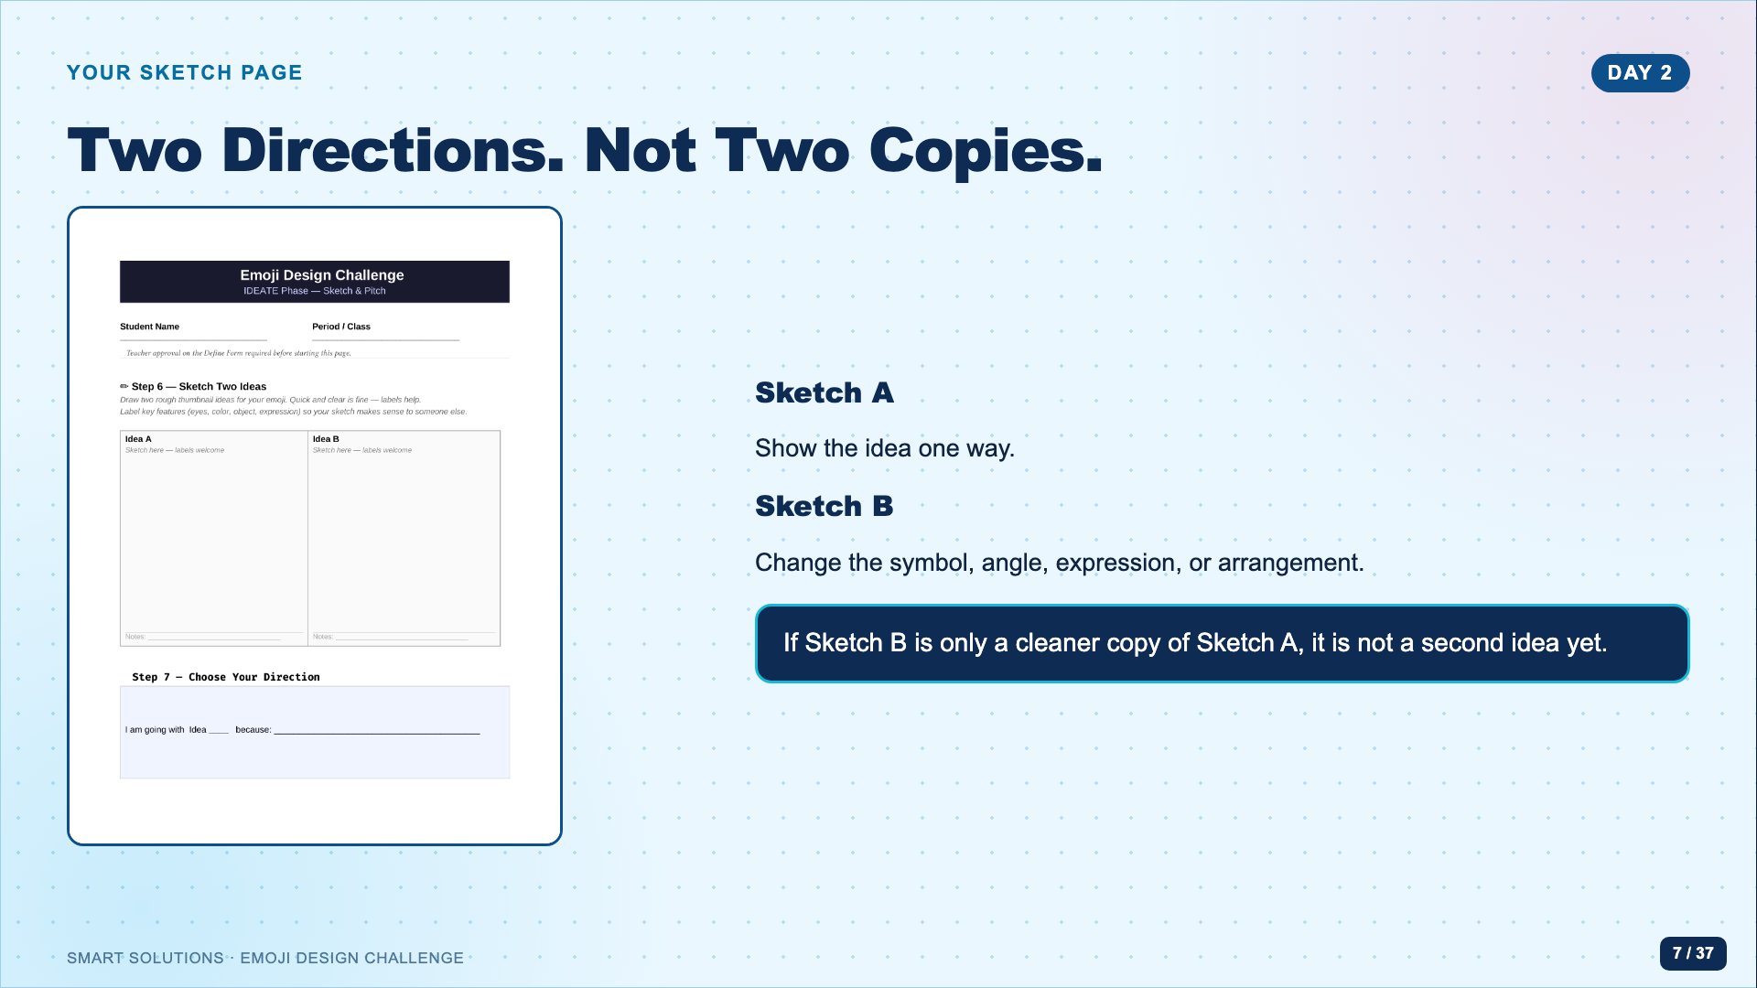
Notes:
Pass out the sketch page. Point to both boxes. Model changing the visual strategy, not just redrawing more neatly. Students can work in pencil first and add color after choosing.
[Sources]
- Emoji Ideate Sketch Page (Lucero classroom materials, 2026).
- Emoji Facilitator Guide (Lucero classroom materials, 2026).

Slide 8
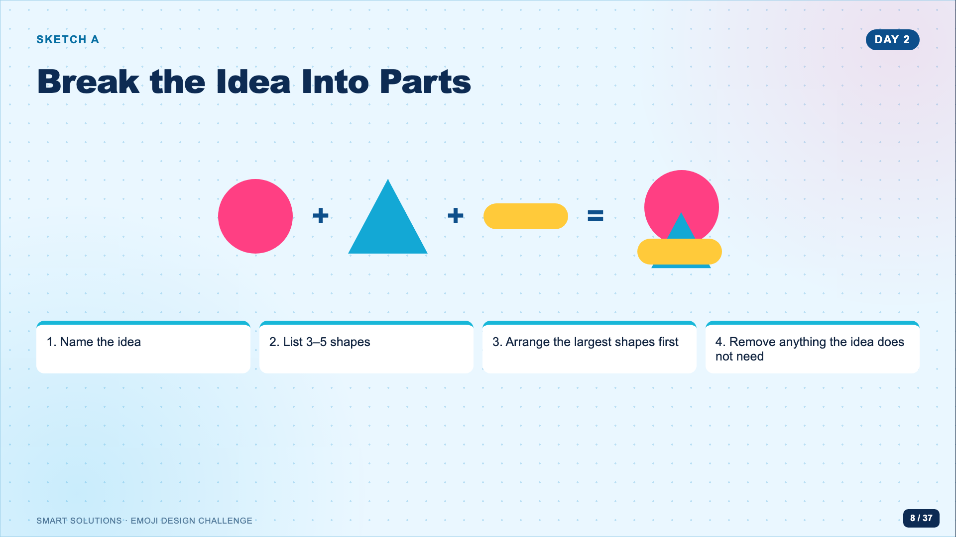
Notes:
Do a quick think-aloud with a neutral example. Keep it abstract enough that students do not copy your finished design. Stress that the largest silhouette should carry most of the meaning.
[Sources]
- Emoji Facilitator Guide (Lucero classroom materials, 2026).

Slide 9
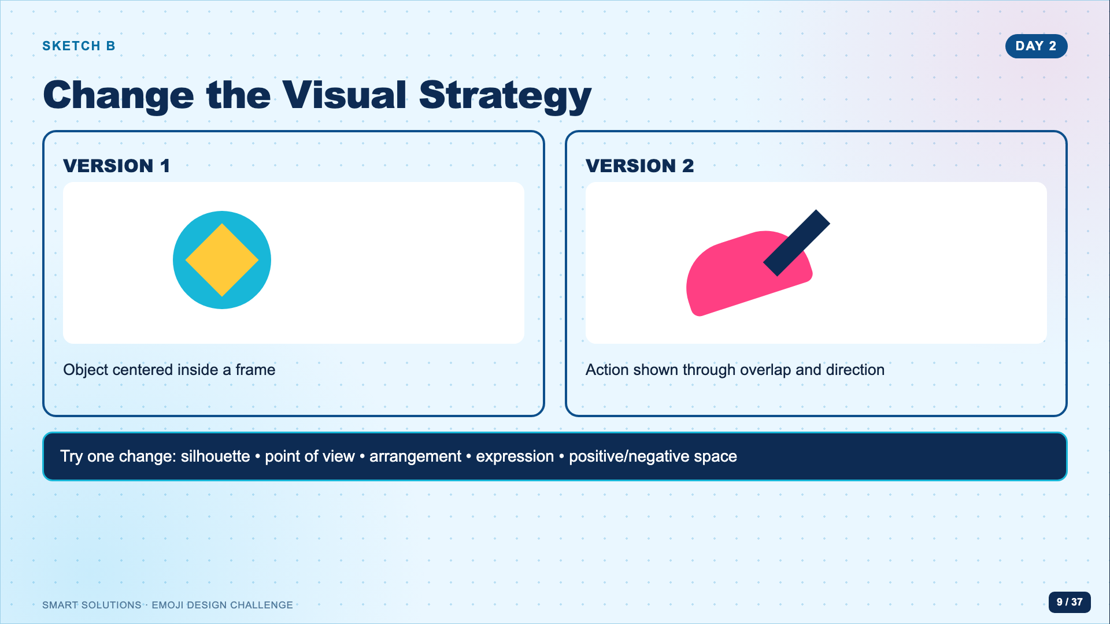
Notes:
Keep this slide up while students create their second direction. If a student is stuck, assign one change from the prompt rather than supplying the answer.
[Sources]
- Emoji Facilitator Guide (Lucero classroom materials, 2026).
- Emoji Ideate Sketch Page (Lucero classroom materials, 2026).

Slide 10
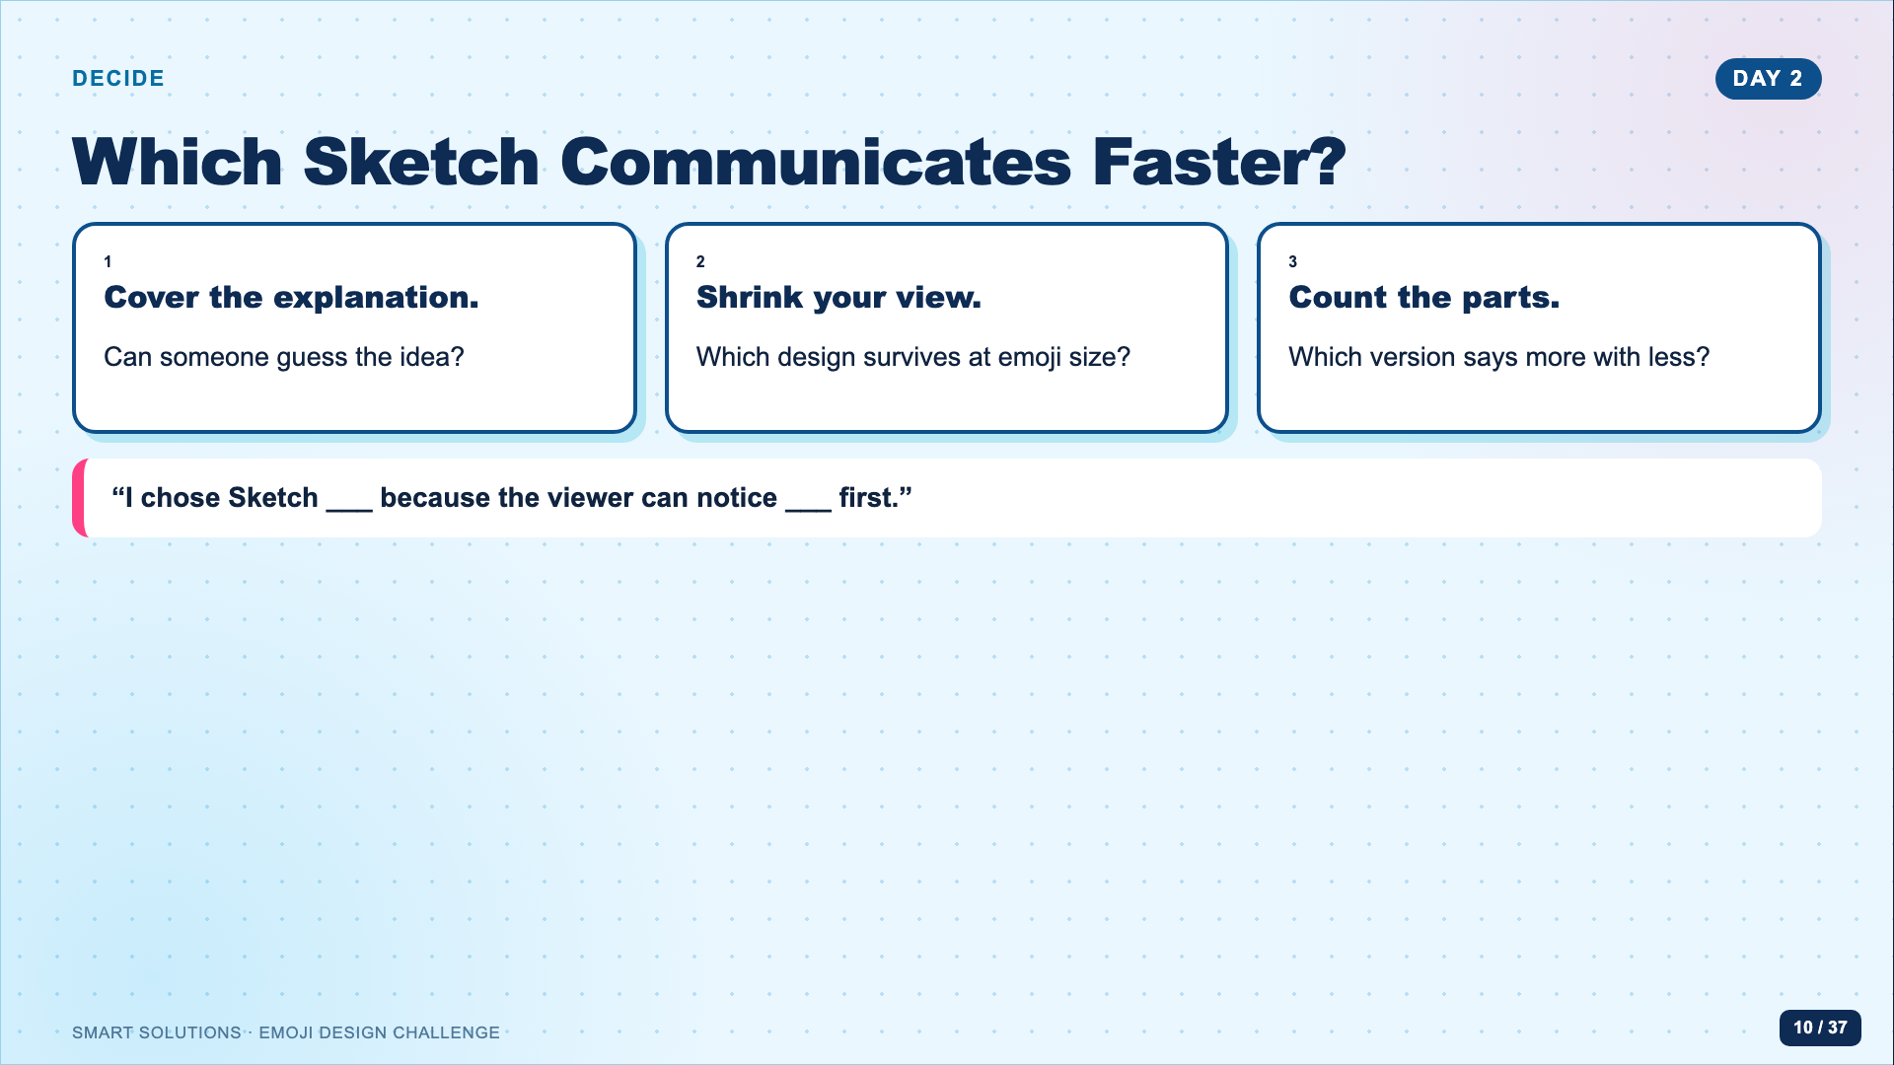
Notes:
Have partners test each other’s two sketches without hearing the explanation first. Students circle one direction only after they have evidence from another viewer.
[Sources]
- Emoji Ideate Sketch Page (Lucero classroom materials, 2026).
- Emoji Facilitator Guide (Lucero classroom materials, 2026).

Slide 11
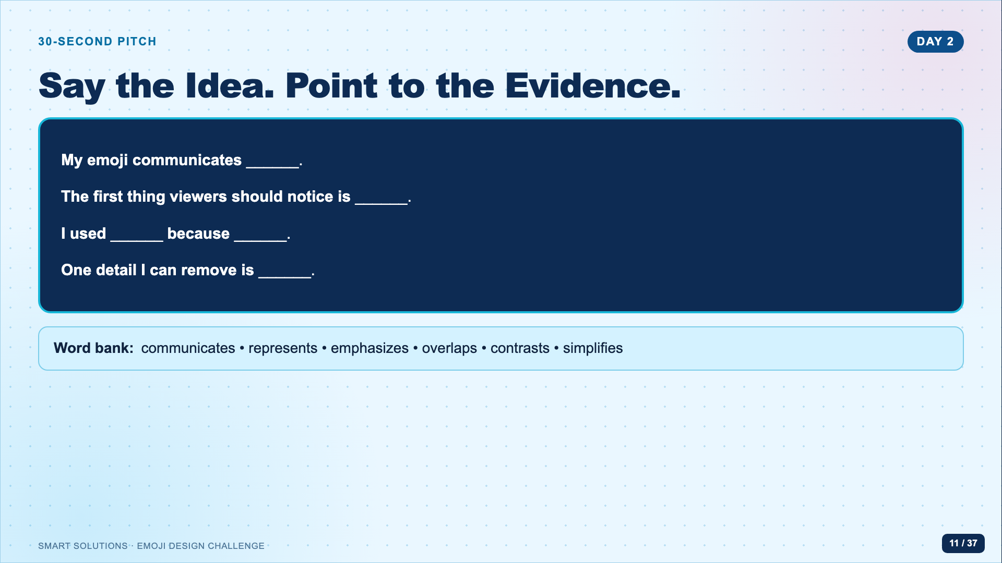
Notes:
Pairs pitch to each other. Listen for students naming a visual decision, not only the topic. Invite one strong example and one example that became clearer after a partner question.
[Sources]
- Emoji Facilitator Guide (Lucero classroom materials, 2026).
- Emoji Ideate Sketch Page (Lucero classroom materials, 2026).

Slide 12
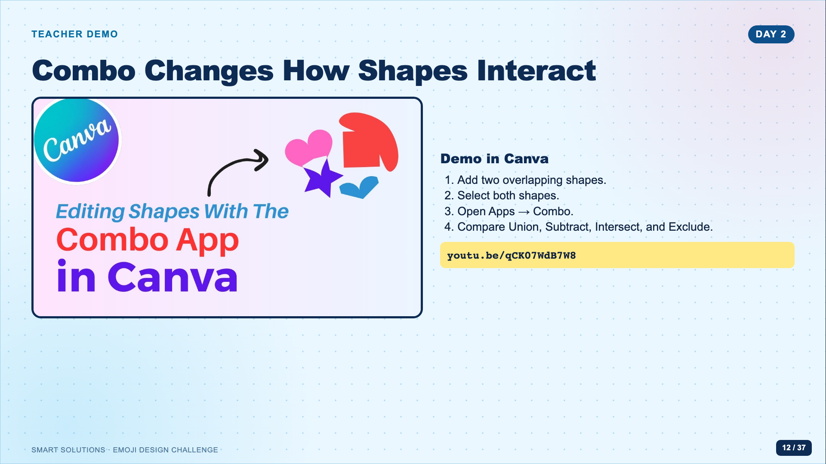
Notes:
Demonstrate with two oversized shapes. Pause after each operation and ask students to predict which area will remain. Use the linked tutorial as the backup or replay route. Clarify that grouping keeps objects together; Combo creates a new compound silhouette.
[Sources]
- The Side Blogger. “Exploring the Combo App for Shape Editing in Canva.” https://www.youtube.com/watch?v=qCK07WdB7W8 (accessed 2026-08-16).

Slide 13
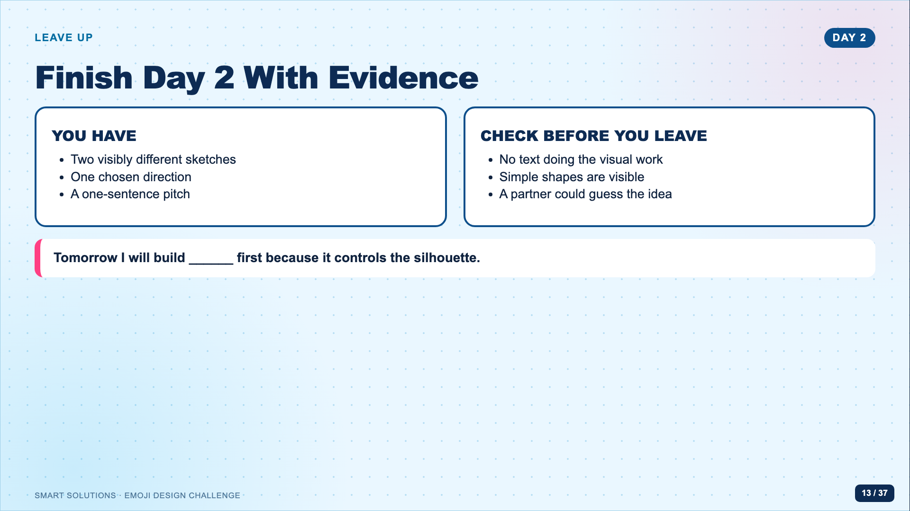
Notes:
Use the pitch as the checkpoint. Collect the sketch page or have students photograph it according to the Canvas route. Do not begin digital production unless both sketches are present.
[Sources]
- Emoji Facilitator Guide (Lucero classroom materials, 2026).
- Emoji Ideate Sketch Page (Lucero classroom materials, 2026).

Slide 14
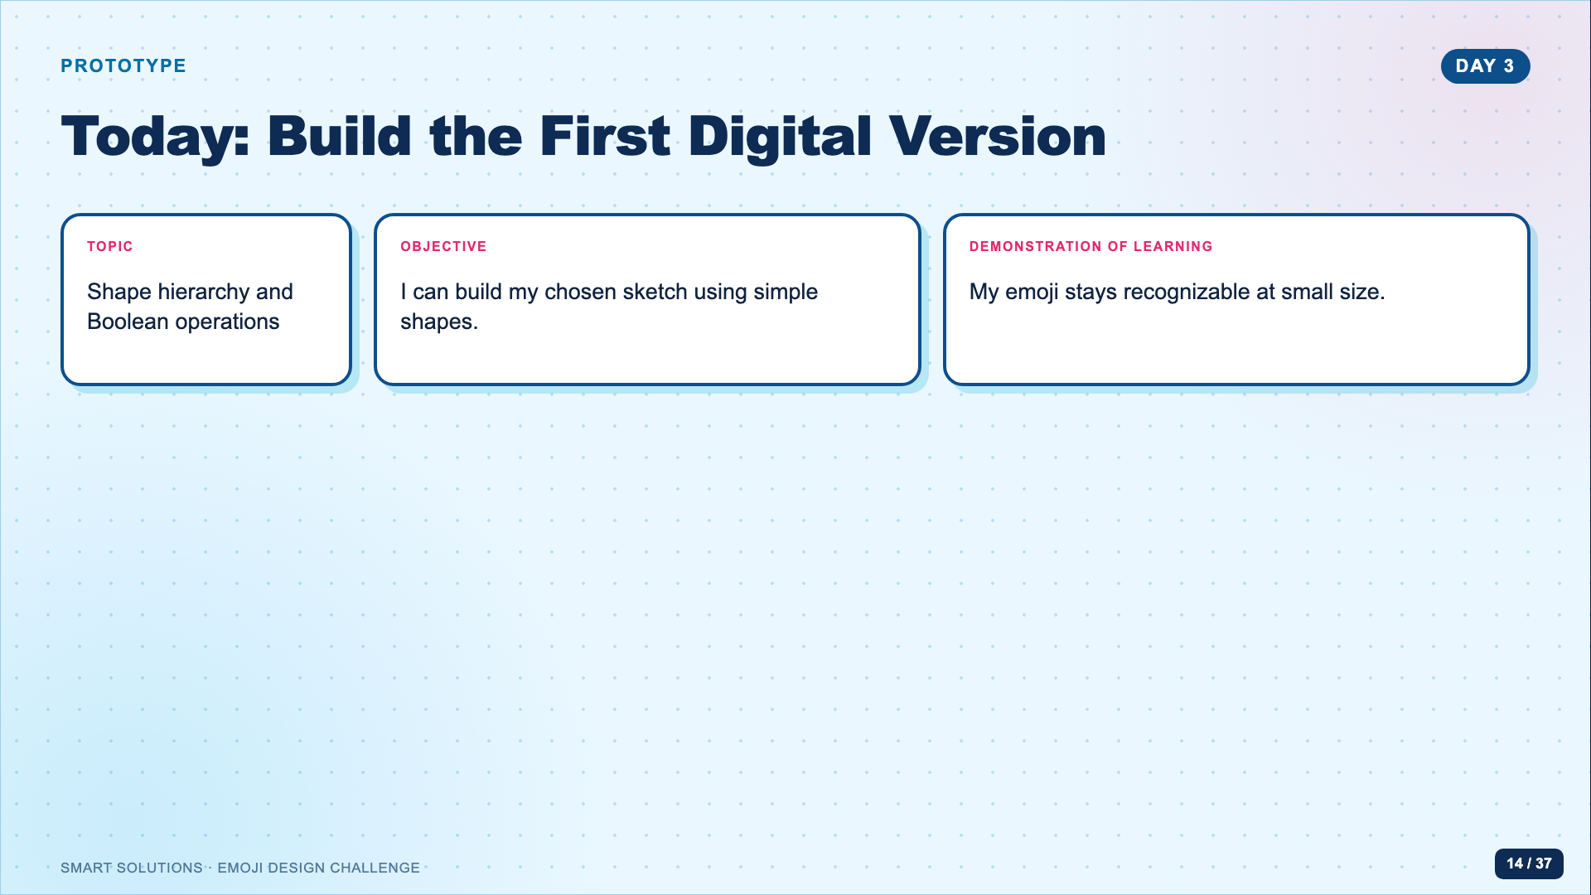
Notes:
Open with the small-size goal. Students should complete a recognizable first version today, not spend the period searching for decorative elements.
[Sources]
- Emoji Facilitator Guide (Lucero classroom materials, 2026).

Slide 15
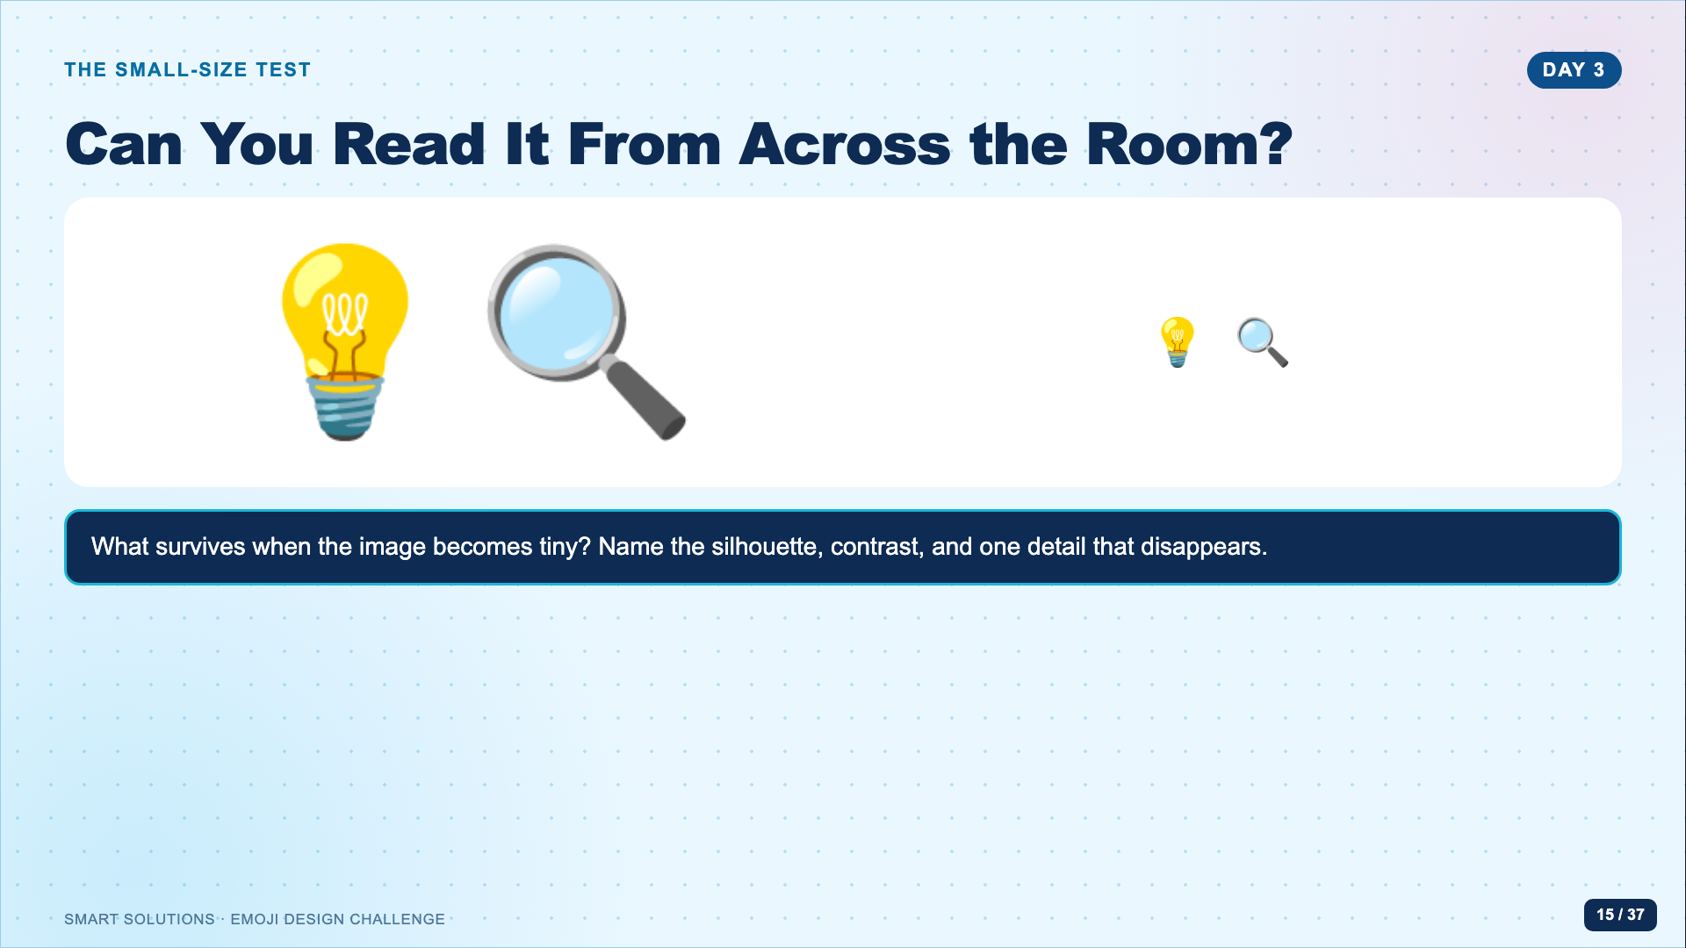
Notes:
Project this slide and physically step back. Students should notice that silhouette and contrast survive while tiny interior details vanish. Make “zoom out often” a classroom routine.
[Sources]
- Google. Noto Emoji image assets, Apache License 2.0. https://github.com/googlefonts/noto-emoji (accessed 2026-08-16).
- Unicode Consortium. “Submitting Emoji Proposals.” https://www.unicode.org/emoji/proposals.html (accessed 2026-08-16).

Slide 16
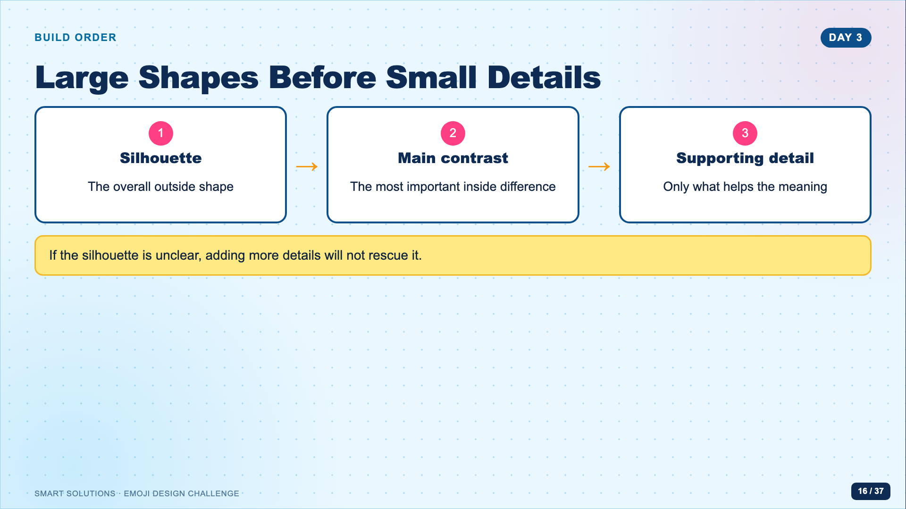
Notes:
Model building the largest background or body shape first, then the main contrasting form, then one supporting detail. Stop before embellishment.
[Sources]
- Emoji Facilitator Guide (Lucero classroom materials, 2026).

Slide 17
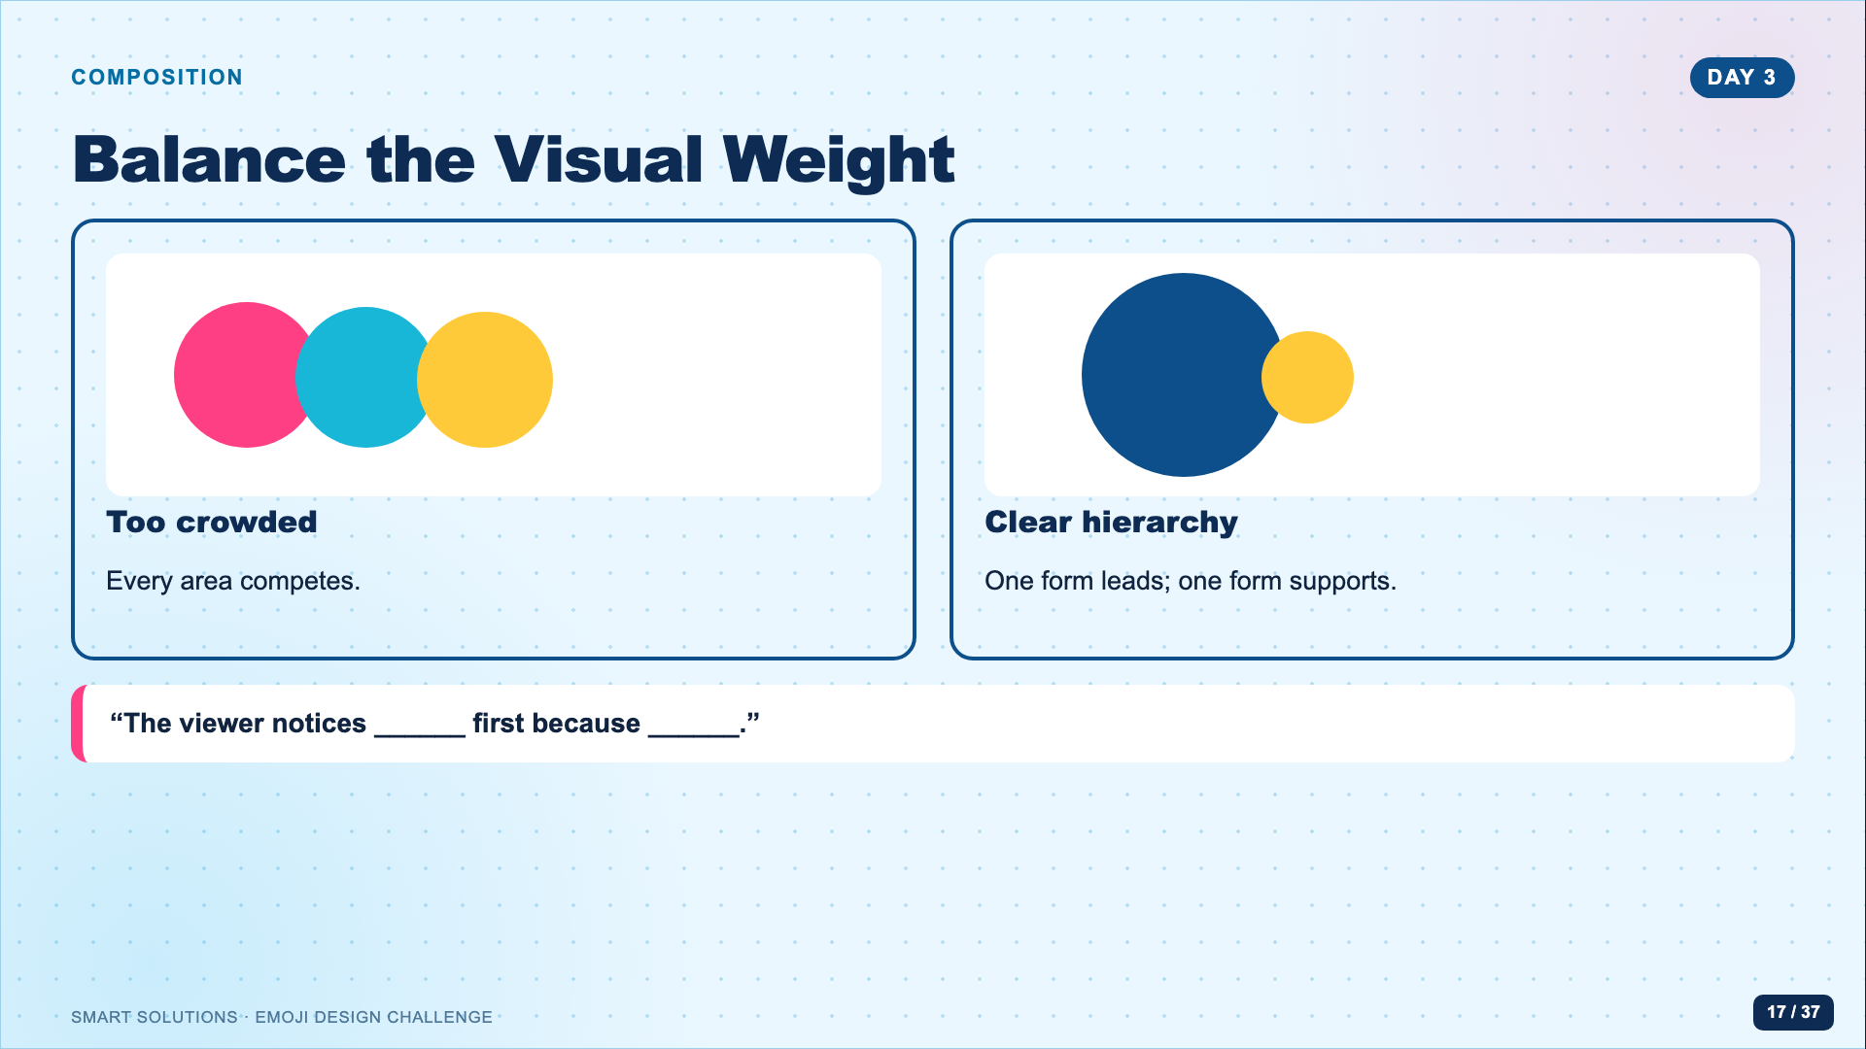
Notes:
Have students point to the visual entry point in their own design. If they point everywhere, ask them to enlarge one form or remove one competing detail.
[Sources]
- Emoji Facilitator Guide (Lucero classroom materials, 2026).

Slide 18
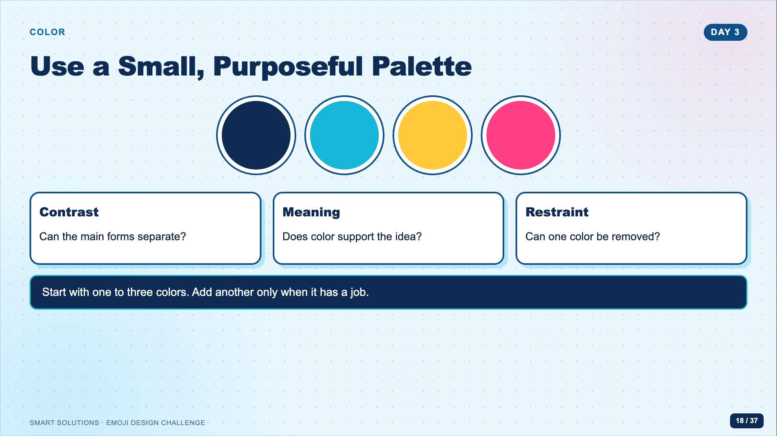
Notes:
Ask students to test the emoji against both a light and dark slide background if possible. The task is color choice, not gradient decoration.
[Sources]
- Emoji Facilitator Guide (Lucero classroom materials, 2026).

Slide 19
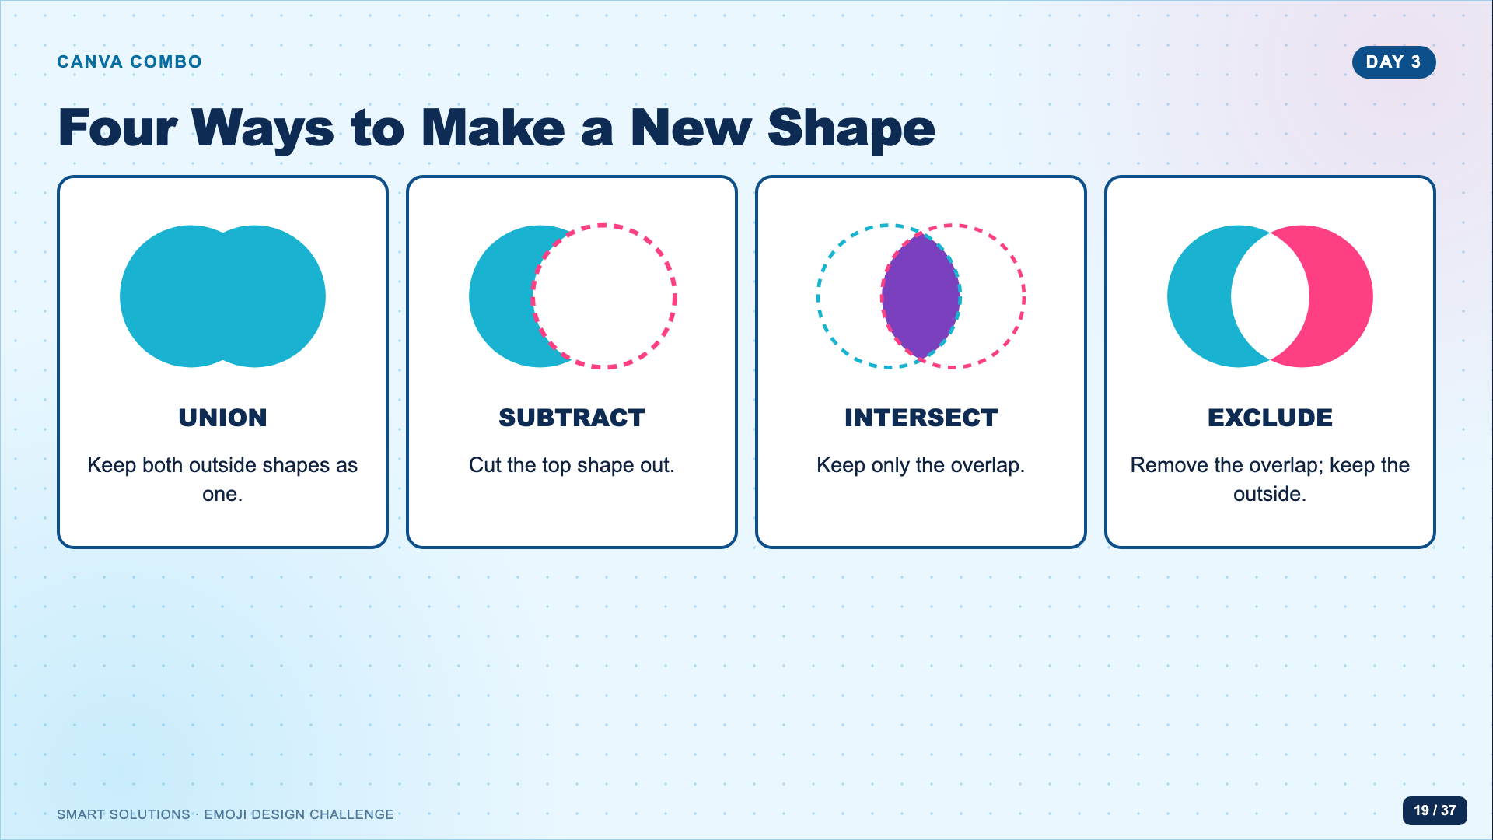
Notes:
Revisit the live demo. Ask students to predict each result before clicking. This language is more precise than calling any group of shapes a compound shape.
[Sources]
- The Side Blogger. “Exploring the Combo App for Shape Editing in Canva.” https://www.youtube.com/watch?v=qCK07WdB7W8 (accessed 2026-08-16).

Slide 20
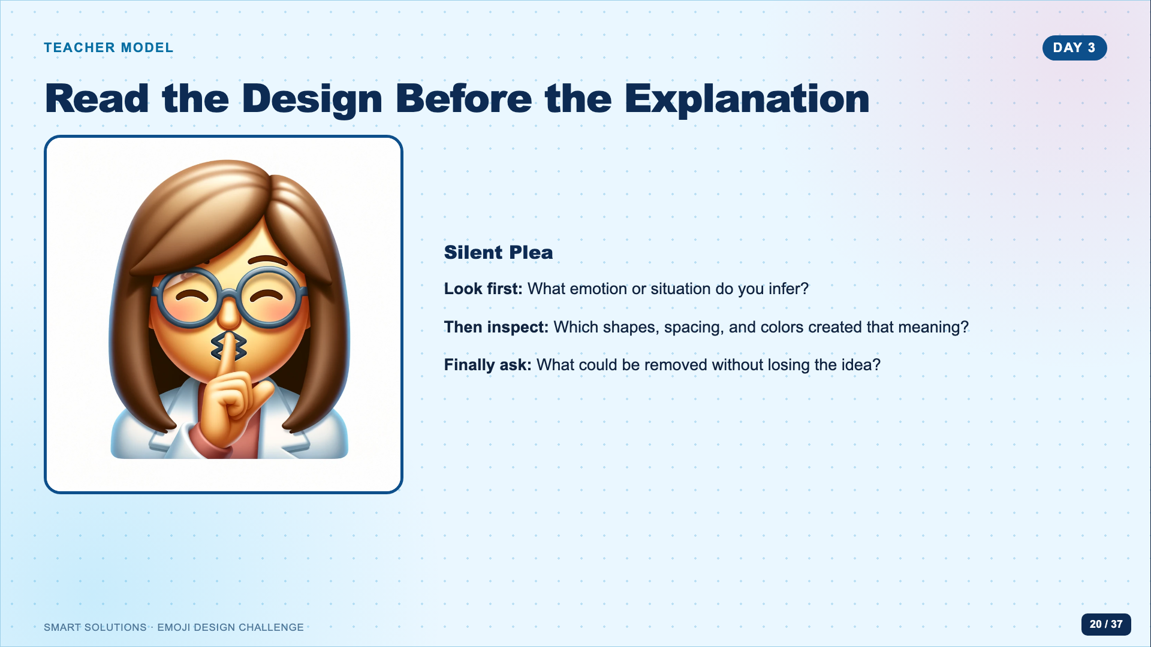
Notes:
Do not explain the model immediately. Let students infer meaning first. Reveal the title after two or three interpretations, then connect their evidence to shape, spacing, and color.
[Sources]
- Emoji showcase slide template and Silent Plea teacher model (Lucero classroom materials, 2026).

Slide 21
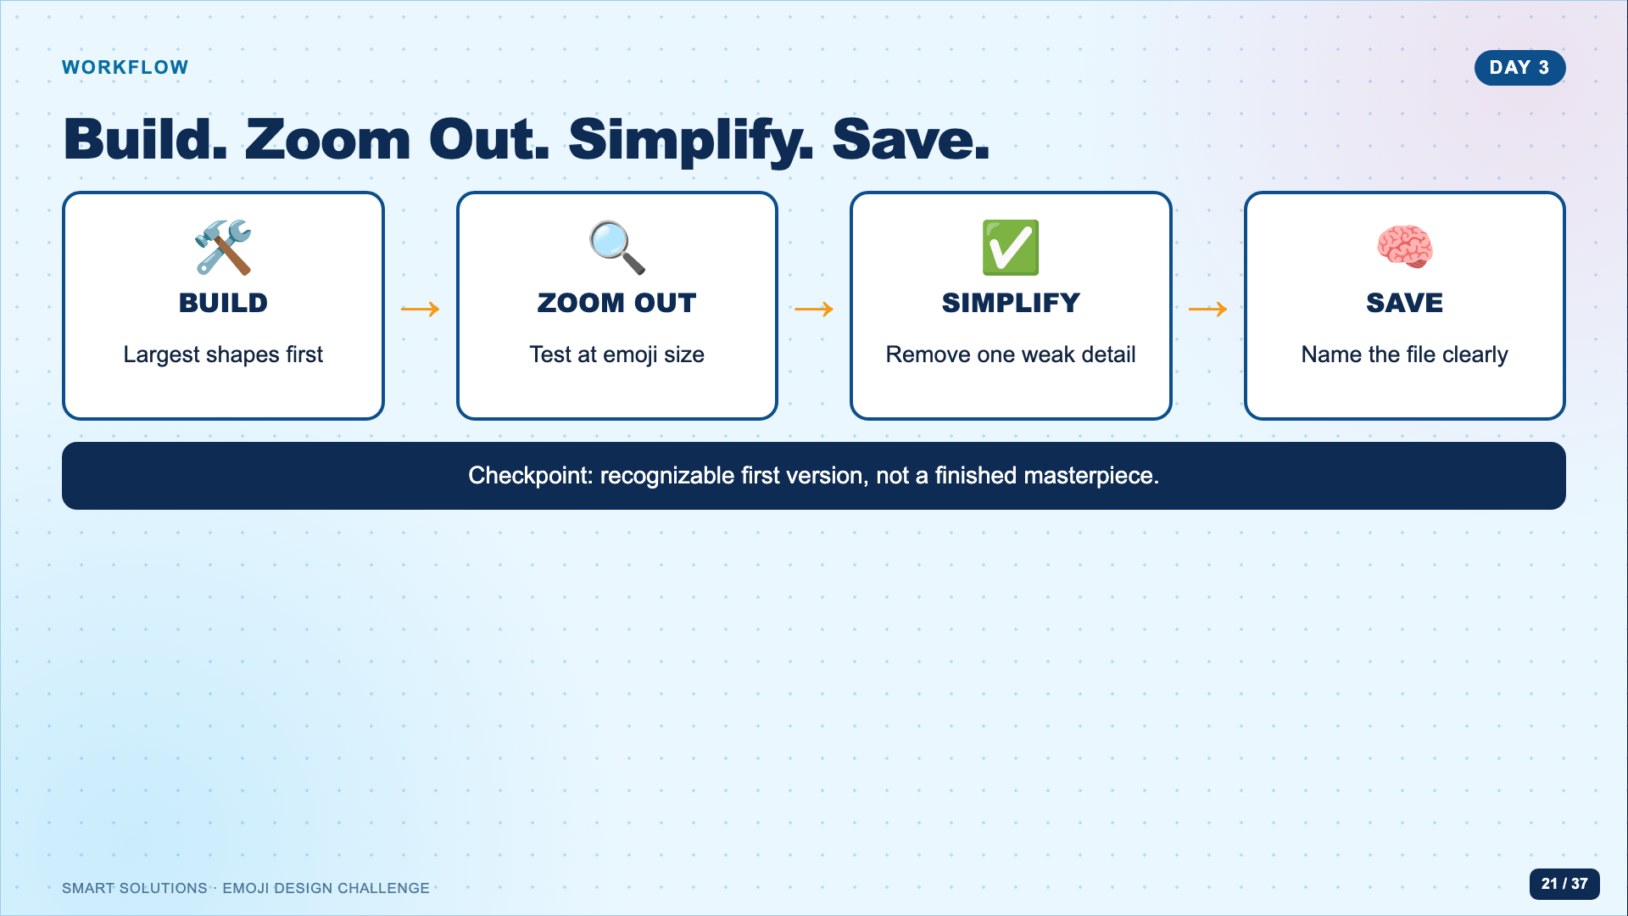
Notes:
Leave this slide up during work time. Circulate in this order: silhouette, readability, Combo operation, then color. Do not let file-search or decoration become the entire period.
[Sources]
- Emoji Facilitator Guide (Lucero classroom materials, 2026).
- The Side Blogger. “Exploring the Combo App for Shape Editing in Canva.” https://www.youtube.com/watch?v=qCK07WdB7W8 (accessed 2026-08-16).
- Google. Noto Emoji image assets, Apache License 2.0. https://github.com/googlefonts/noto-emoji (accessed 2026-08-16).

Slide 22
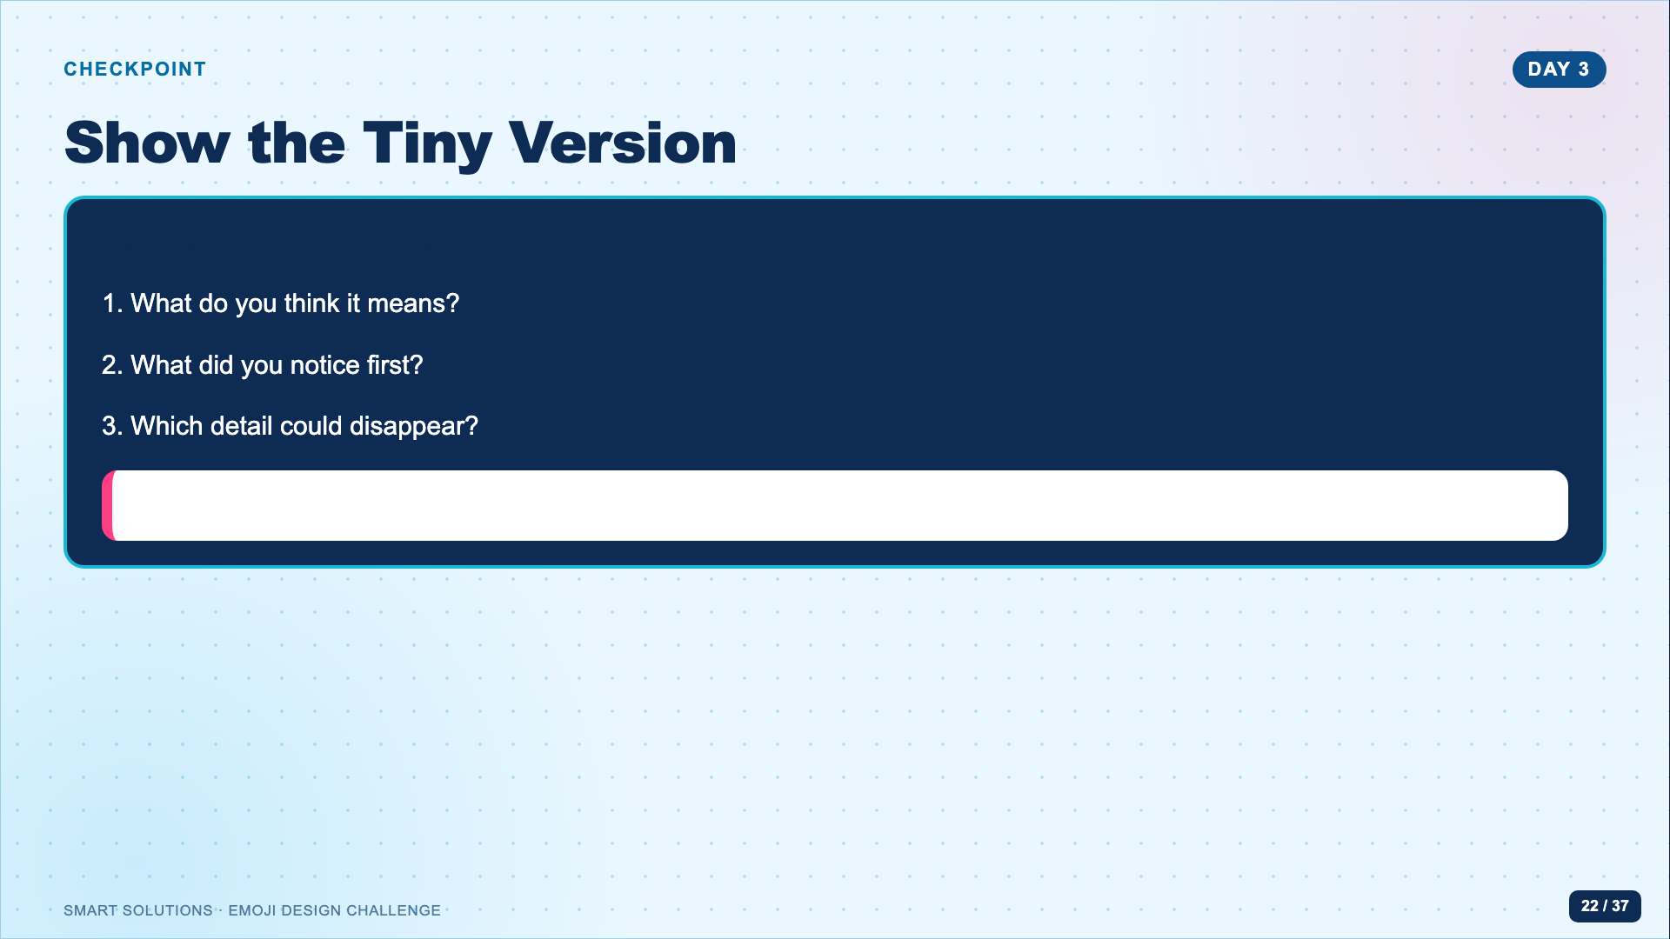
Notes:
Students show the design at small size and do not explain until the partner guesses. Record one revision. This is formative and should not become a polished presentation.
[Sources]
- Emoji Facilitator Guide (Lucero classroom materials, 2026).

Slide 23
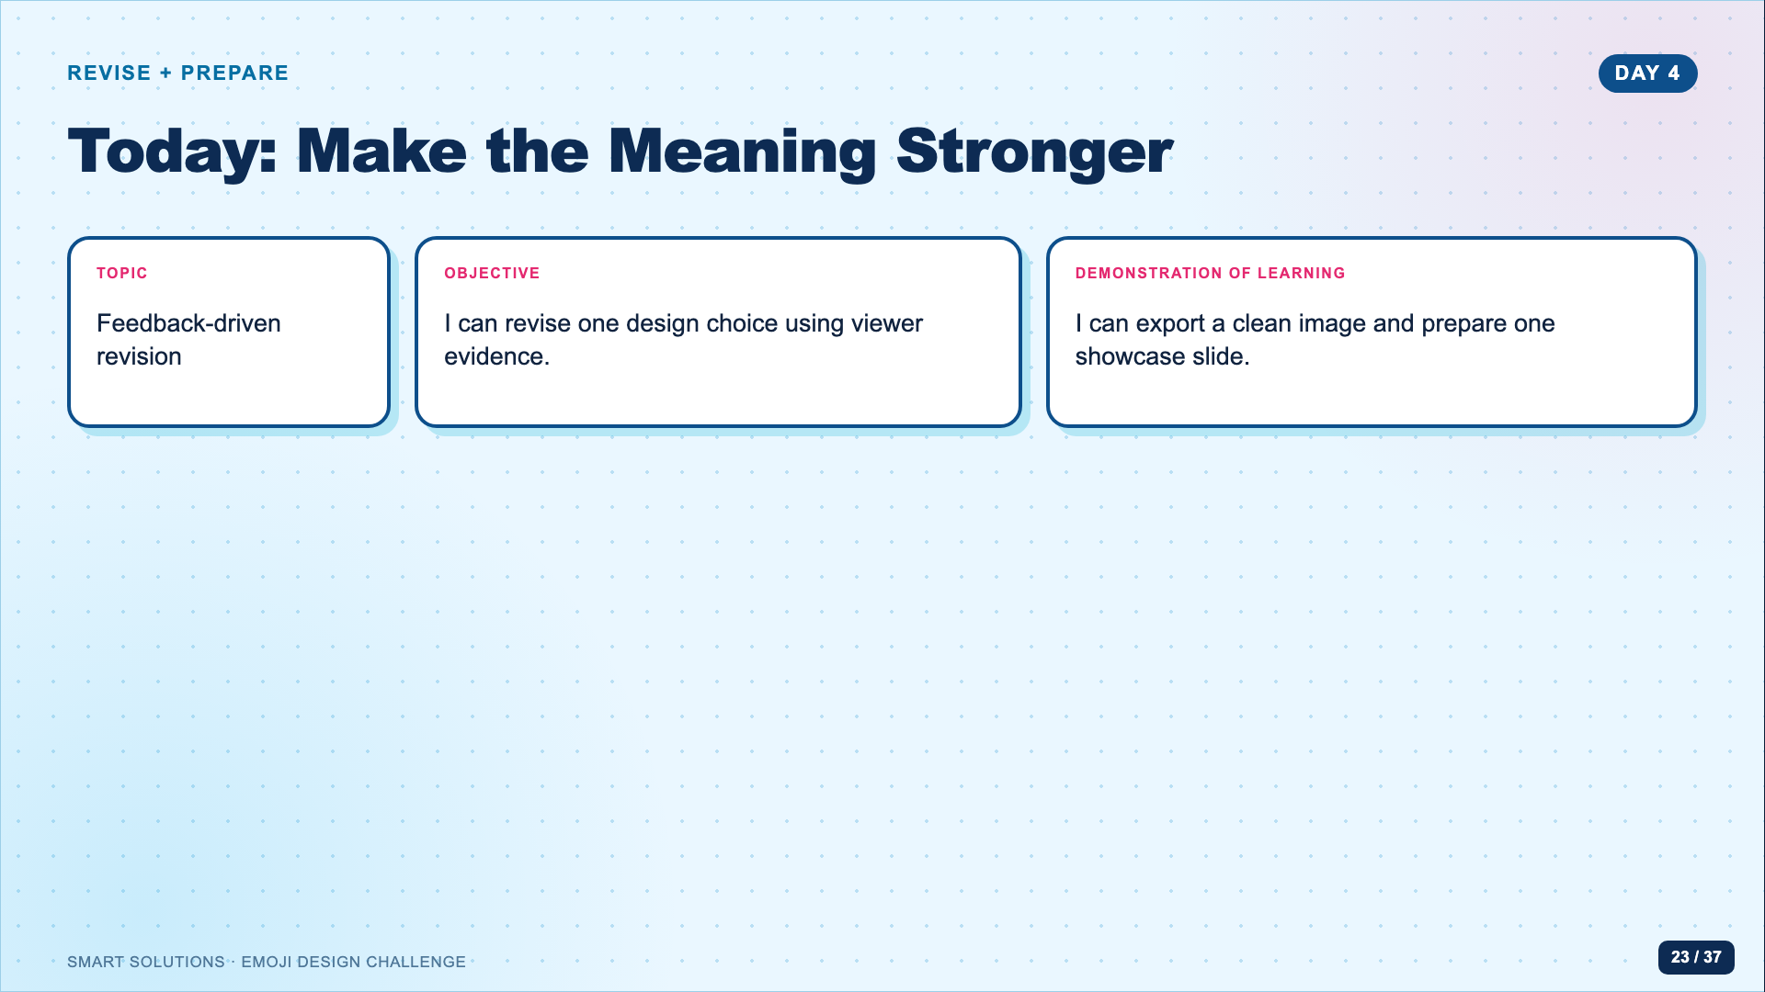
Notes:
Students should make at least one visible revision before exporting. A change counts when it responds to viewer evidence, not when it only adds decoration.
[Sources]
- Emoji Facilitator Guide (Lucero classroom materials, 2026).
- Emoji showcase slide template and Silent Plea teacher model (Lucero classroom materials, 2026).

Slide 24
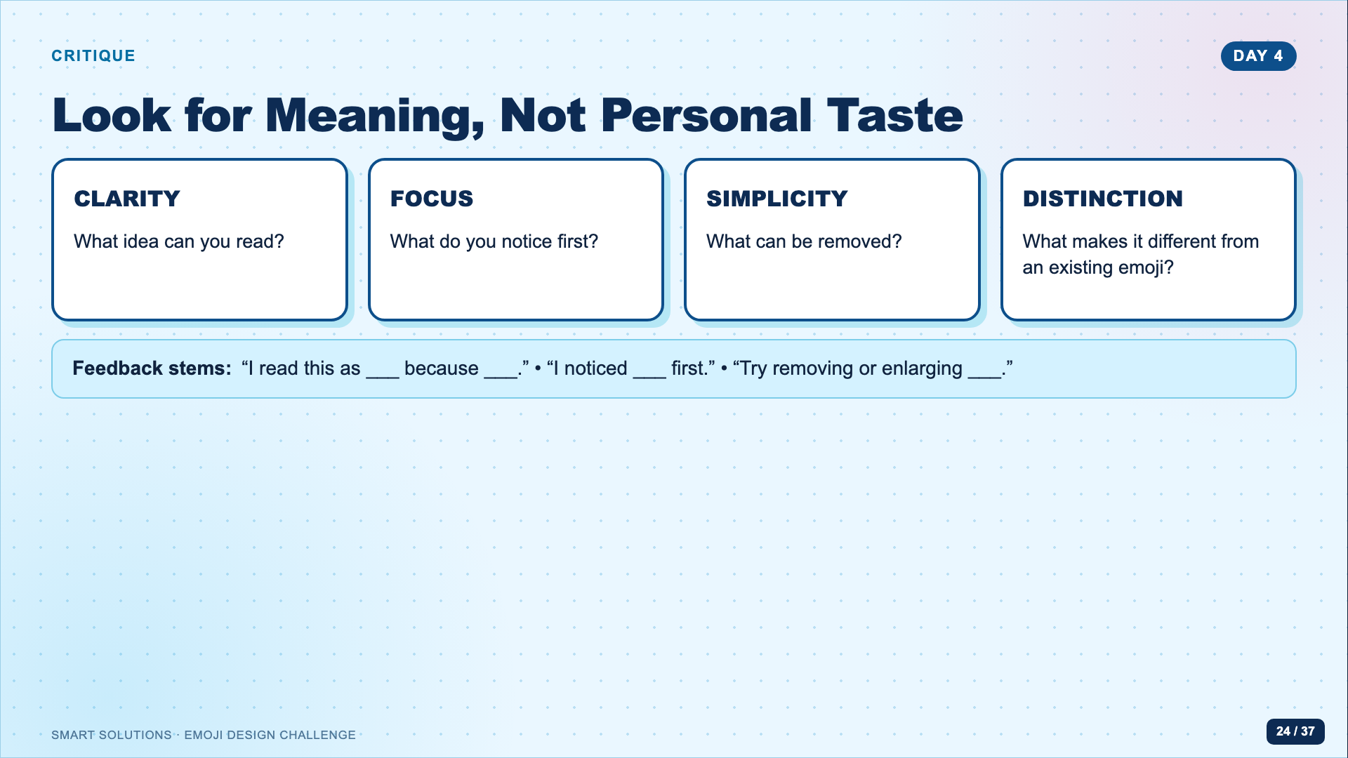
Notes:
Model feedback that describes the visual evidence. Ban “I like it” as a complete response. Students may disagree with feedback, but they must be able to explain their design decision.
[Sources]
- Emoji Facilitator Guide (Lucero classroom materials, 2026).
- Unicode Consortium. “Submitting Emoji Proposals.” https://www.unicode.org/emoji/proposals.html (accessed 2026-08-16).

Slide 25
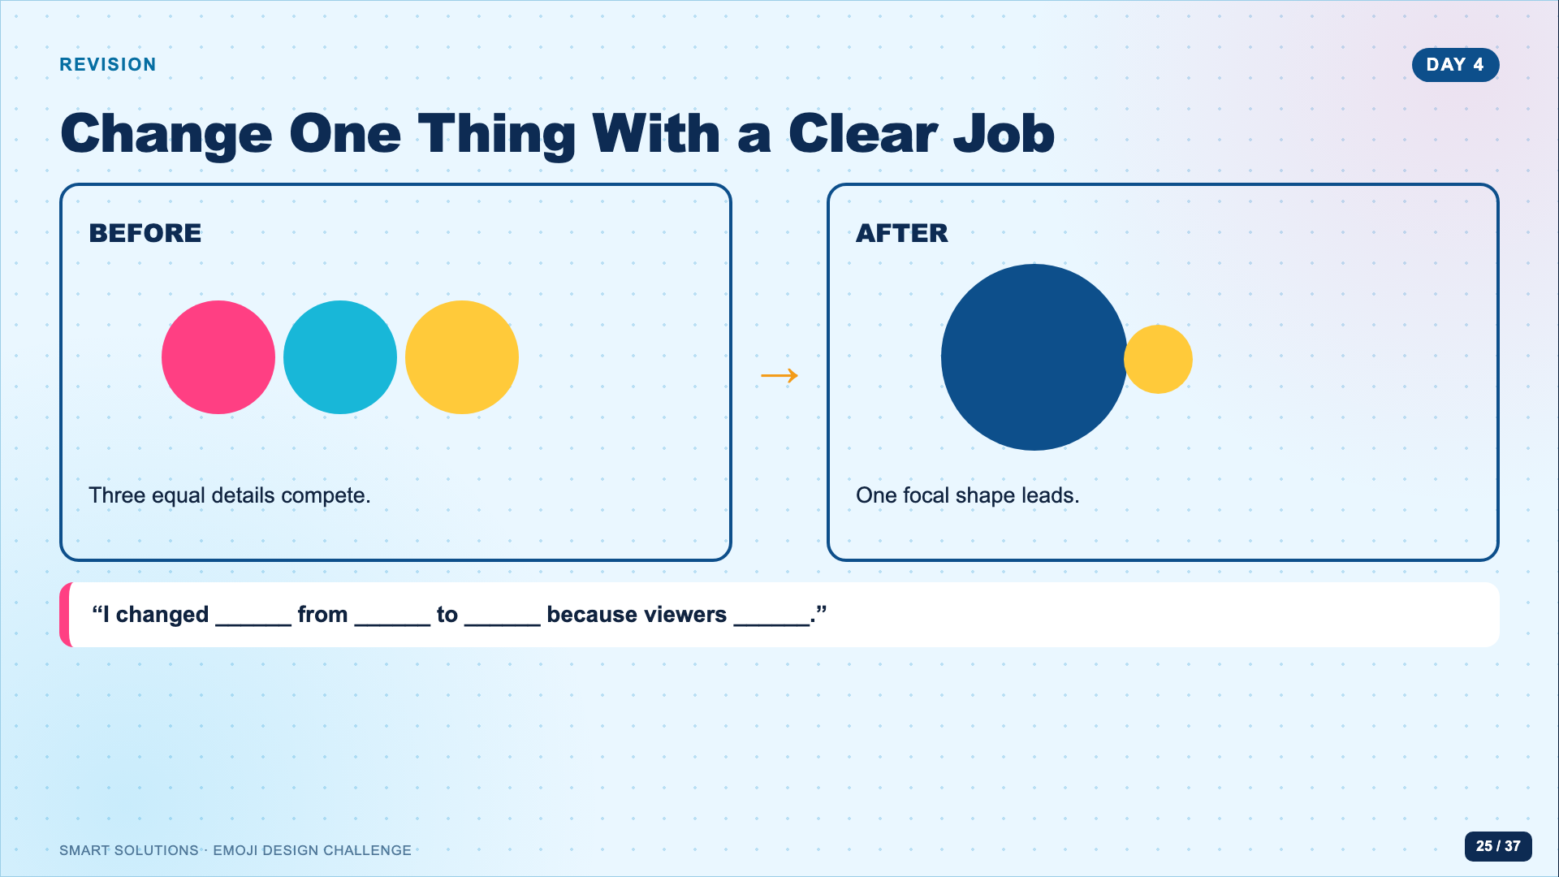
Notes:
Give students five minutes for one deliberate revision before general polishing. Ask them to preserve a screenshot or duplicate of the earlier version if they need evidence of revision.
[Sources]
- Emoji Facilitator Guide (Lucero classroom materials, 2026).

Slide 26
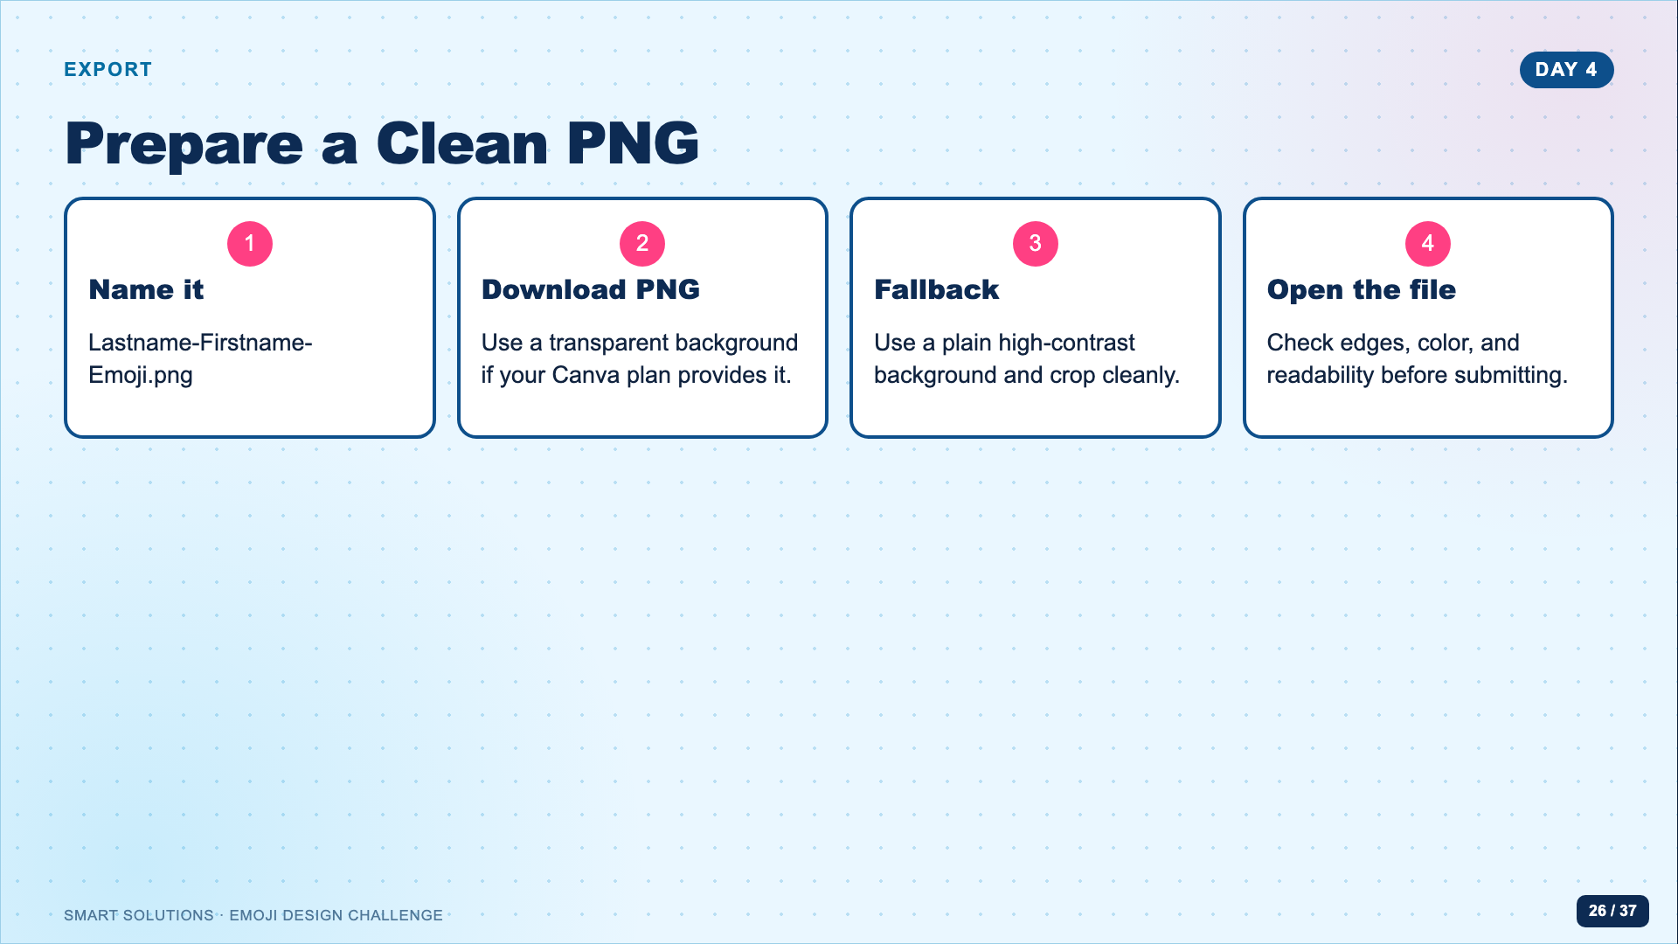
Notes:
Show the export once. Do not promise transparent-background export to every account. The practical fallback is a plain background that does not compete with the symbol.
[Sources]
- Emoji Facilitator Guide (Lucero classroom materials, 2026).

Slide 27
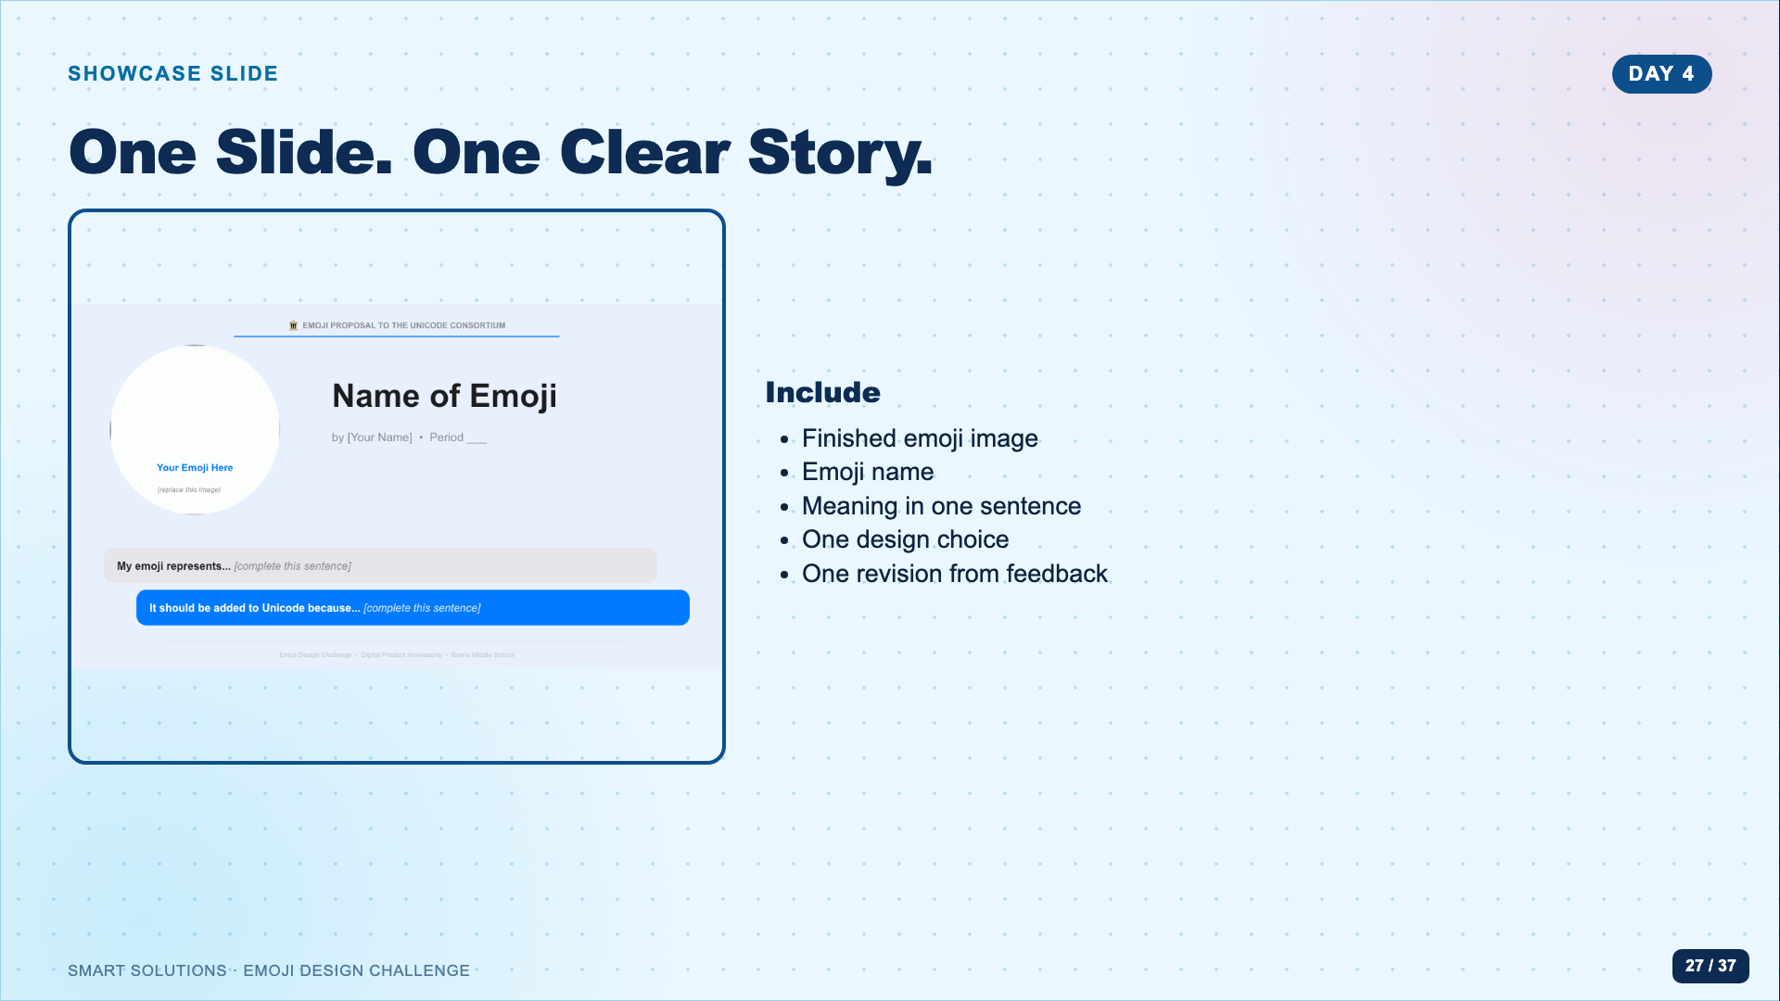
Notes:
Open the editable template from the Canvas hub. Students should not redesign the entire slide. The template creates comparable presentations and keeps attention on the emoji.
[Sources]
- Emoji showcase slide template and Silent Plea teacher model (Lucero classroom materials, 2026).
- Emoji Facilitator Guide (Lucero classroom materials, 2026).

Slide 28
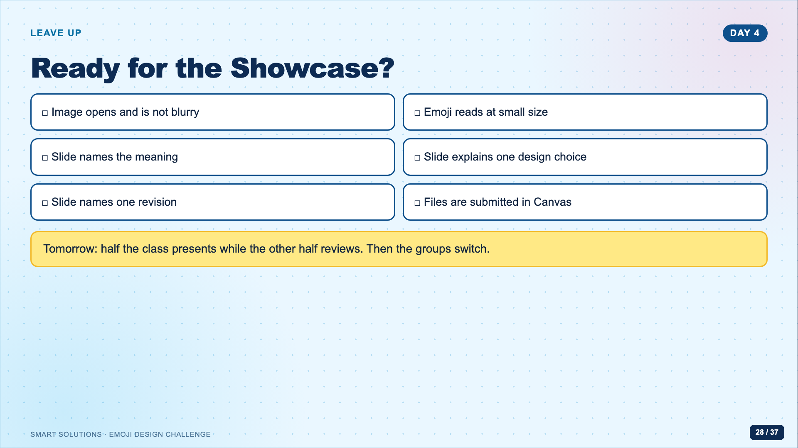
Notes:
Use this as the final Day 4 checkpoint. Confirm the class has a presentation order and enough peer-review copies before Day 5.
[Sources]
- Emoji Facilitator Guide (Lucero classroom materials, 2026).
- Emoji showcase slide template and Silent Plea teacher model (Lucero classroom materials, 2026).

Slide 29
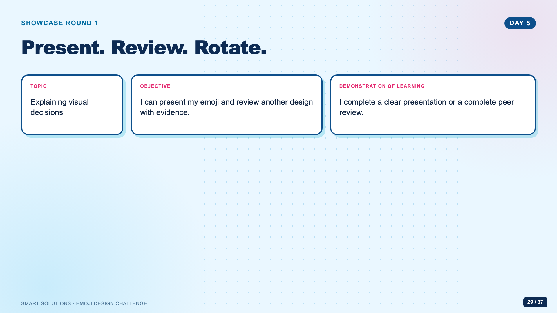
Notes:
Split the class into presenters and reviewers. Presenters remain at assigned stations; reviewers rotate. The next day they swap roles.
[Sources]
- Emoji Facilitator Guide (Lucero classroom materials, 2026).
- Emoji Peer Review Form (Lucero classroom materials, 2026).

Slide 30
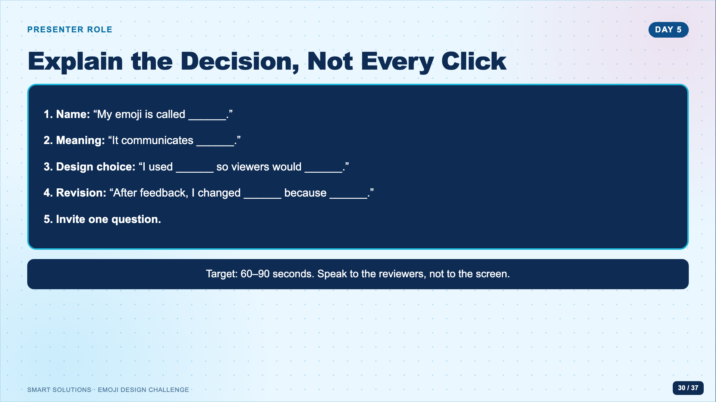
Notes:
Model a concise presentation with the teacher example. Do not let students narrate every Canva step. The presentation should focus on meaning, visual evidence, and revision.
[Sources]
- Emoji Facilitator Guide (Lucero classroom materials, 2026).
- Emoji showcase slide template and Silent Plea teacher model (Lucero classroom materials, 2026).

Slide 31
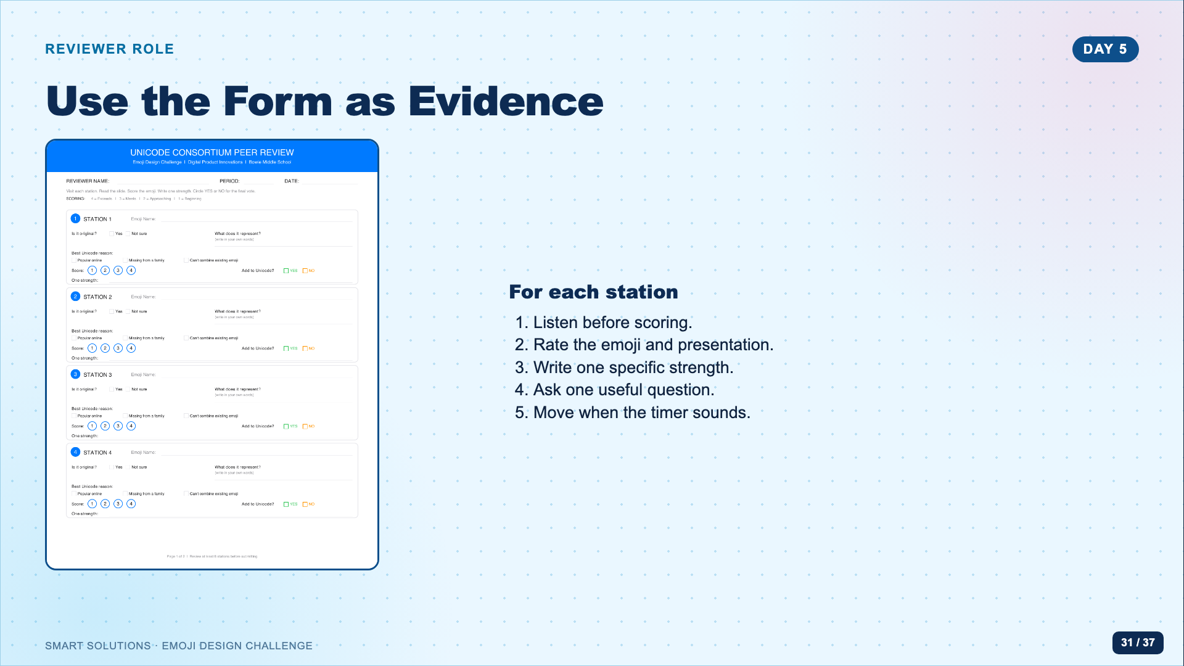
Notes:
Show reviewers where to record the emoji name, ratings, a strength, and a question. Require complete sentences only where the form asks for written feedback; speed should not erase specificity.
[Sources]
- Emoji Peer Review Form (Lucero classroom materials, 2026).
- Emoji Facilitator Guide (Lucero classroom materials, 2026).

Slide 32
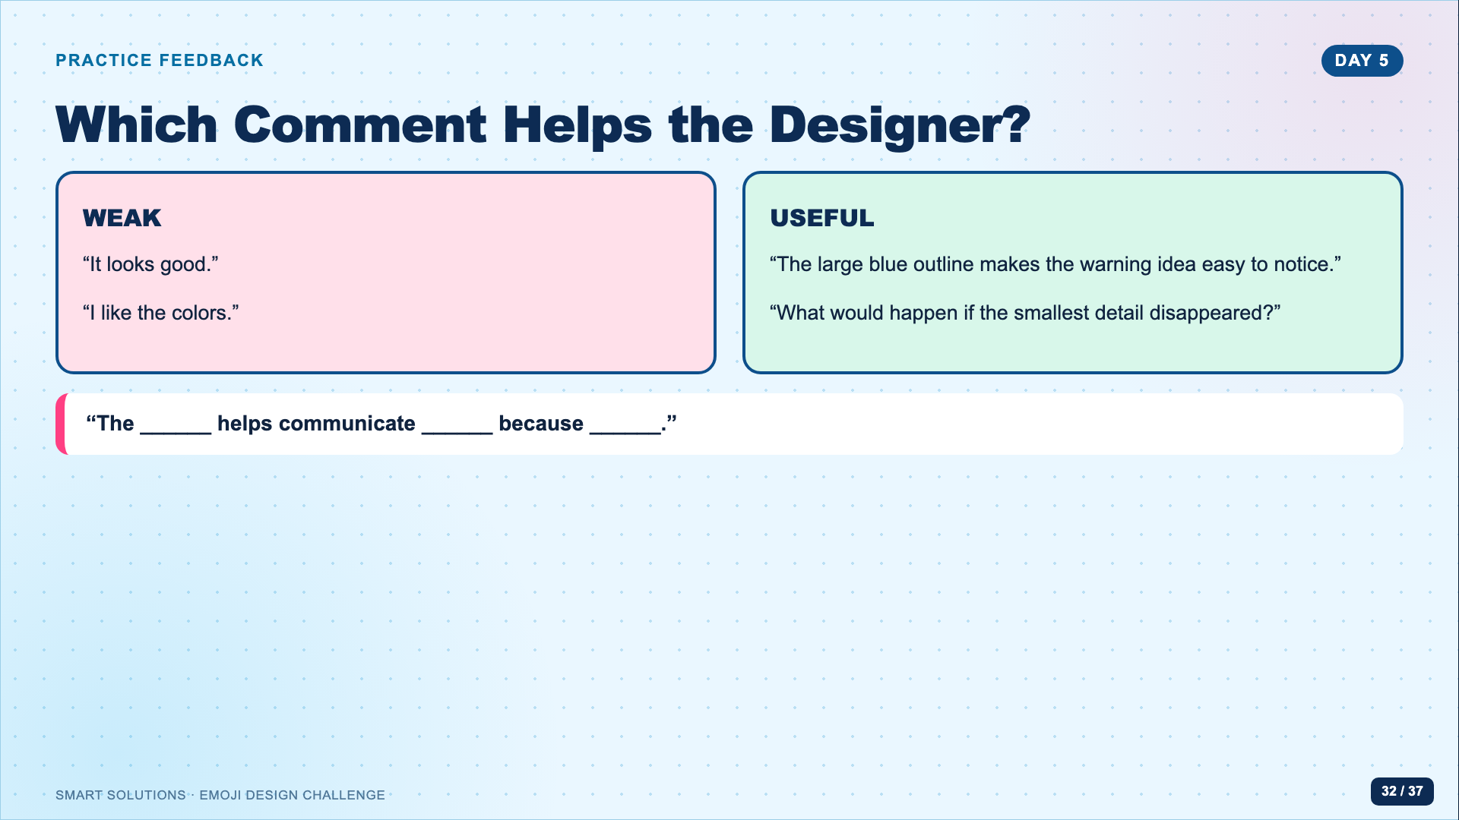
Notes:
Have students improve one weak comment aloud. Useful feedback names a visible feature and connects it to meaning.
[Sources]
- Emoji Peer Review Form (Lucero classroom materials, 2026).
- Emoji Facilitator Guide (Lucero classroom materials, 2026).

Slide 33
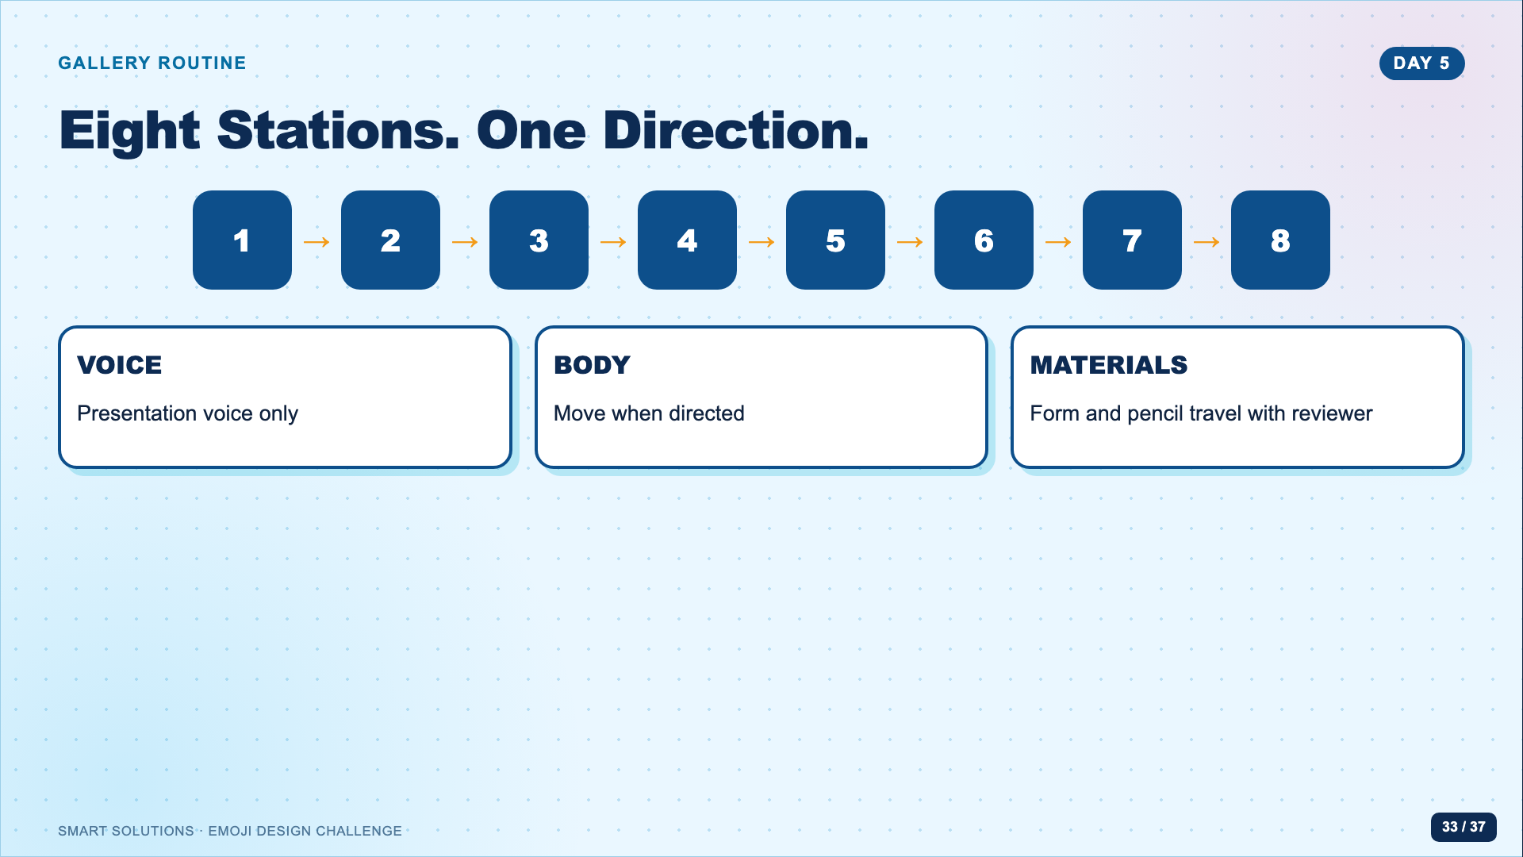
Notes:
Adjust the number of stations to class size. Announce the rotation direction and timer before anyone moves. Keep a spare station for absent presenters or a teacher model.
[Sources]
- Emoji Facilitator Guide (Lucero classroom materials, 2026).
- Emoji Peer Review Form (Lucero classroom materials, 2026).

Slide 34
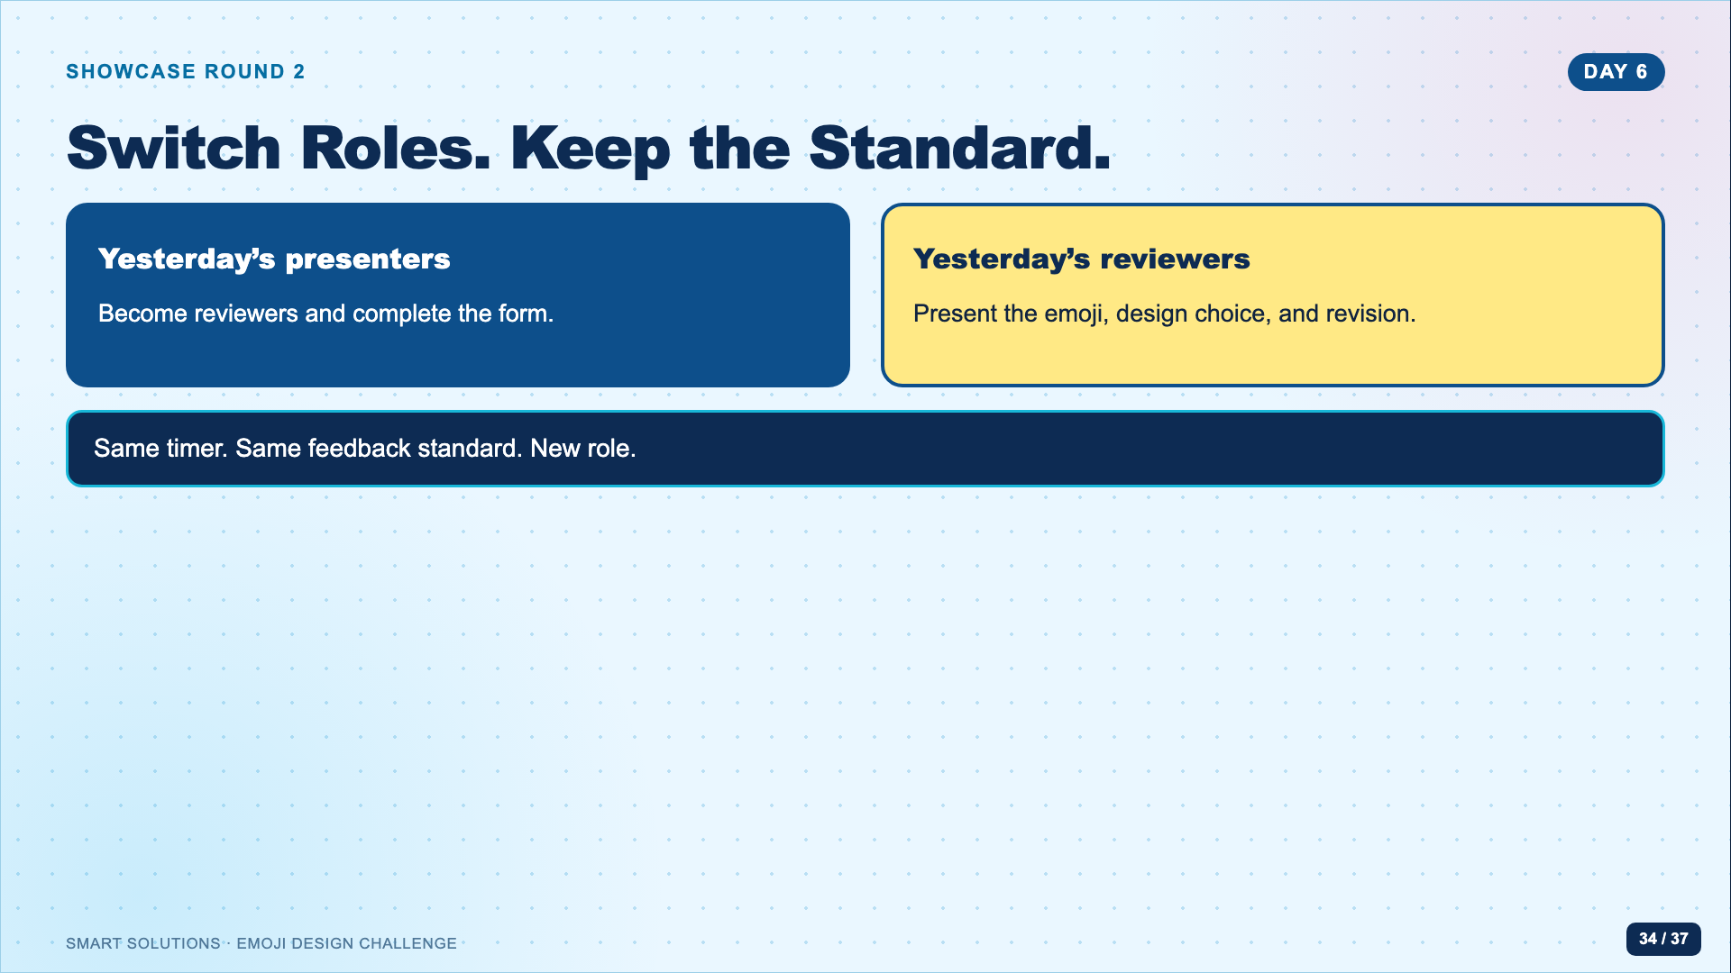
Notes:
Reset expectations instead of reteaching the full routine. Check that every student completes both roles across the two days.
[Sources]
- Emoji Facilitator Guide (Lucero classroom materials, 2026).
- Emoji Peer Review Form (Lucero classroom materials, 2026).

Slide 35
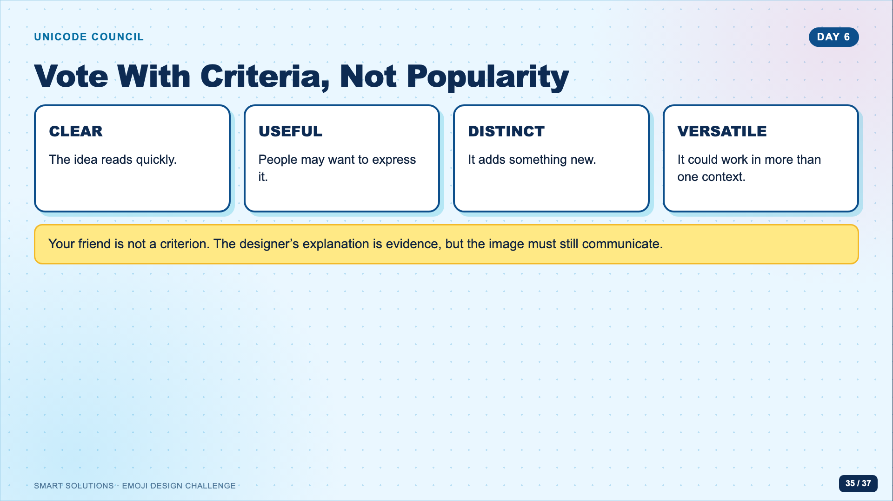
Notes:
Frame the class as a mock review council. Use the paper ballot or the established class voting routine. Avoid public ranking beyond the planned recognition categories.
[Sources]
- Unicode Consortium. “Submitting Emoji Proposals.” https://www.unicode.org/emoji/proposals.html (accessed 2026-08-16).
- Emoji Facilitator Guide (Lucero classroom materials, 2026).
- Emoji Peer Review Form (Lucero classroom materials, 2026).

Slide 36
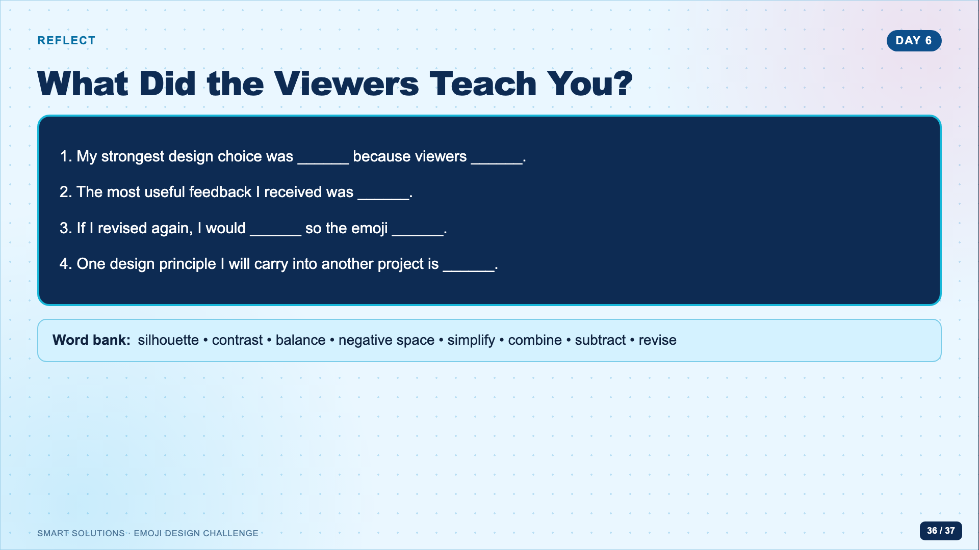
Notes:
Students complete the reflection after both showcase roles. Ask for evidence from a viewer response, not a general statement about effort.
[Sources]
- Emoji Facilitator Guide (Lucero classroom materials, 2026).
- Emoji Peer Review Form (Lucero classroom materials, 2026).

Slide 37
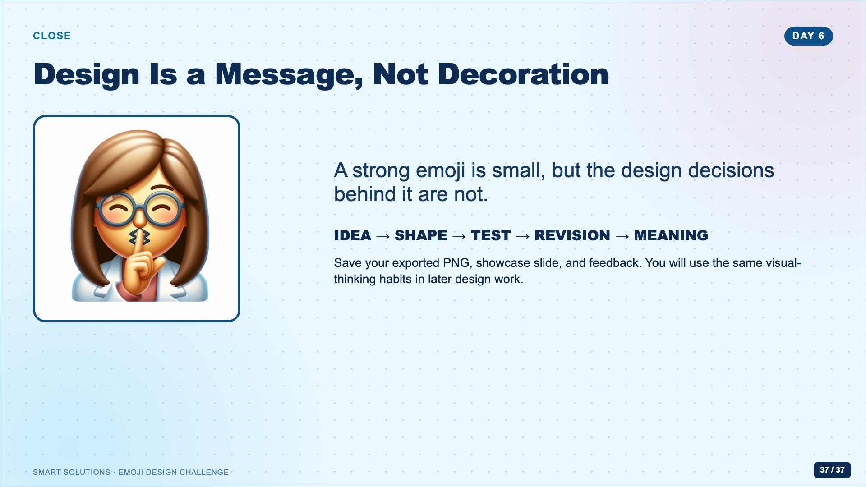
Notes:
Close by naming the transferable learning: designing under constraints, testing with viewers, and revising a visual system. Collect all required Canvas evidence before dismissing.
[Sources]
- Emoji showcase slide template and Silent Plea teacher model (Lucero classroom materials, 2026).
- Emoji Facilitator Guide (Lucero classroom materials, 2026).

