Slide 1
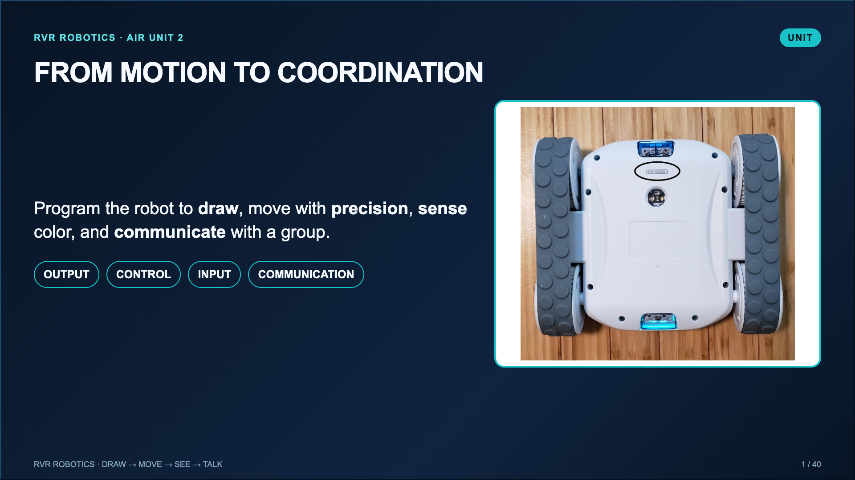
Notes:
Frame the week as one systems progression. Students are not completing disconnected robot tricks. Each lesson adds one capability that the final coordinated challenge needs.
[Sources]
- Lucero classroom lesson, Drawing with RVR Pictionary (2025).

Slide 2
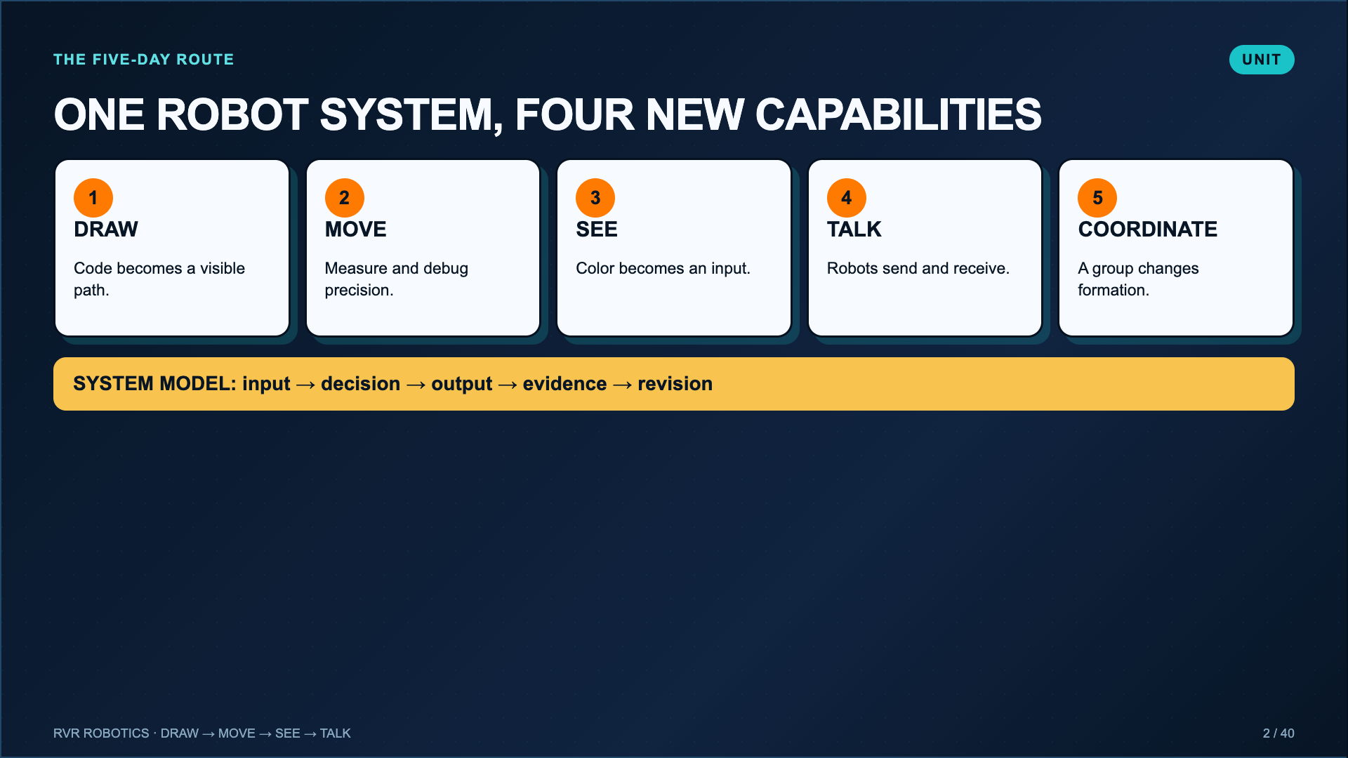
Notes:
Preview the cumulative arc. Drawing, Movement, Seeing, and Talking each build one robot capability. Day 5 gives students time to complete and improve the school-of-fish challenge.
[Sources]
- Lucero classroom lesson, Drawing with RVR Pictionary (2025).
- Lucero classroom evidence worksheet for Sphero RVR+ Blocks 1: Movement (2025).
- Lucero classroom evidence worksheet for The a“MAZE”ing RVR Color Sensor (2025).
- Lucero classroom lesson, Talking with RVR and School-of-Fish Challenge (2025).

Slide 3
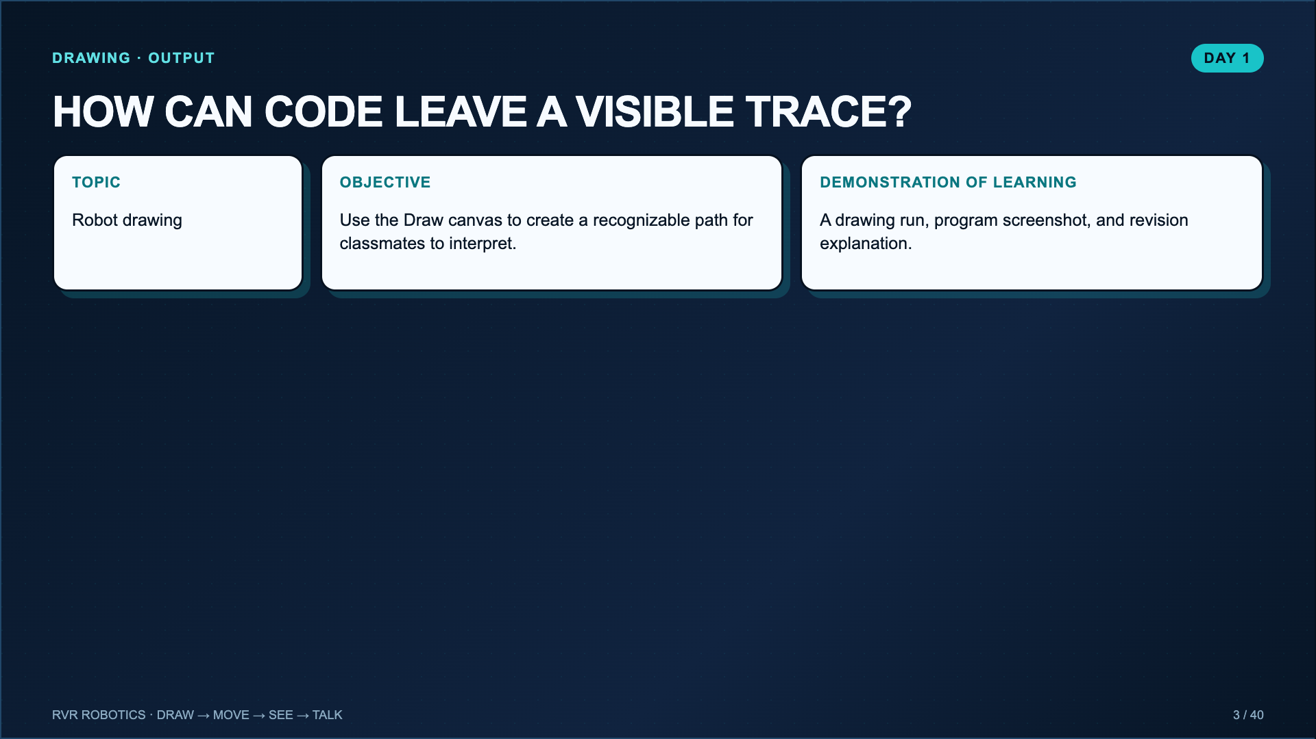
Notes:
Read the objective and evidence. The robot drawing is a debugging artifact: every mistake stays visible on the paper.
[Sources]
- Lucero classroom lesson, Drawing with RVR Pictionary (2025).
- Sphero Edu Activity, Introduction to Sphero Edu: https://edu.sphero.com/cwists/preview/52597

Slide 4
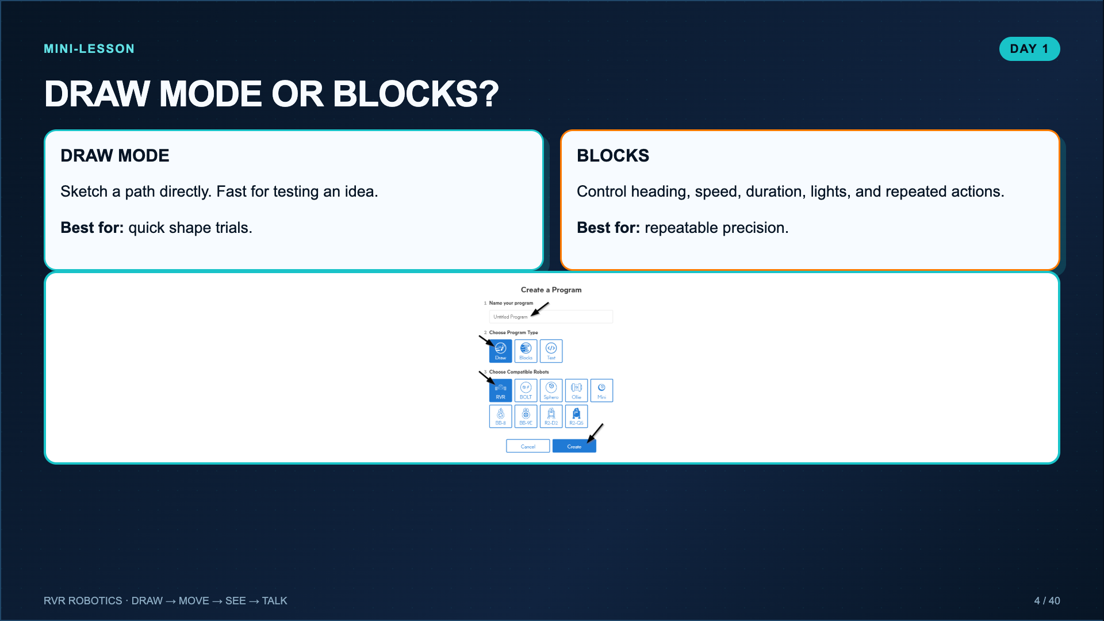
Notes:
Model both program types. Draw mode is not lesser. It answers a different question. Blocks become useful when students need the robot to repeat a specific result.
[Sources]
- Lucero classroom lesson, Drawing with RVR Pictionary (2025).
- Sphero Support, Getting Started with RVR: https://help.sphero.com/sphero-support/getting-started-with-rvr

Slide 5
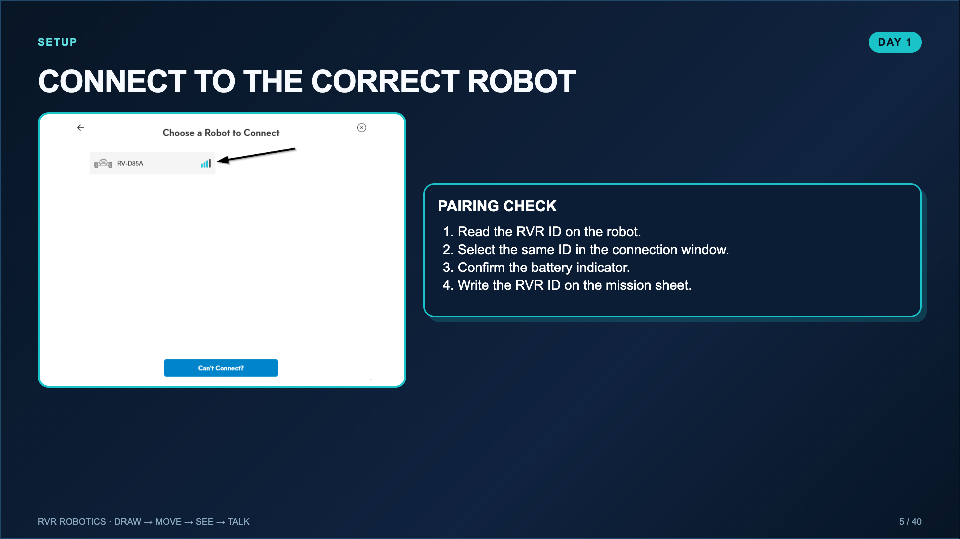
Notes:
Teach robot IDs as part of the routine. This prevents groups from driving one another’s robots and supports a clean station rotation.
[Sources]
- Lucero classroom lesson, Drawing with RVR Pictionary (2025).
- Sphero Support, Connecting Robots in the Sphero Edu Web App: https://help.sphero.com/sphero-support/connecting-robots-in-the-sphero-edu-web-app

Slide 6
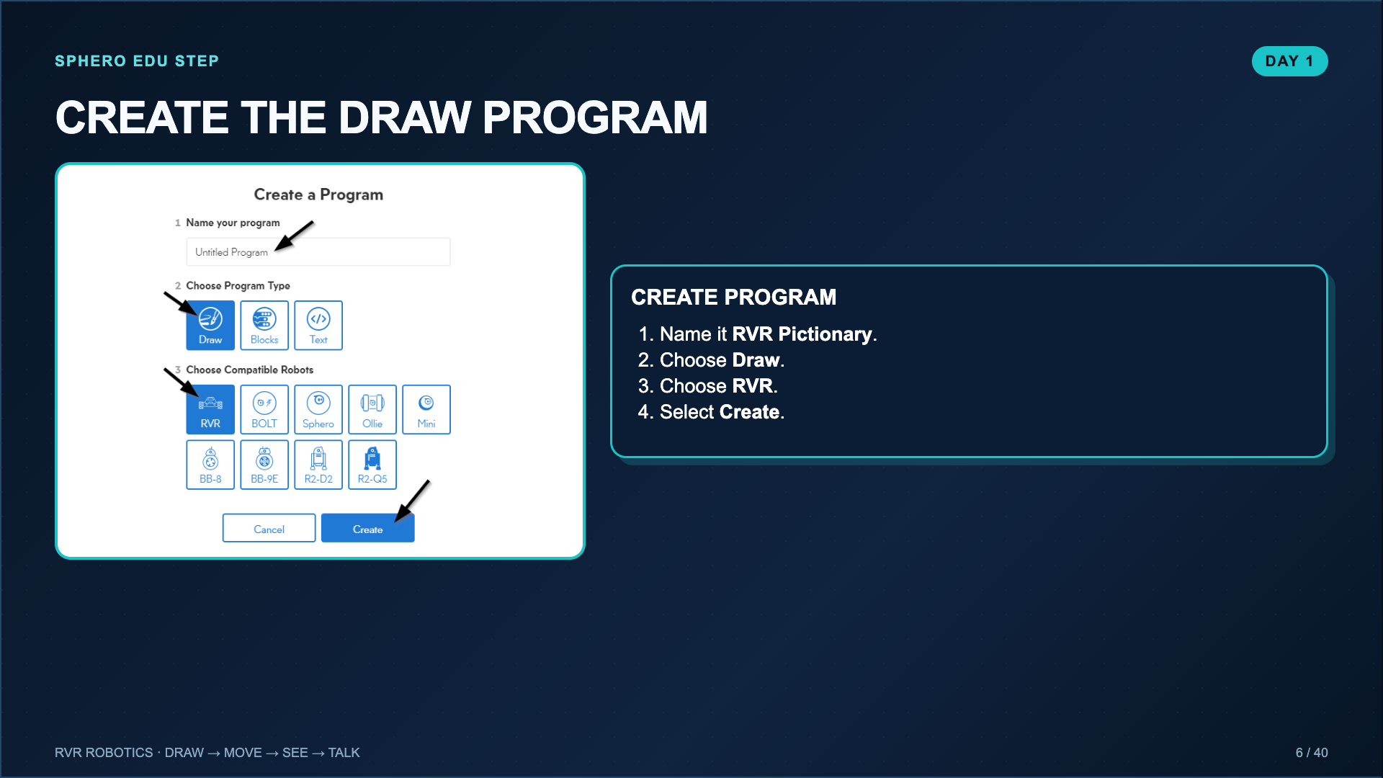
Notes:
This mirrors the official Sphero Edu create-program workflow. Pause until every group has the correct program type and robot selected.
[Sources]
- Lucero classroom lesson, Drawing with RVR Pictionary (2025).
- Sphero Edu Activity, Introduction to Sphero Edu: https://edu.sphero.com/cwists/preview/52597

Slide 7
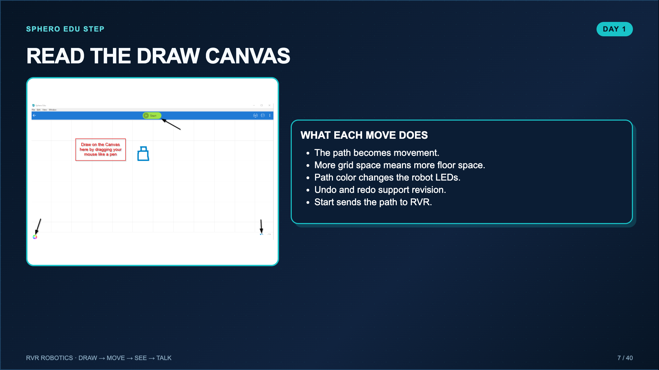
Notes:
Model one tiny shape before students begin. The Lucero worksheet estimates that even a small drawing can need about 20 by 24 inches of clear floor space.
[Sources]
- Lucero classroom lesson, Drawing with RVR Pictionary (2025).
- Sphero Edu Activity, Introduction to Sphero Edu: https://edu.sphero.com/cwists/preview/52597

Slide 8
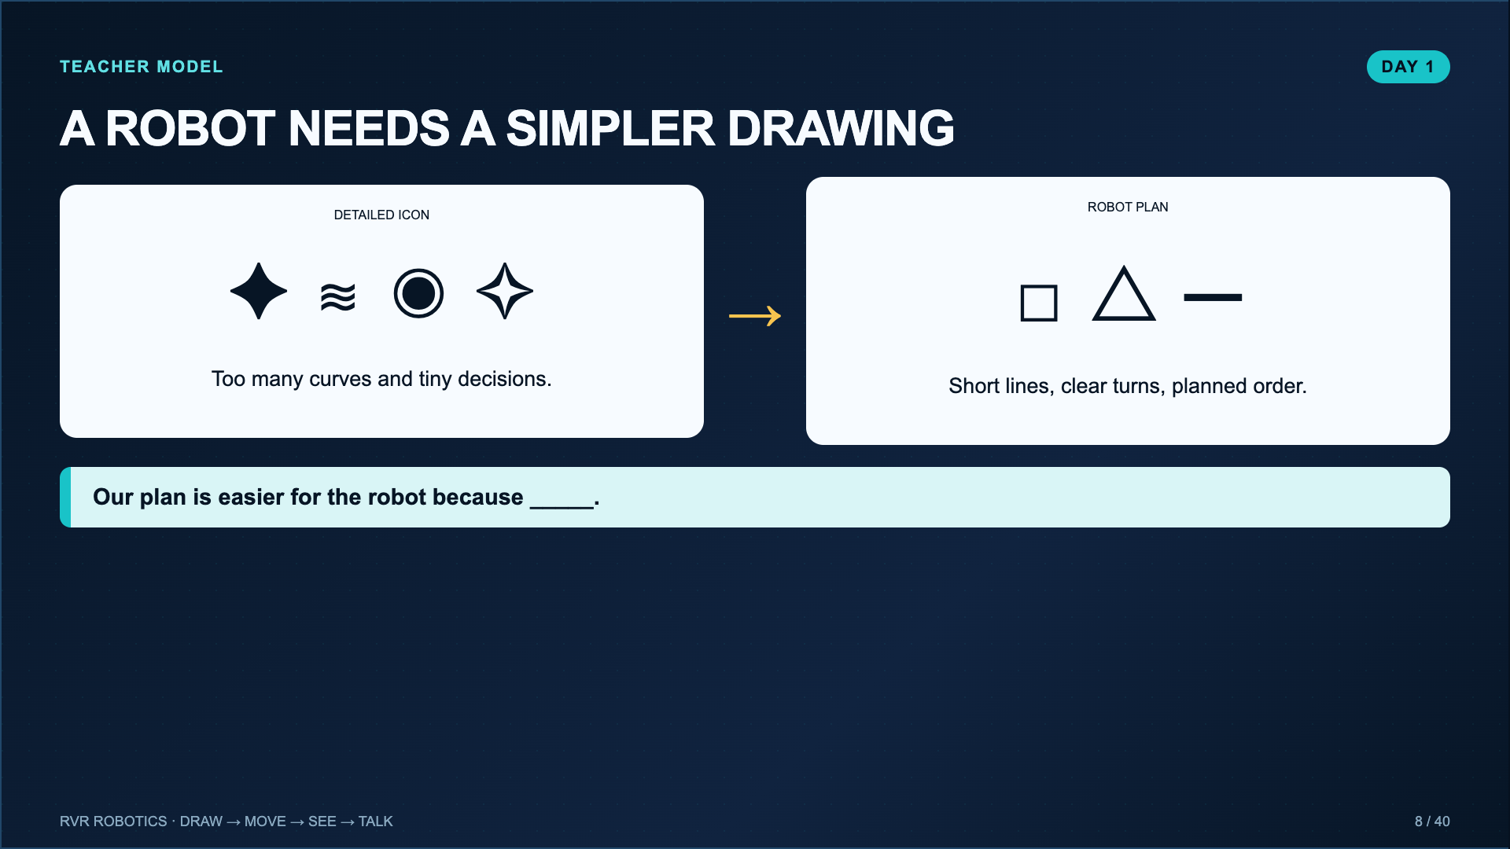
Notes:
Model simplifying one vocabulary word or symbol. Preserve the Pictionary energy: students should still have a real word for classmates to guess.
[Sources]
- Lucero classroom lesson, Drawing with RVR Pictionary (2025).

Slide 9
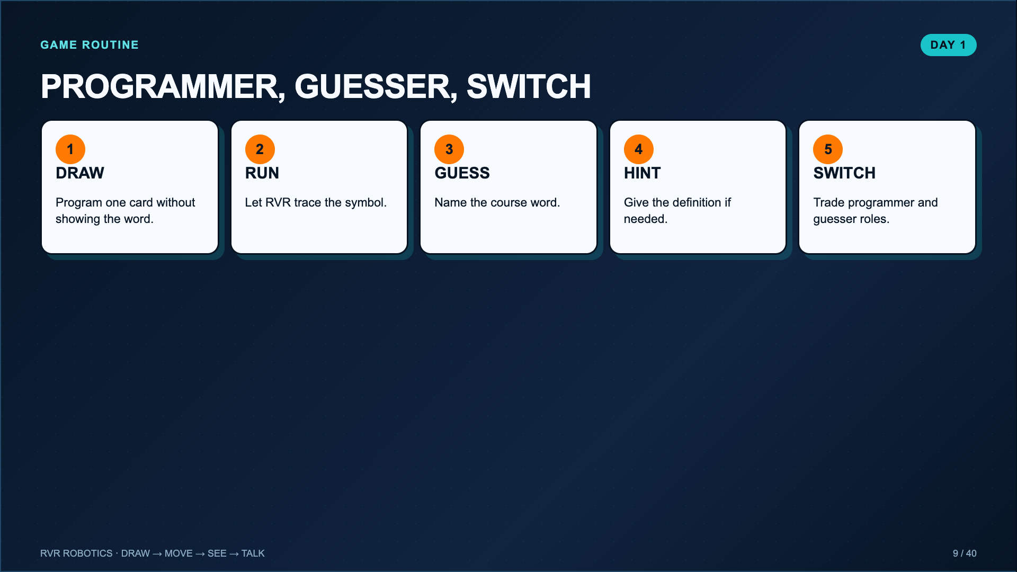
Notes:
Use Programmer, Guesser, Switch to keep every student active. The mission sheet records the strongest run and revision without turning every round into paperwork.
[Sources]
- Lucero classroom lesson, Drawing with RVR Pictionary (2025).

Slide 10
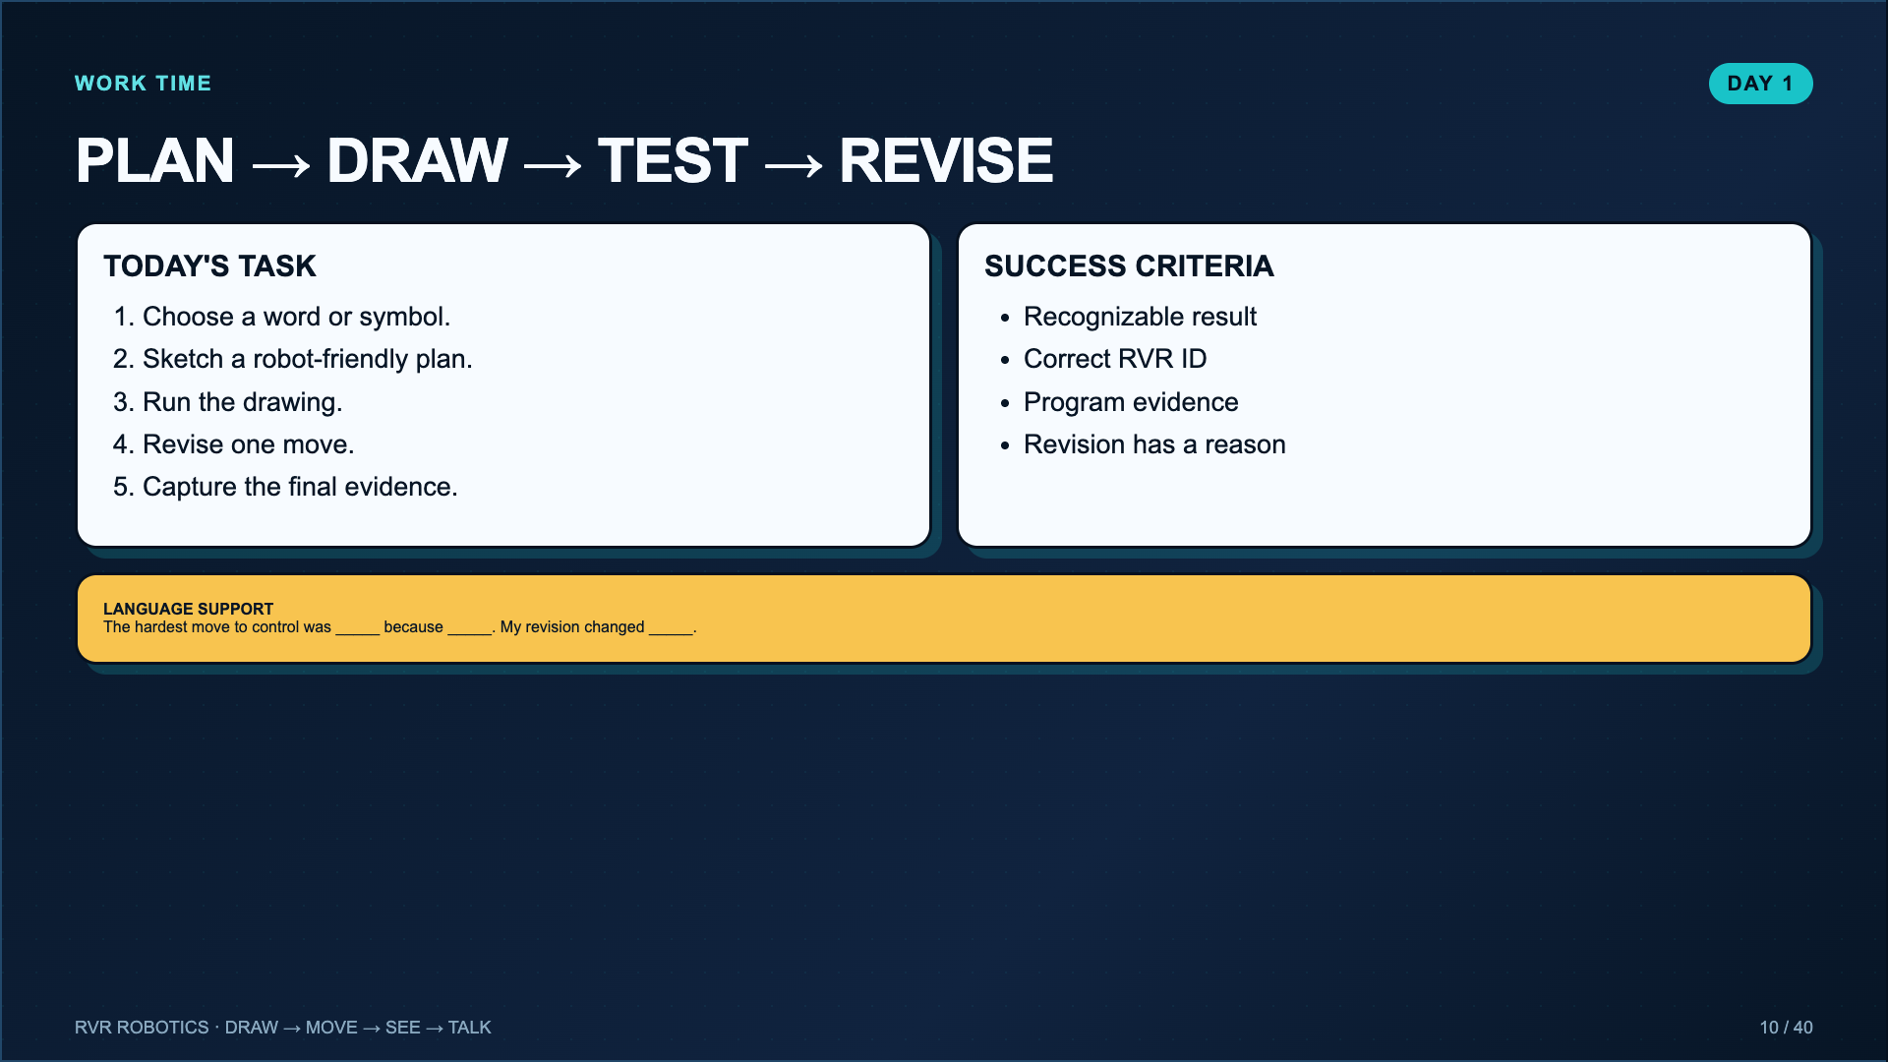
Notes:
Leave this slide projected. Require groups to clear the paper and marker before every run. Stop a group from adding complexity until the simple version works.
[Sources]
- Lucero classroom lesson, Drawing with RVR Pictionary (2025).

Slide 11
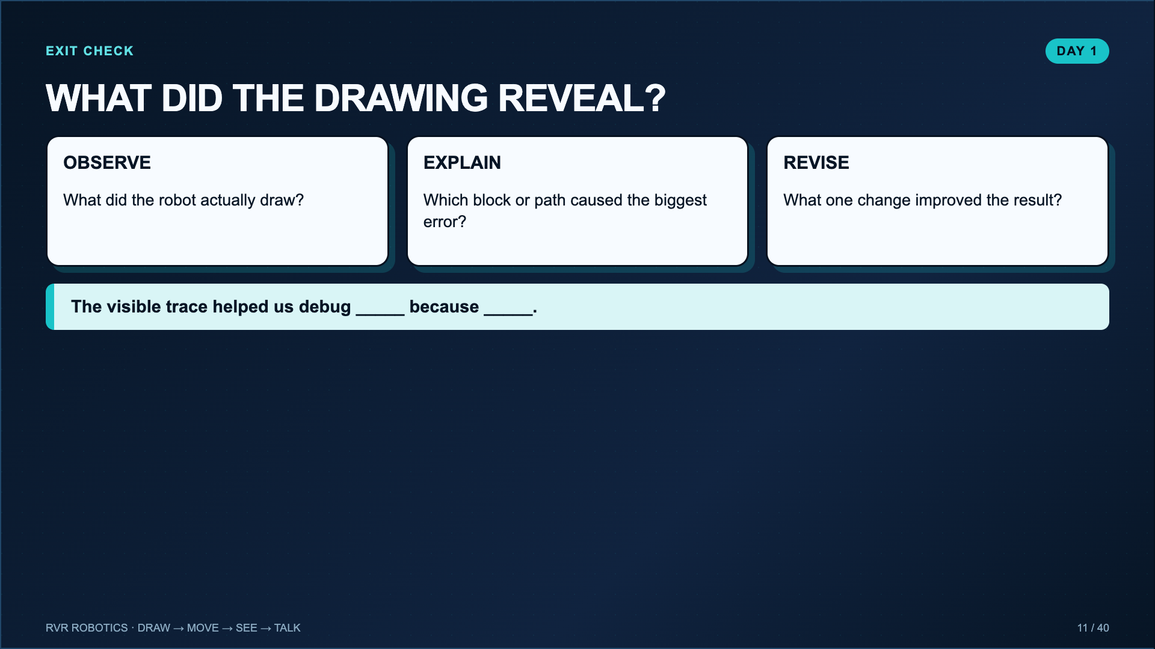
Notes:
Use a short share. Ask one group to show a failed drawing beside the revised drawing so students see that evidence of failure is useful.
[Sources]
- Lucero classroom lesson, Drawing with RVR Pictionary (2025).

Slide 12
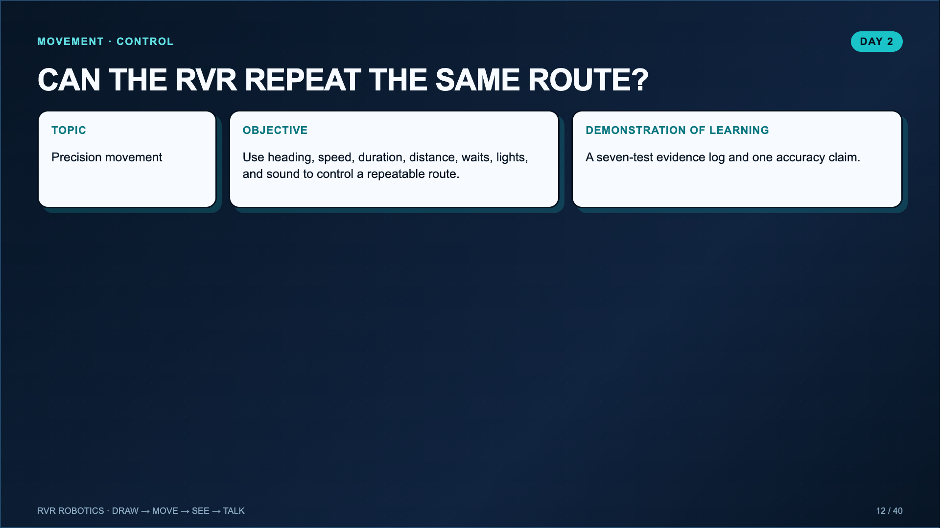
Notes:
Connect back to Day 1. Today the path matters even when there is no marker. Precision means the result is close enough and repeatable for the task.
[Sources]
- Lucero classroom evidence worksheet for Sphero RVR+ Blocks 1: Movement (2025).

Slide 13
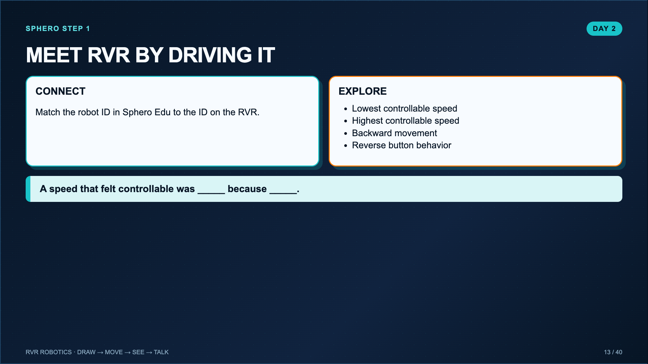
Notes:
Give a brief exploration window and hold students to the four questions. This preserves the useful play in Sphero step 1 without allowing a full class period of free driving.
[Sources]
- Sphero Edu Activity, RVR+ Blocks 1: Movement: https://edu.sphero.com/cwists/preview/67572
- Sphero Support, Connecting Robots in the Sphero Edu Web App: https://help.sphero.com/sphero-support/connecting-robots-in-the-sphero-edu-web-app

Slide 14
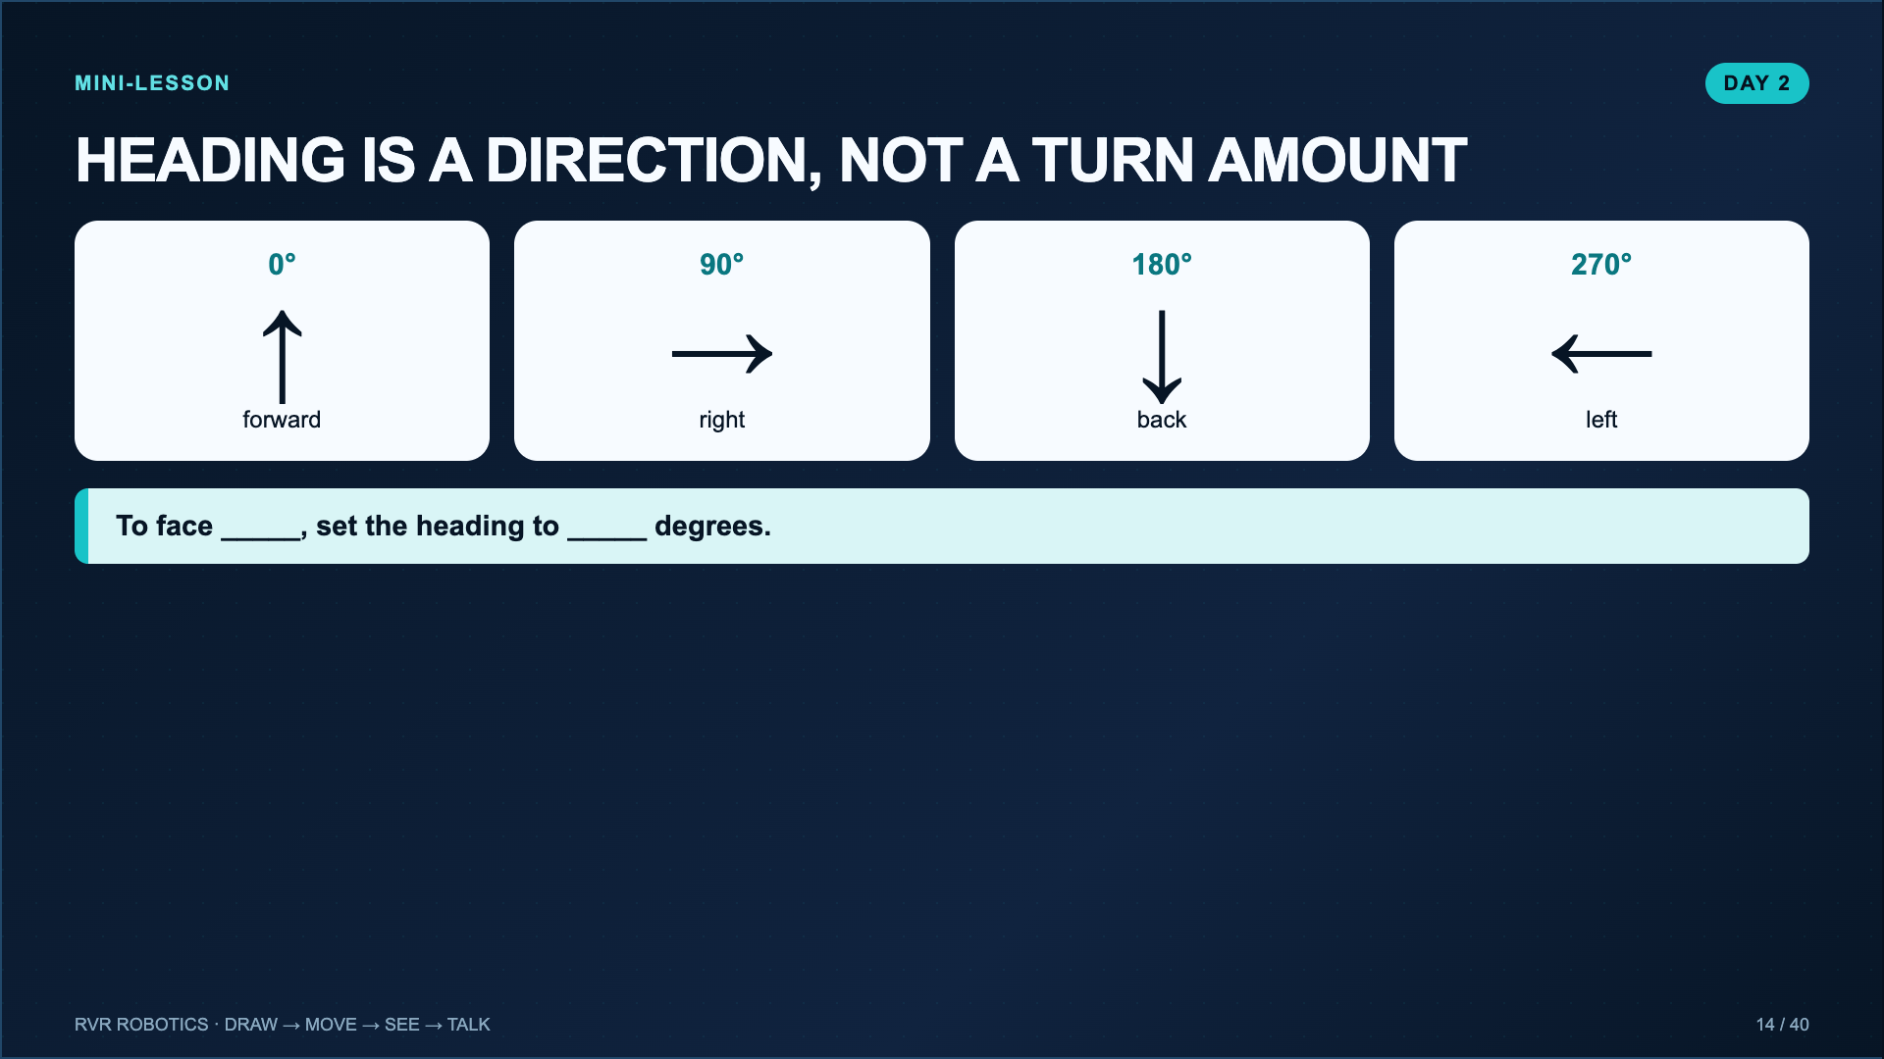
Notes:
Stand facing the same direction as the robot and physically point through the headings. Clarify that a 90-degree heading means face right relative to the start orientation.
[Sources]
- Lucero classroom evidence worksheet for Sphero RVR+ Blocks 1: Movement (2025).

Slide 15
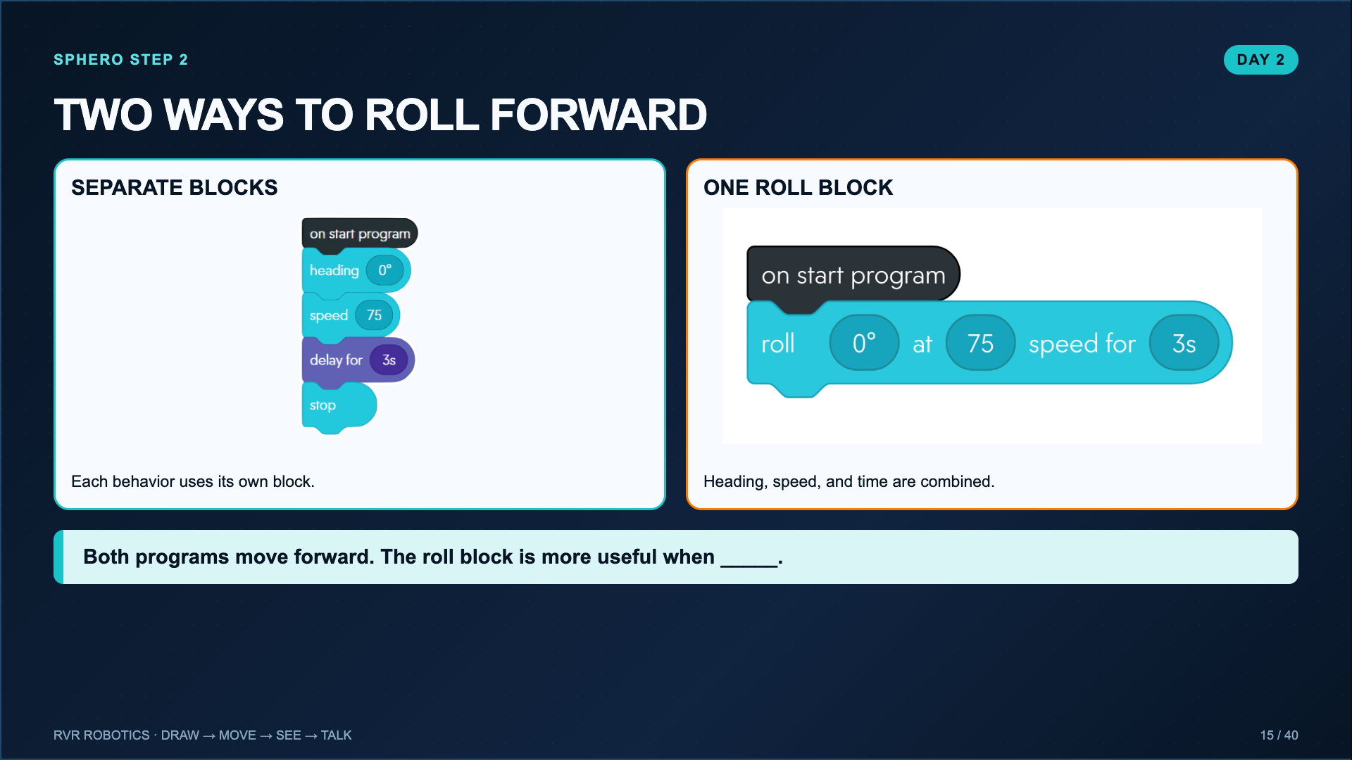
Notes:
Build and run both versions, exactly as Sphero step 2 does. Students need to see that the same behavior can be represented with different block structures.
[Sources]
- Sphero Edu Activity, RVR+ Blocks 1: Movement: https://edu.sphero.com/cwists/preview/67572

Slide 16
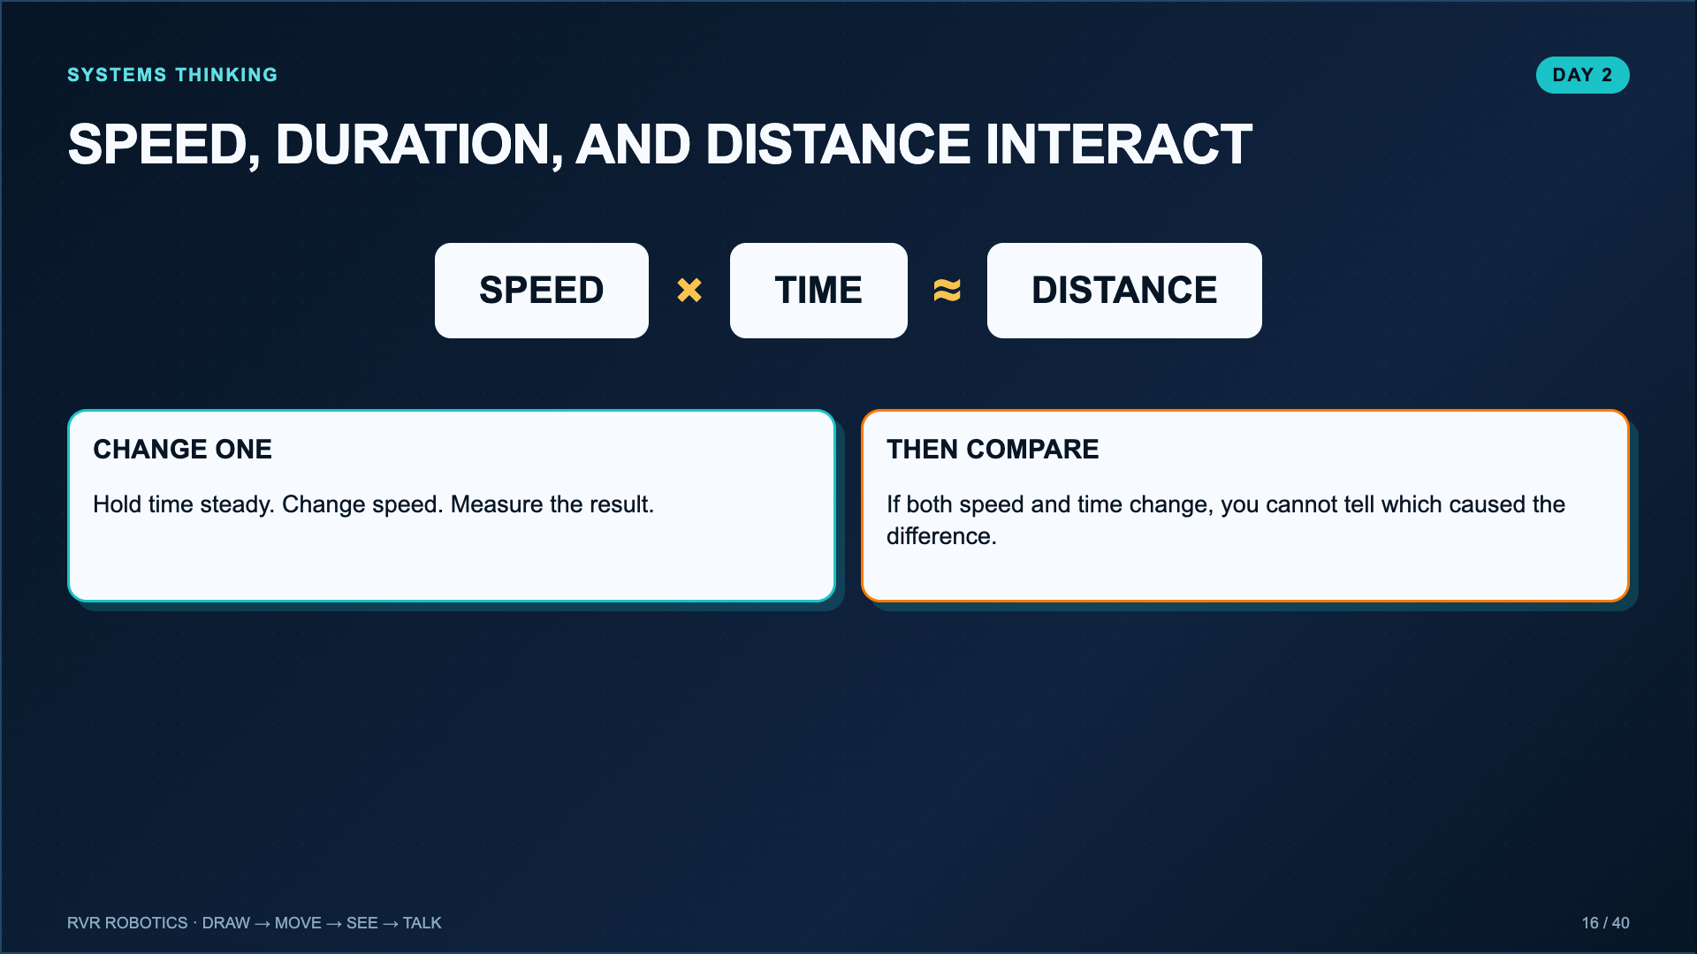
Notes:
Use approximate language because wheel slip, battery level, surface friction, and start orientation affect the result. This is a controlled test, not a physics formula proof.
[Sources]
- Lucero classroom evidence worksheet for Sphero RVR+ Blocks 1: Movement (2025).

Slide 17
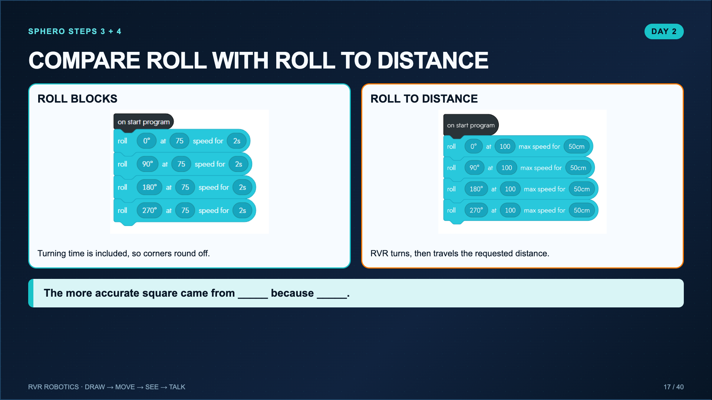
Notes:
Run the roll-block square first. Students should observe the rounded path before replacing it with four roll-to-distance blocks. The contrast is the lesson.
[Sources]
- Sphero Edu Activity, RVR+ Blocks 1: Movement: https://edu.sphero.com/cwists/preview/67572

Slide 18
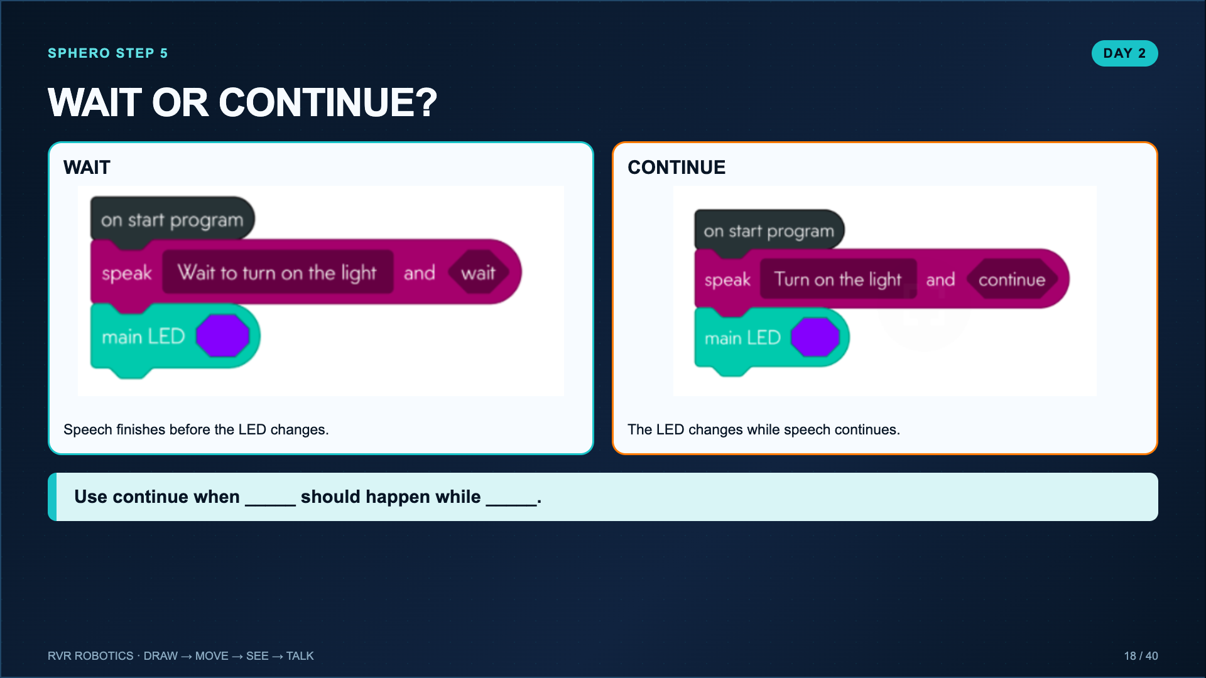
Notes:
Demonstrate the exact Sphero step: a speak block followed by main LED. Change only the speak setting from wait to continue and ask students to describe the evidence.
[Sources]
- Sphero Edu Activity, RVR+ Blocks 1: Movement: https://edu.sphero.com/cwists/preview/67572

Slide 19
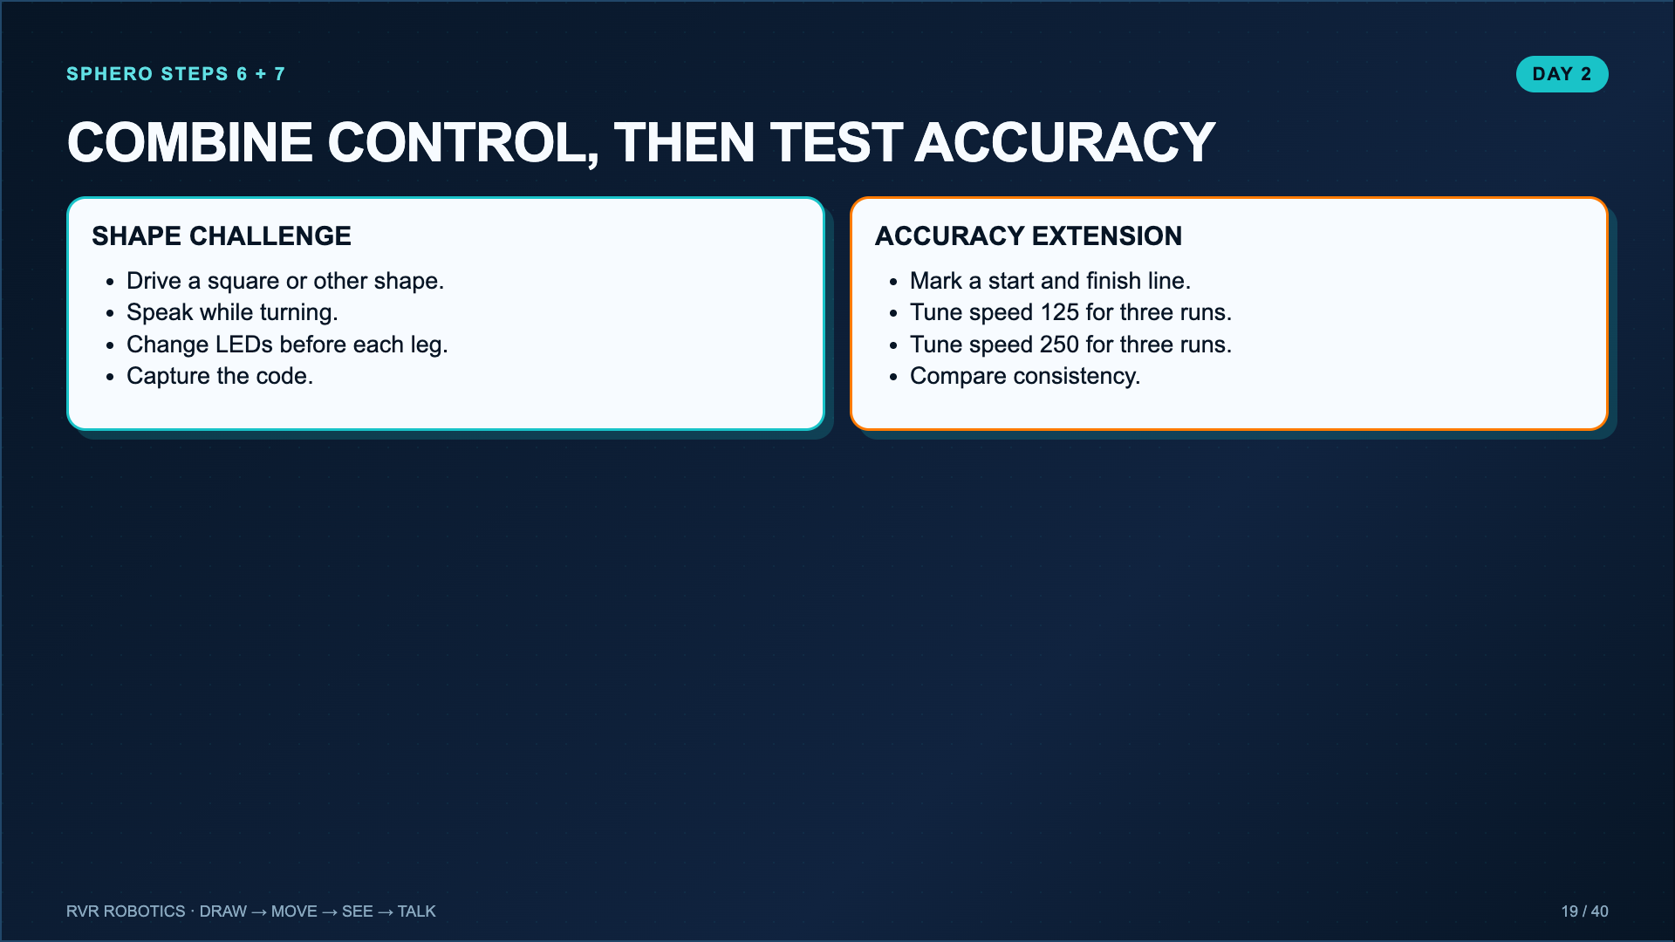
Notes:
The evidence sheet follows all seven Sphero steps. If time is short, complete the shape challenge and use the speed-versus-accuracy test as the extension.
[Sources]
- Sphero Edu Activity, RVR+ Blocks 1: Movement: https://edu.sphero.com/cwists/preview/67572
- Lucero classroom evidence worksheet for Sphero RVR+ Blocks 1: Movement (2025).

Slide 20
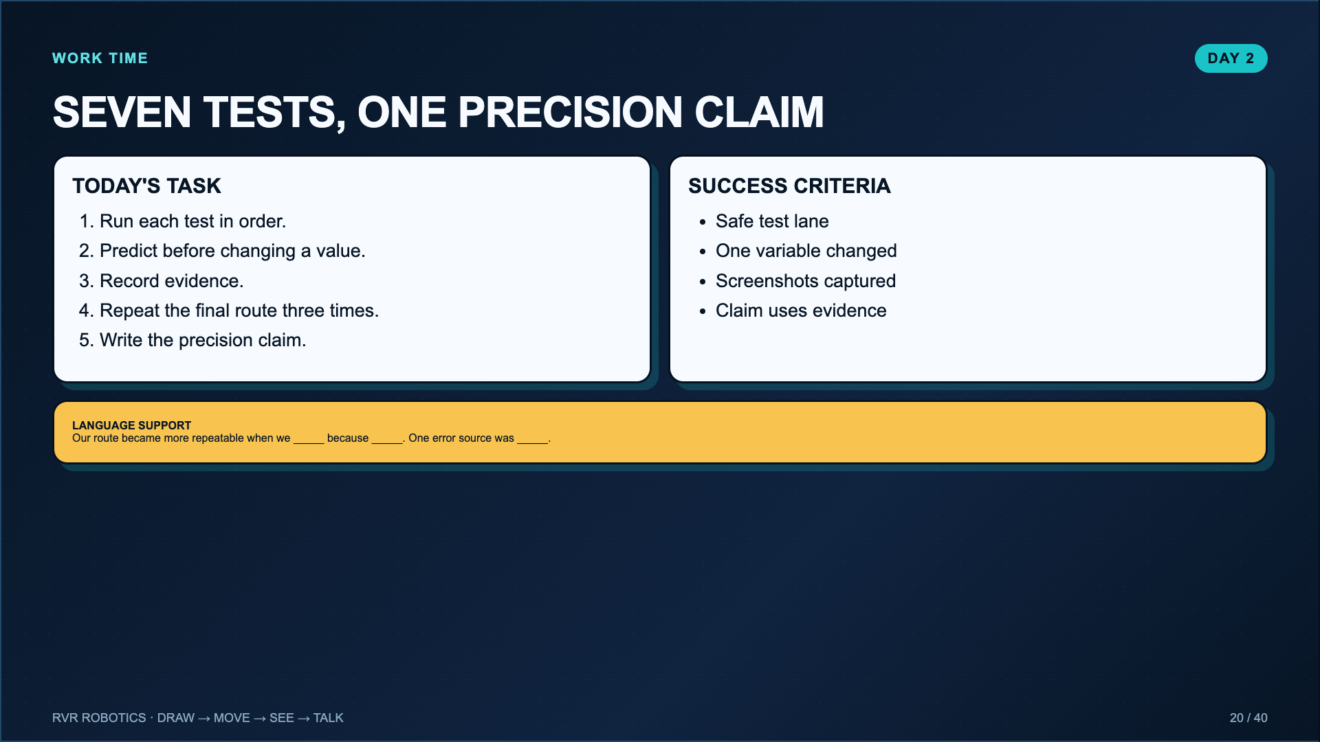
Notes:
Leave projected. The teacher may assign the Sphero Edu activity through a class code, but the tests in the worksheet and slides are sufficient when no class code is available.
[Sources]
- Lucero classroom evidence worksheet for Sphero RVR+ Blocks 1: Movement (2025).

Slide 21
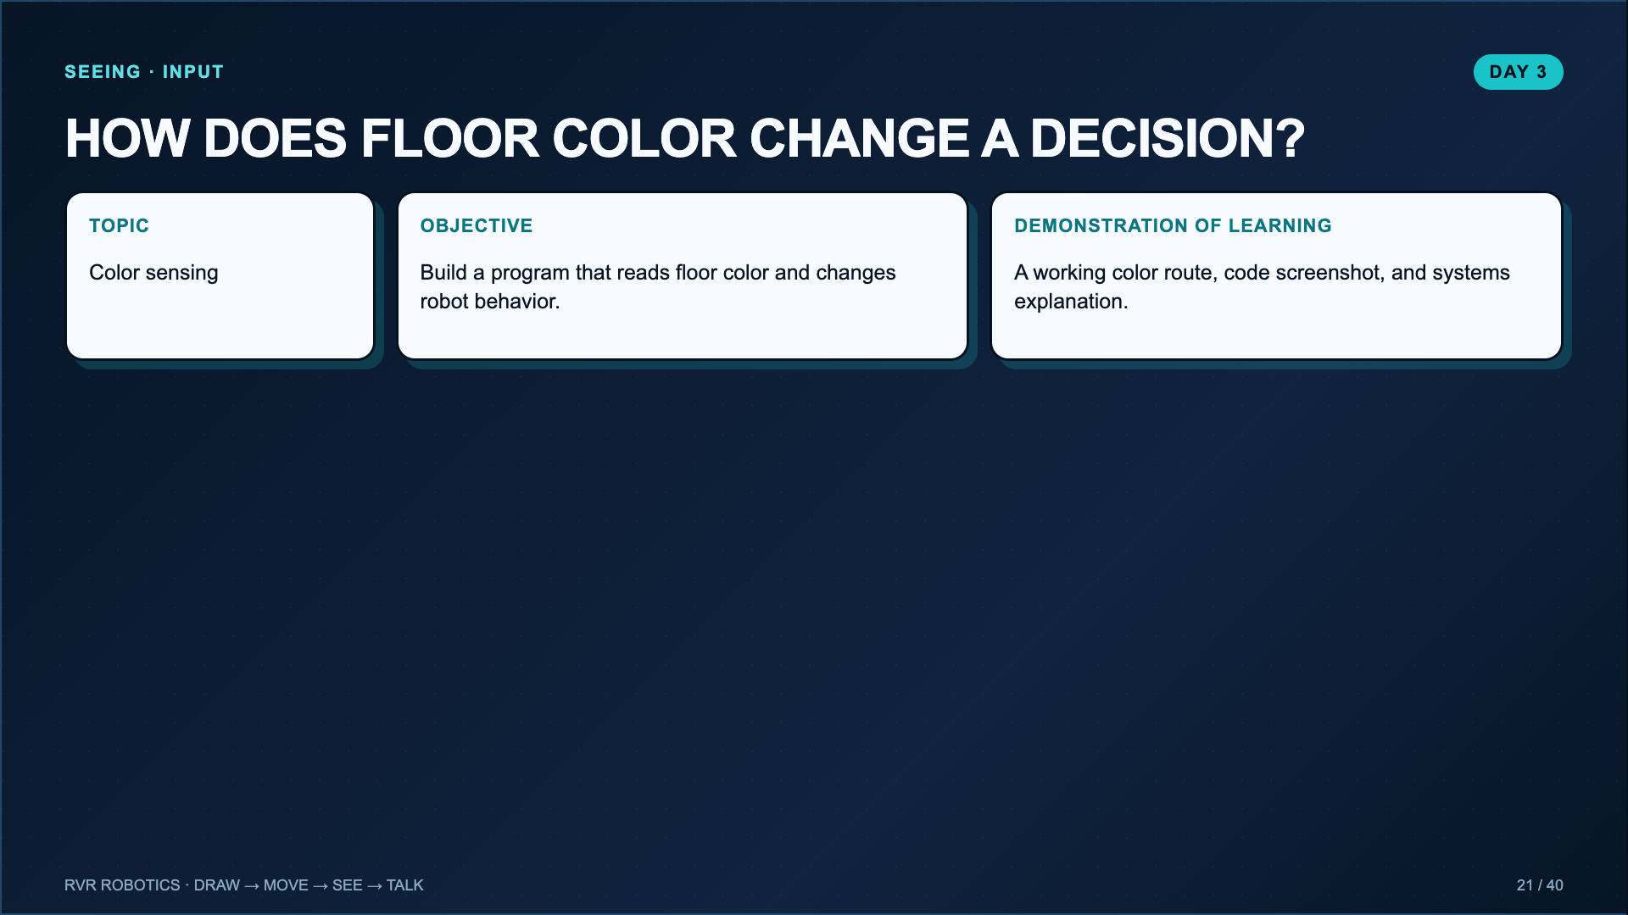
Notes:
Introduce this as the first explicit input lesson. Movement blocks gave commands. The color sensor gives the program information from the environment.
[Sources]
- Lucero classroom evidence worksheet for The a“MAZE”ing RVR Color Sensor (2025).
- Sphero Support, RVR and RVR+ Replacement Color Cards: https://help.sphero.com/sphero-support/rvr-and-rvr-replacement-color-cards

Slide 22
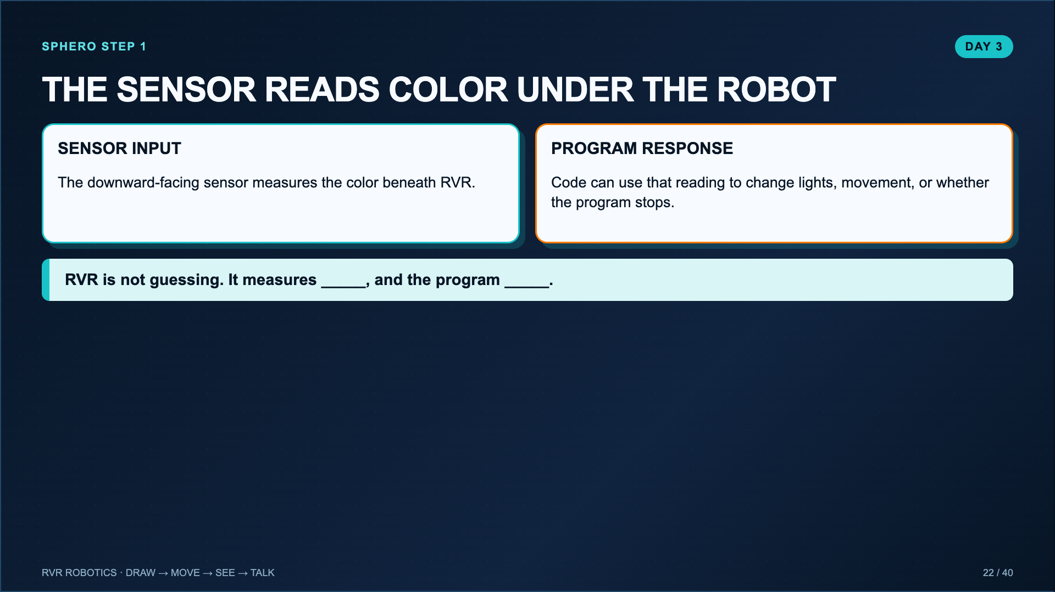
Notes:
Use the Sphero activity video or the Lucero color-sensor video. Point to the physical sensor before students build the route.
[Sources]
- Sphero Edu Activity, The a“MAZE”ing RVR Color Sensor: https://edu.sphero.com/cwists/preview/39616x
- Lucero classroom evidence worksheet for The a“MAZE”ing RVR Color Sensor (2025).

Slide 23
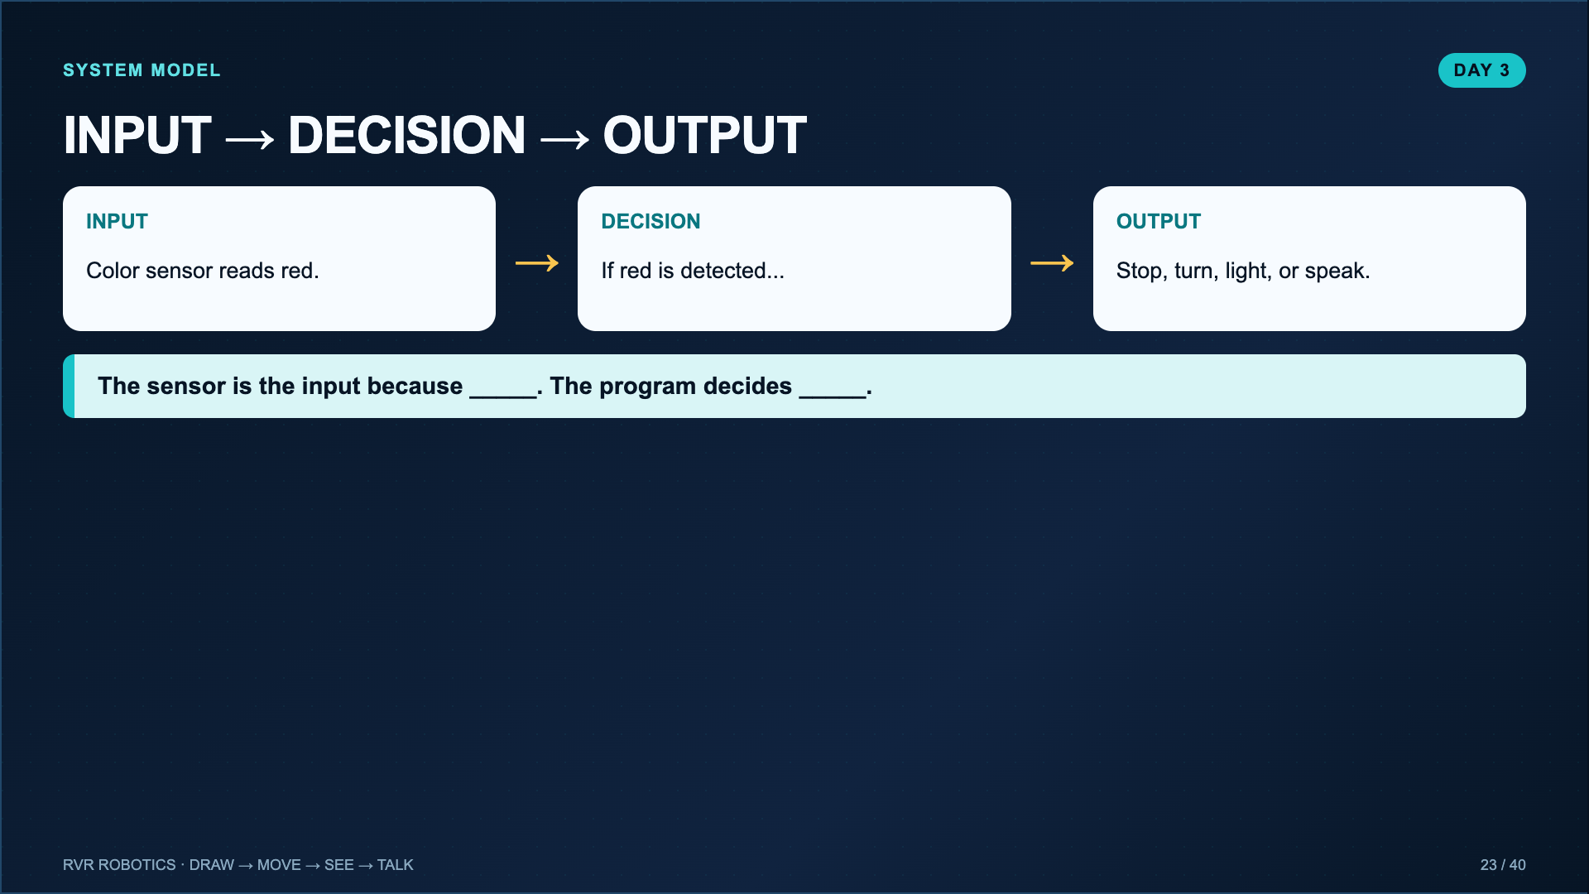
Notes:
Have students point to the physical sensor underneath the RVR. Avoid saying the robot “knows” a color. It reads a sensor value and the code compares that value to a condition.
[Sources]
- Lucero classroom evidence worksheet for The a“MAZE”ing RVR Color Sensor (2025).
- Sphero Support, RVR and RVR+ Replacement Color Cards: https://help.sphero.com/sphero-support/rvr-and-rvr-replacement-color-cards

Slide 24
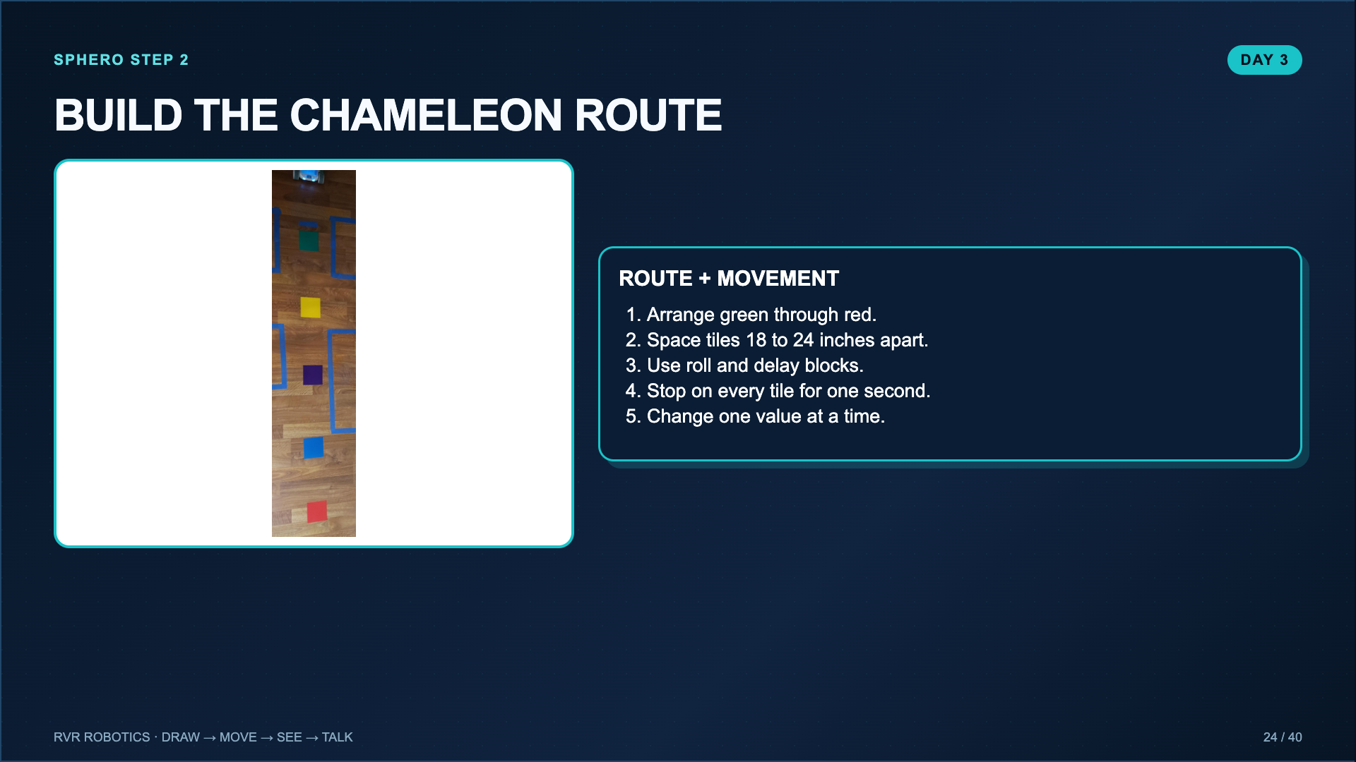
Notes:
The Sphero lesson starts with movement before programming the sensor. This isolates the route and timing problem. Tape every tile flat.
[Sources]
- Lucero classroom evidence worksheet for The a“MAZE”ing RVR Color Sensor (2025).
- Sphero Support, RVR and RVR+ Replacement Color Cards: https://help.sphero.com/sphero-support/rvr-and-rvr-replacement-color-cards
- Sphero Edu Activity, The a“MAZE”ing RVR Color Sensor: https://edu.sphero.com/cwists/preview/39616x

Slide 25
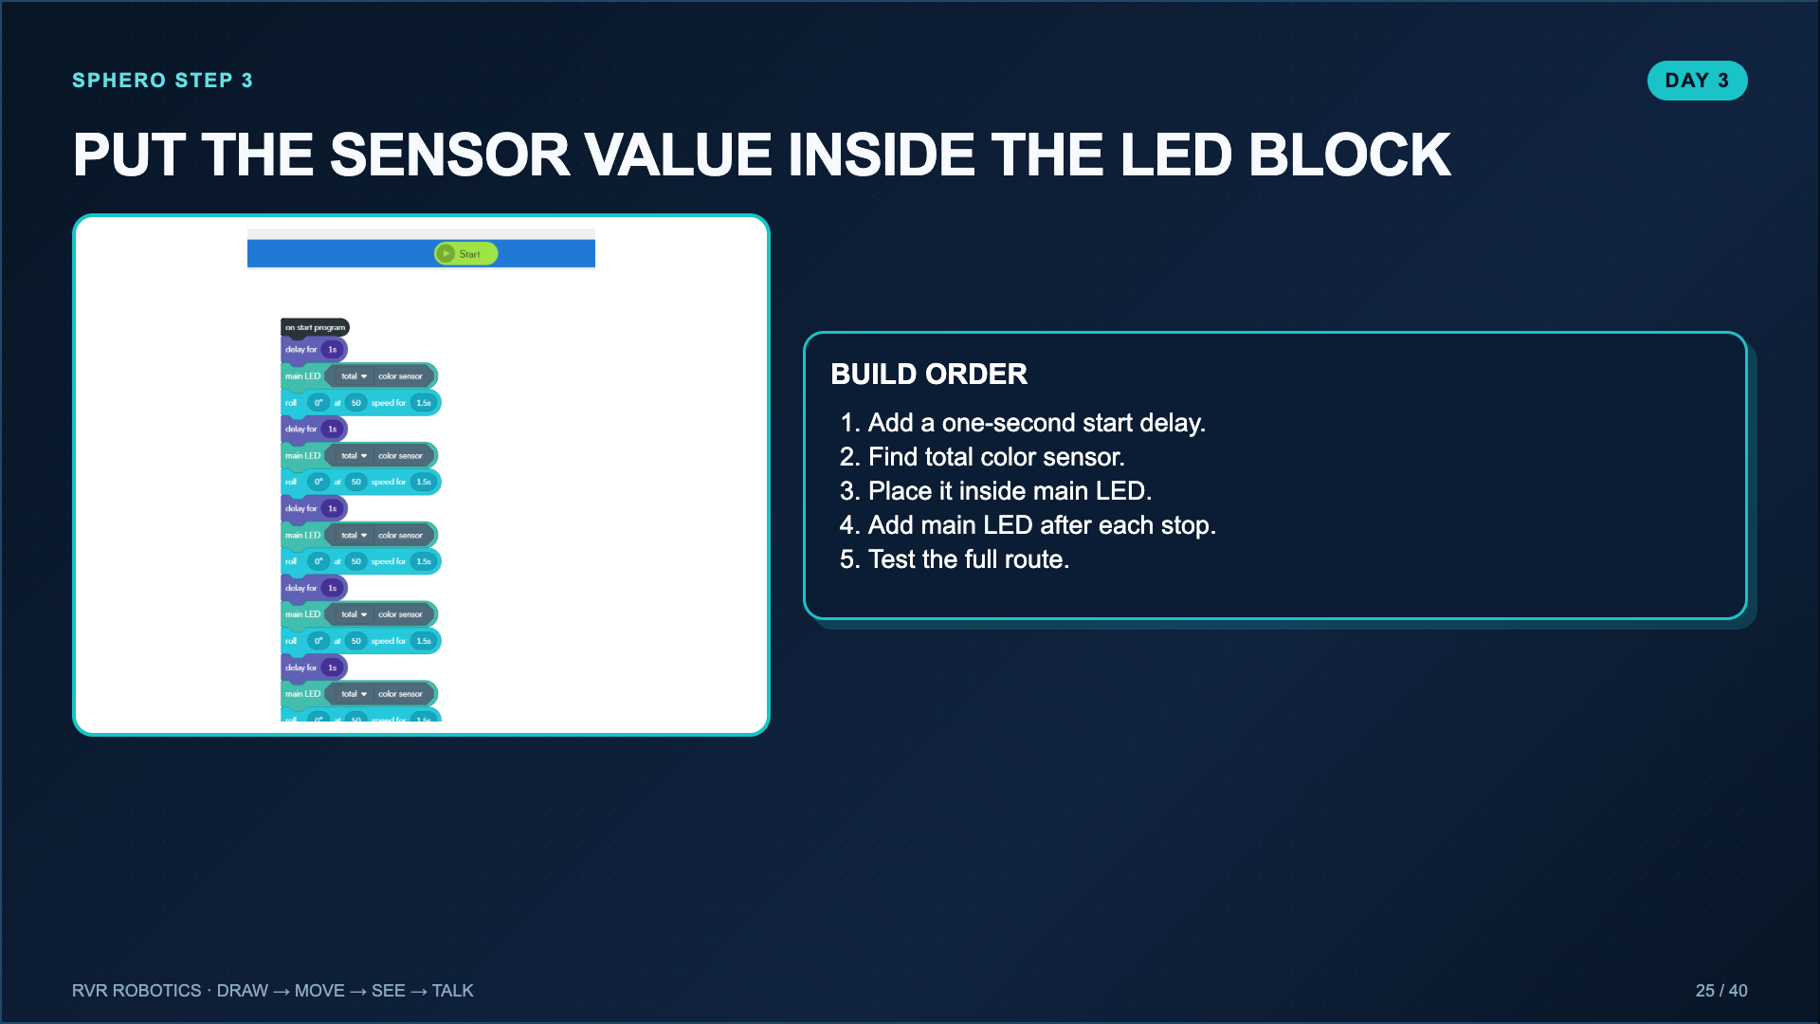
Notes:
The octagonal total color sensor block fits inside the octagonal color field of main LED. The starting delay gives the sensor time to load.
[Sources]
- Lucero classroom evidence worksheet for The a“MAZE”ing RVR Color Sensor (2025).
- Sphero Edu Activity, The a“MAZE”ing RVR Color Sensor: https://edu.sphero.com/cwists/preview/39616x

Slide 26
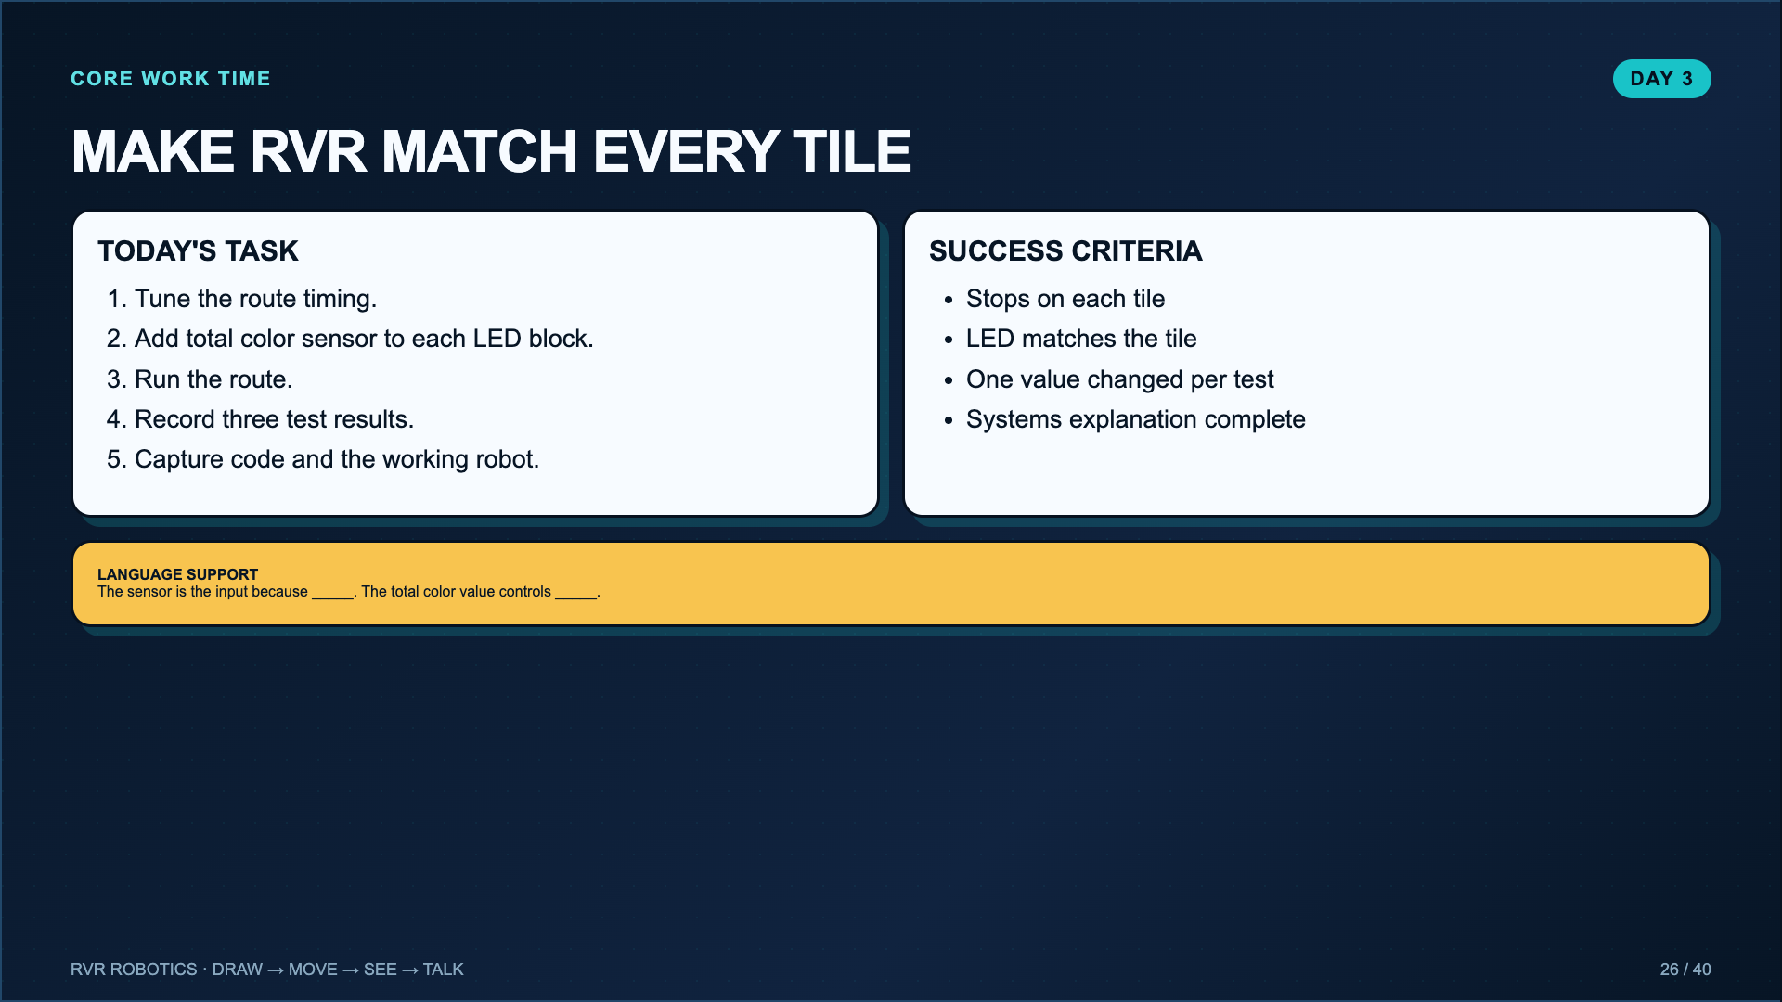
Notes:
Leave projected. Students complete the core color-sensor route and Sphero steps 1 through 3.
[Sources]
- Lucero classroom evidence worksheet for The a“MAZE”ing RVR Color Sensor (2025).
- Sphero Edu Activity, The a“MAZE”ing RVR Color Sensor: https://edu.sphero.com/cwists/preview/39616x

Slide 27
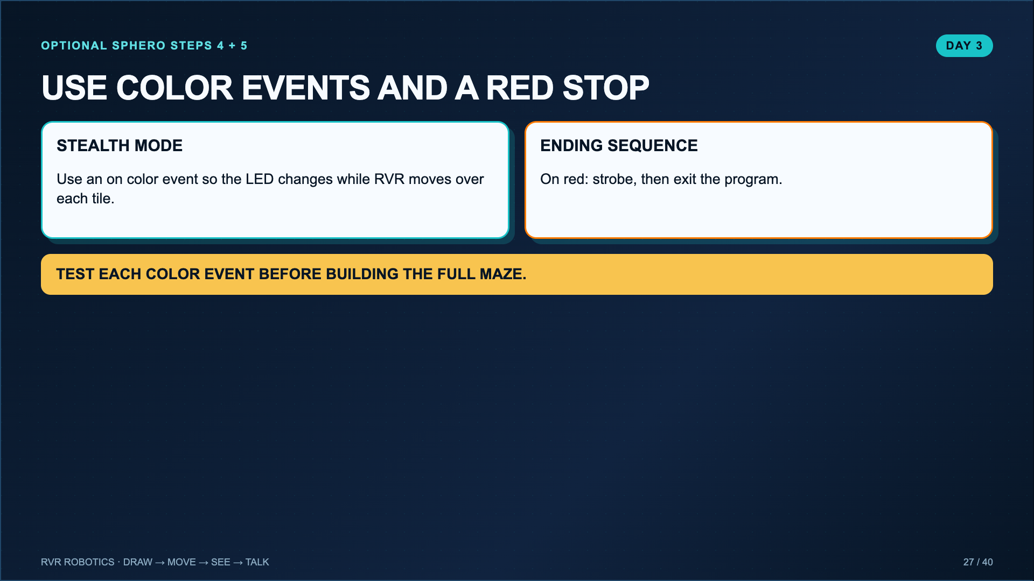
Notes:
Use this when groups finish the core route. Sphero steps 4 and 5 introduce event-driven code and a clear stopping condition.
[Sources]
- Sphero Edu Activity, The a“MAZE”ing RVR Color Sensor: https://edu.sphero.com/cwists/preview/39616x

Slide 28
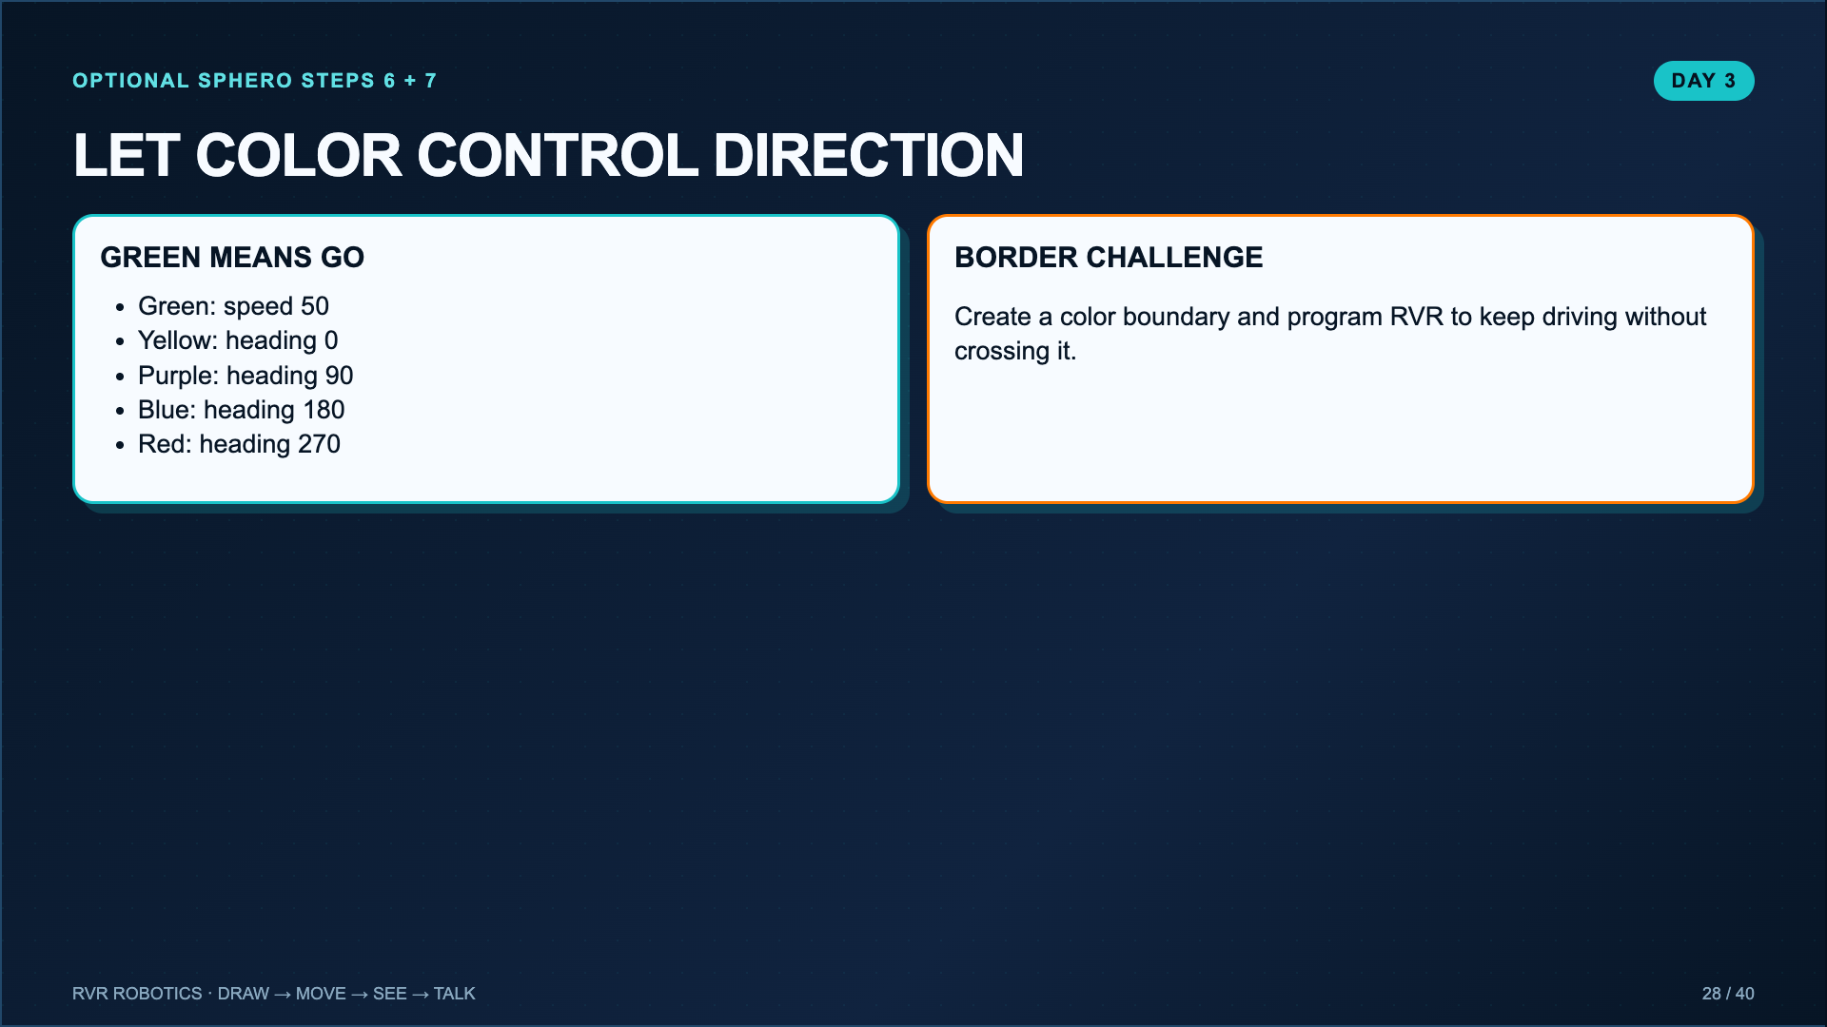
Notes:
This is the Sphero extension, not the default accountability requirement. Use it as an extra challenge or a second color-sensor day.
[Sources]
- Sphero Edu Activity, The a“MAZE”ing RVR Color Sensor: https://edu.sphero.com/cwists/preview/39616x

Slide 29
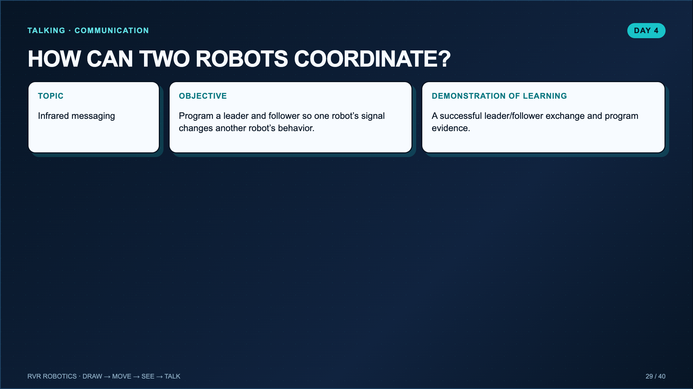
Notes:
Today is the bridge from one robot system to a multi-robot system. Students need at least two RVRs per working cluster, not necessarily per pair.
[Sources]
- Lucero classroom lesson, Talking with RVR and School-of-Fish Challenge (2025).
- Sphero Edu Activity, RVR: IR You Following Me?: https://edu.sphero.com/cwists/preview/39619x

Slide 30
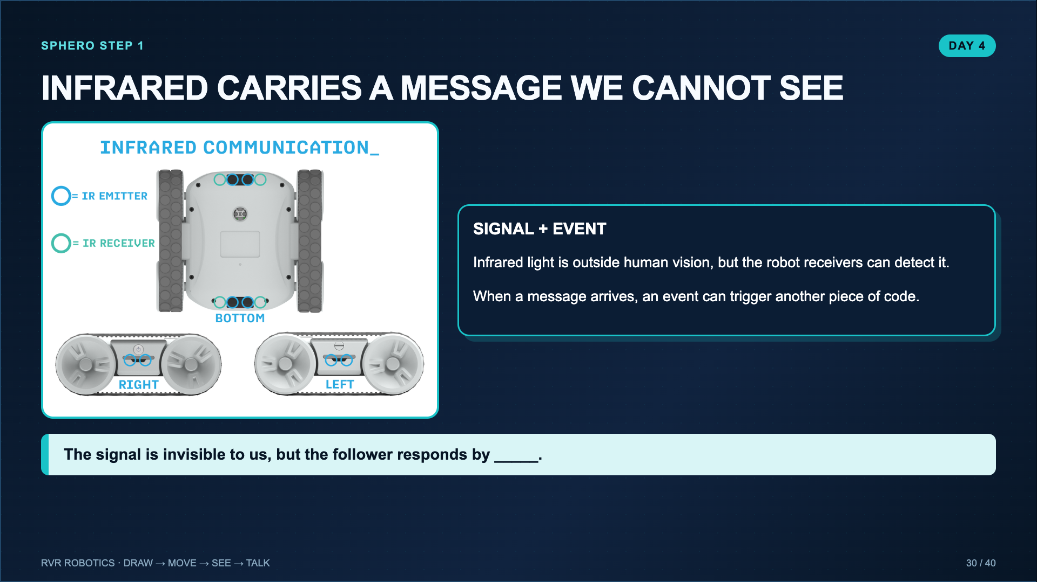
Notes:
Use the Sphero lesson video for the IR overview. Frame infrared as a communication input, not as robot intelligence.
[Sources]
- Sphero Edu Activity, RVR: IR You Following Me?: https://edu.sphero.com/cwists/preview/39619x

Slide 31
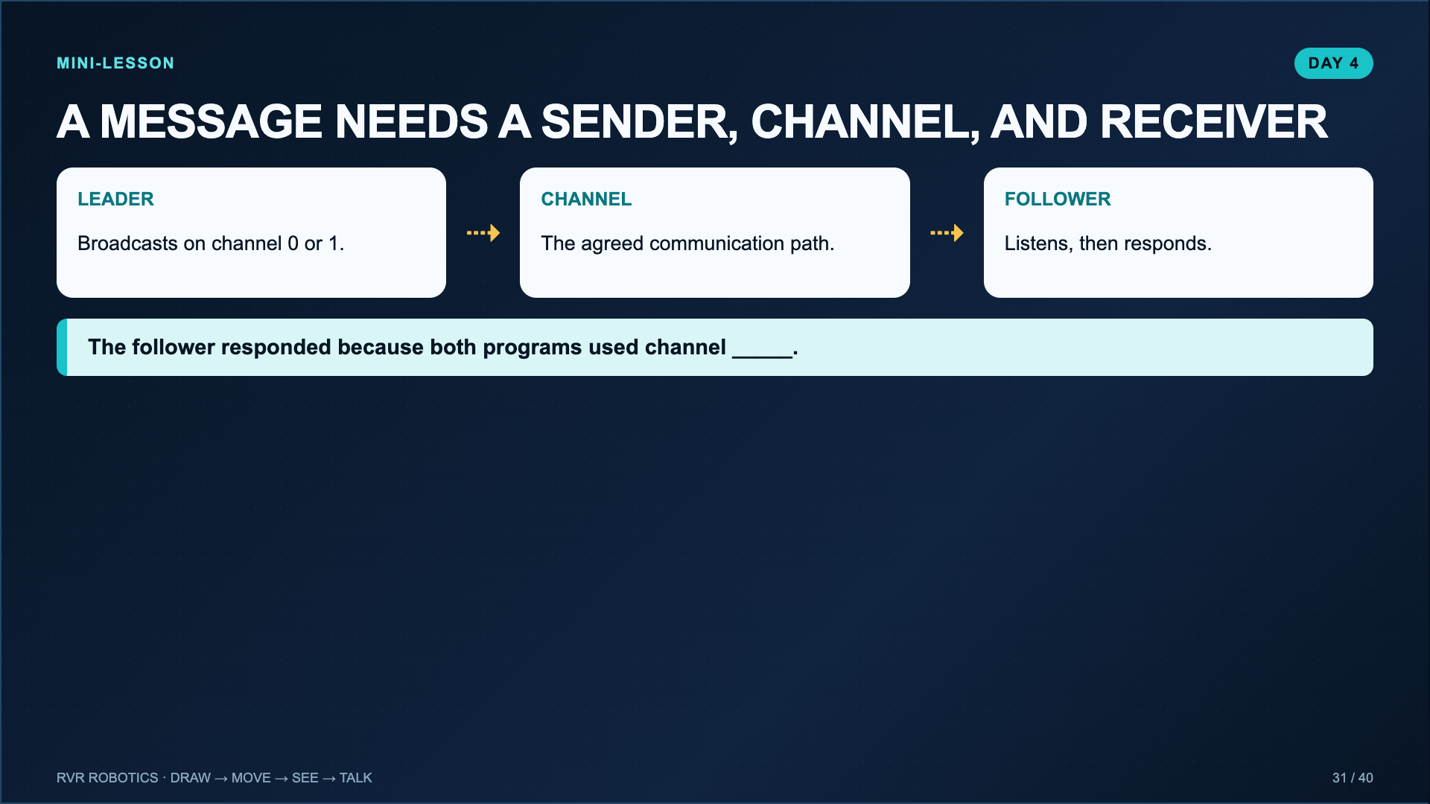
Notes:
Model mismatched channels on purpose. A silent follower creates a useful troubleshooting moment: check connection, channel, and whether the program is running.
[Sources]
- Lucero classroom lesson, Talking with RVR and School-of-Fish Challenge (2025).
- Sphero Edu Activity, RVR: IR You Following Me?: https://edu.sphero.com/cwists/preview/39619x

Slide 32
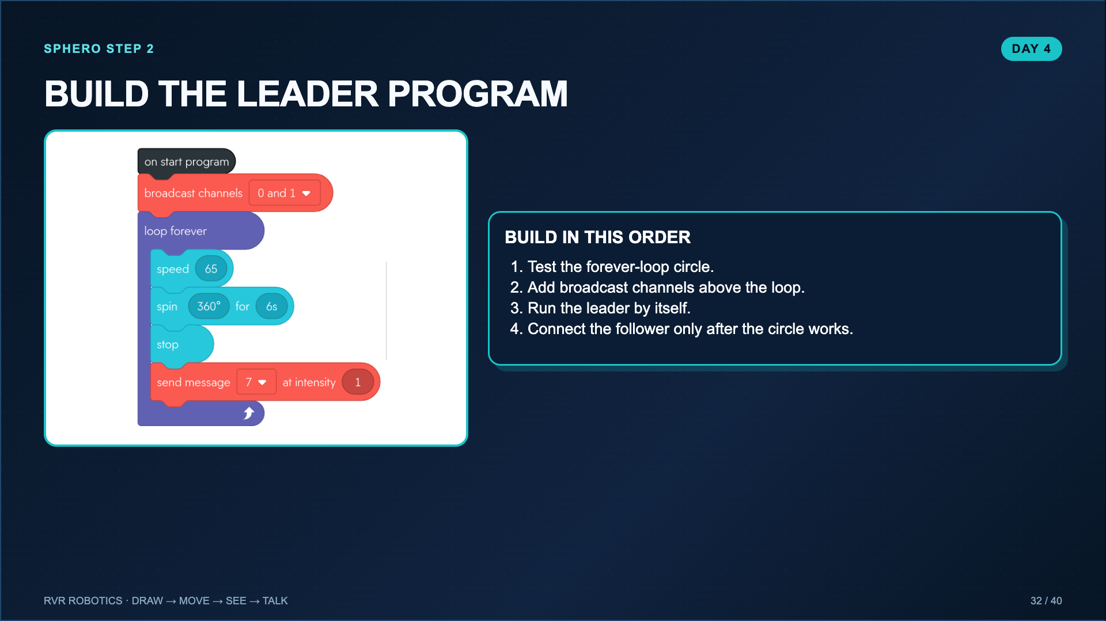
Notes:
Test the circle before adding communication. This follows the exact Sphero order and makes debugging easier.
[Sources]
- Sphero Edu Activity, RVR: IR You Following Me?: https://edu.sphero.com/cwists/preview/39619x
- Lucero classroom lesson, Talking with RVR and School-of-Fish Challenge (2025).

Slide 33
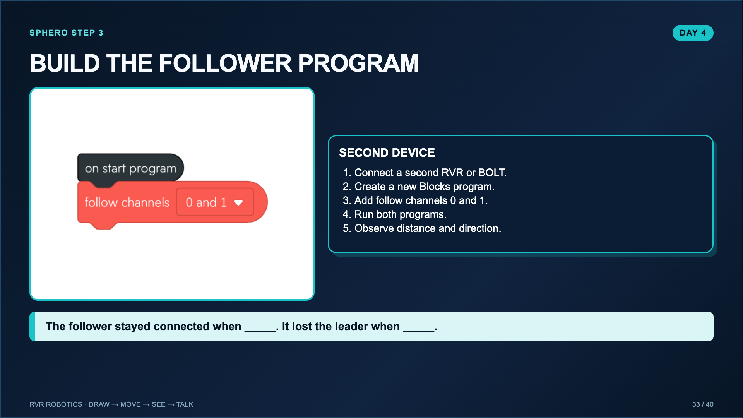
Notes:
The leader and follower need separate programming devices. Give the robots safe space and test the simplest follow behavior before adding effects.
[Sources]
- Sphero Edu Activity, RVR: IR You Following Me?: https://edu.sphero.com/cwists/preview/39619x
- Lucero classroom lesson, Talking with RVR and School-of-Fish Challenge (2025).

Slide 34
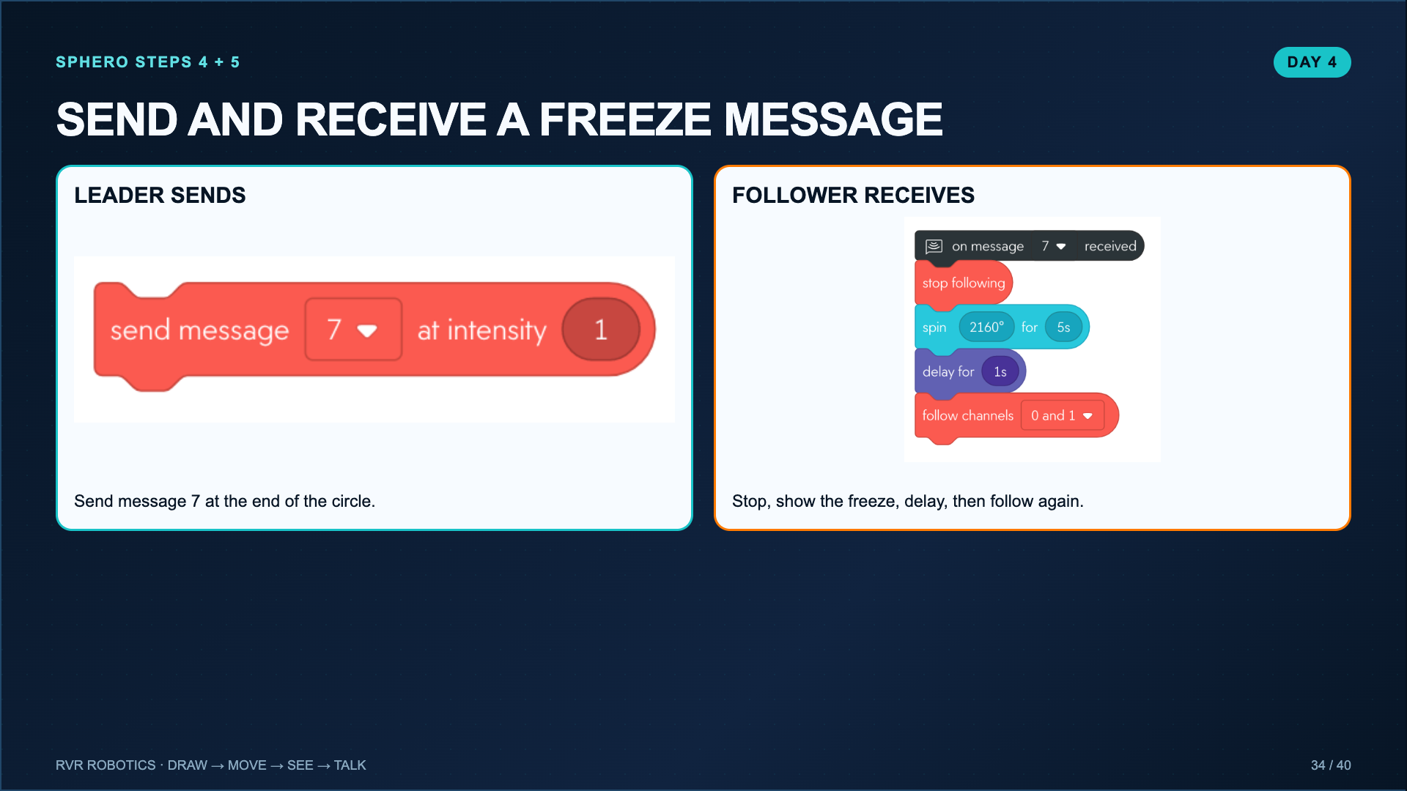
Notes:
A low intensity requires the follower to be close. This creates a visible cause-and-effect message test before the open-ended school-of-fish challenge.
[Sources]
- Sphero Edu Activity, RVR: IR You Following Me?: https://edu.sphero.com/cwists/preview/39619x

Slide 35
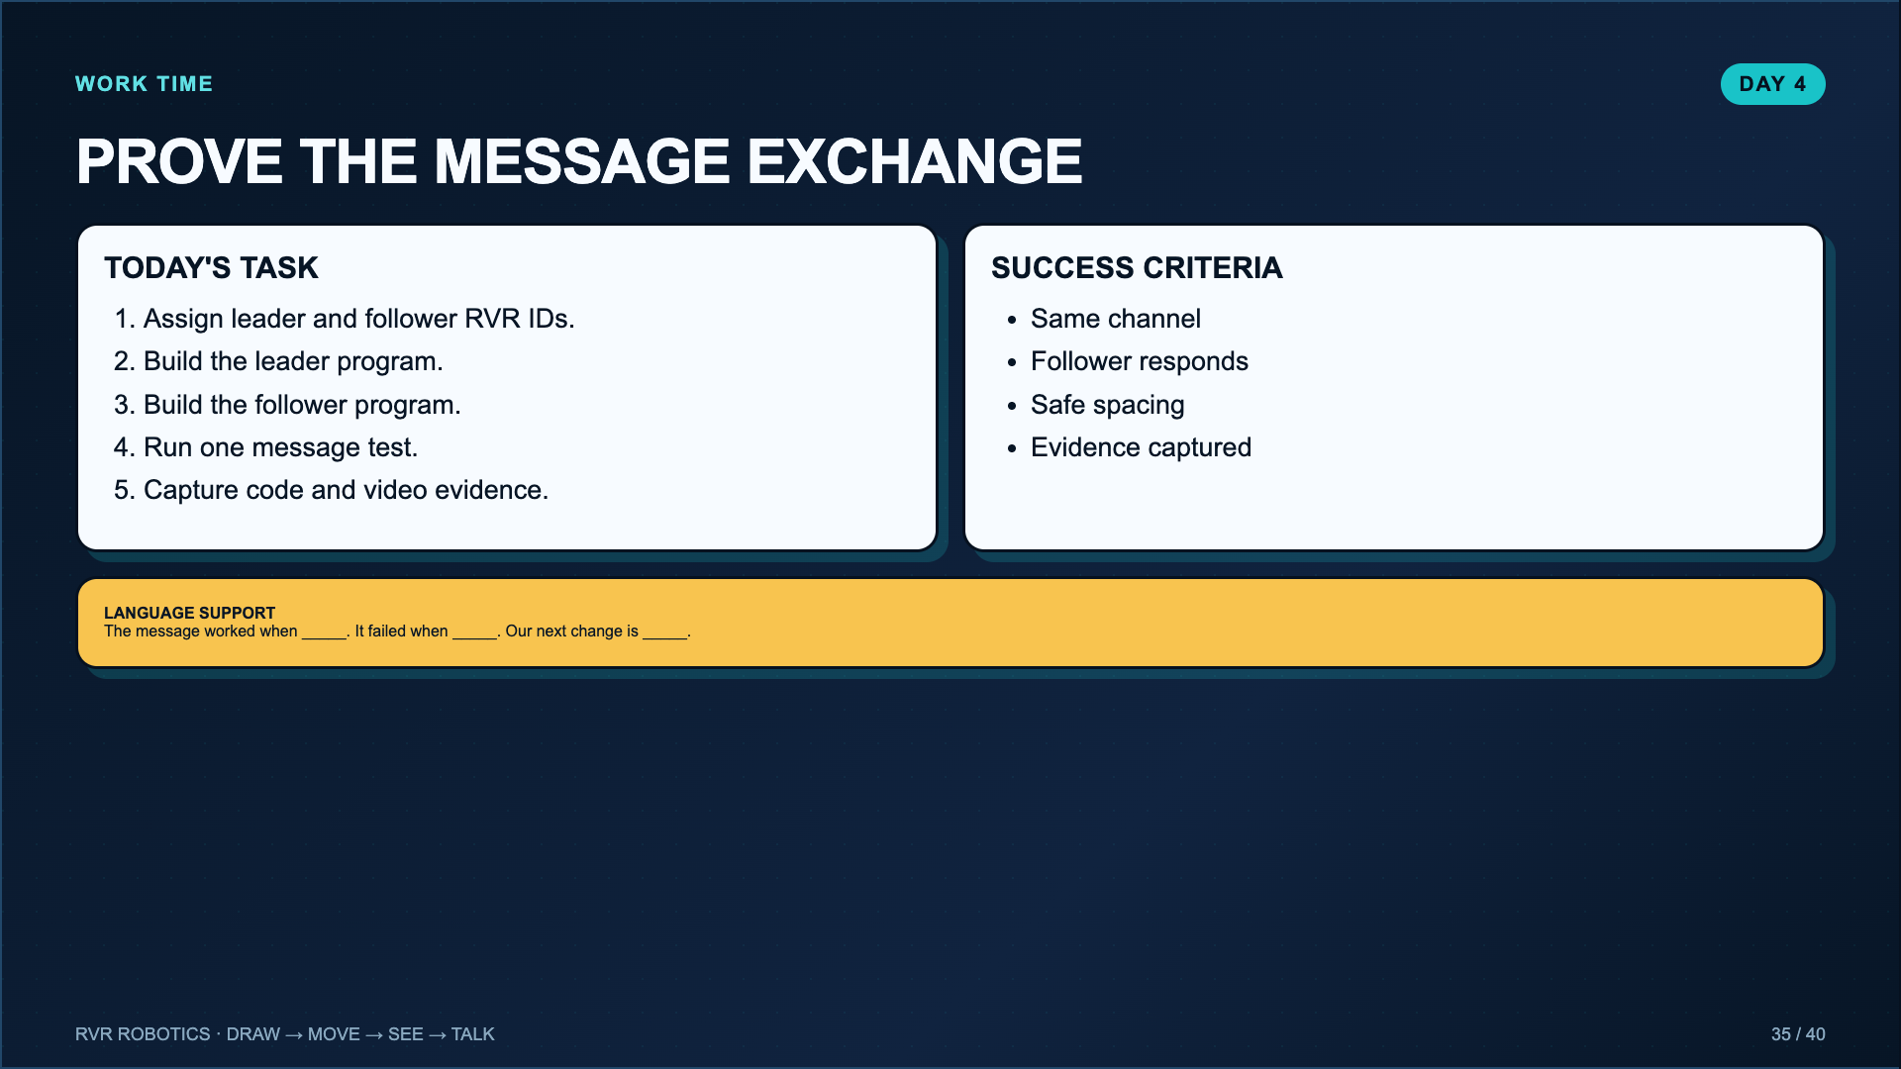
Notes:
Leave projected. Day 4 is complete when the message exchange works. The school-of-fish formation belongs on Day 5 so groups have time to improve it.
[Sources]
- Lucero classroom lesson, Talking with RVR and School-of-Fish Challenge (2025).
- Sphero Edu Activity, RVR: IR You Following Me?: https://edu.sphero.com/cwists/preview/39619x

Slide 36
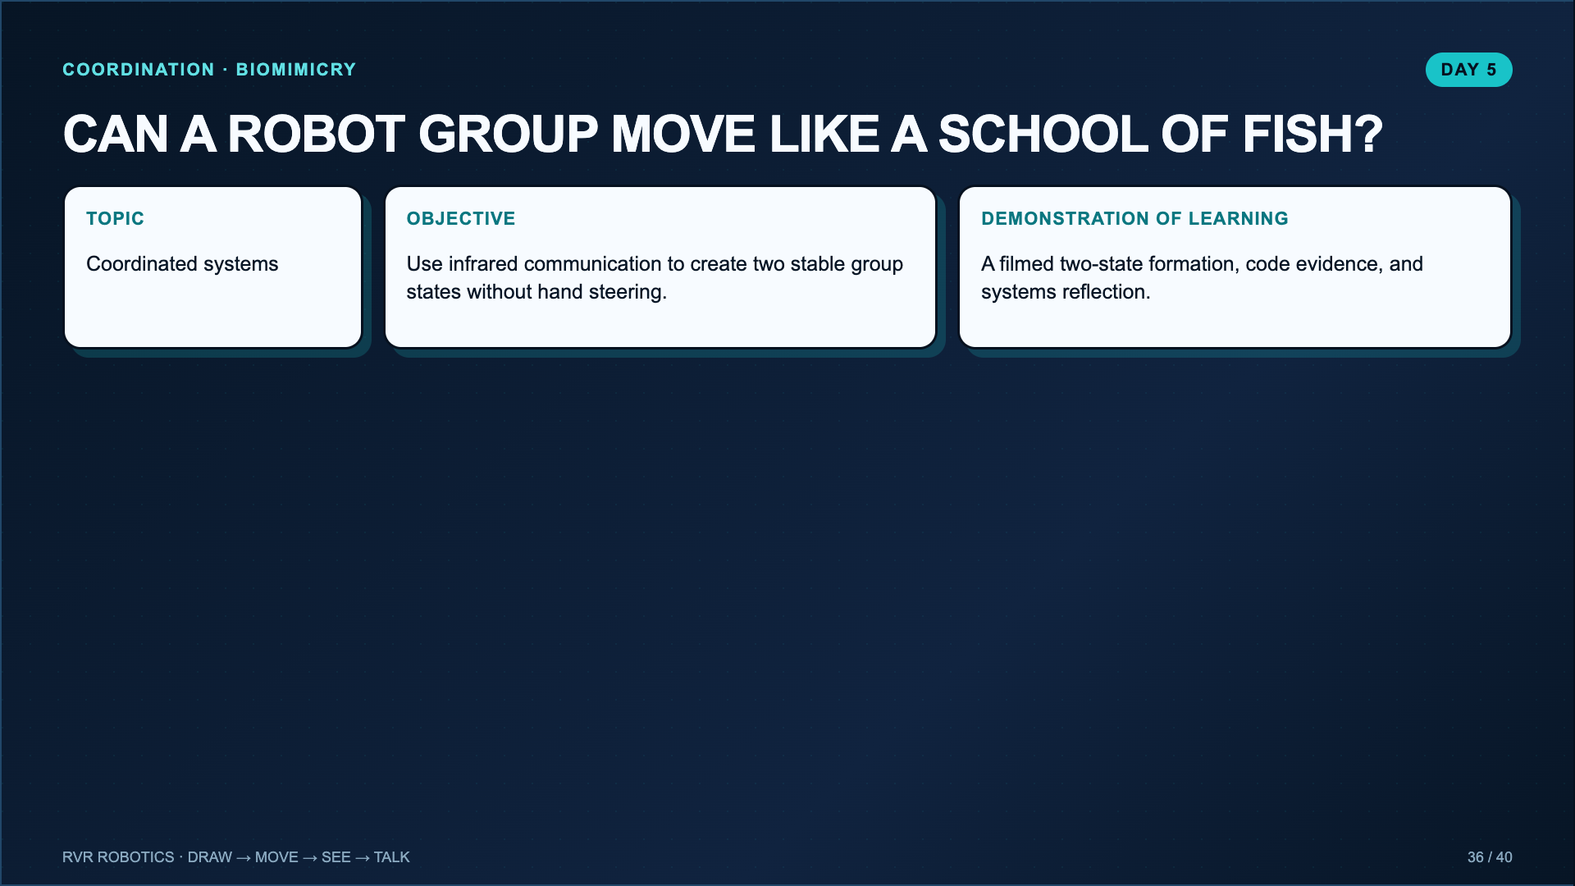
Notes:
Introduce biomimicry as a way to study coordinated systems. The challenge is not to imitate the shape of a fish. It is to imitate decentralized coordination.
[Sources]
- Lucero classroom lesson, Talking with RVR and School-of-Fish Challenge (2025).

Slide 37
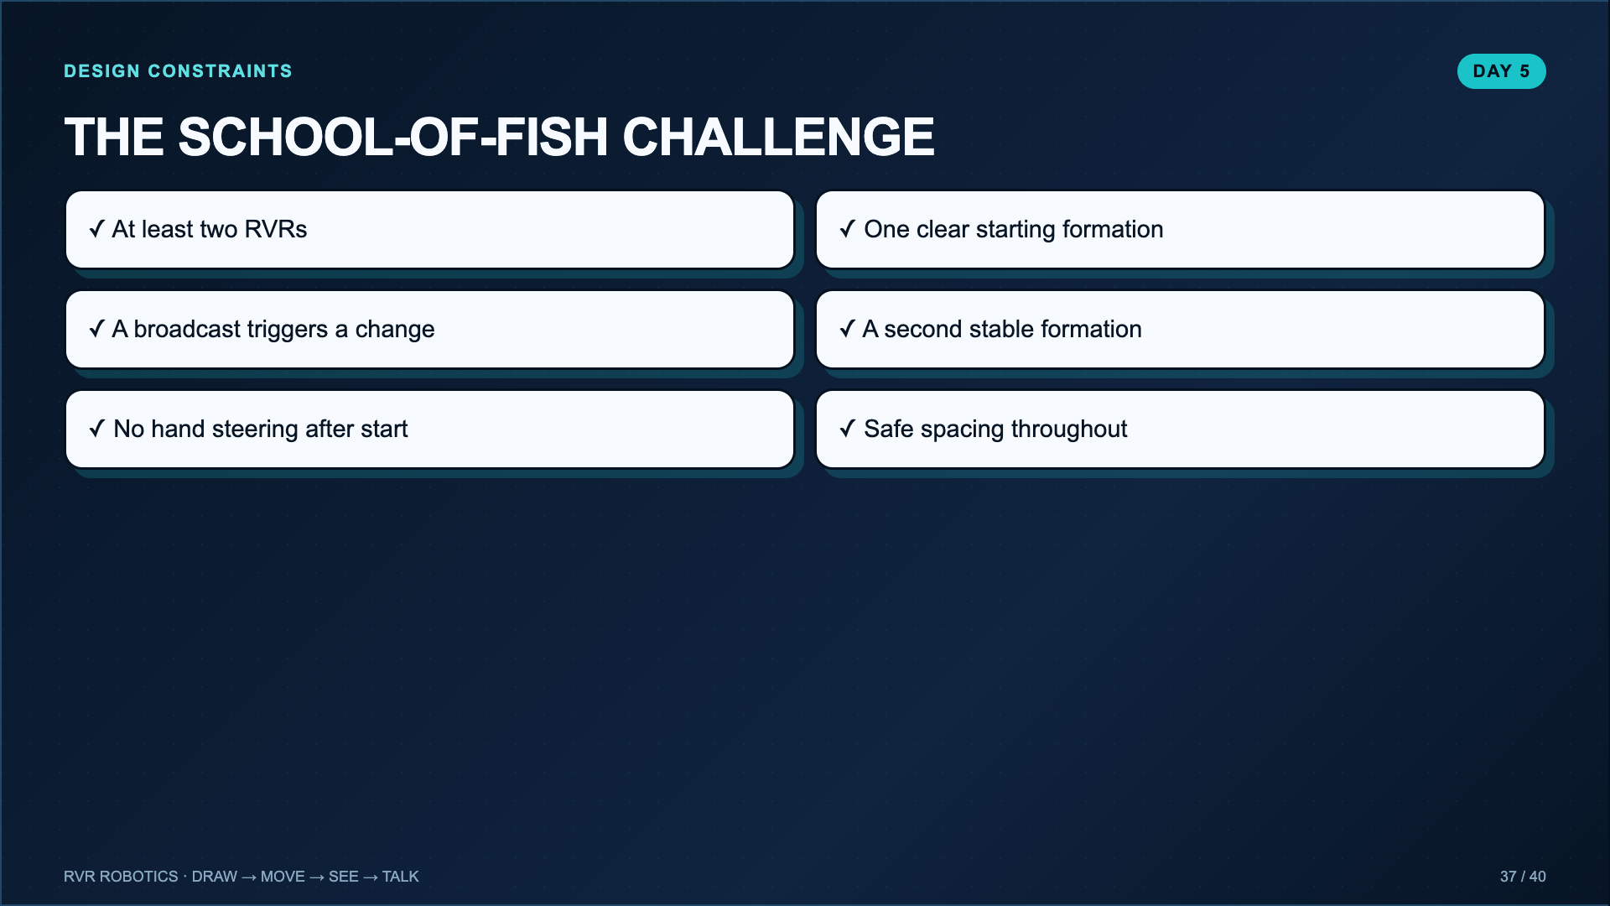
Notes:
Read every constraint. Ask groups to sketch both formations and the trigger before touching code. The constraints create the design problem and keep the challenge assessable.
[Sources]
- Lucero classroom lesson, Talking with RVR and School-of-Fish Challenge (2025).

Slide 38
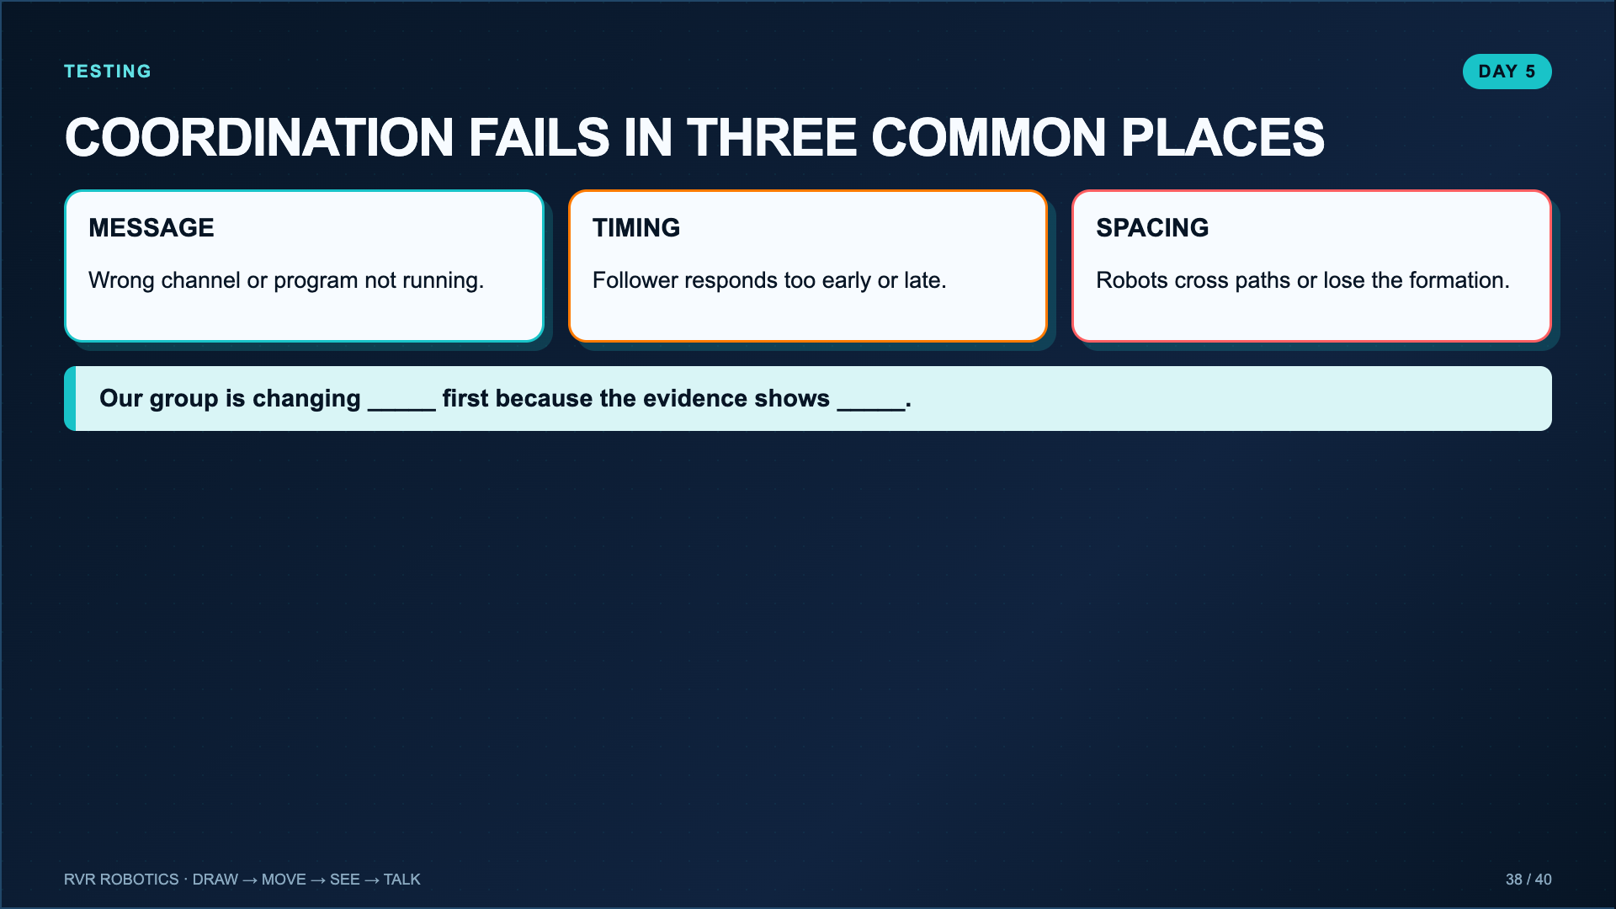
Notes:
Coach one change at a time. A group that changes message, timing, and movement values simultaneously cannot explain what fixed the system.
[Sources]
- Lucero classroom lesson, Talking with RVR and School-of-Fish Challenge (2025).

Slide 39
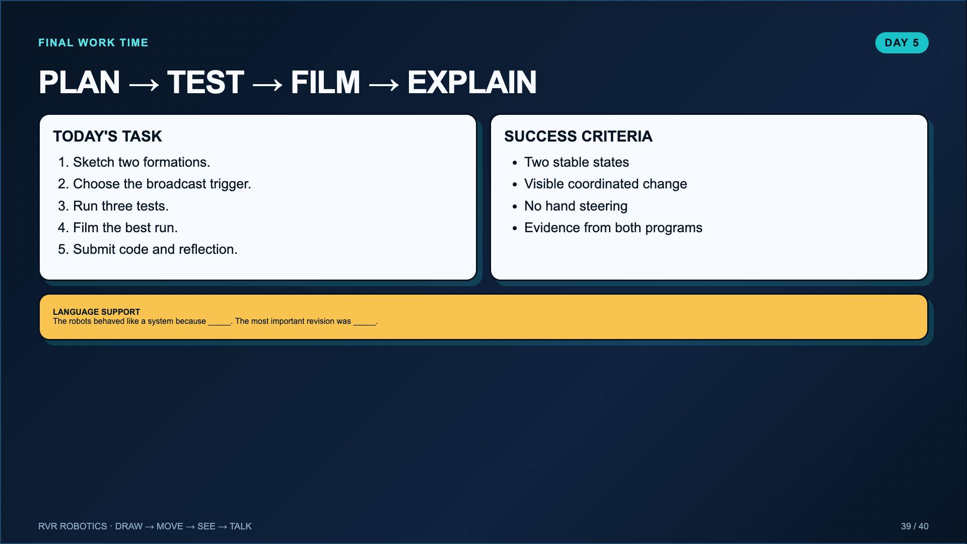
Notes:
Leave projected. If equipment is limited, rotate one programming group, one test group, and one evidence group around a shared robot cluster.
[Sources]
- Lucero classroom lesson, Talking with RVR and School-of-Fish Challenge (2025).

Slide 40
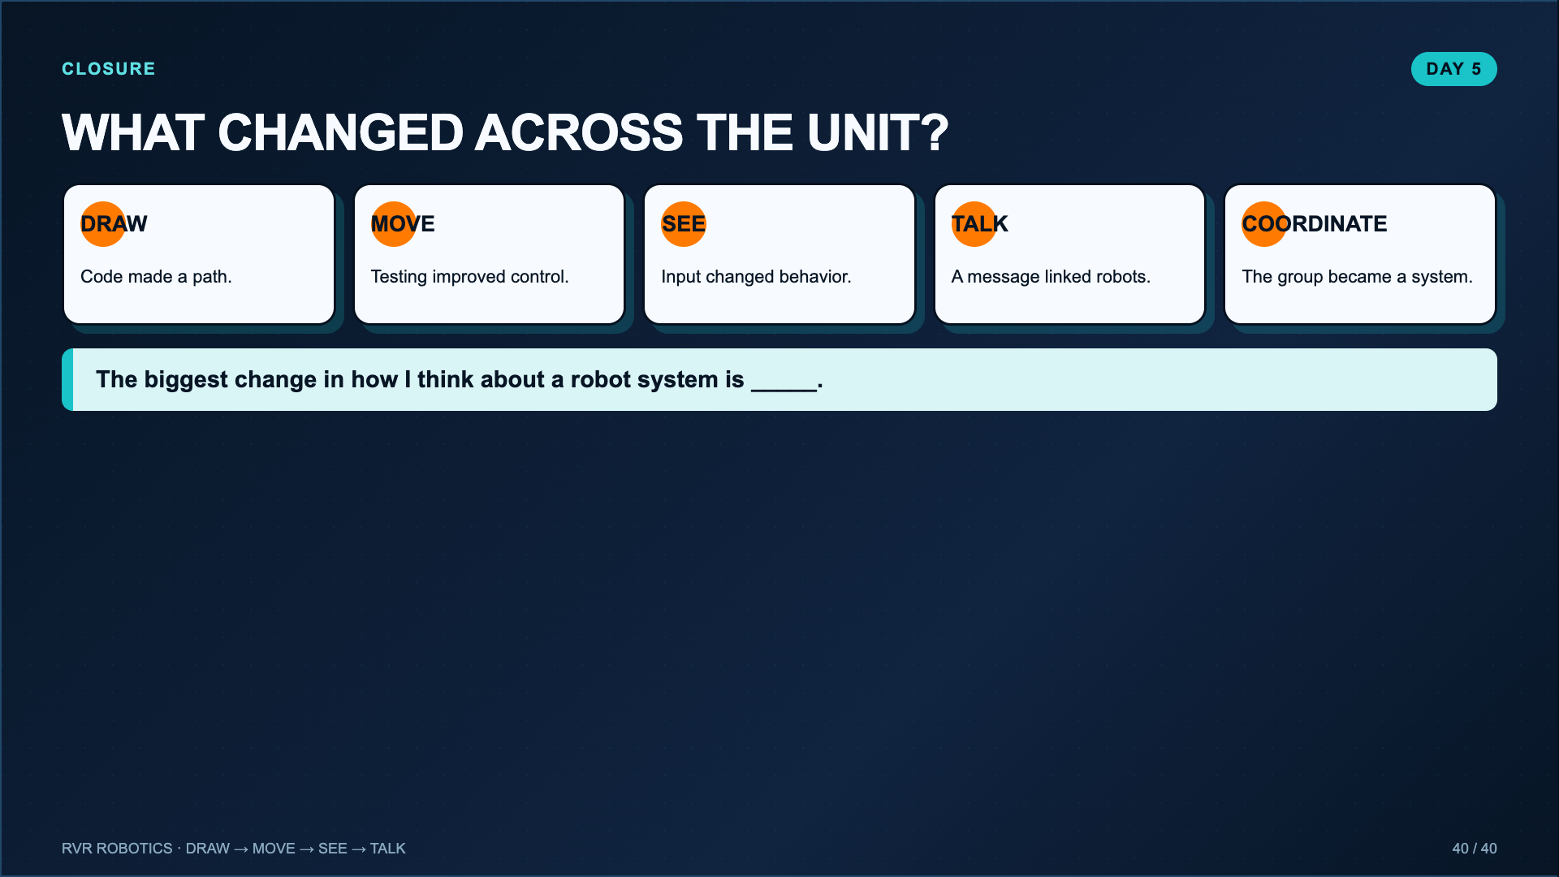
Notes:
End with systems language, not a generic “what did you like?” reflection. Invite students to identify the moment the robot changed from following commands to responding to information.
[Sources]
- Lucero classroom lesson, Drawing with RVR Pictionary (2025).
- Lucero classroom evidence worksheet for Sphero RVR+ Blocks 1: Movement (2025).
- Lucero classroom evidence worksheet for The a“MAZE”ing RVR Color Sensor (2025).
- Lucero classroom lesson, Talking with RVR and School-of-Fish Challenge (2025).

