Slide 1
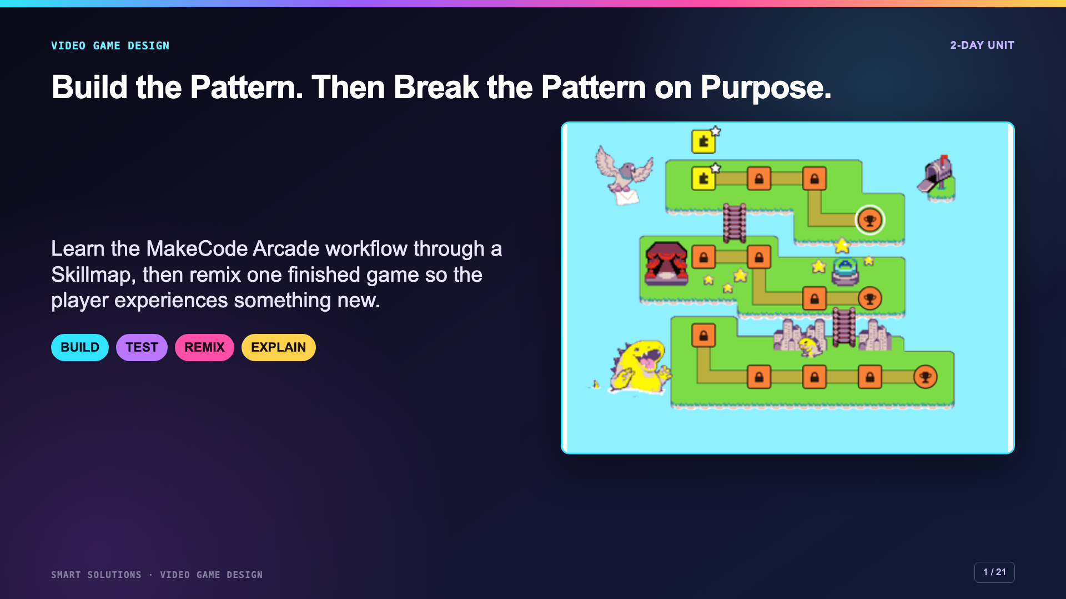
Notes:
Open by naming the two different kinds of thinking. Day 1 is about following and understanding a working pattern. Day 2 is about changing that pattern intentionally.
[Sources]
- Smart Solutions Video Game Design Canvas module, facilitator guide, Lesson 1 Skillmap, Lesson 2 Remix, and rubric 6081. Irving 2027 Template course 23402 (accessed 2026-08-16).
- Microsoft MakeCode Arcade. “Skillmaps.” https://arcade.makecode.com/skillmaps (accessed 2026-08-16).

Slide 2
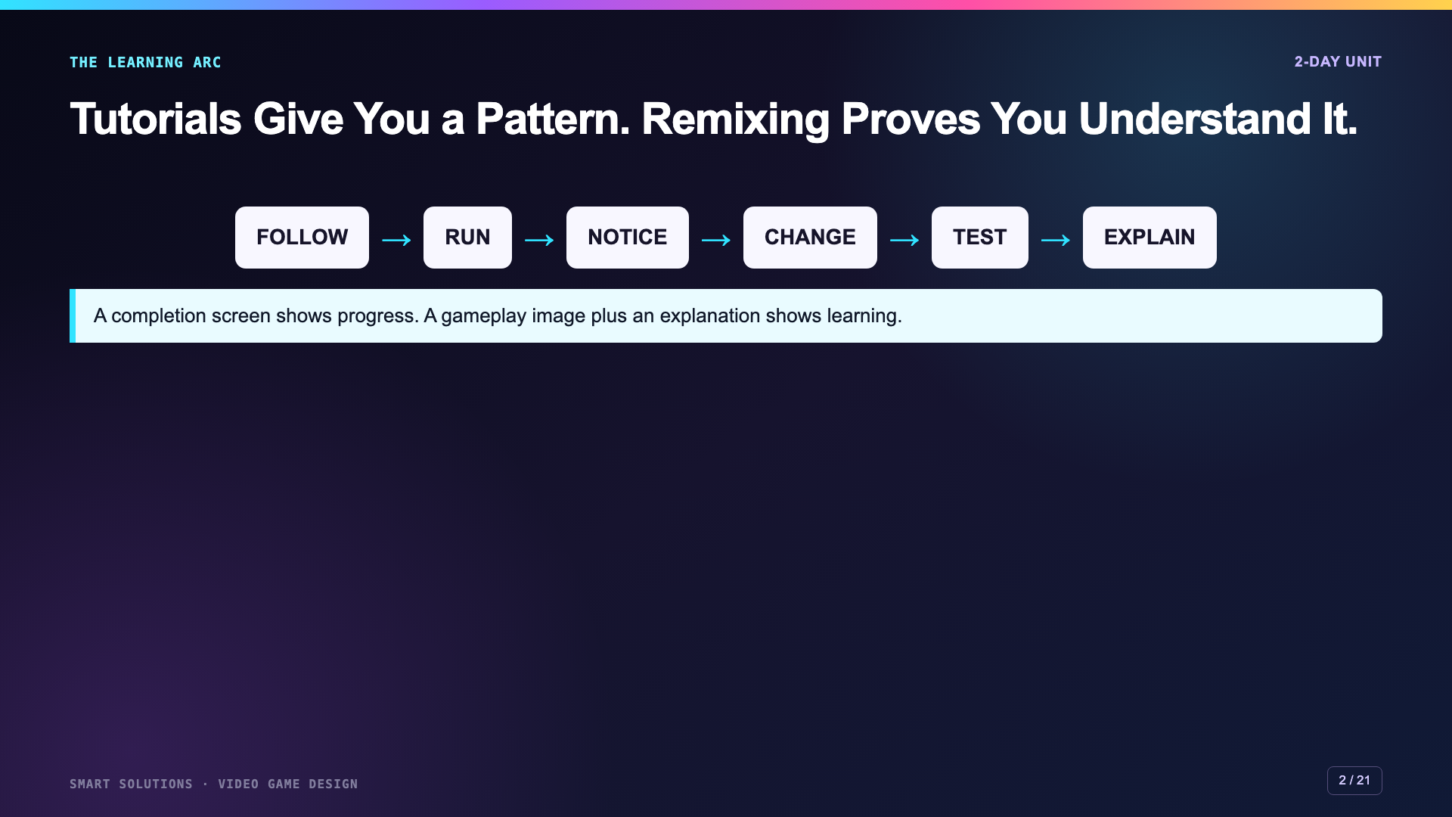
Notes:
Preview the full arc. Tell students that clicking Next is not the goal. They should be able to point to a block, name what it controls, and explain what changed.
[Sources]
- Smart Solutions Video Game Design Canvas module, facilitator guide, Lesson 1 Skillmap, Lesson 2 Remix, and rubric 6081. Irving 2027 Template course 23402 (accessed 2026-08-16).
- Microsoft MakeCode Arcade. “About the Beginner’s Guide to Arcade Games.” https://arcade.makecode.com/skillmap/educator-info/basic-map-info (accessed 2026-08-16).

Slide 3
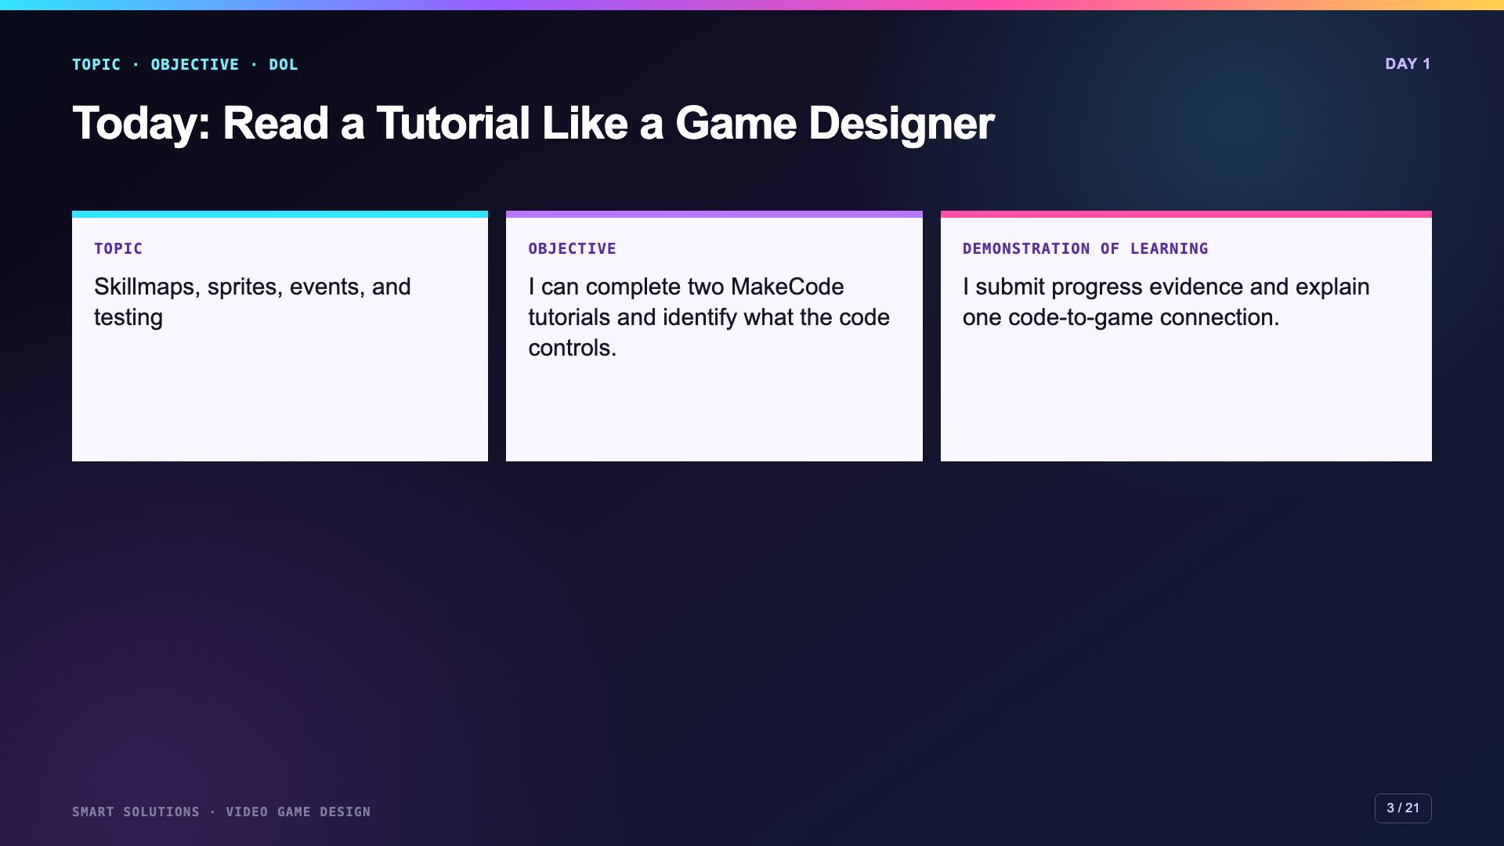
Notes:
Use this administration-ready opening. The two tutorials are the practice route. The code-to-game explanation is the evidence of understanding.
[Sources]
- Smart Solutions Video Game Design Canvas module, facilitator guide, Lesson 1 Skillmap, Lesson 2 Remix, and rubric 6081. Irving 2027 Template course 23402 (accessed 2026-08-16).
- Microsoft MakeCode Arcade. “About the Beginner’s Guide to Arcade Games.” https://arcade.makecode.com/skillmap/educator-info/basic-map-info (accessed 2026-08-16).

Slide 4
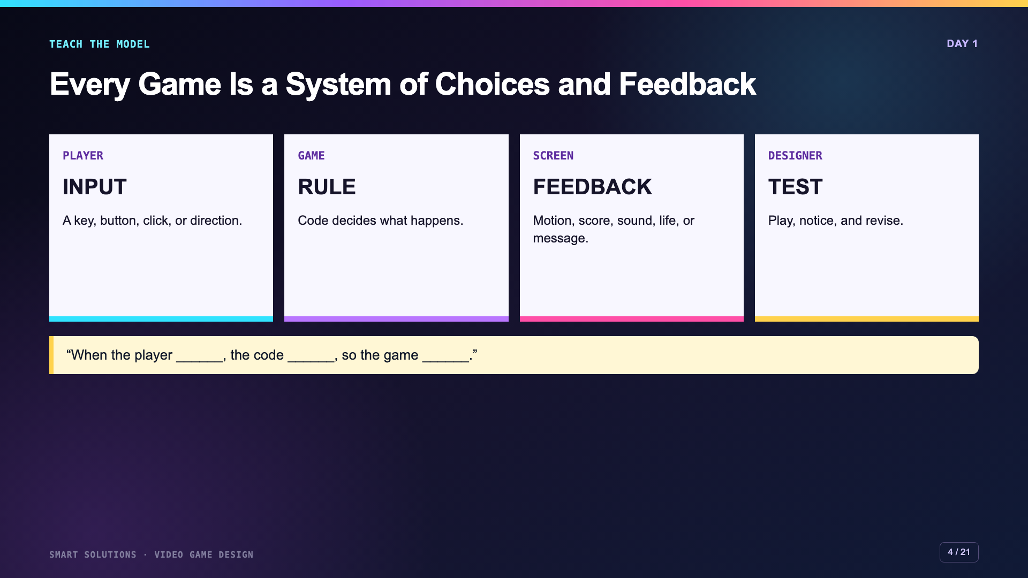
Notes:
Model one familiar game interaction such as pressing A to jump. Ask students to separate the input, the code rule, and the visible feedback.
[Sources]
- Smart Solutions Video Game Design Canvas module, facilitator guide, Lesson 1 Skillmap, Lesson 2 Remix, and rubric 6081. Irving 2027 Template course 23402 (accessed 2026-08-16).
- Microsoft MakeCode Arcade. “Intro to MakeCode Arcade.” https://arcade.makecode.com/tutorials/intro (accessed 2026-08-16).

Slide 5
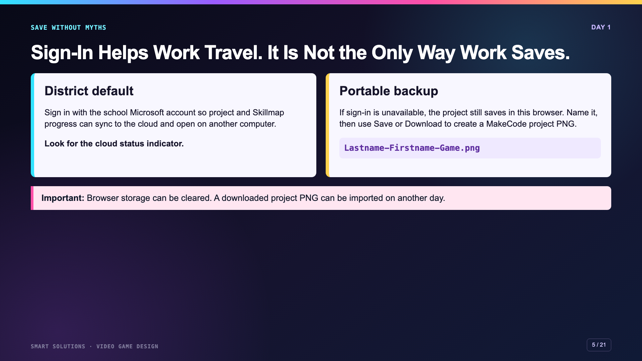
Notes:
Correct the old misconception directly. For Irving, Microsoft sign-in remains the preferred continuity route. Demonstrate the project PNG backup before students begin.
[Sources]
- Microsoft MakeCode Arcade. “Online Accounts and MakeCode.” https://arcade.makecode.com/identity/sign-in (accessed 2026-08-16).
- Microsoft MakeCode Arcade. “Cloud Synchronization in MakeCode.” https://arcade.makecode.com/identity/cloud-sync (accessed 2026-08-16).
- Microsoft MakeCode Arcade. “Saving projects.” https://arcade.makecode.com/save (accessed 2026-08-16).
- Microsoft MakeCode Arcade. “MakeCode Arcade Interface.” https://arcade.makecode.com/ide-tour (accessed 2026-08-16).

Slide 6
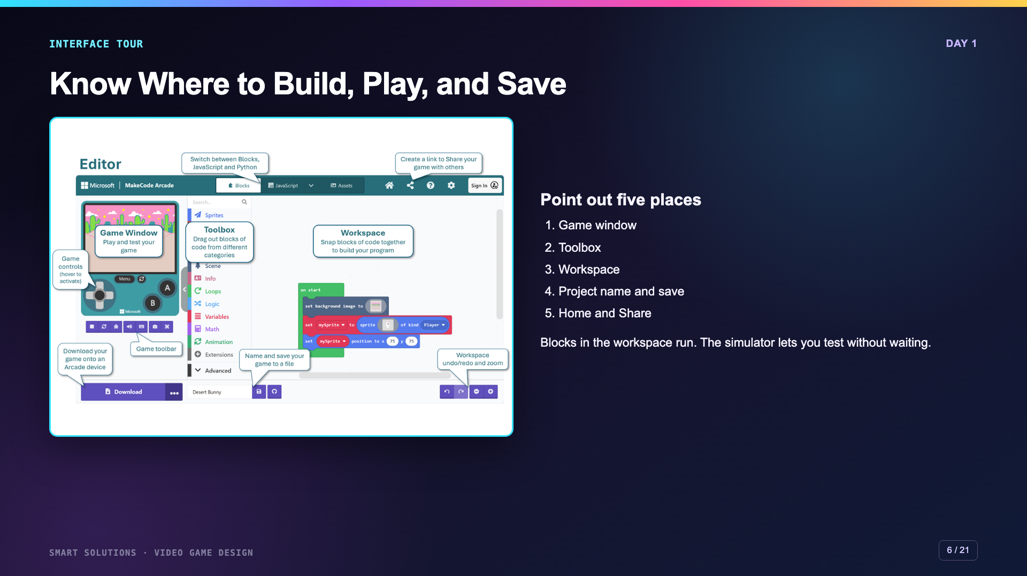
Notes:
Project the official editor diagram, then point to the same five places in a live MakeCode tab. Do not begin a tutorial until students can locate the simulator, toolbox, and workspace.
[Sources]
- Microsoft MakeCode Arcade. “MakeCode Arcade Interface.” https://arcade.makecode.com/ide-tour (accessed 2026-08-16).

Slide 7
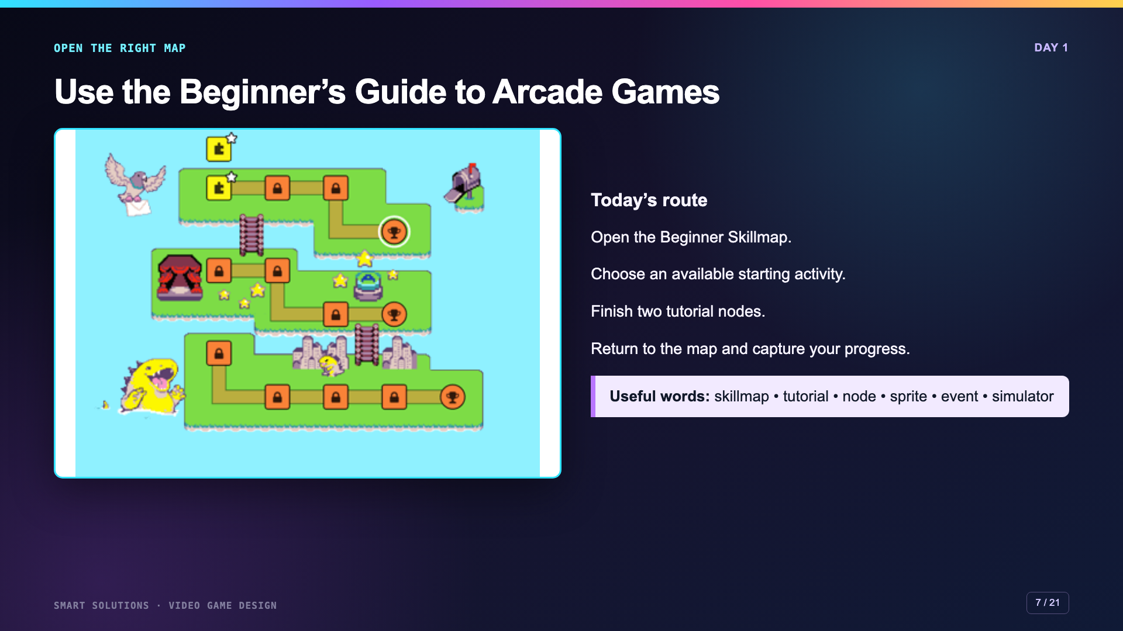
Notes:
Open the exact Beginner Skillmap link from Canvas. The current guide contains eleven tutorials across storytelling, clicker, and collector paths. Two tutorials fit this compressed day.
[Sources]
- Microsoft MakeCode Arcade. “Skillmaps.” https://arcade.makecode.com/skillmaps (accessed 2026-08-16).
- Microsoft MakeCode Arcade. “About the Beginner’s Guide to Arcade Games.” https://arcade.makecode.com/skillmap/educator-info/basic-map-info (accessed 2026-08-16).

Slide 8
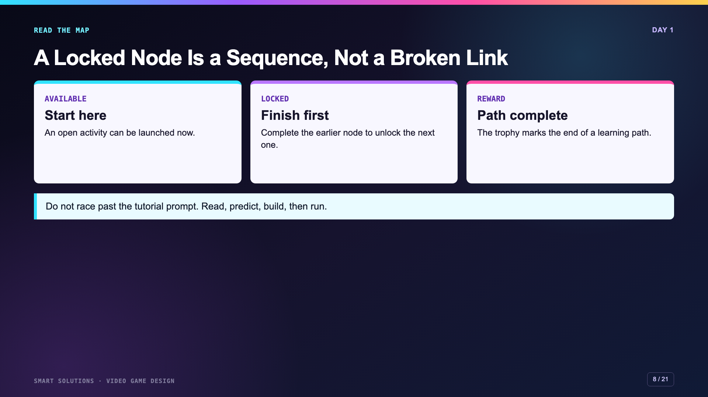
Notes:
Use the map language students see. If the current visual differs slightly, keep the concept: open nodes start work, locked nodes show sequence, and rewards mark completion.
[Sources]
- Microsoft MakeCode Arcade. “About the Beginner’s Guide to Arcade Games.” https://arcade.makecode.com/skillmap/educator-info/basic-map-info (accessed 2026-08-16).
- Glenn Malcolm. “Microsoft Makecode Beginner Skill Map Level One Part 1.” YouTube, 2022. https://www.youtube.com/watch?v=6uLxS2CWLO4 (accessed 2026-08-16).

Slide 9
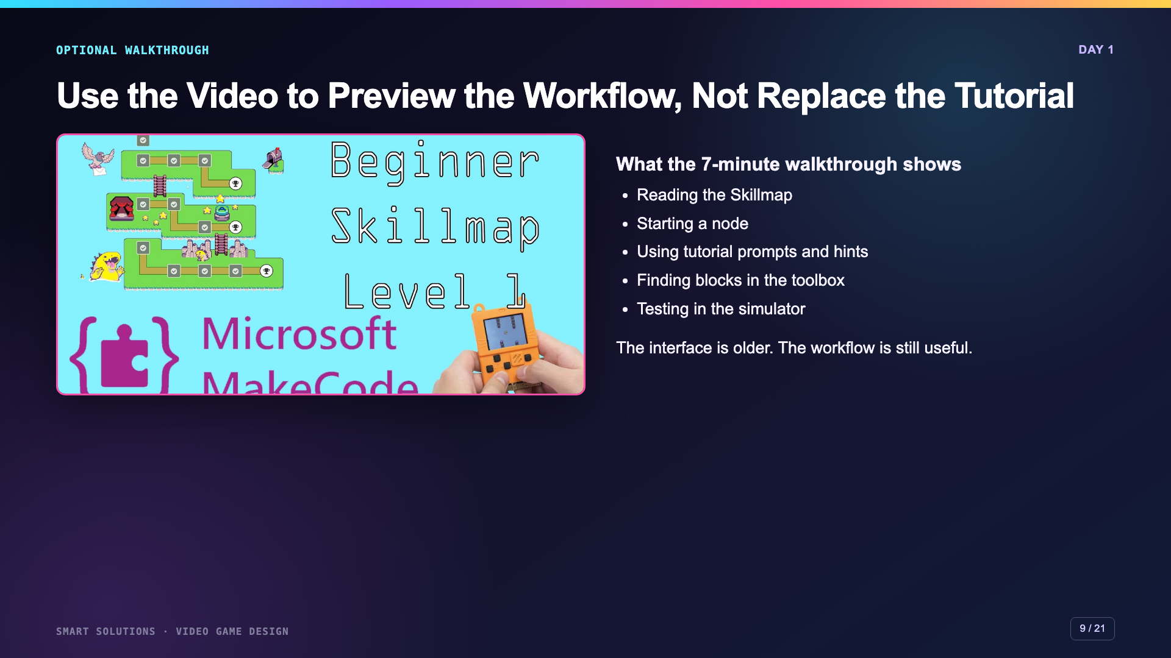
Notes:
This video has no captions or transcript. Use it as an optional preview, pause for questions, and rely on the current live interface for exact button locations.
[Sources]
- Glenn Malcolm. “Microsoft Makecode Beginner Skill Map Level One Part 1.” YouTube, 2022. https://www.youtube.com/watch?v=6uLxS2CWLO4 (accessed 2026-08-16).
- Microsoft MakeCode Arcade. “MakeCode Arcade Interface.” https://arcade.makecode.com/ide-tour (accessed 2026-08-16).
- Microsoft MakeCode Arcade. “Intro to MakeCode Arcade.” https://arcade.makecode.com/tutorials/intro (accessed 2026-08-16).

Slide 10
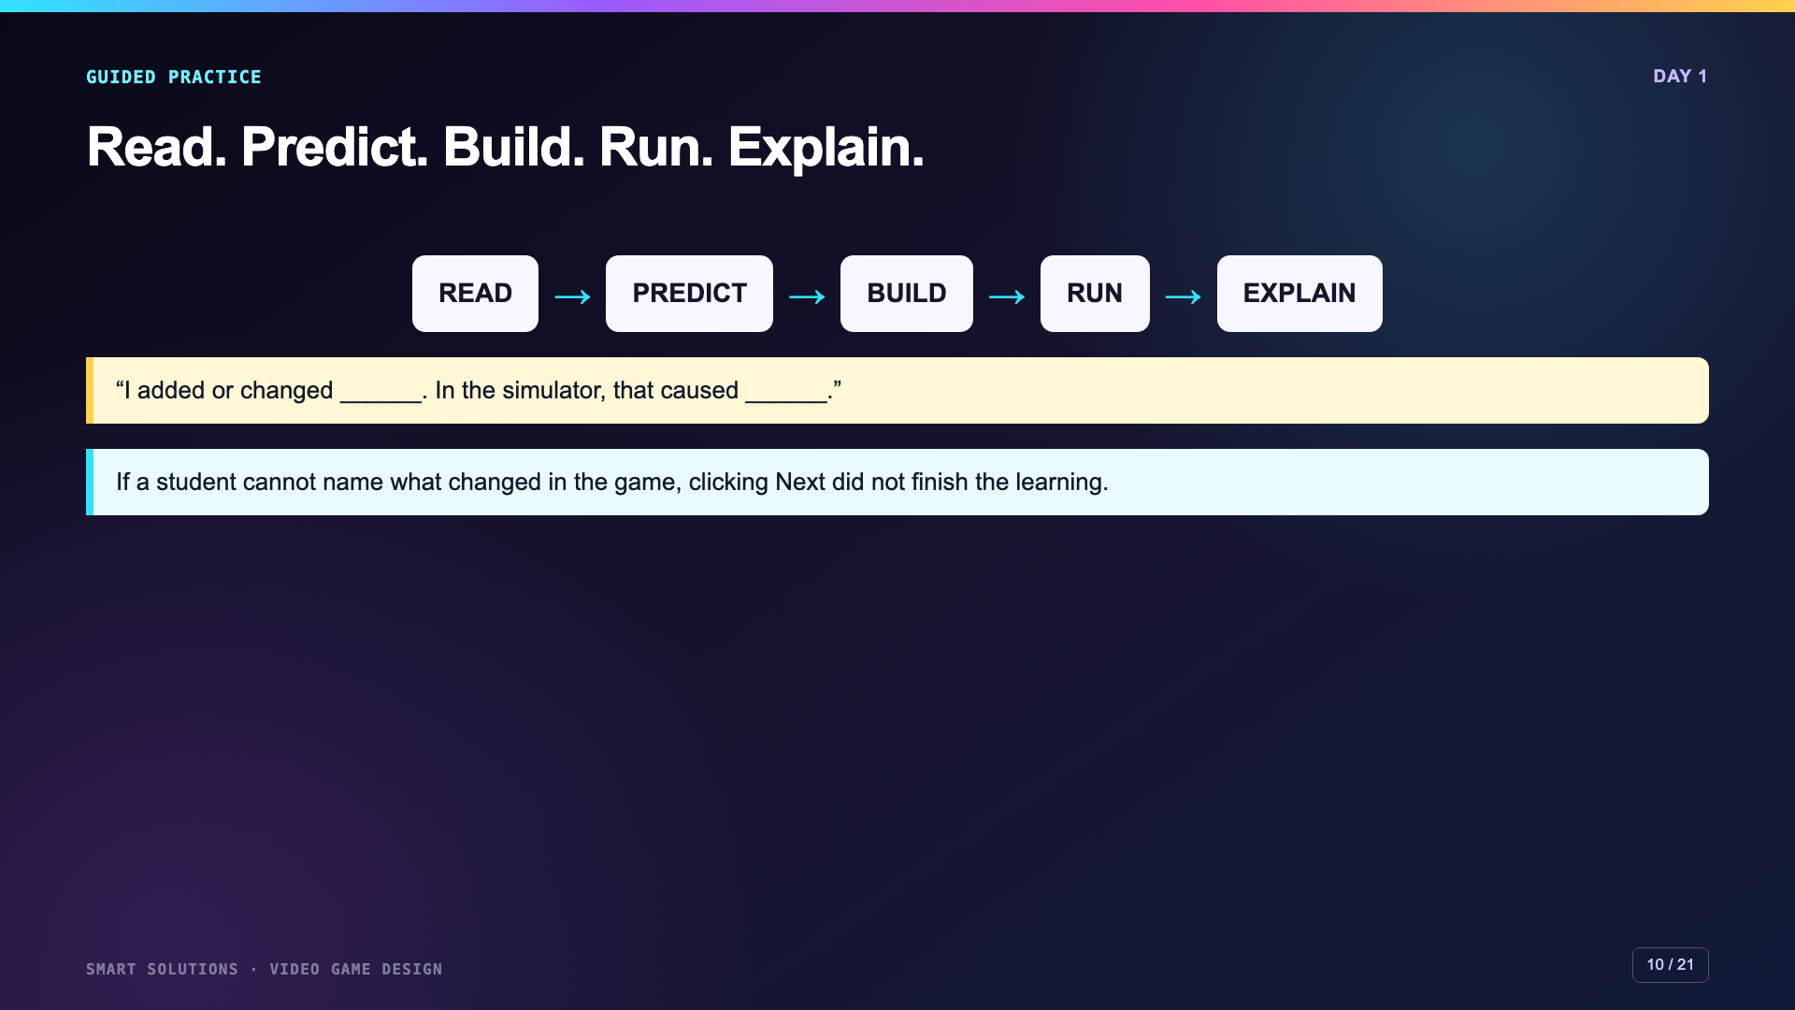
Notes:
Complete one tutorial step as a class. Before running, ask students to predict what the block will change. After running, require a code-to-game sentence.
[Sources]
- Microsoft MakeCode Arcade. “Intro to MakeCode Arcade.” https://arcade.makecode.com/tutorials/intro (accessed 2026-08-16).
- Smart Solutions Video Game Design Canvas module, facilitator guide, Lesson 1 Skillmap, Lesson 2 Remix, and rubric 6081. Irving 2027 Template course 23402 (accessed 2026-08-16).

Slide 11
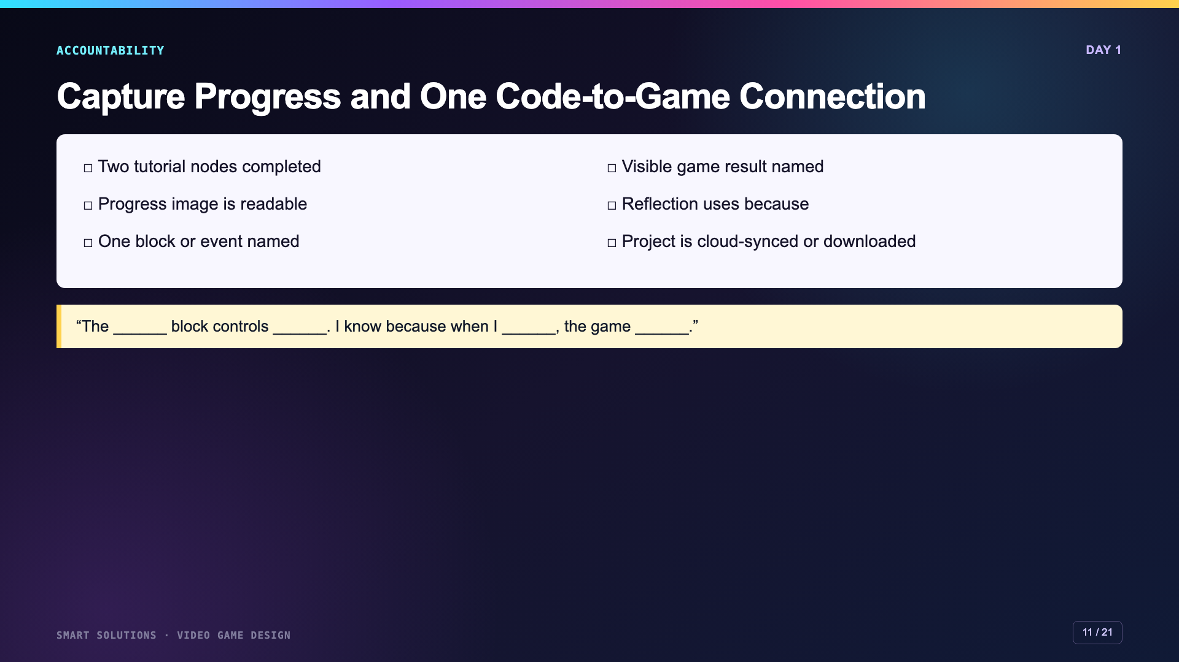
Notes:
Leave this up during submission. The screenshot verifies progress. The explanation is the conceptual evidence.
[Sources]
- Smart Solutions Video Game Design Canvas module, facilitator guide, Lesson 1 Skillmap, Lesson 2 Remix, and rubric 6081. Irving 2027 Template course 23402 (accessed 2026-08-16).
- Microsoft MakeCode Arcade. “Intro to MakeCode Arcade.” https://arcade.makecode.com/tutorials/intro (accessed 2026-08-16).

Slide 12
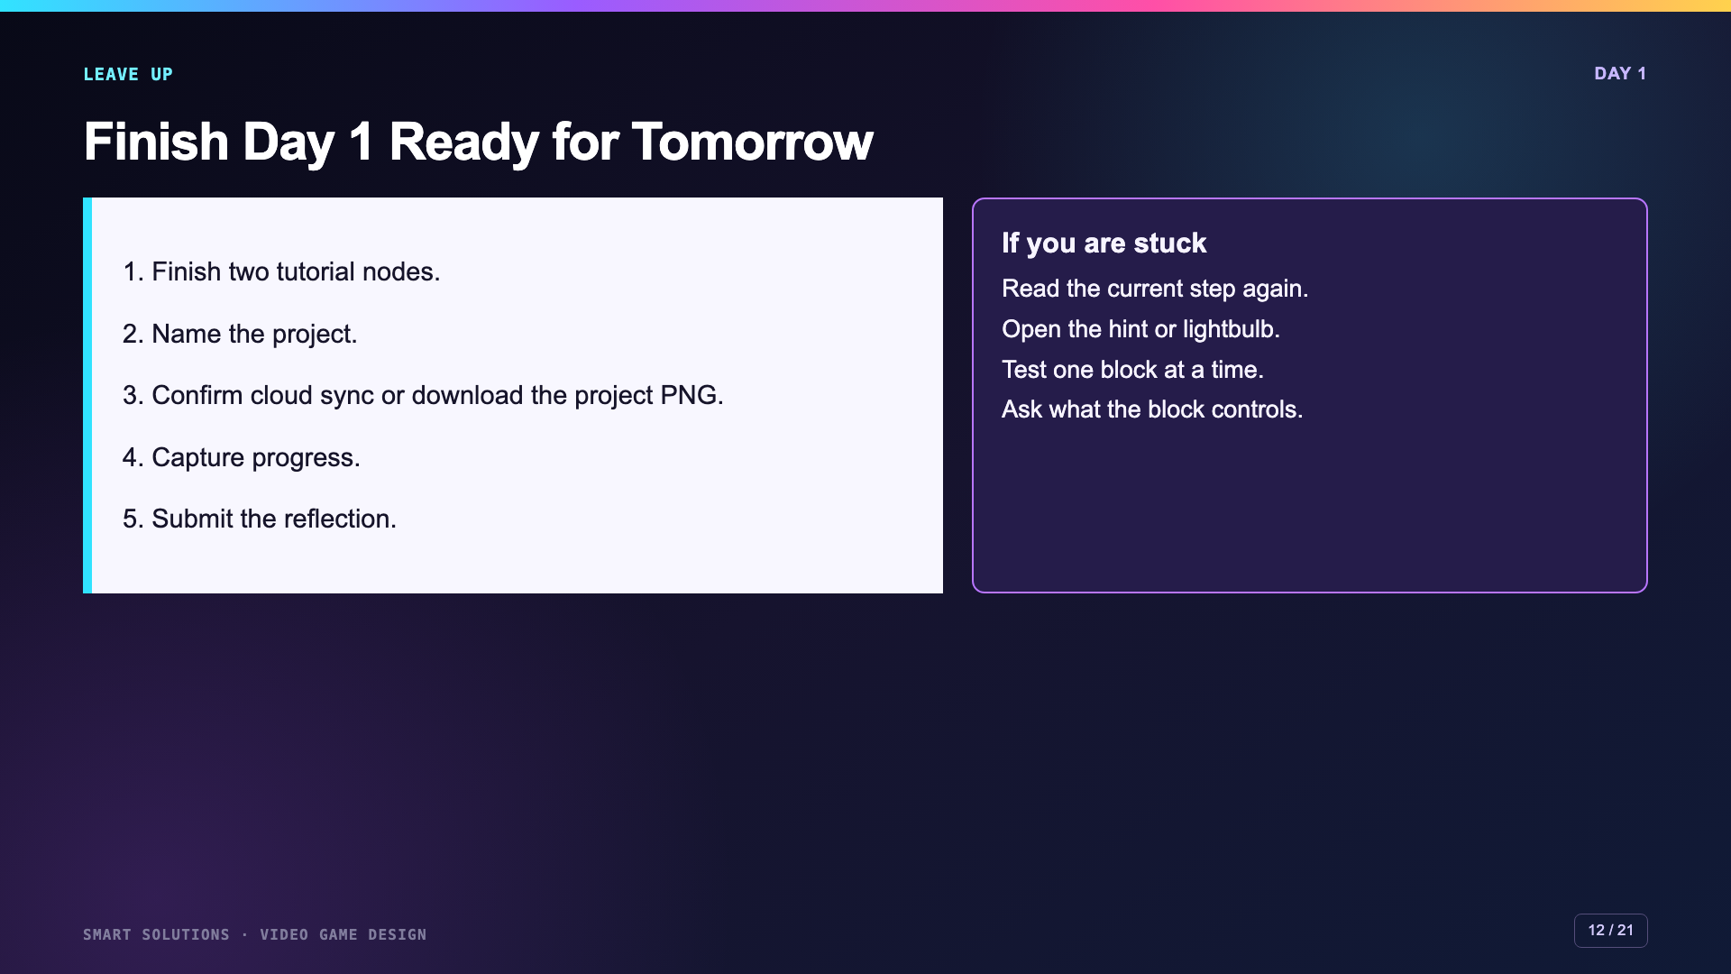
Notes:
Keep this slide projected for work time. Check backup status before dismissal because Day 2 depends on reopening a working project.
[Sources]
- Smart Solutions Video Game Design Canvas module, facilitator guide, Lesson 1 Skillmap, Lesson 2 Remix, and rubric 6081. Irving 2027 Template course 23402 (accessed 2026-08-16).
- Microsoft MakeCode Arcade. “Saving projects.” https://arcade.makecode.com/save (accessed 2026-08-16).
- Microsoft MakeCode Arcade. “Cloud Synchronization in MakeCode.” https://arcade.makecode.com/identity/cloud-sync (accessed 2026-08-16).

Slide 13
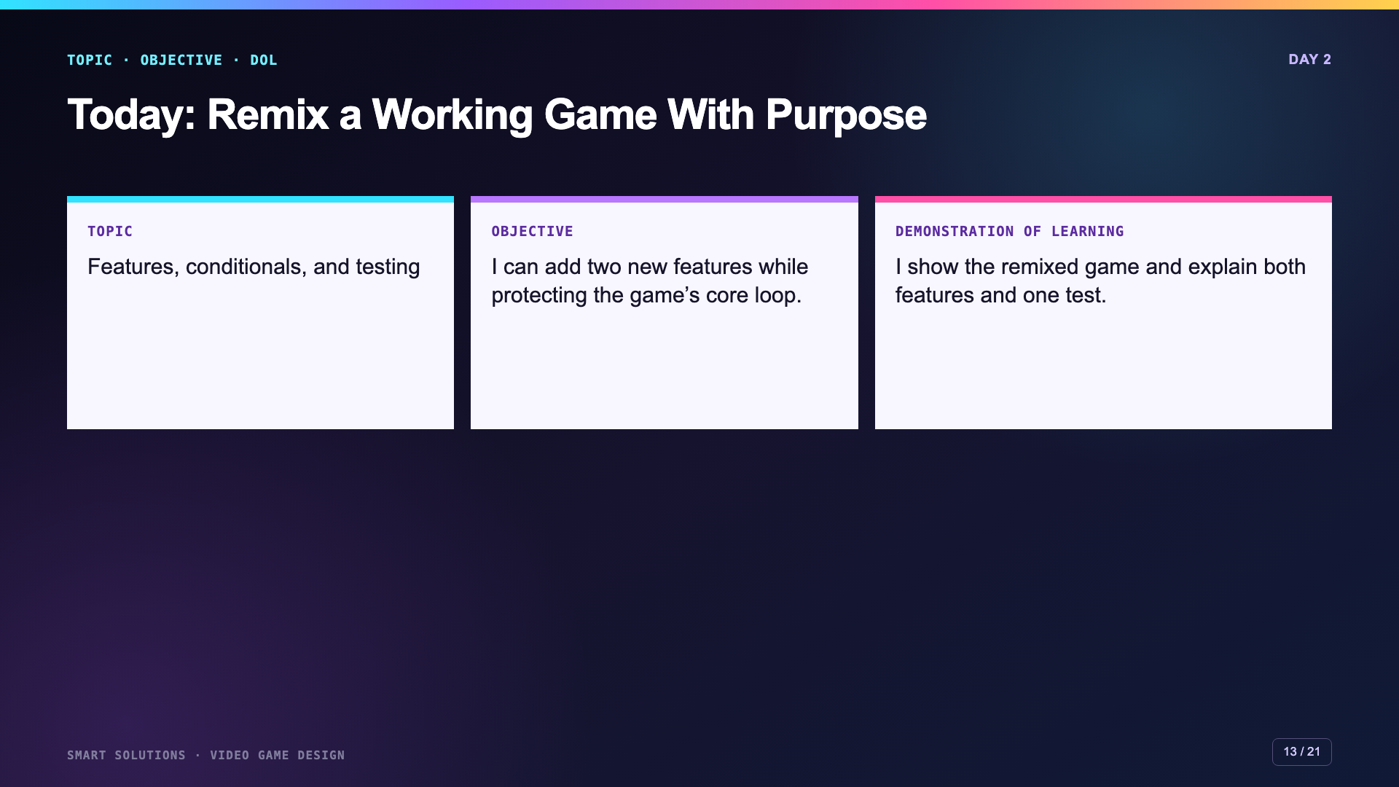
Notes:
Open by distinguishing a remix from random decoration. A remix preserves a working base and changes the player experience intentionally.
[Sources]
- Smart Solutions Video Game Design Canvas module, facilitator guide, Lesson 1 Skillmap, Lesson 2 Remix, and rubric 6081. Irving 2027 Template course 23402 (accessed 2026-08-16).

Slide 14
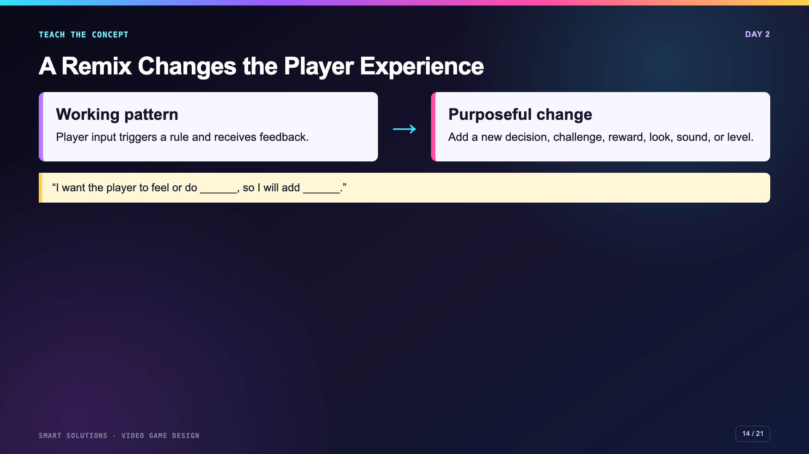
Notes:
Ask students what the player will notice, not only which block they will drag. Feature choice should have a reason.
[Sources]
- Smart Solutions Video Game Design Canvas module, facilitator guide, Lesson 1 Skillmap, Lesson 2 Remix, and rubric 6081. Irving 2027 Template course 23402 (accessed 2026-08-16).
- Microsoft MakeCode Arcade. “MakeCode Arcade Interface.” https://arcade.makecode.com/ide-tour (accessed 2026-08-16).

Slide 15
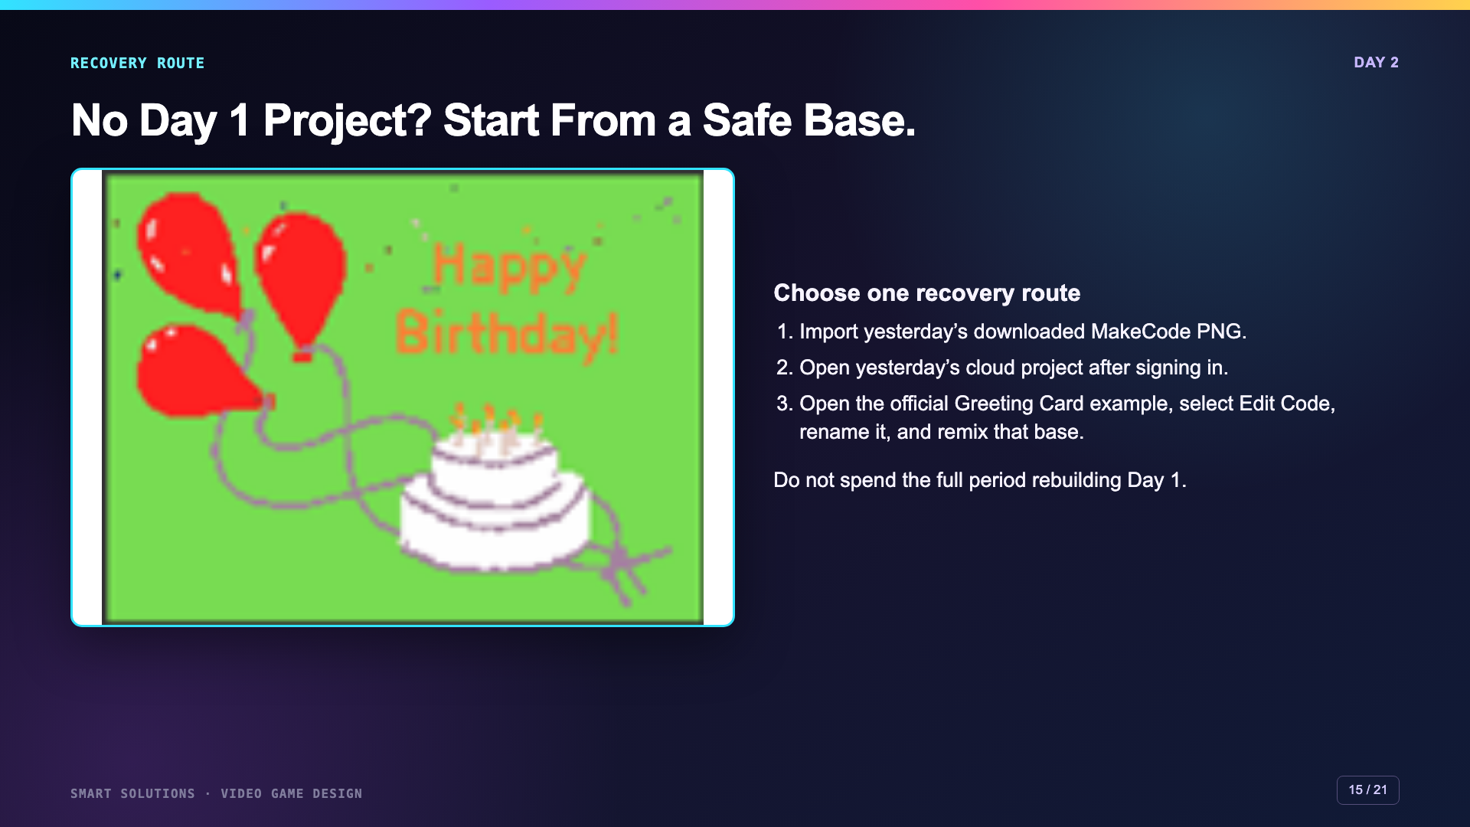
Notes:
Show the three recovery routes before work time. The official Greeting Card example is a bounded fallback for absentees or lost browser storage.
[Sources]
- Microsoft MakeCode Arcade. “Saving projects.” https://arcade.makecode.com/save (accessed 2026-08-16).
- Microsoft MakeCode Arcade. “Cloud Synchronization in MakeCode.” https://arcade.makecode.com/identity/cloud-sync (accessed 2026-08-16).
- Microsoft MakeCode Arcade. “Greeting Card.” https://arcade.makecode.com/14885-64298-31361-79978 (accessed 2026-08-16).
- Microsoft MakeCode Arcade. “About the Beginner’s Guide to Arcade Games.” https://arcade.makecode.com/skillmap/educator-info/basic-map-info (accessed 2026-08-16).

Slide 16
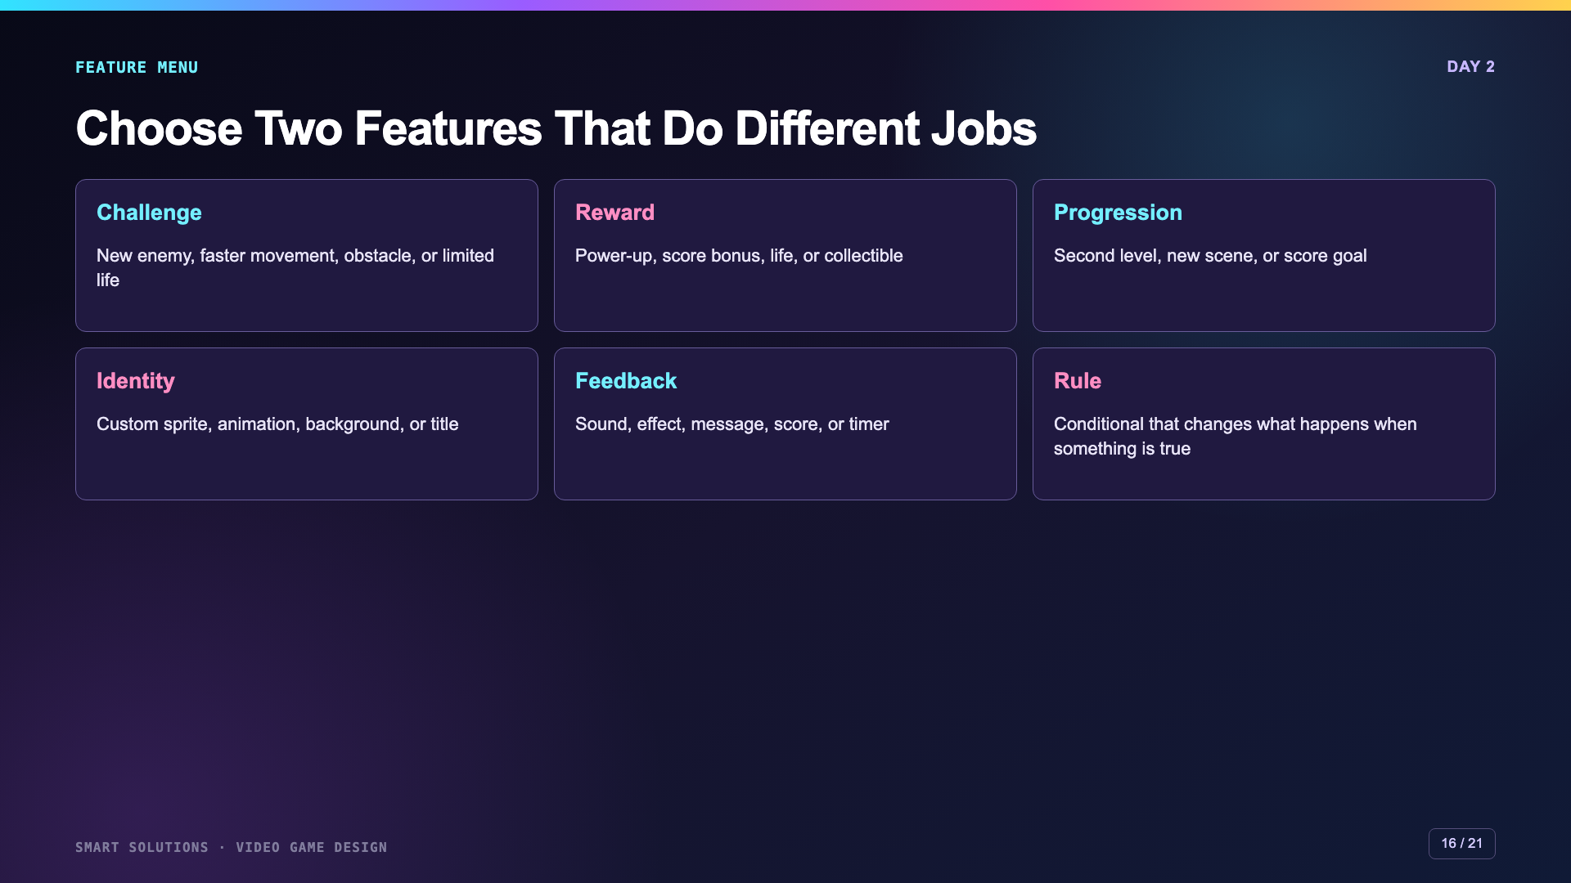
Notes:
Have students choose features from two different categories when possible. This reduces duplicate cosmetic changes and encourages a more meaningful remix.
[Sources]
- Smart Solutions Video Game Design Canvas module, facilitator guide, Lesson 1 Skillmap, Lesson 2 Remix, and rubric 6081. Irving 2027 Template course 23402 (accessed 2026-08-16).
- Microsoft MakeCode Arcade. “Intro to MakeCode Arcade.” https://arcade.makecode.com/tutorials/intro (accessed 2026-08-16).

Slide 17
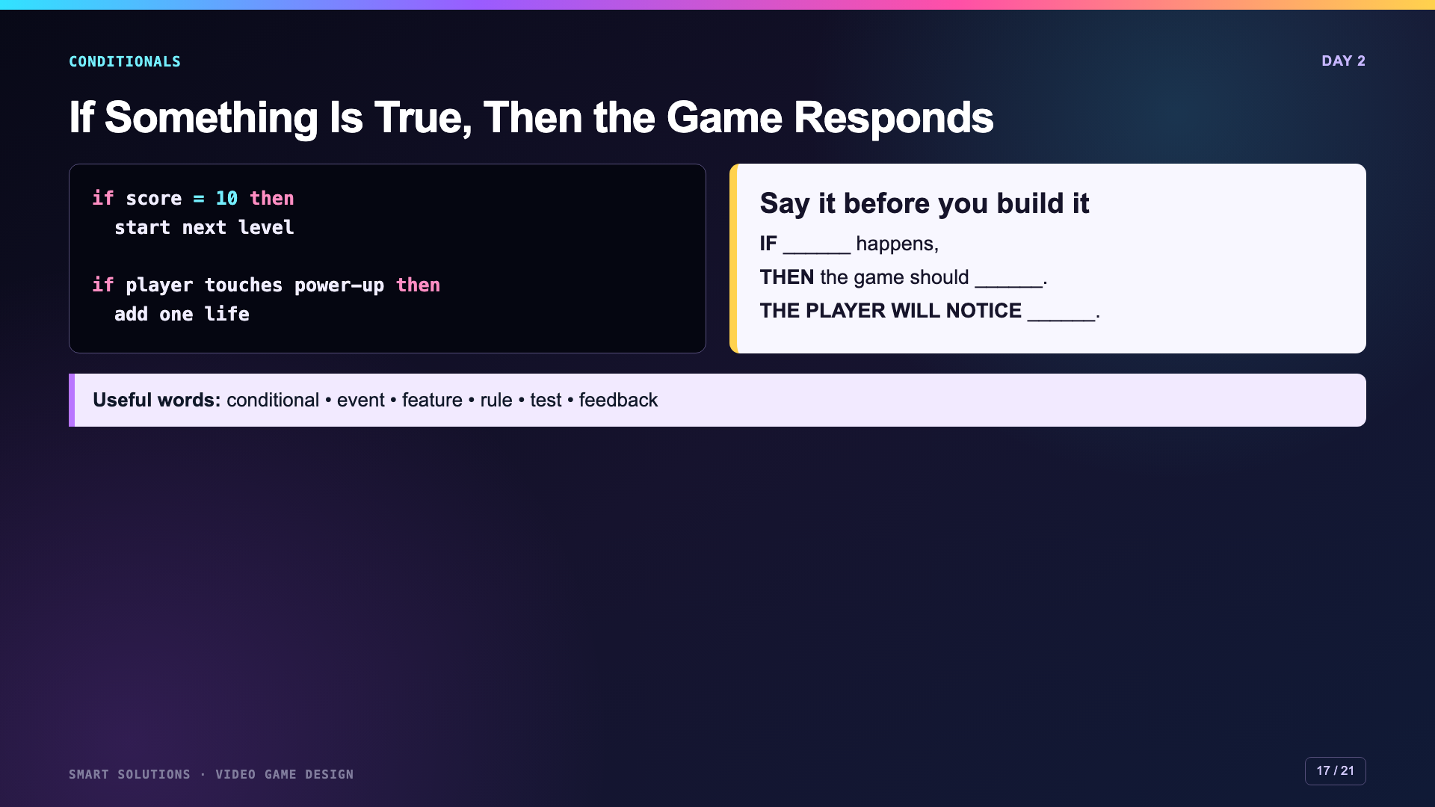
Notes:
Keep conditionals conceptual. Students do not all need the same block. They need a clear trigger, response, and visible player feedback.
[Sources]
- Smart Solutions Video Game Design Canvas module, facilitator guide, Lesson 1 Skillmap, Lesson 2 Remix, and rubric 6081. Irving 2027 Template course 23402 (accessed 2026-08-16).
- Microsoft MakeCode Arcade. “Intro to MakeCode Arcade.” https://arcade.makecode.com/tutorials/intro (accessed 2026-08-16).

Slide 18
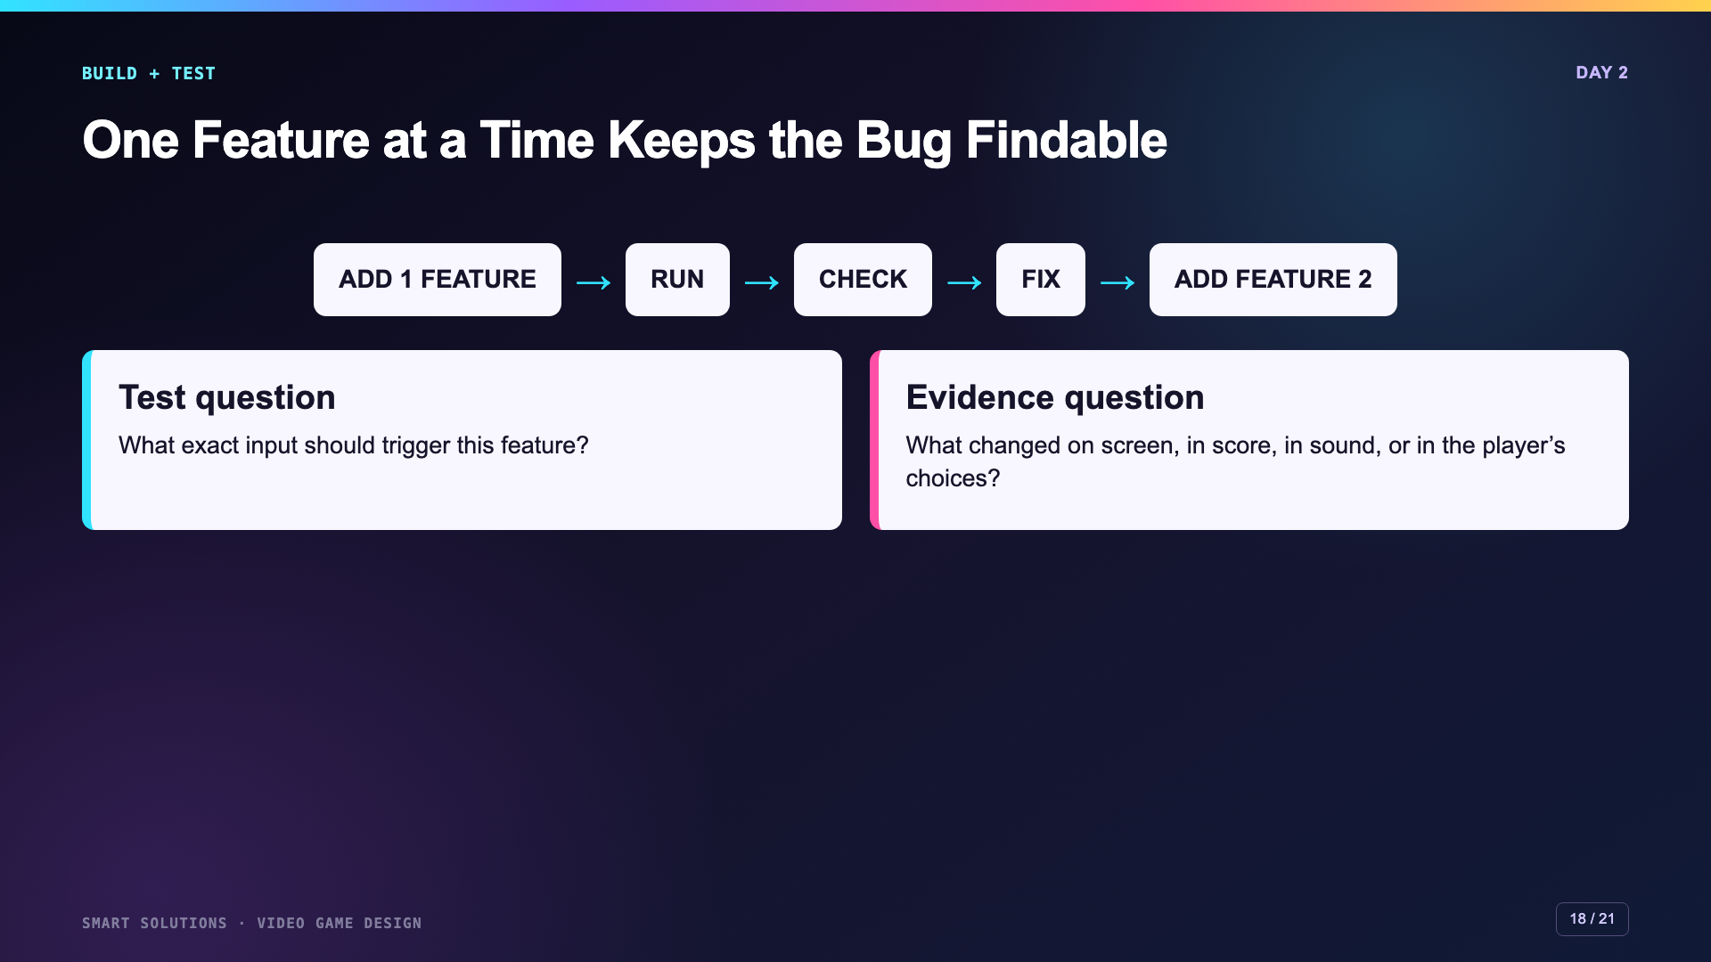
Notes:
Model why adding both features before testing makes debugging harder. Students should run the game after each feature and record one test result.
[Sources]
- Smart Solutions Video Game Design Canvas module, facilitator guide, Lesson 1 Skillmap, Lesson 2 Remix, and rubric 6081. Irving 2027 Template course 23402 (accessed 2026-08-16).
- Microsoft MakeCode Arcade. “Intro to MakeCode Arcade.” https://arcade.makecode.com/tutorials/intro (accessed 2026-08-16).

Slide 19
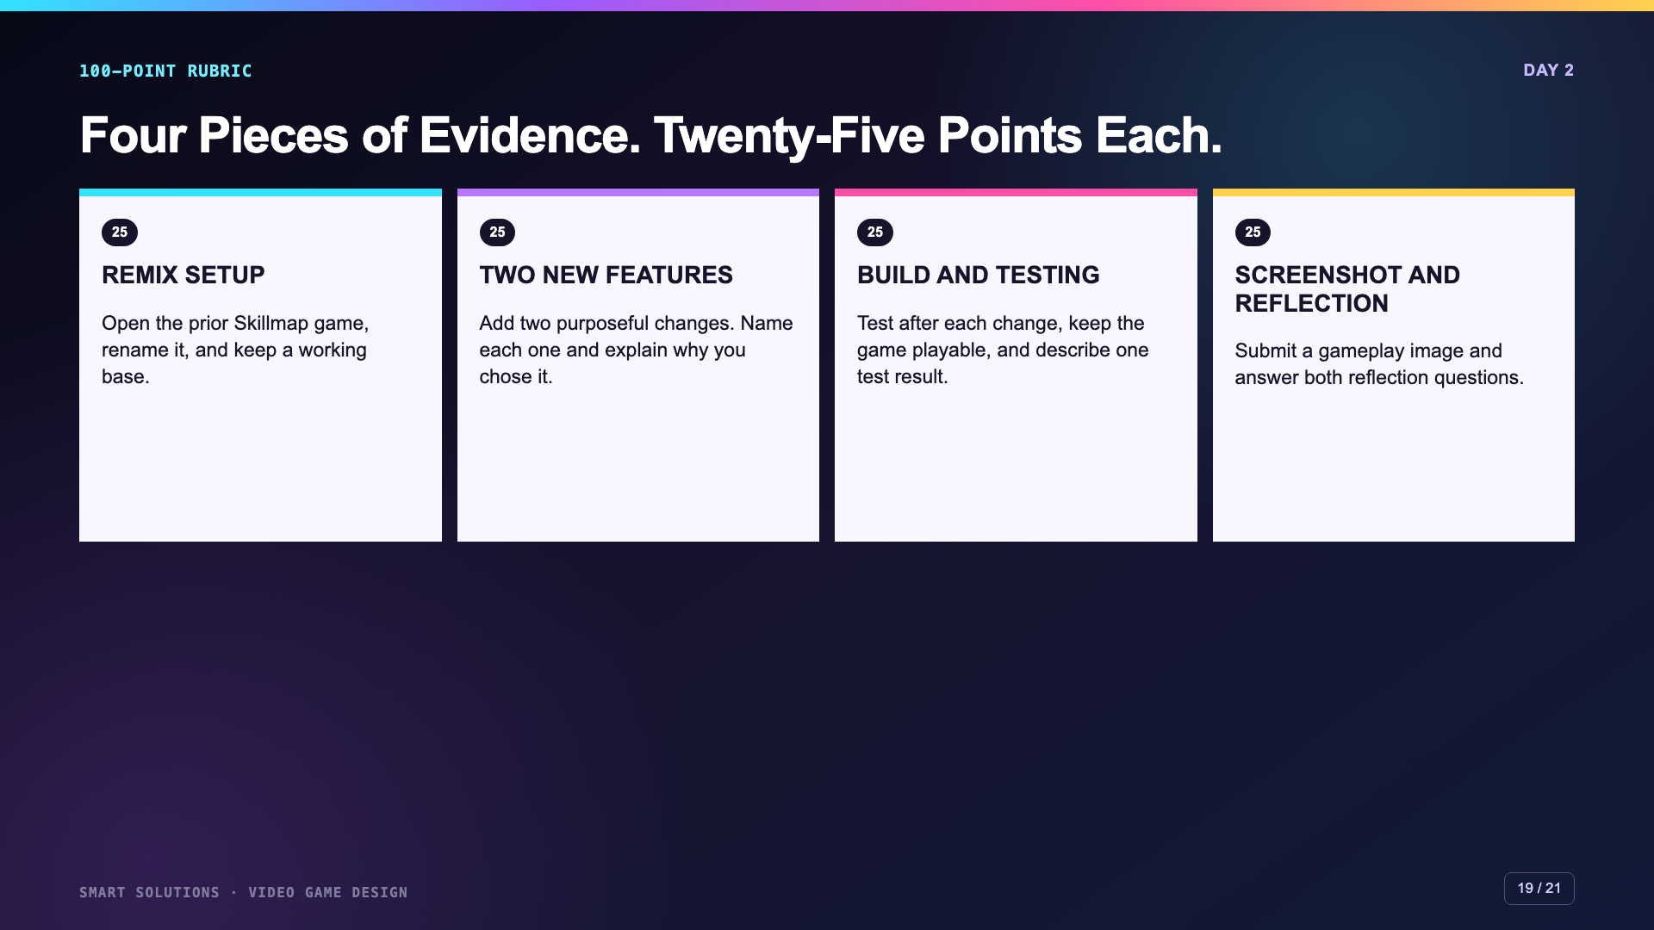
Notes:
Review the exact Canvas rubric before students begin. The product and the explanation both matter. Missing evidence should receive missing credit.
[Sources]
- Smart Solutions Video Game Design Canvas module, facilitator guide, Lesson 1 Skillmap, Lesson 2 Remix, and rubric 6081. Irving 2027 Template course 23402 (accessed 2026-08-16).

Slide 20
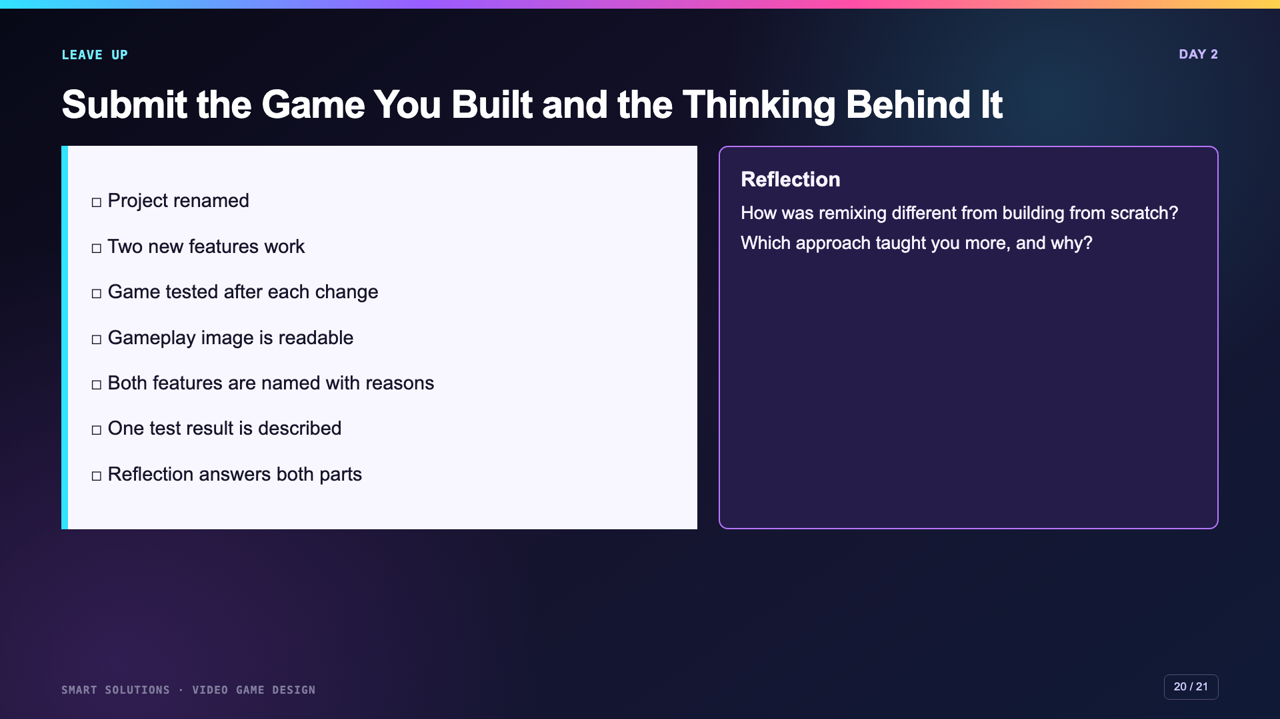
Notes:
Keep this slide projected through submission. Ask students to point to each feature in the gameplay image or live game before turning it in.
[Sources]
- Smart Solutions Video Game Design Canvas module, facilitator guide, Lesson 1 Skillmap, Lesson 2 Remix, and rubric 6081. Irving 2027 Template course 23402 (accessed 2026-08-16).

Slide 21
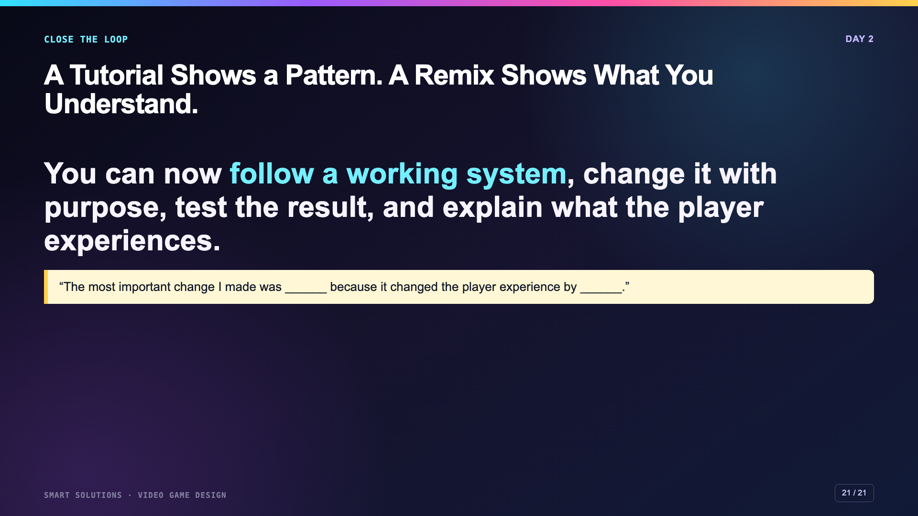
Notes:
Close by returning to the opening learning arc. Invite two or three students to show one feature and name the exact rule or block that controls it.
[Sources]
- Smart Solutions Video Game Design Canvas module, facilitator guide, Lesson 1 Skillmap, Lesson 2 Remix, and rubric 6081. Irving 2027 Template course 23402 (accessed 2026-08-16).
- Microsoft MakeCode Arcade. “About the Beginner’s Guide to Arcade Games.” https://arcade.makecode.com/skillmap/educator-info/basic-map-info (accessed 2026-08-16).

