Slide 1





Career Research Project
Grade 8 College and Career Readiness
Explore career opportunities, develop professional skills, and showcase your findings at our Mock Career Fair
Research
Website
Promotion
Presentation
Reflection
Practice real-world skills and prepare for your future!

Slide 2






Project Map & Canvas Navigation
Follow these 5 steps through your Canvas modules to complete your Career Research Project successfully
1
2
3
4
3
5
Choose a Career
Research Planning
Website Creation
Promotional Materials
Career Fair
Explore options and identify a career path
Gather detailed information
Build your digital portfolio
Present and evaluate
Design marketing materials
Canvas Module 1
Canvas Module 2
Canvas Module 3
Canvas Module 4
Canvas Module 5
Career exploration and self-assessment
Research tools and planning worksheets
Website creation tutorials and examples
Design tools and marketing templates
Presentation guidelines and reflection
Go to Module
Go to Module
Go to Module
Go to Module
Go to Module
Navigate between modules in Canvas to complete each step of your project

Slide 3





Choose Your Career
1
Discover what sparks your interest and find a career path that aligns with your passions, skills, and goals.
Explore your interests and passions
Research job outlook and growth
Discover education requirements
Learn about salary expectations
Canvas Module 1
Get Started

Slide 4
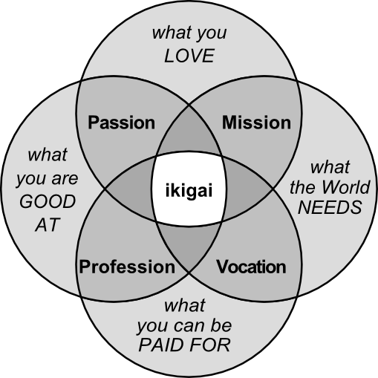






1
Finding Your Purpose: Ikigai
Ikigai is a Japanese concept meaning "a reason for being" that helps find where passion, skills, purpose, and livelihood intersect—ideal for career exploration.
The Four Elements of Ikigai
What You Love (Passion)
What You're Good At (Profession)
Activities that bring you joy and that you'd do even if you weren't paid.
Your natural talents and acquired skills that you excel in.
What You Can Be Paid For (Vocation)
What the World Needs (Mission)
Work that provides financial rewards in the current market.
Services or products that benefit society and address needs.
Applying Ikigai
When researching careers, ask yourself:
Does this career align with activities I love doing?
Connection to Career Research
Use the Ikigai framework to evaluate potential careers. A fulfilling career path should ideally incorporate all four elements, creating a sustainable balance between passion and practicality.
Am I naturally skilled in this area or can I develop these skills?
Is there market demand and compensation for this work?
Does this career contribute something meaningful to society?
TEKS Section 127.2 (1)(C) - Identify various career opportunities within one or more career clusters

Slide 5

Bell Ringer: Discover Your Ikigai
5:00
Reflect on your career path using the Ikigai framework
Using what you learned about Ikigai, identify elements in each of the four circles that apply to you personally.
What you LOVE
What you're GOOD AT
List 3 activities or subjects that you're passionate about and truly enjoy
Identify 3 skills or talents that come naturally to you or that you've developed
What the WORLD NEEDS
What you can be PAID FOR
Consider what problems or needs exist that you might help solve
Research careers that align with your other three circles
This activity helps you discover careers that align with your passions, skills, and purpose

Slide 6







1
Step 1: Choose Your Career – Canvas Connections
Use these tools in Canvas Module 1 to explore career options that match your interests and goals.
Career Research Tools
Career Exploration Tools
XELLO
XELLO
Career One Stop
Complete assessments to match your interests with potential careers. Explore detailed career profiles with education requirements and salary data.
CA Career Zone
O*NET
Salary.com
Explore California-specific career information, including regional demand and local education options for various careers.
Pro Tip
Bureau of Labor Statistics
Explore multiple careers before making your final choice. Select a career that genuinely excites you rather than one that simply seems practical. Your enthusiasm will show in your final project!
Research job outlook, growth projections, and detailed salary data from official government sources.
Canvas Module Connection
Complete the Career Interest Survey in Module 1, then submit your top career choice with a brief explanation of why it interests you. Connect your choice to your personal strengths and interests.
TEKS Section 127.2 (1)(C) - Identify various career opportunities within one or more career clusters

Slide 7




Career Research Planning
2
Let's dig deeper into your career's requirements, skills, outlook, and benefits.
Organize your research findings
Complete planning worksheets
Analyze job market data
Identify career benefits and challenges
Canvas Module 2
Research Tools

Slide 8

Bell Ringer: 'Would You Rather?' – Job Perks
3:00
Would you rather have a high salary but limited work-life balance or a lower salary but better work-life balance?
Think about your priorities and values. Discuss your choice with a partner and explain your reasoning.
Option A
Option B
Consider
High salary, but long hours, limited time off, and high stress levels
Lower salary, but flexible schedule, generous time off, and lower stress
Your lifestyle goals, family needs, financial requirements, and personal fulfillment
This activity helps you identify personal values that will influence your career choices

Slide 9




2
Step 2: Research Tools & Canvas Integration
Career Research Planning
Organize your career research with structured planning tools and resources from Canvas Module 2 to gather comprehensive information.
Education Needed:
Research Resources & Planning
Skills Required:
Salary Range:
Career Research Planning Worksheet
Job Outlook:
Use this structured worksheet to organize information about education requirements, skills needed, salary ranges, job outlook, and more for your chosen career.
Benefits:
Challenges:
Job Outlook Research
Evaluate future prospects, growth trends, and emerging opportunities in your field using BLS data and industry forecasts.
Research Strategy
Start with XELLO for comprehensive basics, then check specialized sites for specific details like regional salary ranges and industry growth trends. Using multiple sources provides a more complete and accurate picture of your career.
Benefits & Challenges Analysis
Identify and document key advantages and potential obstacles in your chosen career to present a balanced view in your final project.
Canvas Module Connection
TEKS Section 127.2 (1)(D) - Research and evaluate emerging occupations related to career interest areas
Complete the Career Research Planning Worksheet in Canvas Module 2. Use resources like XELLO, CareerOneStop, Bureau of Labor Statistics, and O*NET to gather comprehensive information about your career's outlook, requirements, and trends.

Slide 10




Create Your Website
3
Turn your research into a professional and easy-to-navigate website. This is your digital portfolio!
Organize content logically
Build with Google Sites
Present data visually
Showcase education pathways
Canvas Module 3
Start Building

Slide 11

Bell Ringer: What Makes a Good Website?
3:00
Share and discuss: What features make a website enjoyable to view and use?
Think about websites you visit frequently. What elements make them effective, user-friendly, and professional?
Design Elements
User Experience
Content Quality
Layout, colors, fonts, images, and overall visual appeal that engages visitors
Navigation, loading speed, organization, and ease of finding information
Clear information, error-free text, relevant visuals, and professional tone
This activity prepares you for creating your own career research website in Step 3

Slide 12
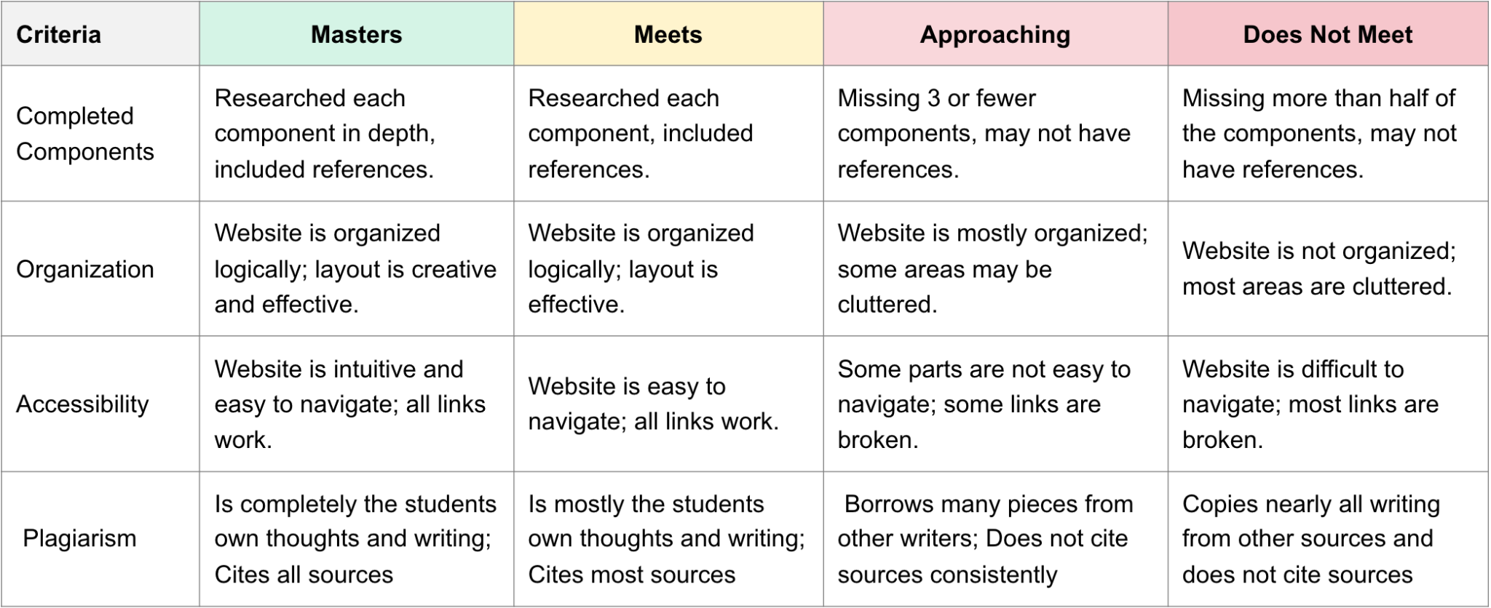


3
Step 3: Website
Create a well-organized website that presents your career research in an accessible and engaging format using Google Sites.
Website Content Requirements
Career Research Elements
TEKS Section 127.2 (4)(C) - Give professional presentations on a topic related to career and college exploration using appropriate technology
(2) The student investigates educational and training requirements for career and education pathways
in one or more of the career clusters.
Your website must include the following components from your research worksheet:
Why you chose this career
Job responsibilities
Education needed
Skills needed
Salary information
Best locations
Job outlook
Benefits & challenges
Website Design Elements
Create a professional website with these key components:
Multiple pages or sections
Navigation menu
Career video (1-5 min)
Professional images
Interview with a professional
References page
Canvas Module Connection
Refer to Canvas Module Step 3 for detailed instructions, examples of successful student websites, and access to the Google Sites tutorial. Your website will be evaluated on organization, accessibility, content quality, and writing conventions.
Website Structure Example
Website Success Tips
Organize information logically with clear headings. Include visuals that enhance understanding, not just for decoration. Proofread carefully for spelling and grammar errors. Test all links before submission. Remember that quality matters more than quantity!

Slide 13




Promotional Materials
4
Design eye-catching promotional materials that will be displayed at the Career Fair. Think like a marketing expert!
Create attention-grabbing headlines
Design visually appealing layouts
Highlight career benefits and perks
Showcase professional branding
Canvas Module 4
Get Started

Slide 14

Bell Ringer: Design Challenge Kickstart
2:00
What slogan or image best represents your chosen career?
Quickly sketch or write your initial ideas for promotional materials that capture the essence of your career choice
For Slogans
For Visuals
Share
Think of short, memorable phrases that highlight the key benefits or unique aspects of your career
Consider symbols, tools, or scenes that instantly communicate what your career involves
Be prepared to explain your design idea to a neighbor and get their feedback
Creating effective promotional materials starts with a strong central concept

Slide 15









4
Step 4: Promotional Materials
Create eye-catching promotional materials that effectively communicate the key benefits of your chosen career.
Example Materials
Choose Your Promotional Formats
Trifold Board or Poster
Perfect for detailed information display with visual impact. Use clear sections and engaging visuals to attract attention.
Trifold Board
Brochure
Flyer or Brochure
Great for quick information sharing. Include a catchy headline, key points, and professional design elements.
Flyer
Poster
Creation Tools
See Canvas for full student examples gallery
Use Canva (recommended), Google tools, or traditional art materials to create your materials based on your skills.
Requirements Checklist
Canvas Module Connection
Eye-catching headline
Catchy motto or question
Visit Canvas Module Step 4 to view student examples, access Canva tutorials, and review the detailed grading rubric. Both materials should share similar branding and style.
Key benefits bullets
Supporting visuals
Contact information
Consistent branding
TEKS Section 127.2 (4)(c) - Give professional presentations on a topic related to career and college exploration

Slide 16








Step 5: Career Fair Presentation
You've reached the final stage! It's time to present your research, evaluate others' presentations, and reflect on your learning journey
1
2
3
4
5
Choose a Career
Research Planning
Website Creation
Promotional Materials
Career Fair
Explore options
Gather information
Digital portfolio
Marketing materials
Present & reflect
Presenter Role
Attendee & Reflection
Present your website
and promotional materials to showcase your career research
Visit other booths
and complete the Attendee Survey for each
Ask thoughtful questions
to learn about diverse career options
Dress professionally
(or in career uniform) to make a good impression
Write a reflection
(200-300 words) on your project experience
Answer questions
about your chosen career with confidence
Consider how this project
has influenced your future plans
Create an engaging display
that attracts visitors to your booth
Congratulations on completing your Career Research Project!
See Canvas Module 5 for complete Career Fair guidelines, rubrics and reflection instructions

