Slide 1
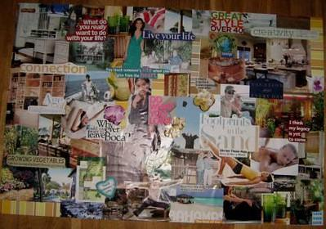
Bell Ringer
You have <<5:00>> minutes to submit your vision board

Slide 2
 |  | Standards & Materials
T | Career Research Project - Day 1 | TEKS Section 127.2 (1)(C) - Identify various career opportunities within one or more career clusters. Materials: Laptop/Tablet Pencil, Paper
O | Students will be introduced to the five components of the Career Research Project and will narrow down their career choices, aligning with TEKS Section 127.2 (1)(C).
D | Students will choose a career for their project using Xello and explain in two sentences why they chose it.
A | Career Components - The five essential parts of the Career Research Project that students must complete.
Y | What career interests me the most and why?
What’s Happening TODAY

Slide 3

Would You Rather? - Work-Life Balance
Would you rather have a high salary but limited work-life balance or a lower salary but better work-life balance?

Slide 4

Career Research Project
Grade 8 College and Career Readiness

Slide 5
 |  | Standards & Materials
T | Career Research Project - Day 1 | TEKS Section 127.2 (1)(C) - Identify various career opportunities within one or more career clusters. Materials: Laptop/Tablet Pencil, Paper
O | Students will be introduced to the five components of the Career Research Project and will narrow down their career choices, aligning with TEKS Section 127.2 (1)(C).
D | Students will choose a career for their project using Xello and explain in two sentences why they chose it.
A | Career Components - The five essential parts of the Career Research Project that students must complete.
Y | What career interests me the most and why?
What’s Happening TODAY

Slide 6
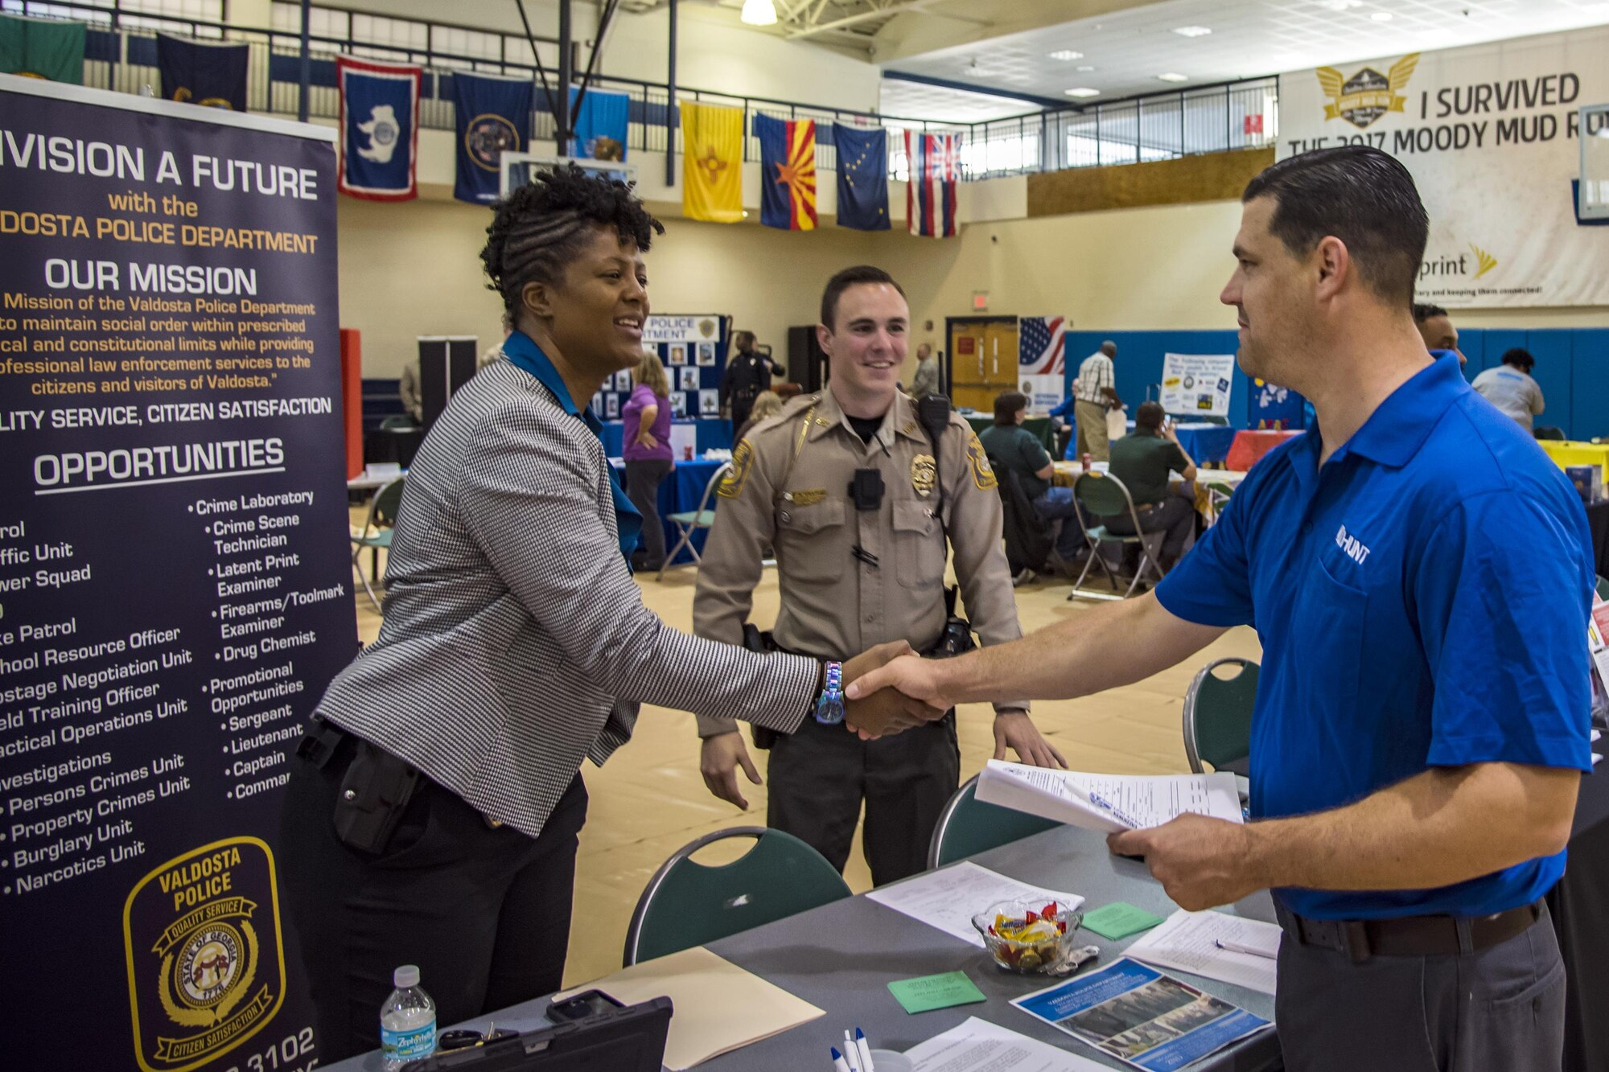
Career Research Overview
In this project, you will explore different careers and gain insights into the skills and education required for each.
You will create a website and design promotional materials to showcase the career you choose.
You will present your findings at a career fair and survey other students' displays to gain a broader perspective.

Slide 7

Part 1: Choosing a Career
Research different career options based on your interests, skills, and passions.
Decide which career you want to pursue for your career fair project.

Slide 8

Part 1: Conducting Research
Use reliable sources such as career websites, government databases, and industry publications to gather information about your chosen career.
Take notes, organize information, and compile a list of key points to include in your website and promotional materials.

Slide 9

Part 2: Creating a Website
Use Google Sites to create your career-focused website.
Include sections such as an introduction, educational requirements, job outlook, salary range, and potential career paths.
Use engaging visuals, informative text, and interactive elements.

Slide 10
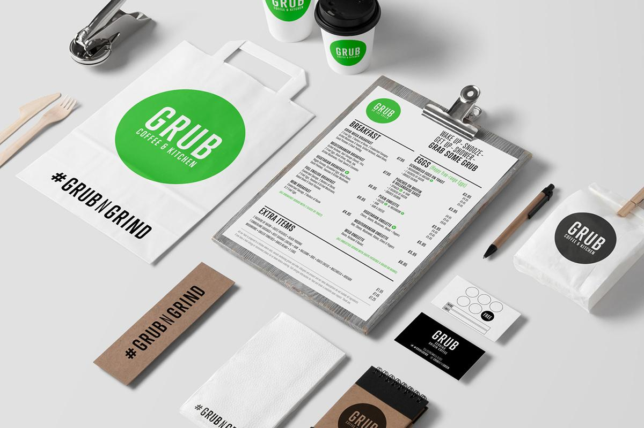
Part 3: Designing Promotional Materials
Create eye-catching posters, brochures, or flyers to promote your chosen career at the career fair.
Include key information such as job responsibilities, and required skills.
Use colors, images, and fonts that align with the career.

Slide 11

Part 4: Presenting at the Career Fair
Prepare a presentation to showcase your research findings and promote the chosen career.
Practice your presentation to ensure clarity, confidence, and effective communication
Engage with the audience, answer their questions.

Slide 12
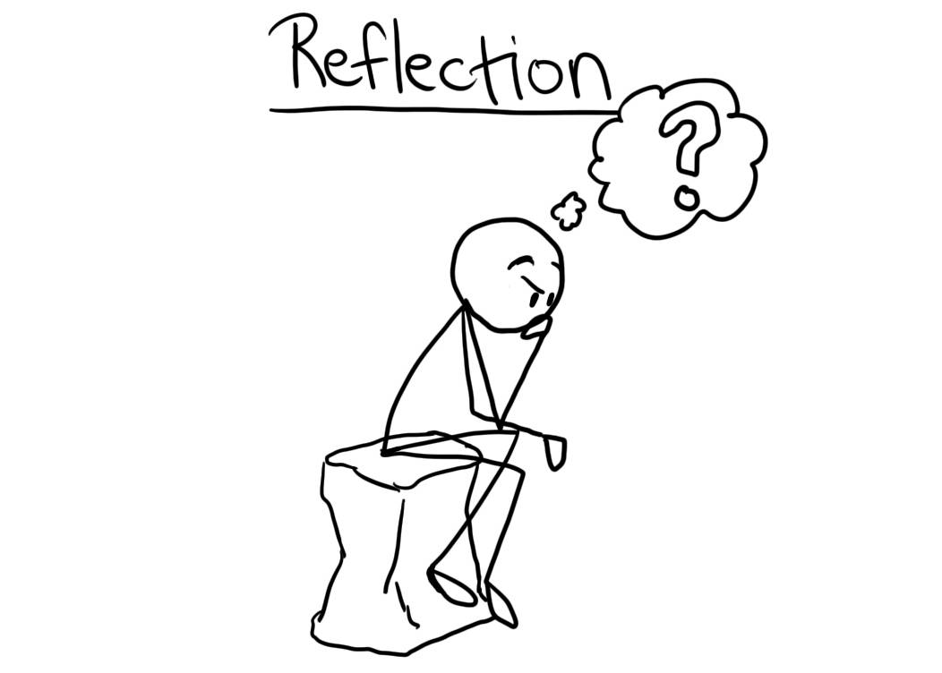
Part 5: Surveying and Questioning Other Students' Displays
Observe and analyze other students' career displays at the fair to gain a broader perspective on different careers.
Ask questions about their research process, interesting findings, challenges faced, and future plans related to their chosen career.

Slide 13

Career Research Project: Part 1 - Choose a Career and Research It
Grade 8 College and Career Readiness Course

Slide 14

Introduction to Career Research Project
Career research involves gathering information about a specific career, such as the job duties, required education, salary, and work environment.

Slide 15

Step 1: Choosing a Career
Exploring Your Interests
Identify your passions and hobbies
Consider your skills and strengths

Slide 16

XELLO - Explore Careers
XELLO is an online platform that helps students explore different careers.
It provides detailed information about various jobs, including required education, skills, and salary expectations.

Slide 17
Other Recommended Research Websites
In addition to XELLO, there are other websites that can help you with career research:
CareerOneStop: Provides information on career exploration, training programs, and job search tools.
Bureau of Labor Statistics: Offers detailed data on job outlook, wages, and required education for various occupations.
O*NET OnLine: Provides comprehensive information on skills, abilities, and work activities associated with different careers.

Slide 18

Submit in Canvas - Choose a Career and Explain Why
After conducting your career research, you will choose a career that interests you and explain why you are drawn to that particular field.
You will submit your response in Canvas.
Be sure to provide specific reasons and examples to support your choice.

Slide 19
 |  | Standards & Materials
T | Career Research Project - Day 2 | TEKS Section 127.2 (1)(D) Research and evaluate emerging occupations related to career interest areas. Materials: Laptop/Tablet Pencil, Worksheet
O | Students will evaluate the job outlook, benefits, and challenges of their chosen careers to understand its future prospects.
D | Students will demonstrate their understanding by completing and submitting their Career Research Planning Sheets.
A | Job Outlook - The projected availability of jobs in a particular field for a specific period.
Y | What have you learned about the future prospects and challenges of your chosen career?
What’s Happening TODAY

Slide 20

Step 2: Career Research Planning Worksheet
To help you organize your career research, use the Career Research Planning Worksheet.
This worksheet will guide you through the research process and ensure you gather all the necessary information about your chosen career.

Slide 21
Would You Rather? - Work-Life Balance
Would you rather have a high salary but limited work-life balance or a lower salary but better work-life balance?

Slide 22
 |  | Standards & Materials
T | Career Research Project - Informational Website | TEKS Section 127.2 (4)(c) Give professional presentations on a topic related to career and college exploration using appropriate technology. Materials: Laptop/Tablet Pencil, Worksheet
O | Learn how to create a digital platform to present their career research
D | Begin building their own websites using Google Sites.
A | Digital Platform - An online space where content can be published and shared.
Y | How can a website effectively communicate your career research?
What’s Happening TODAY

Slide 23
 |  | Standards & Materials
T | Creating Promotional Materials | TEKS Section 127.2 (4)(c) Give professional presentations on a topic related to career and college exploration using appropriate technology. Materials: Laptop/Tablet Pencil, Worksheet
O | Students will learn how to create effective promotional materials to highlight the key aspects of their chosen careers.
D | Students will use Canva or alternative methods to design two types of promotional materials that showcase the selling points of their career
A | Promotional Materials - Items used to advertise a product, service, or cause.
Y | What elements are essential for making your career promotional materials both eye-catching and informative?
What’s Happening TODAY

Slide 24
 |  | Standards & Materials
T | Finalizing Promotional Materials | TEKS Section 127.2 (4)(c) Give professional presentations on a topic related to career and college exploration using appropriate technology. Materials: Laptop/Tablet Pencil, Worksheet
O | Ensure they effectively highlight the key aspects of their chosen career in a professional and creative manner.
D | Students will continue to refine their promotional materials under teacher supervision and aim for completion by the end of Day 9
A | Refinement - The process of making improvements to a project or task.
Y | How do you know when your promotional materials are ready to be shared?
What’s Happening TODAY

Slide 25
 |  | Standards & Materials
T | Finalizing Promotional Materials | TEKS Section 127.2 (4)(c) Give professional presentations on a topic related to career and college exploration using appropriate technology. Materials: Laptop/Tablet Pencil, Worksheet
O | Ensure they effectively highlight the key aspects of their chosen career in a professional and creative manner.
D | Students will continue to refine their promotional materials under teacher supervision and aim for completion by the end of Day 9
A | Refinement - The process of making improvements to a project or task.
Y | How do you know when your promotional materials are ready to be shared?
What’s Happening TODAY

Slide 26
 |  | Standards & Materials
T | Finalizing Promotional Materials | TEKS TEK (4) The student develops skills for personal success. The student is expected to: (A) demonstrate effective time-management and goal-setting strategies; Materials: Laptop/Tablet Pencil, Worksheet
O | Students will practice effective time-management and goal-setting strategies to align their academic performance with their personal goals.
D | Students will complete 30 minutes of TypingClub, check their grades, and ensure all assignments are turned in.
A | Time-management, Goal-setting
Y | How can effective time-management and goal-setting improve your academic performance?
What’s Happening TODAY

