Slide 1

You are the
Unicode Consortium
Grade 6 presentations
Vote on the 3 emojis you want added to our standard
Winners receive extra credit & 3 Dojo Points

Slide 2
What kind of emojis do we want?
Breaking New Ground
Many Different Usages
Relevant & Frequently Used

Slide 3
What are good presentation skills?

Slide 4
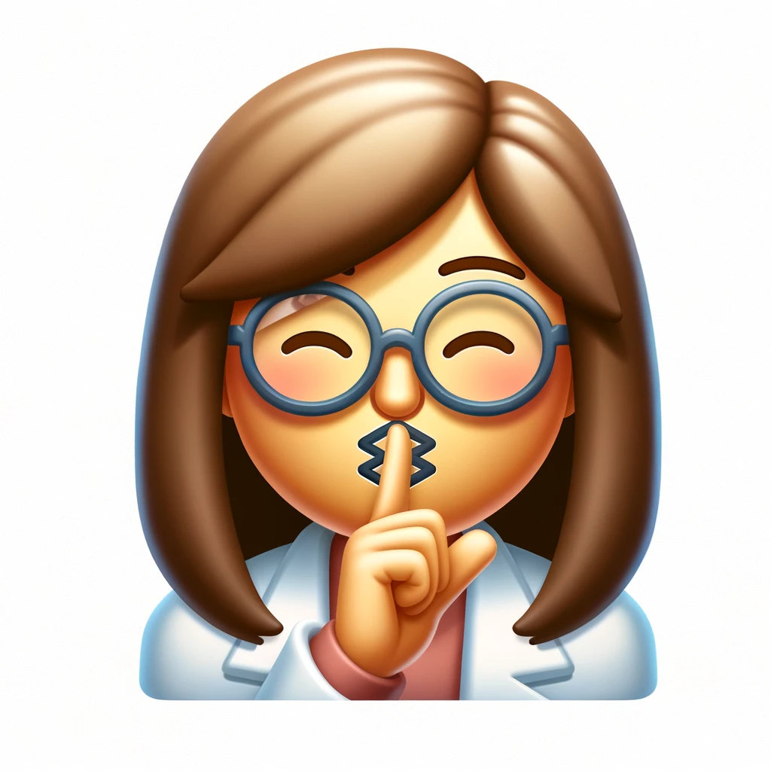
Silent Plea Emoji
Relatable to Teachers
First Education Specific Emoji
Can Be Used By Others
Always Relevant

Slide 5
Name of Emoji
Emoji Here
<<10:00>>
Final Touches
“My emoji represents…”
"I believe many people will use this emoji because..."
"My emoji is the first that expresses the idea of….”
"While there are emojis for [Related Concept], mine stands out because..."
Although we have emojis like..., mine is different because..."
"Years from now, my emoji will still be relevant because..."
"My emoji can mean both... and..."

