Slide 2
History of Emoji

Slide 3
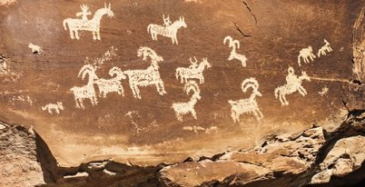
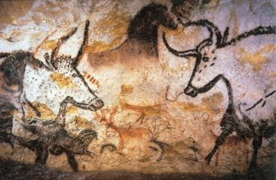
Pictograph Art
Have you ever heard of “Rock Art”? How are they made? With what tools? Well, did you know that there are two types of Rock Art. Petroglyphs and Pictographs. A petroglyph is an image that is carved into a rock. Take a glance at the image below. A pictograph is a drawing or painting that is created on a rock. Notice the difference between the two. ​
Petroglyph = carving ​
Pictograph = drawing/painting

Slide 4
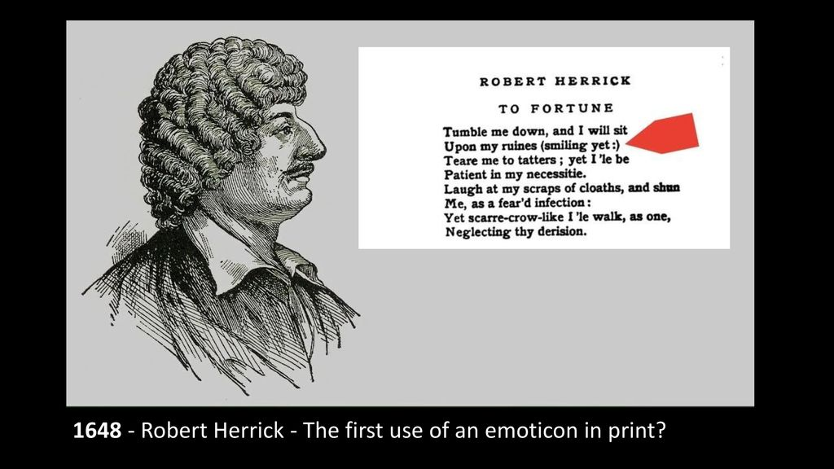

Slide 5
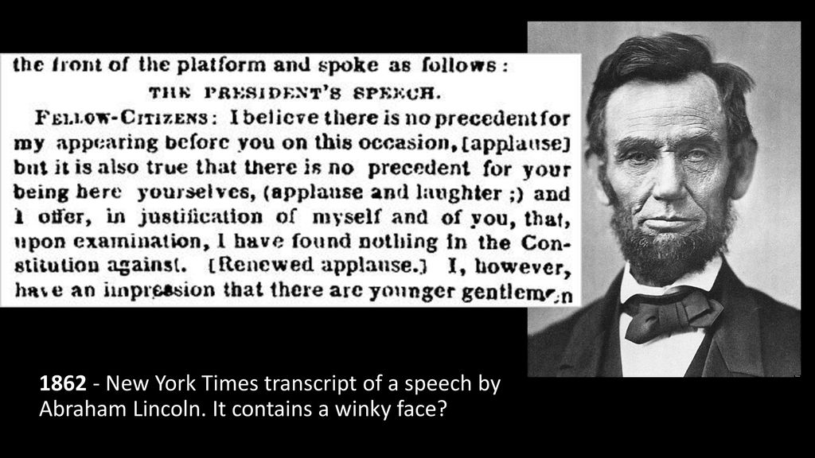

Slide 6
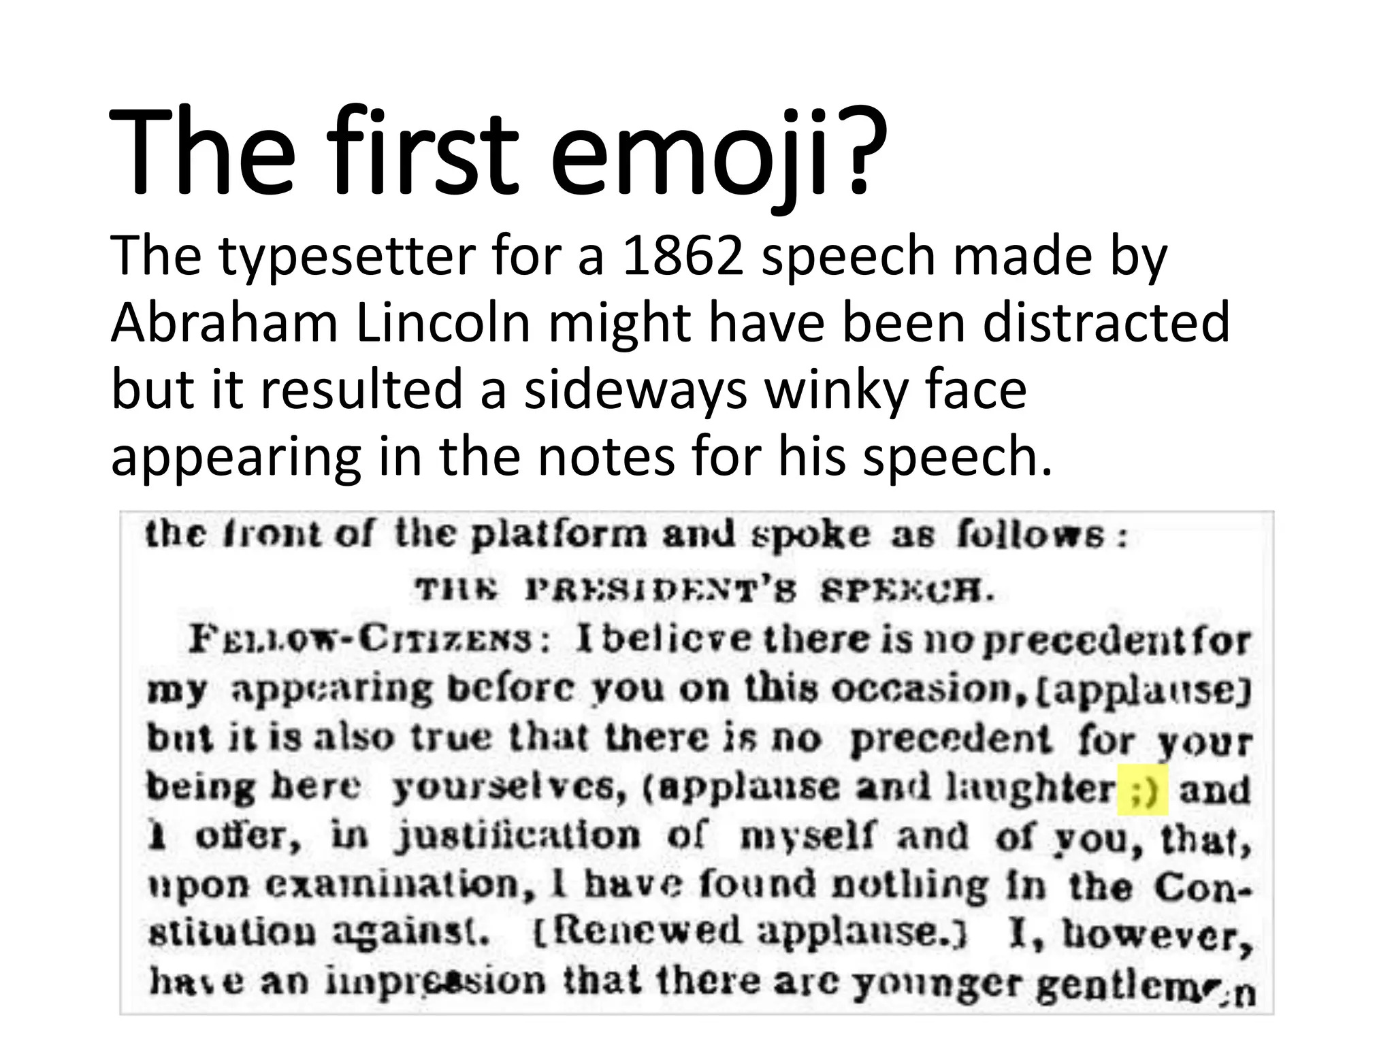

Slide 7
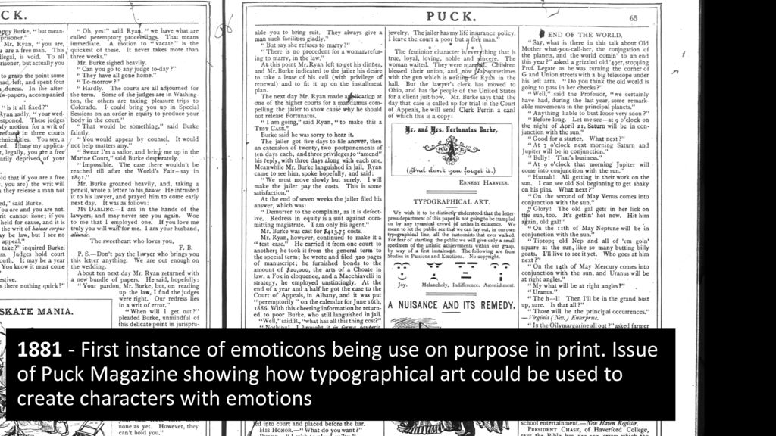

Slide 8
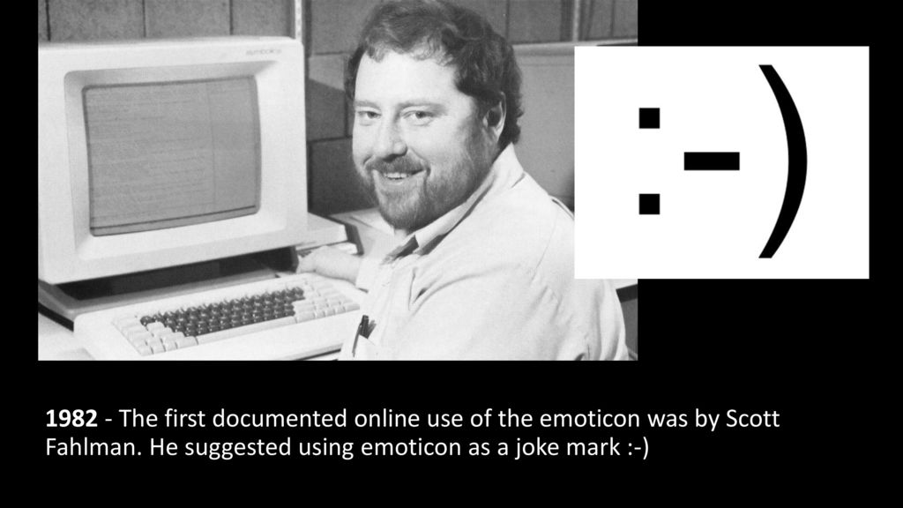

Slide 9
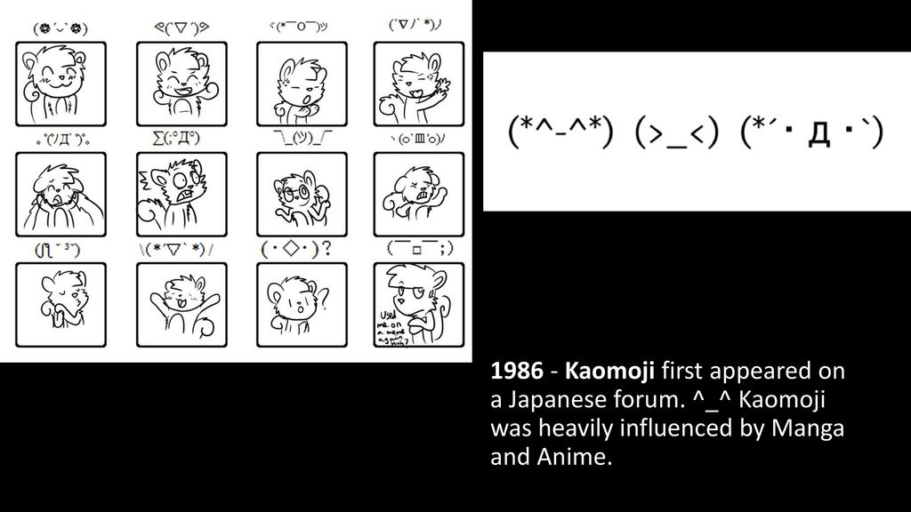

Slide 10
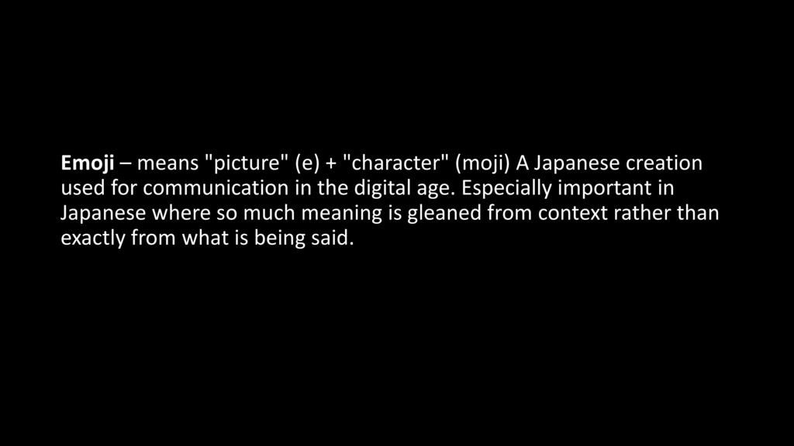

Slide 11
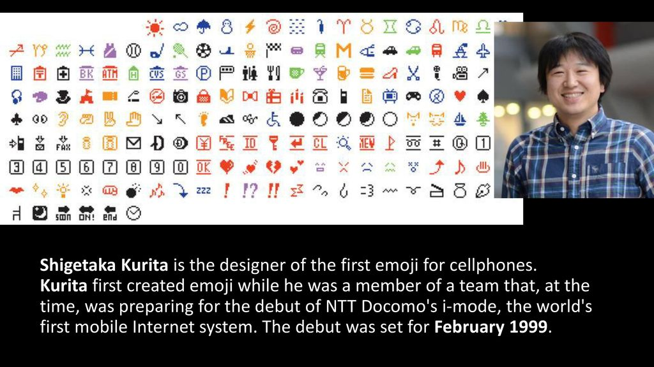

Slide 12


Slide 13
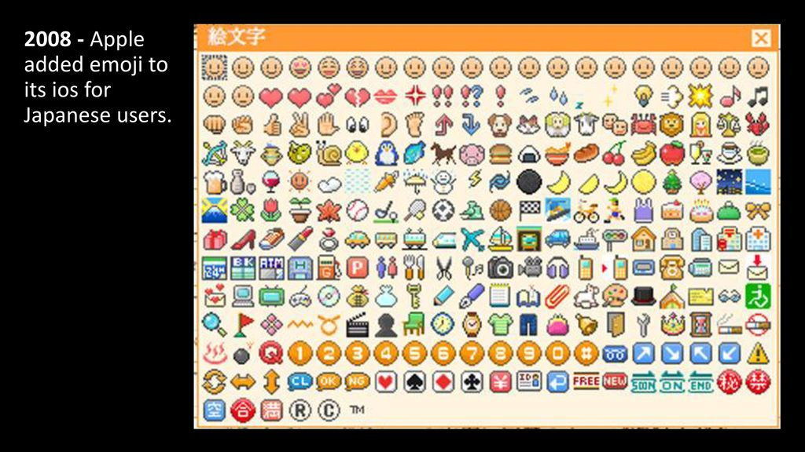


Slide 14
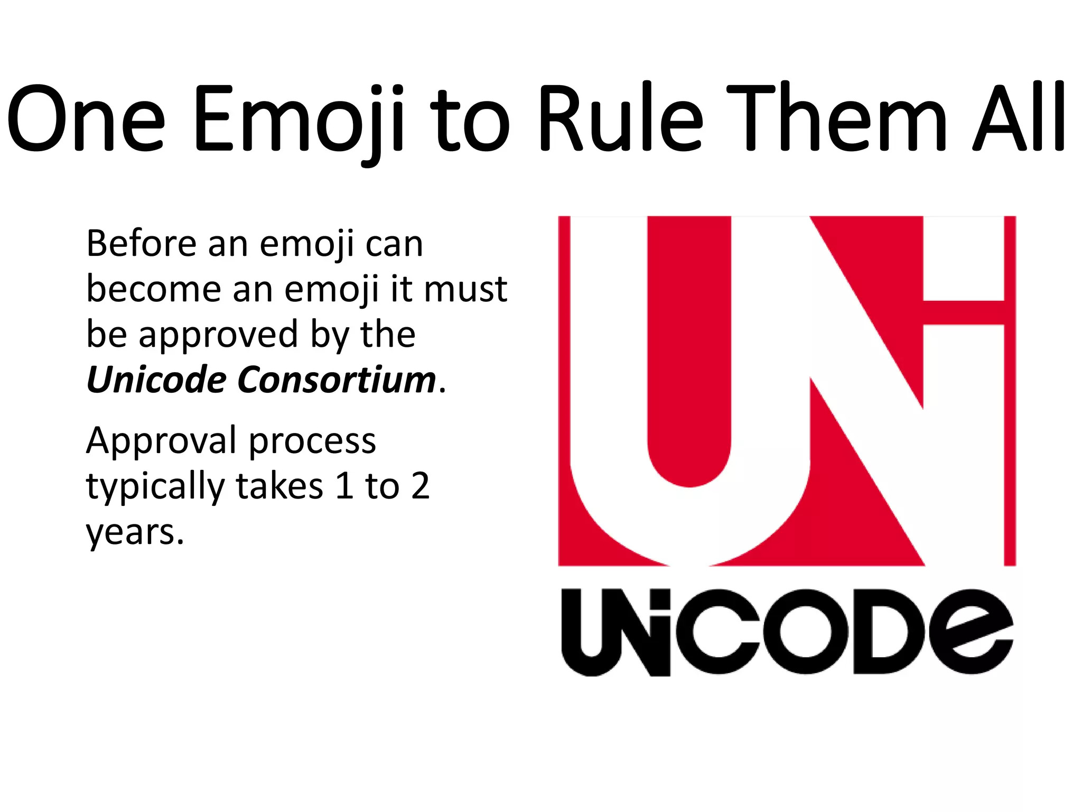

Slide 15


Slide 16
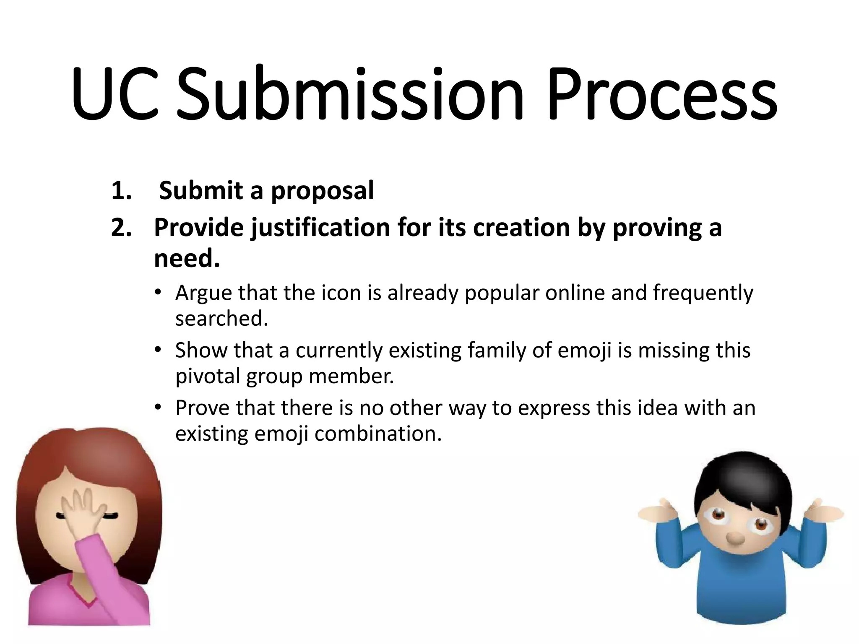

Slide 17
