Slide 1
Verizon Innovative Learning Lab
Pathway: Digital Graphic Design
Lesson: Paths, Shapes, and Colors

Slide 2
Paths, Shapes, and Colors
In this lesson, you will learn how to design custom projects in Canva using paths, shapes and colors.

Slide 3
Warm up
What are some real-world examples of pop-art artists?
Notes:
Teacher Notes: Andy Warhol, Roy Lichtenstein, Yayoi Kusama, Keith Haring

Slide 4
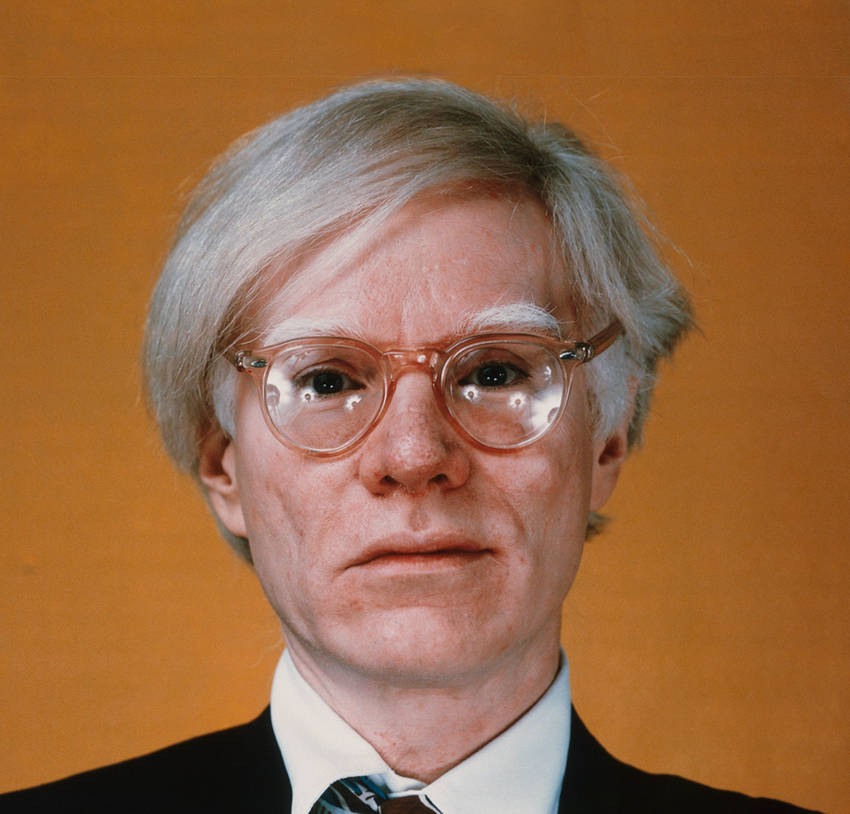
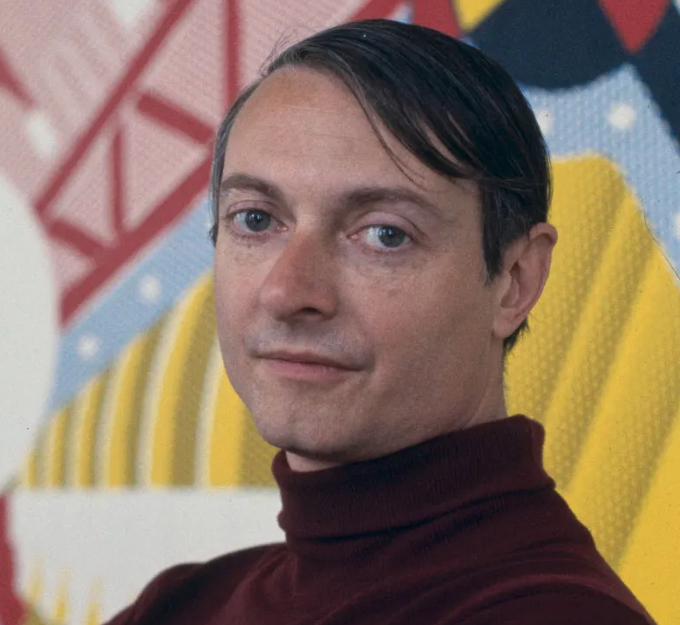
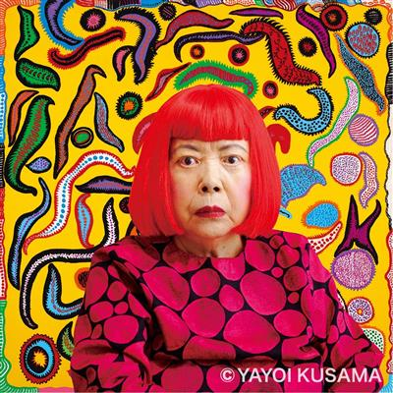
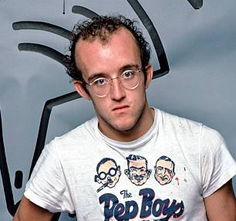
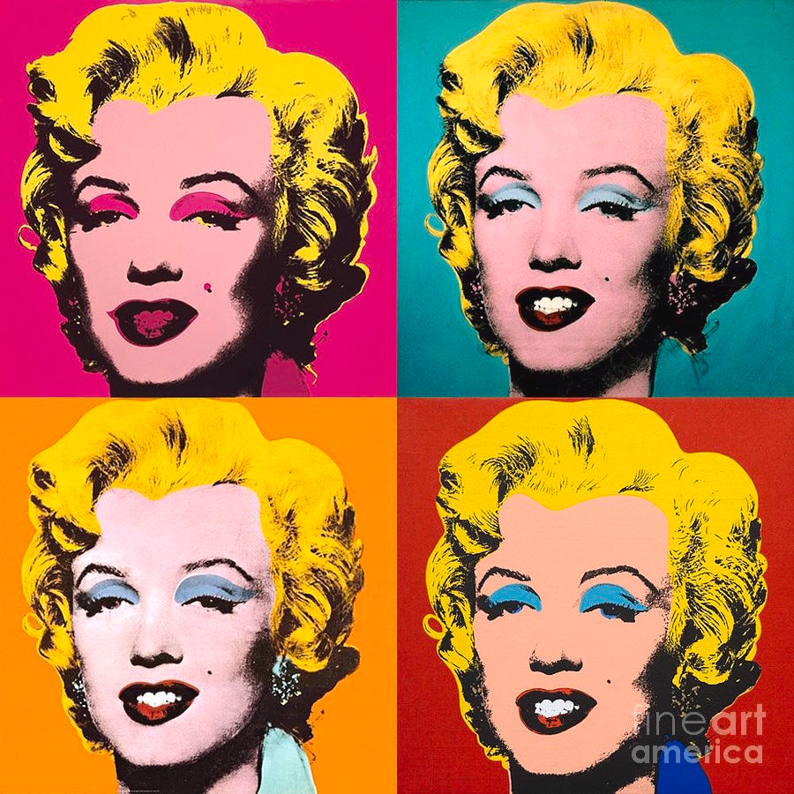

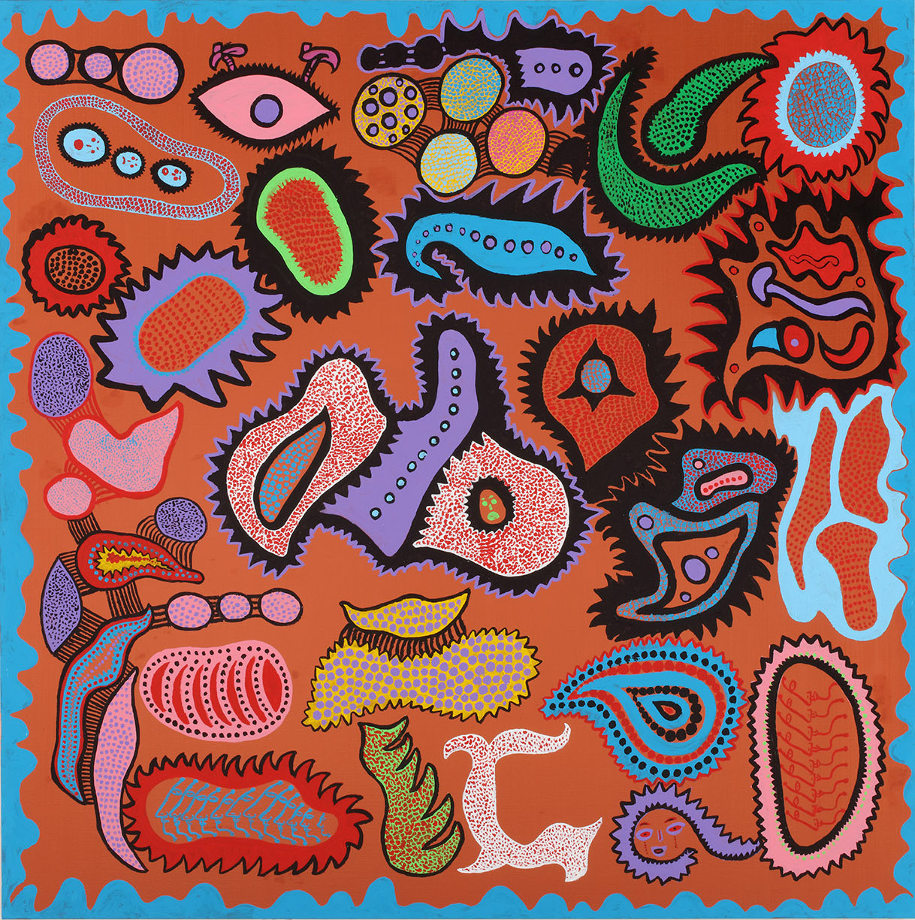
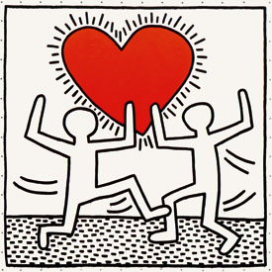
Artist: Andy Warhol
Image Credit: Fine Art America
Photo Credit: Guggenheim Bilbao
Artist: Roy Lichtenstein
Image Credit: NPR
Photo Credit: Britannica
Artist: Yayoi Kusama
Image Credit: Architectural Review
Photo Credit: WiKiArt
Artist: Keith Haring
Image Credit: Haring.com
Photo Credit: Rome Guides

Slide 5
Lesson Objectives
By the end of this lesson, you will be able to
Identify three features of the Pop-Art style from samples.
Use shapes, paths, and colors to create a Pop-Art design in Canva.
Design your own Pop-Art t-shirt by following a video tutorial.

Slide 6

Materials Needed
For this lesson, you will need the following materials:
A laptop/tablet
A Canva account
Optional: Activity Worksheet

Slide 7

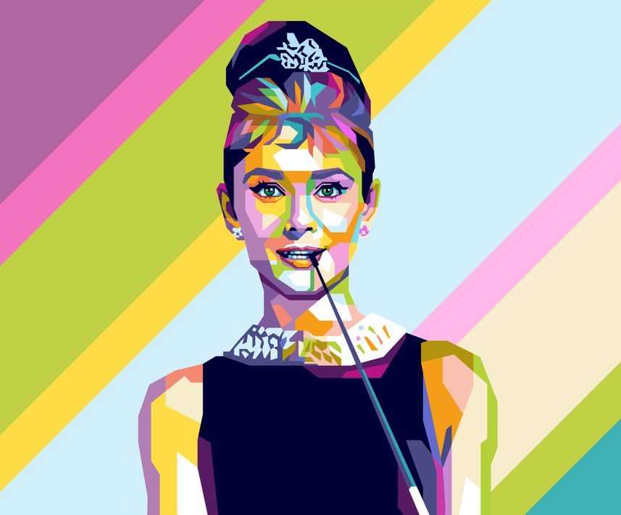

Pop-Art Features
Graphic design software makes it easier than ever to create awesome Pop-Art designs. Notice how these examples use these three Pop-Art features:
Bright-colored shapes with strong borders.
Repeating patterns such as dots, lines, and images
They remind you of comic strips, magazines, and movies (together known as Mass Media).
Notes:
Image #1 credit: https://fineartamerica.com/featured/pop-art-gary-grayson.html
Image #2 credit: https://displate.com/displate/4799955
Image #3 credit: ASU YE Curriculum + Technology team

Slide 8
Knowledge Check
What pop art concept does each image below show?

Slide 9
Knowledge Check Answers
What pop art concept does each image below show?
Bright colored “flash” shapes with solid borders.
Reminder of pop-culture: Actress Audrey Hepburn.
Repeating dot patterns.

Slide 10

Lesson Activity Video: Paths, Shapes, and Colors
Let's jump into it! Watch the video, or follow along in your lesson worksheet.

Slide 11
Activity Instructions: Pop Art t-shirt design
Create your own pop art t-shirt design! Your design should include:
A repetitive background (colors, dots, stripes, whatever you want!)
Text of some kind (maybe your name!)
A border around a shape or text
Add any other shapes or designs you want!
Export your design as a PNG and submit it to your teacher.
Stuck? Try creating a simple pop-art name-tag.

Slide 12
Optional Challenge
Try to recreate this image in Canva!
Export your design as a PNG and submit it along with your poster design.
Image Credit: Fine Art America
Artist: Gary Grayson

Slide 13
Share out!
Answer the reflection questions below on your worksheet or with a partner.
1. What is something new you learned during this lesson?
2. How did you use paths, shapes, and colors to create pop art designs?
3. If you could design and wear a custom hoodie, what would you put on it?

Slide 14
You did it!
High five, you completed this lesson!

