Slide 1
Verizon Innovative Learning Lab
Pathway: Digital Graphic Design
Lesson: Pictographs - Communicating through Shapes

Slide 2
 |  | Standards & Materials
T | Pictographs - Communicating through Shapes | - **CCSS.ELA.L.6:** Language Skills - **CCSS.MATH.MP1:** Problem Solving - **ISTE.4:** Critical Thinking - **NGSS.SEP.1:** Inquiry Skills Materials: Laptop/Tablet, Vectr Account
O | Learn about pictographs and Gestalt Design Principles which influence how designers create icons
D | Design and present a pictograph that represents a word or phrase using Vectr's shape tools and color options.
A | Gestalt Theory: A Psychology of Human Perception; The whole is greater than the sum of its parts.
Y | How can shapes and colors be combined to create pictographs that effectively communicate words or phrases?
What’s Happening TODAY
9/19/2023

Slide 3

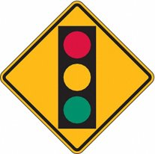
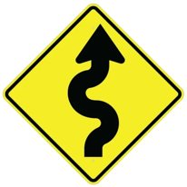
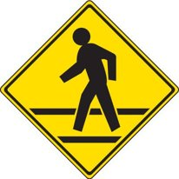
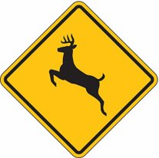
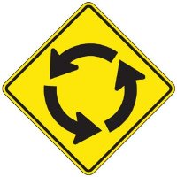
Warm up
Do you recognize any of these images below? Where have you seen them? What do they mean?
Notes:
Bike- bike lane
Traffic light- upcoming traffic light, slow down
Curvy arrow- winding road
Person walking- Pedestrian crossing, slow down, proceed with caution
Deer- Heavy deer traffic, drive with caution
Circle arrows- roundabout

Slide 4
Warm up answer
Yes, many of these images can be found on your way to school or work.

Slide 5
Lesson objectives
By the end of this lesson, you will be able to
Identify and define pictographs​
Identify and Understand why Gestalt Design Principles are considered when creating art ​
Use shape tools, images and color in Vectr to create your own pictograph

Slide 6
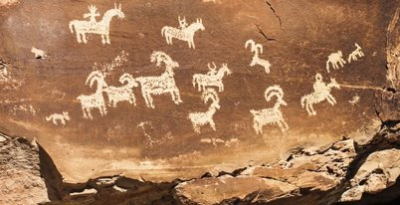
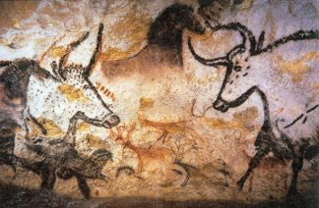
Pictograph Art
Have you ever heard of “Rock Art”? How are they made? With what tools? Well, did you know that there are two types of Rock Art. Petroglyphs and Pictographs. A petroglyph is an image that is carved into a rock. Take a glance at the image below. A pictograph is a drawing or painting that is created on a rock. Notice the difference between the two. ​¿Alguna vez has oído hablar del “arte rupestre”? ¿Cómo se hacen? ¿Con qué herramientas? Bueno, ¿sabías que existen dos tipos de arte rupestre? Petroglifos y Pictografías. Un petroglifo es una imagen tallada en una roca. Eche un vistazo a la imagen a continuación. Una pictografía es un dibujo o pintura que se crea sobre una roca. Note la diferencia entre los dos.​
Petroglyph = carving ​
Pictograph = drawing/painting

Slide 7
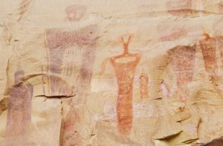

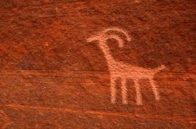
Pictographs through time
The first petroglyph (bottom left) is thought to been carved by Native Americans into the wall of Bucksin Gulch in Southern Utah. The middle pictograph is believed to represent the people of Fremont Culture who used to live in what is now south-central Utah. Finally, the third pictograph which is widely known across the world today as the Wi-Fi icon. ​
Se cree que el primer petroglifo (abajo a la izquierda) fue tallado por nativos americanos en la pared de Bucksin Gulch en el sur de Utah. Se cree que el pictograma del medio representa a la gente de la cultura Fremont que solía vivir en lo que ahora es el centro-sur de Utah. Finalmente, el tercer pictograma, ampliamente conocido en todo el mundo hoy en día como el ícono de Wi-Fi.​

Slide 8
Pictographs through time
A pictogram, also called pictograph, picto or simply icon, is the most simple and efficient way to convey a message or an idea and has been used throughout civilization – from the prehistoric age, to ancient Egypt, until today. Pictograms have constantly evolved over the centuries.​ Un pictograma, también llamado pictografía, picto o simplemente icono, es la forma más sencilla y eficaz de transmitir un mensaje o una idea y se ha utilizado en toda la civilización, desde la época prehistórica hasta el antiguo Egipto, hasta la actualidad. Los pictogramas han evolucionado constantemente a lo largo de los siglos.

Slide 9
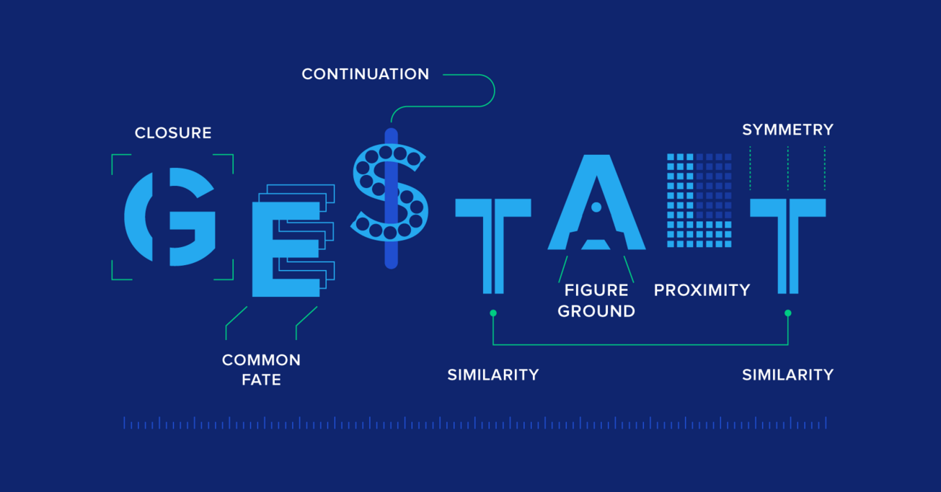

Slide 10
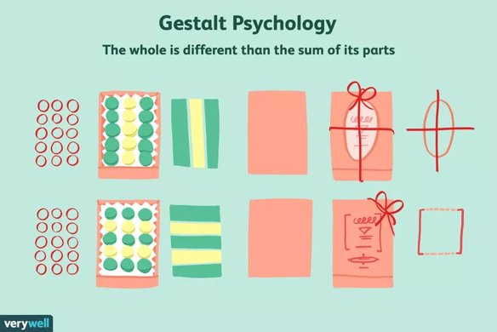
Gestalt Design Principles
[GUHSH] + [TALT] ​
Gestalt Principles of Design are rules that describe how the human brain perceives visual elements. They also support how the brain views the shapes as a single, united form rather than the separate simpler elements involved. ​
Los Principios de Diseño Gestalt son reglas que describen cómo el ojo humano percibe los elementos visuales. También respaldan cómo los ojos ven las formas como una forma única y unida en lugar de los elementos separados más simples involucrados.​
Image credit: verywell mind
Notes:
Gestalt is a German word that roughly means "configuration" or the way things are put together to form a whole object.​

Slide 11
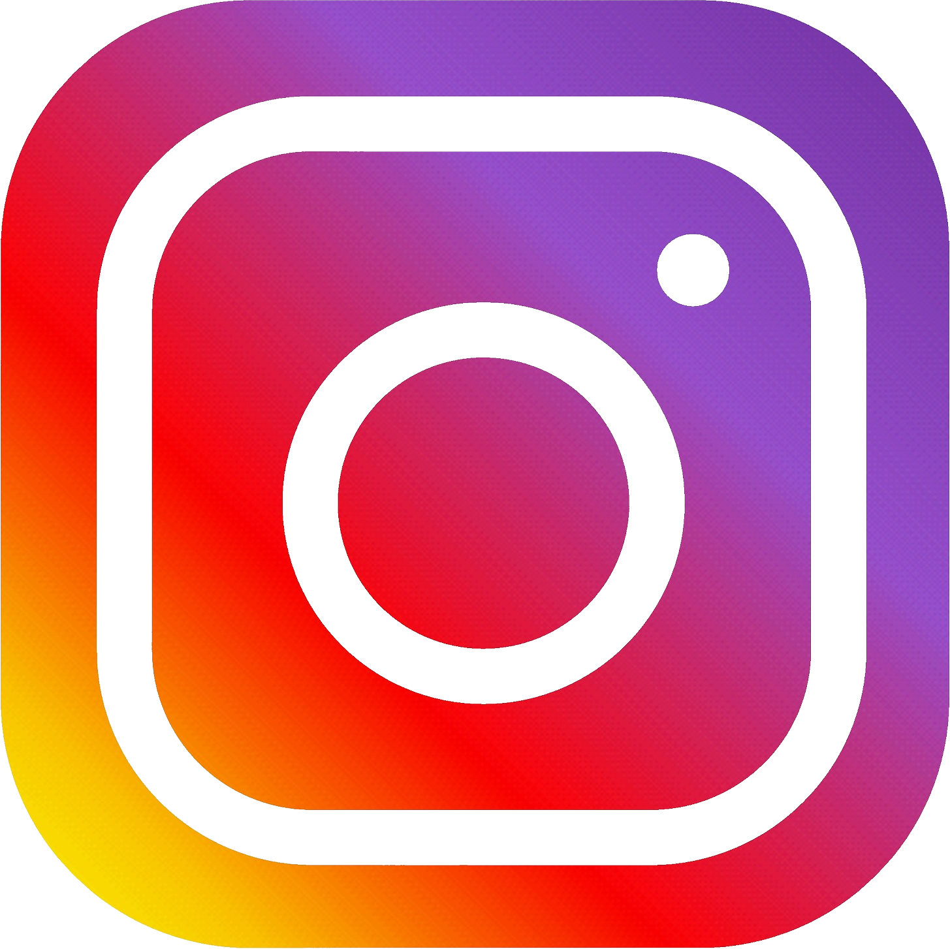
What do you see?

Slide 12
Gestalt Design Principles
[GUHSH] + [TALT] ​
Gestalt Principles of Design are rules that describe how the human brain perceives visual elements. They also support how the brains view the shapes as a single, united form rather than the separate simpler elements involved. ​
Los Principios de Diseño Gestalt son reglas que describen cómo el ojo humano percibe los elementos visuales. También respaldan cómo los ojos ven las formas como una forma única y unida en lugar de los elementos separados más simples involucrados.​
Image credit: verywell mind
Notes:
Gestalt is a German word that roughly means "configuration" or the way things are put together to form a whole object.​

Slide 14
The six Gestalt Design Principles
1. Similarity | Similitud ​
2. Continuation | Continuación​
3. Closure | Cierre ​
4. Proximity | Proximidad ​
5. Figure | Figura/suelo ​
6. Symmetry & Order | Simetría y orden

Slide 15
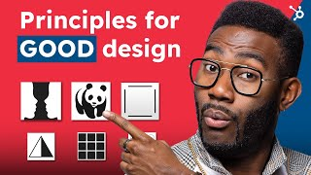

Slide 16
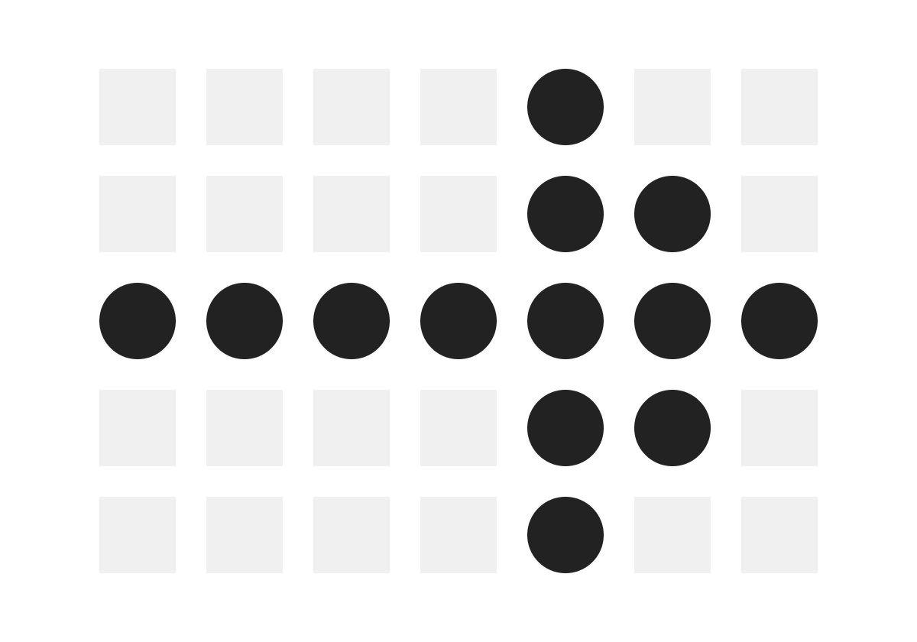
Similarity
It’s natural to group like things together. In Gestalt, similar elements are grouped regardless of their proximity to each other. They can be grouped by color, shape or size. ​

Slide 17
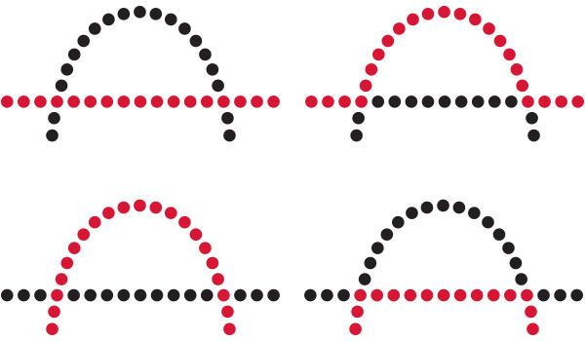
2. Continuation
The law of continuity shows that the human eye will follow the smoothest path when viewing lines, regardless of how the lines were drawn.​
This continuation can be a valuable tool when the goal is to guide a visitor’s eye in a certain direction. They will follow the simplest path on the page, so make sure the most vital parts they should see fall within that path.​

Slide 18
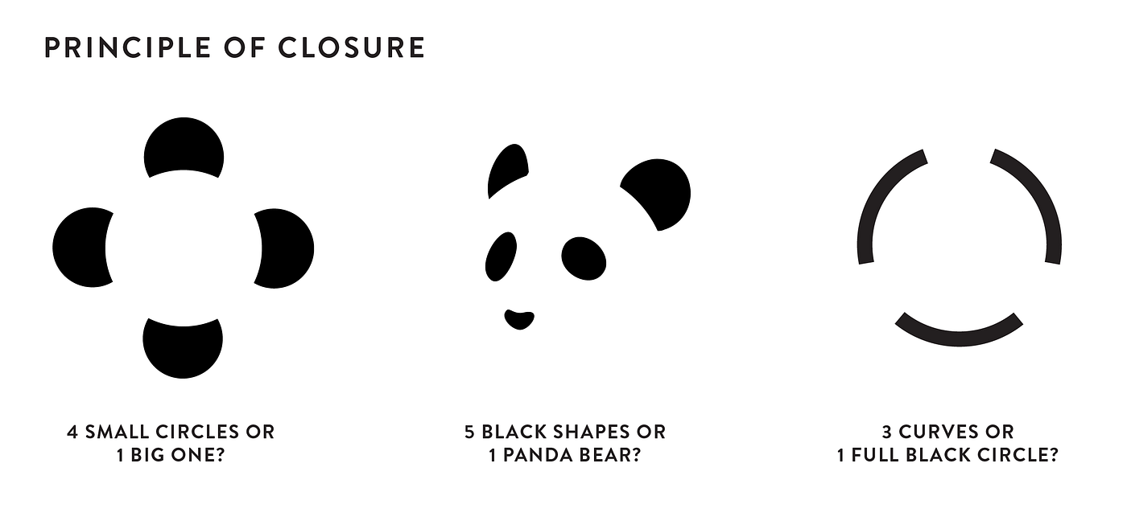
3. Closure
It’s the idea that your brain will fill in the missing parts of a design or image to create a whole.​

Slide 19
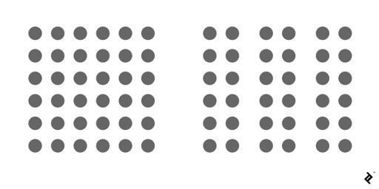
4. Proximity
Proximity refers to how close elements are to one another. The strongest proximity relationships are those between overlapping subjects, but just grouping objects into a single area can also have a strong proximity effect.​
The opposite is also true, of course. By putting space between elements, you can add separation even when their other characteristics are the same. Take this group of circles, for example:​

Slide 20
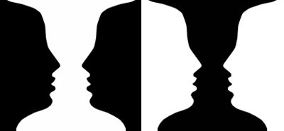
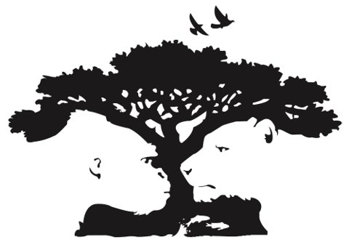
5. Figure/ground
The figure/ground principle is similar to the closure principle in that it takes advantage of the way the brain processes negative space.​

Slide 21
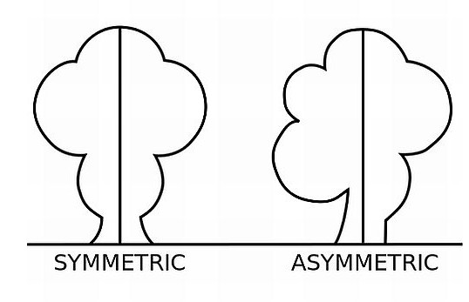
6. Symmetry/order
The law of symmetry and order is also known as prägnanz, the German word for “good figure.” What this principle says is that your brain will perceive ambiguous shapes in as simple a manner as possible.​

Slide 22
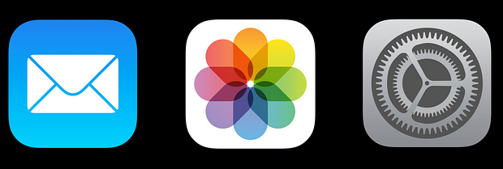

What design principles do you see in these images?
1. Similarity | Similitud ​
2. Continuation | Continuación​
3. Closure | Cierre ​
4. Proximity | Proximidad ​
5. Figure | Figura/suelo ​
6. Symmetry | Simetría

Slide 23
Picture Perfect: Pictographs today
​For this lesson's activity, we will use Vectr to create a pictograph that sends a short message. Consider the pictographs you have seen today and what they represent. ​
Are there pictographs that we need today that don’t currently exist? ​

Slide 24
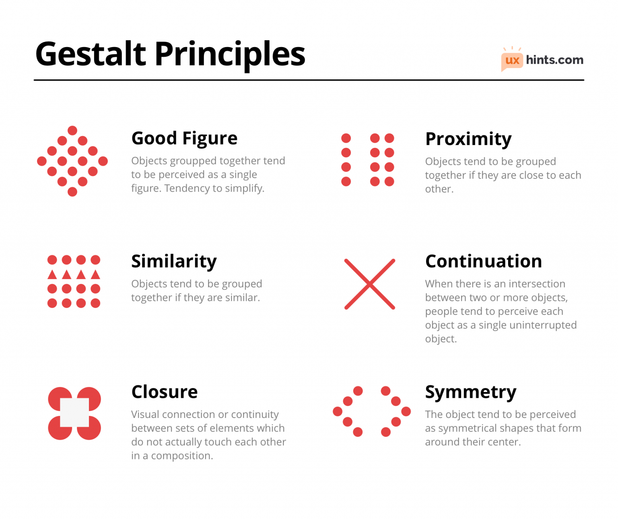
Optional Challenge
Choose another Gestalt Principle and use the concept to create another design in Canva. Be sure to export as a PNG and submit to your teacher!
Image Credit: UX Hints

Slide 25
Share Out!
Answer the reflection questions below on your worksheet or with a partner.
1. What is something new you learned during this lesson?
2. How did you use shapes to communicate?
3. How could you use pictographs to advertise a business or product?

Slide 26
You did it!
High five, you completed this lesson!

