Slide 1
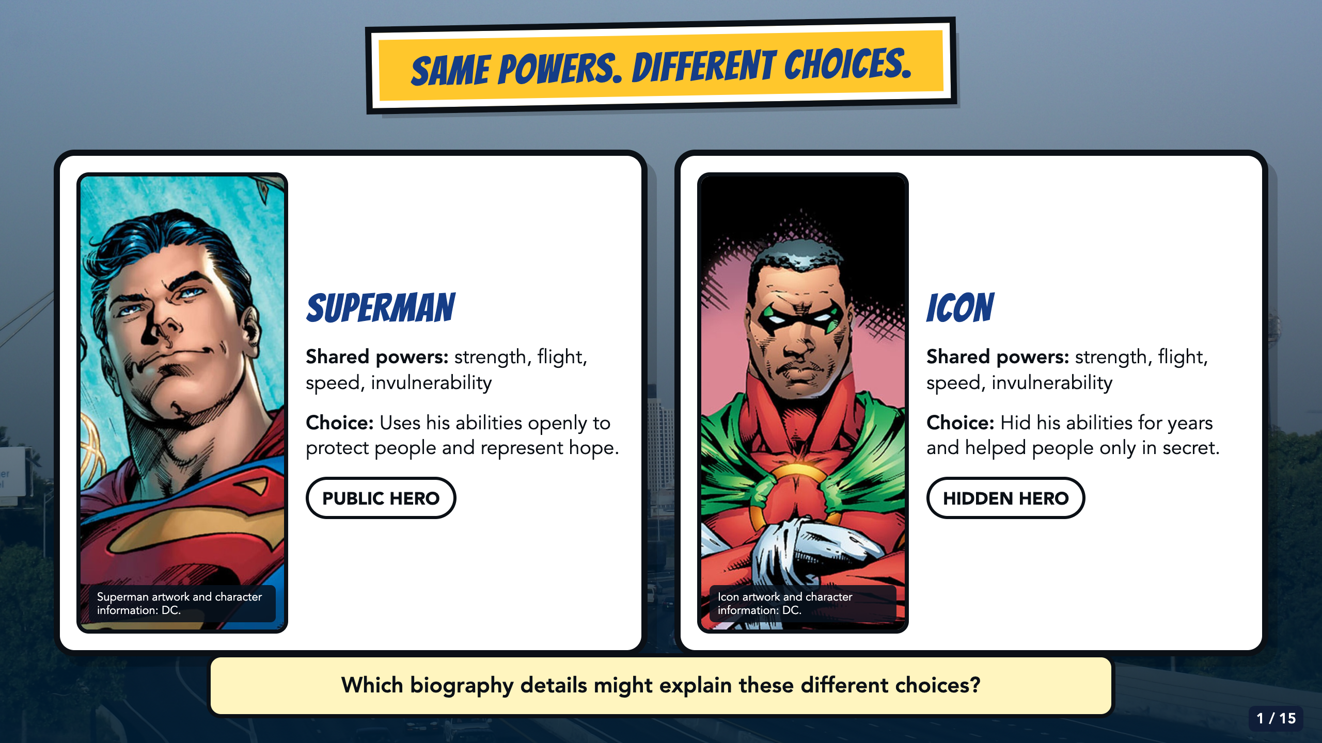
Notes:
Compare the two official character examples, then ask students which biography details might explain their different choices. The point is that an ability alone does not explain a choice. Accept spoken, written, or partner-rehearsed responses.
[Sources]
- Superman and Icon character information: https://www.dc.com/characters/superman and https://www.dc.com/characters/icon ; artwork served from DC official media: https://static.dc.com/dc/files/default_images/Char_Thumb_Superman_5c3fc2758f6984.90100206.jpg?w=900 and https://static.dc.com/dc/files/default_images/Char_Thumb_Icon_6036ccbd64bd04.69640376.jpg?w=900
- Owner-approved staged Comics Lesson 2 bodies: tmp/comic_scaffold_agent/lesson_2_biography.html and teacher_guide_lesson_2.html.
- Dallas skyline photograph by medea_material, CC BY 2.0; cropped and color-treated: https://commons.wikimedia.org/wiki/File:Skyline_of_Dallas,_TX.jpg

Slide 2
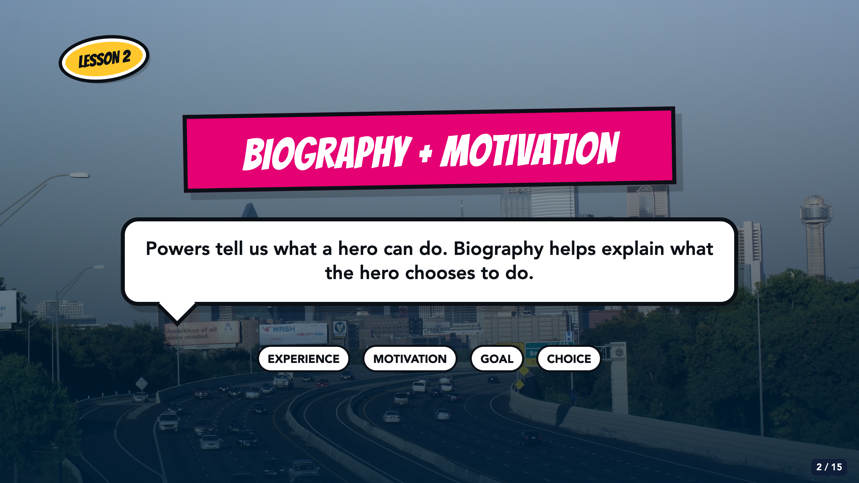
Notes:
Frame the lesson in one contrast: powers tell us what a hero can do; biography helps explain what the hero chooses to do. Do not turn this into a brand-promise lesson. That comes later in Animation.
[Sources]
- Elisha Lucero, Lesson 2: Superhero Bios.pptx and superhero_biography_lesson_2_20250818011110.pdf, From Google Drive 2026/Units/SS U0 (Superhero)/My Slides/.
- Owner-approved staged Comics Lesson 2 bodies: tmp/comic_scaffold_agent/lesson_2_biography.html and teacher_guide_lesson_2.html.
- Dallas skyline photograph by medea_material, CC BY 2.0; cropped and color-treated: https://commons.wikimedia.org/wiki/File:Skyline_of_Dallas,_TX.jpg

Slide 3
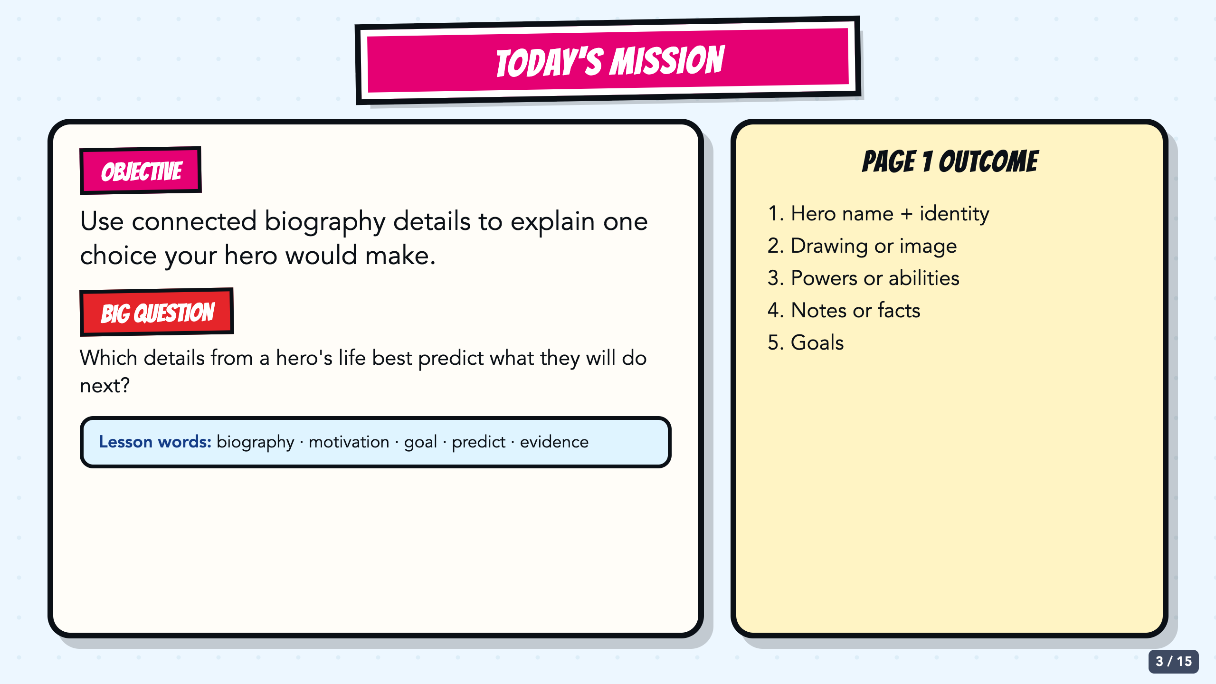
Notes:
Read the objective and big question aloud. Students will finish Page 1 with identity, abilities, stats, notes or facts, and goals. The learning target is the connection among details, not the amount of decoration.
[Sources]
- Elisha Lucero, Lesson 2: Superhero Bios.pptx and superhero_biography_lesson_2_20250818011110.pdf, From Google Drive 2026/Units/SS U0 (Superhero)/My Slides/.
- Owner-approved staged Comics Lesson 2 bodies: tmp/comic_scaffold_agent/lesson_2_biography.html and teacher_guide_lesson_2.html.
- Superhero biography template from the inherited Comics module, Canvas course 23158 file 2894387 (Screenshot 2024-08-20 at 4.01.41 PM.png). The source image itself credits Najarin, 2015.

Slide 4
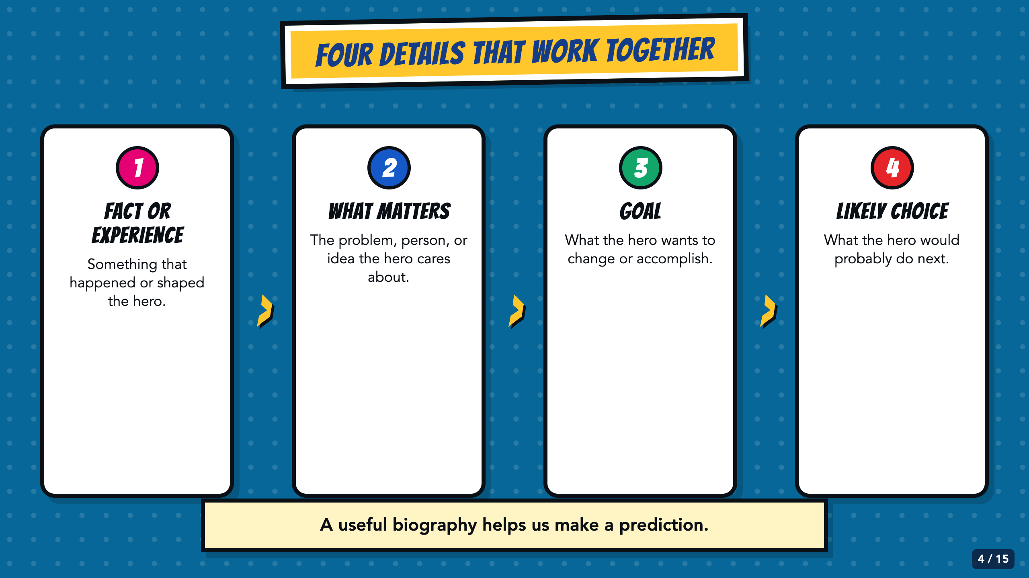
Notes:
Build the chain one step at a time. Ask students for an example after each box. Explain that the likely choice is a prediction supported by the earlier details, not another fact students must invent first.
[Sources]
- Owner-approved staged Comics Lesson 2 bodies: tmp/comic_scaffold_agent/lesson_2_biography.html and teacher_guide_lesson_2.html.
- Emoji and CSS shapes are used only as simple process or decorative markers.

Slide 5
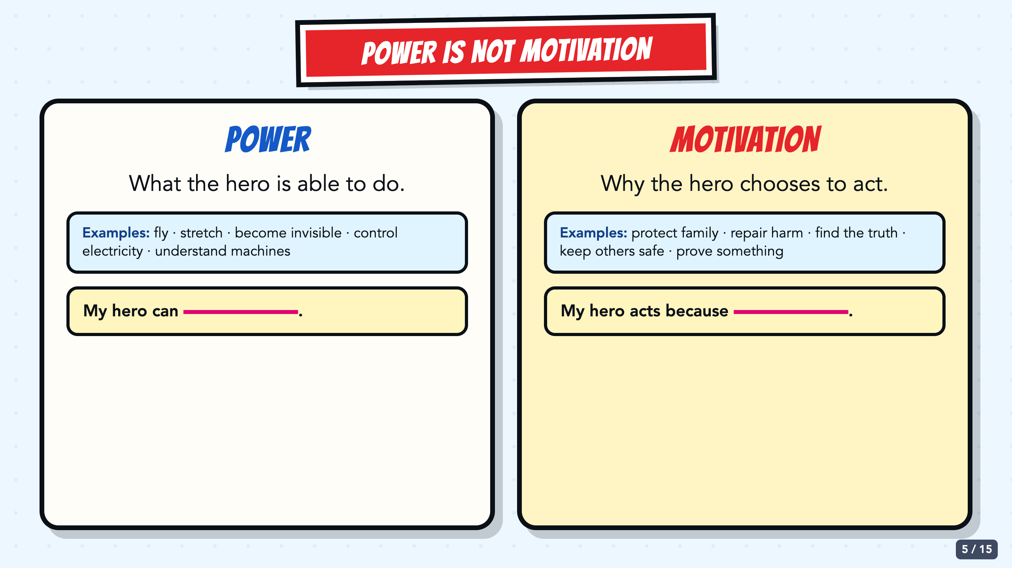
Notes:
Have students sort two or three oral examples into power or motivation. Keep asking 'What can the hero do?' versus 'Why does the hero choose to act?' Use the stems before asking students to write independently.
[Sources]
- Owner-approved staged Comics Lesson 2 bodies: tmp/comic_scaffold_agent/lesson_2_biography.html and teacher_guide_lesson_2.html.

Slide 6
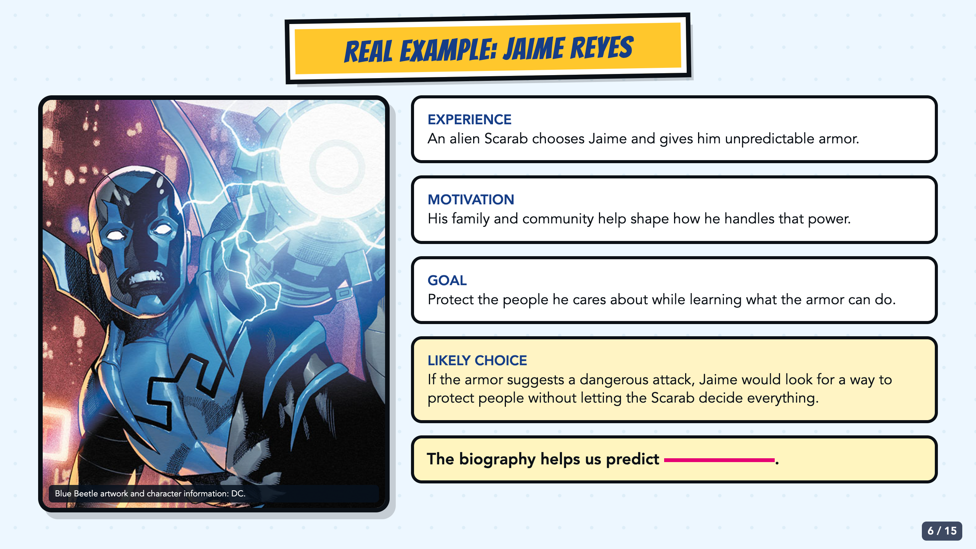
Notes:
Use Jaime Reyes as a short, recognizable example of connected details. Point out that the Scarab gives him power, while family and community shape how he handles it. Ask students to finish the prediction stem with evidence from the slide.
[Sources]
- Jaime Reyes and Blue Beetle information: https://www.dc.com/bluebeetle and https://www.dc.com/blog/2023/08/25/feeling-blue-why-jaime-reyes-is-the-hero-of-the-summer ; artwork served from DC official media: https://static.dc.com/2023-08/DC.com_20230814_JaimeReyes_BlogRoll_Mobile_4x3_.jpg

Slide 7
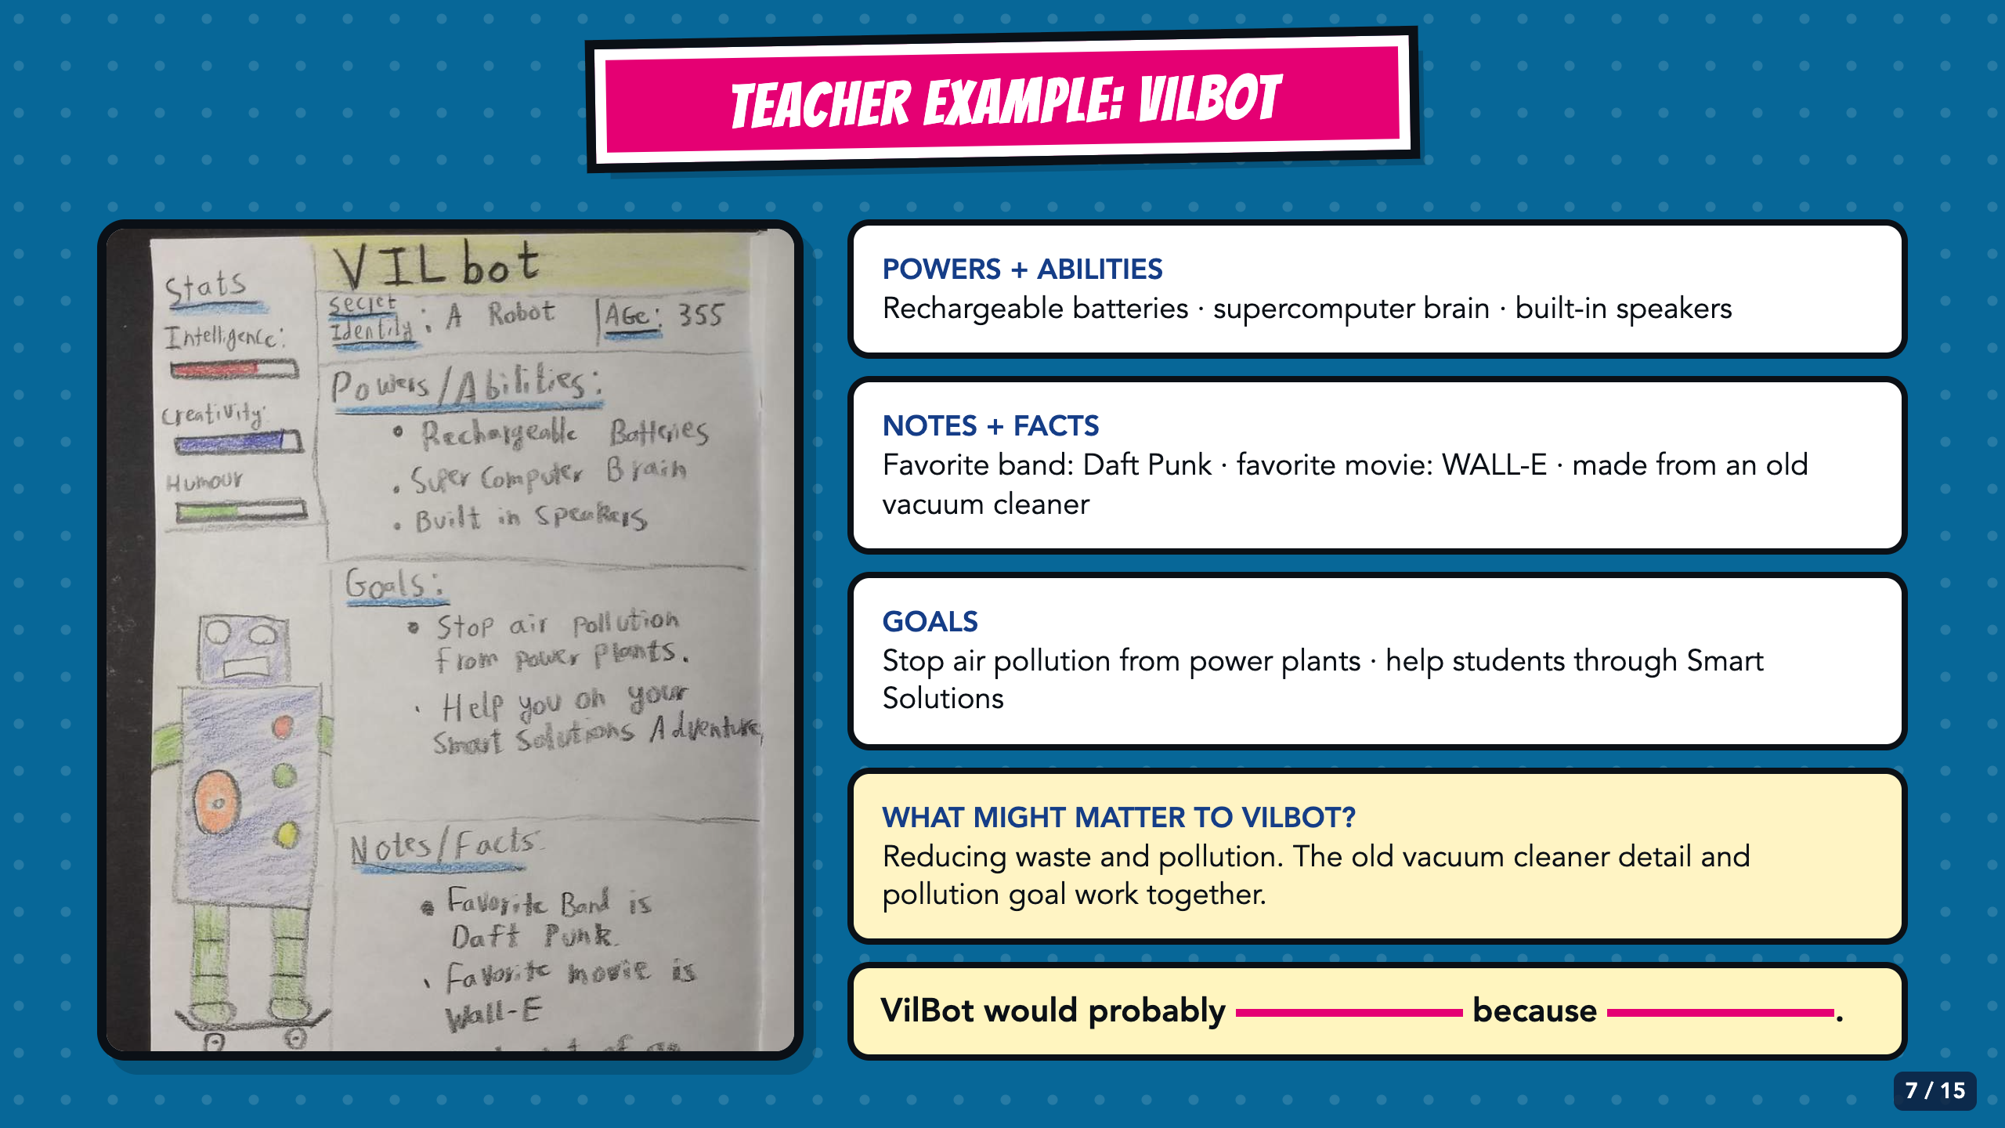
Notes:
Read the completed VILBot page with students. Separate what the page explicitly says from what readers can infer. The old-vacuum detail and pollution goal together suggest that reuse and waste reduction matter to VILBot.
[Sources]
- Completed VILBot teacher exemplar from the inherited Comics module, Canvas course 23158 file 2894388 (VIlBotExample.jpg), supplied by Elisha Lucero.
- Owner-approved staged Comics Lesson 2 bodies: tmp/comic_scaffold_agent/lesson_2_biography.html and teacher_guide_lesson_2.html.

Slide 8
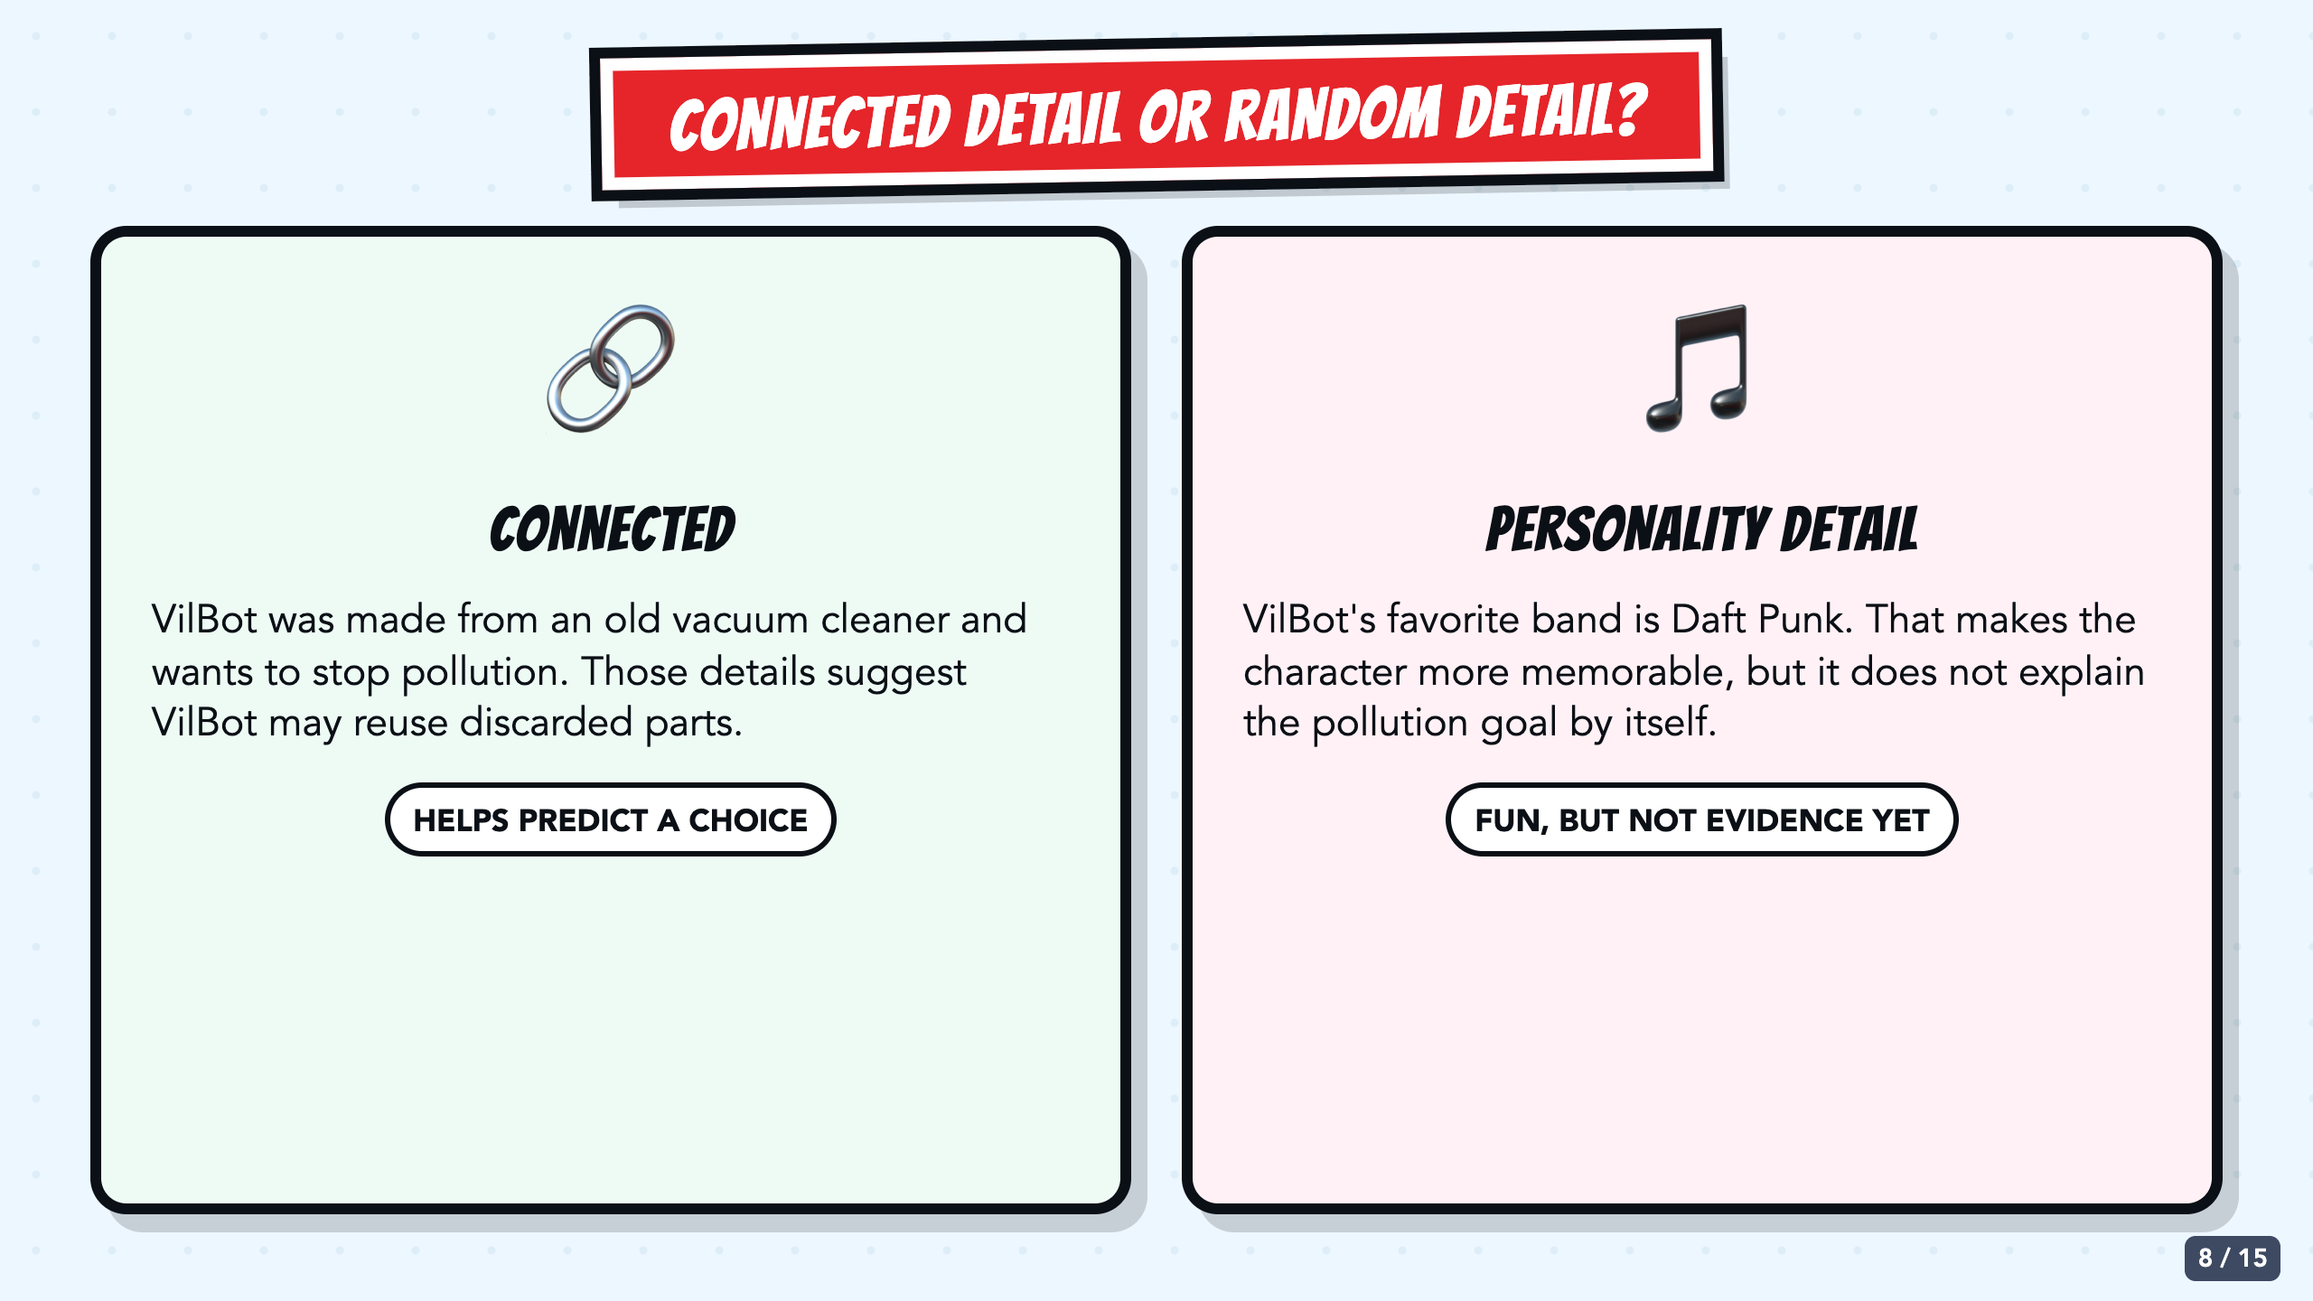
Notes:
Ask which VILBot details help predict a response to discarded electronics and why. The Daft Punk fact adds personality, but it does not explain the pollution goal by itself. Students may keep fun facts after the connected evidence is clear.
[Sources]
- Completed VILBot teacher exemplar from the inherited Comics module, Canvas course 23158 file 2894388 (VIlBotExample.jpg), supplied by Elisha Lucero.
- Owner-approved staged Comics Lesson 2 bodies: tmp/comic_scaffold_agent/lesson_2_biography.html and teacher_guide_lesson_2.html.

Slide 9
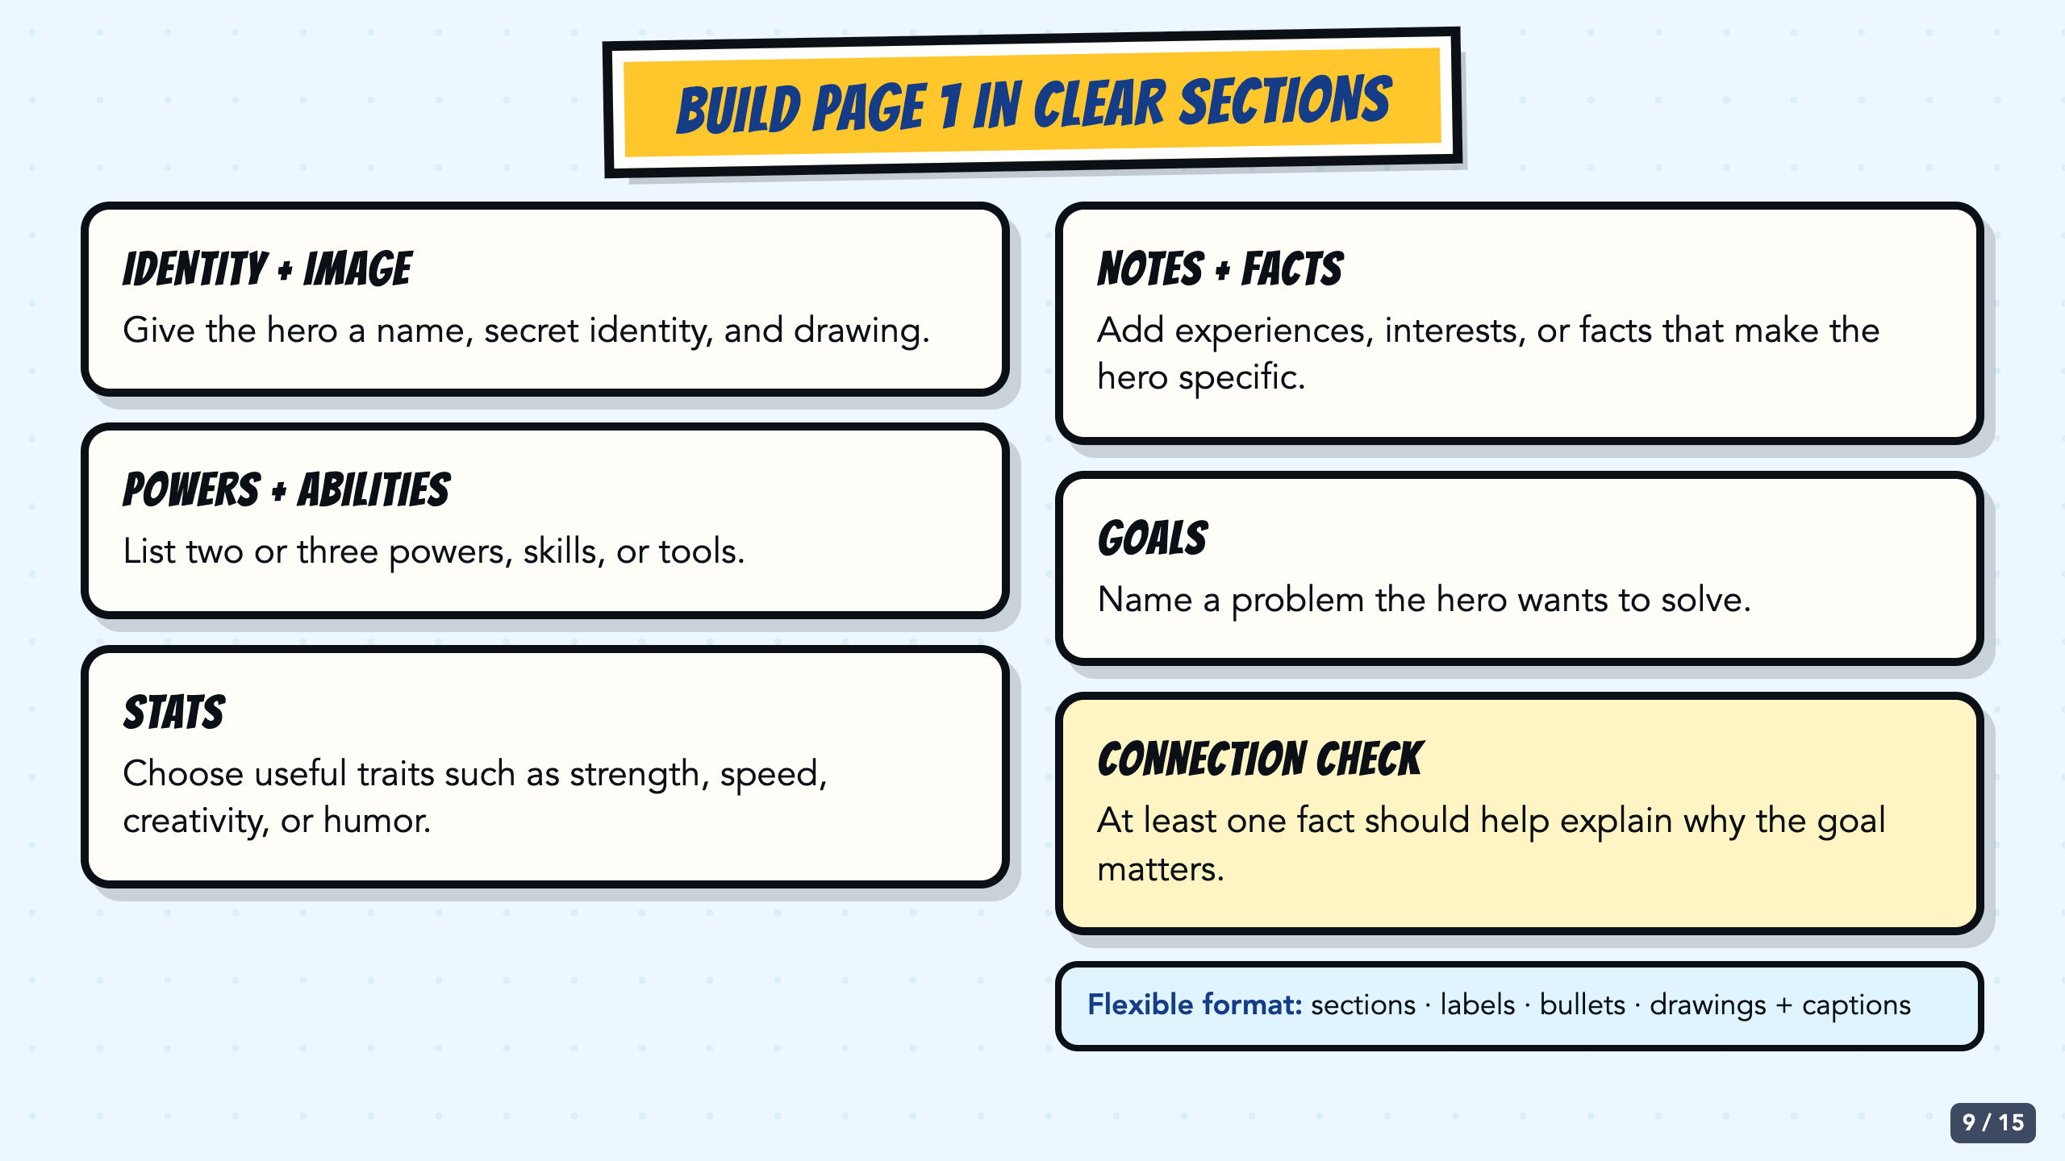
Notes:
Show students the same sections they will see on the original teal template: identity, image, powers or abilities, stats, notes or facts, and goals. The template is a visual guide, not a tracing requirement.
[Sources]
- Owner-approved staged Comics Lesson 2 bodies: tmp/comic_scaffold_agent/lesson_2_biography.html and teacher_guide_lesson_2.html.
- Superhero biography template from the inherited Comics module, Canvas course 23158 file 2894387 (Screenshot 2024-08-20 at 4.01.41 PM.png). The source image itself credits Najarin, 2015.

Slide 10
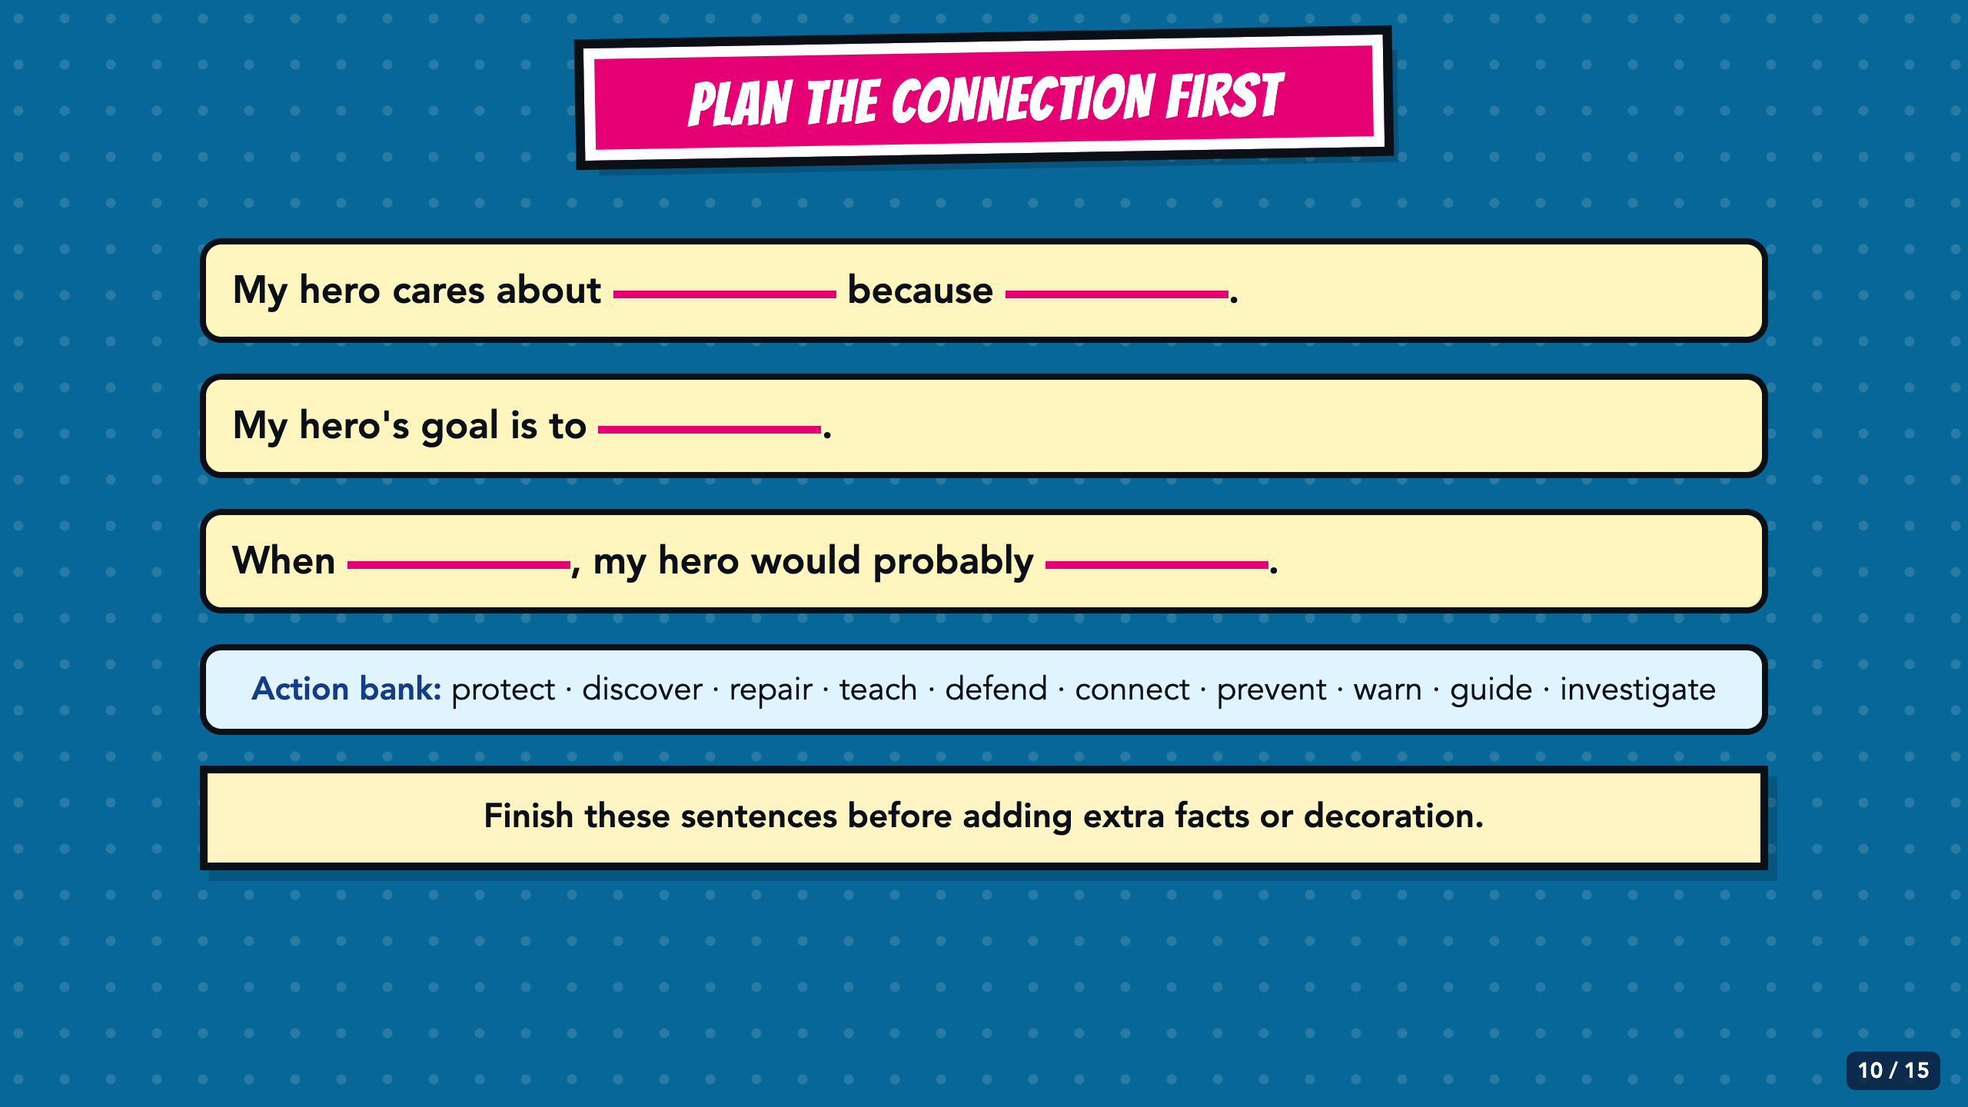
Notes:
Have students complete the three stems before they add extra biography facts. The action bank supports emerging bilingual students and anyone who needs a more precise verb.
[Sources]
- Owner-approved staged Comics Lesson 2 bodies: tmp/comic_scaffold_agent/lesson_2_biography.html and teacher_guide_lesson_2.html.

Slide 11
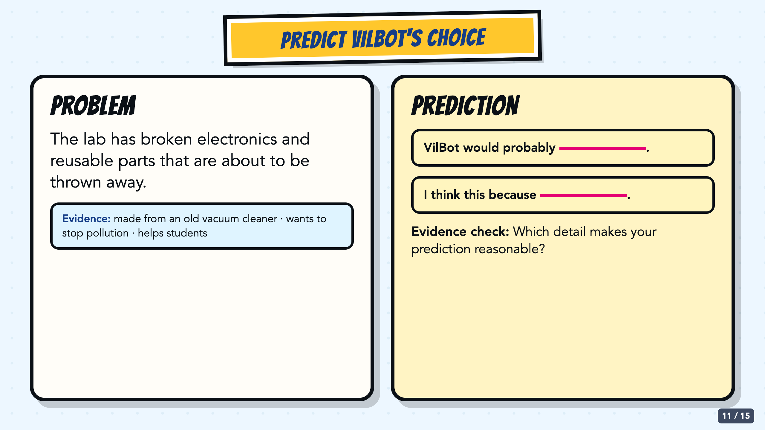
Notes:
Run this as guided practice. Students predict VILBot's response to reusable electronics headed for the trash and cite one detail from the completed biography page.
[Sources]
- Completed VILBot teacher exemplar from the inherited Comics module, Canvas course 23158 file 2894388 (VIlBotExample.jpg), supplied by Elisha Lucero.
- Owner-approved staged Comics Lesson 2 bodies: tmp/comic_scaffold_agent/lesson_2_biography.html and teacher_guide_lesson_2.html.

Slide 12
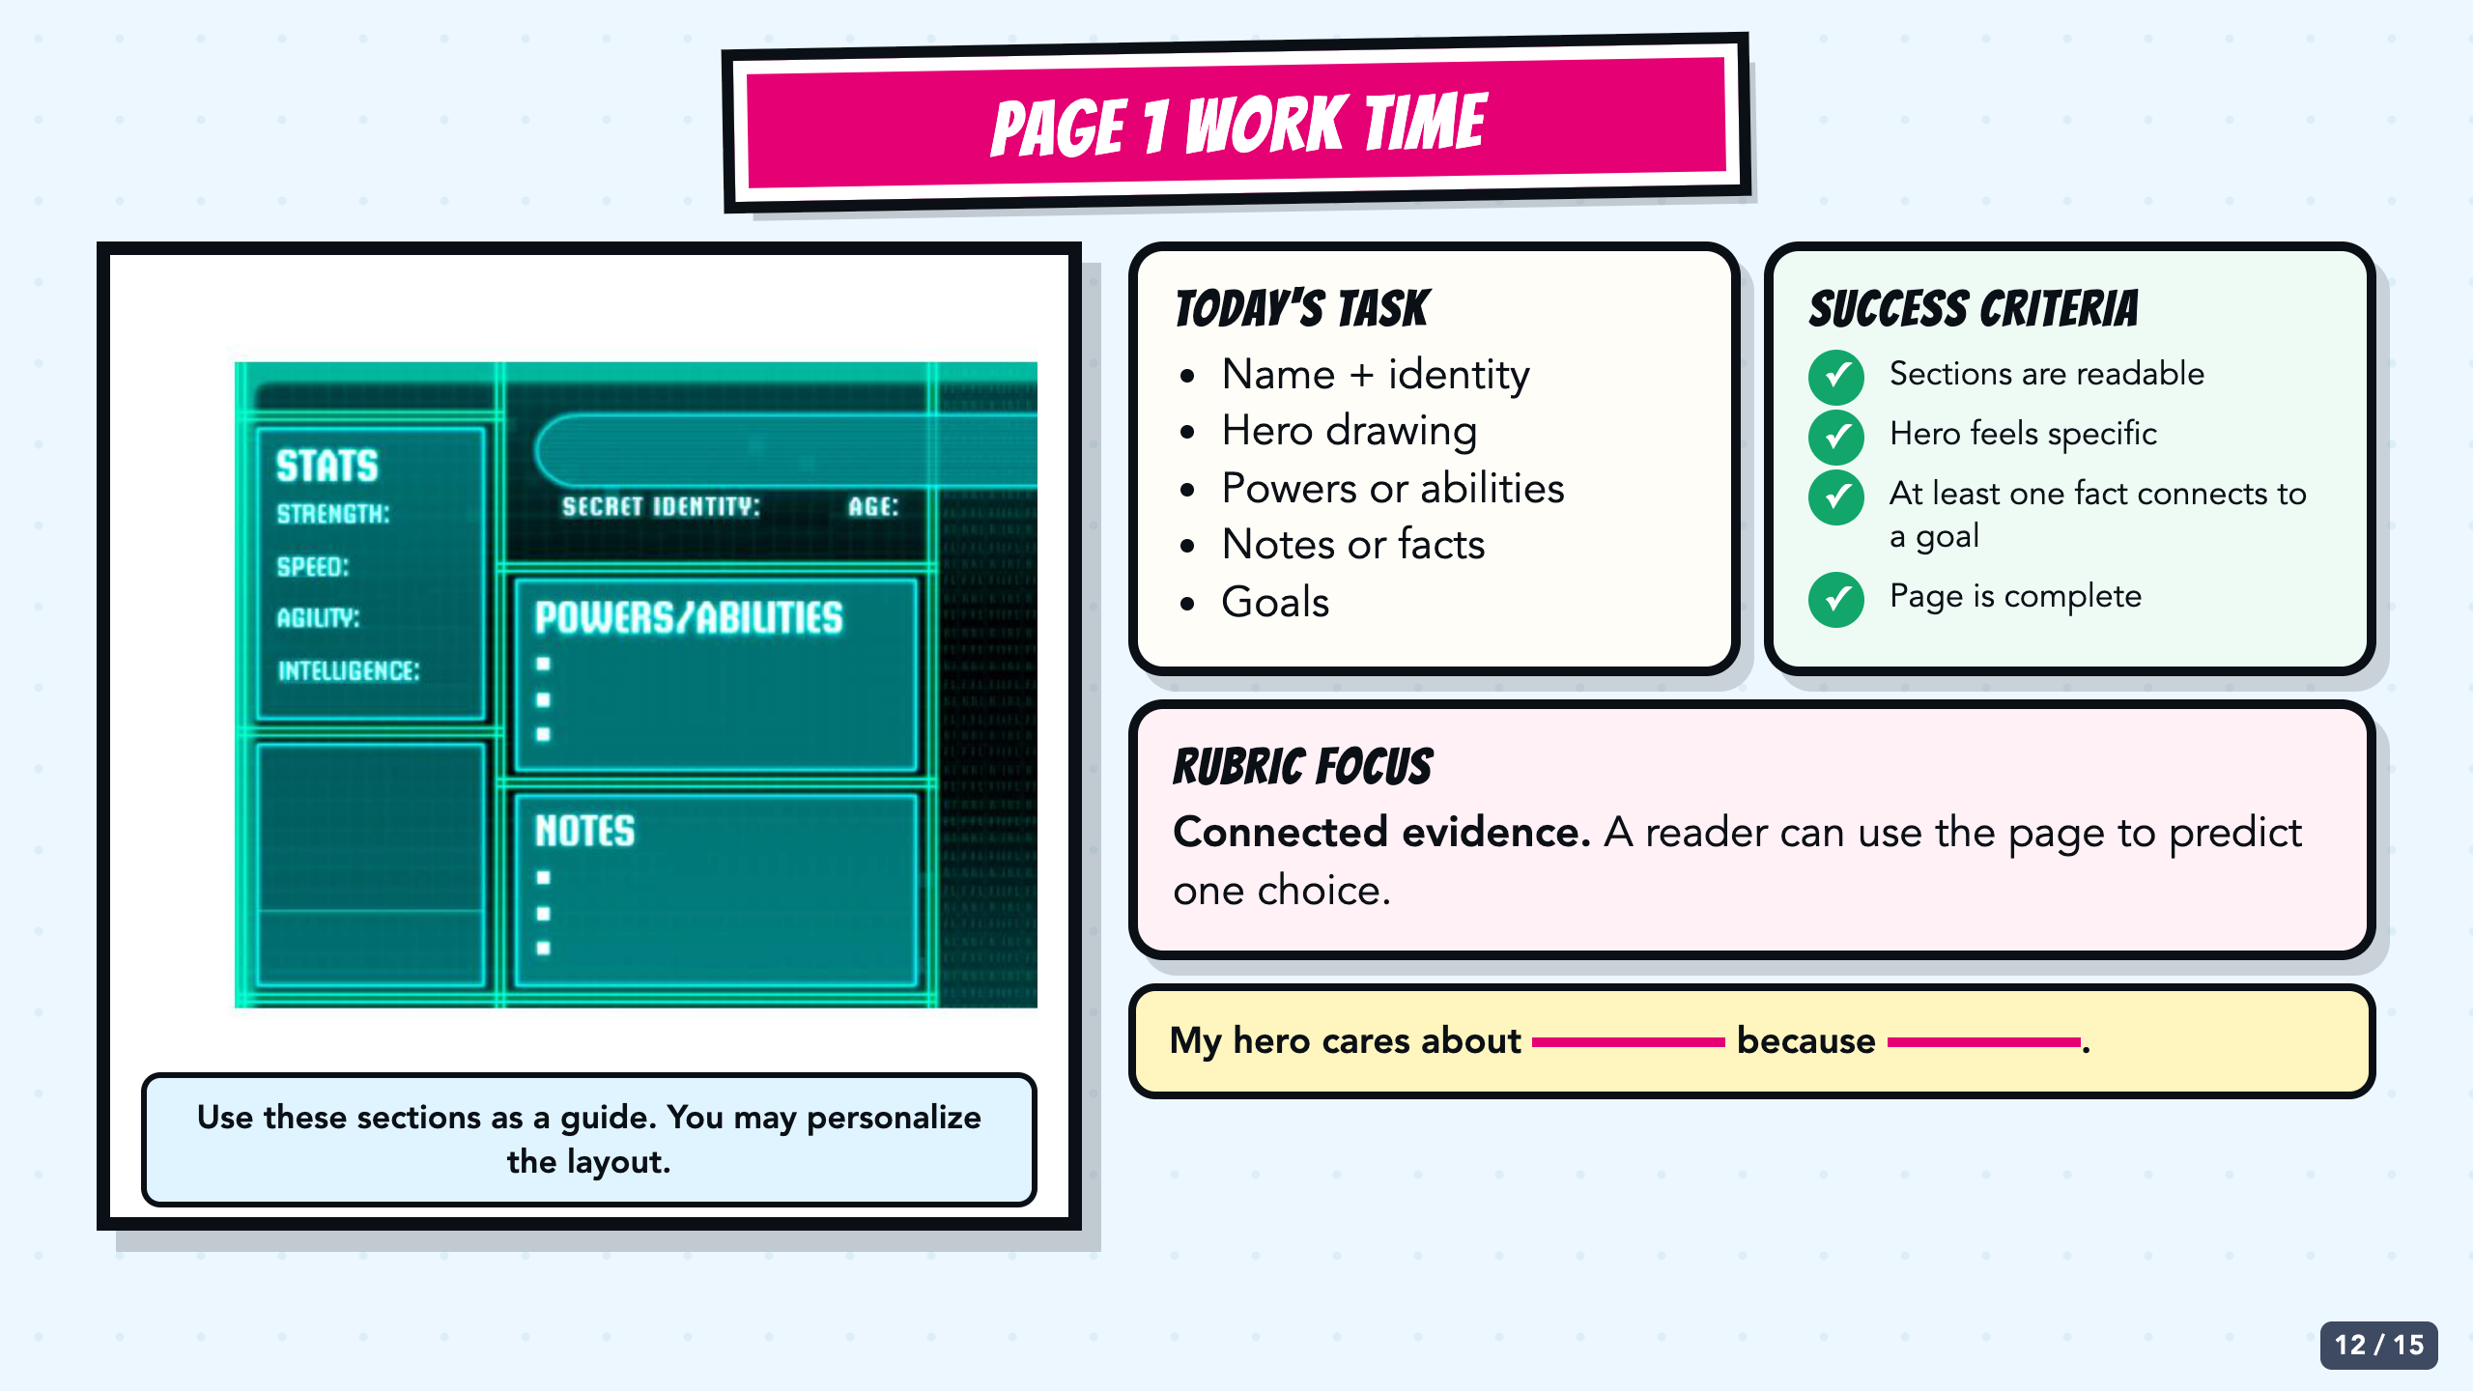
Notes:
Leave this slide projected during work time. It uses the original teal biography template and keeps the task, success criteria, rubric focus, and sentence stem visible. Circulate by asking which fact connects to a goal and what choice those details help predict.
[Sources]
- Superhero biography template from the inherited Comics module, Canvas course 23158 file 2894387 (Screenshot 2024-08-20 at 4.01.41 PM.png). The source image itself credits Najarin, 2015.
- Owner-approved staged Comics Lesson 2 bodies: tmp/comic_scaffold_agent/lesson_2_biography.html and teacher_guide_lesson_2.html.

Slide 13
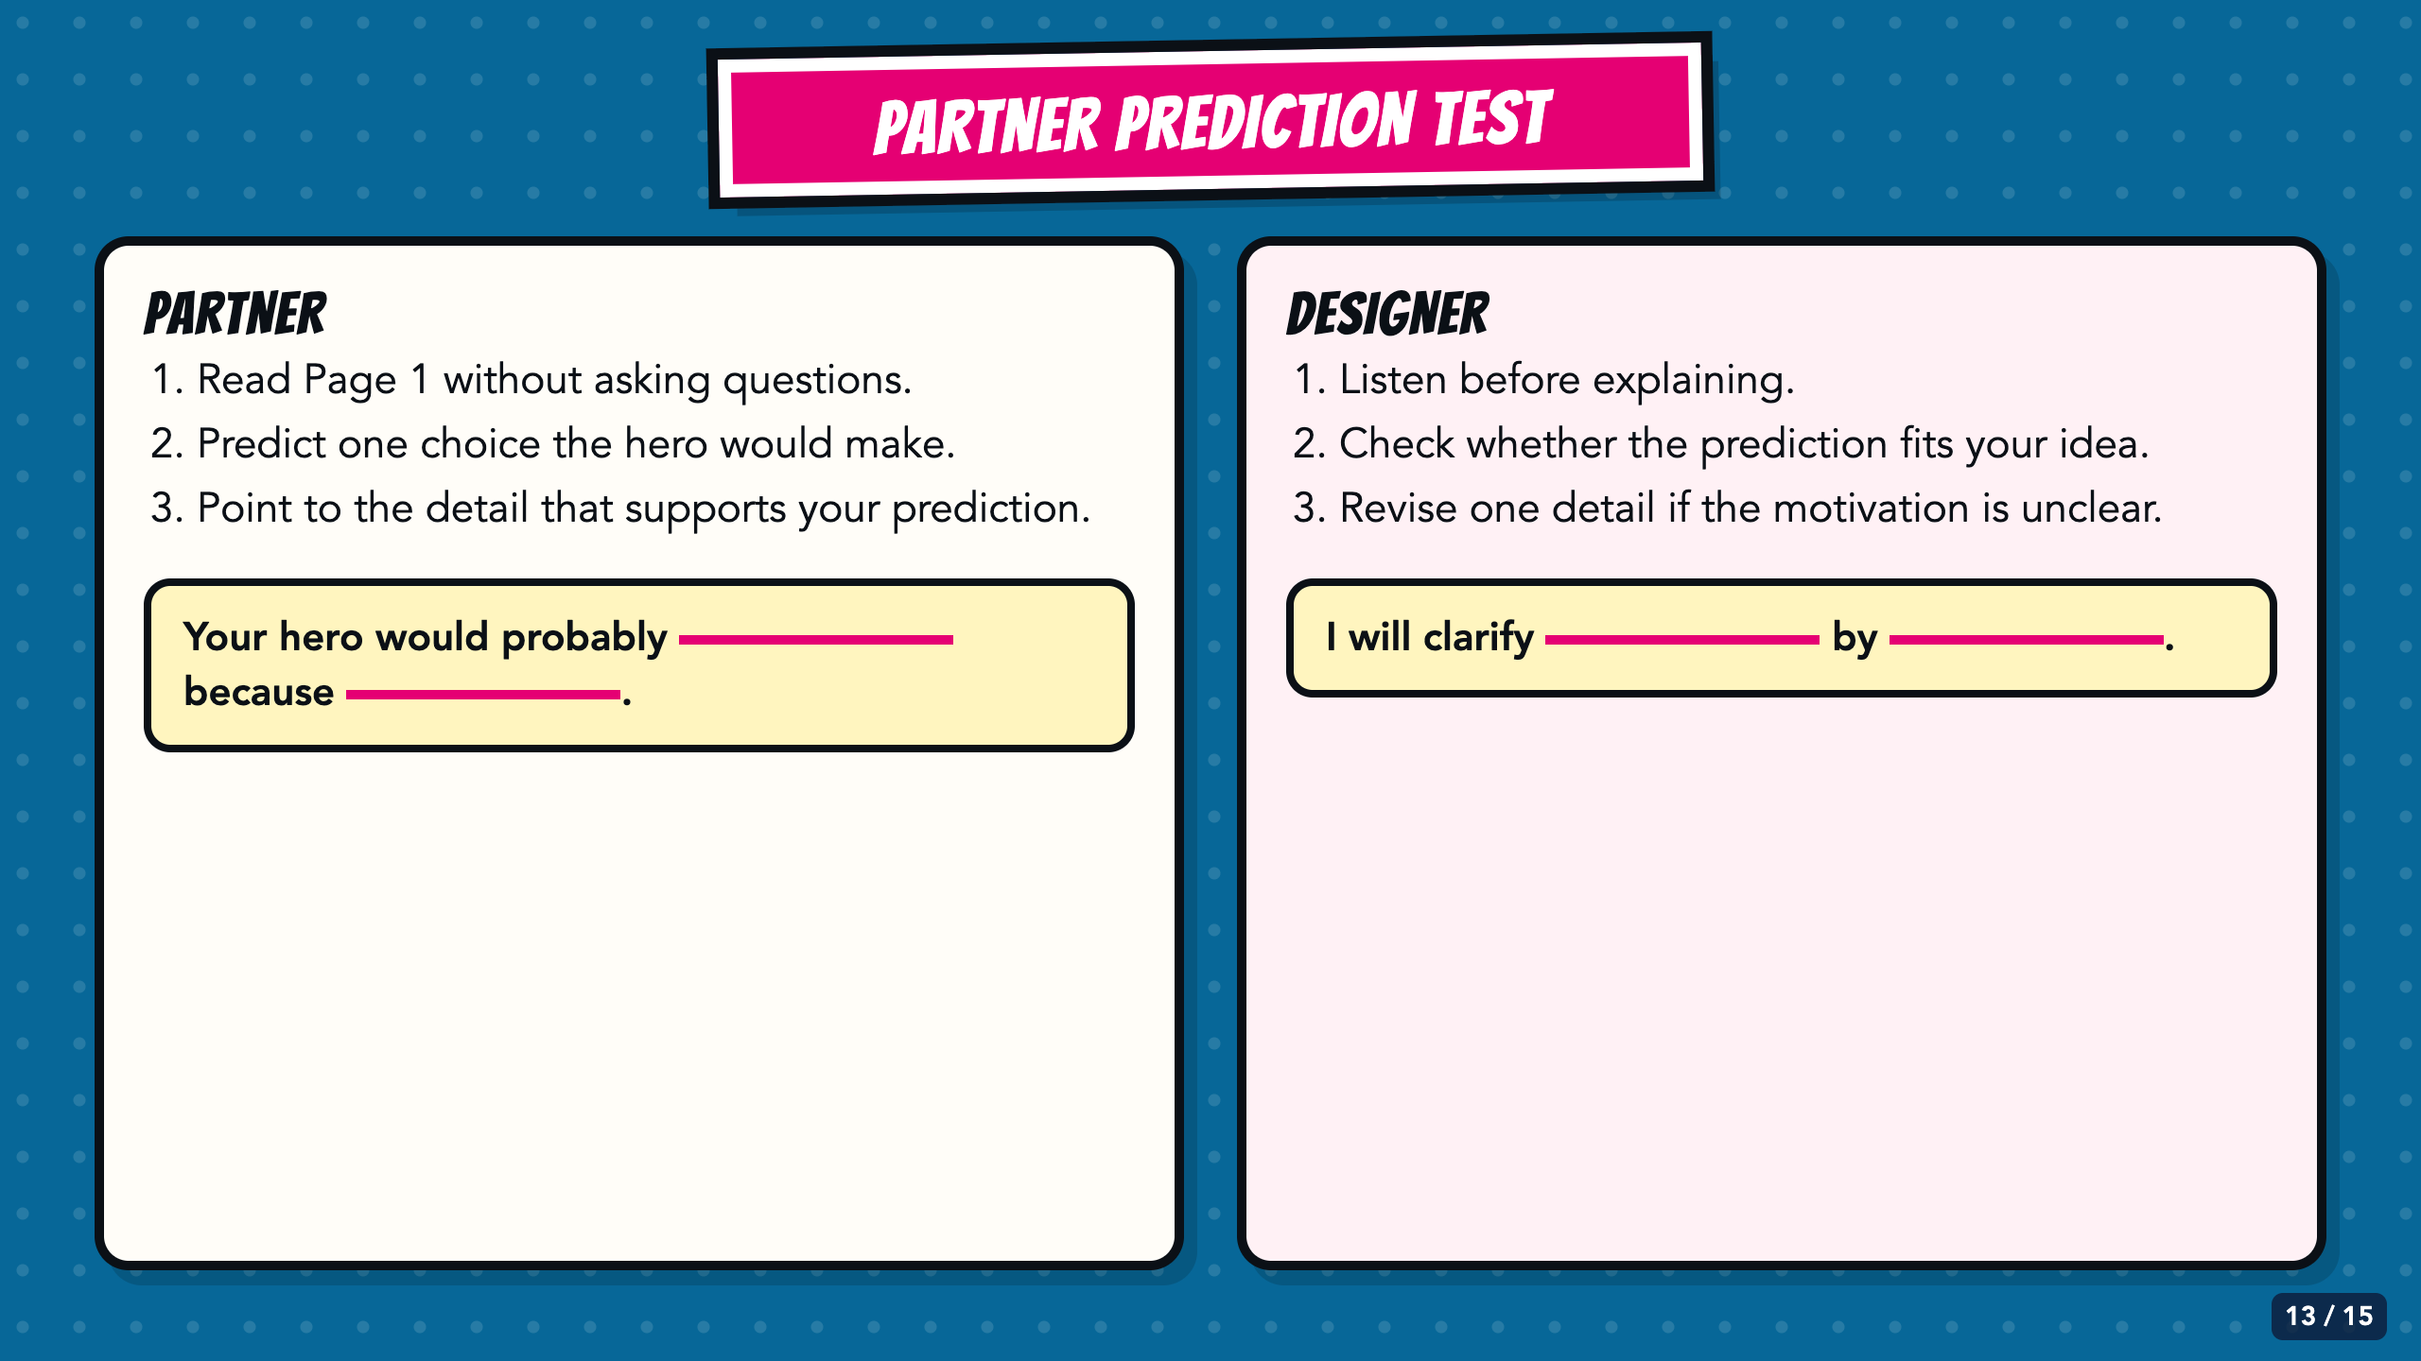
Notes:
Give partners a brief silent read before they speak. The partner predicts one choice and points to evidence; the designer listens before explaining. A mismatch tells the designer exactly what needs clarification.
[Sources]
- Owner-approved staged Comics Lesson 2 bodies: tmp/comic_scaffold_agent/lesson_2_biography.html and teacher_guide_lesson_2.html.

Slide 14
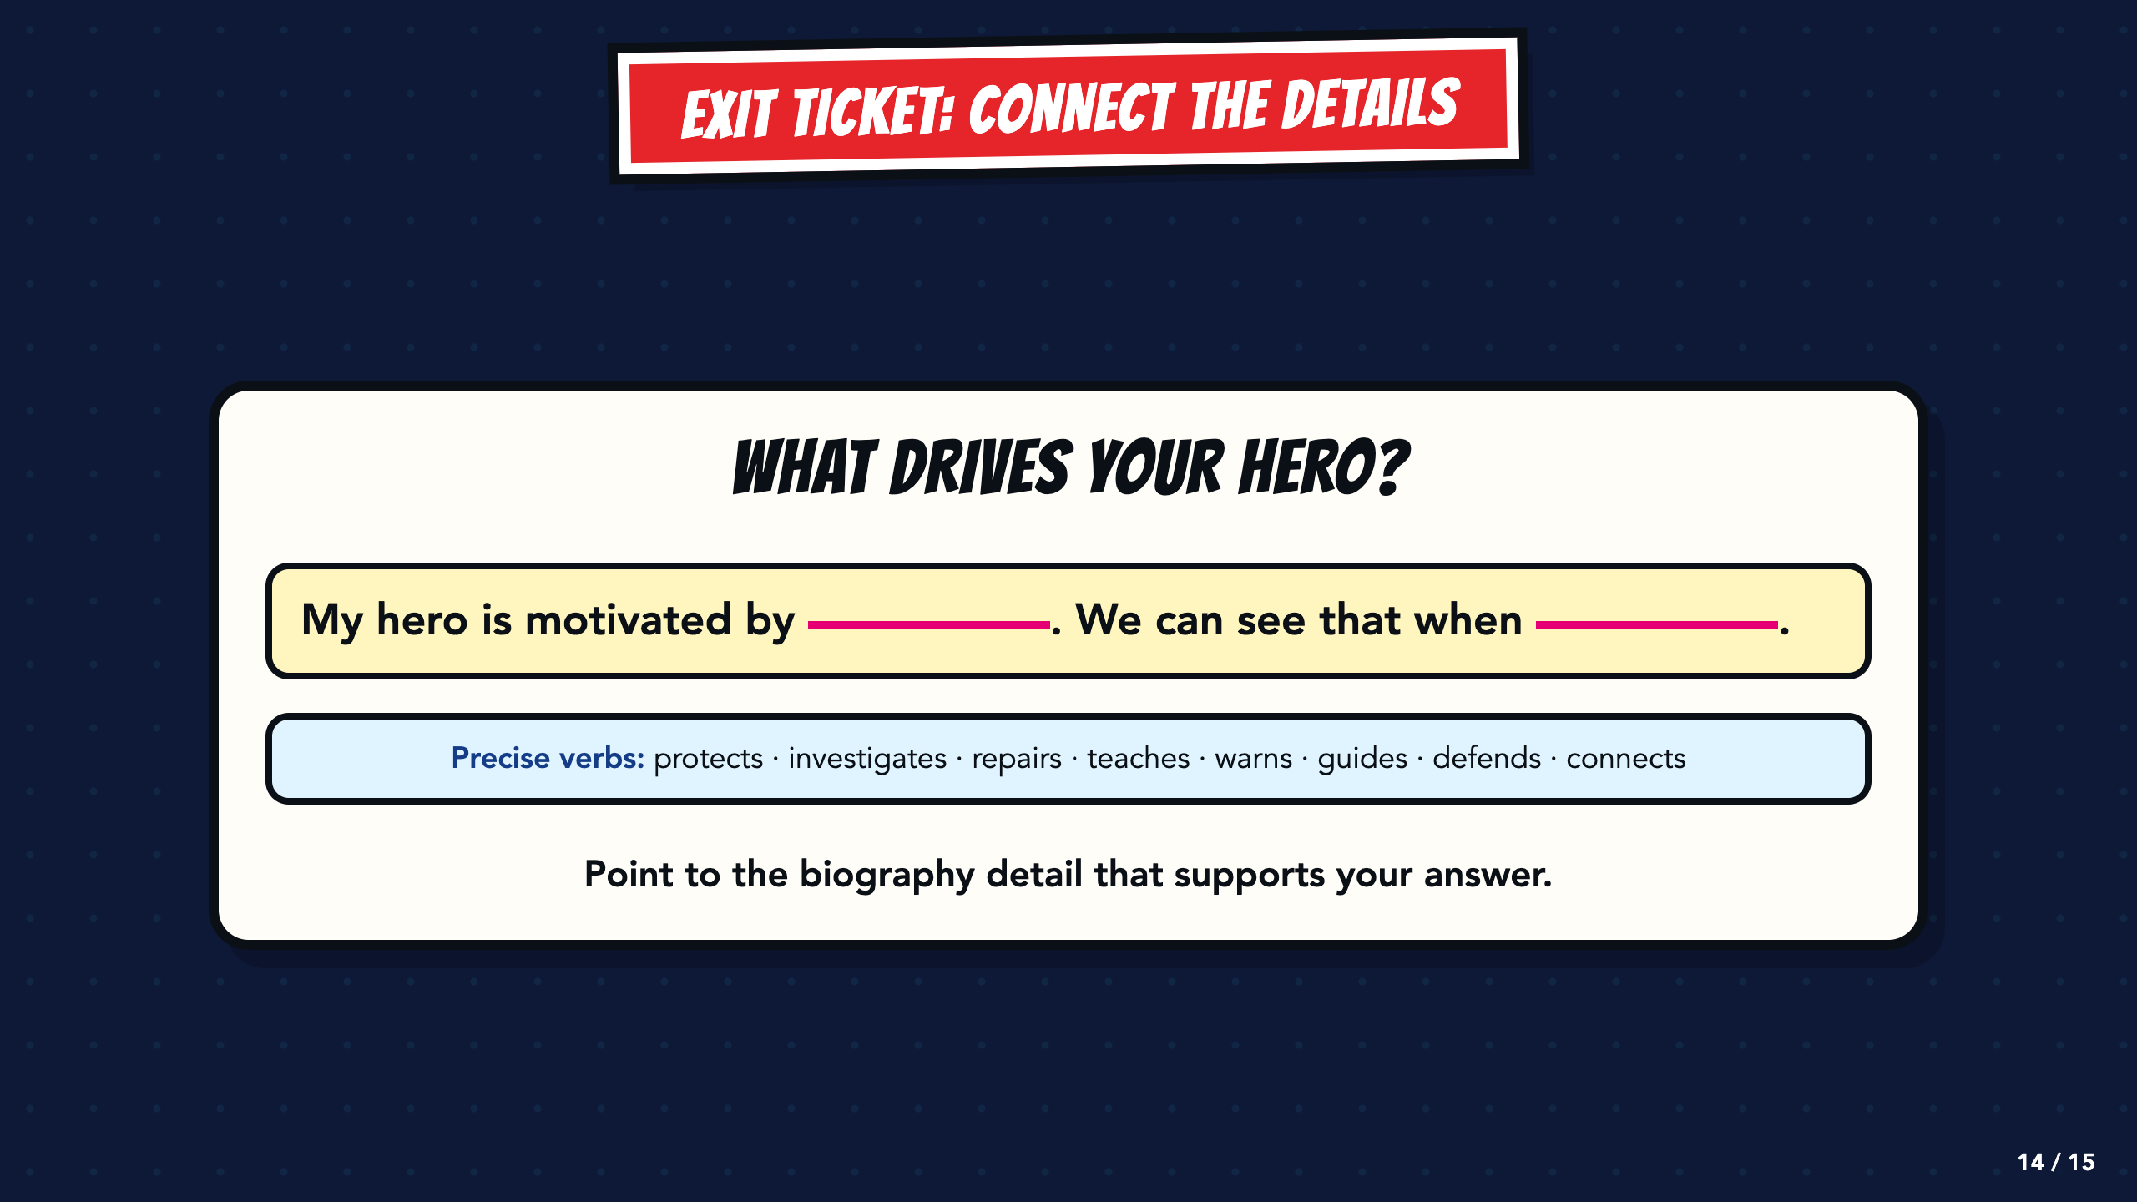
Notes:
Use the sentence as a written, oral, or point-and-explain exit ticket. Require one motivation and one visible biography detail that supports it.
[Sources]
- Owner-approved staged Comics Lesson 2 bodies: tmp/comic_scaffold_agent/lesson_2_biography.html and teacher_guide_lesson_2.html.

Slide 15
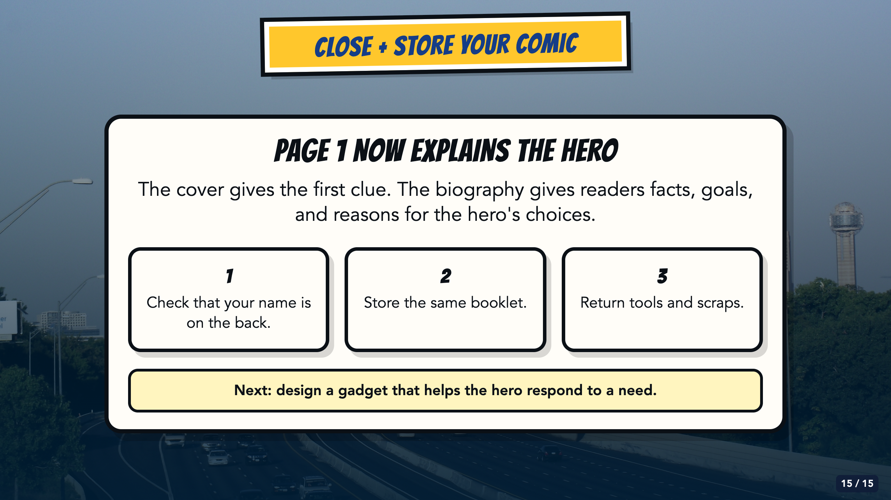
Notes:
Students keep the same booklet for all five Comics lessons. Check names on the back, collect or store the comics, and preview Lesson 3 as designing a gadget that helps the hero respond to a need.
[Sources]
- Elisha Lucero, Lesson 2: Superhero Bios.pptx and superhero_biography_lesson_2_20250818011110.pdf, From Google Drive 2026/Units/SS U0 (Superhero)/My Slides/.
- Owner-approved staged Comics Lesson 2 bodies: tmp/comic_scaffold_agent/lesson_2_biography.html and teacher_guide_lesson_2.html.
- Dallas skyline photograph by medea_material, CC BY 2.0; cropped and color-treated: https://commons.wikimedia.org/wiki/File:Skyline_of_Dallas,_TX.jpg

