Slide 1
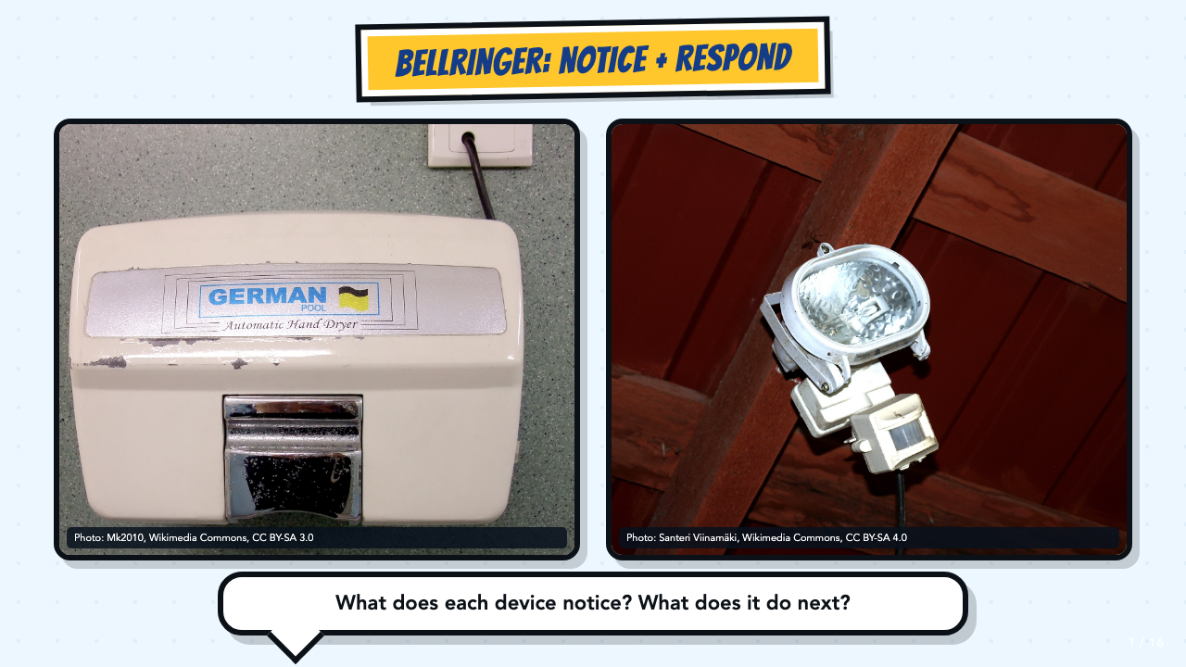
Notes:
Give students 60 to 90 seconds to write or talk with a partner. Accept everyday language first. Then introduce input and output after students describe what the devices notice and do.
[Sources]
- Automatic hand dryer photograph by Mk2010, CC BY-SA 3.0; cropped and resized: https://commons.wikimedia.org/wiki/File:Automatic_hand_dryer.JPG
- Motion sensor light photograph by Santeri Viinamäki, CC BY-SA 4.0; cropped and resized: https://commons.wikimedia.org/wiki/File:Motion_sensor_light.jpg

Slide 2
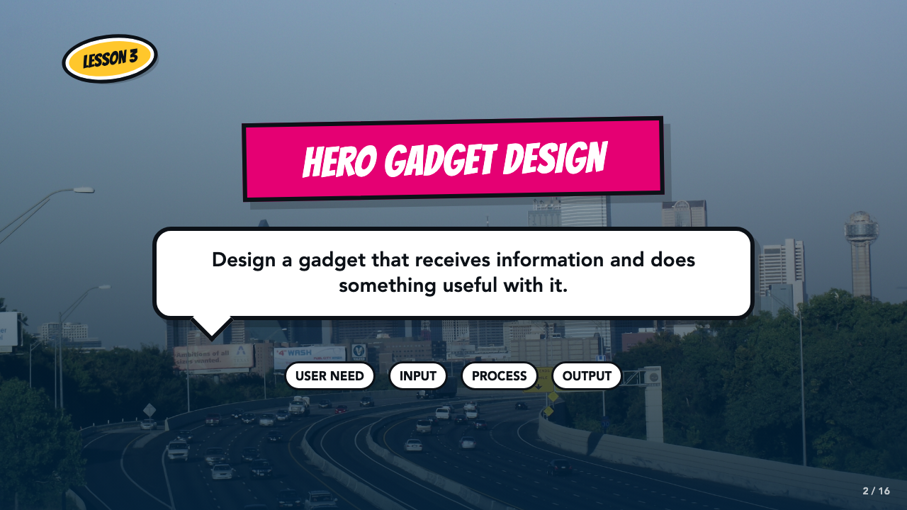
Notes:
Frame the lesson around one job: design a gadget that receives information and does something useful with it. Students keep the same hero from Lessons 1 and 2.
[Sources]
- Smart Solutions Lesson 3 course-author slide deck.
- Smart Solutions Comics Lesson 3 student and teacher materials.
- Dallas skyline photograph by medea_material, CC BY 2.0; cropped and resized: https://commons.wikimedia.org/wiki/File:Skyline_of_Dallas,_TX.jpg

Slide 3
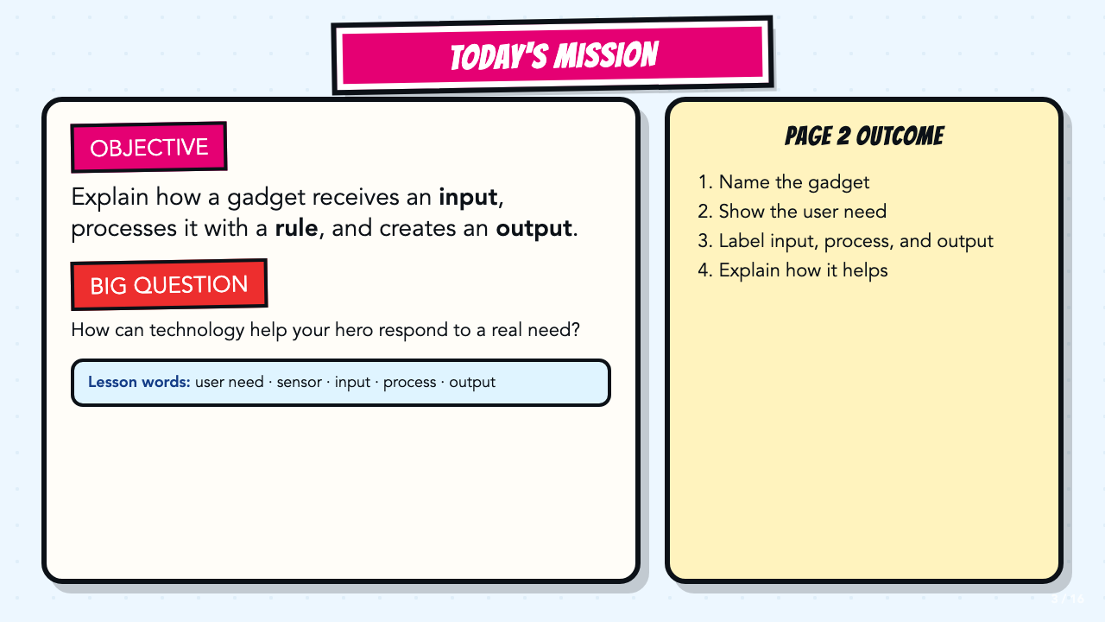
Notes:
Read the objective and Page 2 outcome aloud. Keep the lesson words visible while students talk through the first example.
[Sources]
- Smart Solutions Comics Lesson 3 student and teacher materials.
- ASU What Is Smart Technology facilitator guide, teacher copy: https://docs.google.com/document/d/1WzESLB2_sKgK8GsYEU7bsYHYmLap3Jpac6ObqwSNsK0/copy
- ASU Design Smart Technology facilitator guide, teacher copy: https://docs.google.com/document/d/191JK2LFDDdLaSI8gYLmsLjaY8E5jpKb2DsPx1luVN_4/copy

Slide 4
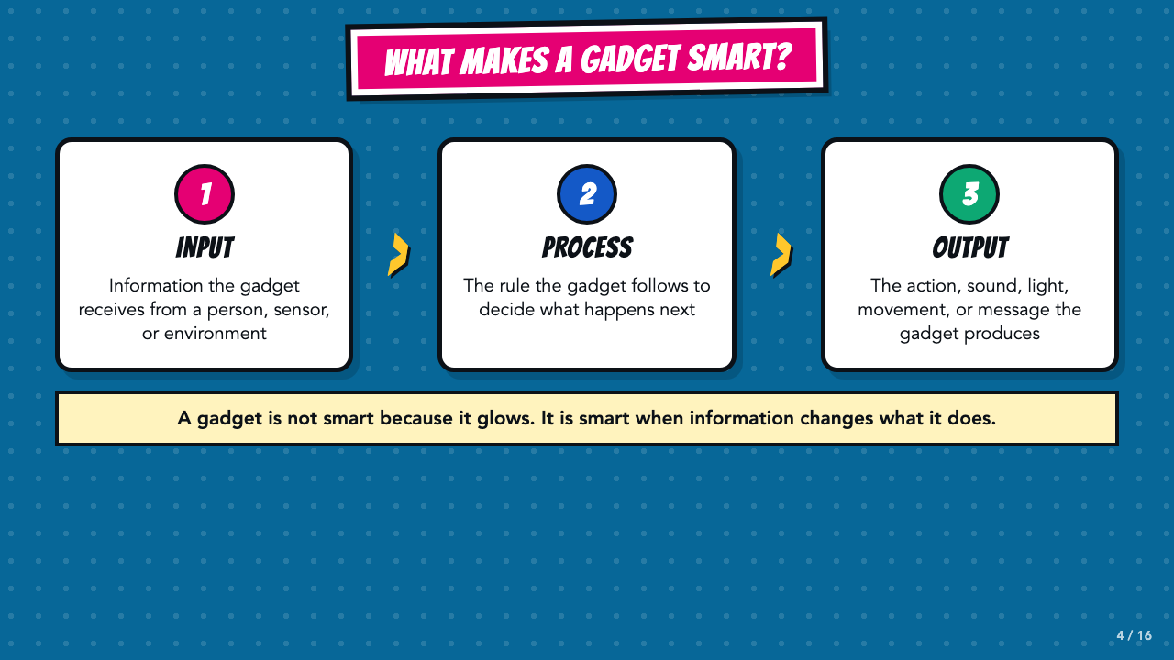
Notes:
Use the four-part system shown here: user need, input, process, output. The process is the rule the gadget follows. Ask students for an example of information changing what a device does.
[Sources]
- ASU What Is Smart Technology facilitator guide, teacher copy: https://docs.google.com/document/d/1WzESLB2_sKgK8GsYEU7bsYHYmLap3Jpac6ObqwSNsK0/copy
- ASU Design Smart Technology facilitator guide, teacher copy: https://docs.google.com/document/d/191JK2LFDDdLaSI8gYLmsLjaY8E5jpKb2DsPx1luVN_4/copy

Slide 5
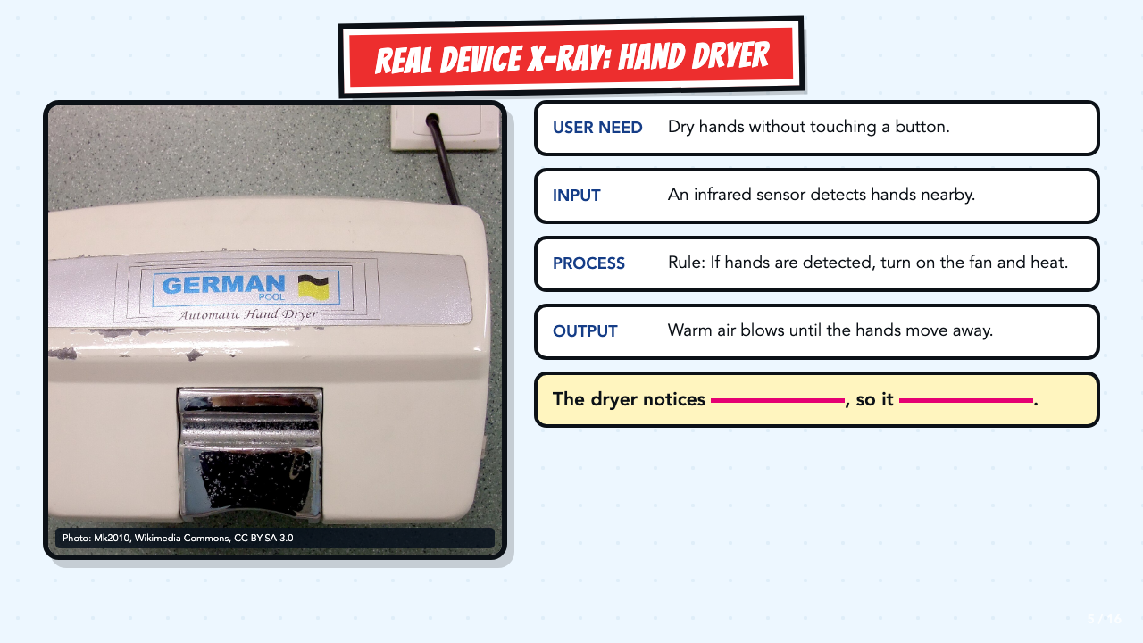
Notes:
Model the full chain. Input is the information, not the sensor part itself. The sensor receives the input. The process can often be stated as an if-then rule.
[Sources]
- Automatic hand dryer photograph by Mk2010, CC BY-SA 3.0; cropped and resized: https://commons.wikimedia.org/wiki/File:Automatic_hand_dryer.JPG
- ASU What Is Smart Technology facilitator guide, teacher copy: https://docs.google.com/document/d/1WzESLB2_sKgK8GsYEU7bsYHYmLap3Jpac6ObqwSNsK0/copy
- ASU Design Smart Technology facilitator guide, teacher copy: https://docs.google.com/document/d/191JK2LFDDdLaSI8gYLmsLjaY8E5jpKb2DsPx1luVN_4/copy

Slide 6
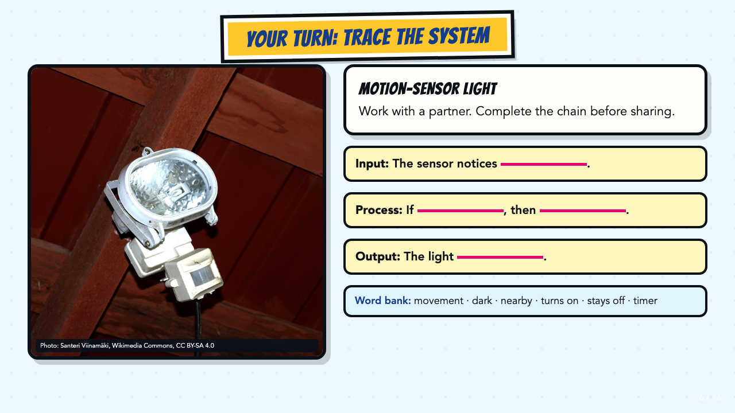
Notes:
Let partners complete all three stems before whole-class sharing. A strong response distinguishes movement as the input from light turning on as the output.
[Sources]
- Motion sensor light photograph by Santeri Viinamäki, CC BY-SA 4.0; cropped and resized: https://commons.wikimedia.org/wiki/File:Motion_sensor_light.jpg
- ASU What Is Smart Technology facilitator guide, teacher copy: https://docs.google.com/document/d/1WzESLB2_sKgK8GsYEU7bsYHYmLap3Jpac6ObqwSNsK0/copy

Slide 7
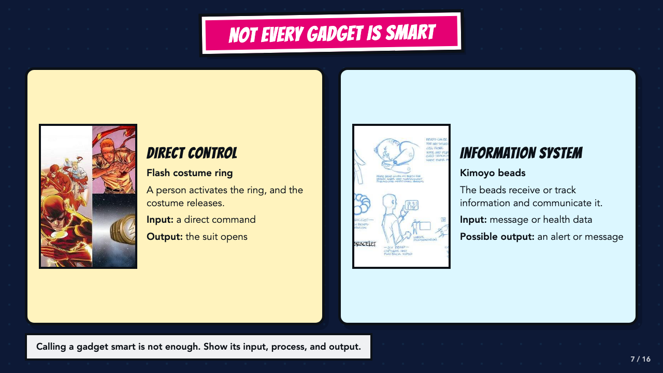
Notes:
Use the comparison to clarify that useful technology is not automatically smart technology. The Flash ring follows a direct user command. Kimoyo beads receive or track information, process it, and communicate a result.
[Sources]
- Smart Solutions Lesson 3 course-author slide deck.
- The Flash #763, DC, official issue page describing the Flash ring: https://www.dc.com/comics/the-flash-2016/the-flash-763
- Wakanda's Tech Today, Marvel, official description of Kimoyo beads: https://www.marvel.com/articles/comics/wakanda-s-tech-today-the-reviews-are-in

Slide 8
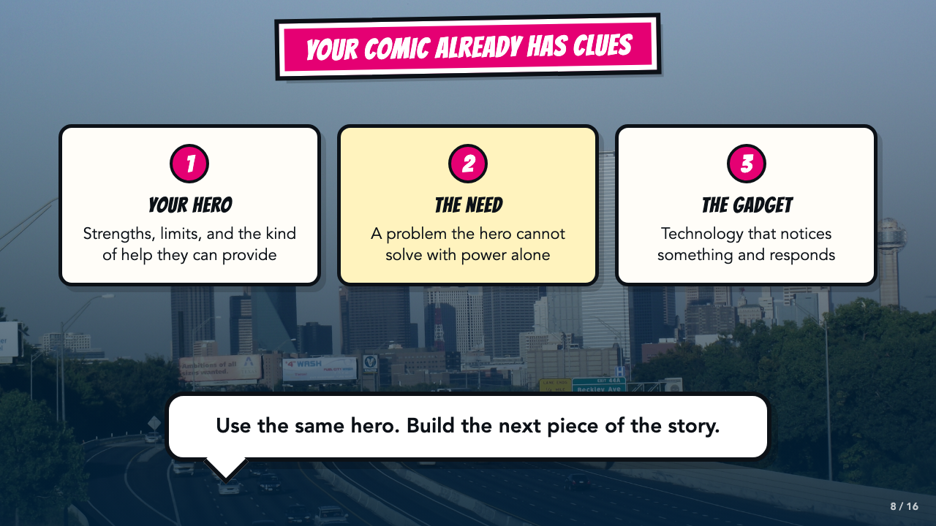
Notes:
Have students point to the hero they already made, then name a problem that powers alone cannot solve. Do not ask them to invent a new character.
[Sources]
- Smart Solutions Lesson 3 course-author slide deck.
- Smart Solutions Comics Lesson 3 student and teacher materials.
- Dallas skyline photograph by medea_material, CC BY 2.0; cropped and resized: https://commons.wikimedia.org/wiki/File:Skyline_of_Dallas,_TX.jpg

Slide 9
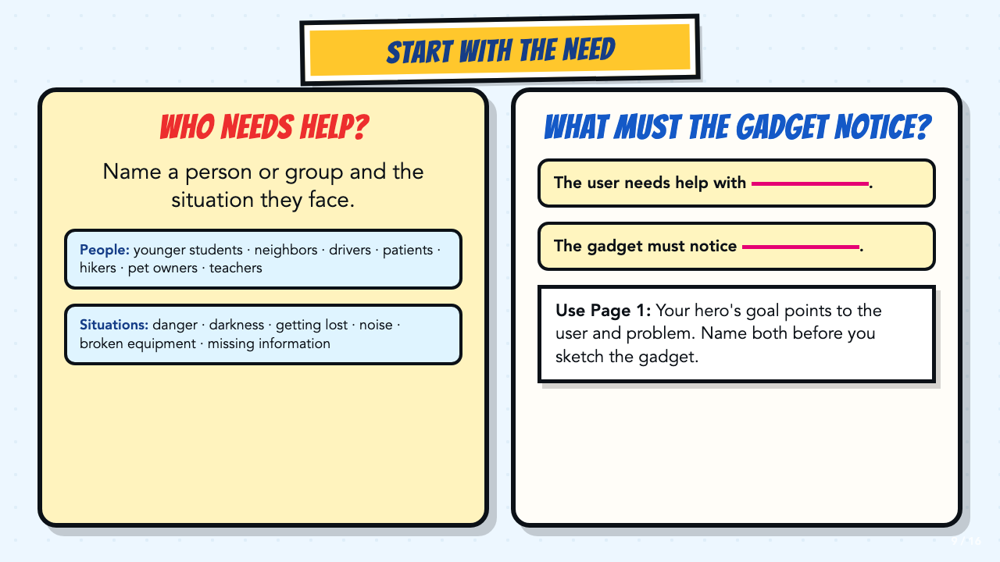
Notes:
Require a specific user and situation before students name a gadget. Ask them to use the hero goal on Page 1 as evidence for the user and need.
[Sources]
- Smart Solutions Comics Lesson 3 student and teacher materials.
- ASU Design Smart Technology facilitator guide, teacher copy: https://docs.google.com/document/d/191JK2LFDDdLaSI8gYLmsLjaY8E5jpKb2DsPx1luVN_4/copy
- ASU Design Smart Technology worksheet: https://docs.google.com/document/d/1Vn0nT9B3tXr37D5lYxqgGXpkm5yrIeMC/copy

Slide 10
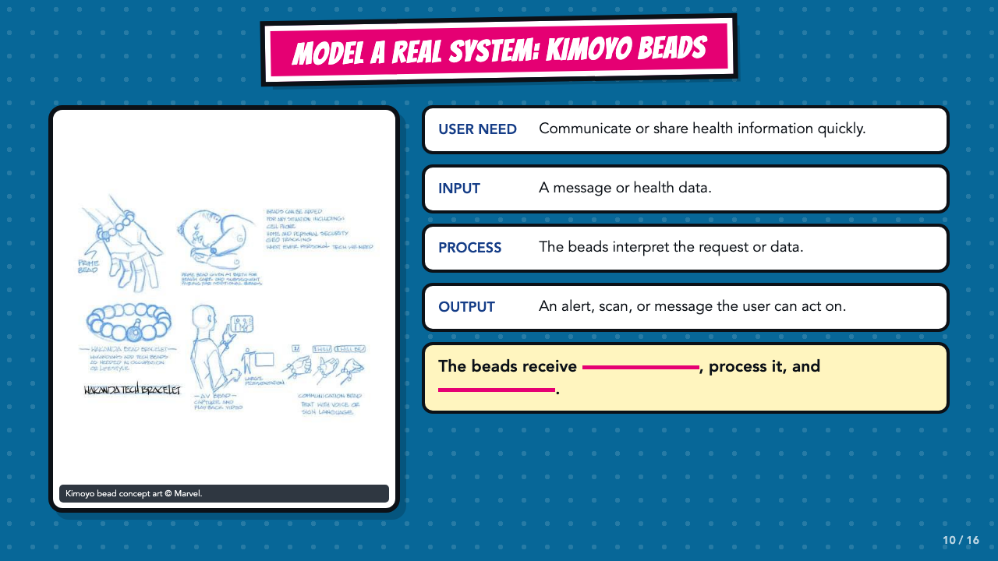
Notes:
Trace the Kimoyo system aloud. Name the user need, input, process, and output, then have students test whether the output answers the need.
[Sources]
- Smart Solutions Lesson 3 course-author slide deck.
- Wakanda's Tech Today, Marvel, official description of Kimoyo beads: https://www.marvel.com/articles/comics/wakanda-s-tech-today-the-reviews-are-in
- ASU What Is Smart Technology facilitator guide, teacher copy: https://docs.google.com/document/d/1WzESLB2_sKgK8GsYEU7bsYHYmLap3Jpac6ObqwSNsK0/copy

Slide 11
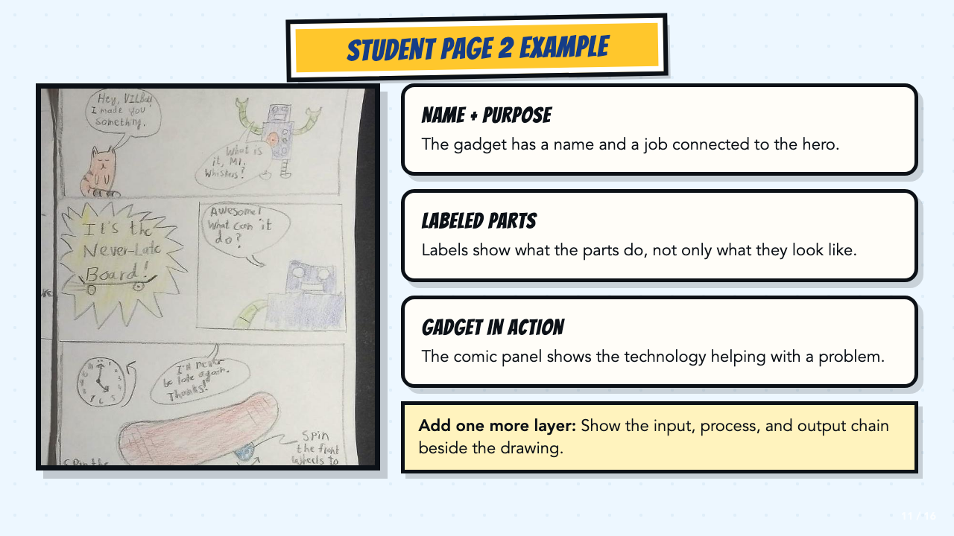
Notes:
Use the authentic student page to make the physical outcome concrete. Point out the name, labeled parts, and gadget-in-action panel. Students add the input, process, and output chain beside their drawing.
[Sources]
- Smart Solutions Lesson 3 course-author slide deck.
- Authentic student Page 2 work supplied by the course author.
- Smart Solutions Comics Lesson 3 student and teacher materials.

Slide 12
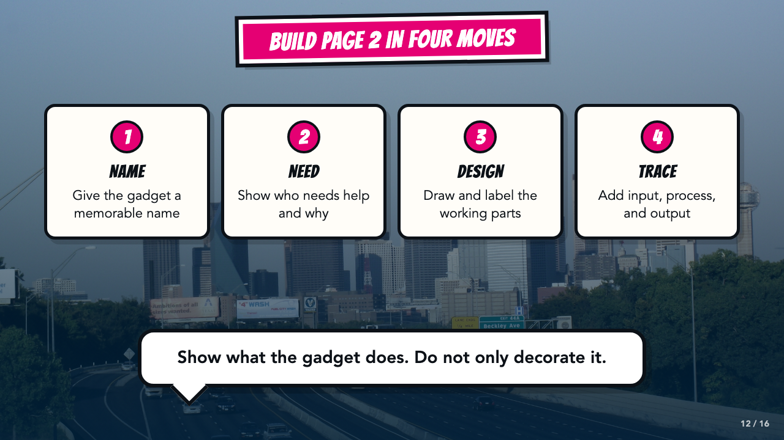
Notes:
Preview the four moves before work begins. Page 2 should show function, not only decoration.
[Sources]
- Smart Solutions Lesson 3 course-author slide deck.
- Smart Solutions Comics Lesson 3 student and teacher materials.
- Dallas skyline photograph by medea_material, CC BY 2.0; cropped and resized: https://commons.wikimedia.org/wiki/File:Skyline_of_Dallas,_TX.jpg

Slide 13
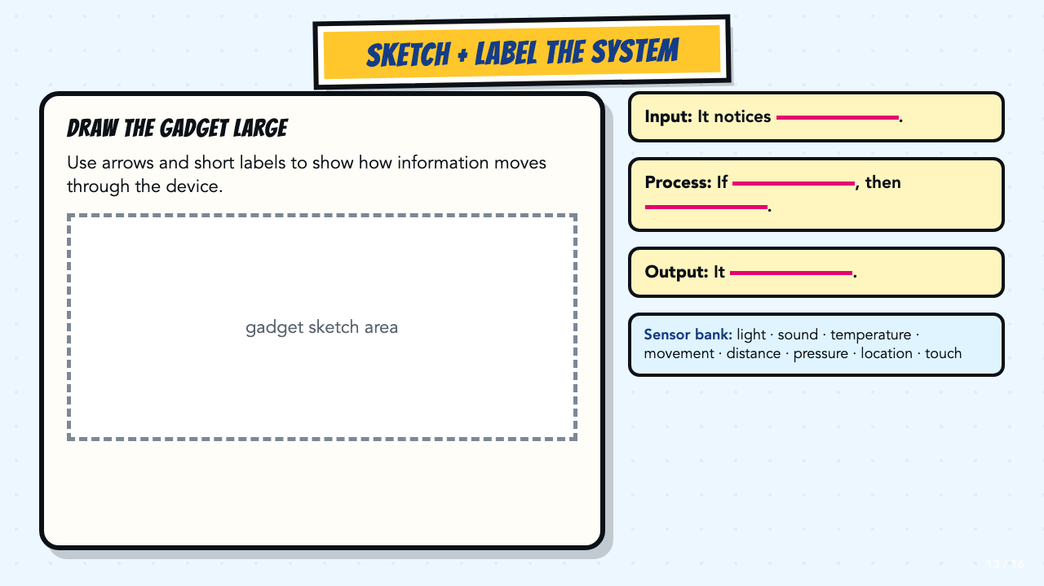
Notes:
Students should draw large enough to label the working parts. Keep the sensor word bank visible for emerging bilingual students and anyone who needs idea support.
[Sources]
- Smart Solutions Comics Lesson 3 student and teacher materials.
- ASU Design Smart Technology facilitator guide, teacher copy: https://docs.google.com/document/d/191JK2LFDDdLaSI8gYLmsLjaY8E5jpKb2DsPx1luVN_4/copy
- ASU Design Smart Technology worksheet: https://docs.google.com/document/d/1Vn0nT9B3tXr37D5lYxqgGXpkm5yrIeMC/copy

Slide 14
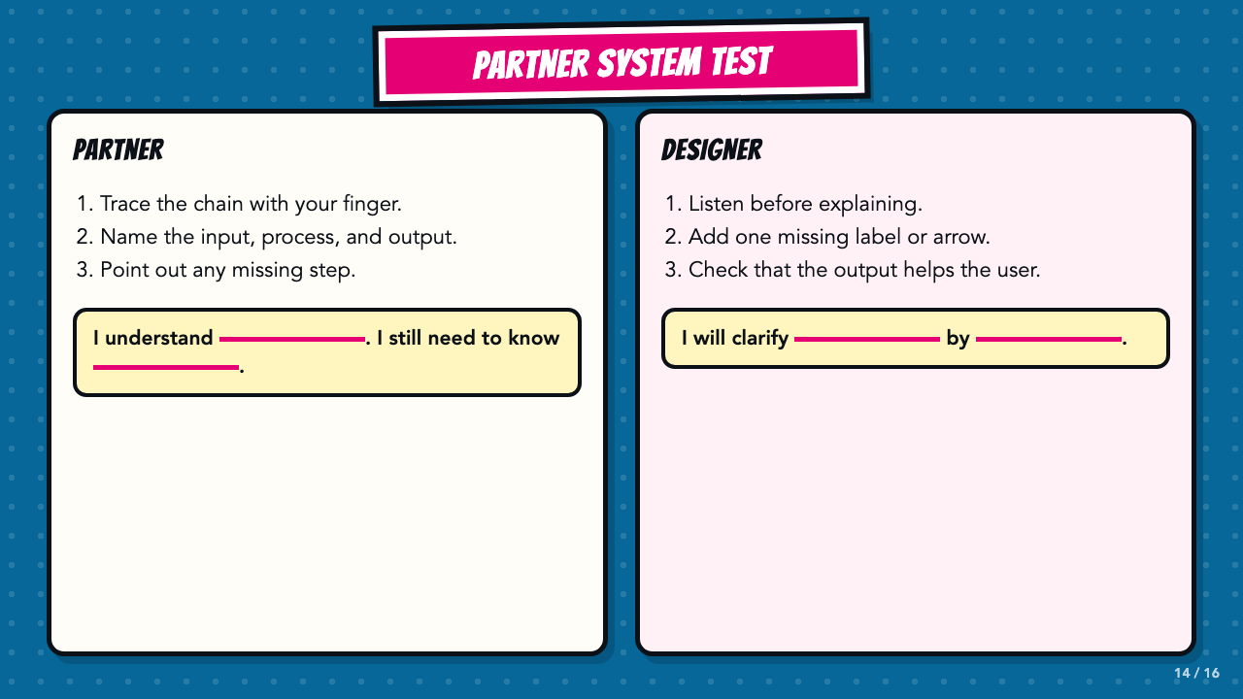
Notes:
The partner traces the system before the designer explains. This exposes missing logic that can be hidden by a polished drawing. Require one concrete revision when a step is unclear.
[Sources]
- Smart Solutions Comics Lesson 3 student and teacher materials.
- ASU Design Smart Technology facilitator guide, teacher copy: https://docs.google.com/document/d/191JK2LFDDdLaSI8gYLmsLjaY8E5jpKb2DsPx1luVN_4/copy

Slide 15
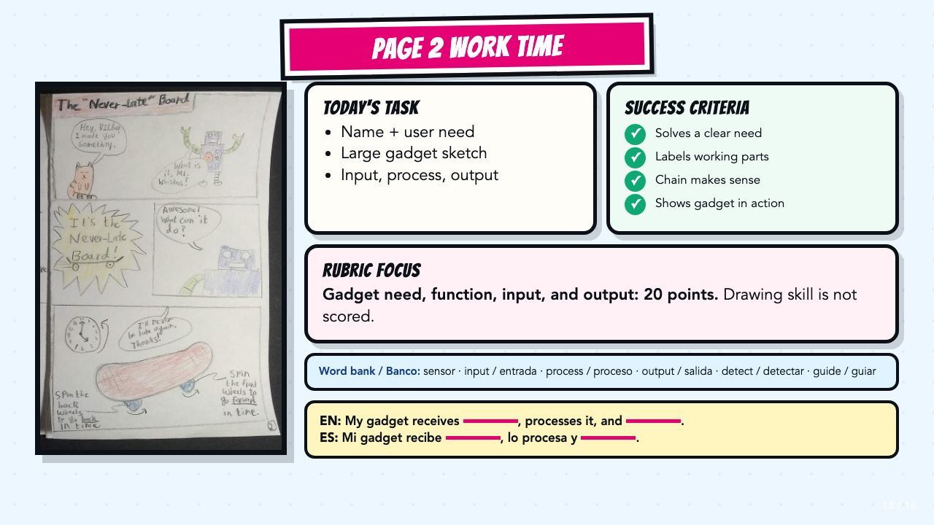
Notes:
Leave this slide projected during independent or partner work. Read the exact 20-point gadget criterion before students begin, and direct students to the bilingual word bank and stems when they need language support.
[Sources]
- Smart Solutions Lesson 3 course-author slide deck.
- Authentic student Page 2 work supplied by the course author.
- Smart Solutions Comics Lesson 3 student and teacher materials.

Slide 16
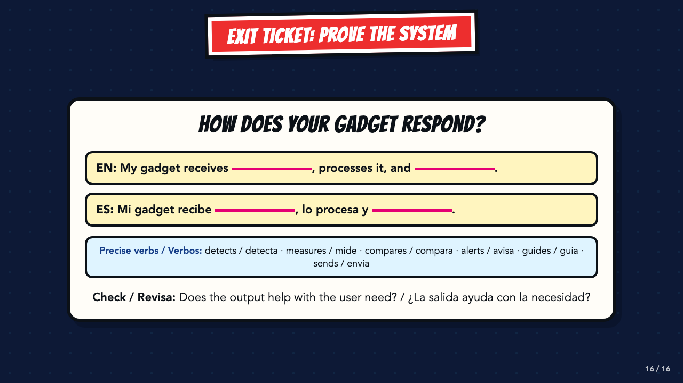
Notes:
Use the stem as a written or oral exit ticket. Listen for a real input, a clear condition, and an output that addresses the user need.
[Sources]
- Smart Solutions Comics Lesson 3 student and teacher materials.
- ASU Design Smart Technology facilitator guide, teacher copy: https://docs.google.com/document/d/191JK2LFDDdLaSI8gYLmsLjaY8E5jpKb2DsPx1luVN_4/copy
- ASU Design Smart Technology worksheet: https://docs.google.com/document/d/1Vn0nT9B3tXr37D5lYxqgGXpkm5yrIeMC/copy

