Slide 1
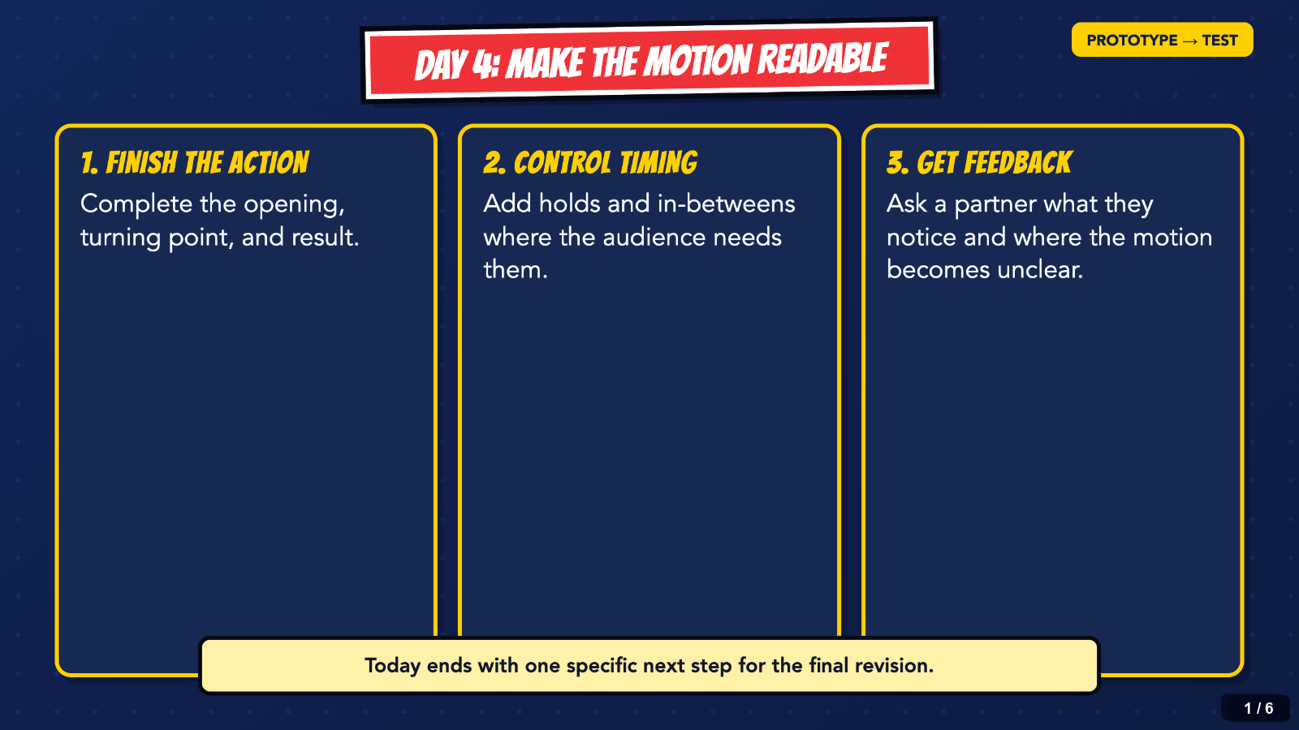
Notes:
Start here. Students should finish the action, control the timing, and leave with one feedback-based next step. This loop advances every 18 seconds and repeats. Use the Slide Show controls to pause or resume automatic timings. Use the arrow keys to move manually.
[Sources]
- Irving ISD VILS 2027 Template Animation student pages, rubric, and facilitator guide.

Slide 2
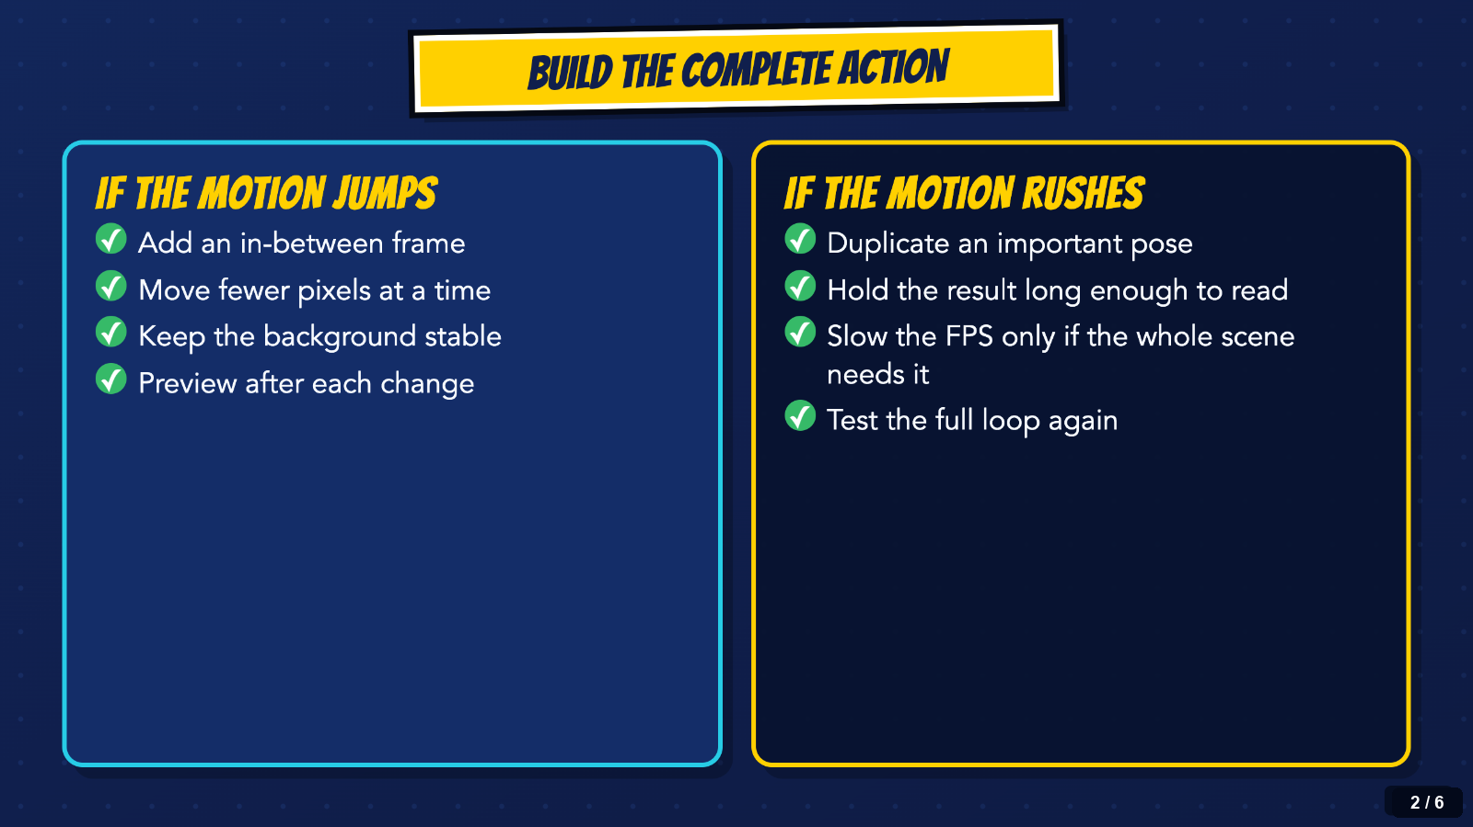
Notes:
Use this as the definition of a complete Day 4 pass. The whole scene must reach a visible result before students spend time on decorative polish.
[Sources]
- Irving ISD VILS 2027 Template Animation student pages, rubric, and facilitator guide.

Slide 3
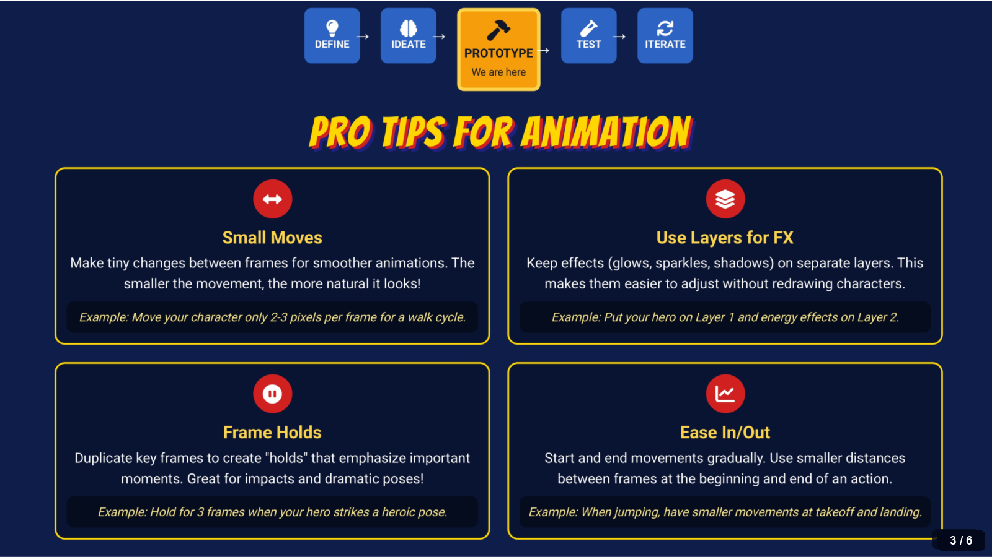
Notes:
Pause here when the class needs a craft reminder. Small moves, layers, frame holds, and ease in or out are tools for readability, not extra requirements.
[Sources]
- Irving ISD VILS 2027 Template Animation student pages, rubric, and facilitator guide.
- Course-author-created Superhero Piskel Canva deck: Superhero Micro-Animation in Piskel.

Slide 4
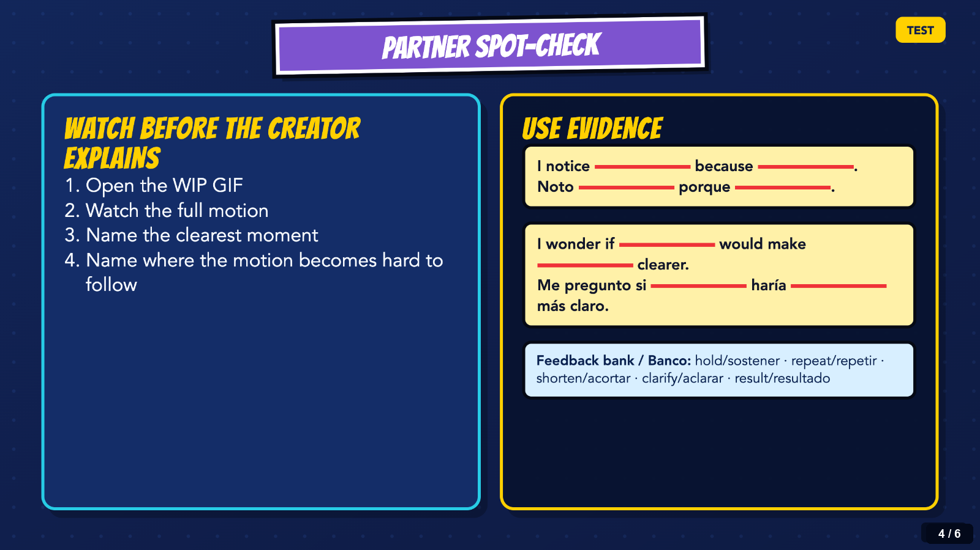
Notes:
Partners watch before the creator explains. Ask for one specific notice and one question about action, timing, or the visible result.
[Sources]
- Irving ISD VILS 2027 Template Animation student pages, rubric, and facilitator guide.

Slide 5
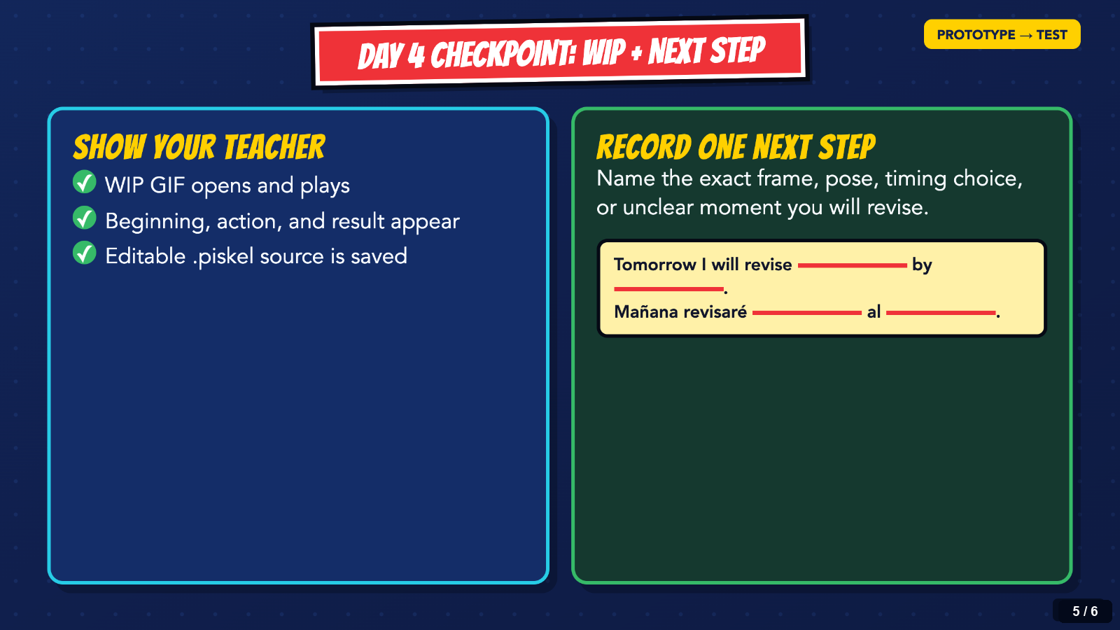
Notes:
Before cleanup, every student exports a WIP GIF, opens it outside Piskel, and records one concrete next step. Save the editable .piskel source too.
[Sources]
- Irving ISD VILS 2027 Template Animation student pages, rubric, and facilitator guide.

Slide 6
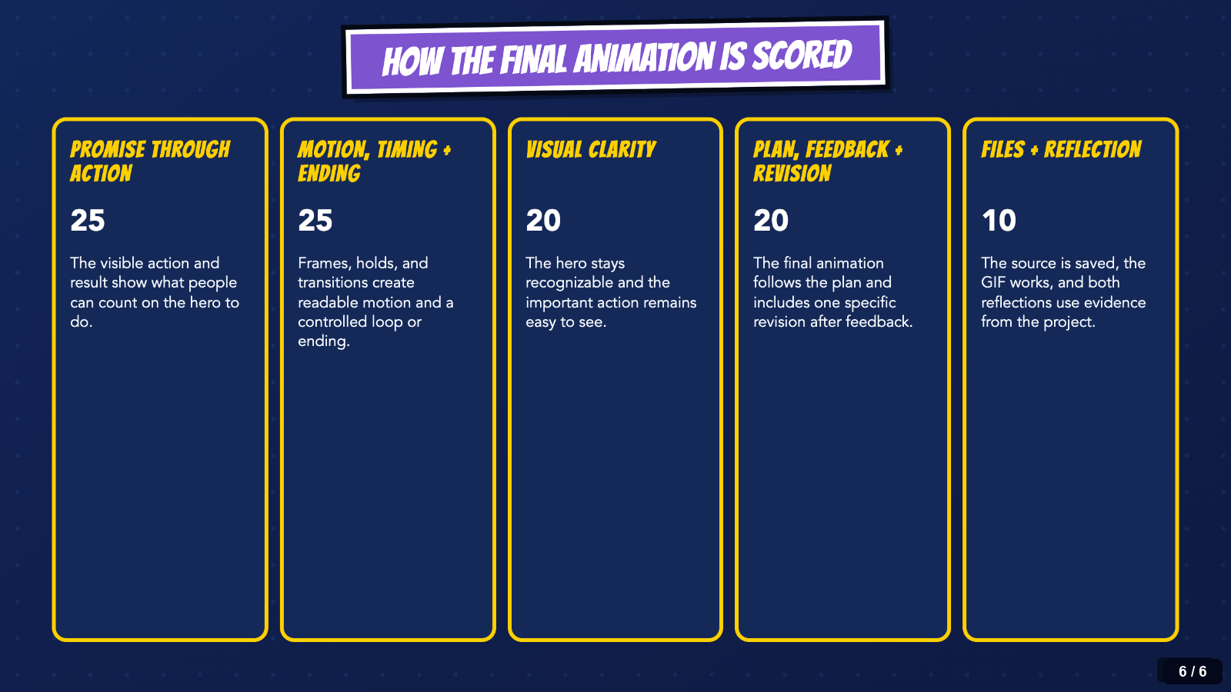
Notes:
Keep this grading snapshot visible when students need to prioritize. The five criteria total 100 points and match the Canvas rubric.
[Sources]
- Irving ISD VILS 2027 Template Animation student pages, rubric, and facilitator guide.

