Slide 1


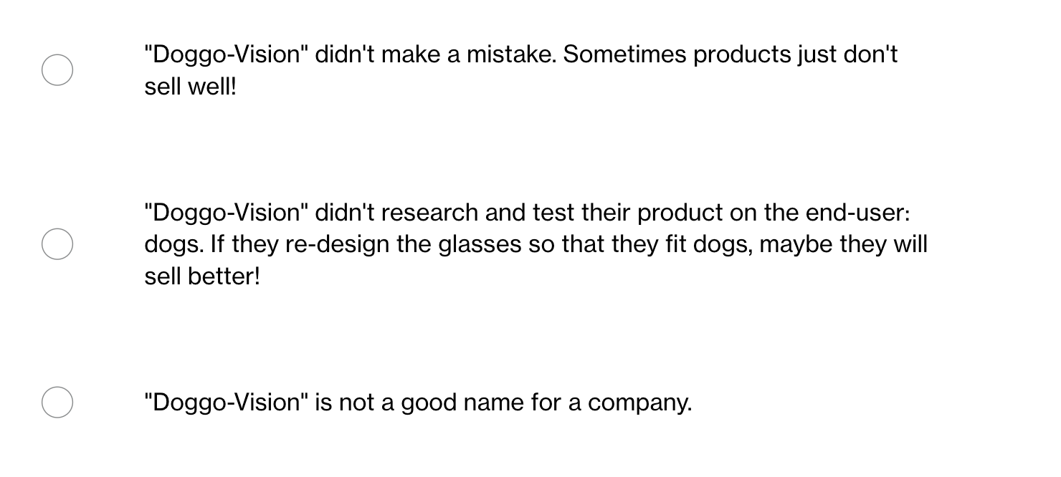
A company called "Doggo-Vision" recently spent 1 million dollars developing reading glasses for dogs. However, no customers bought their product! The glasses don't fit dogs and keep falling off.
What was "Doggo-Vision's" mistake?
Time: 1 min.
Voice: 🔴 Silent.
Body: Sit tall, eyes on screen.

Slide 2
Design Thinking is all about understanding what the user wants or needs, and testing out the ideas you come up with.
“Doggo-Vision” didn’t research and test their product on the end-user: dogs. If they redesign the glasses so that they fit dogs, maybe they will sell better!
Time: 1 min.
Voice: 🔴 Silent.
Body: Sit tall, eyes on screen.

Slide 3
Ready, Set, Design! Self Guided Design Thinking Activity
ASU Edson E & I Youth Entrepreneurship
Ready, Set, Design!
A quick pit stop to learn Design Thinking
Time: 1 min.
Voice: 🔴 Silent.
Body: Sit tall, eyes on screen.

Slide 4

 |  | Standards
O | Students will understand the steps of the Design Thinking process and how it can be applied to solve real-world challenges. | 4B: Identify skills that can be transferable among a variety of careers, such as creativity, problem-solving, and innovation.
D | Participating in a fast-paced design challenge, creating a prototype, and completing a worksheet that defines each step of the Design Thinking process.
Chapter 2: Ready, Set, Design!

Slide 5
Ready, Set, Design! Self Guided Design Thinking Activity
ASU Edson E & I Youth Entrepreneurship
Why We're Doing This
Solve like designers
Build fast to learn fast
Good ideas often look messy first
Time: 1 min. Voice: 🔴 Silent. Body: Sit upright, eyes on presenter.

Slide 6
Ready, Set, Design! Self Guided Design Thinking Activity
ASU Edson E & I Youth Entrepreneurship
The 5 Steps at a Glance
Empathize
Understand the user
Define
State the problem
Ideate
Brainstorm solutions
Prototype
Build a model
Test
Try it out
We will touch all five steps today!
Time: 2 min.
Voice: 🔴 Silent.
Body: Eyes on screen, sitting upright.

Slide 7
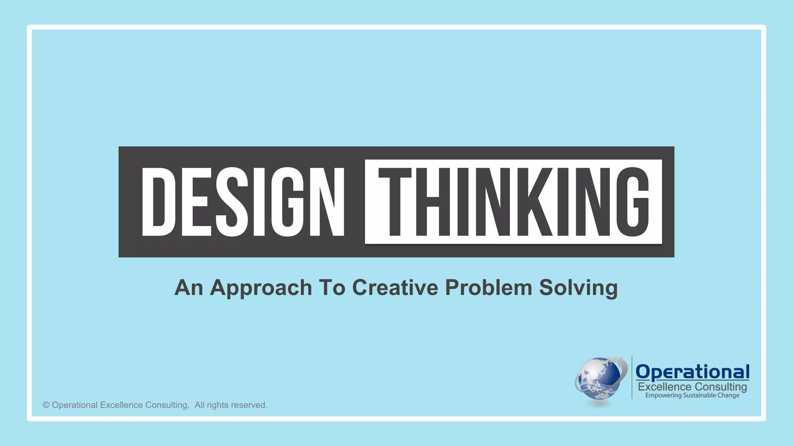

Slide 8
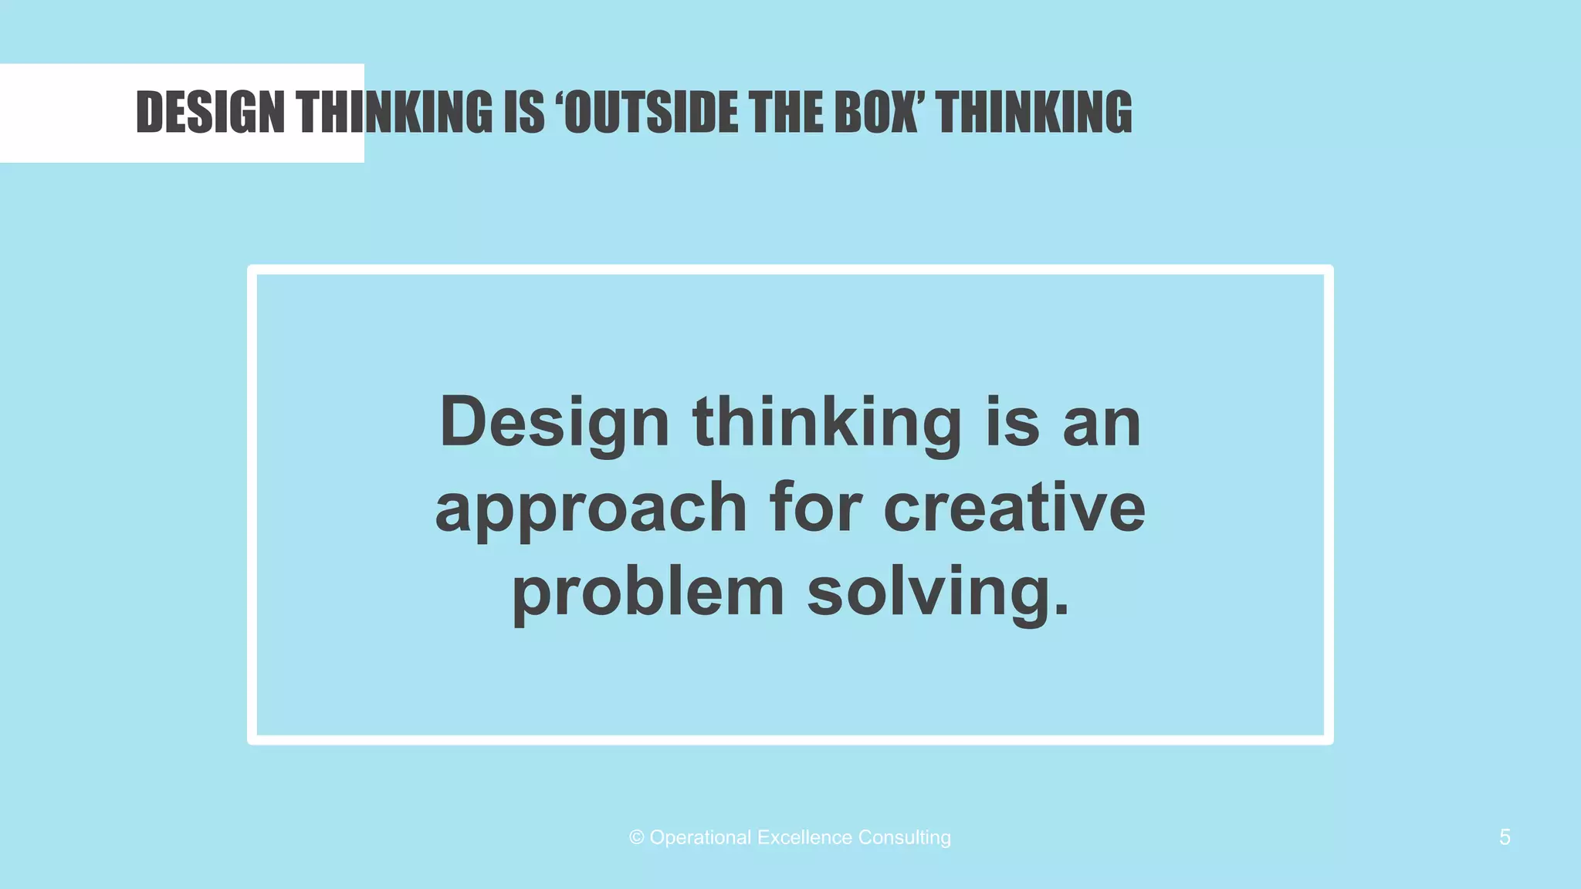

Slide 9
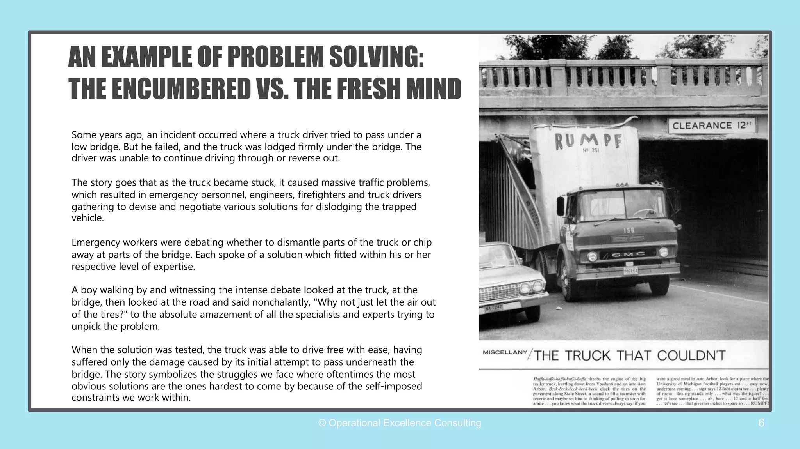
Body: Talking with table; Prepare to share

Slide 10
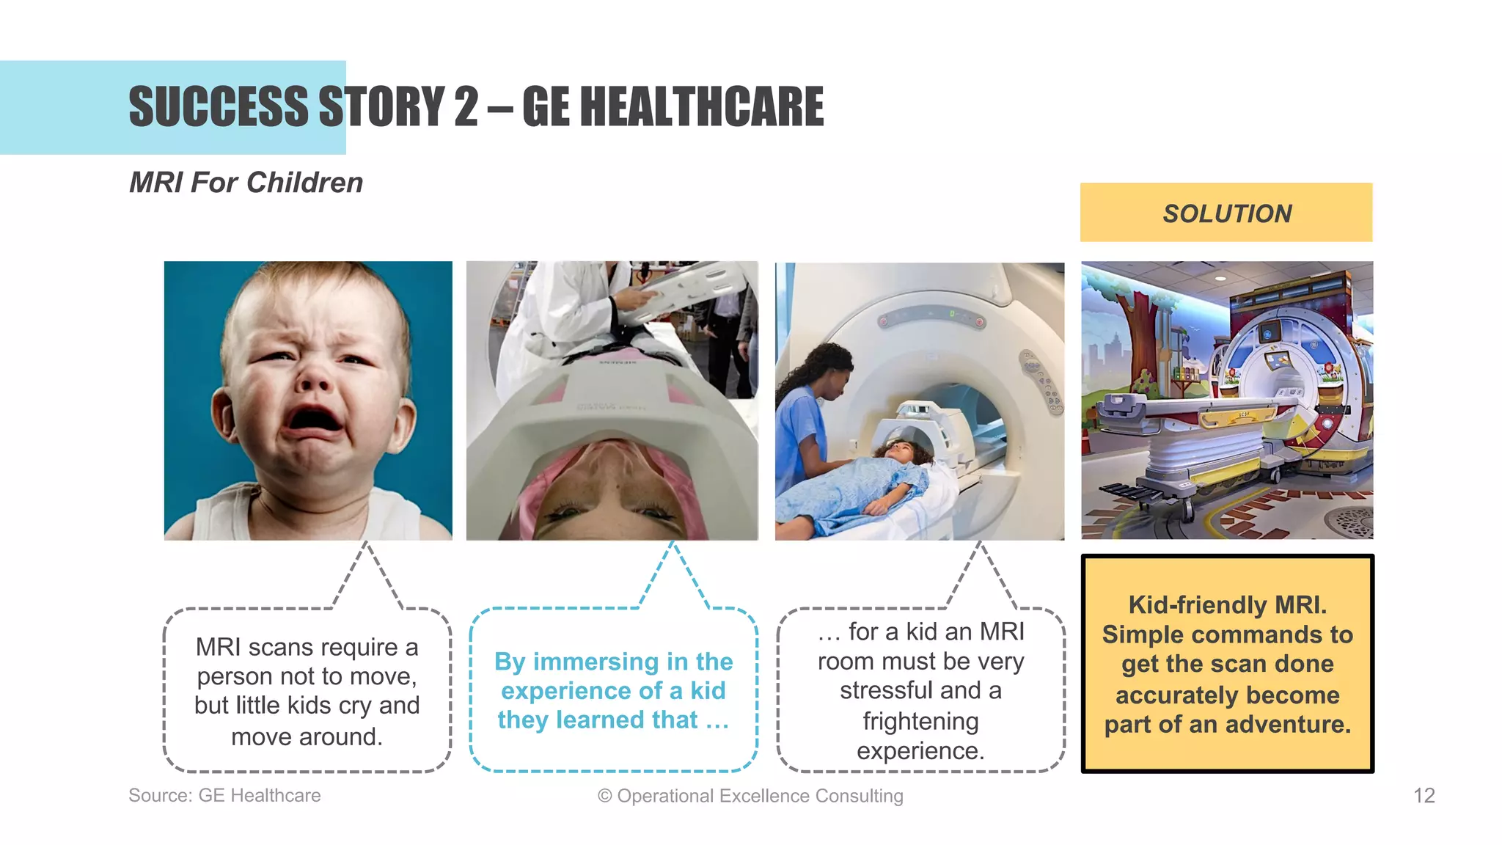

Slide 11
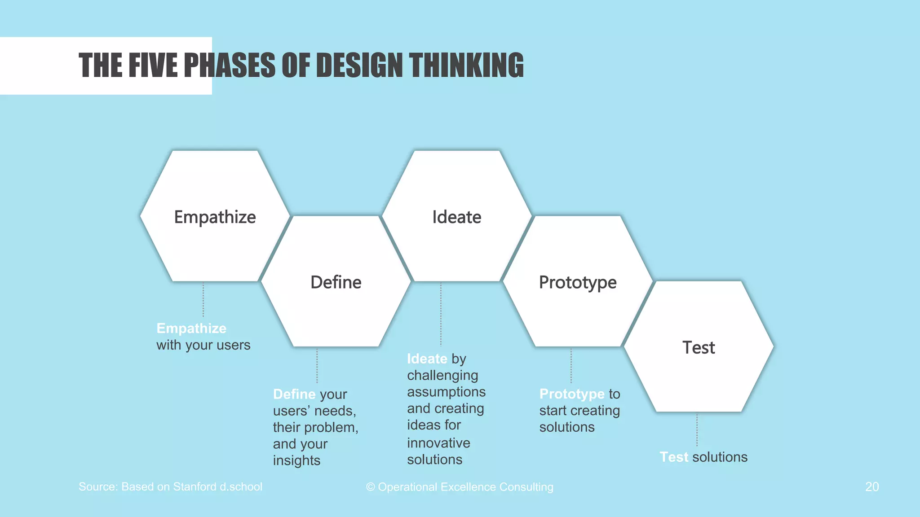

Slide 12
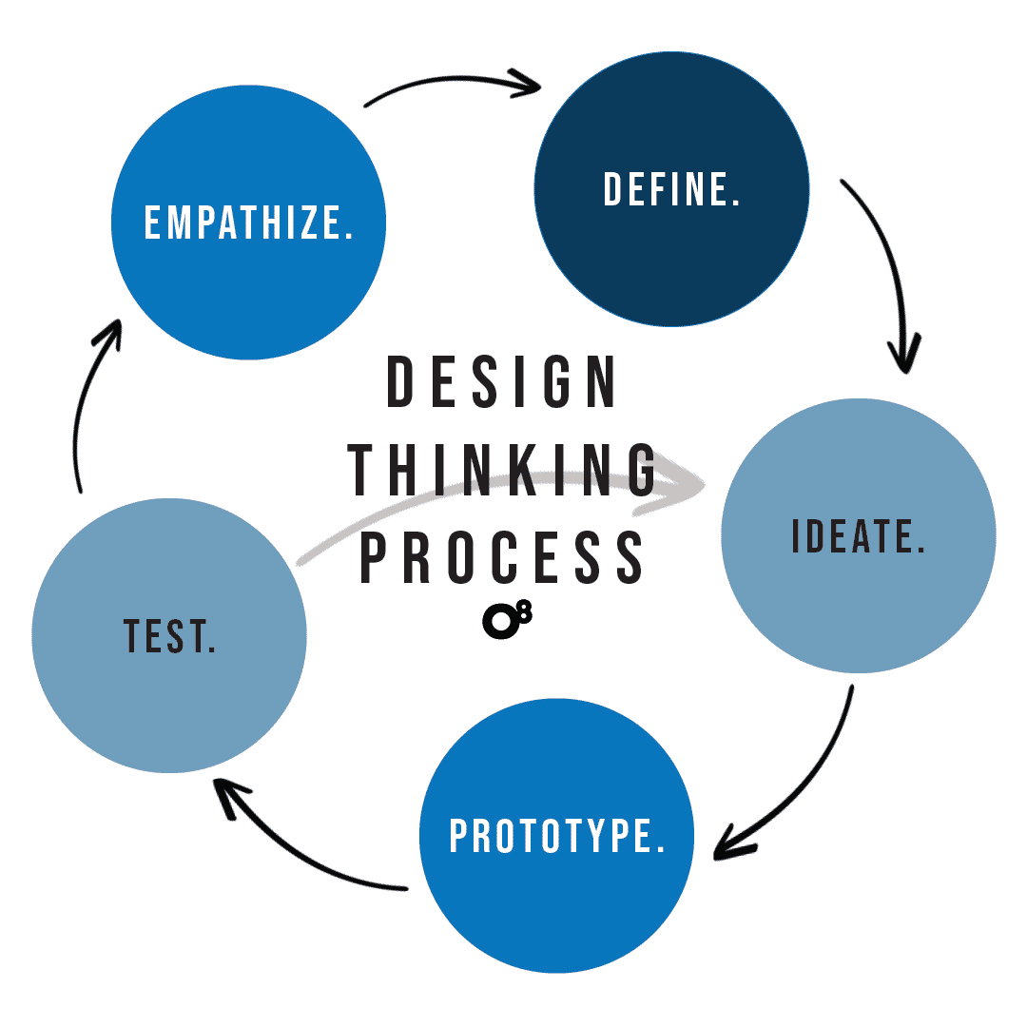

Slide 13
Ready, Set, Design! Self Guided Design Thinking Activity
ASU Edson E & I Youth Entrepreneurship
Form Squads & Grab a Kit
Groups of 4
One materials bag per group
One person from each group comes to collect the bag
Time: 1 min.
Voice: 🟡 Whisper.
Body: Stand, form teams, one person collects bag, return to stations.

Slide 14


Ready, Set, Design! Self Guided Design Thinking Activity
ASU Edson E & I Youth Entrepreneurship
What's In the Bag?
Fasteners
Surfaces
Structures
4-5 items: pipe cleaners, rubber bands, paperclips, string
2-3 items: cardboard squares, balloons, paper
3-4 items: popsicle sticks, straws, aluminum foil
Note: Items may vary by bag. That's part of the challenge!
Time: 1 min. Voice: 🟡 Whisper. Body: Hands examining materials, eyes on items, remain seated.

Slide 15
Ready, Set, Design! Self Guided Design Thinking Activity
ASU Edson E & I Youth Entrepreneurship
RULES OF THE GAME
You will have 10 minutes to build a prototype (small model) that solves your challenge.
Use only the materials in the bag.
You can't design a solution that already exists.
Time: 1 min.
Voice: 🔴 Silent.
Body: Sit still, eyes on teacher.

Slide 16
Ready, Set, Design! Self Guided Design Thinking Activity
ASU Edson E & I Youth Entrepreneurship
What is your challenge card?
^{DEFINE}
1
2
3
4
5
I need to protect myself from the rain.
I need to bring my lunch to school.
I need to collect and carry small things.
I need to keep my hands warm.
I need to carry groceries up several flights of stairs.
Action: Write your challenge on your group paper.
Time: 2 min.
Voice: 🟡 Whisper.
Body: Pick a card, return to seat, eyes down.
Body: Pick a challenge; Write challenge words on paper

Slide 17
Ready, Set, Design! Self Guided Design Thinking Activity
ASU Edson E & I Youth Entrepreneurship
IDEATE
Step 3
2-MINUTE BRAINSTORM
Helpful Hints:
Talk with your team & write down ideas!
Rough is fine
The wilder the idea, the better
Activity:
Change and combine as you go
Sketch or write at least 3 solutions
No idea is too wild or crazy
Focus on quantity, not quality
Think about a real user
"A prototype isn't meant to be perfect - it's meant to help you learn!"
Time: 2 min. Voice: 🟢 Talk. Body: Pencils moving on paper, bodies leaning in, eyes on teammates' ideas.

Slide 18


Ready, Set, Design! Self Guided Design Thinking Activity
ASU Edson E & I Youth Entrepreneurship
STEP 4: DESIGN THINKING PROCESS
The wilder the idea, the better
PROTOTYPE
Change and combine as you go
Think about a real user
10:00
(COUNTDOWN)
Time: 10 min.
Voice: 🟢 Talk.
Body: Hands building, sitting with group, materials on desk.

Slide 19




Ready, Set, Design! Self Guided Design Thinking Activity
ASU Edson E & I Youth Entrepreneurship
DESIGN THINKING STEP 5
TEST
Fit - Does it adjust to the user?
Strength - Will it hold up to use?
02:00
Attachments - Are connections secure?
Comfort - Is it pleasant to use?
Evaluate and Improve!
Speed - Can the user operate it quickly?
Test your prototype once. Circle the biggest issue. Make a single change now.
Time: 2 min.
Voice: 🟢 Talk
Body: Hands testing prototype, make one physical adjustment

Slide 20


Ready, Set, Design! Self Guided Design Thinking Activity
ASU Edson E & I Youth Entrepreneurship
Presenter Mode
SHARE YOUR SOLUTIONS!
Take turns sharing your group's solution with the rest of the class.
Read your challenge card, then explain how your prototype (small model) solves the challenge.
30 seconds per team
Time: 8-12 min. Voice: 🔴 Silent. Body: Eyes on presenter, hands still, nod to show attention.

Slide 21




Ready, Set, Design! Self Guided Design Thinking Activity
ASU Edson E & I Youth Entrepreneurship
Map to the 5 Steps
Empathize
Define
Ideate
Prototype
Test
•
Which step did you feel the most during the activity?
•
Which step would you want more practice with?
Time: 2 min. Voice: 🟡 Whisper. Body: Turn to face partner, whisper-discuss, remain seated.

Slide 22

Ready, Set, Design! Self Guided Design Thinking Activity
ASU Edson E & I Youth Entrepreneurship
Exit Ticket
If you had 5 more minutes, what would you try next?
If we had five more minutes we would try _____________
Submission: Write a complete sentence on a group paper
Time: 3 min. Voice: 🟢 Talk Body: Write in a complete sentence. Raise hand when done.

Slide 23
Ready, Set, Design! Self Guided Design Thinking Activity
ASU Edson E & I Youth Entrepreneurship
Clean and Reset
Place reusable materials back in the bag
Throw away broken or unusable materials
Clear tables completely
Check floor for dropped items
Time: 2 min. Voice: 🟢 Talk Body: Stand and circulate, hands sorting materials, check floor and tables.

Slide 24
Ready, Set, Design! Self Guided Design Thinking Activity
ASU Edson E & I Youth Entrepreneurship
Design Thinking In Space
See how NASA uses the same design thinking steps you just practiced!
Watch how engineers create prototypes of space capsules before sending them to the International Space Station.
Put on your ClassVR headsets to watch: NASA's Commercial Crew Program VR 360 Tour https://www.youtube.com/watch?v=BMvPLd25LV8
Time: 5 min. Voice: 🔴 Silent. Body: Seated with ClassVR headsets on, hands in lap.

Slide 25
Ready, Set, Design! Self Guided Design Thinking Activity
ASU Edson E & I Youth Entrepreneurship
Exit Ticket (Longer)
Which part of your prototype worked best and why?
If you had 5 more minutes, what would you try next?
Submission: Write on a sticky note or submit through LMS
Time: 3 min. Voice: 🔴 Silent. Body: Write quietly, eyes on paper, raise hand when done.

